Slide 1

Notes:
Welcome to the High Focus Without Distraction Webinar presented by Mark Tittley – The Productive Life

Slide 2
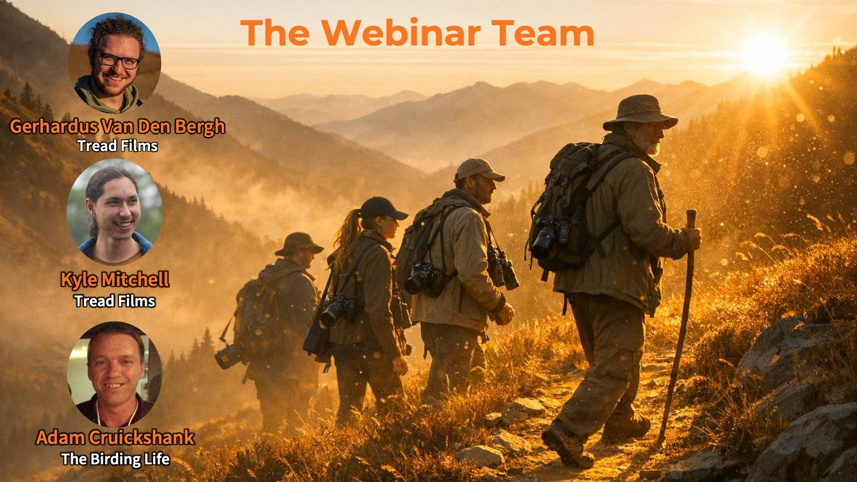
Notes:
The Webinar Team: First some introduction, the team who has helped to pull off this webinar includes: Gerhardus Van Ben Bergh and Kyle Mitchell from Tread Films and Adam Cruickshank from The Birding Life.

Slide 3
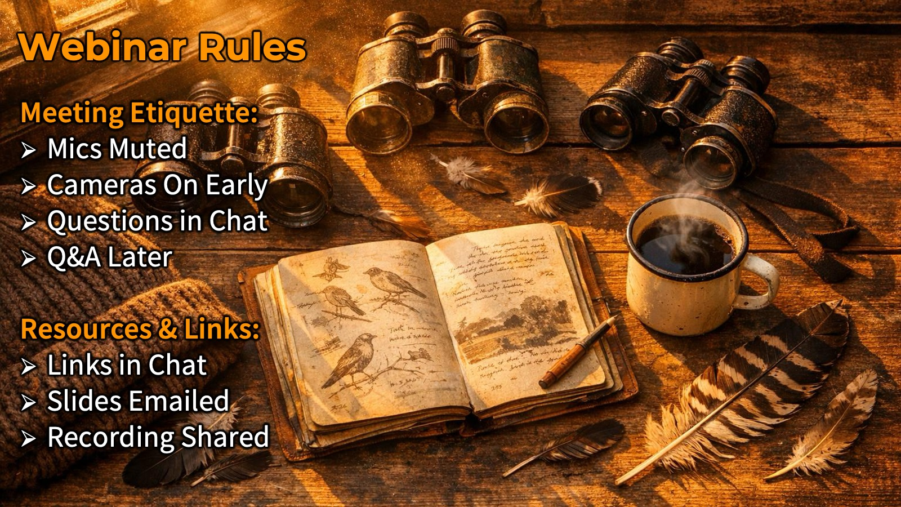
Notes:
Before I continue with introductions, a few quick housekeeping points to make sure we get the most out of our time together. First, please stay muted during the presentation to keep the audio clear. We’d love to see you during our intro section, so feel free to flick your cameras on, but feel free to switch them off later if that helps you focus.
Regarding questions, please drop them in the chat as we go - Adam and Gerhardus are keeping an eye on those for us, and we will handle them in a dedicated Q&A session later. Also, we will be sharing links in the chat throughout the night, so if you see a resource on the screen, check the chat to grab the link. Finally, you don’t need to worry about taking screenshots of the slides - we are recording this, and I’ll send out the video replay and the full presentation to you via email afterwards.

Slide 4
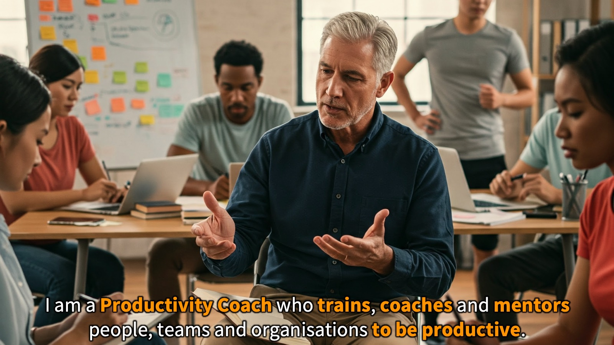
Notes:
I am a Productivity Coach who trains, coaches and mentors people, teams and organisations to be productive. I help people live a life that is balanced, purposeful, and free from the constant noise of "busyness.”

Slide 5
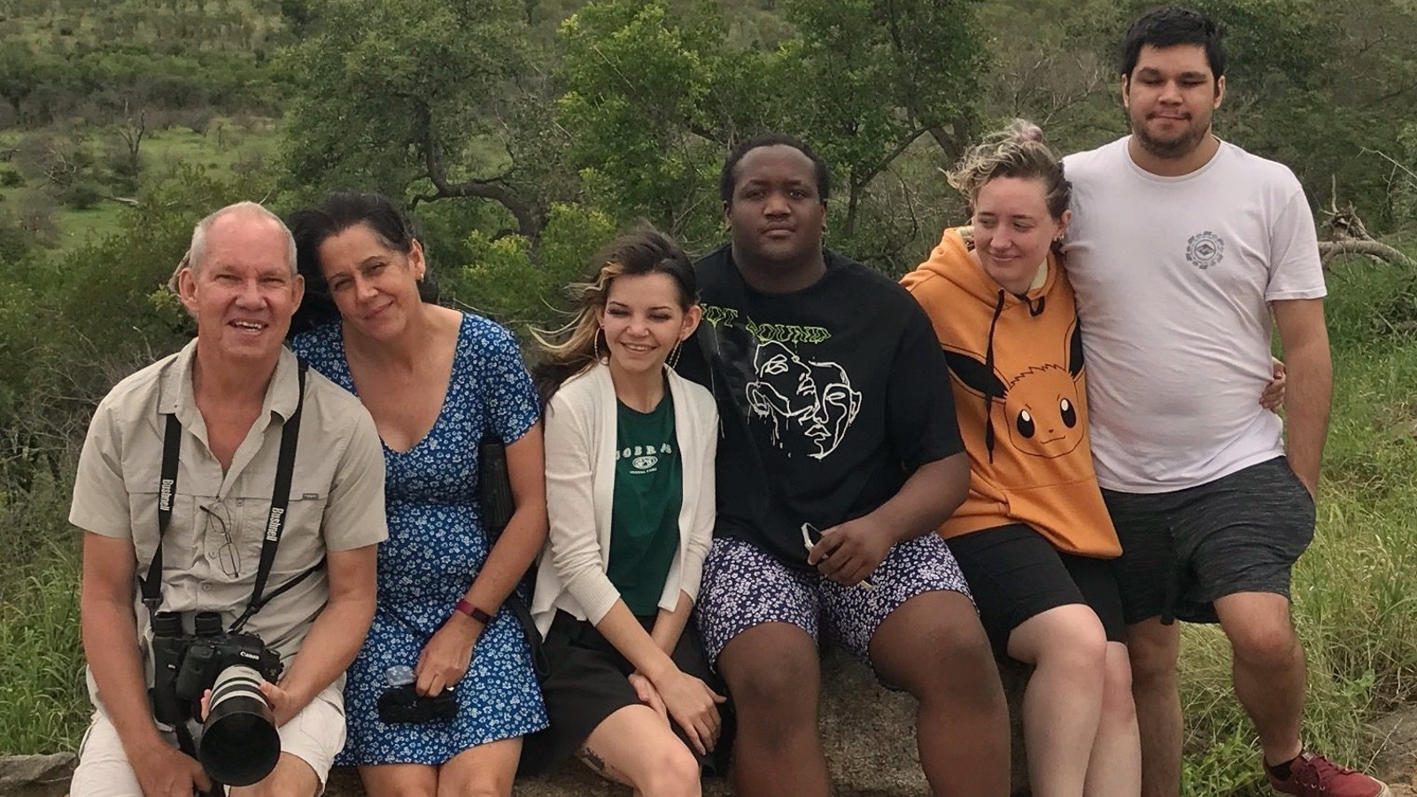
Notes:
I am married to Debbie and am the proud father of three “kids”: Keegan, Ashley and Drew.

Slide 6

Notes:
Chat: Type your Name; where you’re joining from; and what steals your focus?

Slide 7
Notes:
So, let’s get into it – and welcome again to the High Focus Without Distraction Webinar starting with a quick comment about each of the key words: Focus and Distraction!

Slide 8
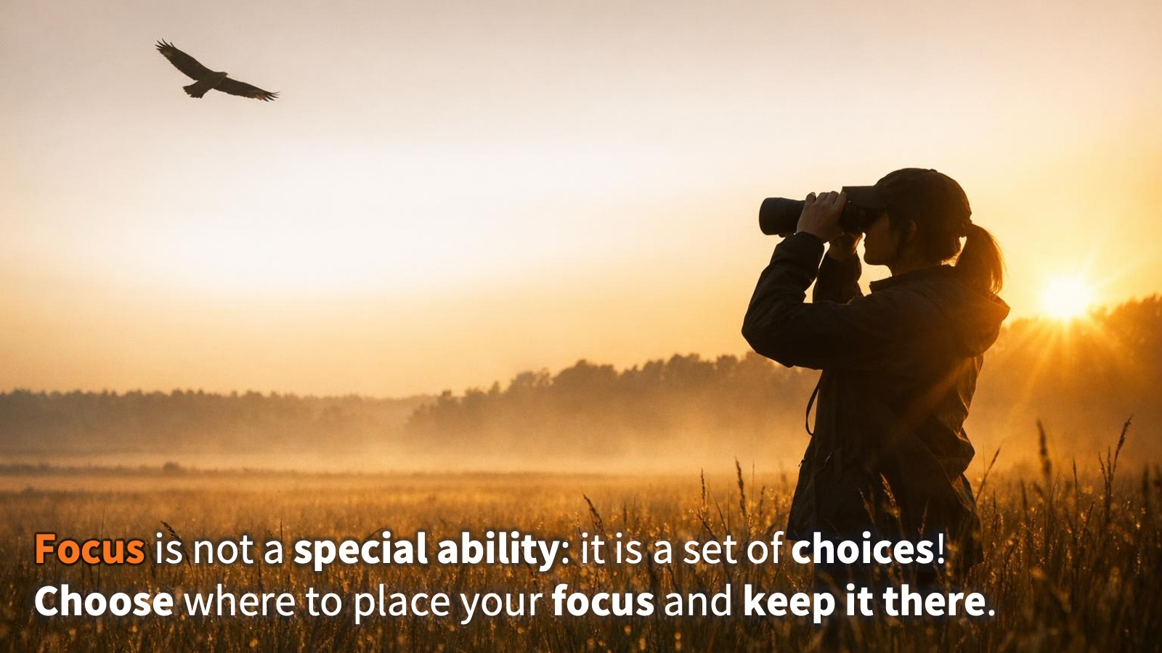
Notes:
Focus is not a trait or special ability: it's a set of choices! You choose where to place your focus and keep it there.

Slide 9
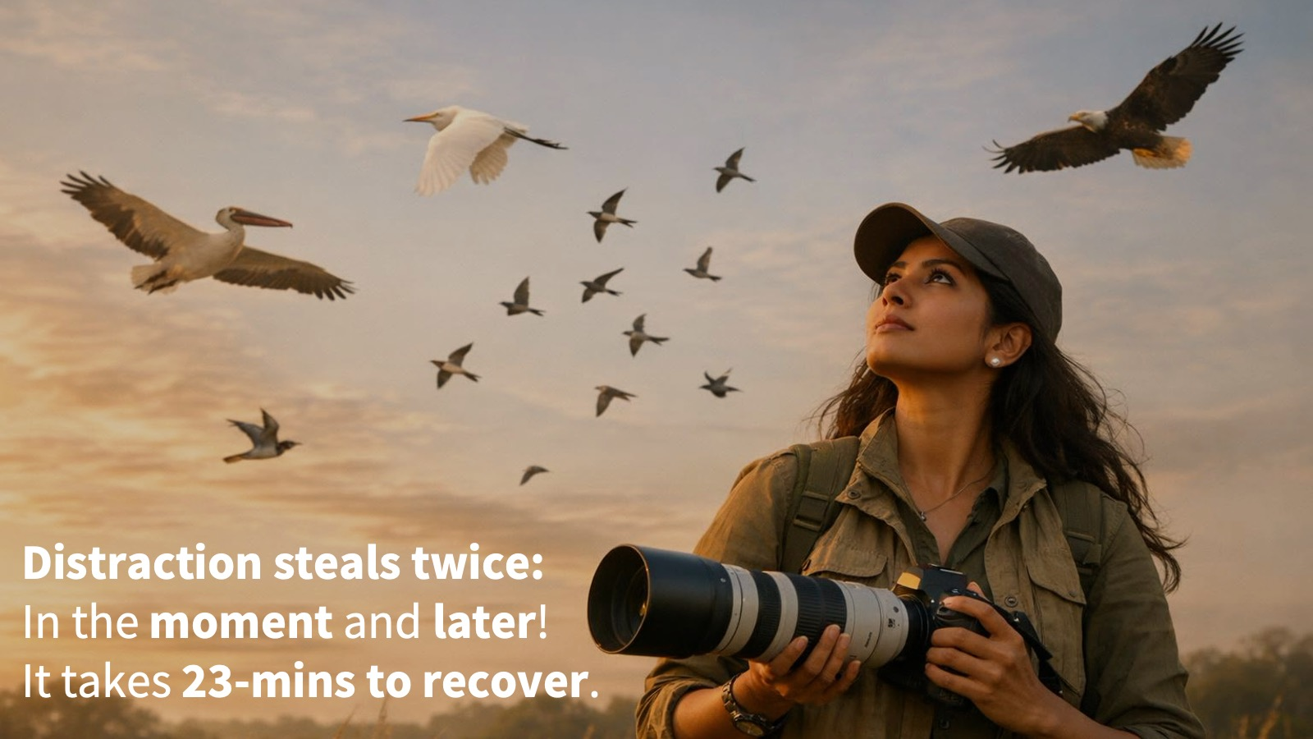
Notes:
Distraction Steals Twice: In the moment and later! It takes 23-mins to recover.

Slide 10
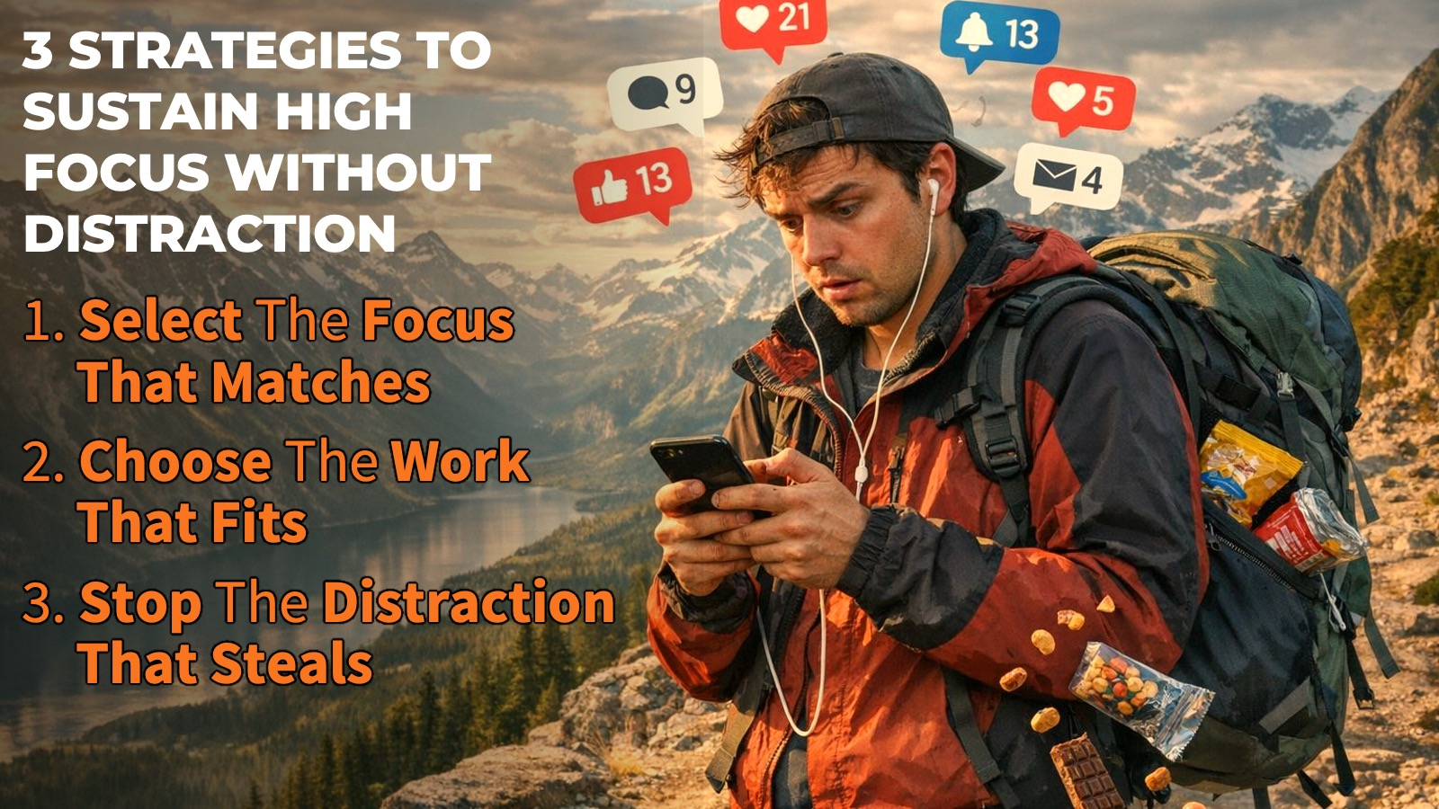
Notes:
Overview: There are 3 Strategies to sustain High Focus Without Distraction: (1) Select The Focus That Matches; (2) Choose The Work That Fits and (3) Stop The Distraction That Steals.

Slide 11
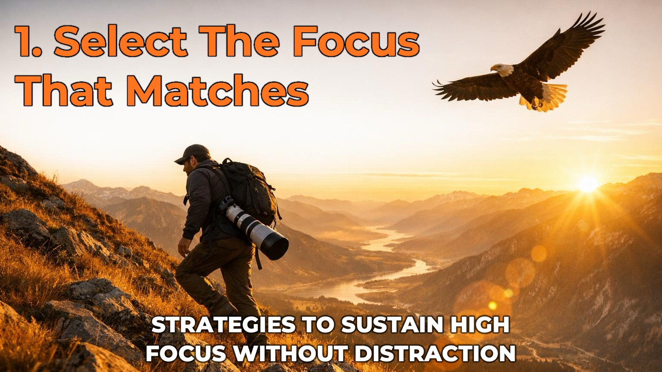
Notes:
The first strategy to sustain high focus without distraction: (1) Select The Focus That Matches;

Slide 12
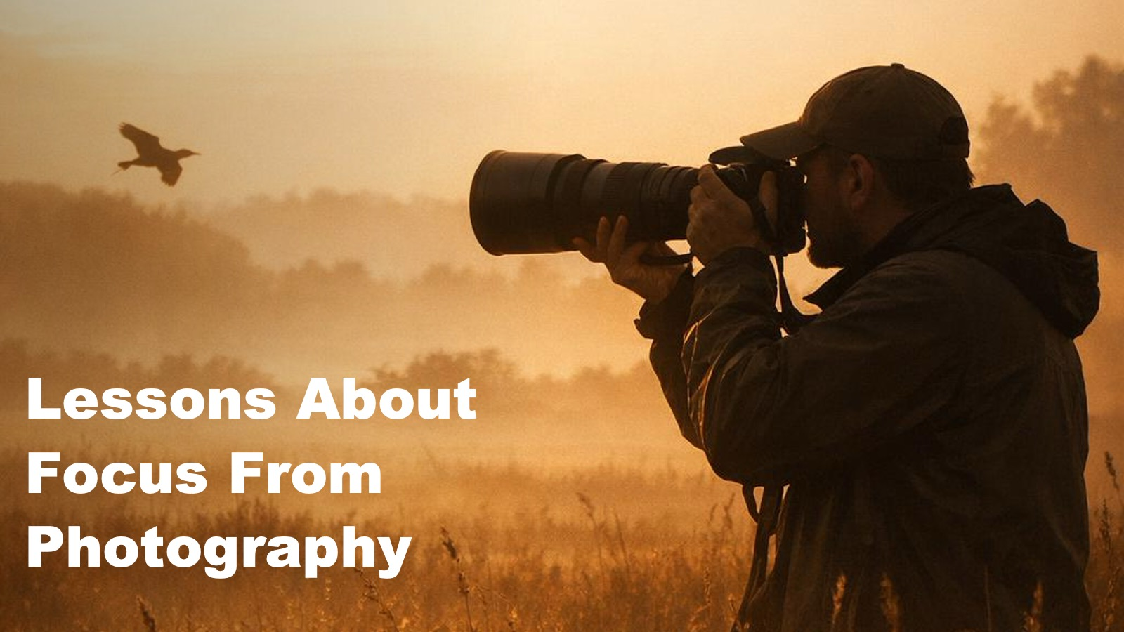
Notes:
Lessons About Focus From Photography

Slide 13
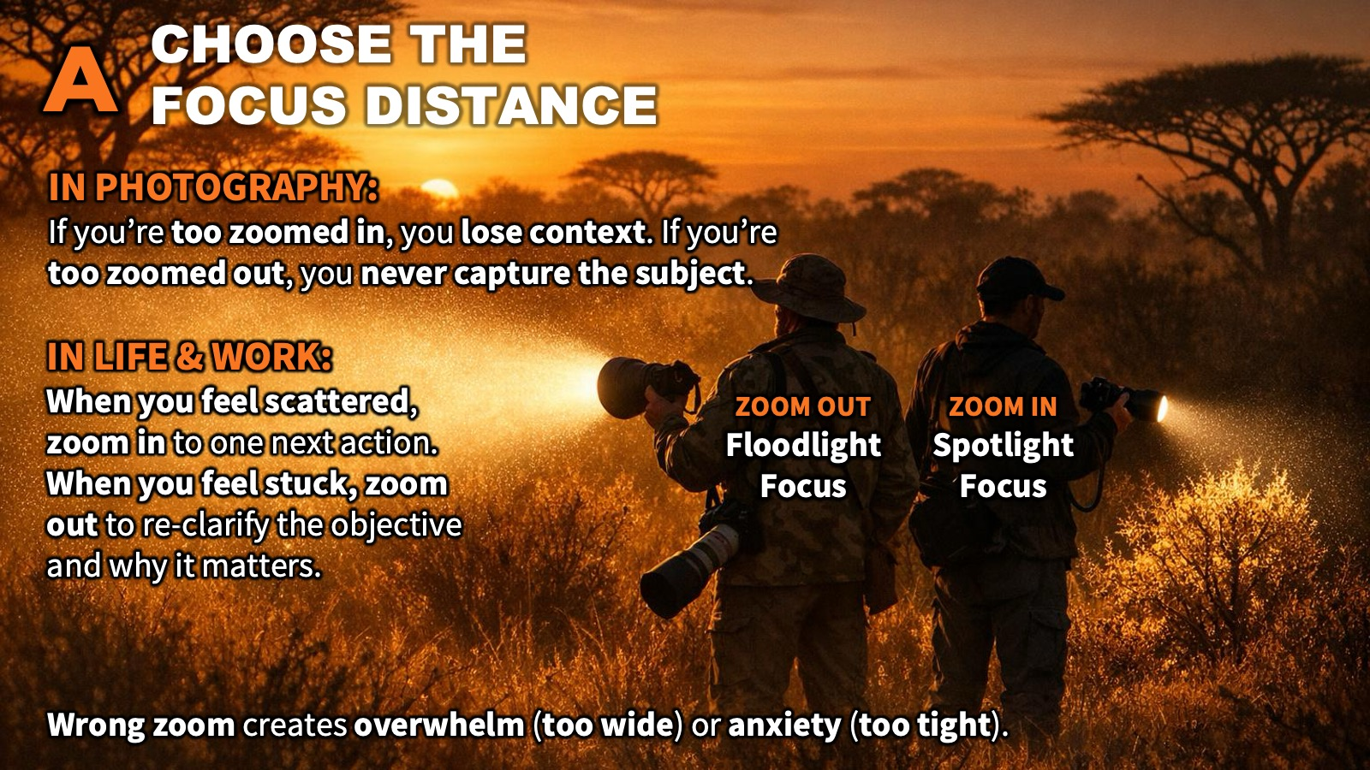
Notes:
A. Choose The Right Zoom
When I am out birding with my Canon 7D and the 100-400mm zoom lens, I can feel the difference between being scattered and being locked in. If the bush is alive with movement and I keep swinging the lens from one rustle to the next, I end up seeing everything and capturing nothing - my attention is wide, but shallow. The moment I choose to Zoom In, I stop scanning and commit to one bird, one perch, one gap in the reeds, and I work the scene. Other times, the opposite is true - I have zoomed in too hard, I am tracking a bird through branches, and I start missing what the light and background are doing. Then I deliberately Zoom Out, back the focal length off, step back with my eyes, re-check the whole frame and the story of the moment, and only then do I tighten back in to take the shot that actually matters.
Photography springboard: If you’re too zoomed in, you lose context. If you’re too zoomed out, you never capture the subject.
Real-life move: When you feel scattered, zoom in to one next action. When you feel stuck, zoom out to re-clarify the objective and why it matters.
Simple line: Wrong zoom creates either overwhelm (too wide) or anxiety (too tight).
ZOOM IN: Spotlight Focus vs ZOOM OUT: Floodlight Focus: Close vs Far; Narrow vs Wide; Today vs Tomorrow; This Year vs Next Year

Slide 14
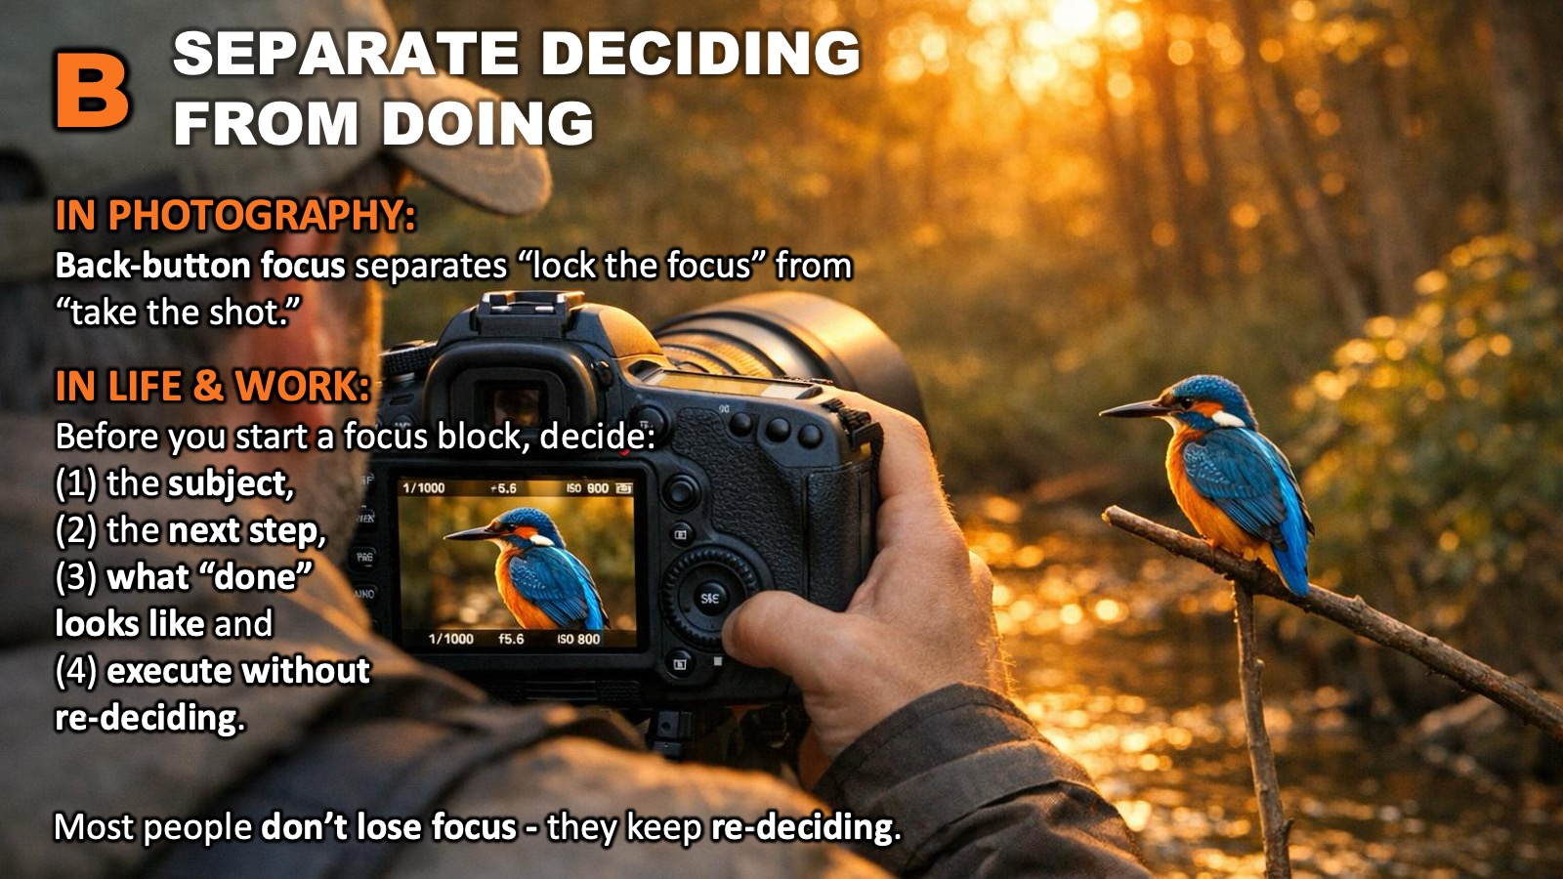
Notes:
B. Separate Deciding From Doing
In the field, I have learned about locking in my focus so I don’t miss a shot. I see this most clearly when I want the bird to be sharp but not centered in the frame - like a kingfisher sitting on a branch above a stream, poised to dive. If I half-press the shutter to focus and then I recompose to place the kingfisher off-center, the moment I press the shutter fully the camera often re-focuses on the river, the bank, or the vegetation with stronger contrast - and the bird I cared about is suddenly soft and the shot is ruined. That is where back-button focus is a gift. I use the back button to lock focus on the bird’s eye, then I can move the camera to compose the frame the way I want, and when I press the shutter it only takes the shot - it does not go hunting for a new focus point.
Photography springboard: Back-button focus separates “lock focus” from “take the shot”.
Real-life move: Before you start a focus block, decide: (a) the subject, (b) the next step, (c) what “done” looks like. Then execute without re-deciding.
Simple line: Most people don’t lose focus - they keep re-deciding.

Slide 15
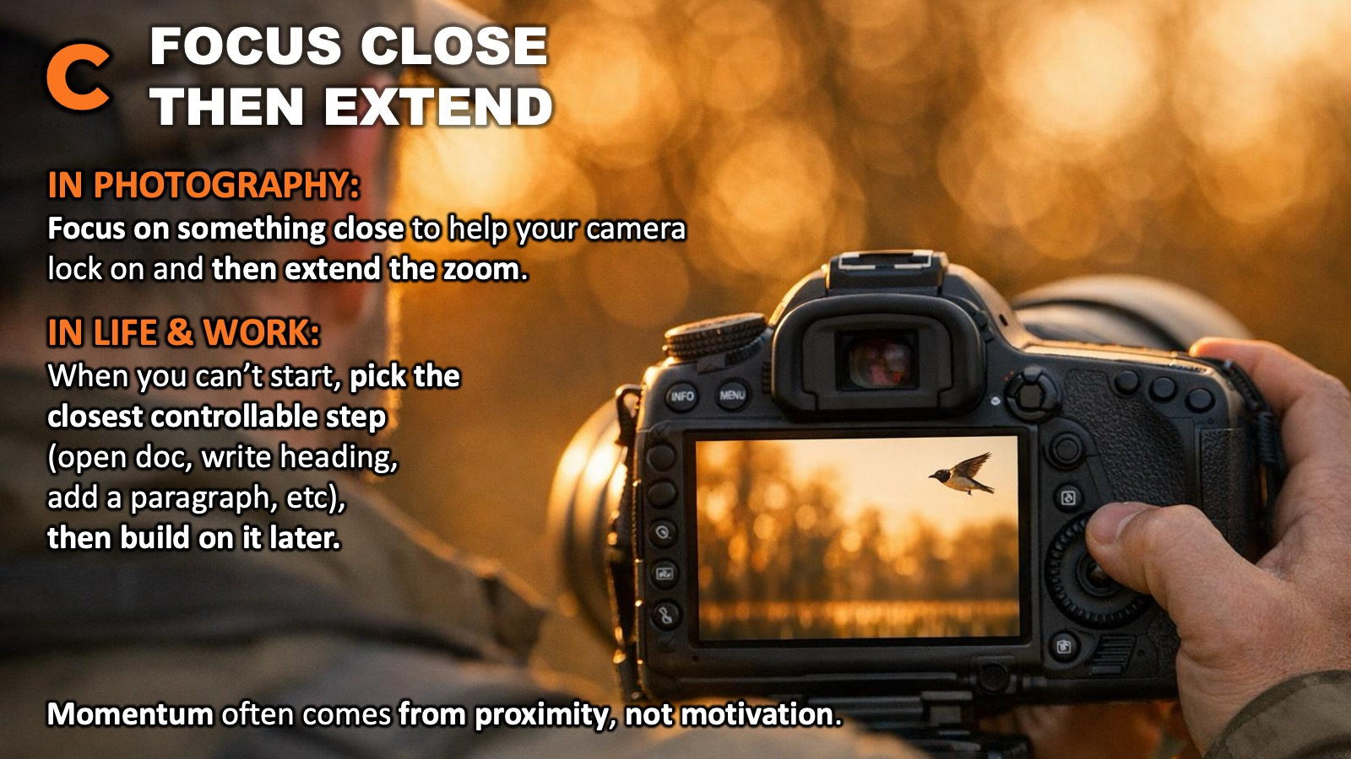
Notes:
C. Start Close, Then Extend Far
There is a frustration that I experience when I am trying to take a photo of a raptor flying in the sky and my camera will “hunt” as it tries to lock focus on the bird - especially at longer focal lengths when the bird is far and the lens has too much searching to do. If I lift the camera and try to go straight from nothing to a distant subject, the focus can sweep back and forth and I lose precious seconds. So I use a small field trick - I start close. I will focus on a nearby branch, a reed, a rock, or even the edge of a tree trunk that is roughly the same distance as the bird. Once the lens is “in the neighborhood,” it can extend out and lock much faster when I move the point onto the bird. It feels like I am giving the camera an anchor point so it does not panic. Practically, this is how I stop missing shots - I do not demand perfect focus from chaos, I give the system something controllable first, and then I reach for the bigger target.
Photography springboard: When the camera hunts, focusing on something closer first helps it lock and then extend.
Real-life move: When you can’t start, pick the closest controllable step (open doc, write heading, send the first line), then build out toward the bigger target.
Simple line: Momentum often comes from proximity, not motivation.

Slide 16
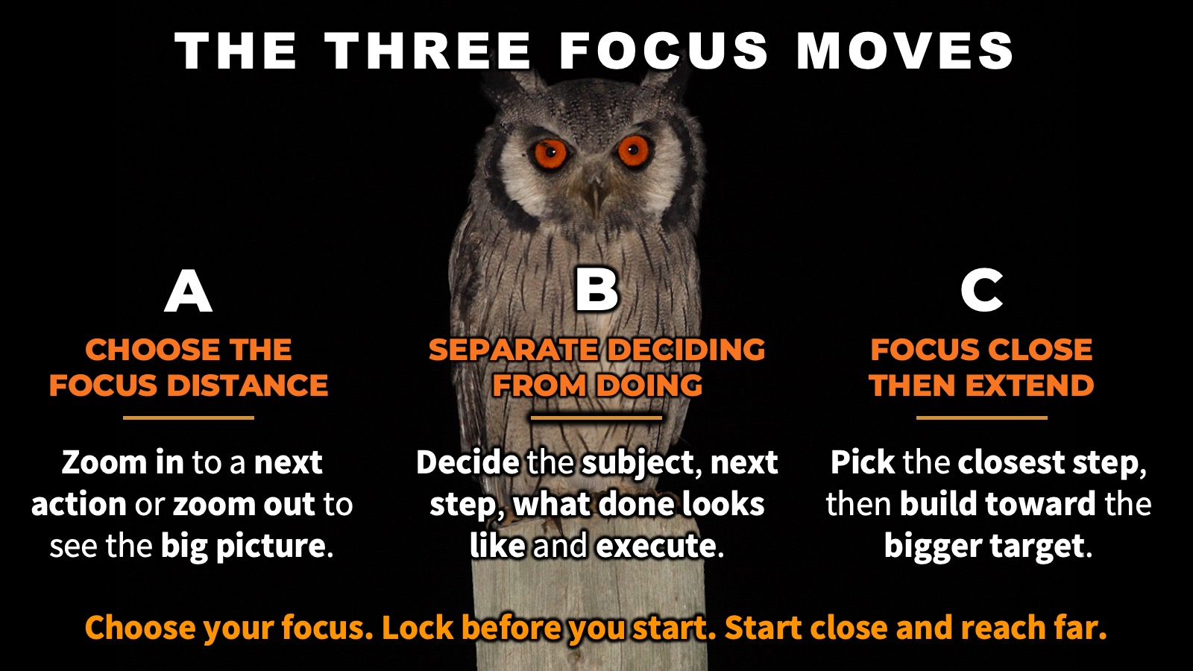
Notes:
Summary: The 3 Focus Moves: (A) Choose your focus distance (Zoom in to one next action or zoom out to see the big picture); (B) Separate Deciding From Doing (Decide the subject, next step, and what done looks like, Then execute); (C) Focus Close Then Extend (Pick the closest step, then build toward the bigger target). Choose your focus. Lock before you start. Start close and reach far.

Slide 17
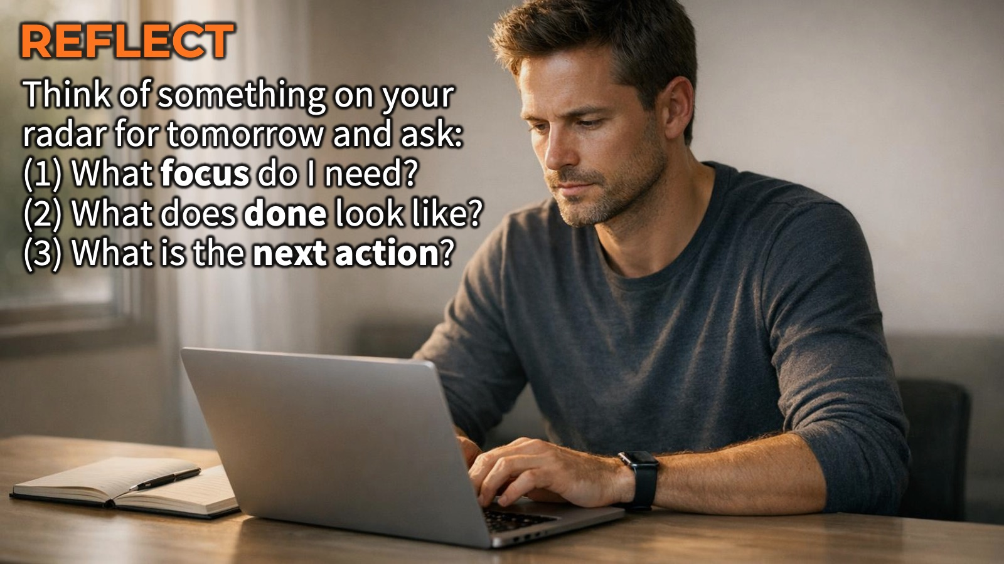
Notes:
Reflect: Think of something on your radar for tomorrow and ask:
(1) What focus do I need?
(2) What does done look like?
(3) What is the next action?

Slide 18

Notes:
Chat: Share in the chat the task you must get done tomorrow, the kind of focus you need and the one thing you must get done!

Slide 19
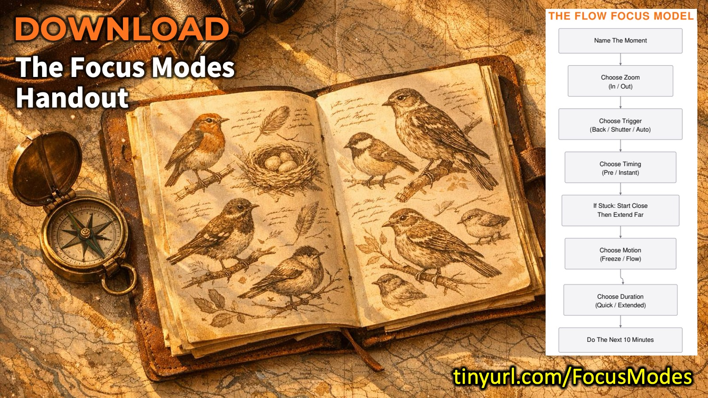
Notes:
Download: The 6 Focus Modes Handout. Link: https://tinyurl.com/FocusModes

Slide 20
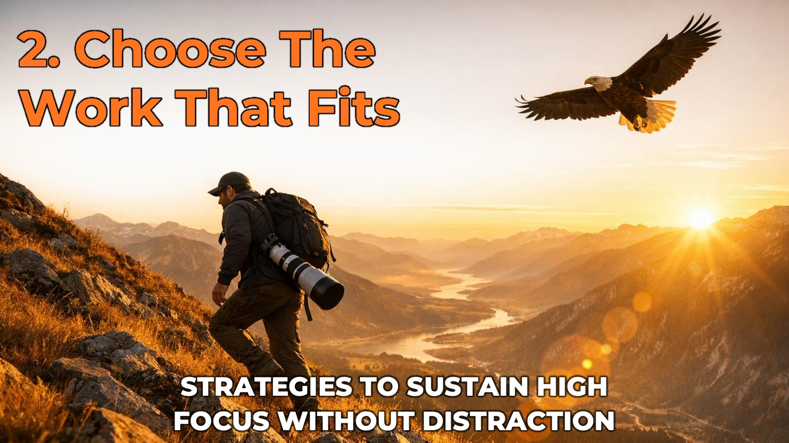
Notes:
The second strategy to sustain high focus without distraction is: (2) Choose the work that fits.

Slide 21
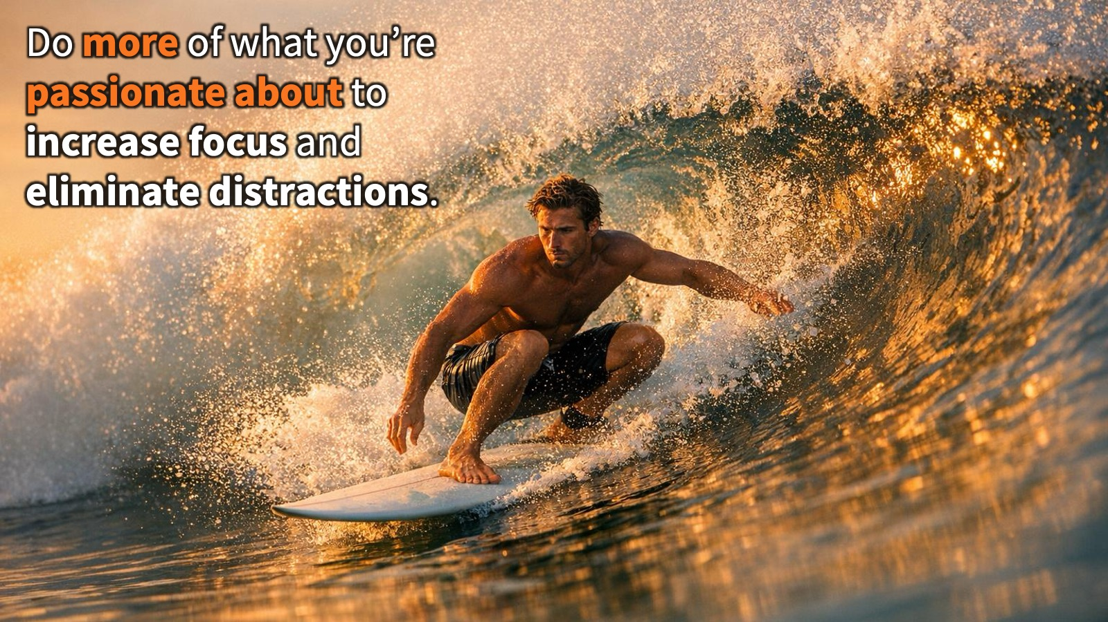
Notes:
Here is the secret to focus: Do more of what you’re passionate about to increase focus and eliminate distractions.

Slide 22
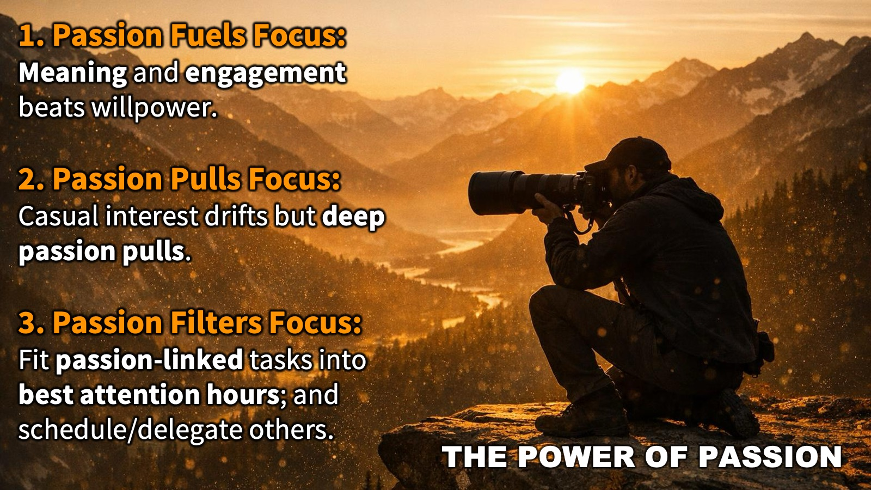
Notes:
The Power of Passion: Passion is critical to Focus because: (1) Passion Fuels Focus transforms productivity from a test of discipline into a natural consequence of engagement, as true meaning consistently outperforms the rigid limitations of willpower. When a task is deeply tied to your purpose, the mental friction that typically leads to procrastination dissolves, allowing you to sustain high-intensity concentration without the need for constant self-coercion. By anchoring your work in what genuinely matters, you replace the exhausting effort of "trying" with the natural, sustained drive of being truly invested in the outcome. (2) Passion Pulls Focus describes the magnetic quality of work that resonates with your core interests, turning the act of focusing into an effortless gravitational pull rather than a forced push. While casual interests often drift under the slightest pressure of distraction, deep passion creates a robust lock-on effect that keeps your attention centered even when your environment becomes noisy or demanding. This means that when you are aligned with your passion, you spend less time fighting to stay on task and more time in the flow, as your internal drive naturally repels distractions that fail to align with your deeper goals. (3) Passion Filters Focus is more than just a scheduling tool; it is a strategic sorting mechanism that protects your most valuable resource—your attention. By using your passion as a filter, you can ruthlessly eliminate "noise" by identifying and dropping tasks that lack genuine pull, while reserving your "best attention hours" for passion-linked work that demands your peak intensity. Ultimately, this filter allows you to move beyond superficial "Quick Look" triage and provides the emotional stamina required for the deep, "sit-and-stay" moments that lead to true mastery in your life and work.

Slide 23
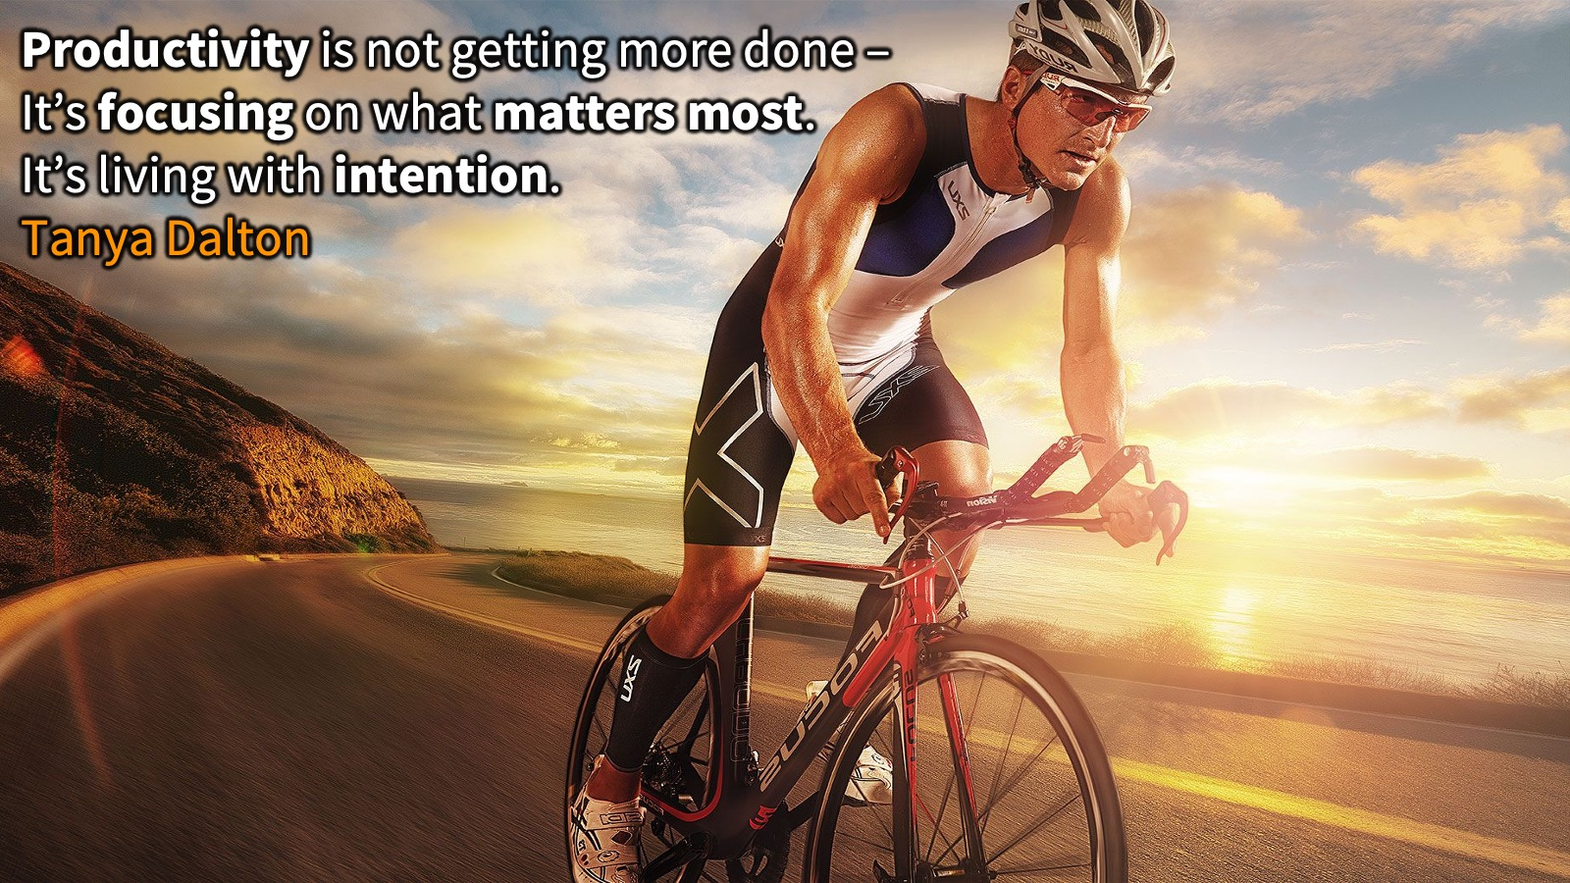
Notes:
Productivity is not getting more done – it’s focusing on what matters most. It’s living with intention. (Tanya Dalton)

Slide 24
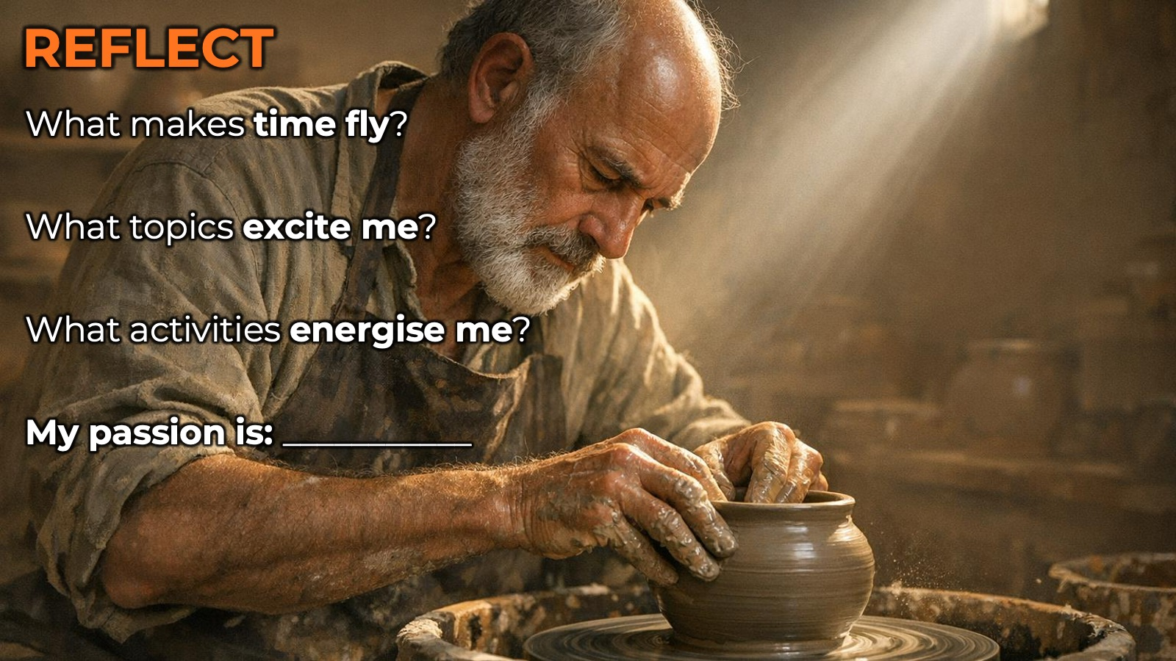
Notes:
Reflect: Use these 3 questions to start identifying what you are passionate about: What makes time fly? What topics excite me? What activities energise me? Then complete the sentence: My Passion is...

Slide 25
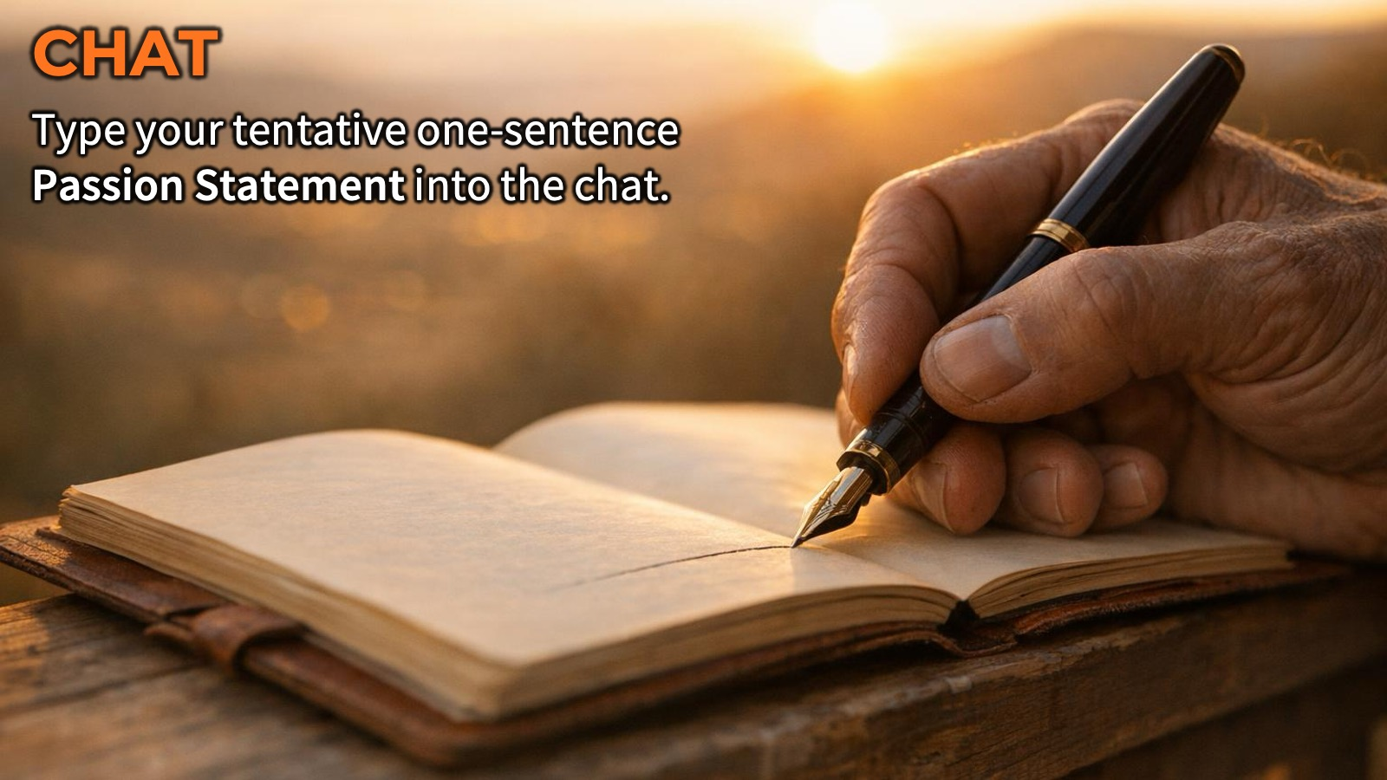
Notes:
Chat: Type: Drop your tentative one-sentence Passion Statement (rough draft).

Slide 26
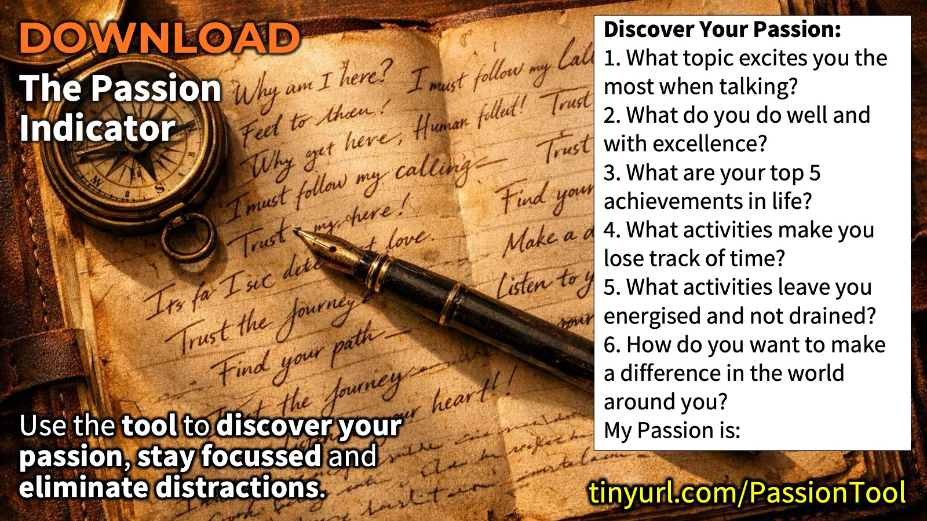
Notes:
Download: The Passion Indicator. Link: https://tinyurl.com/PassionTool

Slide 27
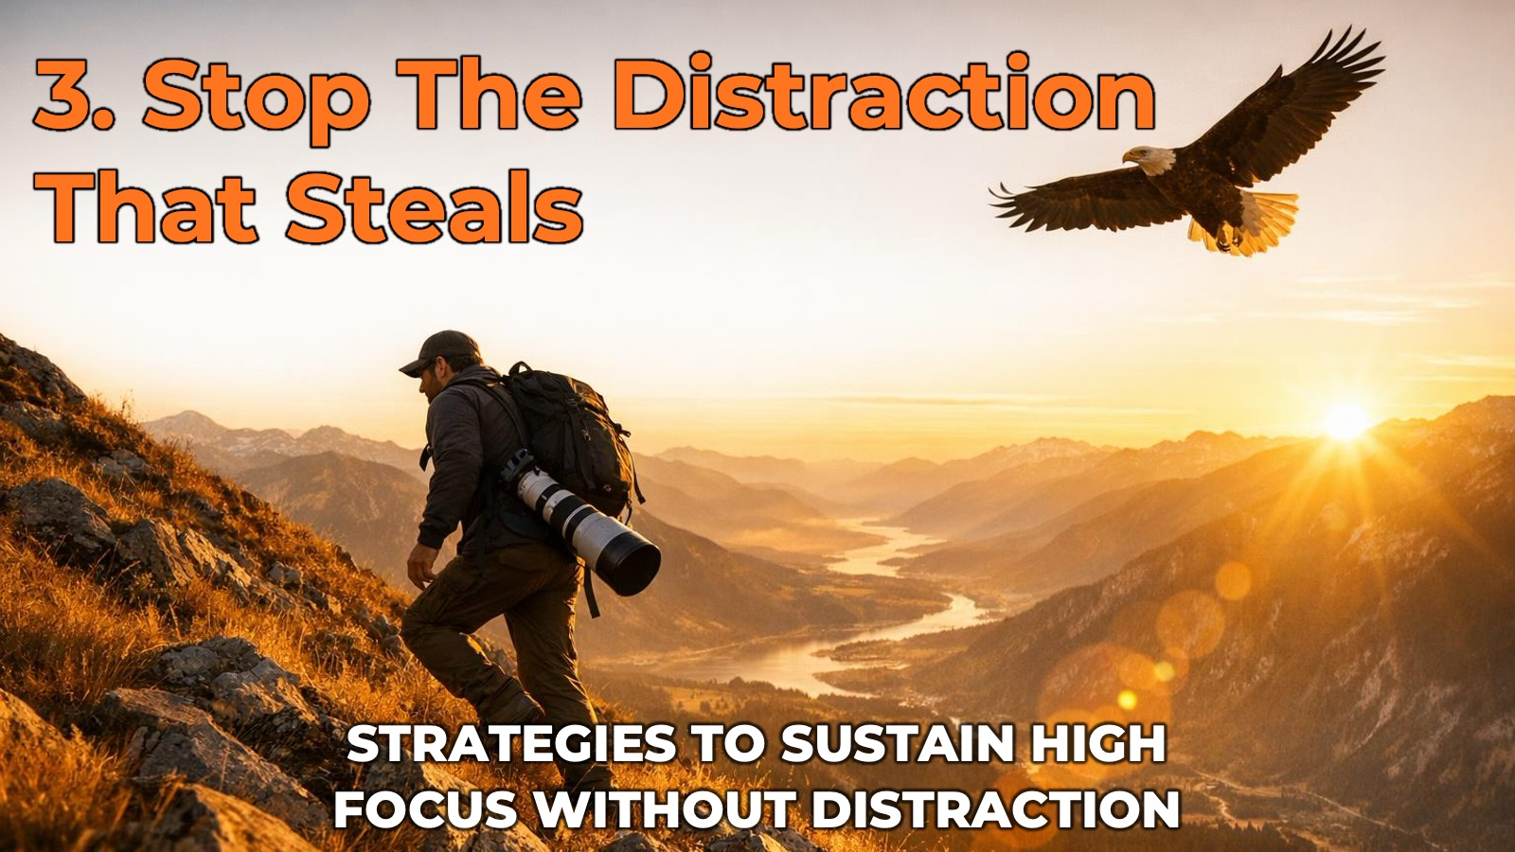
Notes:
The third strategy to sustain high focus without distraction: (3) Stop The Distraction That Steals.

Slide 28
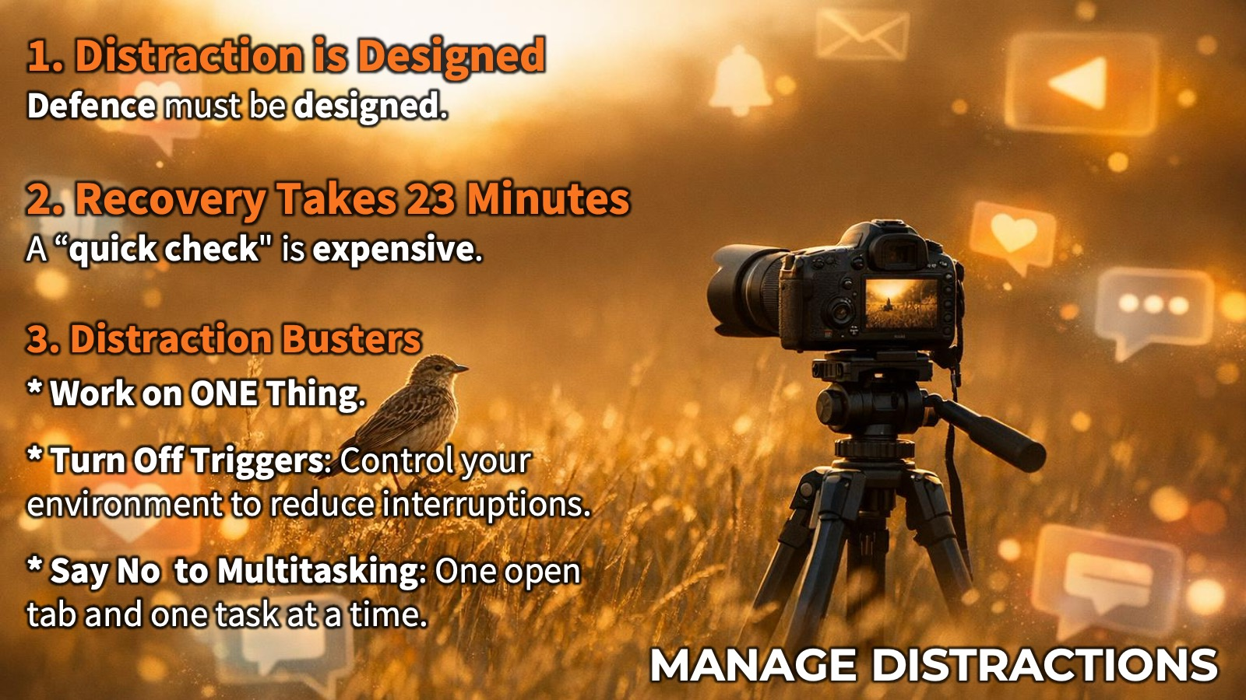
Notes:
You can Manager Distractions: (1) Distraction is Designed: Defence must be designed. (2) Recovery Takes 23 Minutes: A “quick check" is expensive. (3) Distraction Busters: Work on ONE Thing at a time; Turn Off Triggers: Control your environment to reduce interruptions; and Say No to Multitasking: One open tab and one task at a time.

Slide 29
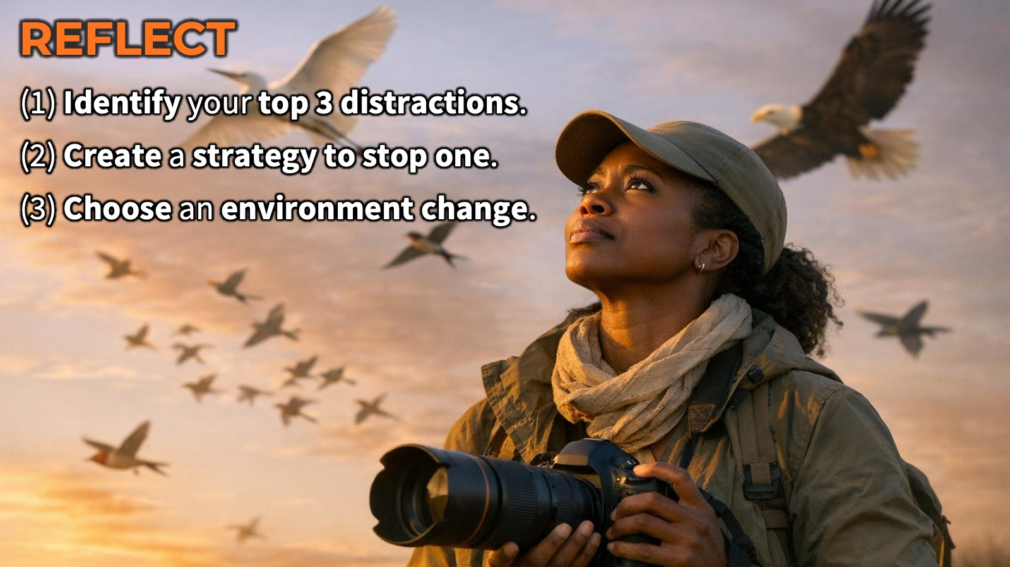
Notes:
Reflect: (1) Identify your top 3 distractions. (2) Create a strategy to stop one (3) Choose an environment change.

Slide 30

Notes:
Chat: Type one distraction and your strategy to eliminate it

Slide 31
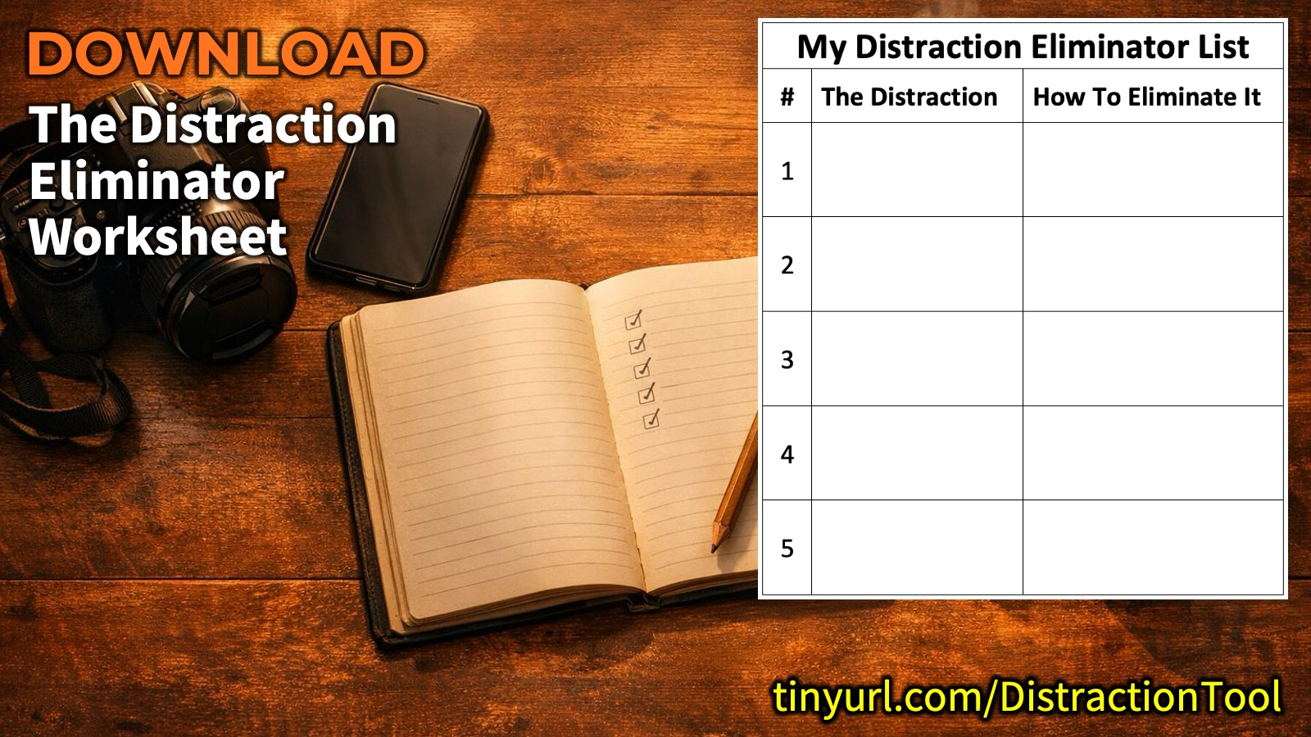
Notes:
Download: The Distraction Eliminator Worksheet. Link: https://tinyurl.com/DistractionTool

Slide 32
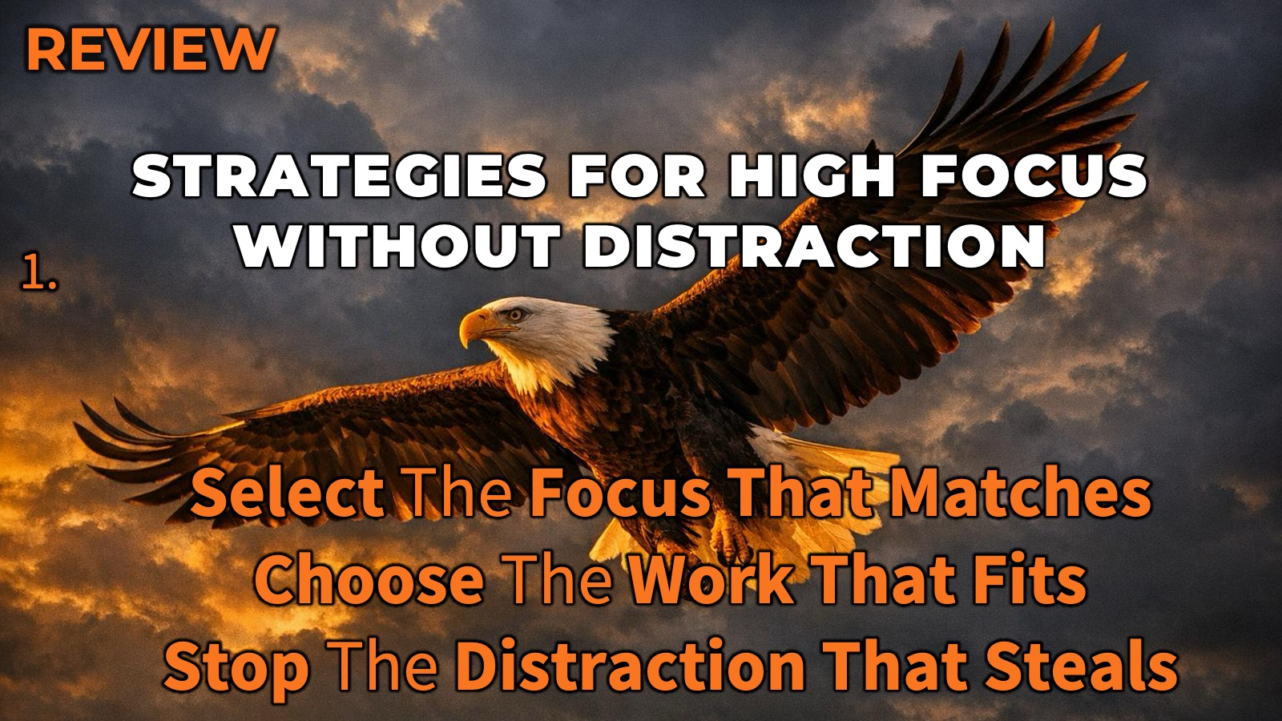
Notes:
Review: Three Strategies for High Focus Without Distraction: (1) Select The Focus That Matches; (2) Choose The Work That Fits and (3) Stop The Distraction That Steals.

Slide 33
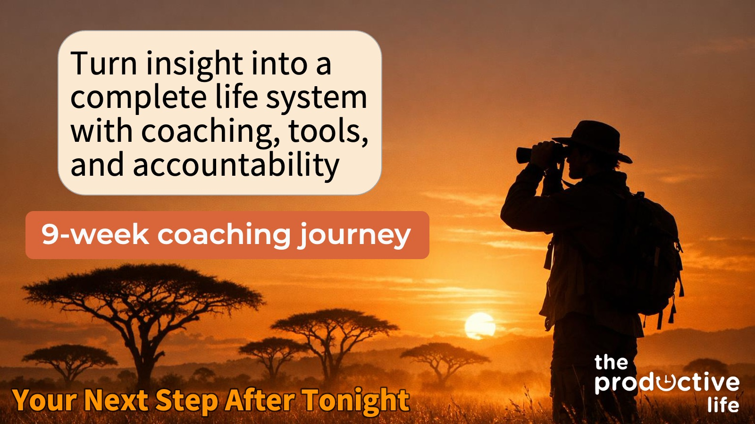
Notes:
Your Next Step After Tonight: Turn insight into a complete life system with coaching, tools, and accountability. The 9-week Coaching Journey.

Slide 34
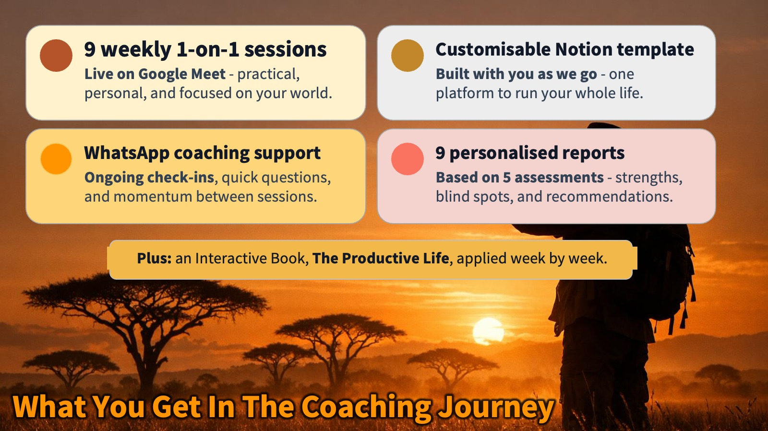
Notes:
What You Get In The 9-Week Coaching Journey:
(1) 9 weekly 1-on-1 sessions: Live on Google Meet - practical, personal, and focused on your world.
(2) WhatsApp coaching support: Ongoing check-ins, quick questions, and momentum between sessions.
(3) Customisable Notion template: Built with you as we go - one platform to run your whole life.
(4) 9 personalised reports: Based on 5 assessments - strengths, blind spots, and recommendations.
(5) Plus: an Interactive Book, The Productive Life, applied week by week.

Slide 35
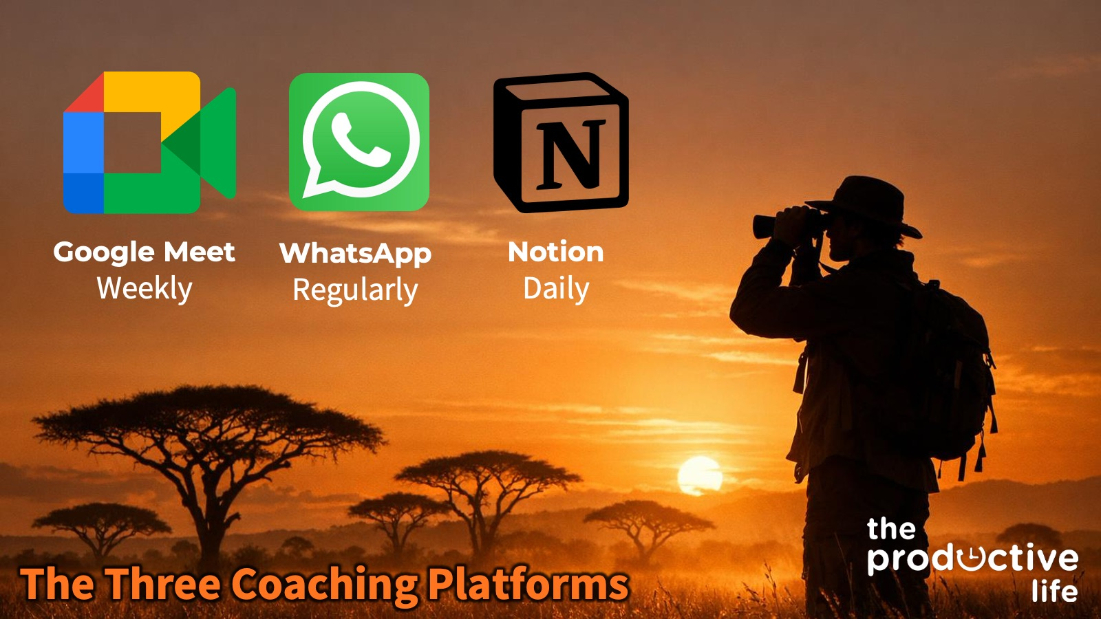
Notes:
The Three Coaching Platforms We Use: (1) Google Meet: Online every week for 45 minutes to an hour. (2) WhatsApp – our main way to stay in touch regularly. (3) Notion App – you will use it daily.

Slide 36
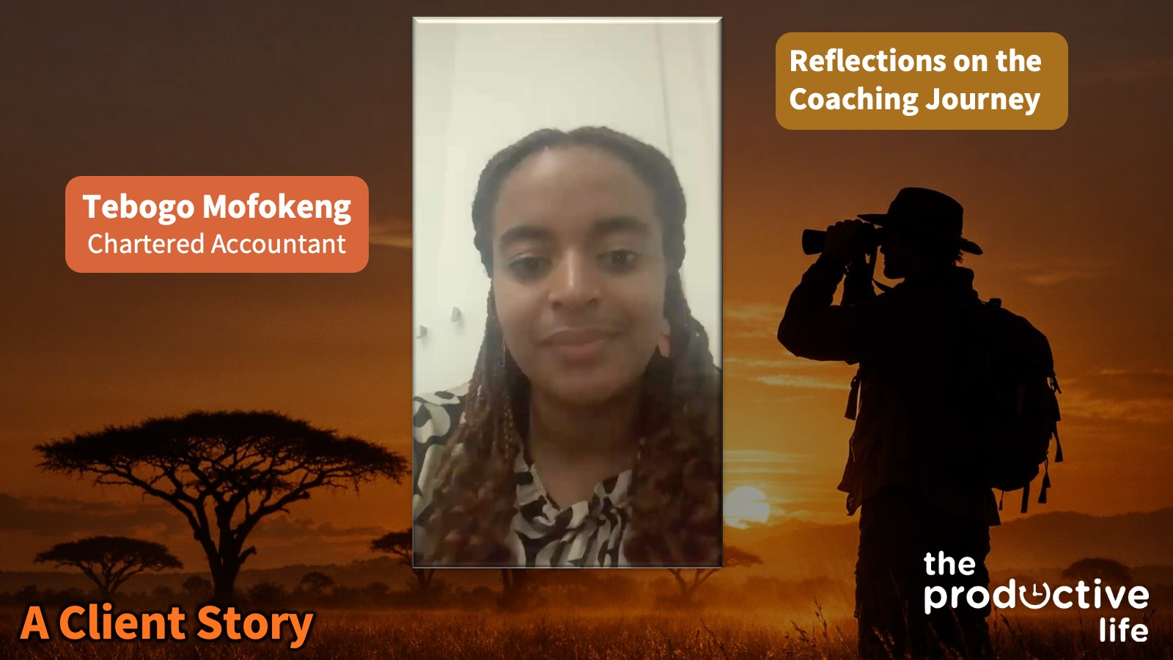
Notes:
Let’s hear from one of the clients I have coached about the impact of the coaching journey on her life. This is Tebogo Mofokeng a Chartered Accountant.

Slide 37
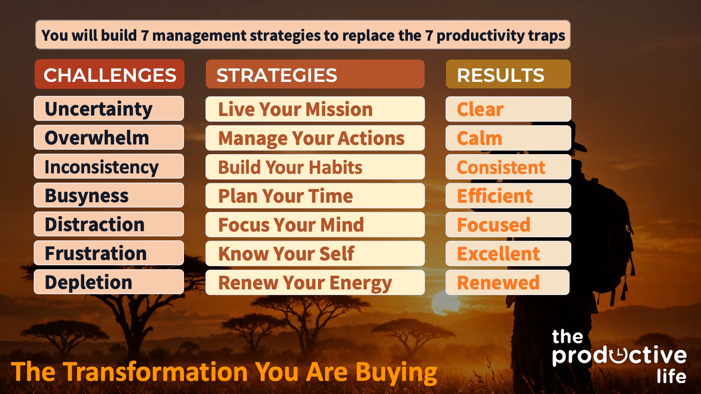
Notes:
The Transformation You Are Buying: You will build 7 management strategies to replace the 7 productivity traps:
The Productive Life Coaching Journey: Challenges → Solutions → Results.
Struggling with Uncertainty -> Live Your Mission -> Get Clear.
Sinking With Overwhelm -> Manage Your Actions -> Get Calm.
Battling With Inconsistency -> Build Your Habits -> Get Consistent.
Drowning With Busyness -> Plan Your Time -> Get Efficient.
Drifting With Distraction -> Focus Your Mind -> Get Focussed.
Coping With Frustration -> Know Your Self -> Get Excellent.
Fading With Depletion -> Renew Your Energy -> Get Renewed.

Slide 38
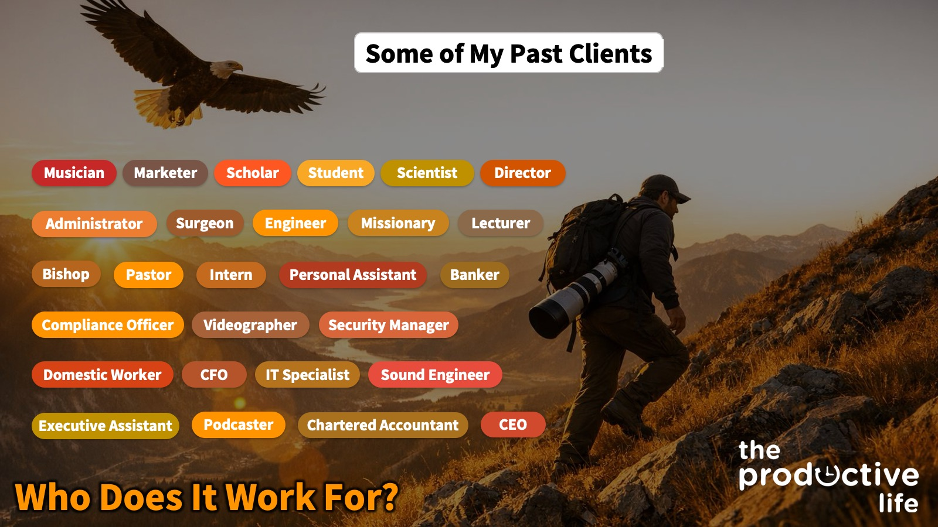
Notes:
Who Will It Work For? Some of my past clients include: Musician, Marketer, Scholar, Student, Scientist, Director, Administrator, Surgeon, Engineer, Missionary, Domestic Worker, Chartered Accountant, Bishop, Pastor, Intern, Personal Assistant, Executive Assistant, Project Manager, Lecturer, Compliance Officer, Videographer, CFO, CEO, Security Manager, IT, Sound Engineer, Podcaster, Banker.

Slide 39
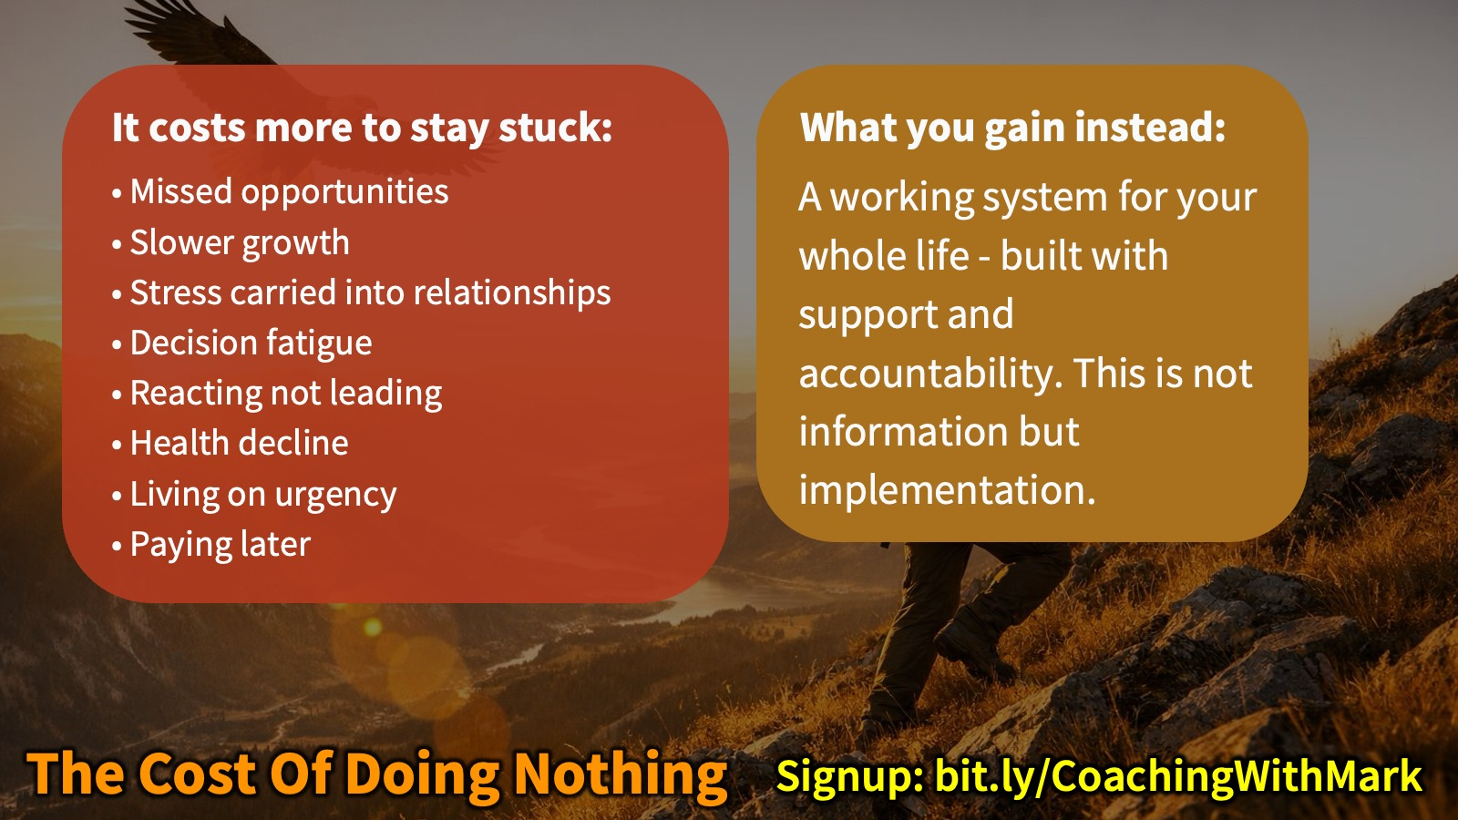
Notes:
The Cost Of Doing Nothing:
It costs more to stay stuck: Missed opportunities and slower growth, Stress carried into home and relationships. Decision fatigue - reacting, never leading. Health decline - Living on urgency. Paying later with time, money, and regret
What you gain instead: A working system for your whole life - built with support and accountability. This is not information but implementation.

Slide 40
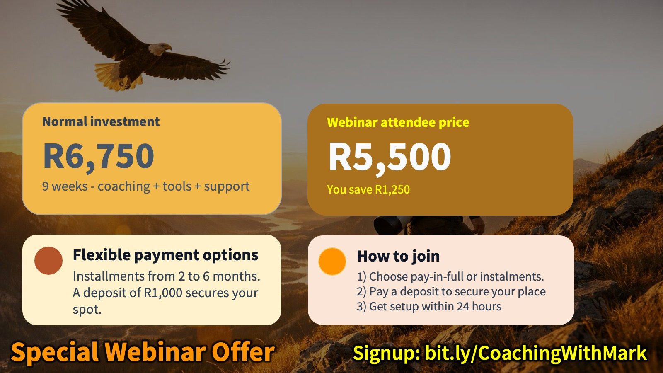
Notes:
Special Webinar Offer:
Normal investment: R6,750 - 9 weeks - coaching + tools + support
Webinar attendee price: R5,500 - Installments from 2 to 6 months.
9 weeks - coaching + tools + support: Installments from 2 to 6 months. A deposit of R1,000 secures spot.
How to join: Choose pay-in-full or instalments. Pay a deposit to secure your place. Get setup within 24 hours

Slide 41
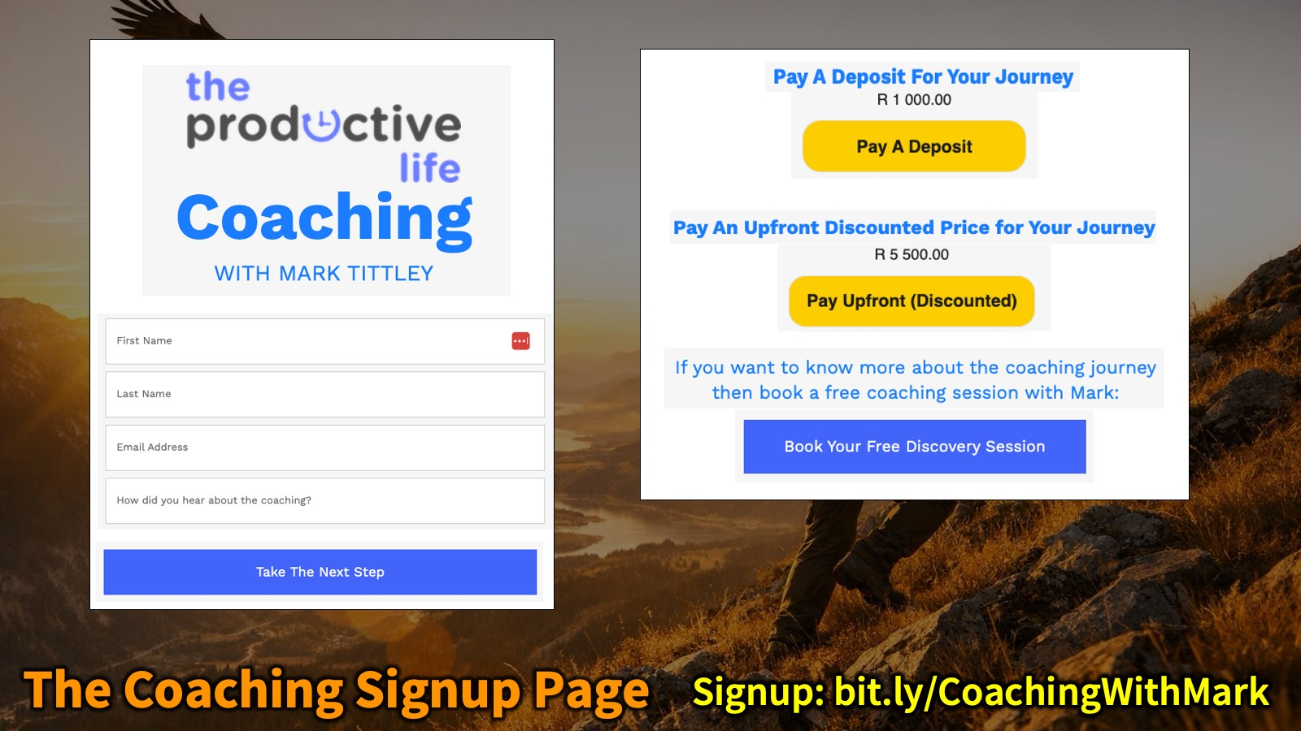
Notes:
This is what to expect when you visit the Coaching Page at: www.bit.ly/CoachingWithMark

Slide 42

Notes:
Back to the High Focus Without Distraction Webinar!

Slide 43
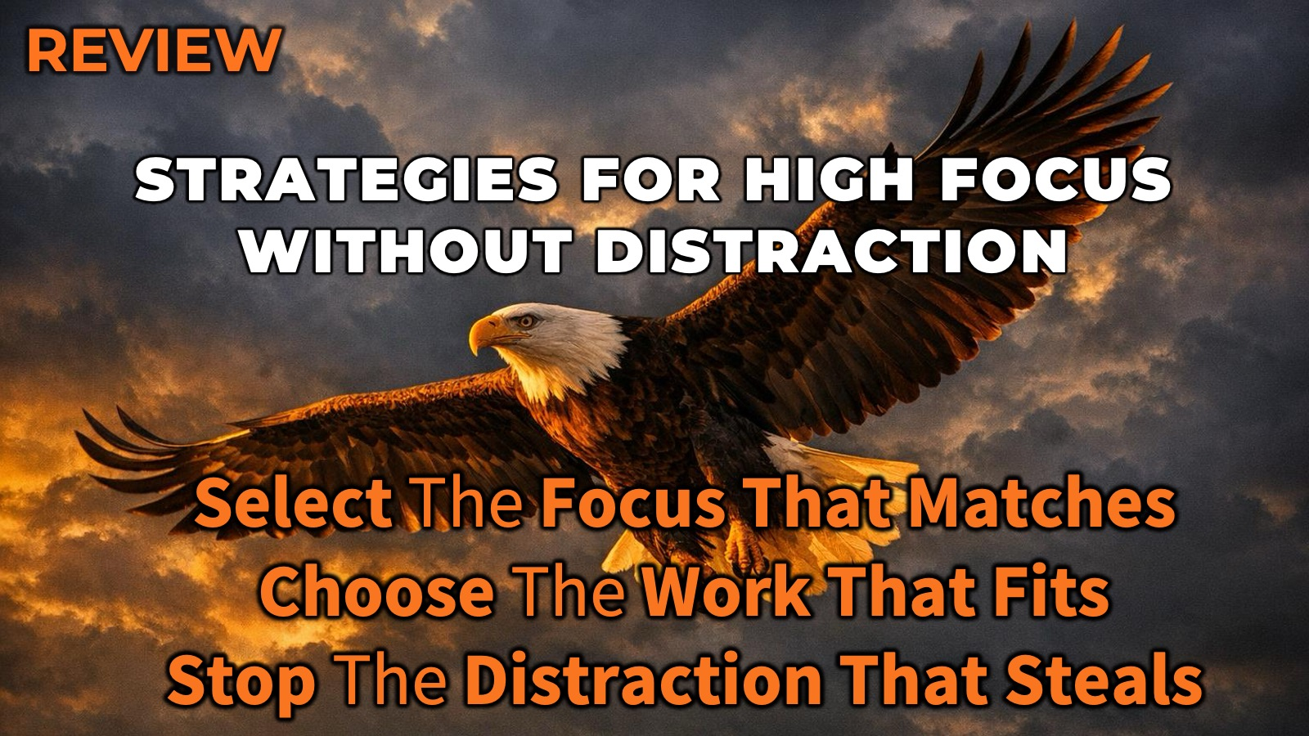
Notes:
Review: Three Strategies for High Focus Without Distraction: (1) Select The Focus That Matches; (2) Choose The Work That Fits and (3) Stop The Distraction That Steals.

Slide 44
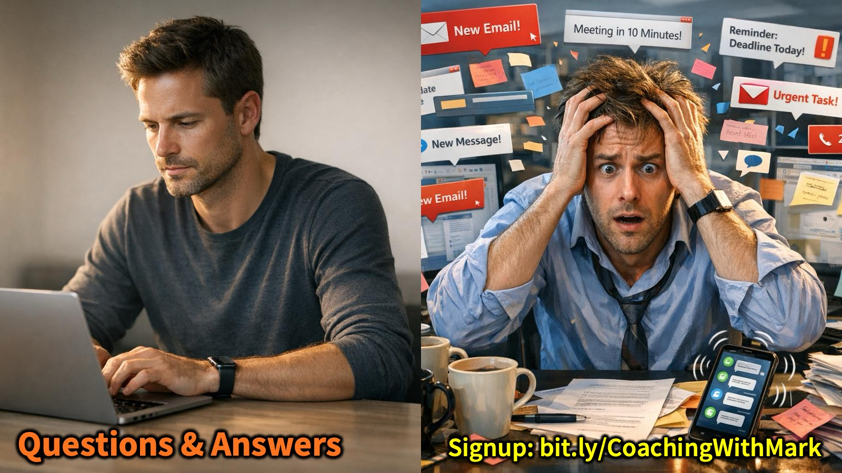
Notes:
Questions & Answers: What questions do you have about how to sustain focus despite distractions?

Slide 45
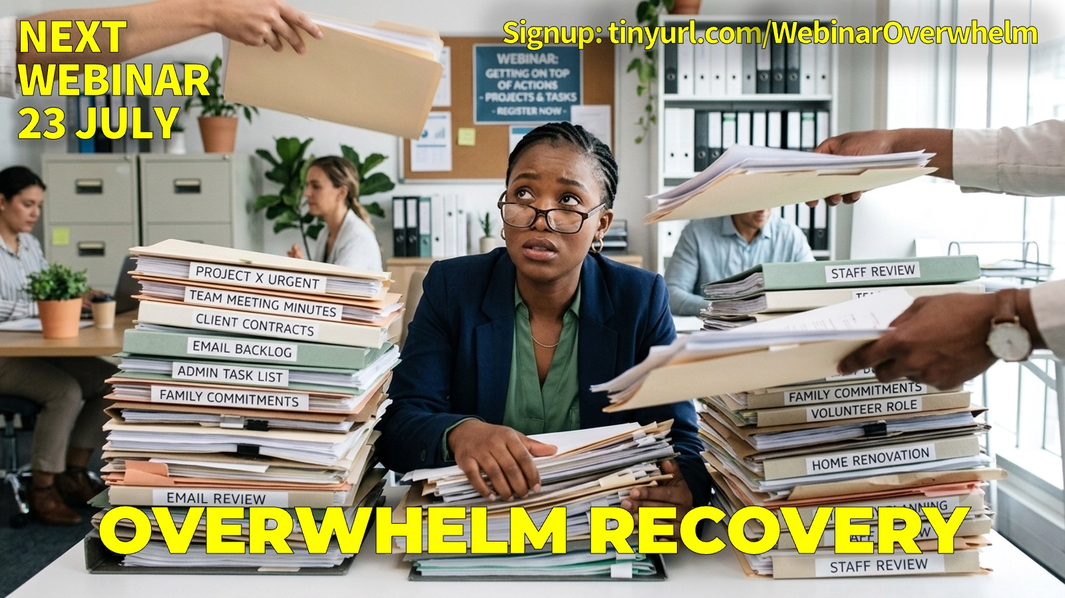
Notes:
Next Webinar: Overwhelm Recovery on 23 July at 19:00. Signup: tinyurl.com/WebinarOverwhelm

Slide 46
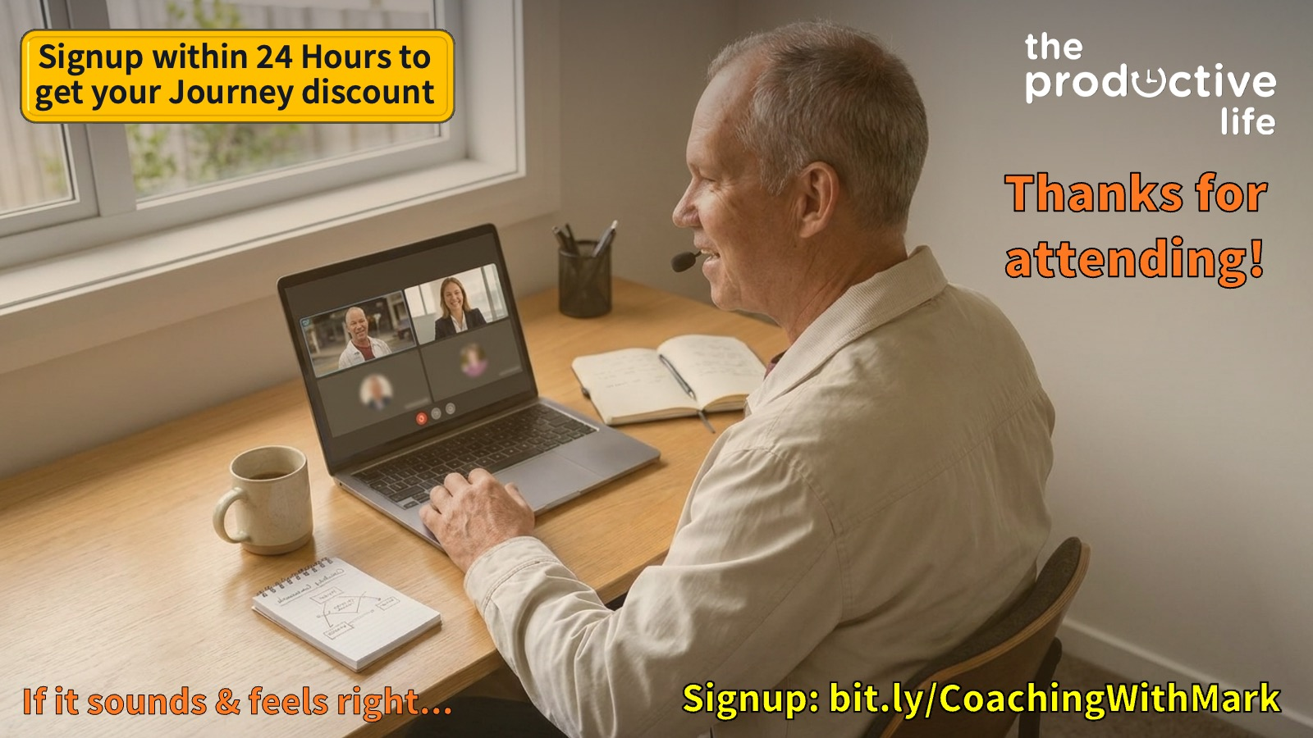
Notes:
Thank You: (1) Sign up for the coaching journey within 24 hours for your webinar discount. (2) Thank you for investing your time tonight..

