Slide 1
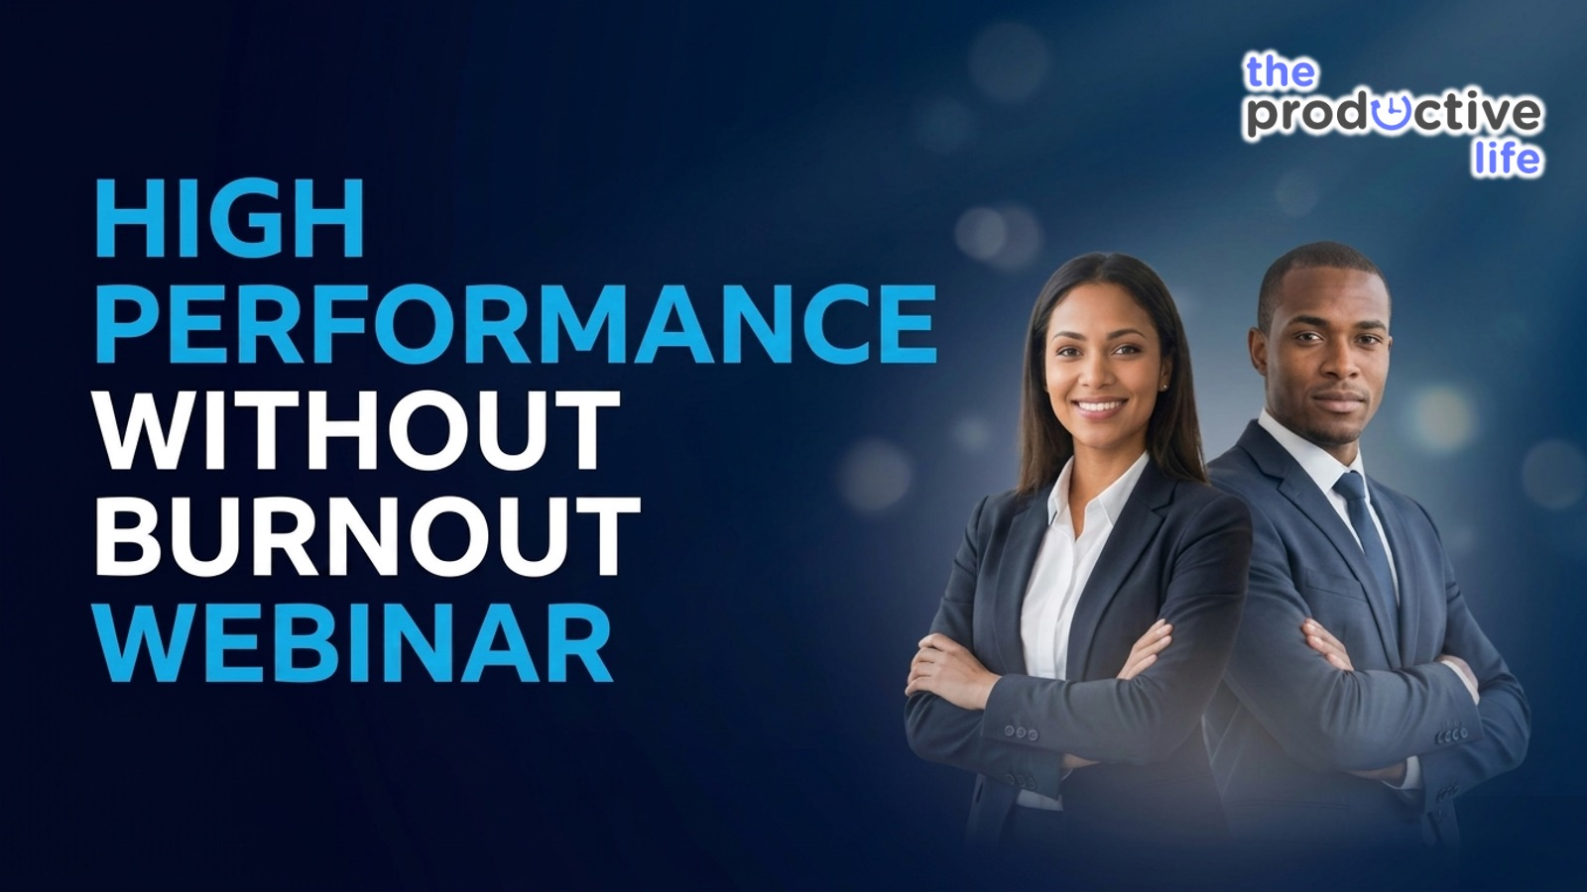
Notes:
Welcome to the High Performance Without Burnout Webinar!

Slide 2
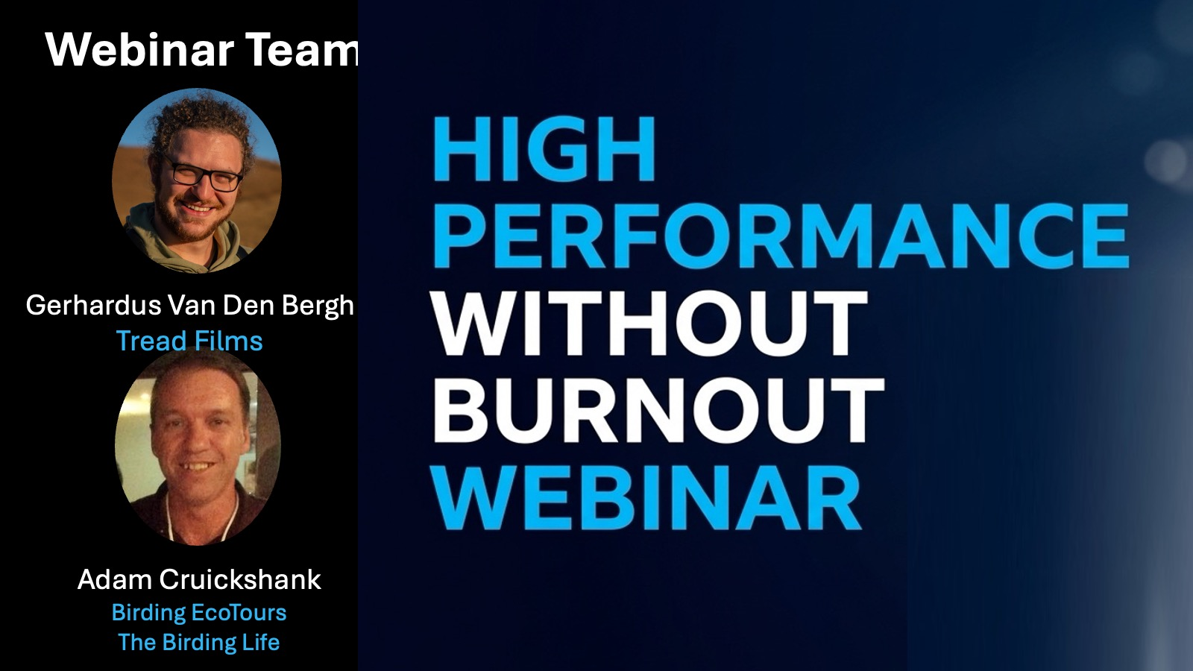
Notes:
The Webinar Team: First some introduction, the team who has helped to pull off this webinar includes: Gerhardus Van Ben Bergh from Tread Films and Adam Cruickshank from Birding EcoTours and The Birding Life.

Slide 3
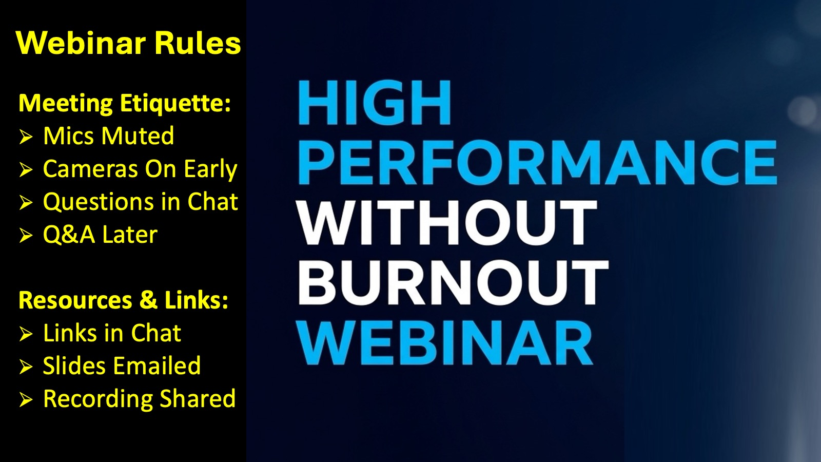
Notes:
Before I continue with introductions, a few quick housekeeping points to make sure we get the most out of our time together. First, please stay muted during the presentation to keep the audio clear. We’d love to see you during our intro section, so feel free to flick your cameras on, but feel free to switch them off later if that helps you focus.
Regarding questions, please drop them in the chat as we go - Adam and Gerhardus are keeping an eye on those for us, and we will handle them in a dedicated Q&A session later. Also, we will be sharing links in the chat throughout the night, so if you see a resource on the screen, check the chat to grab the link. Finally, you don’t need to worry about taking screenshots of the slides - we are recording this, and I’ll send out the video replay and the full presentation to you via email afterwards.

Slide 4
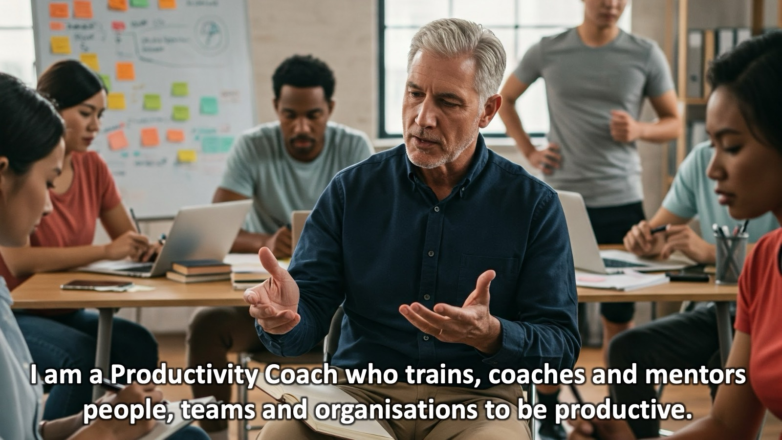
Notes:
I am a Productivity Coach who trains, coaches and mentors people, teams and organisations to be productive. I help people live a life that is balanced, purposeful, and free from the constant noise of "busyness.”

Slide 5
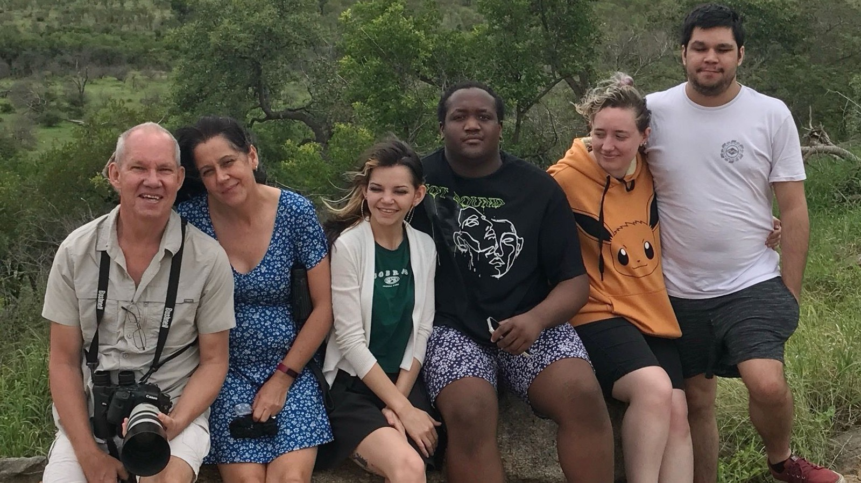
Notes:
I am married to Debbie and am the proud father of three “kids”: Keegan, Ashley and Drew.

Slide 6
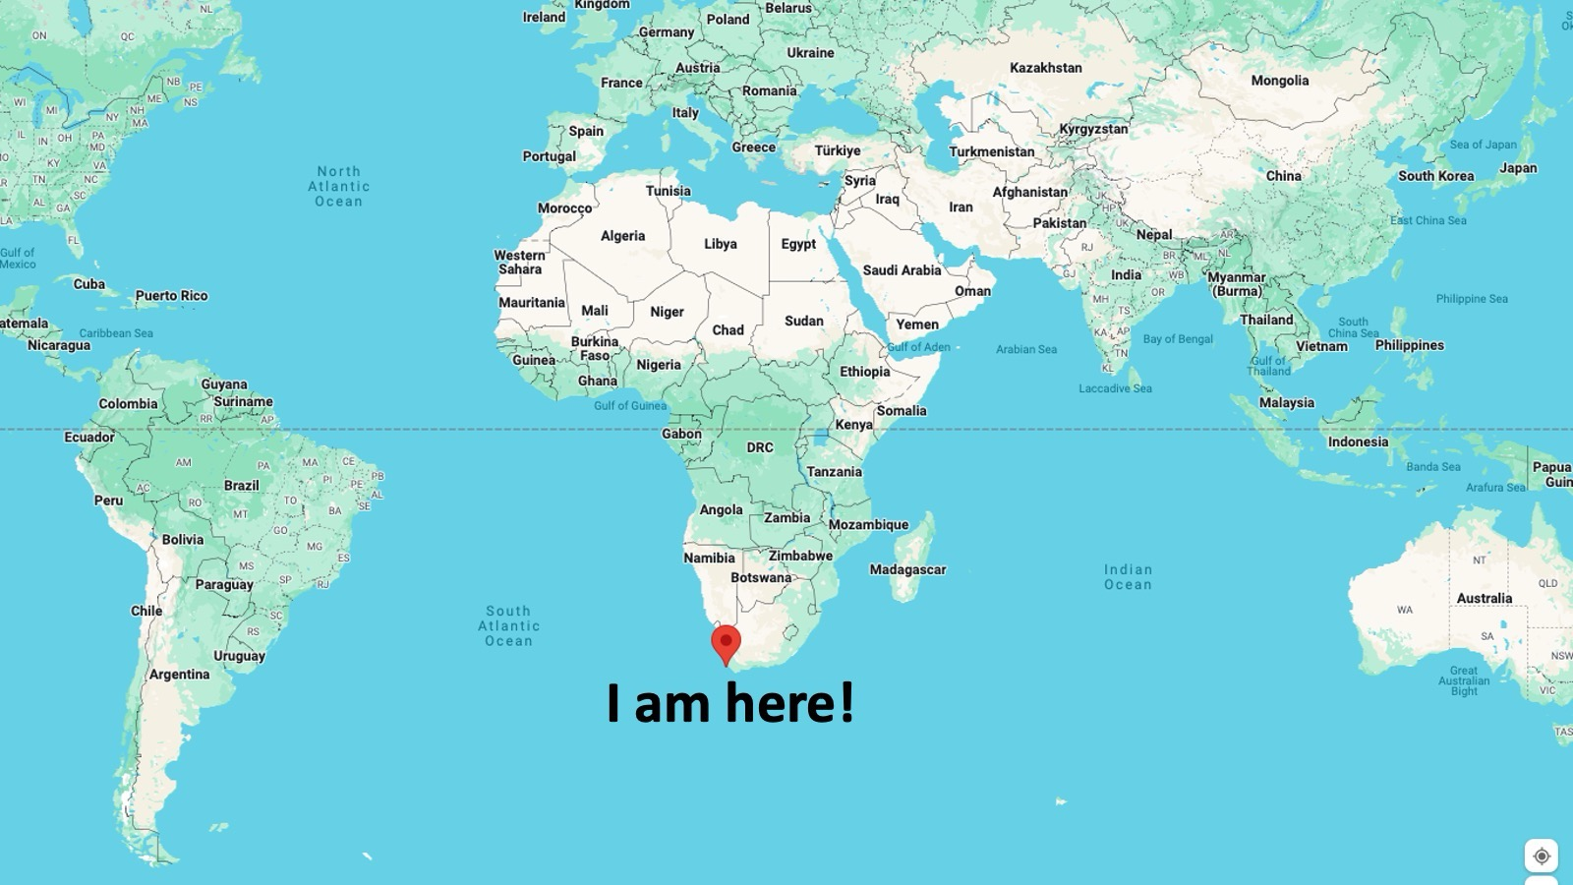
Notes:
I am based in Cape Town.

Slide 7
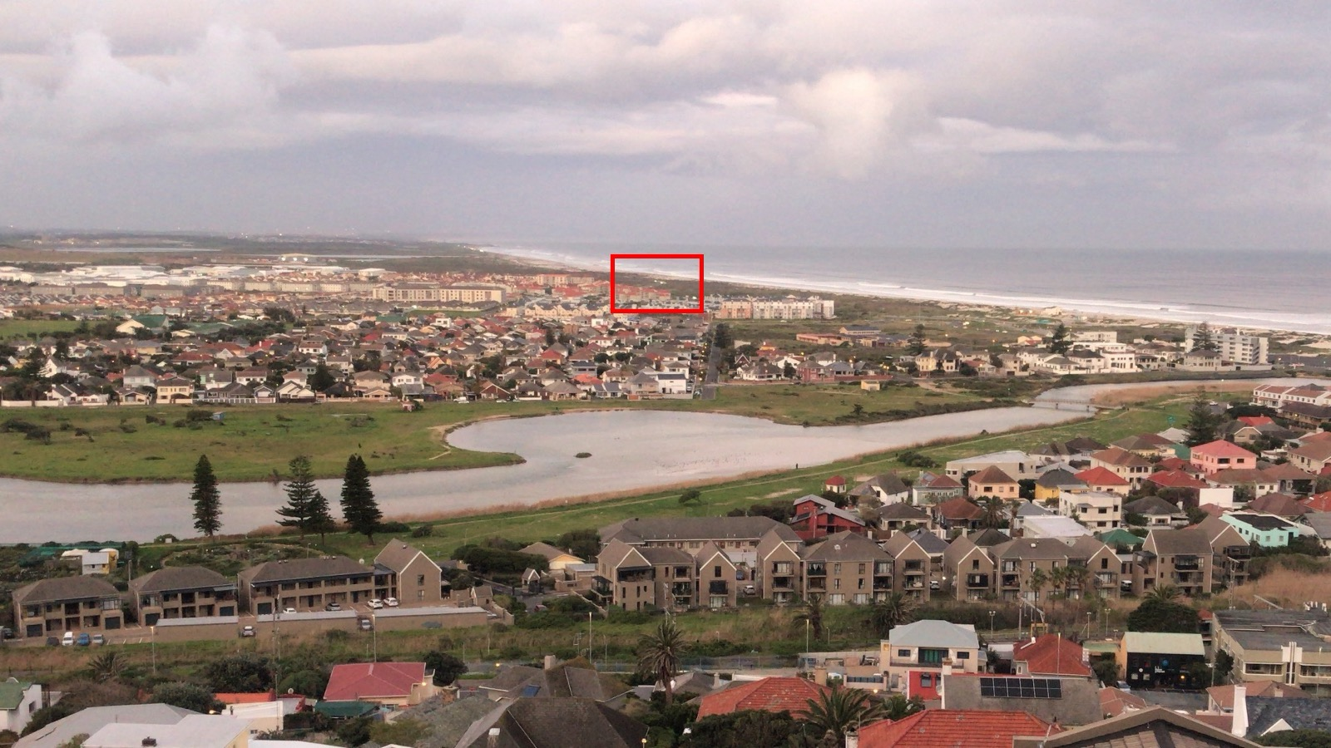
Notes:
I live in the coastal town of Muizenburg which is about 25 minutes from the Cape Town CBD.

Slide 8
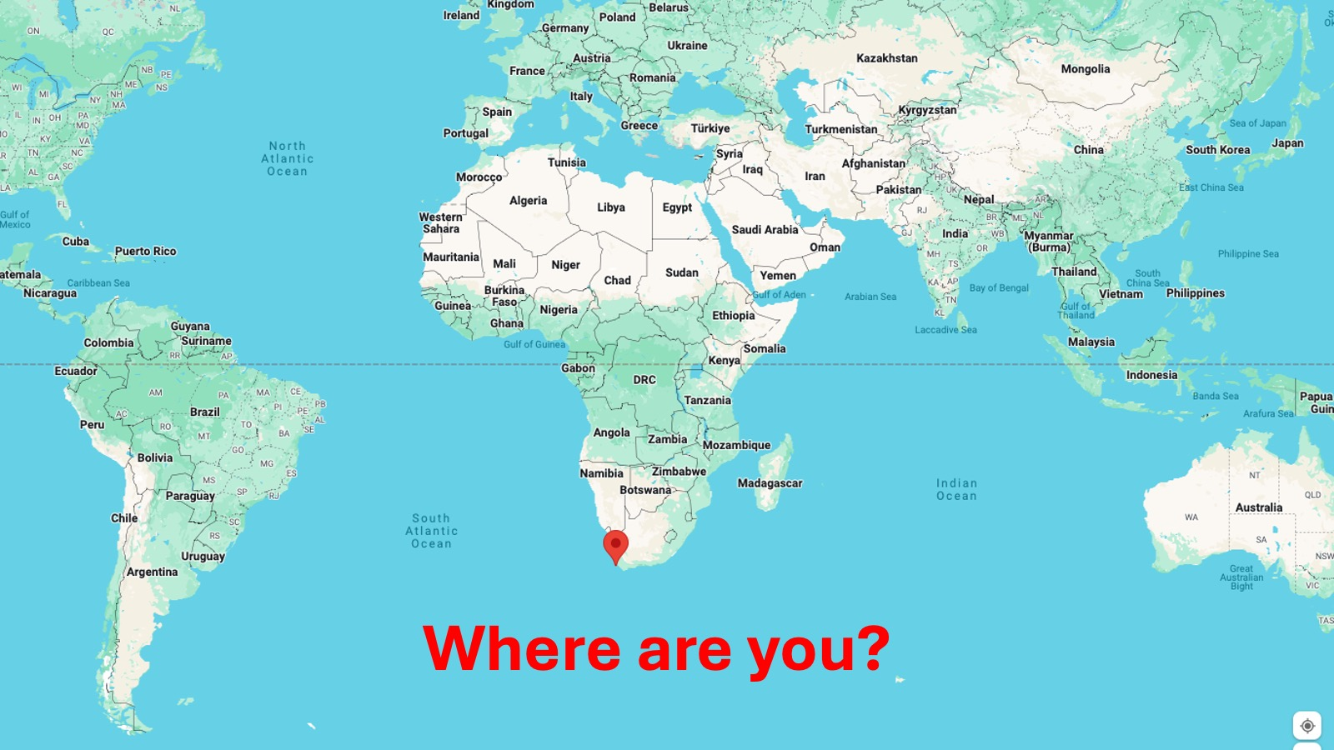
Notes:
Where are you? Post in the chat where you are from in the world - you can add your job title too if you don’t mind.

Slide 9
Notes:
So welcome to the High Performance Without Burnout Webinar. Thank you for signing up and showing up!

Slide 10
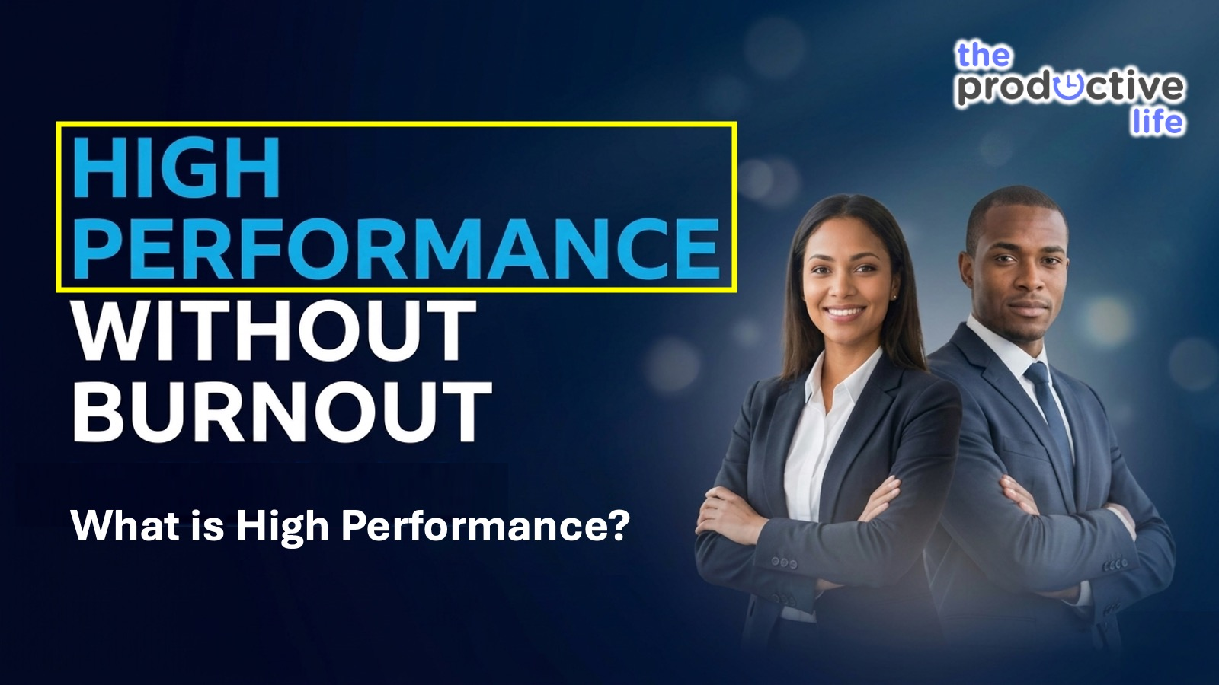
Notes:
Let’s start by asking: What is High Performance?

Slide 11
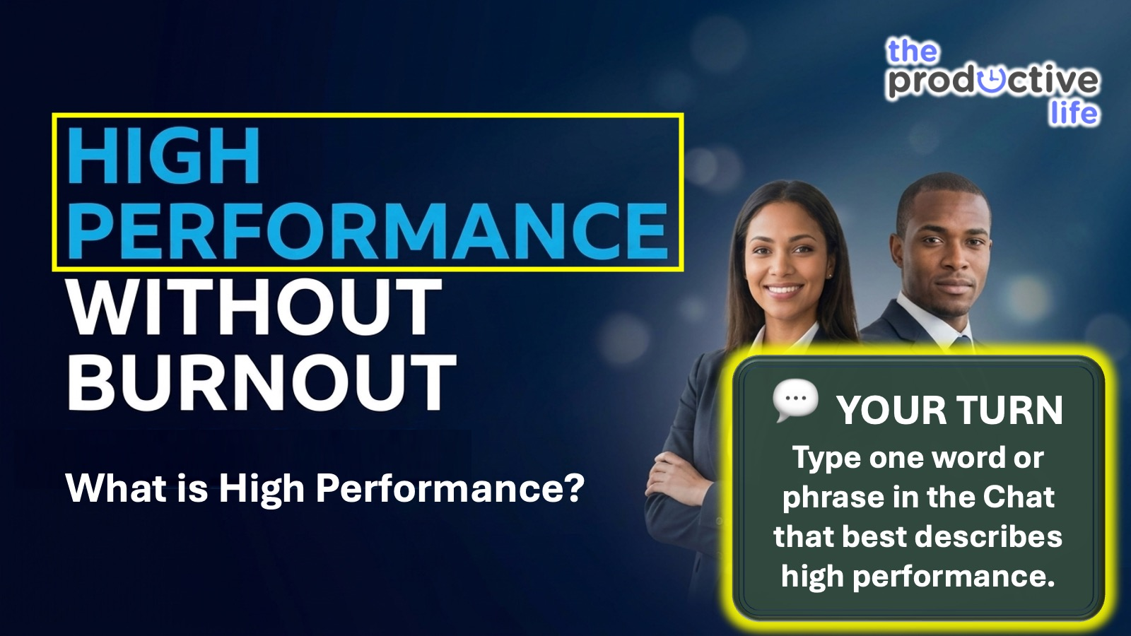
Notes:
Interaction: Type one word or phrase in the Chat that best described burnout for you. It could be a catchphrase like: Firing on all cylinders.

Slide 12

Notes:
What is High Performance? Succeeding beyond standard norms consistently over the long-term, while maintaining positive well-being and relationships. Brendon Burchard, High Performance Habits

Slide 13

Notes:
Here is a formula to remember what High Performance is : Excellence + Consistency + Sustainability = High Performance

Slide 14
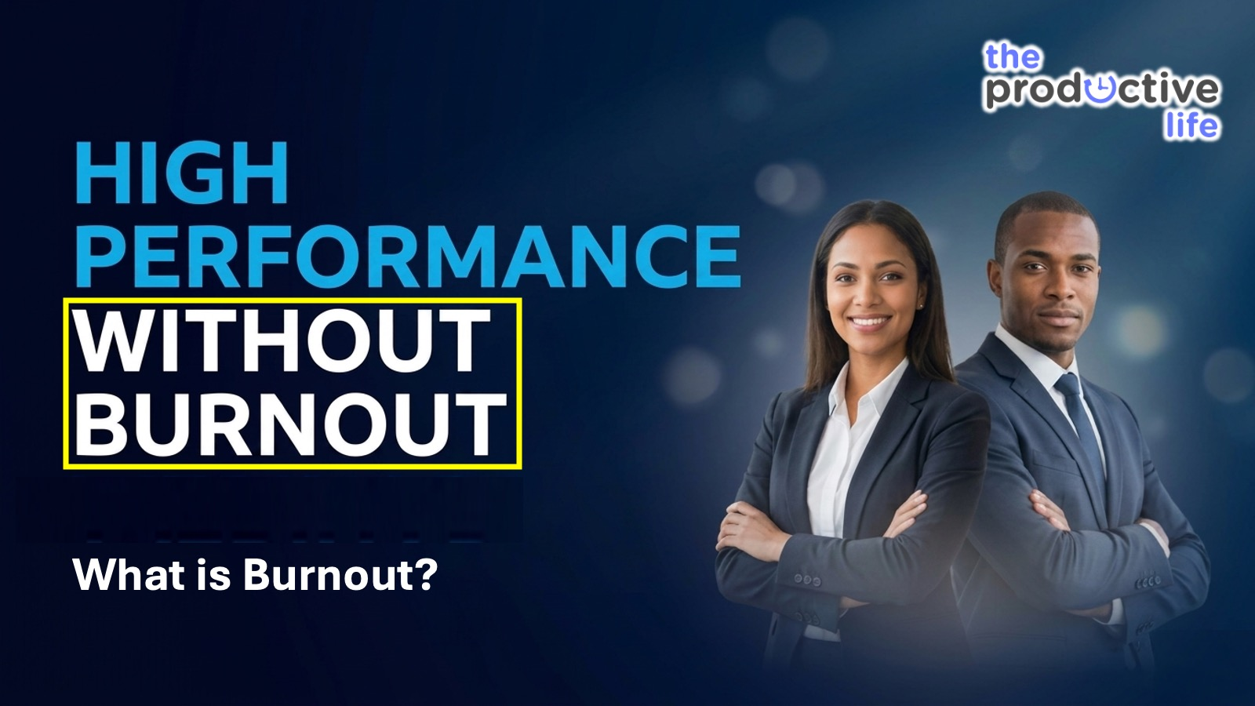
Notes:
Now that we have defined High Performance, what is Burnout?

Slide 15
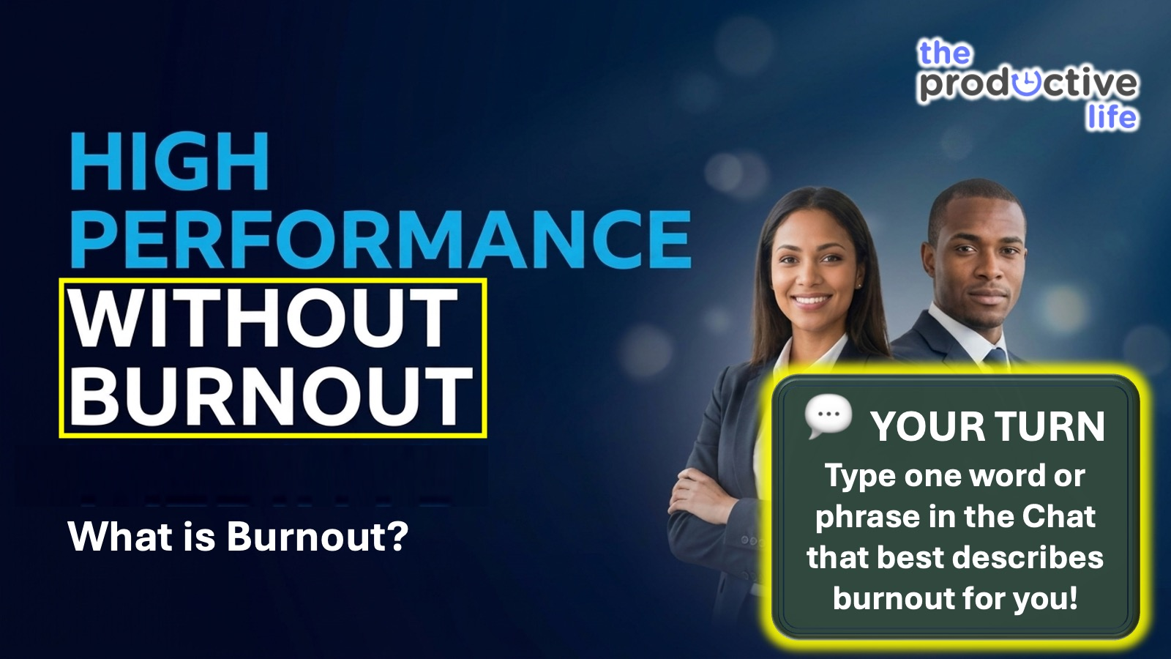
Notes:
Interaction: Type one word or phrase in the Chat that best described burnout for you!

Slide 16
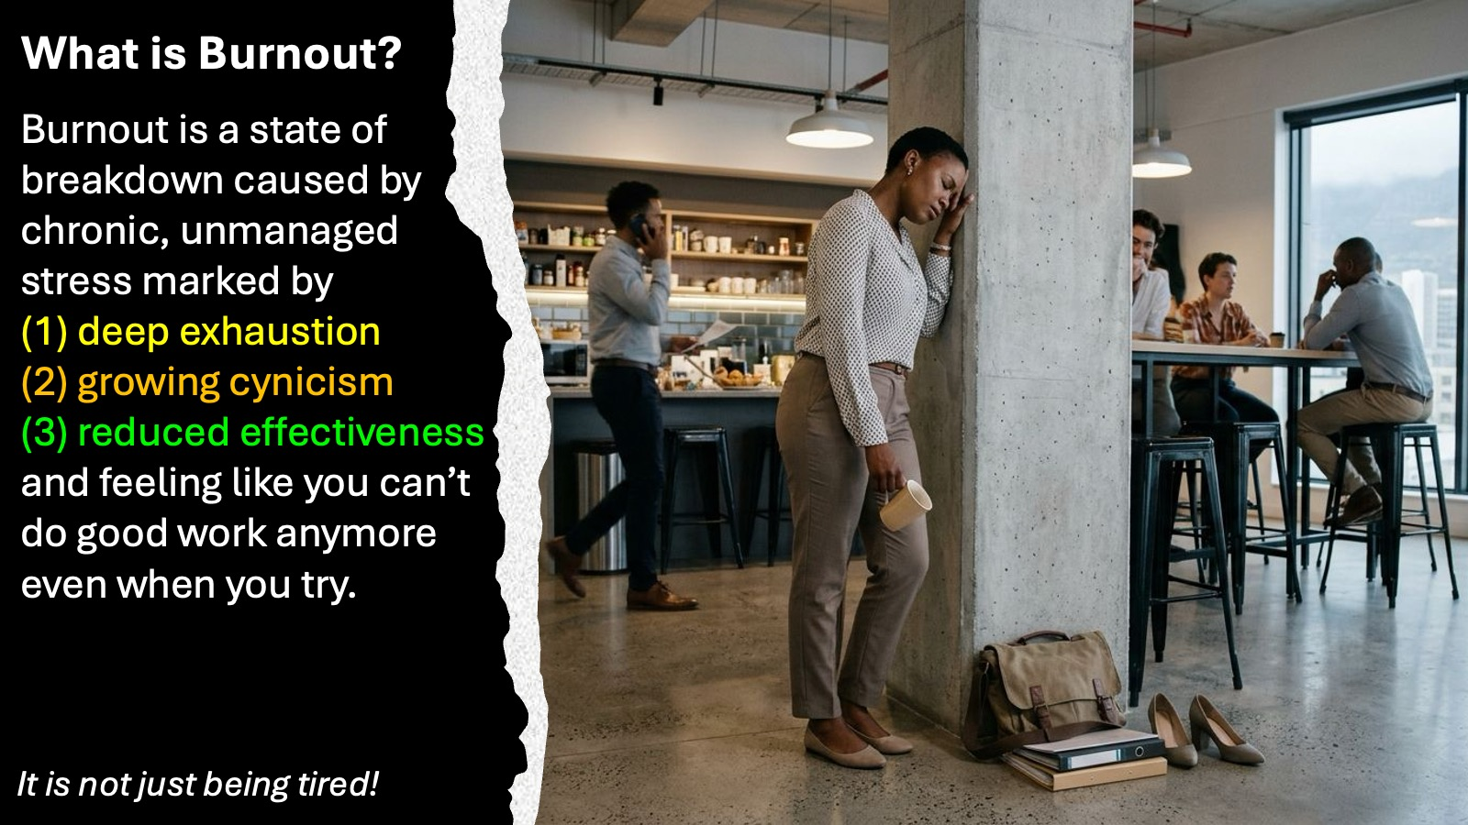
Notes:
What is Burnout? Burnout is a state of breakdown caused by chronic, unmanaged stress marked by (1) deep exhaustion, (2) growing cynicism, (3) reduced effectiveness and feeling like you can’t do good work anymore even when you try.⁠ It is not just being tired.

Slide 17
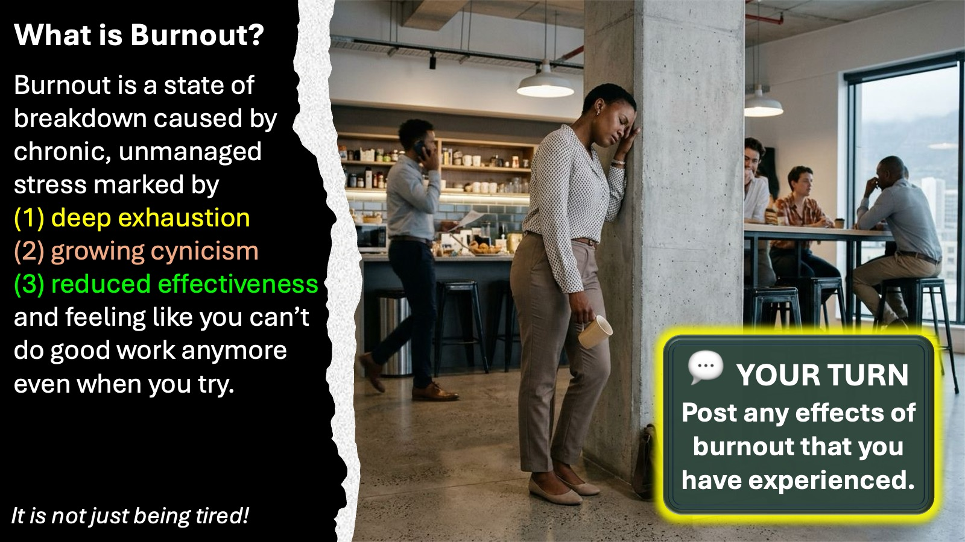
Notes:
Interaction: Post in the chat whether you have experienced any of the three effects of burnout.

Slide 18
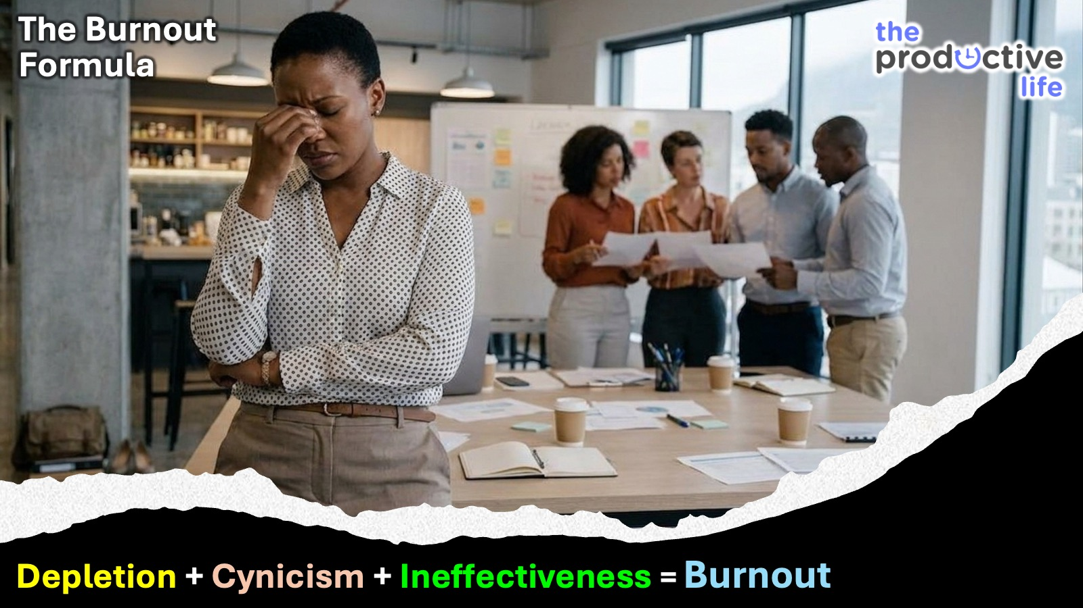
Notes:
Here is a formula to remember what Burnout is: Depletion + Cynicism + Ineffectiveness = Burnout

Slide 19
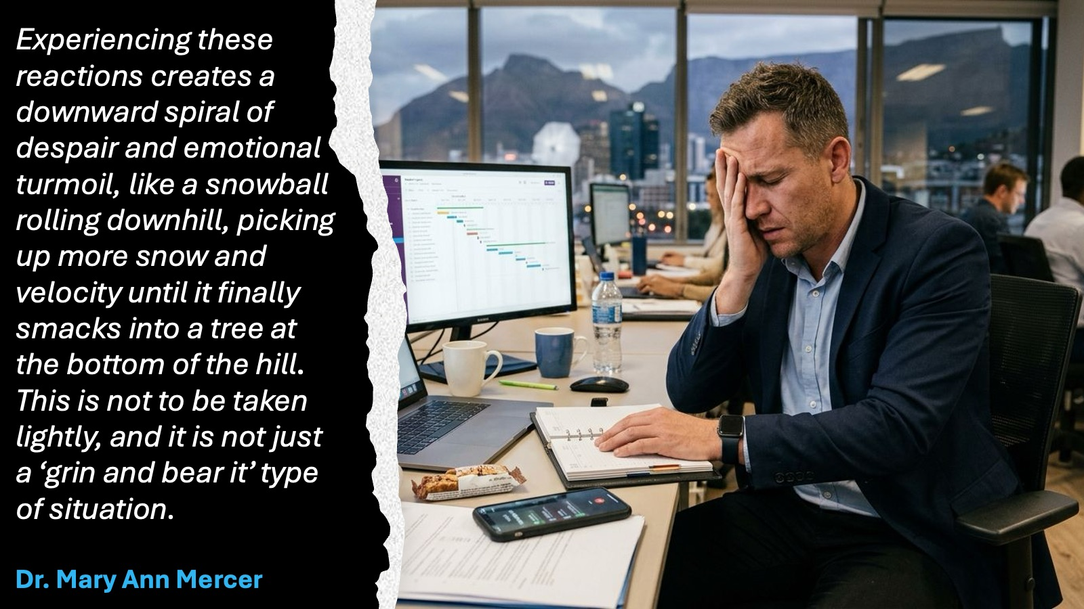
Notes:
“Experiencing these reactions can create a downward spiral of despair and emotional turmoil, It’s like a snowball rolling downhill, picking up more snow and velocity until it finally smacks into a tree at the bottom of the hill. This is not to be taken lightly, and it is not just a ‘grin and bear it’ type of situation.” Dr. Mary Ann V. Mercer, a psychologist and author out of Barrington, Illinois.

Slide 20
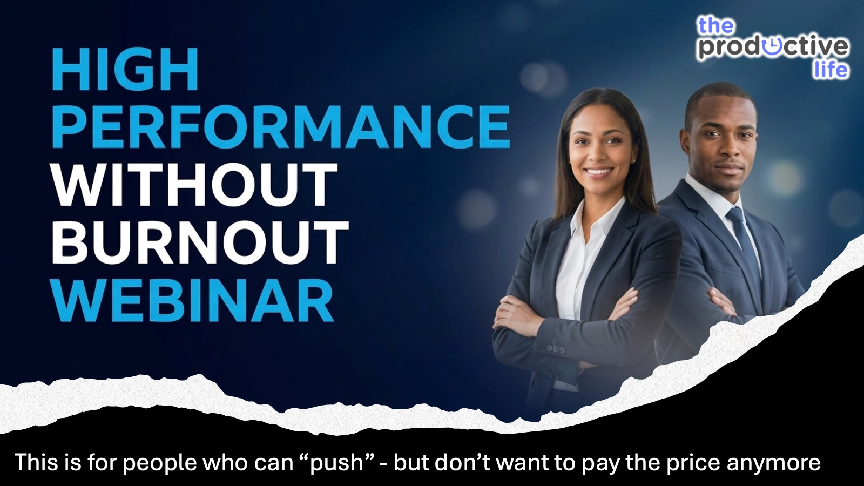

Slide 21
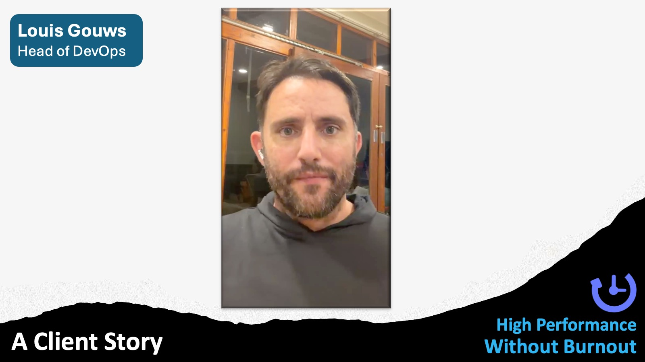
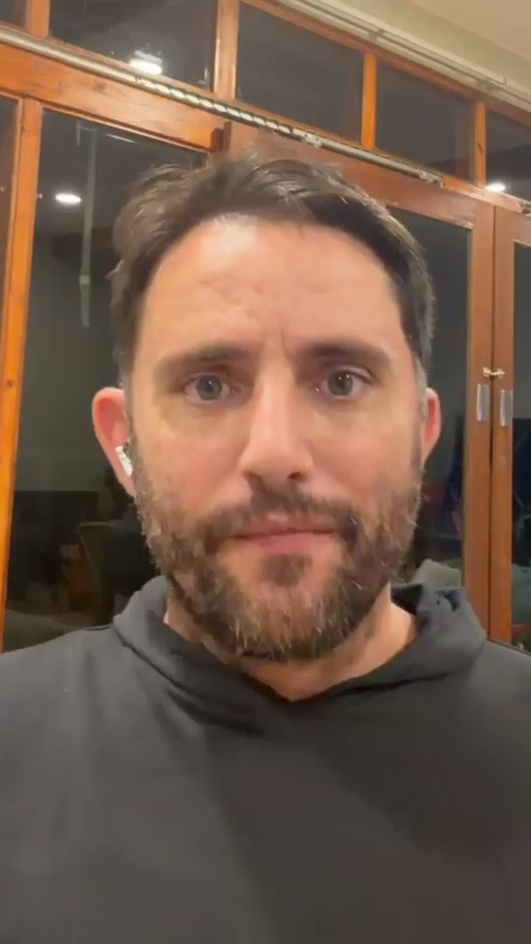
Notes:
Let’s hear from one of clients that I am currently coaching who dealt with burnout. This is Louie Gouws Head of DevOps.

Slide 22
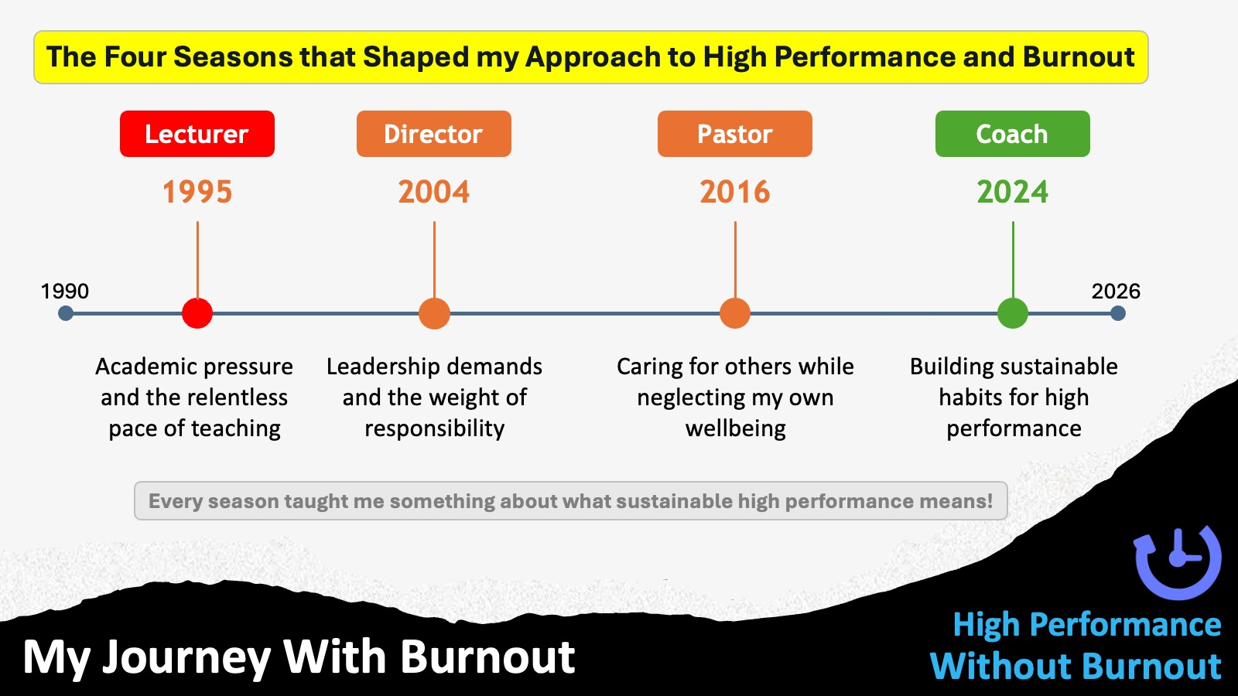
Notes:
My Journey With Burnout:My Journey With Burnout
As I look back over my life, I recall the times I have encountered burnout. Here is the condensed version of my timeline:
(1) Lecturer (1995): I was lecturing at a seminary, travelling across South Africa to speak at workshops, and working late into the evenings to prepare. The strain became too much; my wife told me she was leaving with our two children. Thankfully, it was a cry for me to be present rather than an end to our marriage. Seven weeks of marriage counselling helped me create the boundaries necessary to return to high performance without burnout.
(2) Director of Sonlife Africa (2004): I launched an organisation to train leaders across the continent, eventually working in 16 countries. While rewarding, spending two weeks a month travelling put immense strain on my relationships. I realised I needed to delegate, so I appointed a South African country leader—Ed, who is actually on the call this evening—and regional leaders to oversee the work. This allowed me to pull back from an unsustainable pace until I eventually handed the organisation over to others.
(3) Pastor (2016): I found myself allowing my passion for working with high schoolers to consume my entire life. Even though the work was good, I realised I was at risk of falling back into the same patterns I experienced as a lecturer in 1995. I accepted a position as an overseer of leadership and staff development at my church. This change allowed me to step back from the late nights and weekends away, protecting my time with my family.
(4) Coach (2024–Present): Since 2024, I have been self-employed as a coach. While the pressure to build a business is immense and requires hard work, the lessons I have learned over the years—and the principles and strategies I live by—ensure that I am able to perform at a high level without burning out. What I am teaching you tonight has been shaped by the realities of every season of my life.

Slide 23
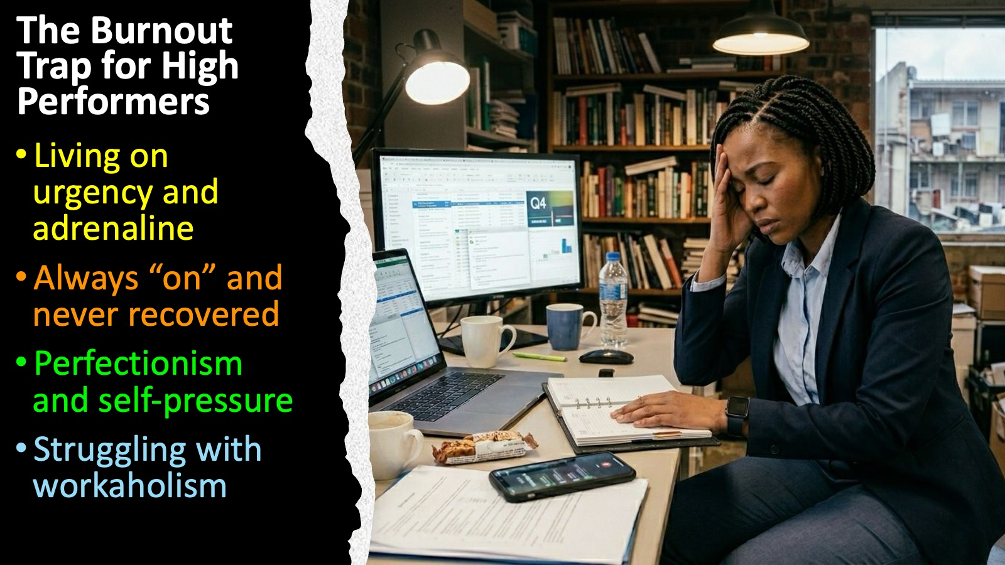
Notes:
The Burnout Trap for High Performers: (1) Living on urgency and adrenaline. (2) Always “on” and never recovered. (3) Perfectionism and self-pressure. (4) Struggling with workaholism.

Slide 24
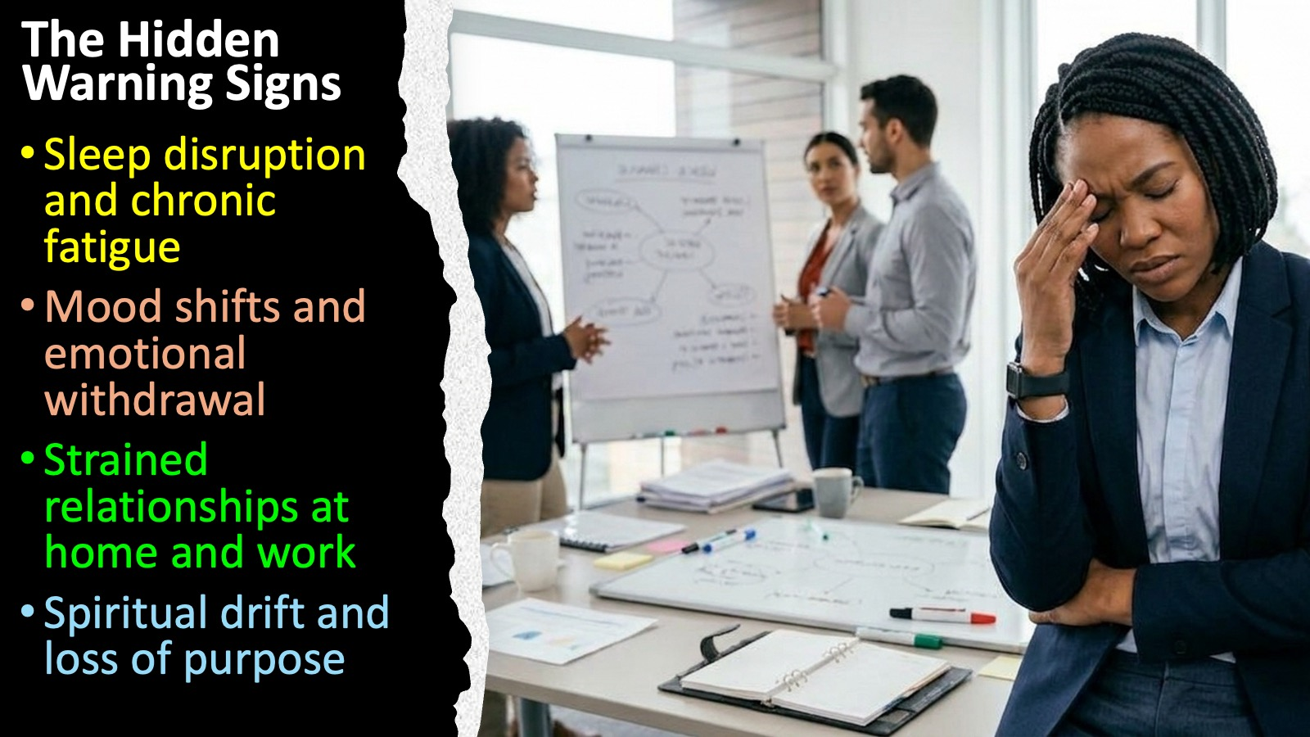
Notes:
The Hidden Warning Signs: (1) Sleep disruption and chronic fatigue. (2) Mood shifts and emotional withdrawal. (3) Strained relationships at home and work. (4) Spiritual drift and loss of purpose.

Slide 25
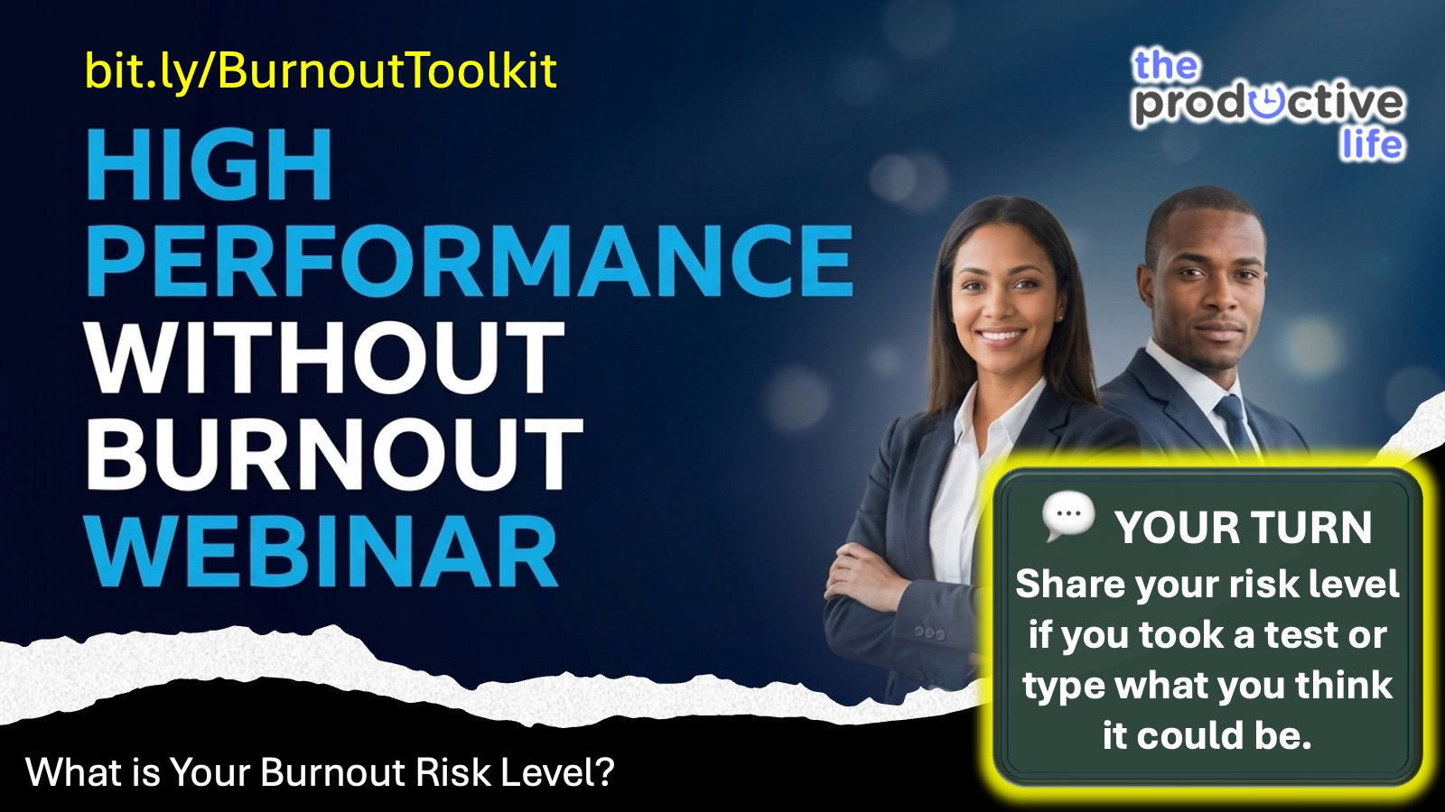
Notes:
What is Your Burnout Risk Level? Share your risk level if you took a test or type what you think it could be.

Slide 26
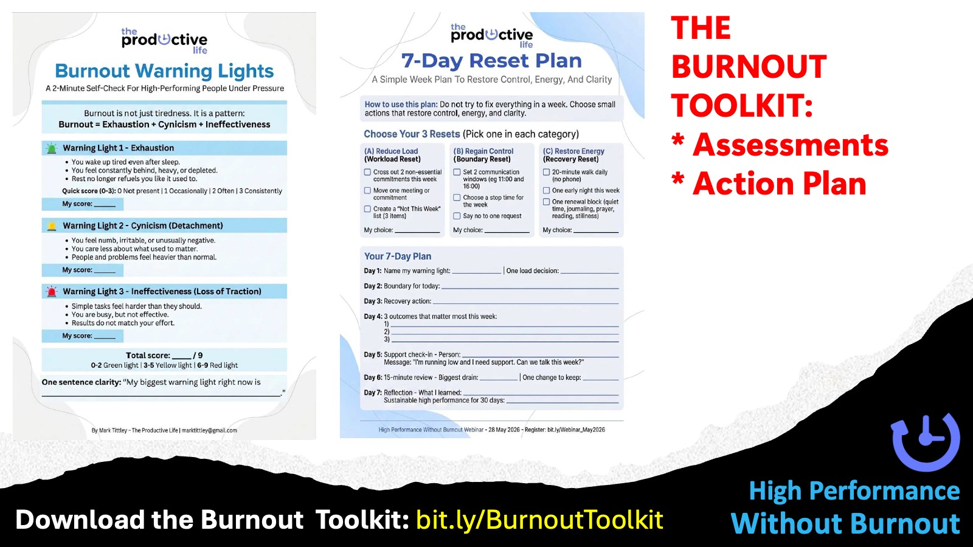
Notes:
Download the Burnout Toolkit: bit.ly/BurnoutToolkit

Slide 27
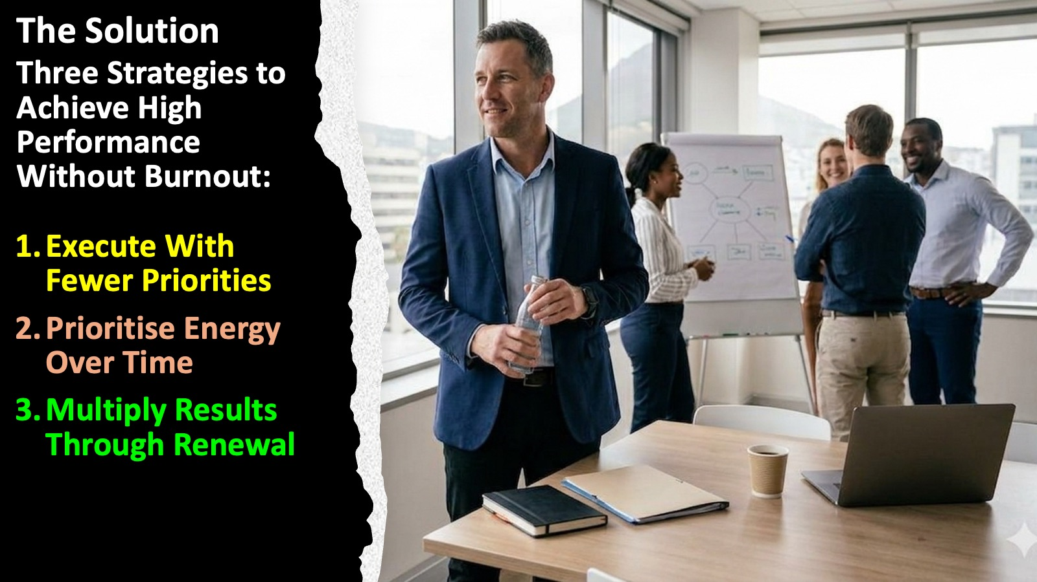
Notes:
The Solution: Three Strategies to Achieve High Performance Without Burnout: (1) Execute With Fewer Priorities, (2) Prioritise Energy Over Time, (3) Multiply Results Through Renewal.

Slide 28
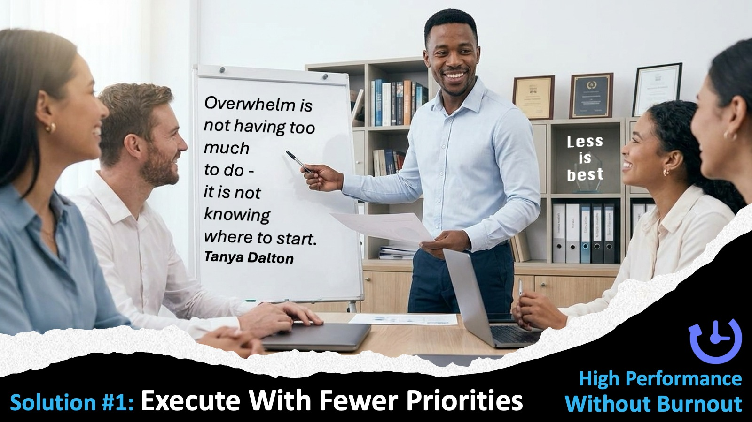
Notes:
Solution #1: Execute With Fewer Priorities

Slide 29
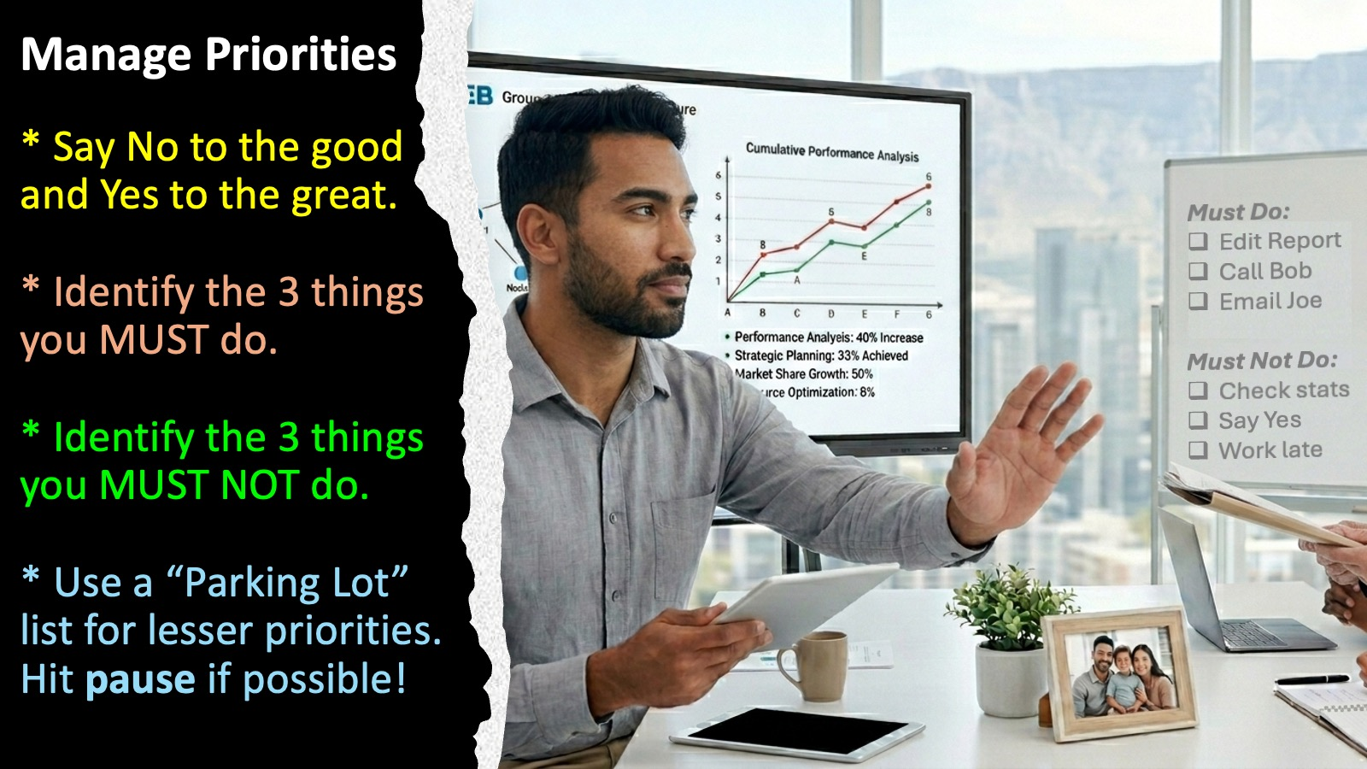
Notes:
Manage Priorities: (1) Say No to the good and Yes to the great. (2) Identify the 3 things you MUST do. (3) Identify the 3 things you MUST NOT do. (4) Use a “Parking Lot” list for lesser priorities.

Slide 30
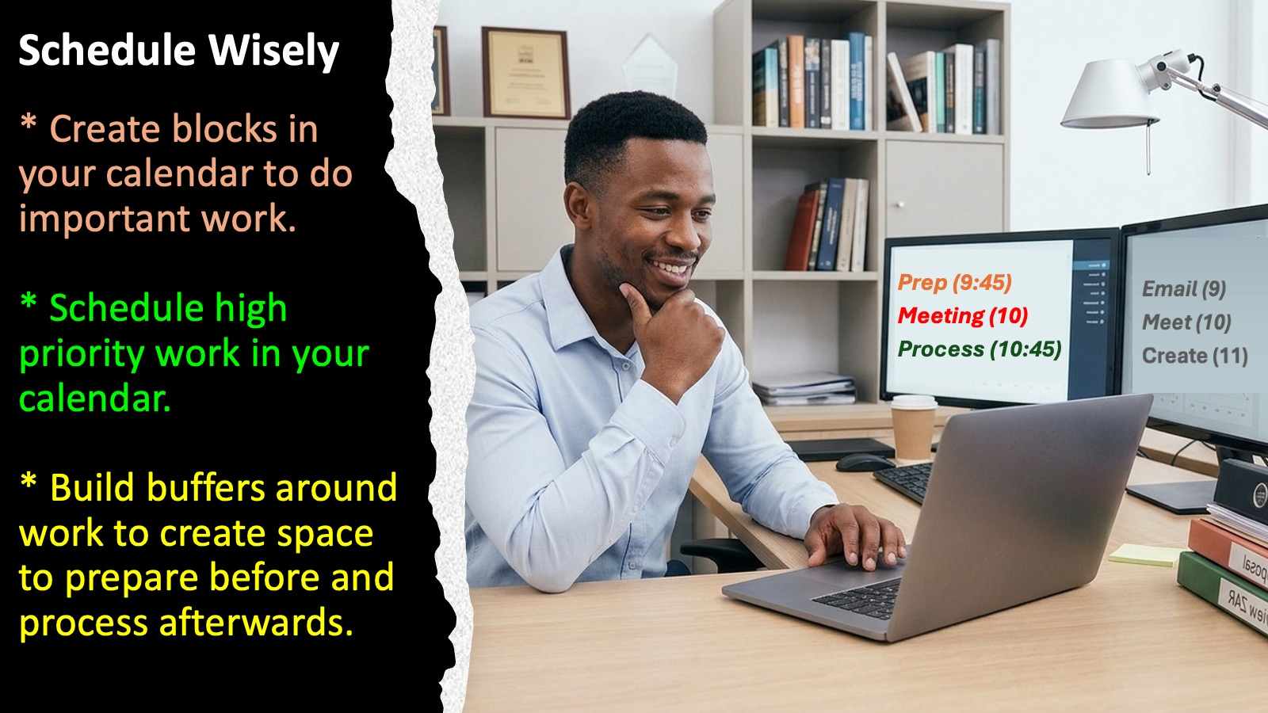
Notes:
Reduce Overload; (1) Create Blocks in your calendar to do important work. (2) Schedule high priority work in your calendar. (3) Build buffers around work to create space to prepare before and process afterwards.

Slide 31
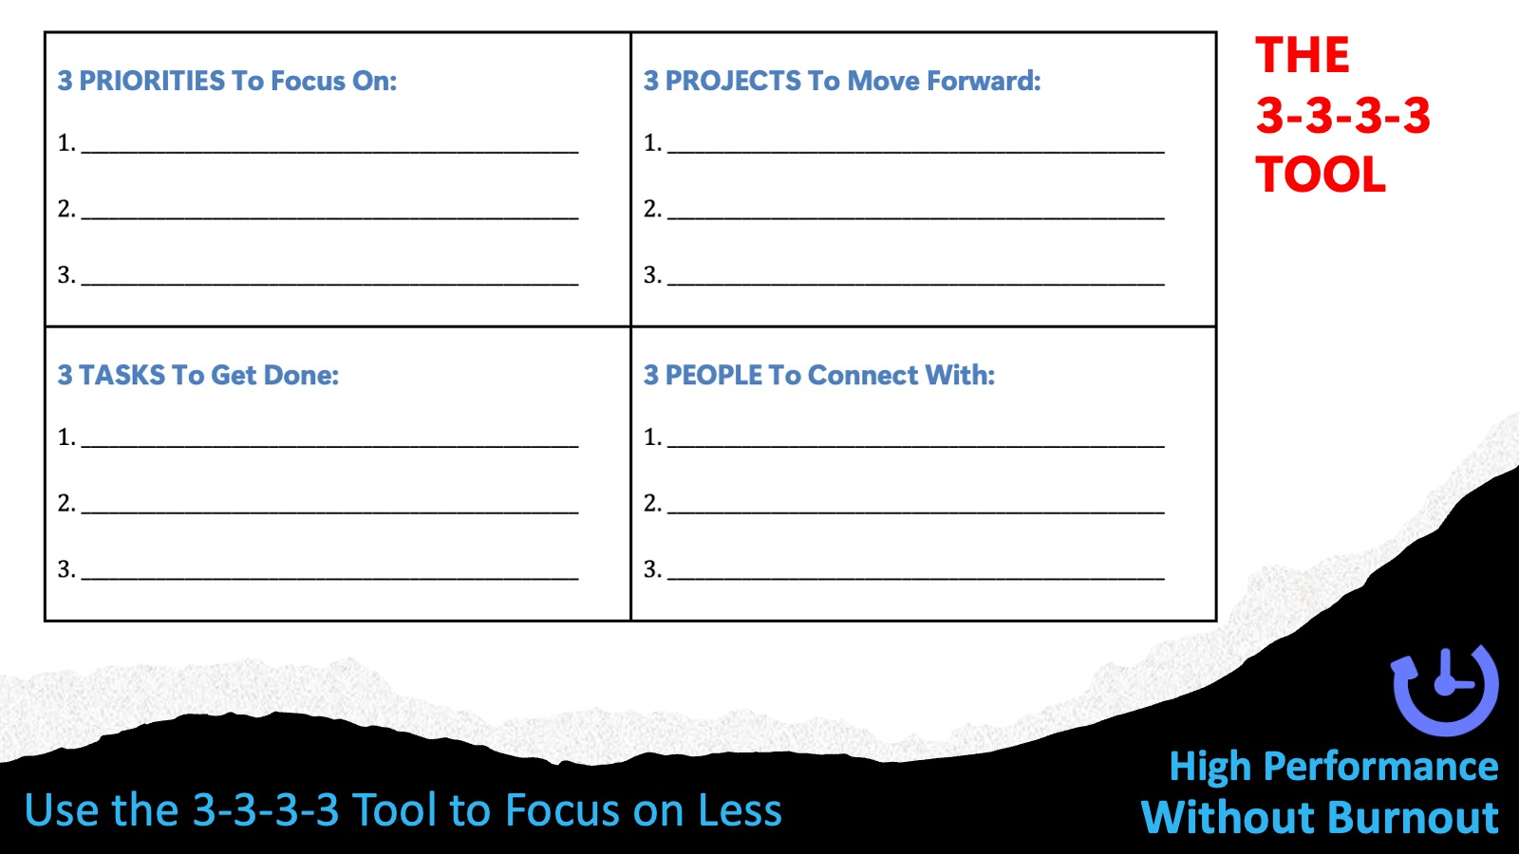
Notes:
Use the 3-3-3-3 Tool for each time frame in your life: Day, Week, Month, Year, Decade. Identify 3 priorities to focus on, 3 Projects to Move Forward, 3 Tasks to Get Done and 3 People to Connect With.

Slide 32
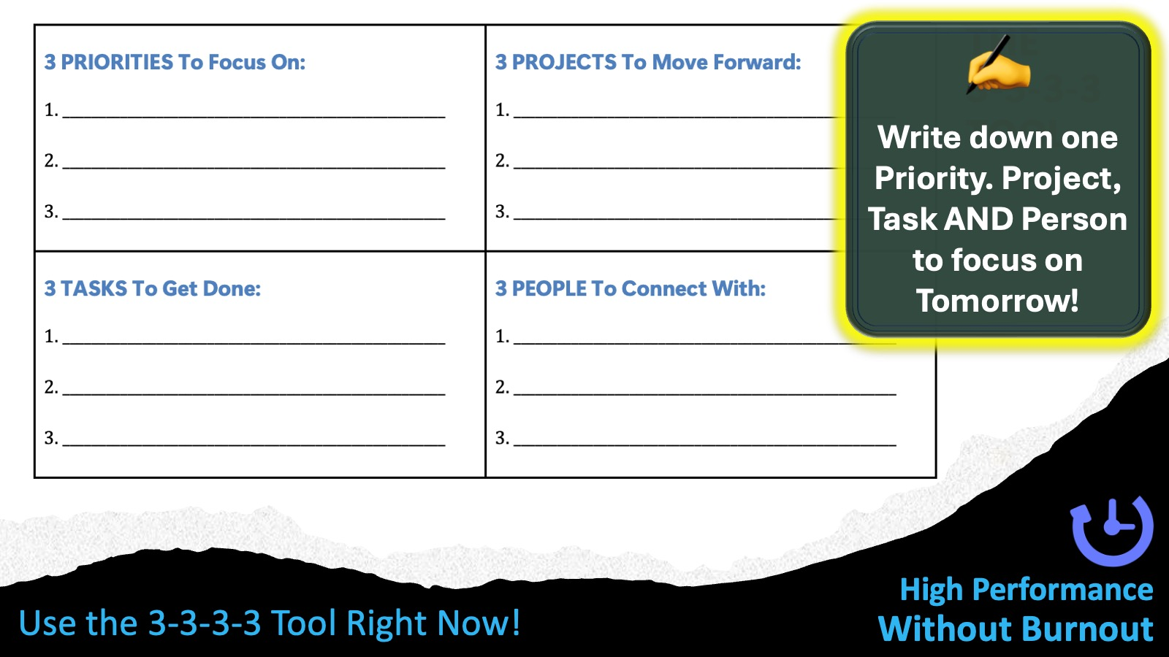
Notes:
Use the 3-3-3-3 Tool Right Now: Write down one Priority. Project, Task AND Person to focus on Tomorrow!

Slide 33
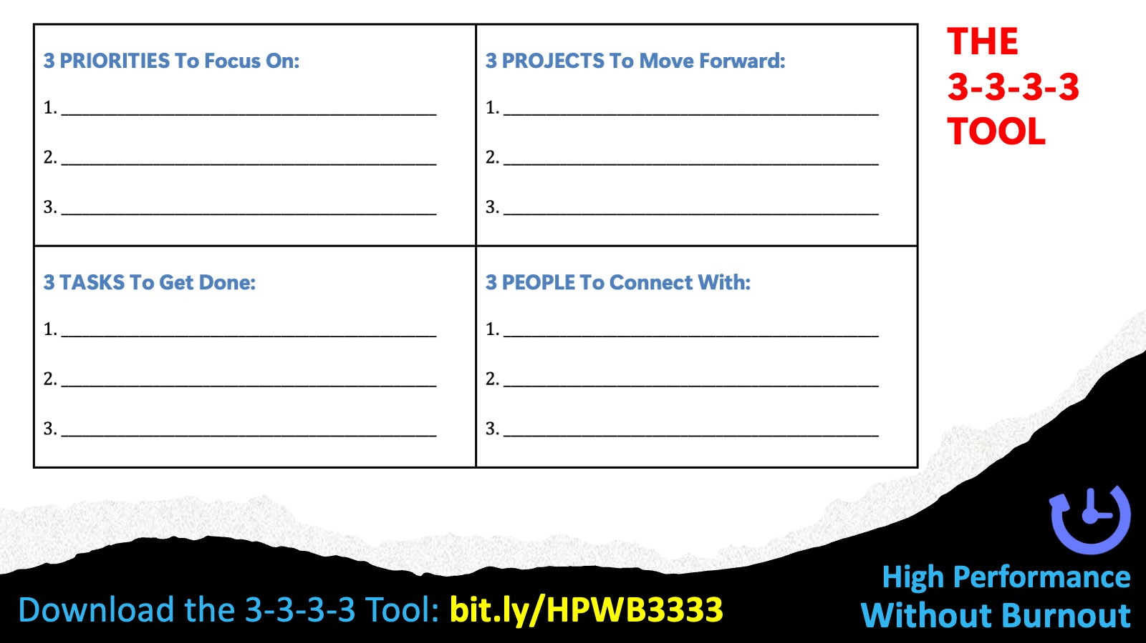
Notes:
Download the 3-3-3-3 Tool: bit.ly/HPWB3333

Slide 34
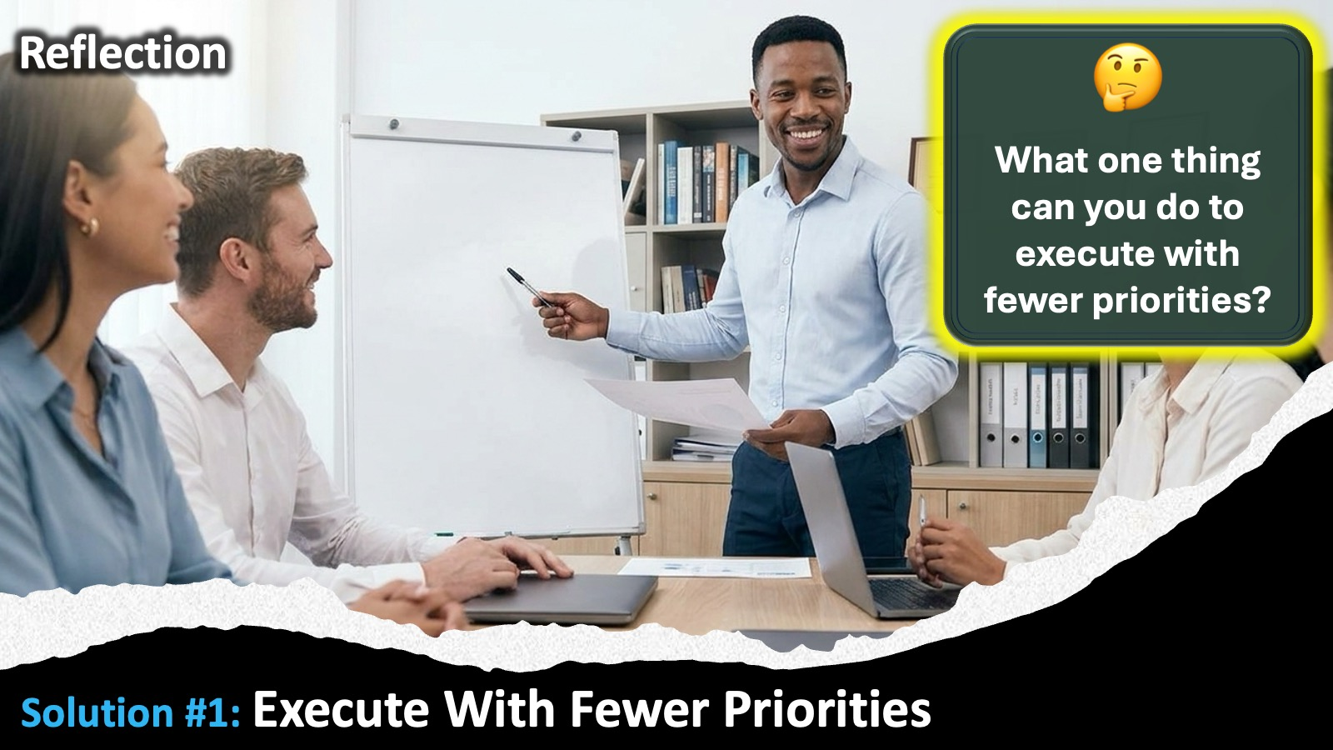
Notes:
Solution #1: Reflect: What one things can you do to execute with fewer priorities?

Slide 35
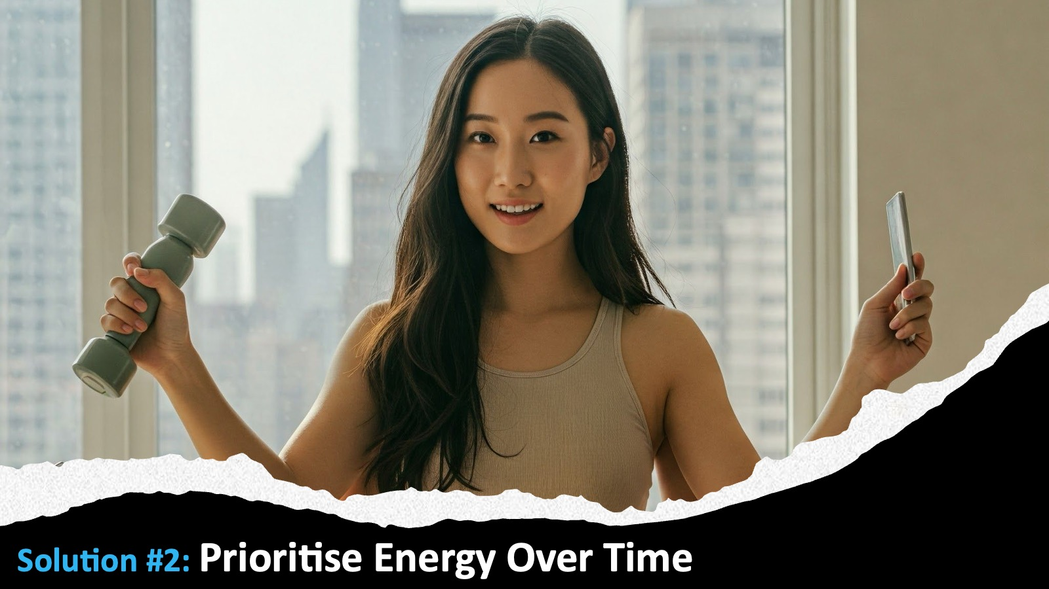
Notes:
Solution #2: Prioritise Energy Over Time

Slide 36

Notes:
Target Energy: (1) Protect your mornings - use your best energy where it matters the most. (2) Match task type to energy level: deep work vs. shallow work. (3) Plan your day around energy peaks, not just deadlines.

Slide 37

Notes:
Manage Energy : (1) Block high-energy hours for your highest-value work; (2) Schedule admin, emails, and routine tasks for low-energy windows. (3) Guard recovery time as fiercely as you guard meeting time.

Slide 38
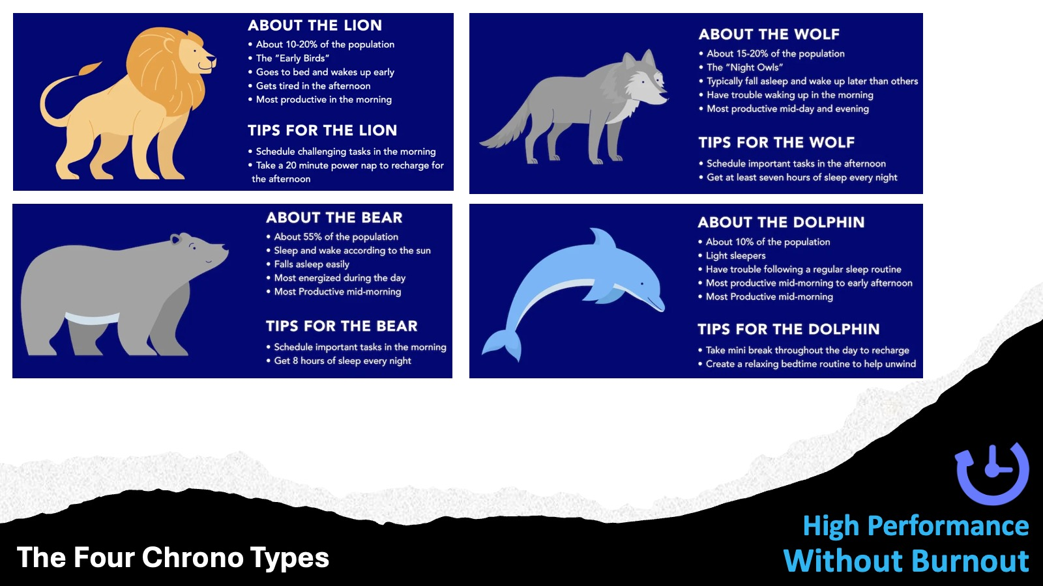
Notes:
The Four Chrono Types: The four chronotypes describe an individual's natural sleep-wake patterns and peak energy levels throughout the day. Lions are typical early risers who find themselves most productive and alert in the morning hours, though their energy tends to taper off significantly by the evening. Bears, who make up the largest percentage of the population, align their energy levels with the sun, peaking during the middle of the day and easily adapting to standard corporate schedules. Wolves are classic night owls who experience a surge of creativity and focus in the late afternoon and evening, often struggling with early mornings. Dolphins, named after the marine mammal that sleeps with only half its brain at a time, are light, sensitive, or irregular sleepers who often experience low-grade fatigue during the day and a burst of anxious energy late at night.

Slide 39
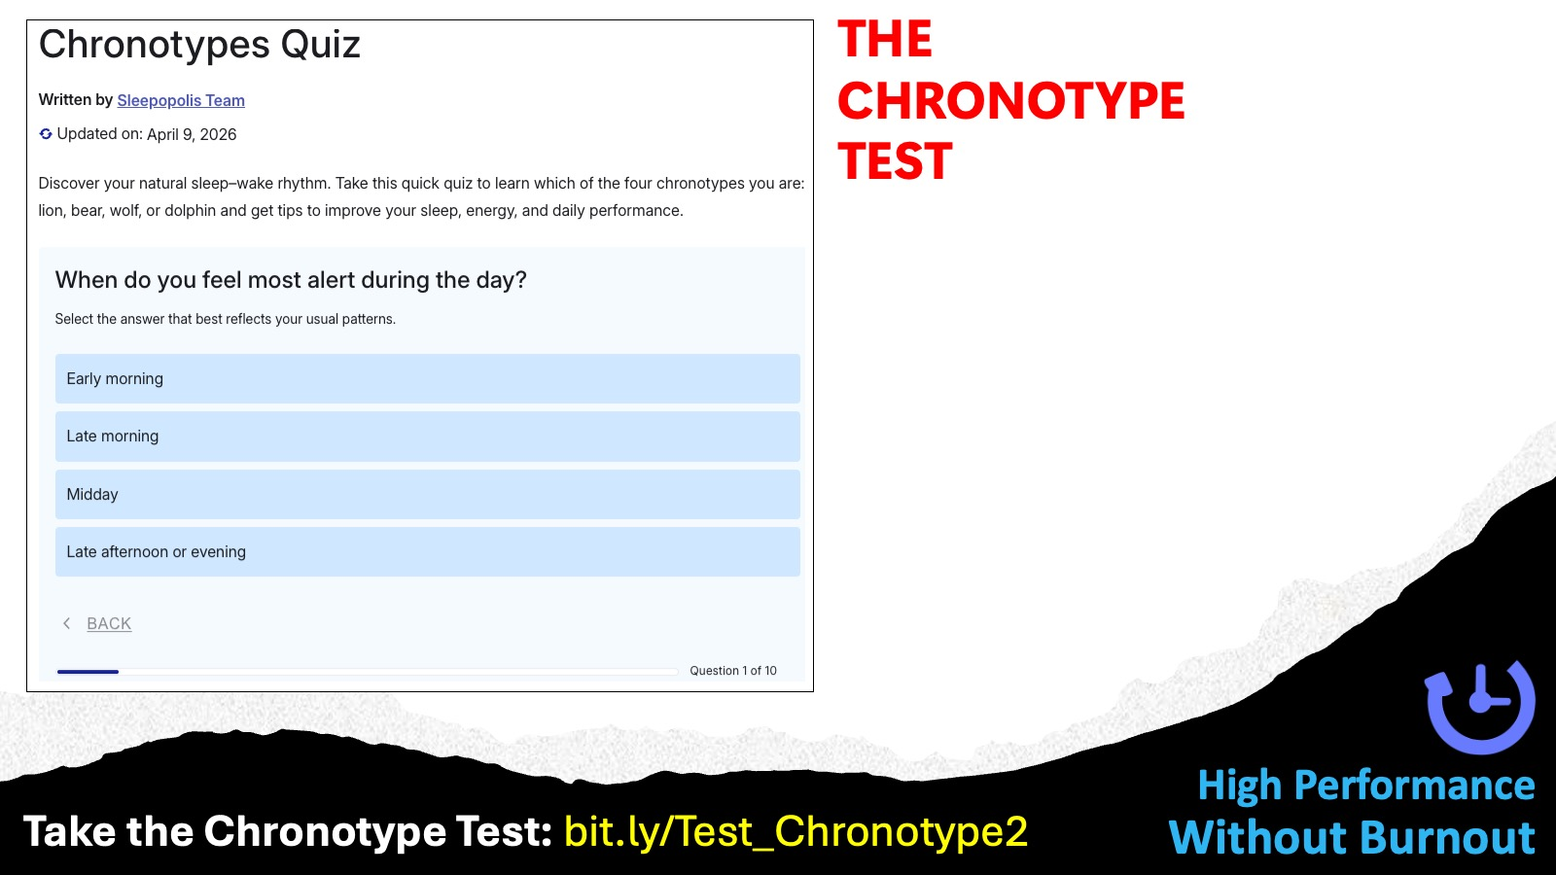
Notes:
Take the Chronotype Test: bit.ly/Test_Chronotype2

Slide 40
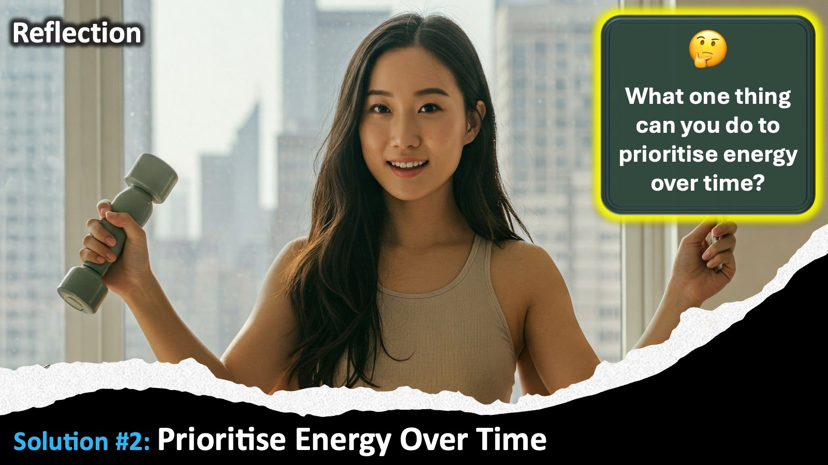
Notes:
Solution #2: Reflection What one thing can you do to prioritise energy over time?

Slide 41

Notes:
Strategy #3: Multiply Results Through Renewal.

Slide 42
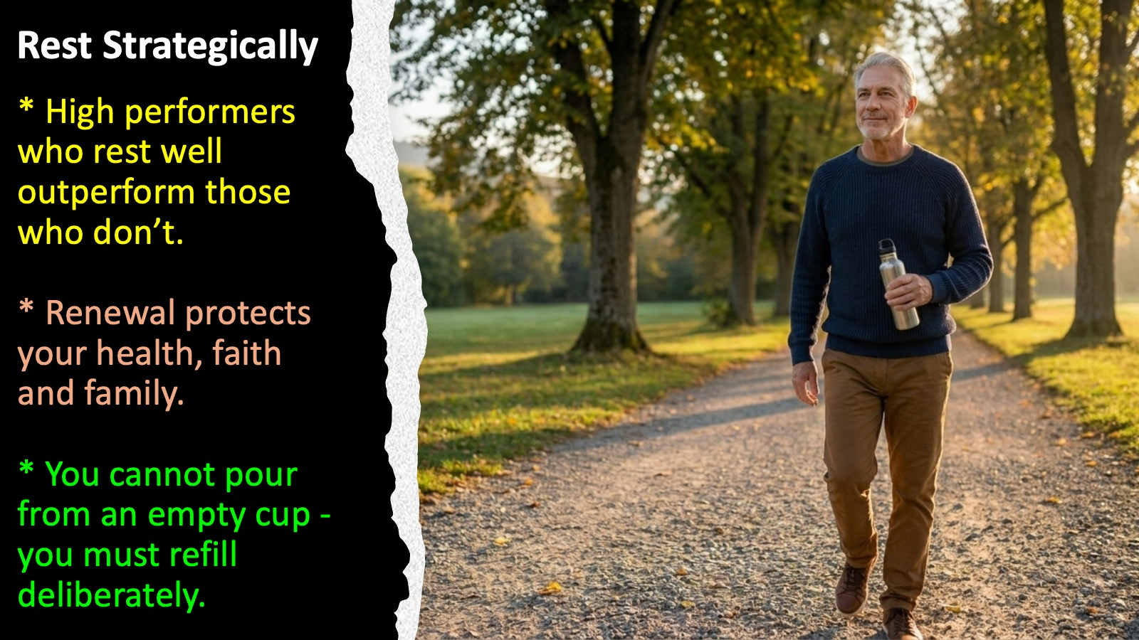
Notes:
Rest Strategically (Rest is not laziness): (1) High performers who rest well outperform those who don’t. (2) Renewal protects your health, faith, and family. (3) You cannot pour from an empty cup – you must refill deliberately.

Slide 43
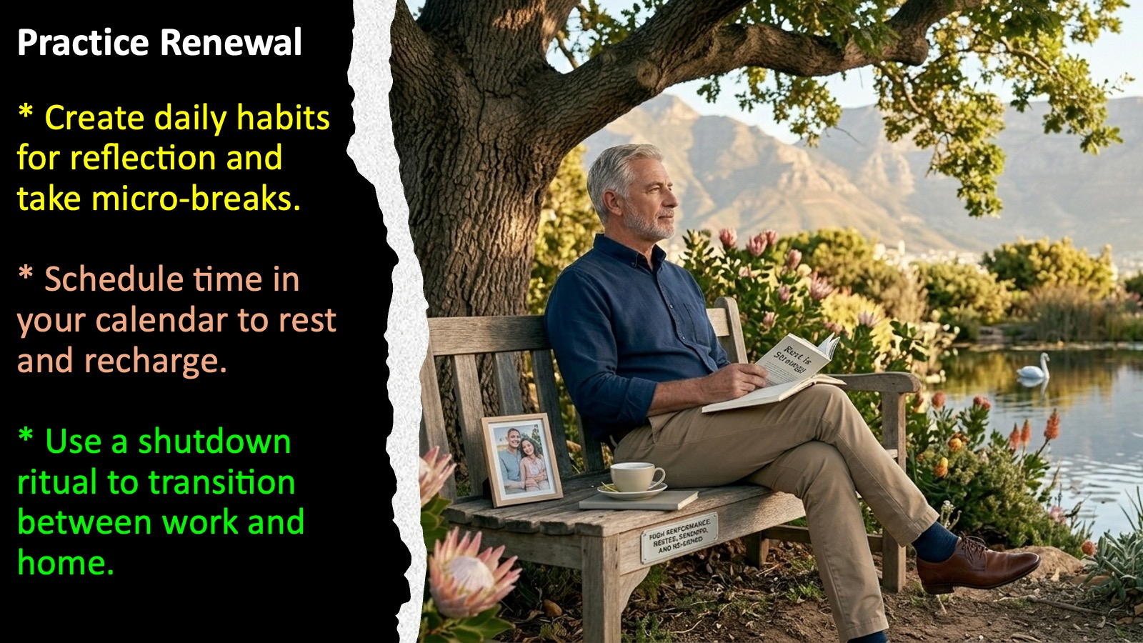
Notes:
Practice Renewal: (1) Create daily habits for reflection and take micro-breaks. (2) Schedule time in your calendar to rest and recharge. (3) Use a shutdown ritual to transition between work and home.

Slide 44
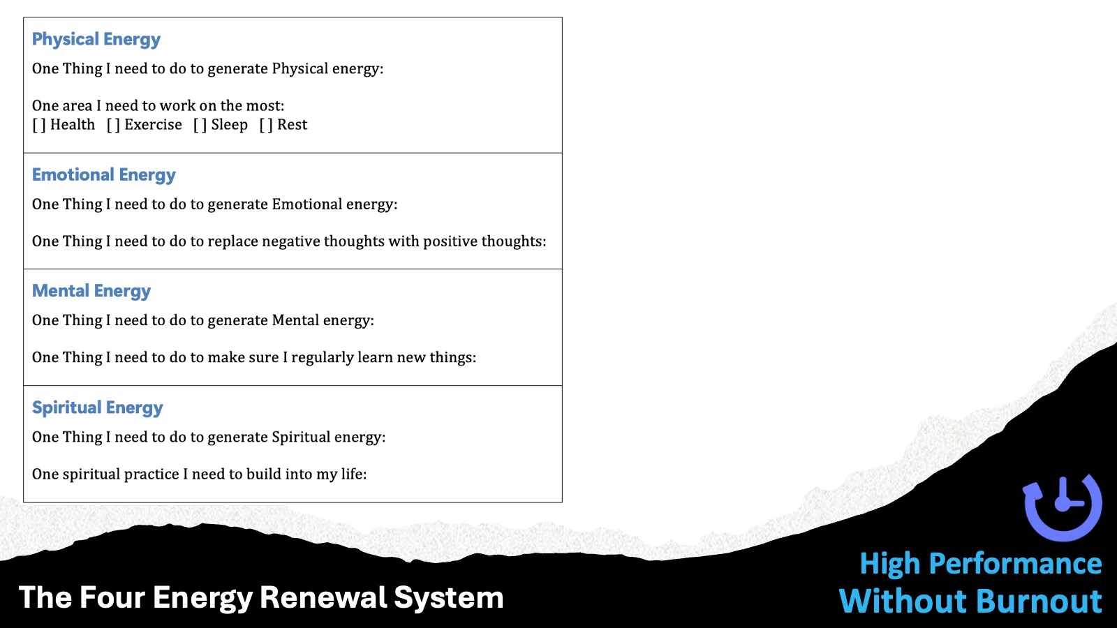
Notes:
The Four Energy Renewal System: Physical, Emotional, mental and Spiritual

Slide 45
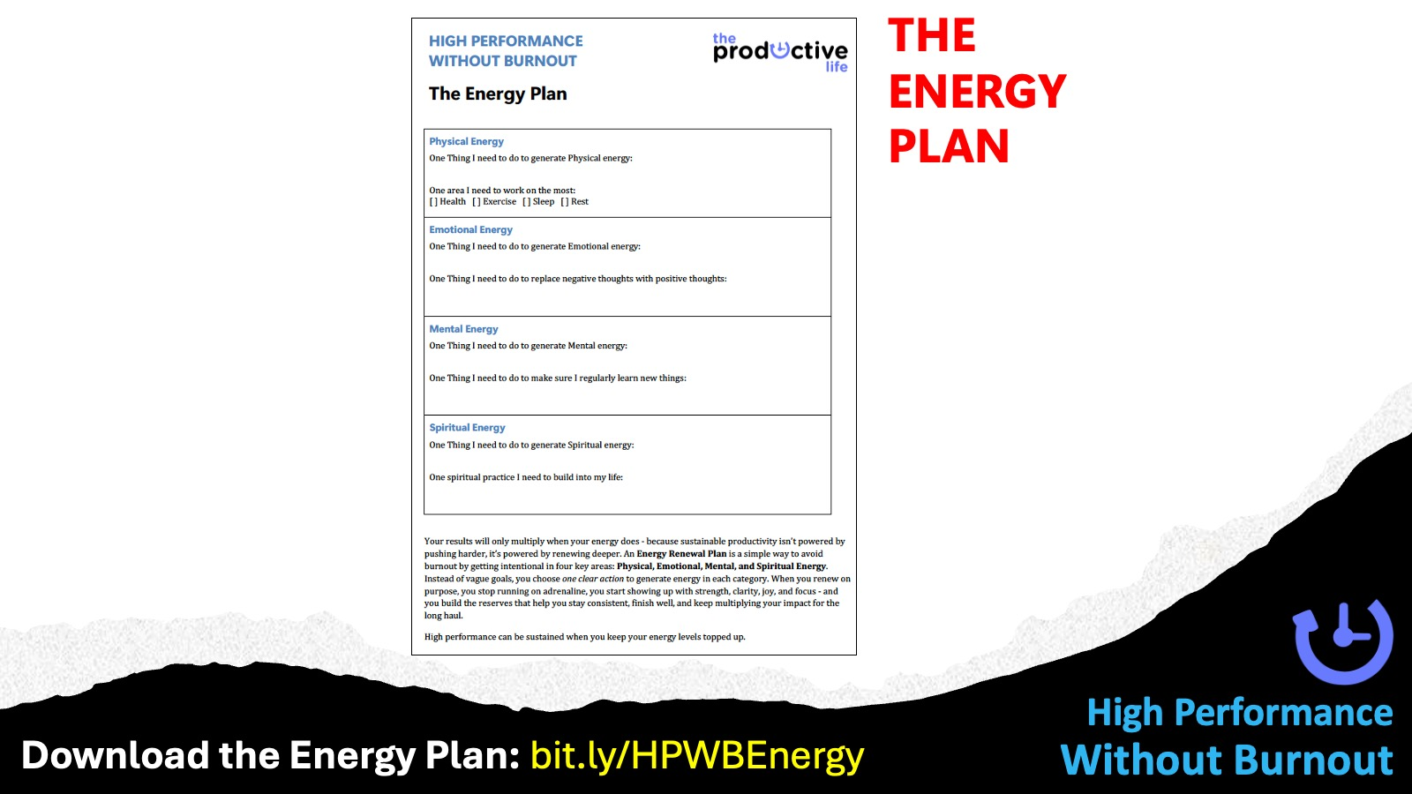
Notes:
Download the Energy Plan: bit.ly/HPWBEnergy

Slide 46
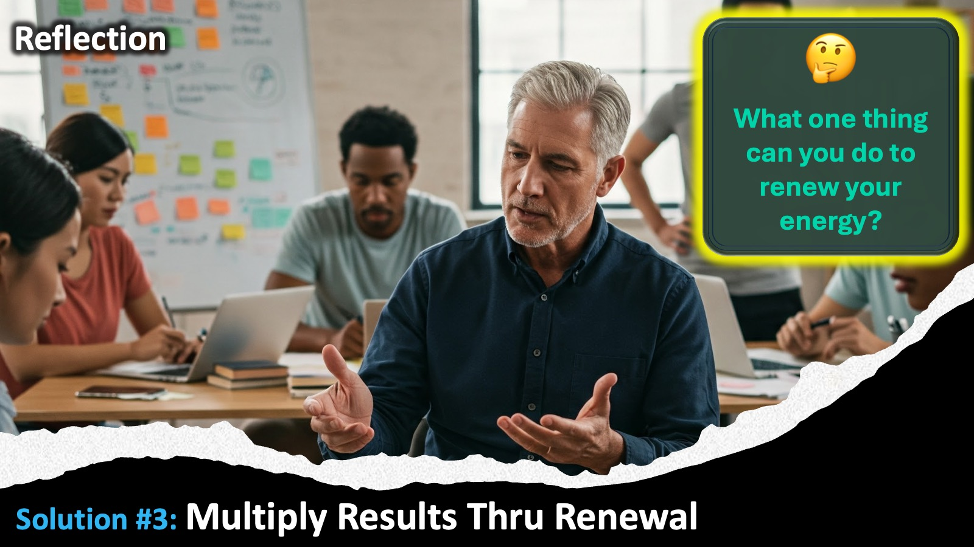
Notes:
Solution #3 Reflection: What one thing can you do to renew your energy?

Slide 47
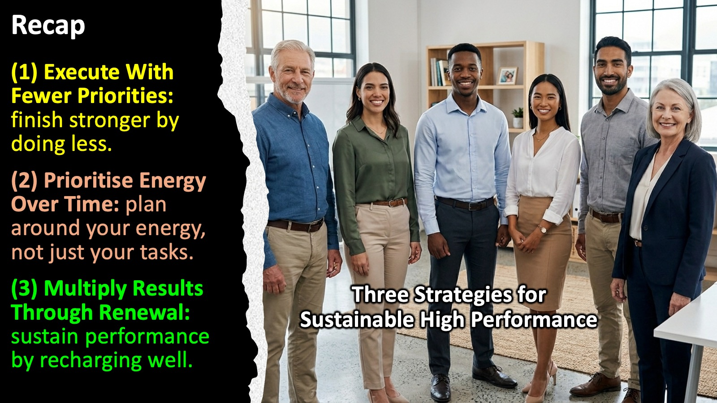
Notes:
Recap: Three Strategies for Sustainable High Performance: (1) Prioritise Energy Over Time : plan around your energy, not just your tasks. (2) Execute With Fewer Priorities: finish stronger by doing less. (3) Multiply Results Through Renewal: sustain performance by recharging well.

Slide 48
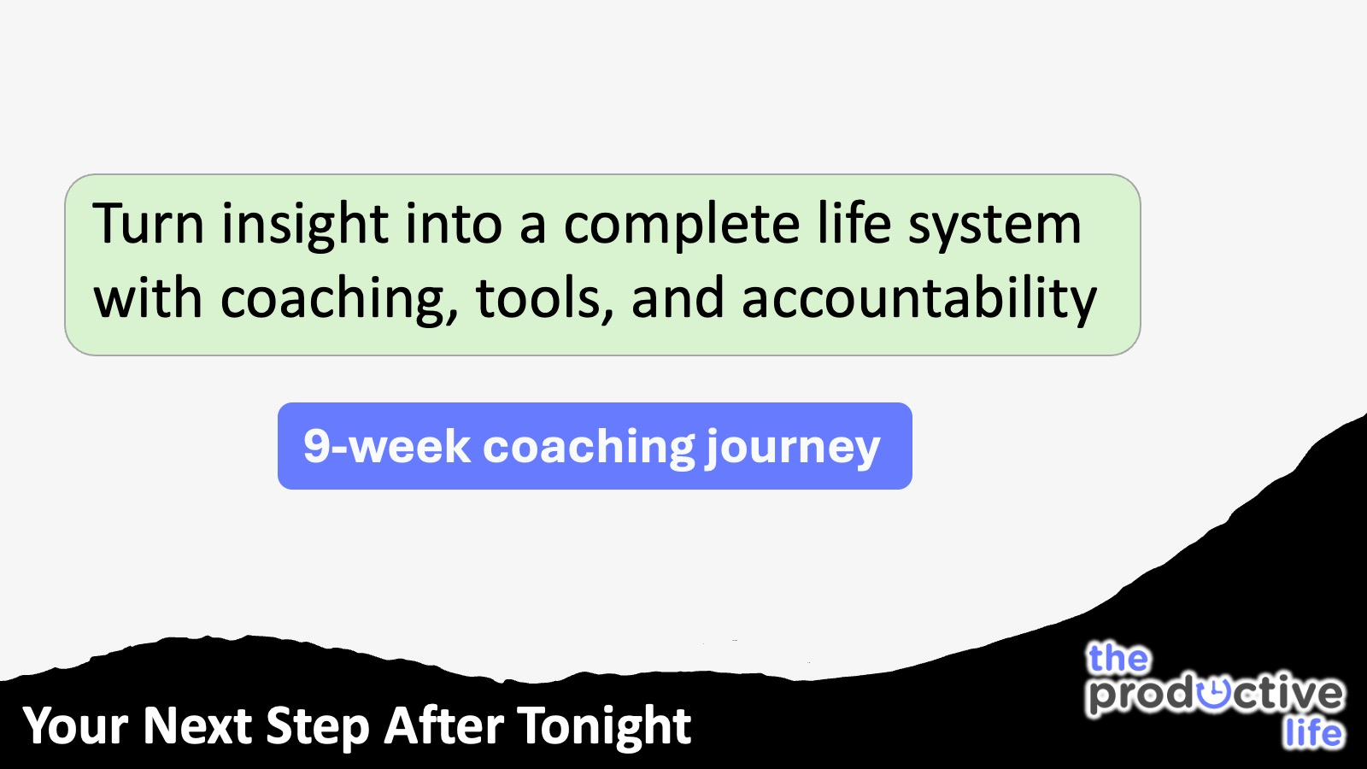
Notes:
Your Next Step After Tonight: Turn insight into a complete life system with coaching, tools, and accountability. The 9-week Coaching Journey.

Slide 49
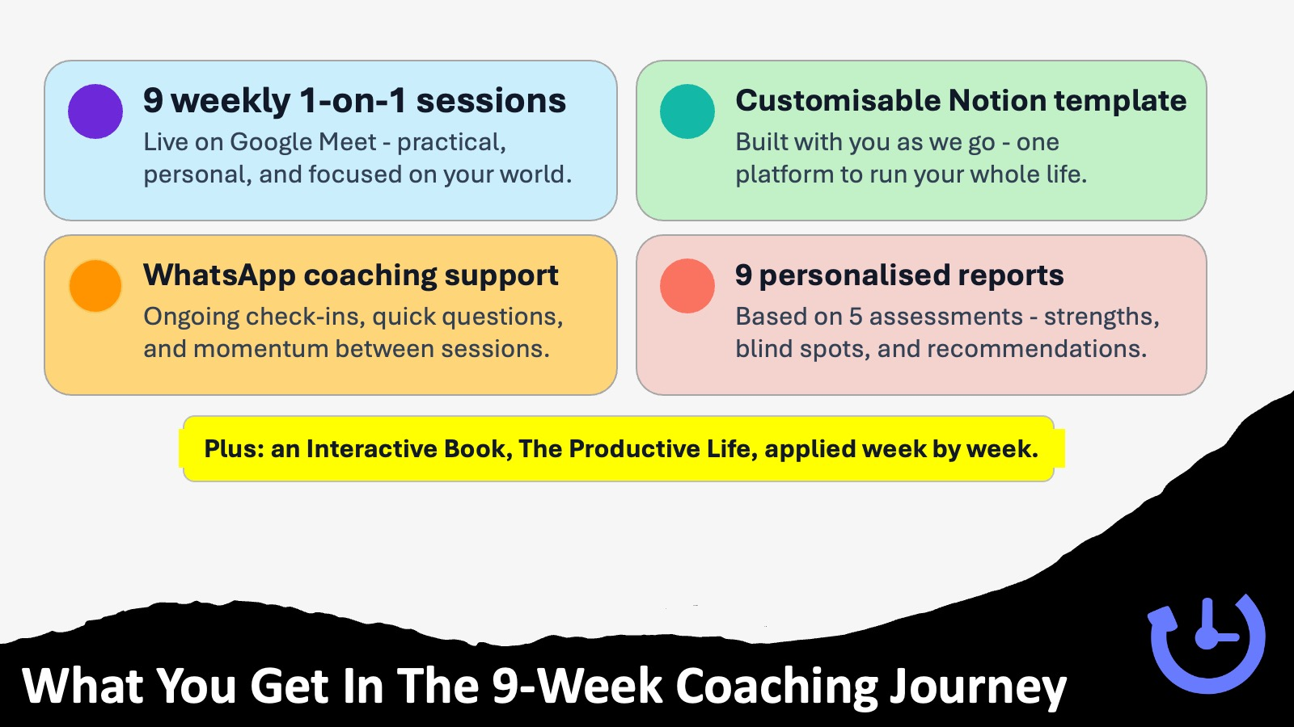
Notes:
What You Get In The 9-Week Coaching Journey:
(1) 9 weekly 1-on-1 sessions: Live on Google Meet - practical, personal, and focused on your world.
(2) WhatsApp coaching support: Ongoing check-ins, quick questions, and momentum between sessions.
(3) Customisable Notion template: Built with you as we go - one platform to run your whole life.
(4) 9 personalised reports: Based on 5 assessments - strengths, blind spots, and recommendations.
(5) Plus: an Interactive Book, The Productive Life, applied week by week.

Slide 50
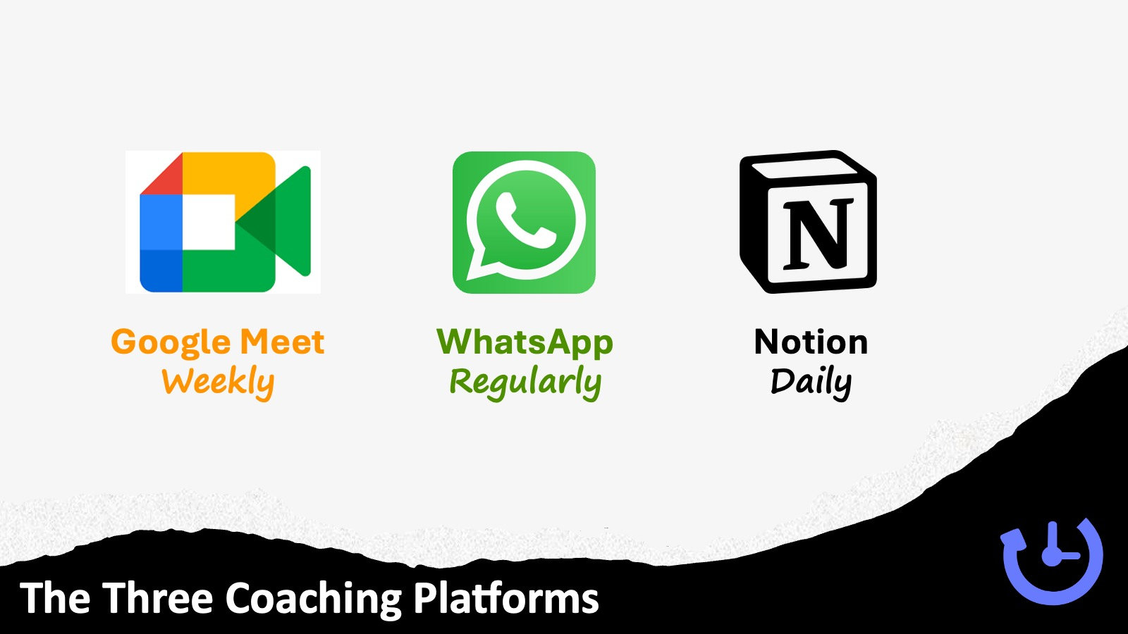
Notes:
The Three Coaching Platforms We Use: (1) Google Meet: Online every week for 45 minutes to an hour. (2) WhatsApp – our main way to stay in touch regularly. (3) Notion App – you will use it daily.

Slide 51
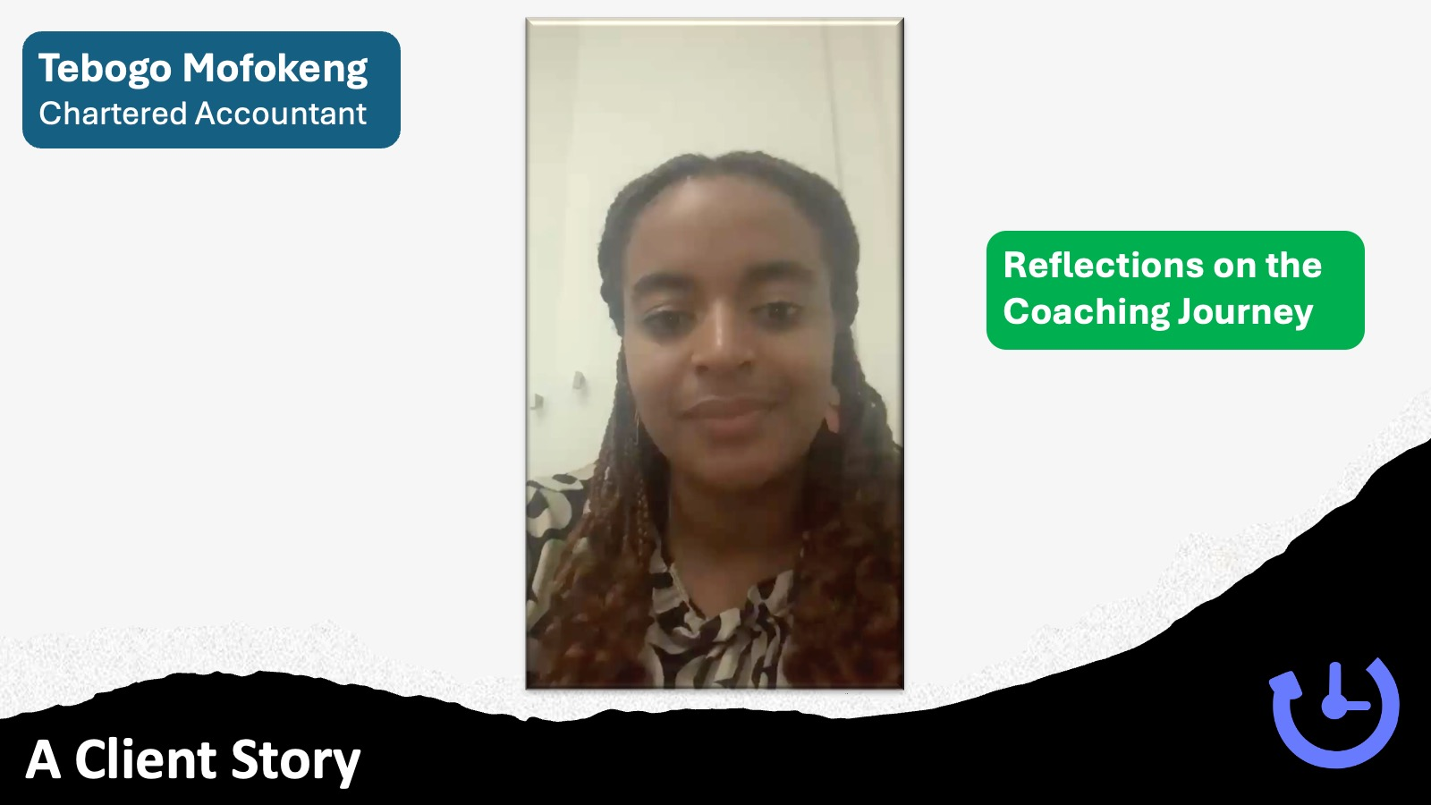
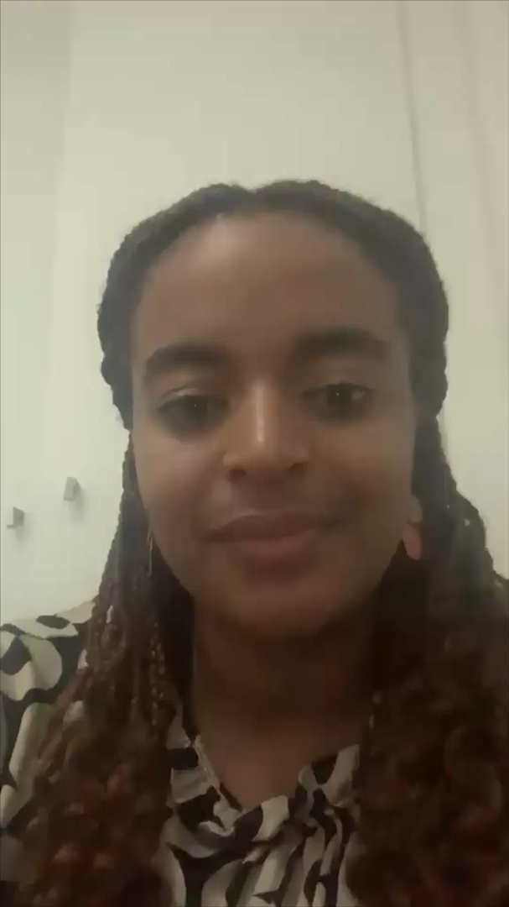
Notes:
Let’s hear from one of the clients I have coached about the impact of the coaching journey on her life. This is Tebogo Mofokeng a Chartered Accountant.

Slide 52
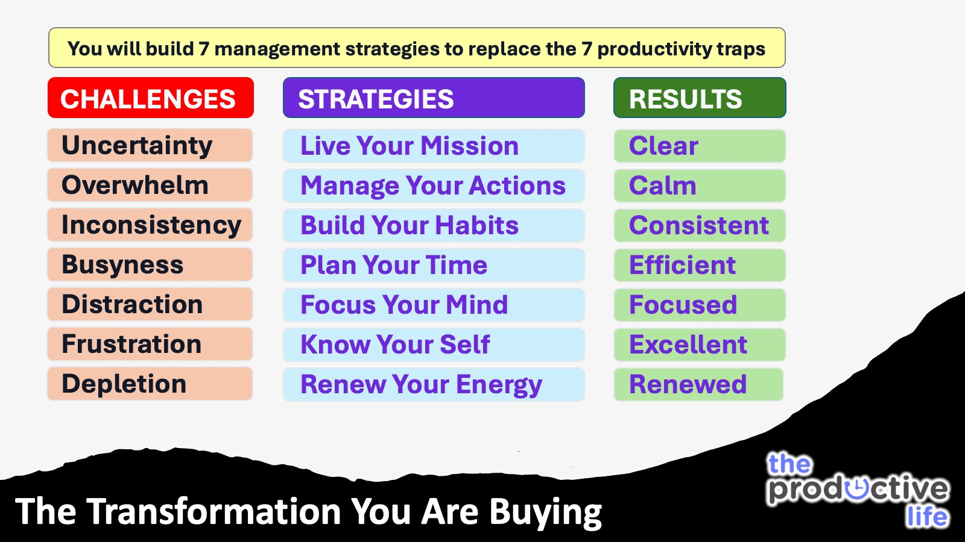
Notes:
The Transformation You Are Buying: You will build 7 management strategies to replace the 7 productivity traps:
The Productive Life Coaching Journey: Challenges → Solutions → Results.
Struggling with Uncertainty -> Live Your Mission -> Get Clear.
Sinking With Overwhelm -> Manage Your Actions -> Get Calm.
Battling With Inconsistency -> Build Your Habits -> Get Consistent.
Drowning With Busyness -> Plan Your Time -> Get Efficient.
Drifting With Distraction -> Focus Your Mind -> Get Focussed.
Coping With Frustration -> Know Your Self -> Get Excellent.
Fading With Depletion -> Renew Your Energy -> Get Renewed.

Slide 53
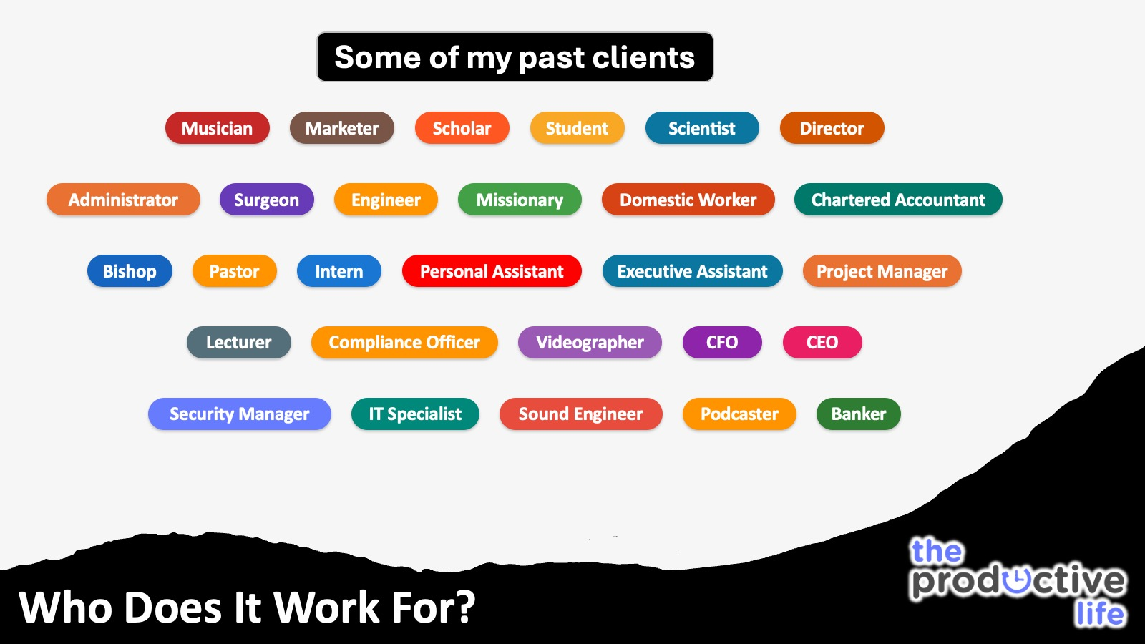
Notes:
Who Will It Work For? Some of my past clients include: Musician, Marketer, Scholar, Student, Scientist, Director, Administrator, Surgeon, Engineer, Missionary, Domestic Worker, Chartered Accountant, Bishop, Pastor, Intern, Personal Assistant, Executive Assistant, Project Manager, Lecturer, Compliance Officer, Videographer, CFO, CEO, Security Manager, IT, Sound Engineer, Podcaster, Banker.

Slide 54
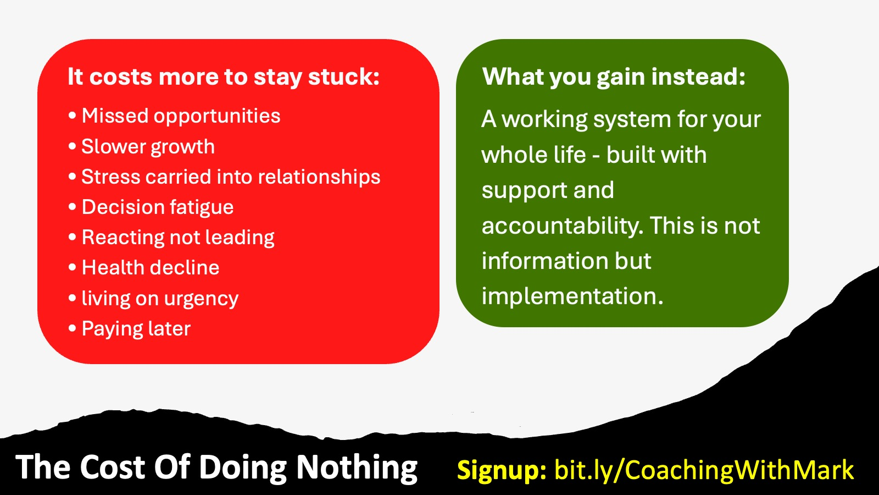
Notes:
The Cost Of Doing Nothing:
It costs more to stay stuck: Missed opportunities and slower growth, Stress carried into home and relationships. Decision fatigue - reacting, never leading. Health decline - living on urgency. Paying later with time, money, and regret
What you gain instead: A working system for your whole life - built with support and accountability. This is not information but implementation.

Slide 55

Notes:
Special Webinar Offer:
Normal investment: R6,750 - 9 weeks - coaching + tools + support
Webinar attendee price: R5,500 - Installments from 2 to 6 months.
9 weeks - coaching + tools + support: Installments from 2 to 6 months. A deposit of R1,000 secures spot.
How to join: Choose pay-in-full or instalments. Pay a deposit to secure your place. I will onboard you within 24 hours

Slide 56

Notes:
This is what to expect when you visit the Coaching Page at: www.bit.ly/CoachingWithMark

Slide 57
Notes:
Okay, back to high performance without burnout!

Slide 58

Notes:
Recap: Three Strategies for Sustainable High Performance: (1) Execute With Fewer Priorities: finish stronger by doing less. (2) Prioritise Energy Over Time : plan around your energy, not just your calendar. (3) Multiply Results Through Renewal: sustain performance by recharging well.

Slide 59

Notes:
Questions & Answers: What questions do you have about sustainable high performance?

Slide 60

Notes:
Preview: Be sure to attend the next Webinar! Here is the link to signup: bit.ly/Webinar_Focus

Slide 61

Notes:
Thank You: (1) Sign up for the coaching journey within 24 hours for your webinar discount. (2) Thank you for investing your time tonight.. (3) Remember: high performance is sustainable when you prioritise energy, focus on fewer priorities, and multiply results through renewal.

