Slide 1
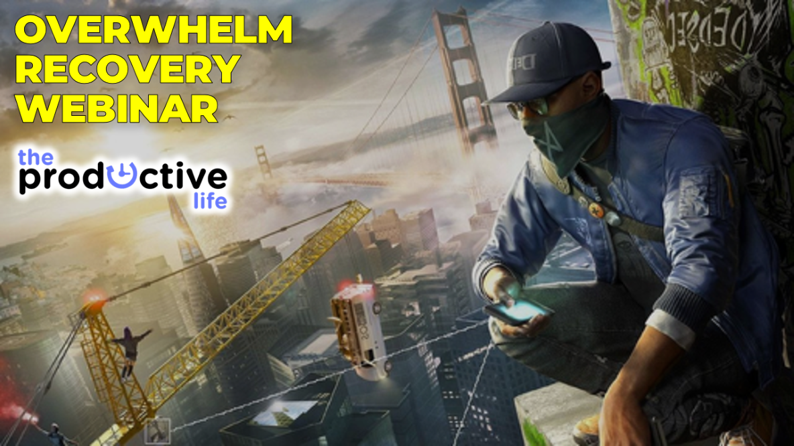
Notes:
Welcome to the Overwhelm Recovery Webinar presented by Mark Tittley – The Productive Life

Slide 2
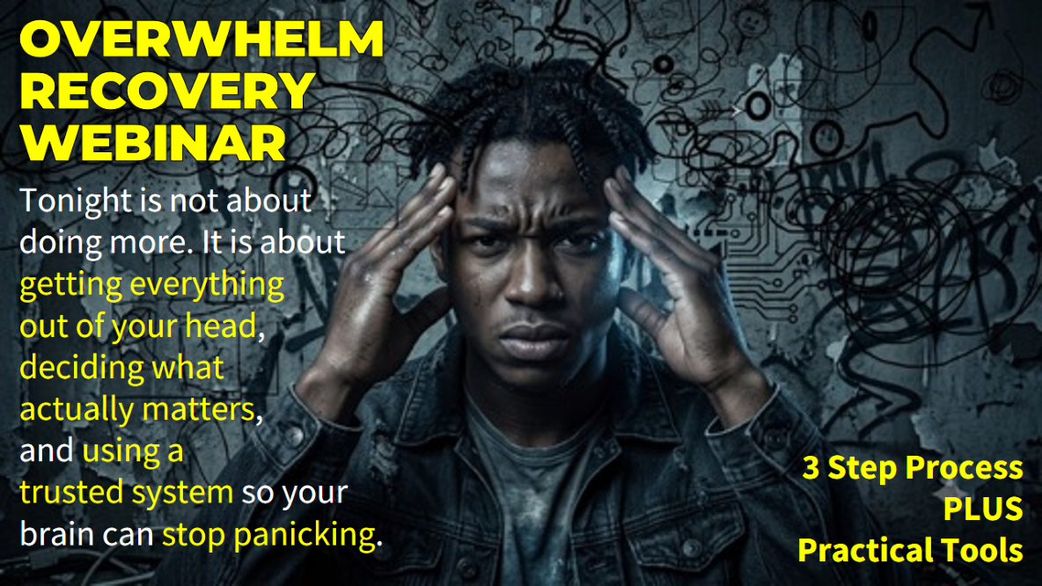
Notes:
Tonight is not about doing more. It is about getting everything out of your head, deciding what actually matters, and using a simple task and project system so your brain can stop panicking.
I’ll teach in 3 step process and give you practical tools.

Slide 3
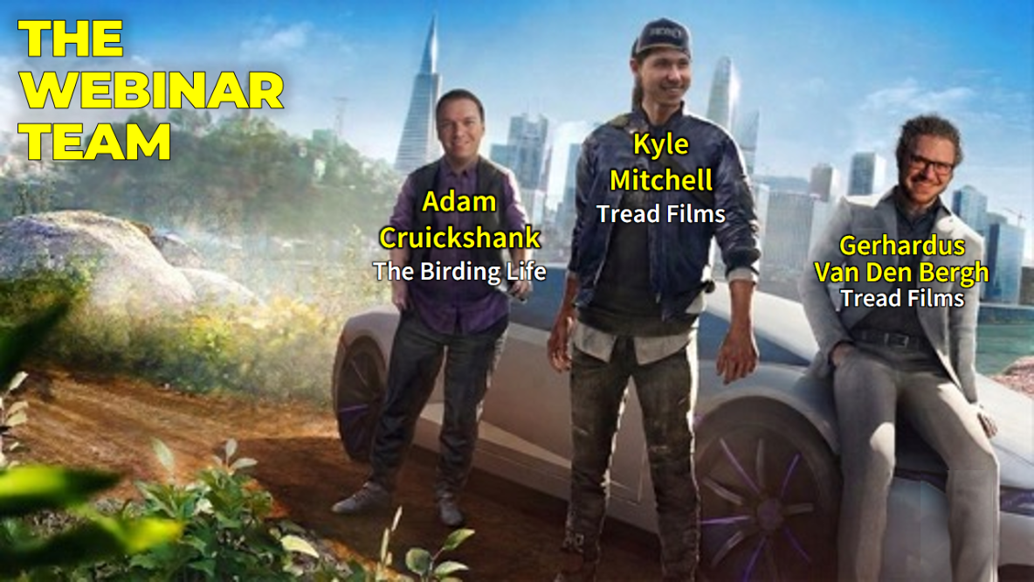
Notes:
The Webinar Team: First some introduction, the team who has helped to pull off this webinar includes: Gerhardus Van Ben Bergh and Kyle Mitchell from Tread Films and Adam Cruickshank from The Birding Life.

Slide 4
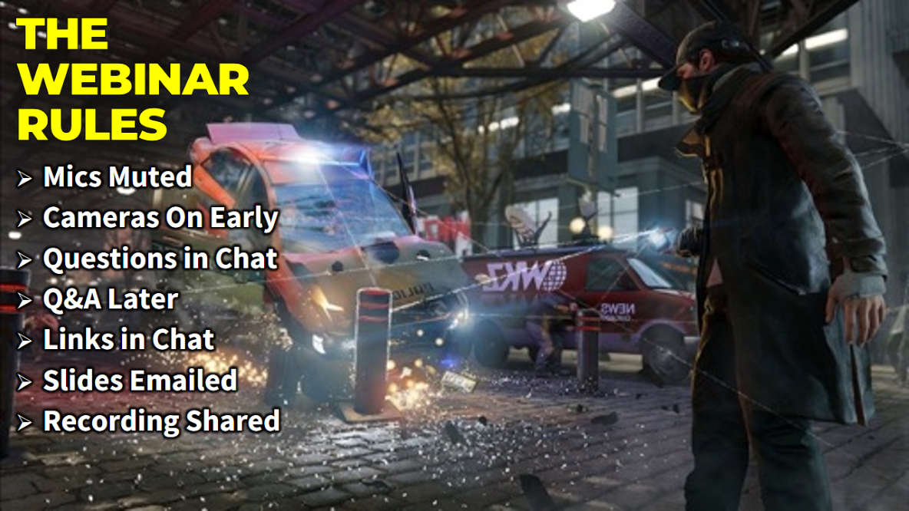
Notes:
Before I continue with introductions, a few quick housekeeping points to make sure we get the most out of our time together. First, please stay muted during the presentation to keep the audio clear. We’d love to see you during our intro section, so feel free to flick your cameras on, but feel free to switch them off later if that helps you focus.
Regarding questions, please drop them in the chat as we go - Adam and Gerhardus are keeping an eye on those for us, and we will handle them in a dedicated Q&A session later. Also, we will be sharing links in the chat throughout the night, so if you see a resource on the screen, check the chat to grab the link. Finally, you don’t need to worry about taking screenshots of the slides - we are recording this, and I’ll send out the video replay and the full presentation to you via email afterwards.

Slide 5
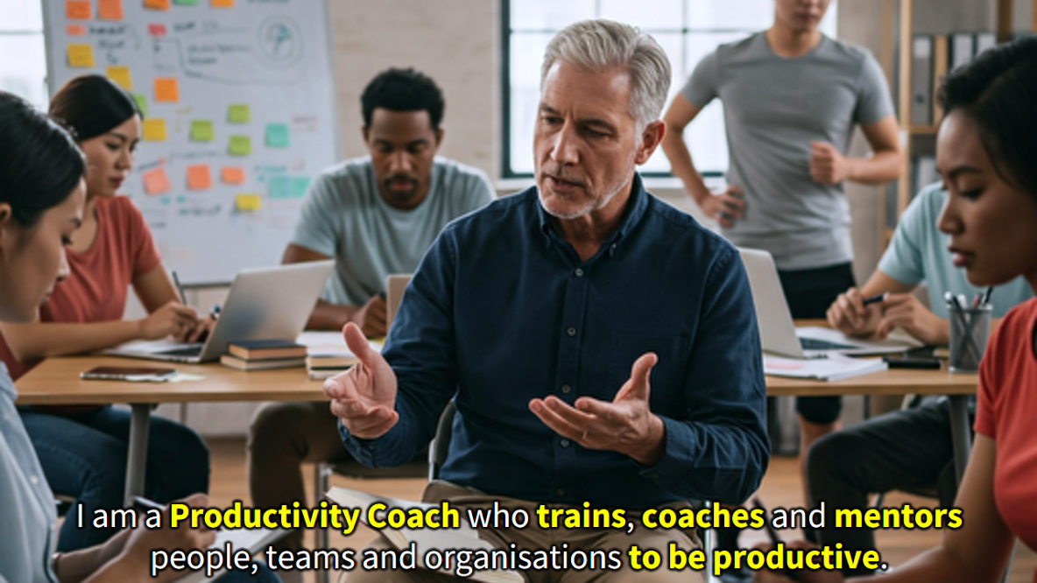
Notes:
I am a Productivity Coach who trains, coaches and mentors people, teams and organisations to be productive. I help people live a life that is balanced, purposeful, and free from the constant noise of "busyness.”

Slide 6

Notes:
I am married to Debbie and am the proud father of three “kids”: Keegan, Ashley and Drew.

Slide 7

Notes:
Chat: Share your Name, City and a fun fact about yourself if you are bold!

Slide 8
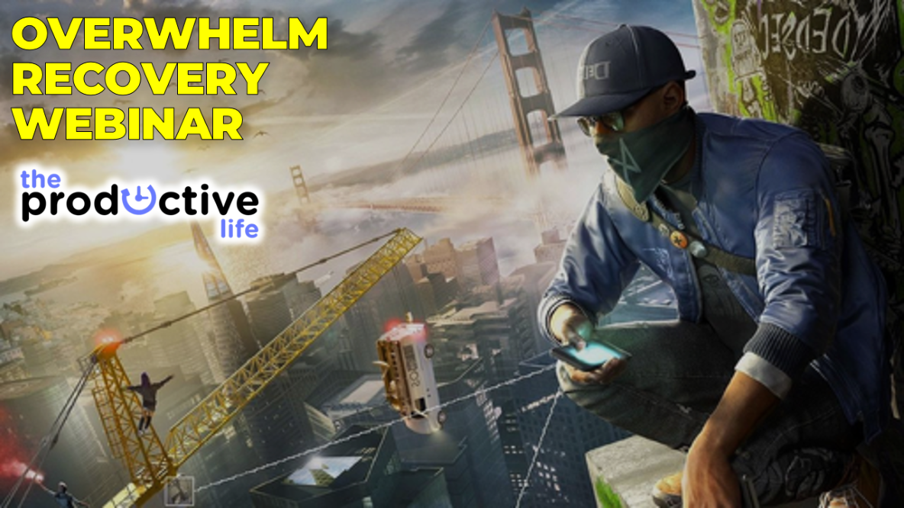
Notes:
So, welcome to the Overwhelm Recovery Webinar presented by Mark Tittley – The Productive Life

Slide 9
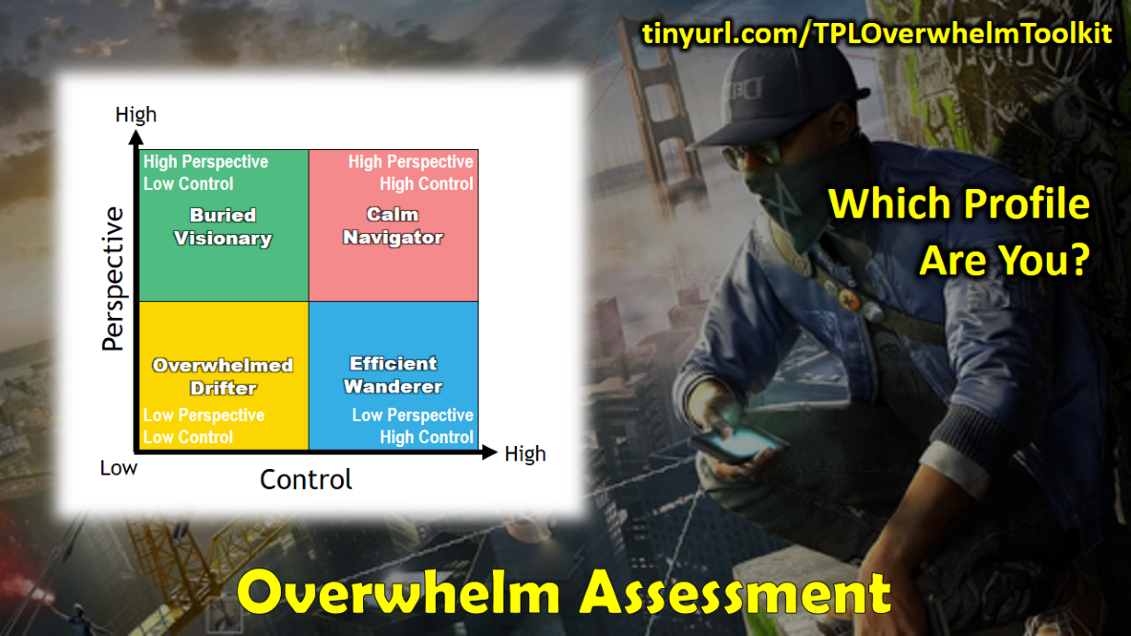
Notes:
The Overwhelm Assessment: If you took the Overwhelm Recovery Assessment you would have discovered an assessment that looks at two aspects of personal management: (1) To what extent you are in Control of what needs to be done in life, and (2) To what extent you have Perspective about what should be done in life. This is similar to the difference between Effectiveness which is doing the Right Thing (Perspective) and Efficiency which is doing things right (Control). These two Axes create four quadrants which suggest four different Styles that will affect how we experience Overwhelm in our lives. The goal is to move up and to the right in the model to become the Calm navigator ideally. Here is a link to get the Assessment and a Guide to understand your results: https://tinyurl.com/TPLOverwhelmToolkit

Slide 10

Notes:
The Overwhelm Self-Assessment: You can score y ourself for now: (1) To what extent you are in Control of what needs to be done in life (find a place on the horizontal xis), and (2) To what extent you have Perspective about what should be done in life (move up or down but not left or right). This will place you in one of the quadrants to discover your Profile.

Slide 11
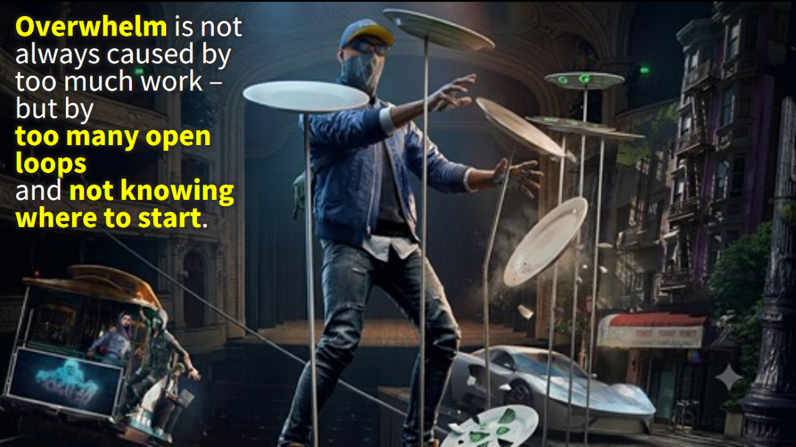
Notes:
Overwhelm is not always caused by too much work - it is often caused by too many open loops and not knowing where to start. Spinning plates represent open loops - each plate is an active, unfinished project or commitment that drains your mental bandwidth to keep from crashing. Falling plates trigger reaction mode - instead of focusing on meaningful progress, you are forced to make split-second decisions about which wobble to save first. Overwhelm is a management issue, not a workload issue - it is the heavy cognitive load of keeping too many cycles spinning at the exact same time. It really is about Control AND Perspective as the Overwhelm Assessment reveals.

Slide 12
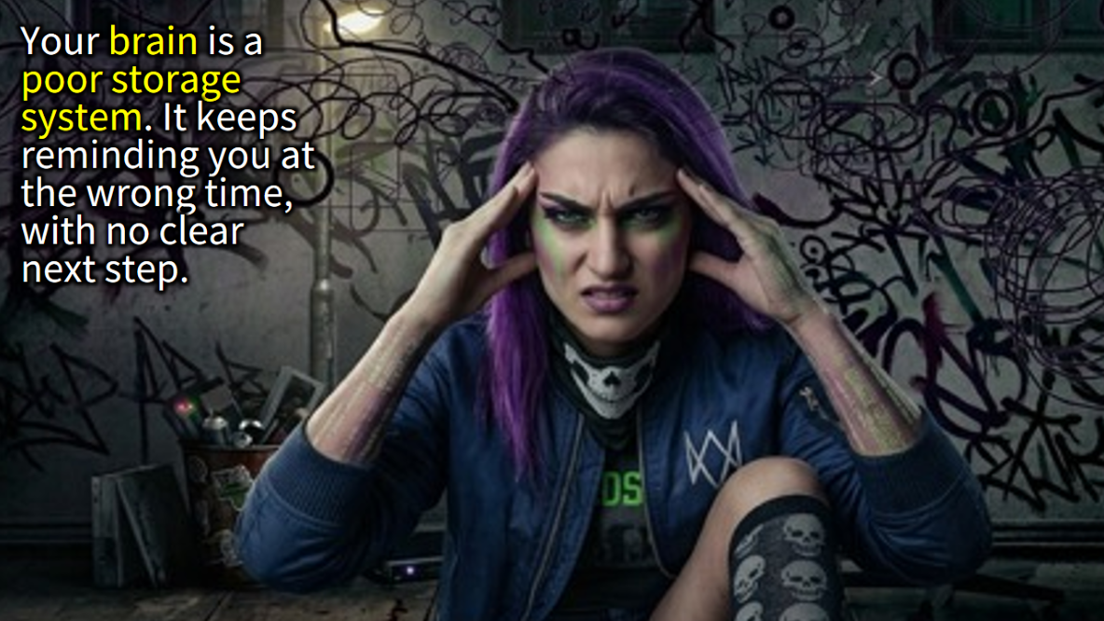
Notes:
Your brain is a poor storage system. It keeps reminding you at the wrong time, with no clear next step.

Slide 13
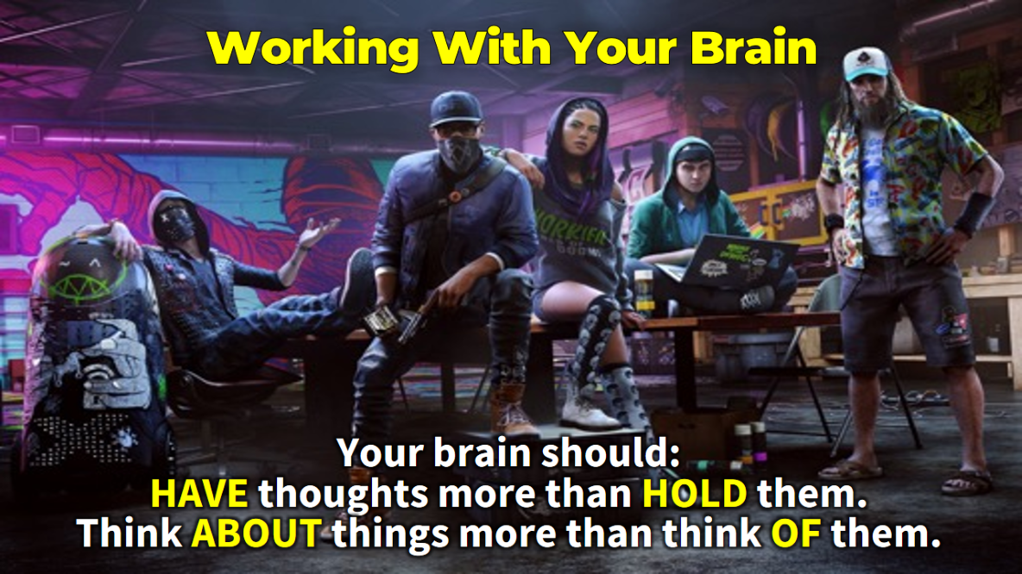
Notes:
David Allen says that “the brain is better at having thoughts than holding them” So you should HAVE thoughts more than HOLD them and you should think ABOUT things more than think OF them.

Slide 14
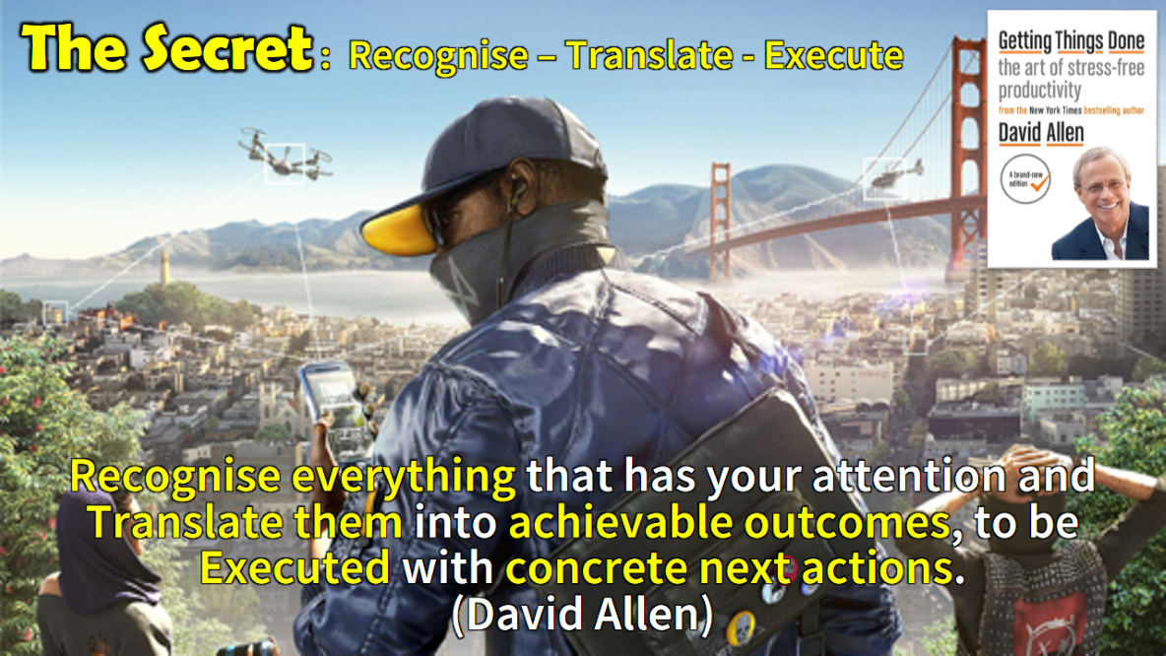
Notes:
The Secret is captured in this quote: Recognise everything that has your attention and translate them into achievable outcomes, to be executed with concrete next actions. David Allen

Slide 15
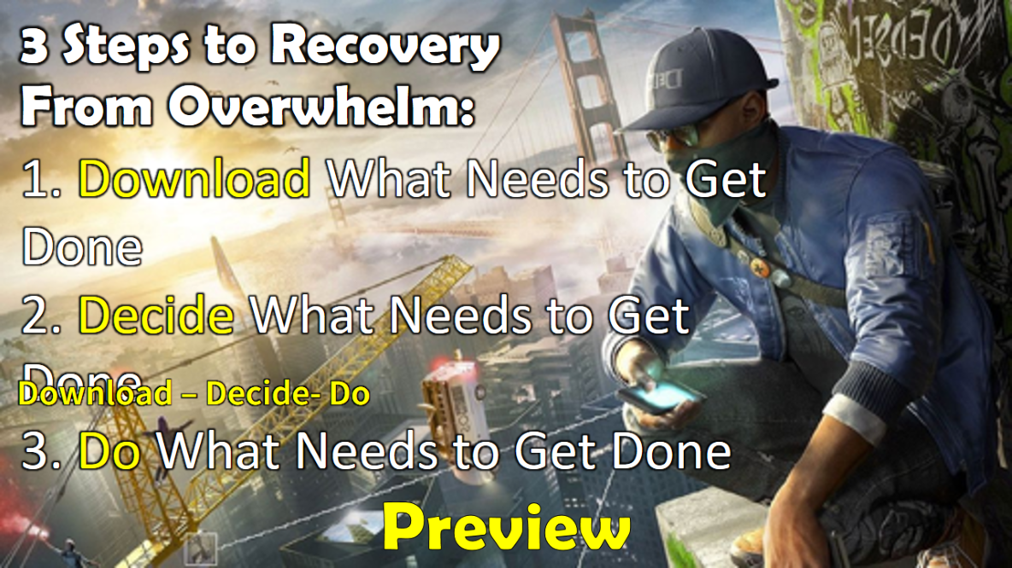
Notes:
Preview: 3 Steps to Recovery From Overwhelm:
(1) Download What Needs to Get Done
(2) Decide What Needs to Get Done
(3) Do What Needs to Get Done

Slide 16
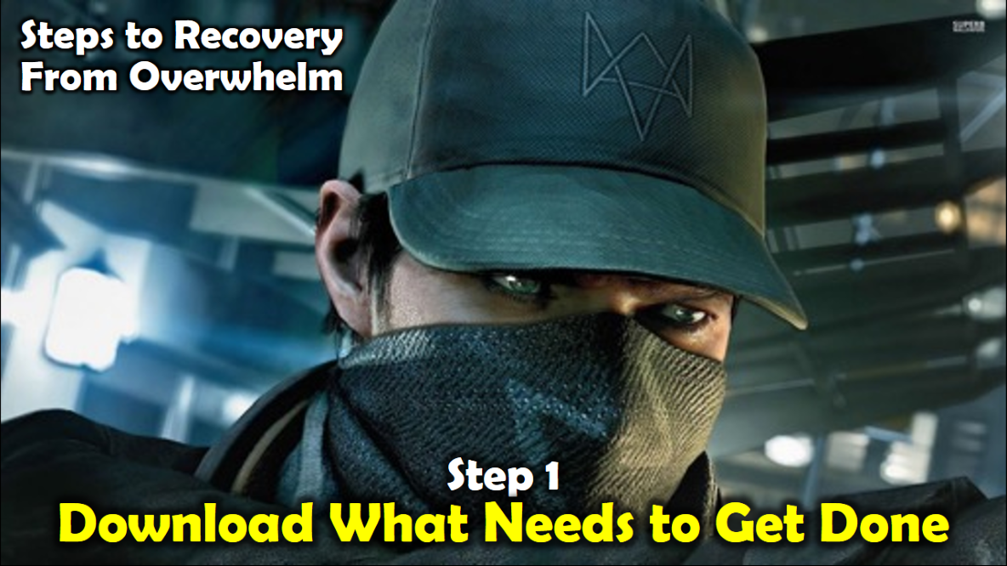
Notes:
Step #1: Download What Needs to Get Done

Slide 17
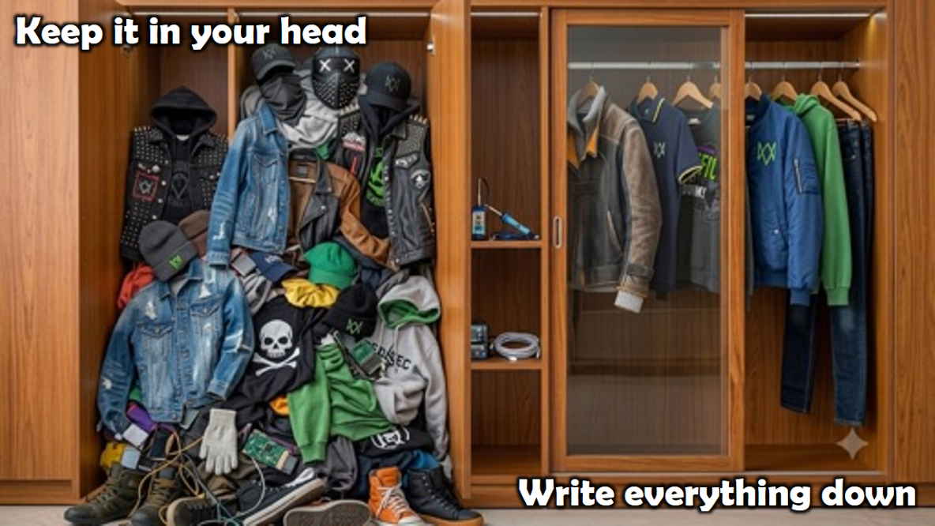
Notes:
Step #1: Download What Needs to Get Done

Slide 18
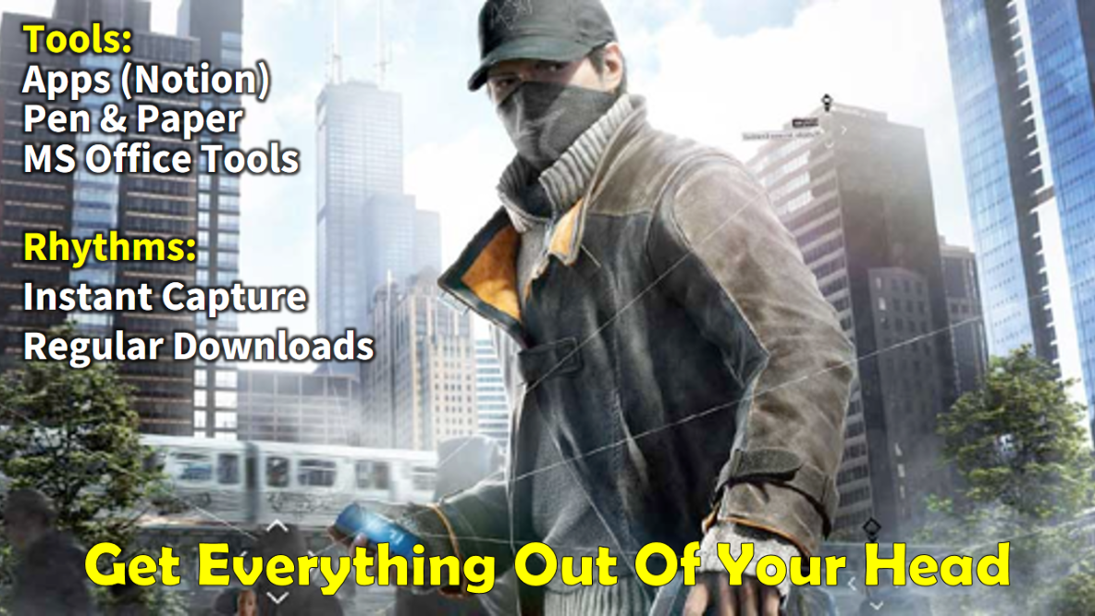
Notes:
The first step is to get everything out of your head – whether it's from an app, text message, or a random piece of paper – and Download it into a system you trust, such as a Master Task List on paper or in an app like Notion. This reduces the overwhelm caused by tasks floating around in our minds. Two key practices here are: (1) Regular Downloads: Continuously clear your mind to prevent things from piling up or getting buried. (2) Instant Capture: The moment you think of something, immediately add it to your list for later action.

Slide 19
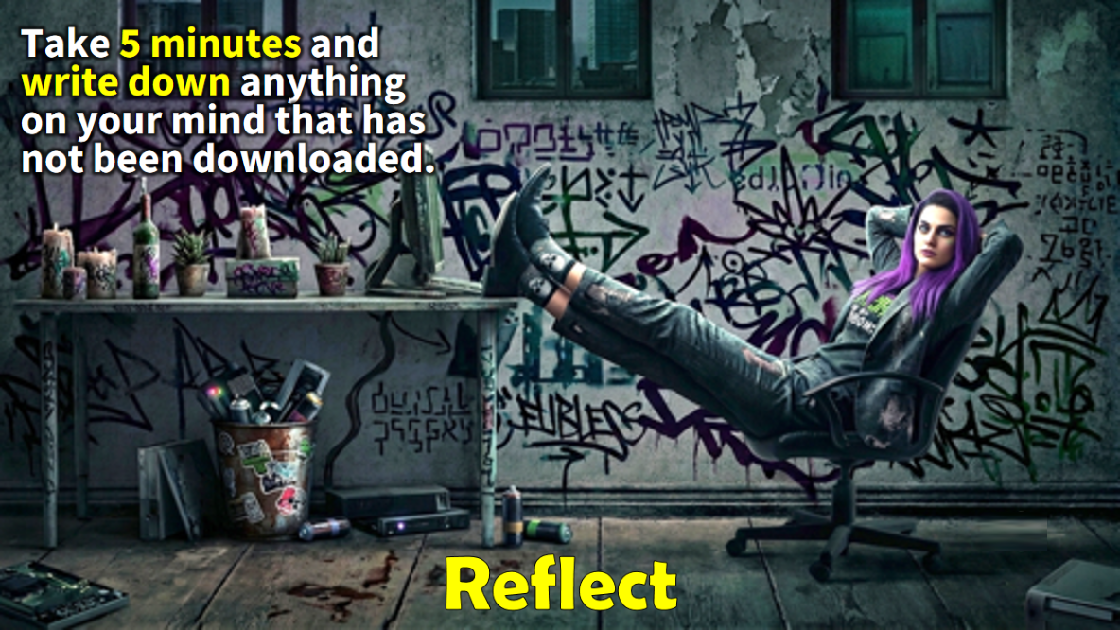
Notes:
Activity: Take 5 minutes and write down anything that has your attention:

Slide 20

Notes:
Chat: Share one thing you just captured that has been taking up the most mental space.

Slide 21

Notes:
Get: Use this link to get the Download Tool: tinyurl.com/TPLDownload

Slide 22
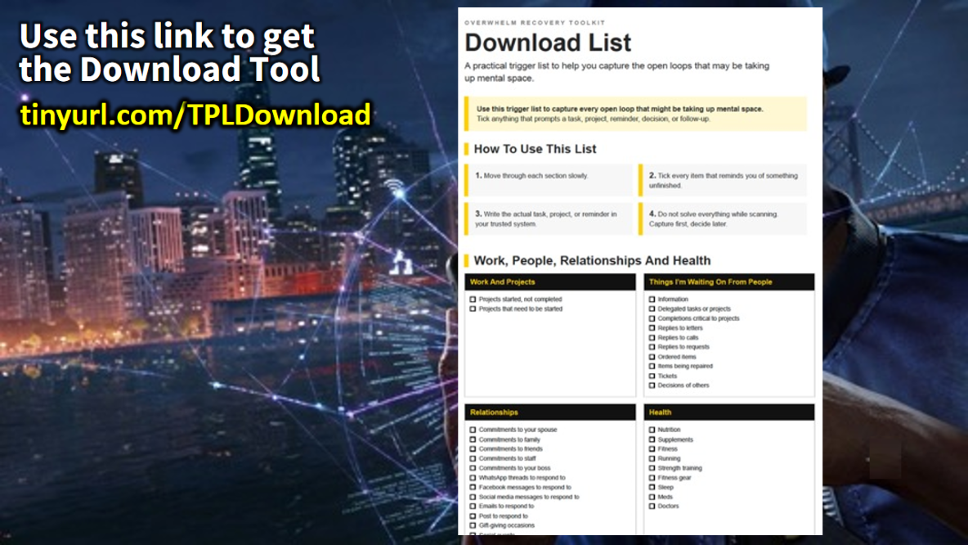
Notes:
Get: Use this link to get the Download Tool: tinyurl.com/TPLDownload

Slide 23
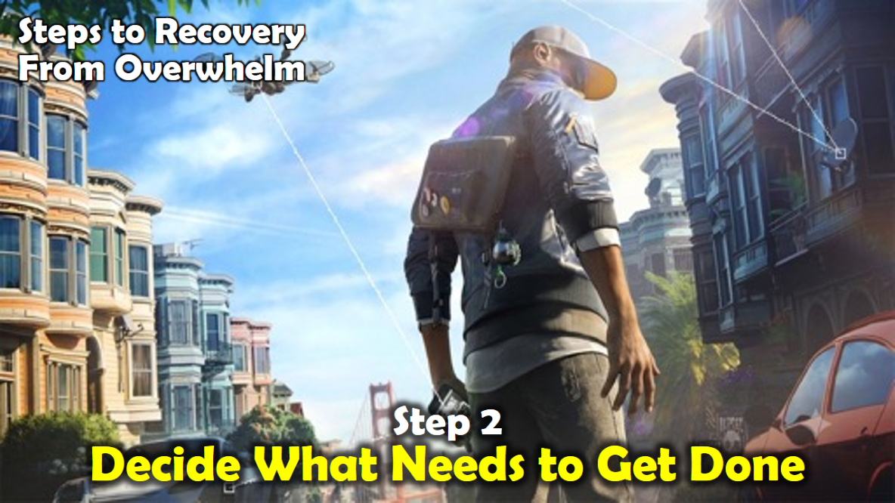
Notes:
Step 2: Decide What Needs to Get Done
The second practice that is critical to manage your actions is to learn to make good decision about stuff that needs to happen in your life. For me this means that I don’t shuffle things around delaying the decision-making process but I pick something up and decide what needs to be done with it as soon as I can. No matter what I touch, whether it is an email I receive or an invitation to an event, I give it attention and respond to it as soon as I get a chance. I use the Two Minute Rule from David Allen: If something will take me less than two minutes to do, I do it right away. If you are prone to procrastination, this will be a real game changer for you!

Slide 24
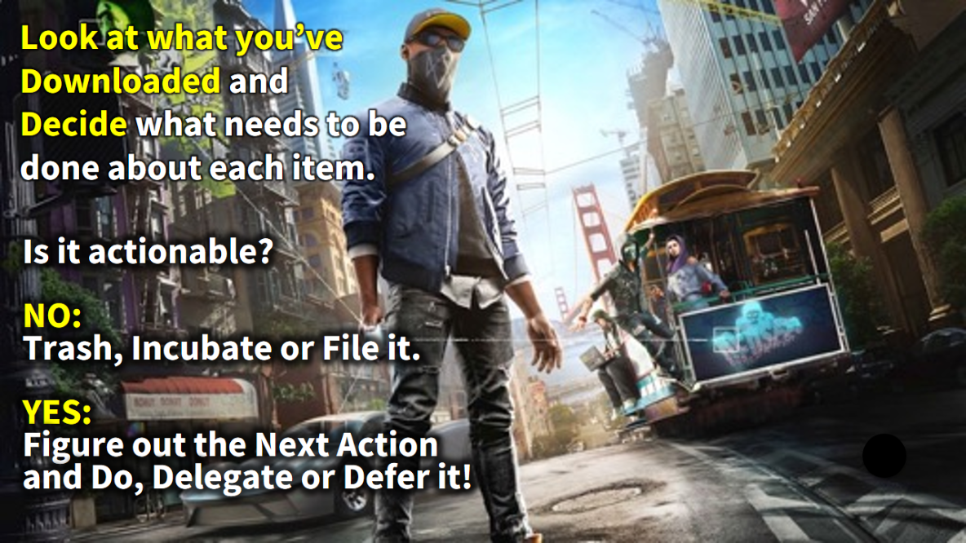
Notes:
Thing 2: DECIDE What Needs to Get Done
Next, look at what you've downloaded and Decide what needs to be done. Drawing on the GTD approach, ask: Is it actionable? (1) If it's NOT actionable, you can: (a) Trash it: Get it out of your way. I(b) Incubate it: Schedule it for later. (c) File it: For future access.(2) If it IS actionable, then you can move to the next step and do it. If an item involves multiple steps, add it to your Project List, ensuring each task is completed until the project is finished. It's crucial to add details to your tasks, such as Due Dates (when it absolutely must be done) or Contexts that describe the type of task or location where it's done (e.g., Email, Call, Errand, Home, Office, Meeting, Someday, Waiting for). All these processed tasks are now ready for the next step.

Slide 25
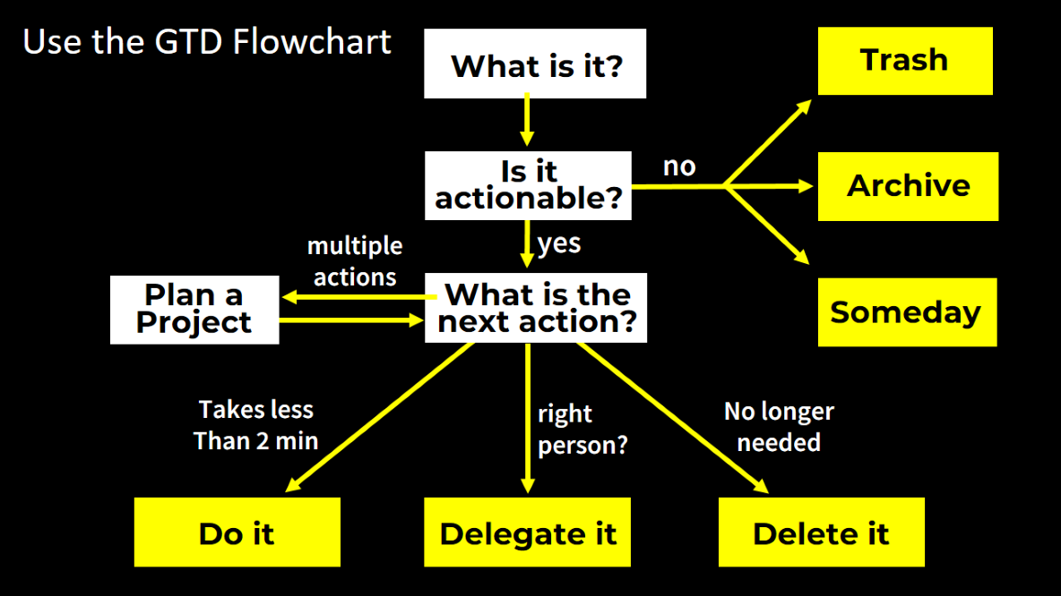
Notes:
Drawing on the GTD approach, ask: Is it actionable? (1) If it's NOT actionable, you can: (a) Trash it: Get it out of your way. I(b) Incubate it: Schedule it for later. (c) File it: For future access.(2) If it IS actionable, then you can move to the next step and do it. If an item involves multiple steps, add it to your Project List, ensuring each task is completed until the project is finished.

Slide 26
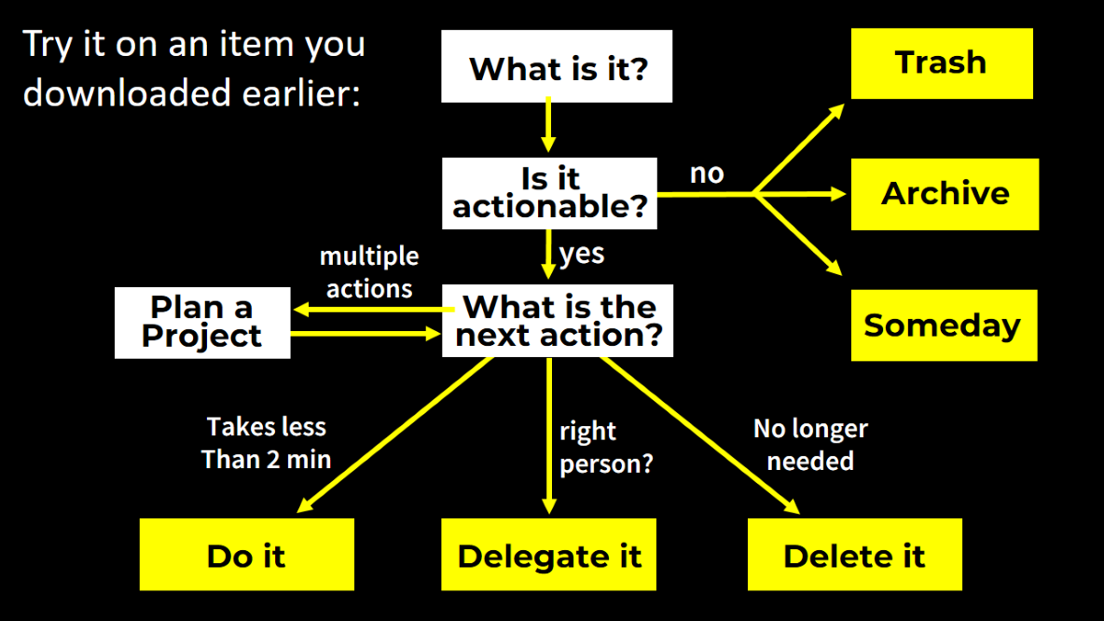
Notes:
Try the process on an item that you downloaded from your mind earlier.

Slide 27
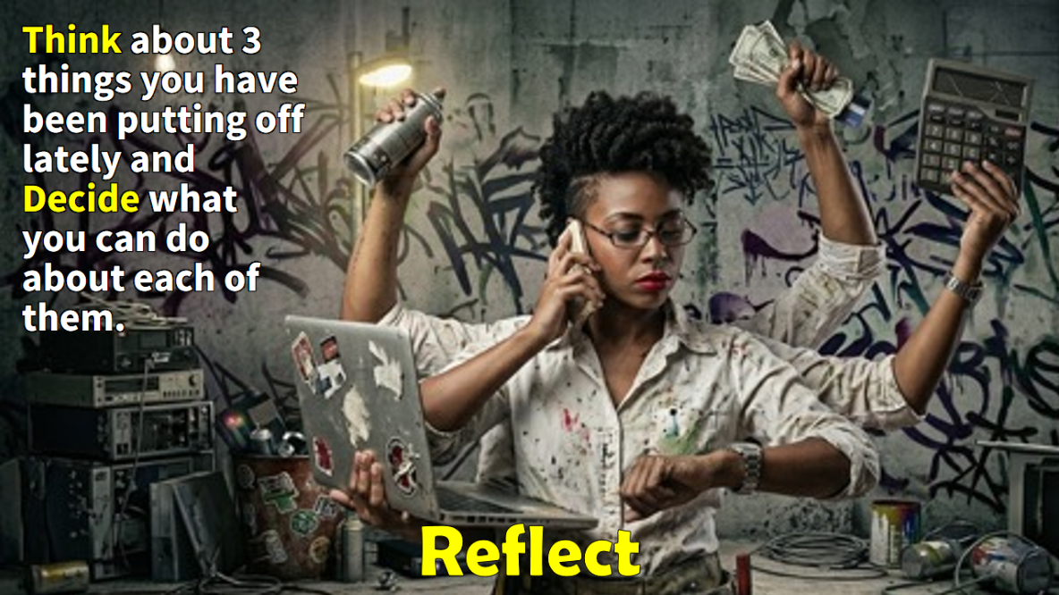
Notes:
Reflect: Think about 3 things you have been putting off lately and decide what you can do about each of them:

Slide 28

Notes:
Chat: Share one thing you have been putting off an what you have decided to do about it.

Slide 29

Notes:
Get: Use this link to get the Decide Tool: tinyurl.com/TPLDecision

Slide 30
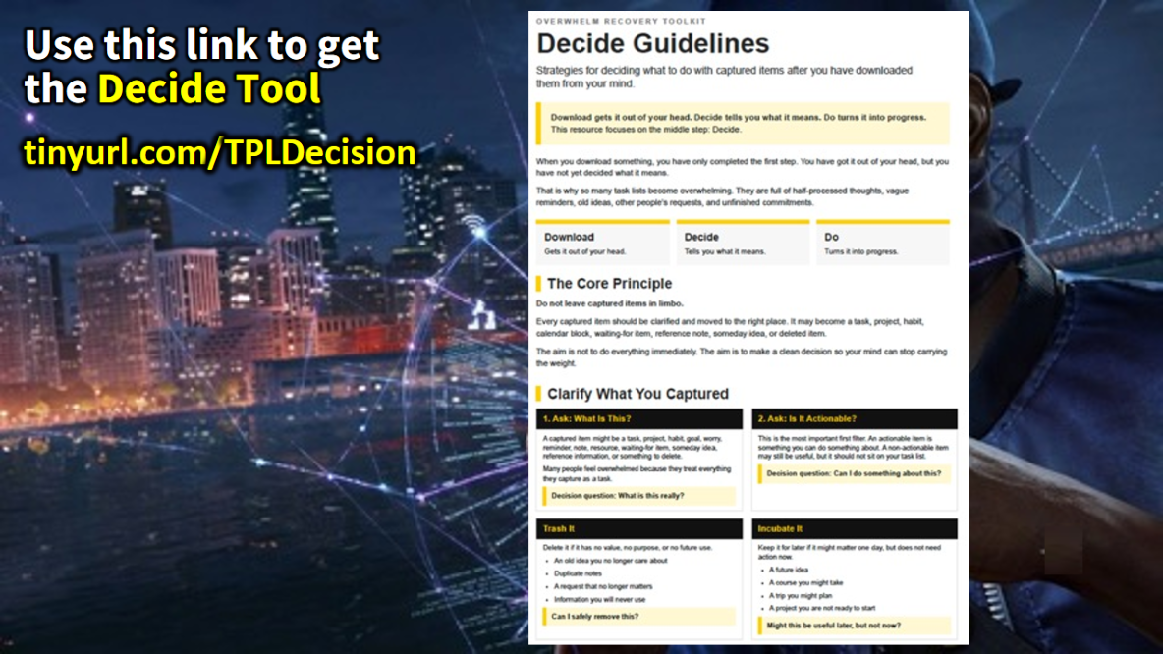
Notes:
Get: Use this link to get the Decide Tool: tinyurl.com/TPLDecision

Slide 31
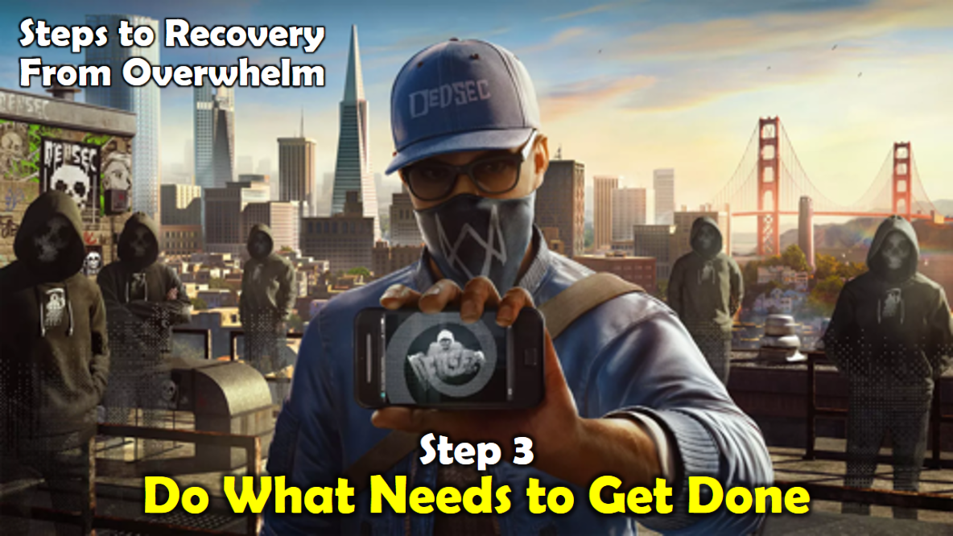
Notes:
Practice #3: Do What Needs to Get Done
The third practice that is critical to manage your actions is to do what you need to do to get things done. GTD has helped me ask a key question to deal with stuff that appears on my radar: Is it actionable? If you answer NO, then you can Trash it, Incubate it or File it. If you answer YES you have two choices: firstly, you can treat it as a Project that will take multiple steps to accomplish; or secondly, you must figure out your very Next Action. There are three things you can do with a next action: Do it; Delegate it or Defer it. As you work through David Allen’s book you will learn how to become a master at using this simple but effective strategy for handling everything that needs to get done in life.

Slide 32
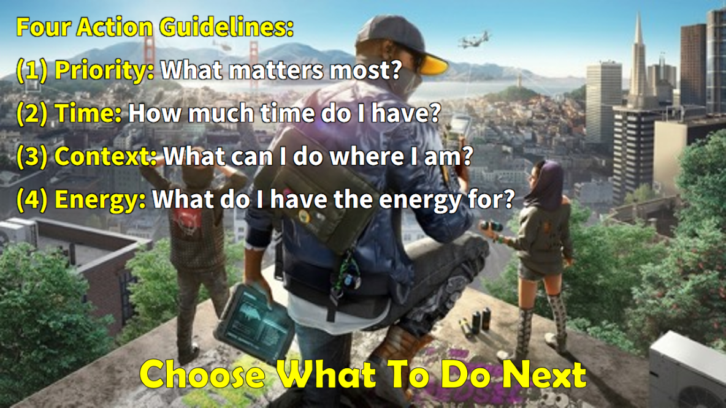
Notes:
Choose What To Do Next: There are four guidelines that determine what we can do next: (1) Priority: Do tasks that are t he most urgent and important. (2) Time: Do what you can based on the available time you have. Your calendar is a vital tool here. (3) Context: Handle tasks based on your current environment or situation. For example, deal with all your emails in a dedicated time slot, or complete multiple errands together. (4) Energy: Different tasks require different amounts of energy so it helps to match the work to your available energy for optimal productivity.

Slide 33
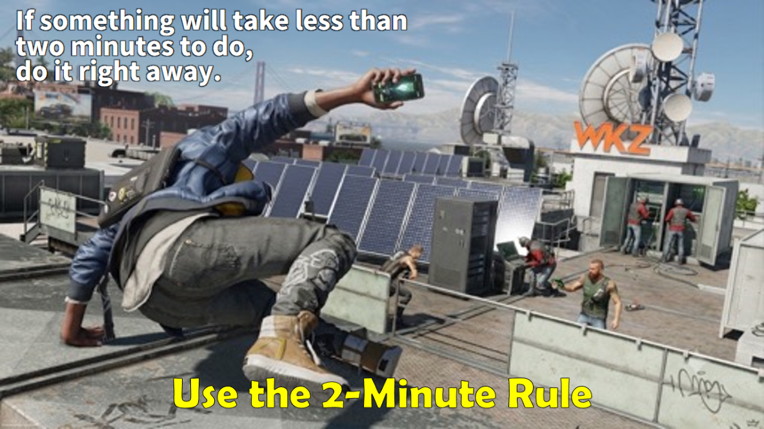
Notes:
Use the 2-Minute Rule: If something will take me less than two minutes to do, I do it right away. If you are prone to procrastination, this will be a real game changer for you!

Slide 34
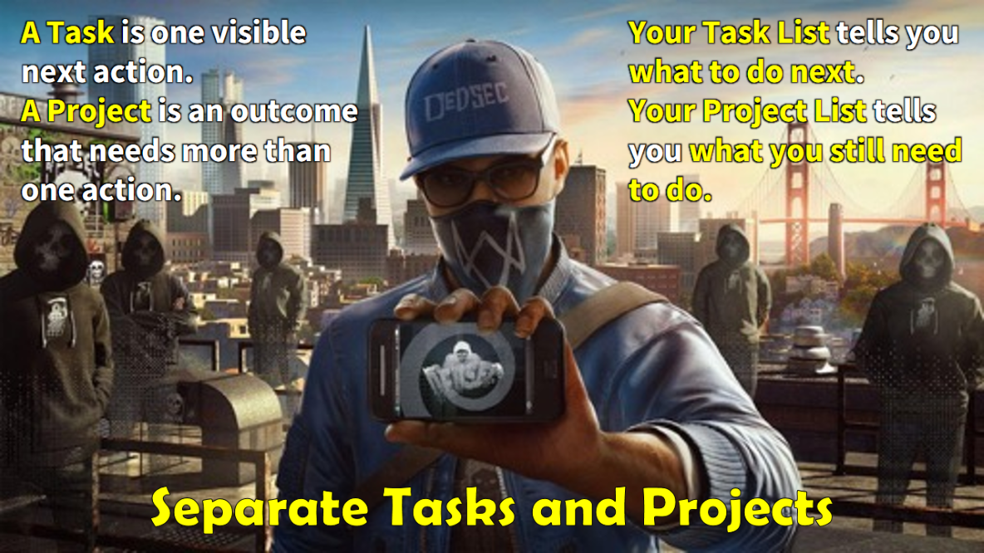
Notes:
(3) Separate Tasks and Projects: If something will take a number of tasks to get done, then treat it like a Project and track all related Tasks! A Task is one visible next action. A Project is an outcome that needs more than one action. Your Task List tells you what to do next. Your Project List tells you what you still need to do.

Slide 35
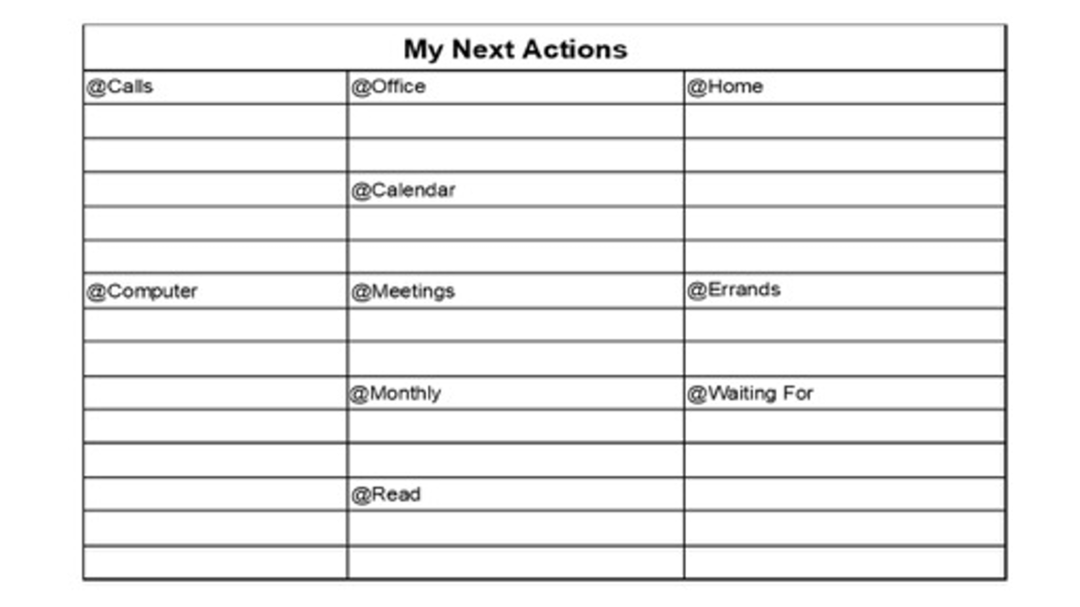

Slide 36
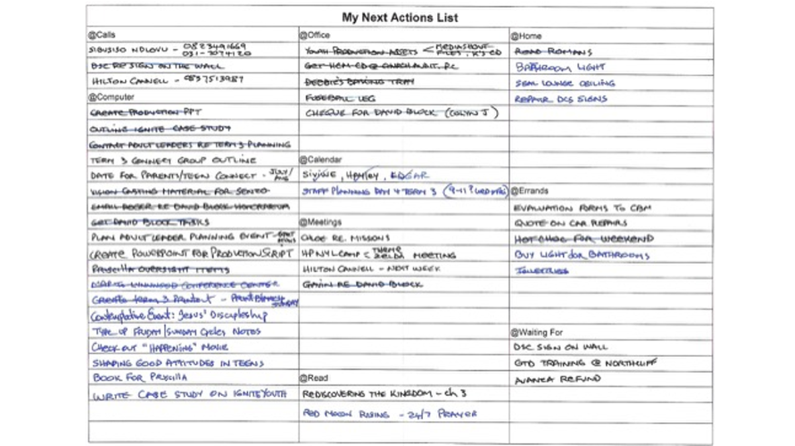
Notes:
Here is a sample of a paper based Next Actions List!

Slide 37
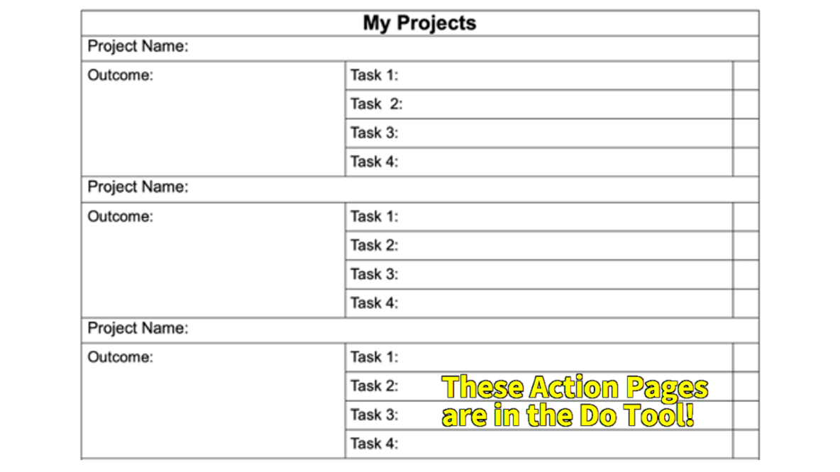
Notes:
There is a Projects list you can to manage anything that will take more than 1 action to complete – ie, Projects.

Slide 38
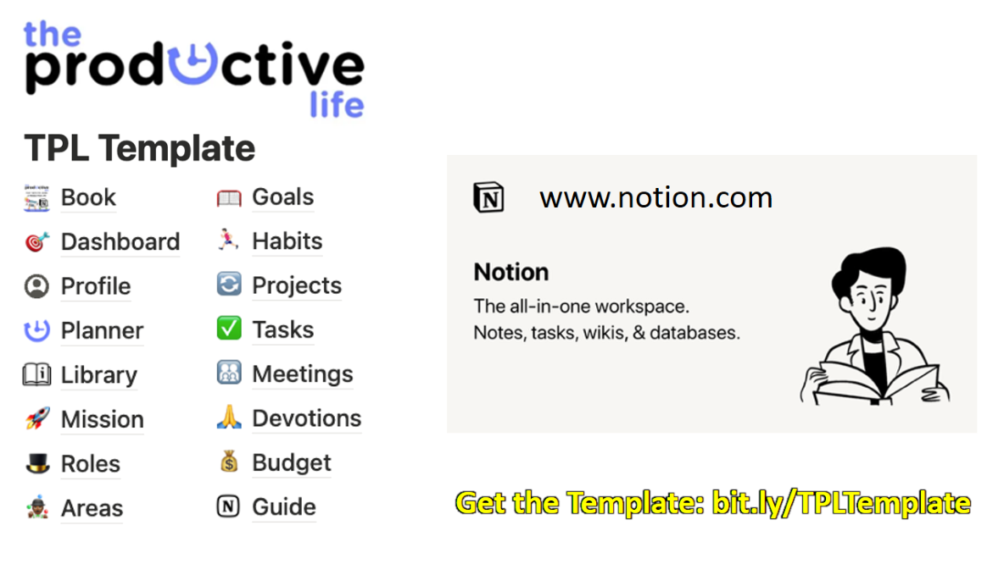
Notes:
My clients are taught how to use Notion to manage their Actions with interconnected Task and Project databases. You can download the template from Gumroad using this link: bit.ly/TPLTemplate

Slide 39
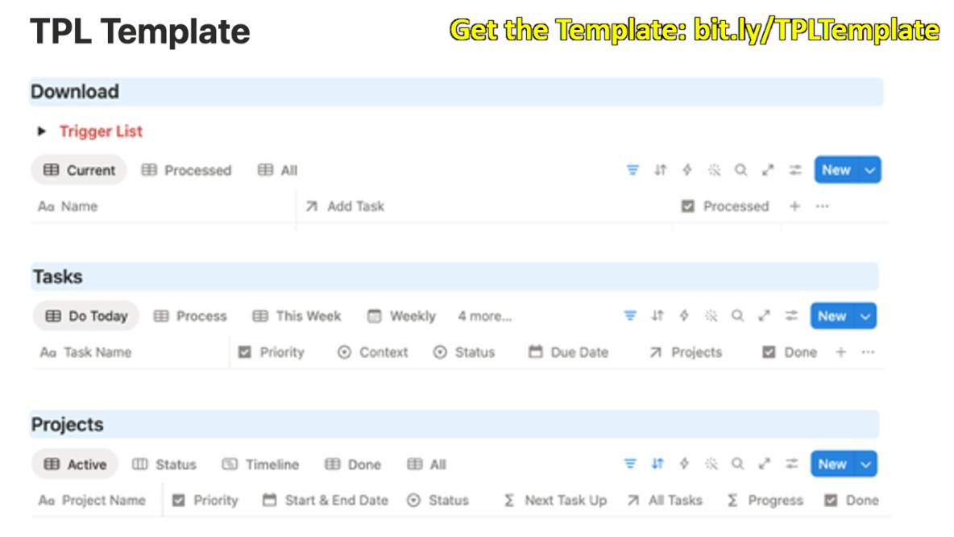
Notes:
Here are the sections where you would manage your Download, Deciding and Doing in Notion!

Slide 40
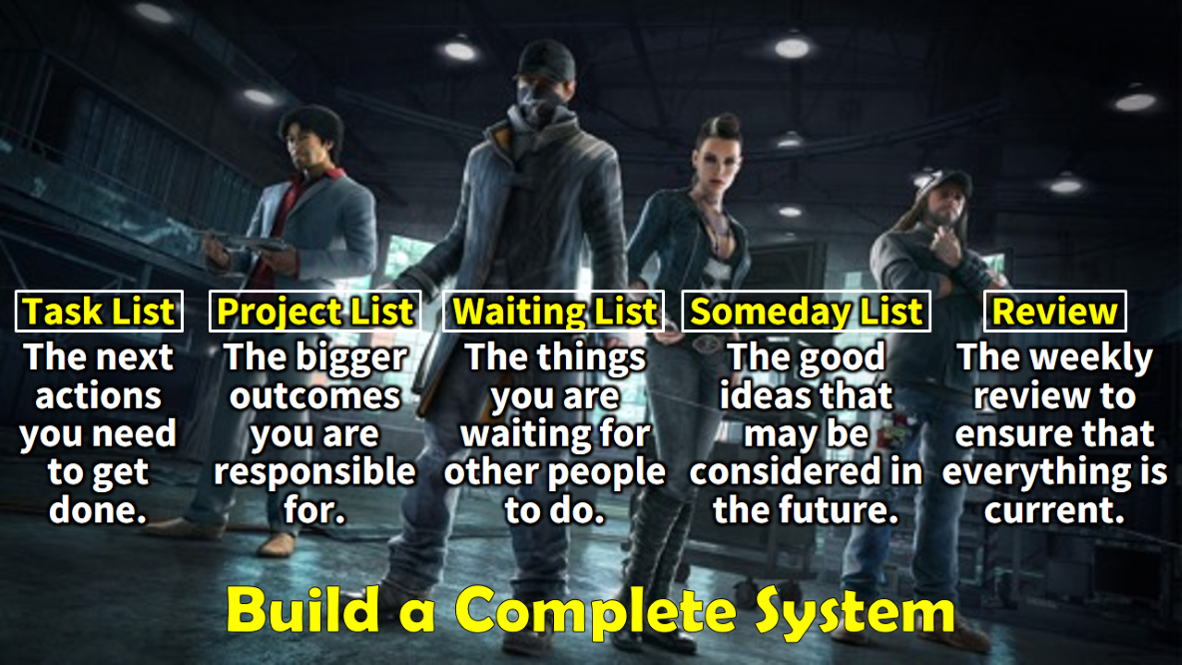
Notes:
Build a Complete System: (1) Task List: The next actions you need to get done. (2) Project List: The bigger outcomes you are responsible for. (3) Waiting List: The things you are waiting for other people to do. (4) Someday List: The good ideas that may be considered in the future. (5) Weekly Review: The weekly review to ensure that everything is current.

Slide 41
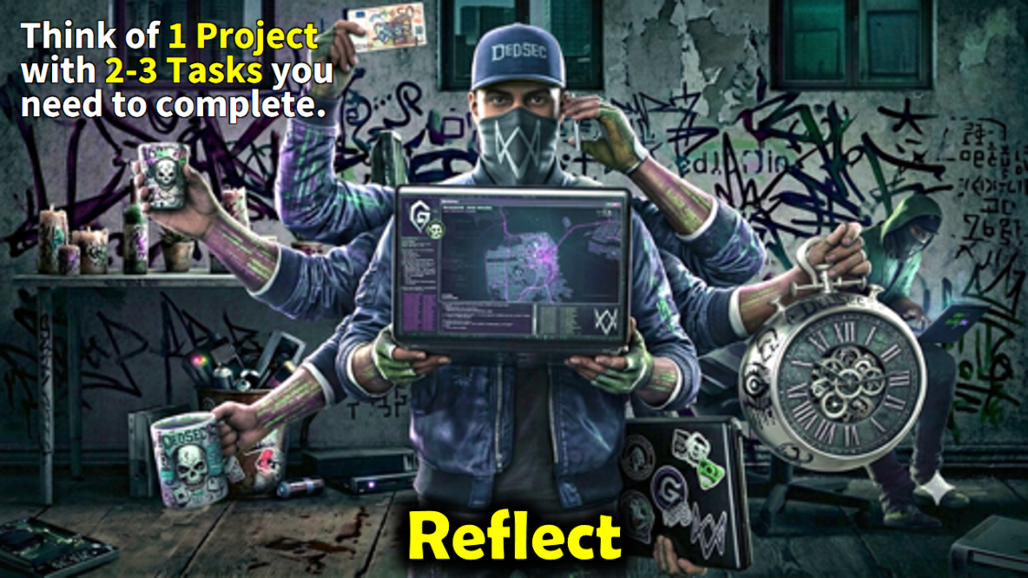
Notes:
Reflect: Think of 1 Project with 2-3 Tasks you need to complete.

Slide 42

Notes:
Chat: Type one next action you can take in the next 24 hours.”

Slide 43

Notes:
Get: Use this link to get the Do Tool: tinyurl.com/TPLDoing

Slide 44
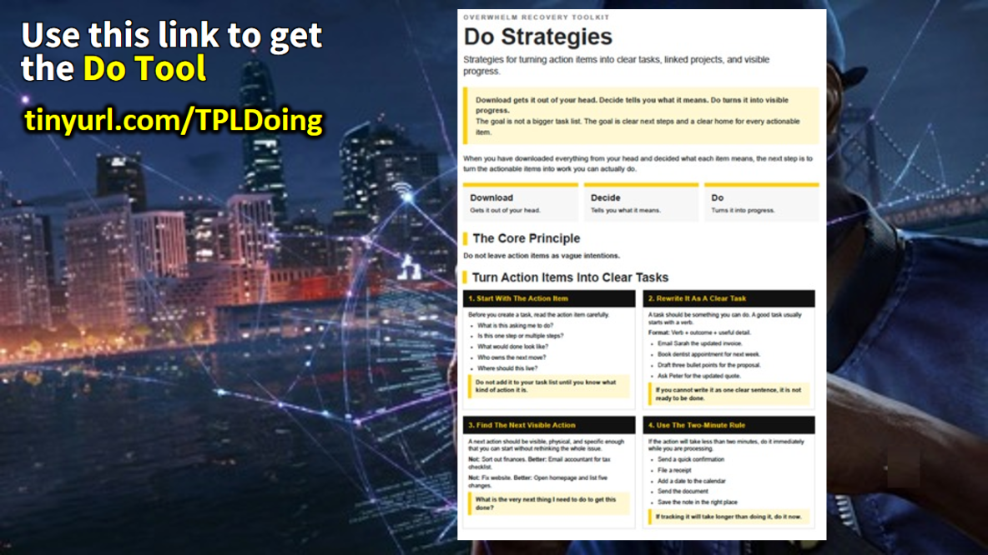
Notes:
Get: Use this link to get the Do Tool: tinyurl.com/TPLDoing

Slide 45
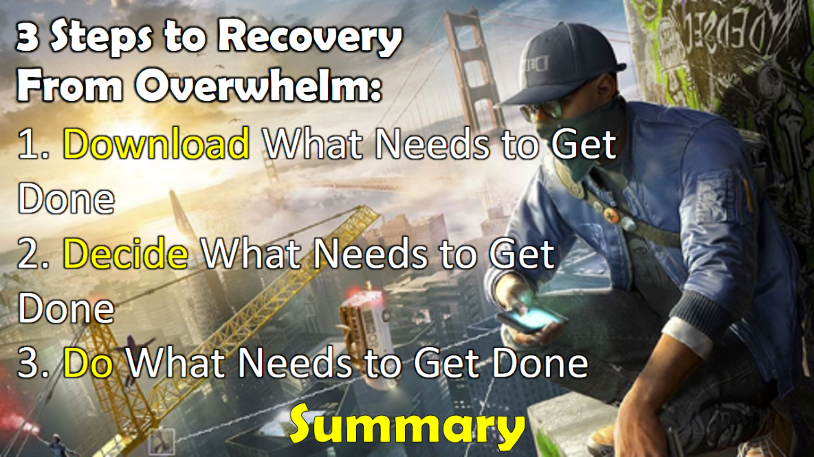
Notes:
Summary: 3 Steps to Recovery From Overwhelm: (1) Download What Needs to Get Done. (2) Decide What Needs to Get Done. (3) Do What Needs to Get Done.

Slide 46
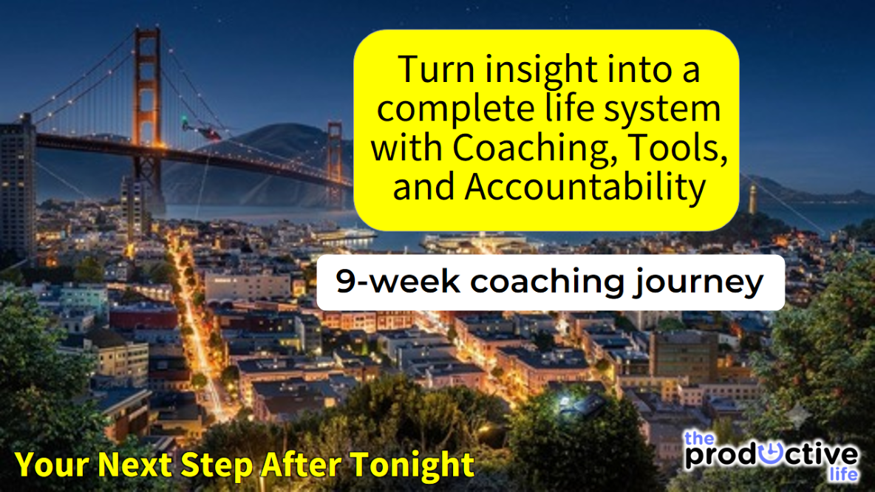
Notes:
Your Next Step After Tonight: Turn insight into a complete life system with coaching, tools, and accountability. The 9-week Coaching Journey.

Slide 47
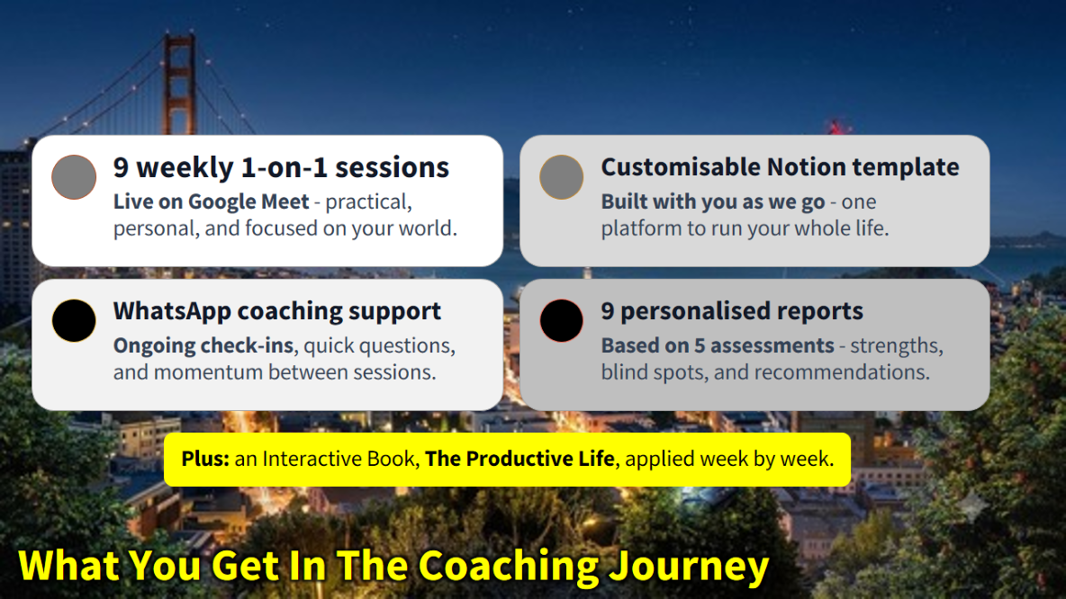
Notes:
What You Get In The 9-Week Coaching Journey:
(1) 9 weekly 1-on-1 sessions: Live on Google Meet - practical, personal, and focused on your world.
(2) WhatsApp coaching support: Ongoing check-ins, quick questions, and momentum between sessions.
(3) Customisable Notion template: Built with you as we go - one platform to run your whole life.
(4) 9 personalised reports: Based on 5 assessments - strengths, blind spots, and recommendations.
(5) Plus: an Interactive Book, The Productive Life, applied week by week.

Slide 48
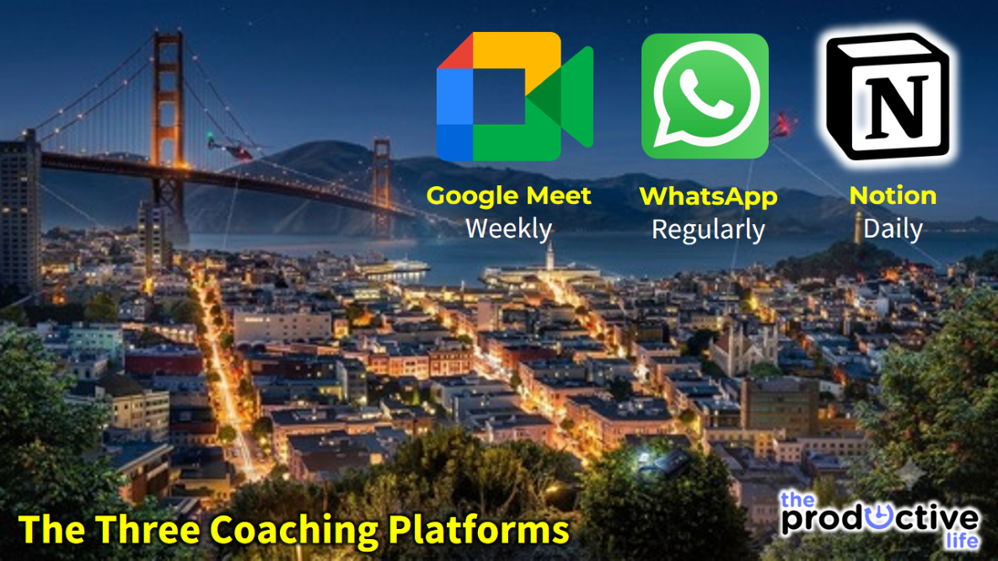
Notes:
The Three Coaching Platforms We Use: (1) Google Meet: Online every week for 45 minutes to an hour. (2) WhatsApp – our main way to stay in touch regularly. (3) Notion App – you will use it daily.

Slide 49
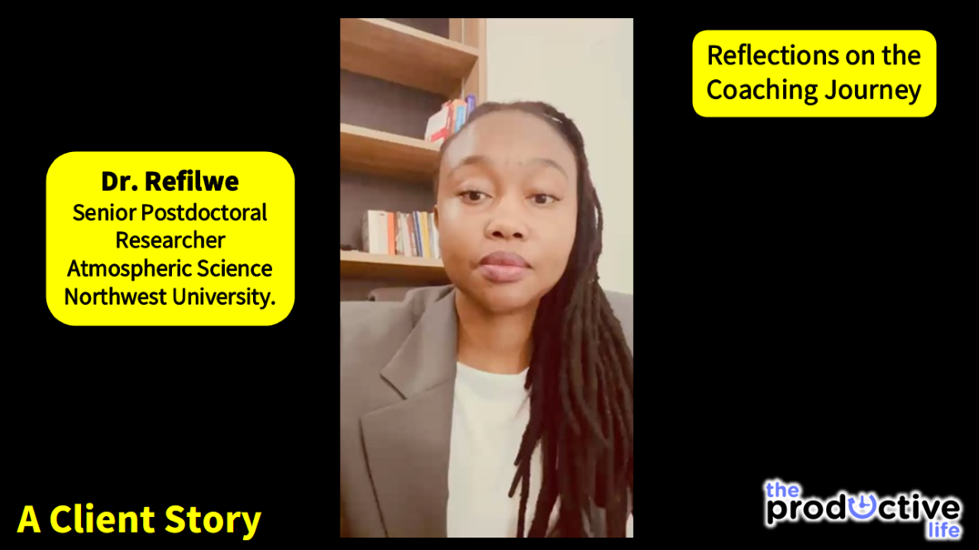
Notes:
Let’s hear from one of the clients I have coached about the impact of the coaching journey on her life. This is Tebogo Mofokeng a Chartered Accountant.

Slide 50
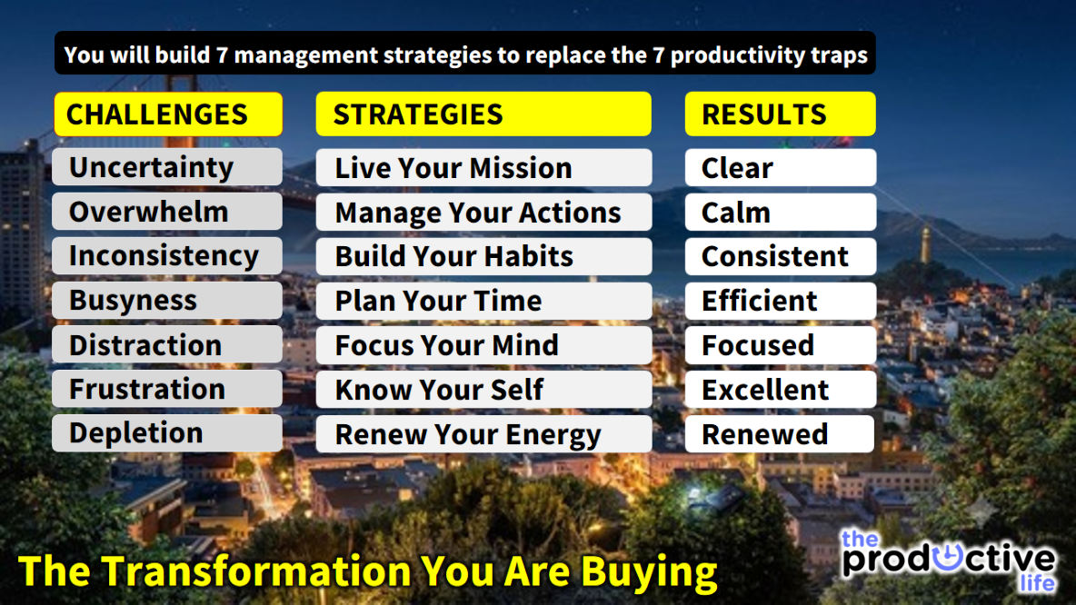
Notes:
The Transformation You Are Buying: You will build 7 management strategies to replace the 7 productivity traps:
The Productive Life Coaching Journey: Challenges → Solutions → Results.
Struggling with Uncertainty -> Live Your Mission -> Get Clear.
Sinking With Overwhelm -> Manage Your Actions -> Get Calm.
Battling With Inconsistency -> Build Your Habits -> Get Consistent.
Drowning With Busyness -> Plan Your Time -> Get Efficient.
Drifting With Distraction -> Focus Your Mind -> Get Focussed.
Coping With Frustration -> Know Your Self -> Get Excellent.
Fading With Depletion -> Renew Your Energy -> Get Renewed.

Slide 51
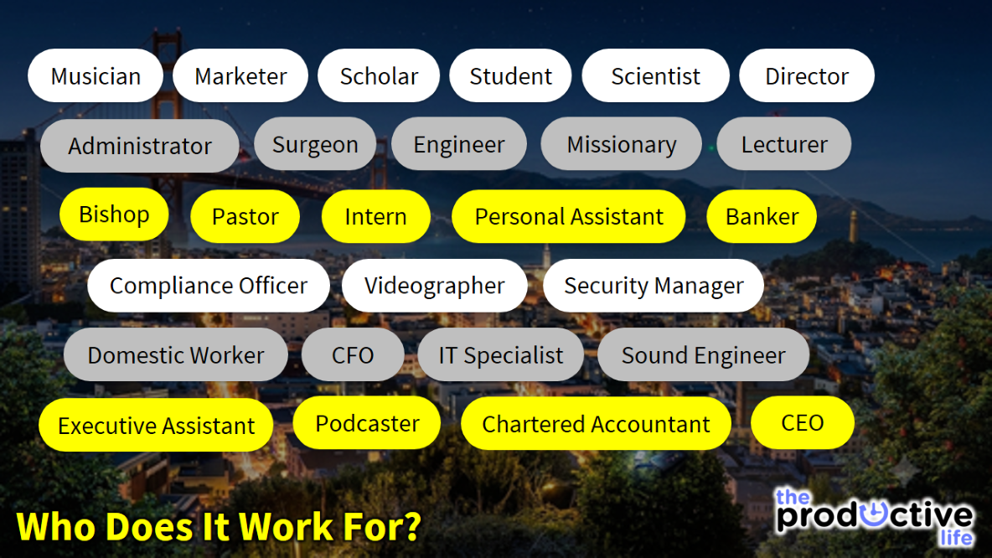
Notes:
Who Will It Work For? Some of my past clients include: Musician, Marketer, Scholar, Student, Scientist, Director, Administrator, Surgeon, Engineer, Missionary, Domestic Worker, Chartered Accountant, Bishop, Pastor, Intern, Personal Assistant, Executive Assistant, Project Manager, Lecturer, Compliance Officer, Videographer, CFO, CEO, Security Manager, IT, Sound Engineer, Podcaster, Banker.

Slide 52
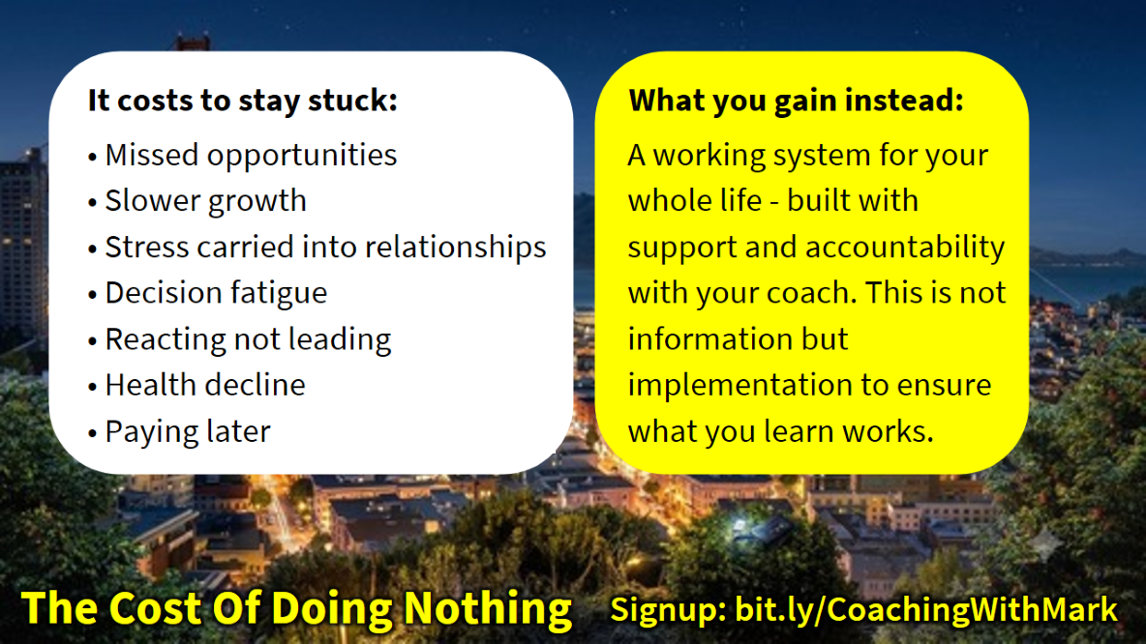
Notes:
The Cost Of Doing Nothing:
It costs more to stay stuck: Missed opportunities and slower growth, Stress carried into home and relationships. Decision fatigue - reacting, never leading. Health decline - Living on urgency. Paying later with time, money, and regret
What you gain instead: A working system for your whole life - built with support and accountability. This is not information but implementation.

Slide 53
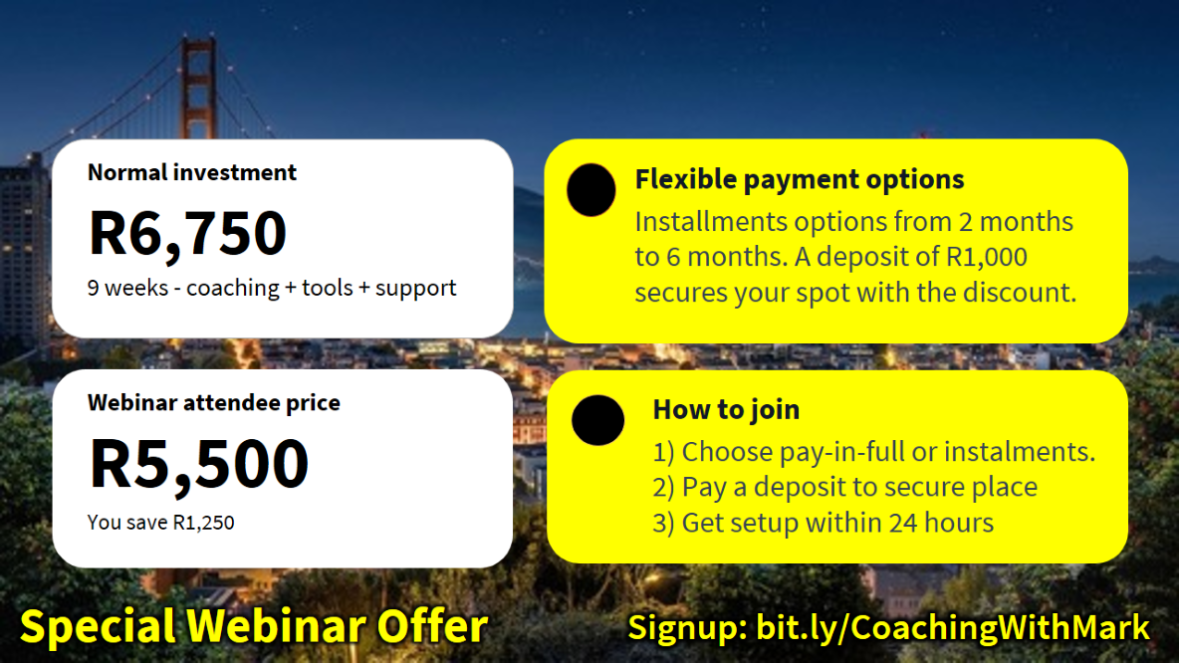
Notes:
Special Webinar Offer:
Normal investment: R6,750 - 9 weeks - coaching + tools + support
Webinar attendee price: R5,500 - Installments from 2 to 6 months.
9 weeks - coaching + tools + support: Installments from 2 to 6 months. A deposit of R1,000 secures spot.
How to join: Choose pay-in-full or instalments. Pay a deposit to secure your place. Get setup within 24 hours

Slide 54
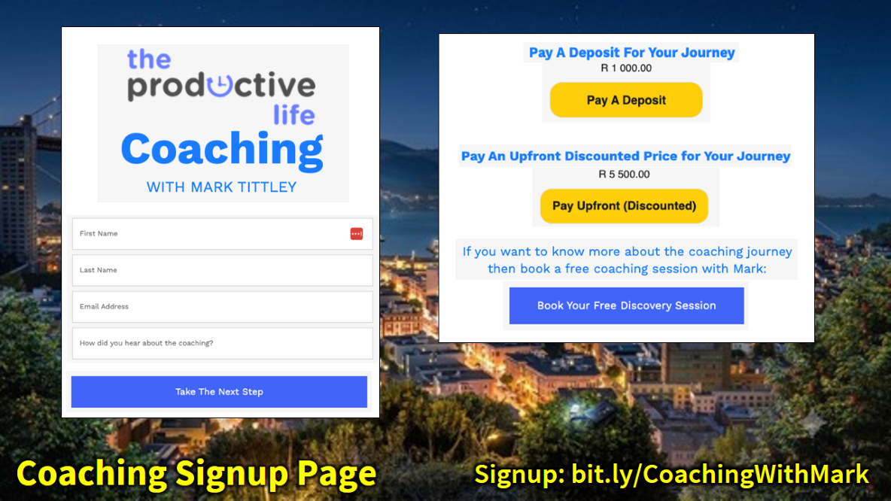
Notes:
This is what to expect when you visit the Coaching Page at: www.bit.ly/CoachingWithMark

Slide 55
Notes:
Summary: 3 Steps to Recovery From Overwhelm: (1) Download What Needs to Get Done. (2) Decide What Needs to Get Done. (3) Do What Needs to Get Done.

Slide 56
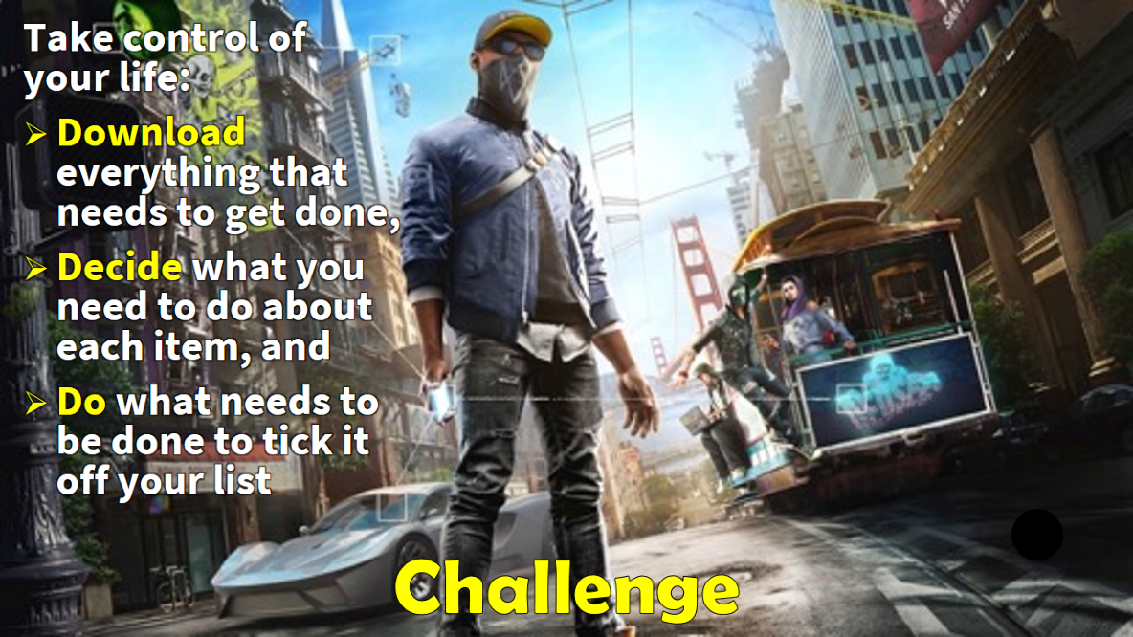
Notes:
Challenge: Take control of your life: Download everything that needs to get done, Decide what you need to do about each item, and Do what needs to be done to tick it off your list.

Slide 57

Notes:
Questions & Answers: What questions do you have about how to recover from overwhelm?

Slide 58

Notes:
Next Webinar: High Excellence Without Frustration: How to stop fighting yourself and work with how you’re wired

Slide 59
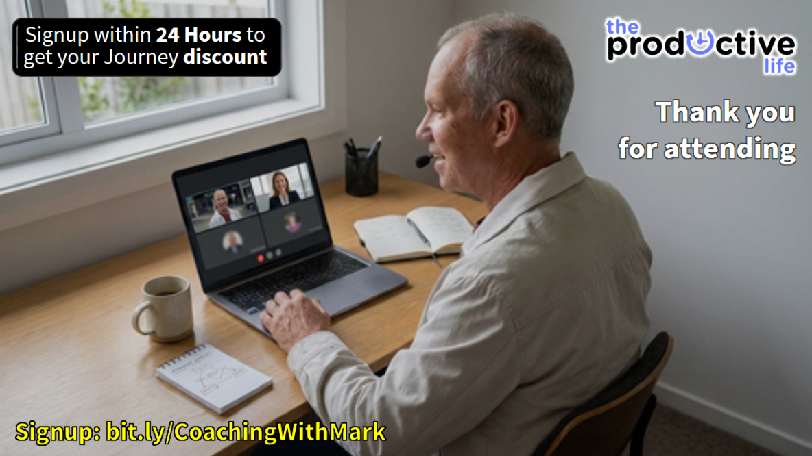
Notes:
Thank You: (1) Sign up for the coaching journey within 24 hours for your webinar discount. (2) Thank you for investing your time tonight.

