Slide 1
Notes:
Today we want to give you each a booklet that will help you on your journey as a new follower of Jesus. We will spend the next 5 weeks going through the booklet.

Slide 2
Notes:
In the Introduction you learnt the following:

Slide 3
Notes:
1. What happened to me? Check out the booklet to see what happens when we are saved. The Electronic version of the booklet is in the Facebook group’s albums for convenience.

Slide 4
Notes:
2. Can I be sure I am saved?

Slide 5
Notes:
3. What happens next?

Slide 6
Notes:
How do you grow a relationship with a friend?

Slide 7
Notes:
How do you grow your relationship with Jesus? We are going to explore 5 ways that you can grow your relationship with Jesus.

Slide 8
Notes:
1. Read what God has written

Slide 9
Notes:
2. Talk to God

Slide 10
Notes:
3. Be With God’s Friends

Slide 11
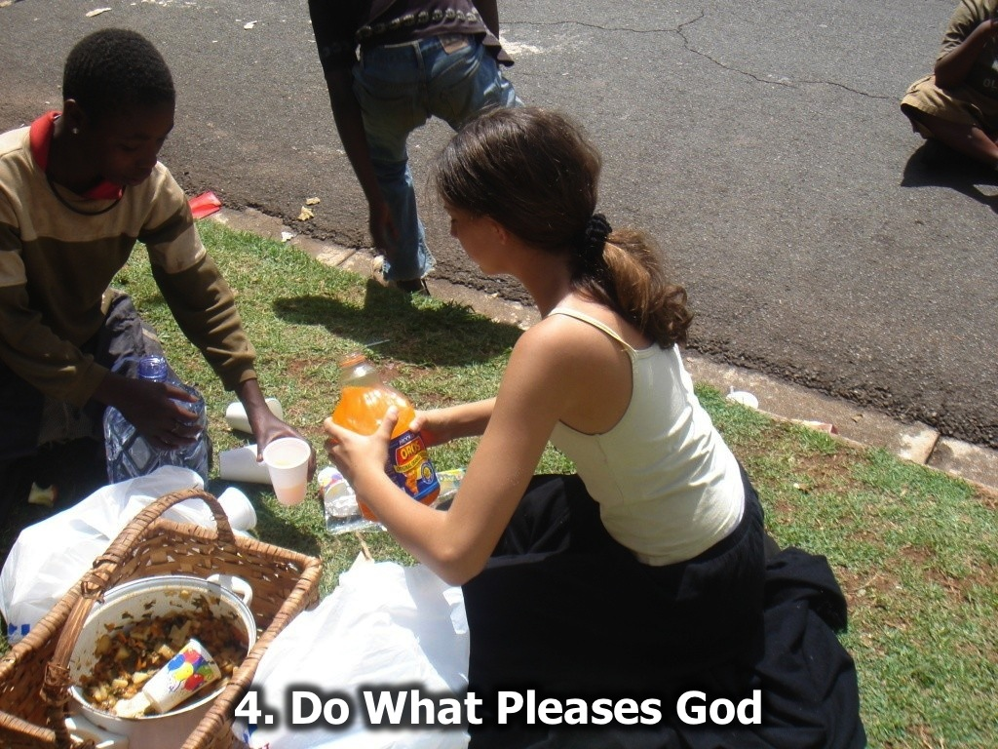
Notes:
4. Do What Pleases God

Slide 12
Notes:
5. Talk About Your Relationship

Slide 13
Notes:
In the coming weeks we will explore these 5 ways to grow your relationship with Jesus.

Slide 14
Notes:
So let’s look at how to read what God has written!

Slide 15
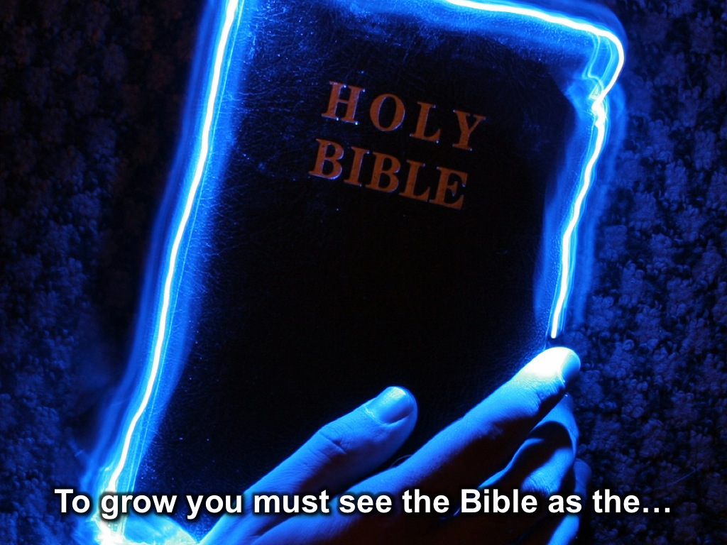
Notes:
To grow you must see the Bible as the…

Slide 16
Notes:
Key to spiritual growth

Slide 17
Notes:
Way to victory over temptation

Slide 18
Notes:
Secret to a pure and holy life.

Slide 19
Notes:
Pathway to success

Slide 20
Notes:
Guide to God’s Will for Your Life

Slide 21
Notes:
To grow closer to God you need: (1) A daily appointment with God.

Slide 22
Notes:
(2) A way to listen to God – get a Bible, notebook, pen and a set of questions!

Slide 23
Notes:
Choose a passage and ask whether there is a:

Slide 24
Notes:
(1) Sin to Avoid?

Slide 25
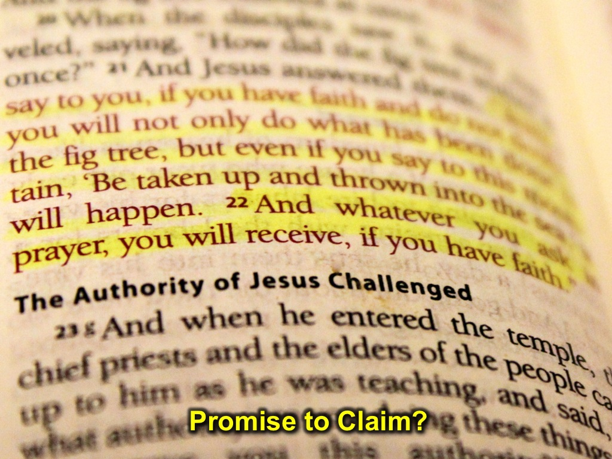
Notes:
(2) Promise to Claim?

Slide 26
Notes:
(3) Example to Follow?

Slide 27
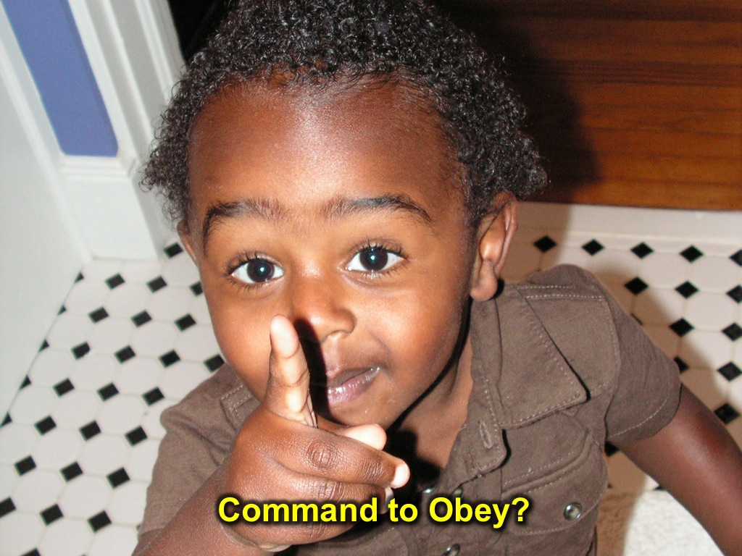
Notes:
(4) Command to Obey?

Slide 28
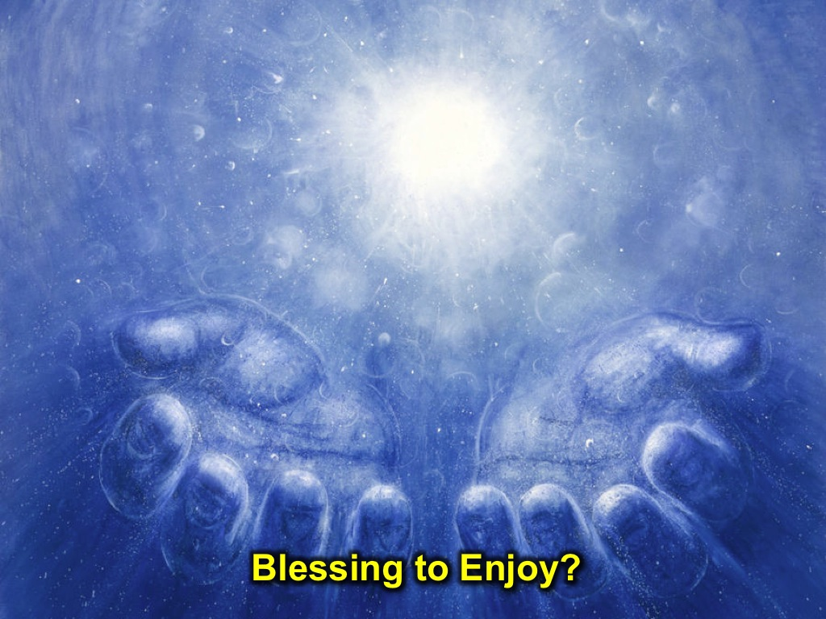
Notes:
(5) Blessing to Enjoy?

Slide 29
Notes:
So every day, when you sit down to have you daily devotions, you should choose a passage and ask whether there is a: (1) Sin to Avoid? (2) Promise to Claim? (3) Example to Follow? (4) Command to Obey? (5) Blessing to Enjoy?

Slide 30
Notes:
Let’s practise with a selection of verses from Mark chapter 1!

Slide 31
Notes:
Next week we will look at how to talk to God!

