Slide 1
Notes:
Two weeks ago we gave you each a booklet that will help you on your journey – the Engage Book.

Slide 2
Notes:
How do you grow your relationship with Jesus? We are exploring 5 ways that you can grow your relationship with Jesus.

Slide 3
Notes:
In week 1 we learnt how to read what God has written!

Slide 4
Notes:
The second way to grow your relationship with Jesus is to talk to him!

Slide 5
Notes:
This week we are going to learn how hanging out with God’s friends will grow our relationship with God.

Slide 6
Notes:
Where do God’s friends hang out?

Slide 7
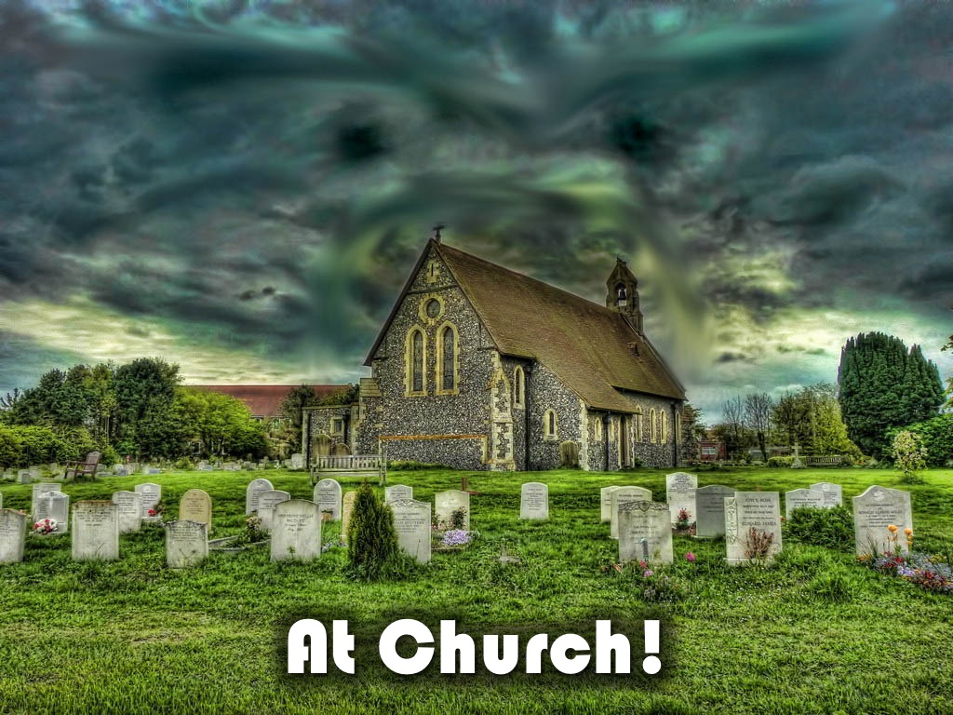
Notes:
At Church

Slide 8
Notes:
1. What is the Church?

Slide 9
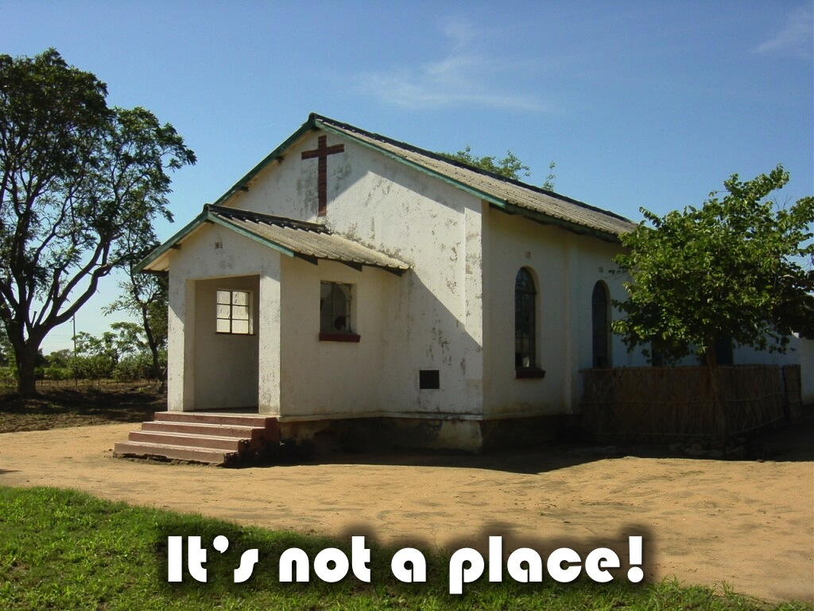
Notes:
It is not a building!!!

Slide 10
Notes:
When you became a Christian God joined you with other believers into Church. The word church comes from a Greek word which means: “called-out ones”. The church is made up of people who have been called out and brought together for a common purpose. The Bible uses several figures of speech to describe the church:

Slide 11
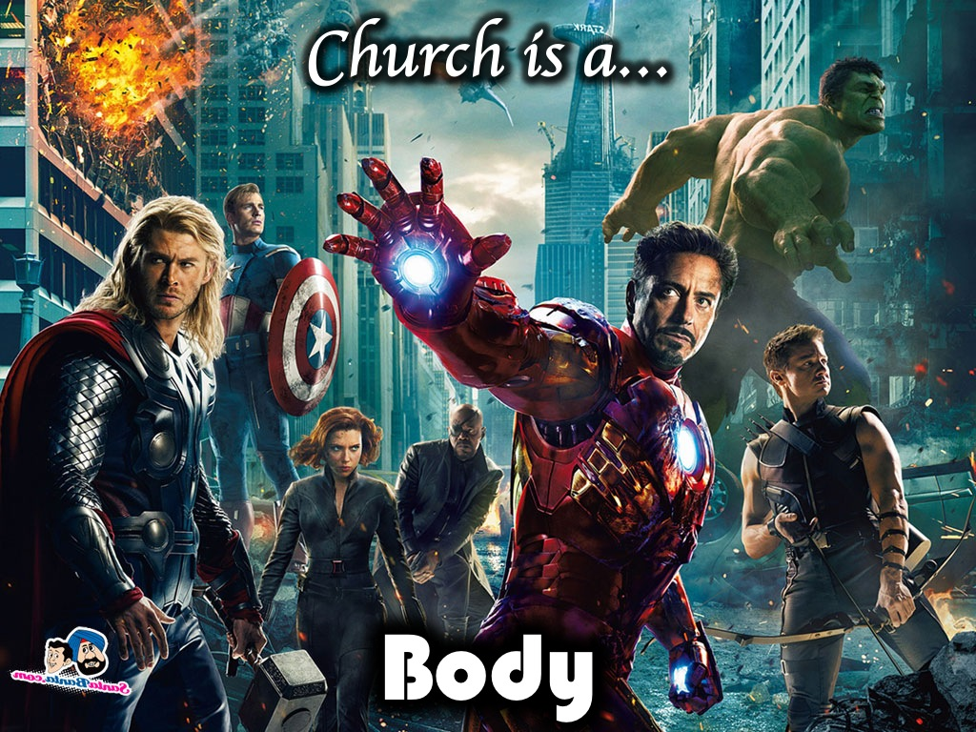
Notes:
A. Body - The church is a body of believers who have been called together. Each person is unique, but connected to each other.
Just as each of us has one body with many members, and these members do not all have the same function, so in Christ we who are many form one body, and each member belongs to all the others. Romans 12:4-5

Slide 12
Notes:
B. Building - The church is a building that God has designed. As we grow we become a building in which God lives by his Holy Spirit.
Consequently, you are no longer foreigners and aliens, but fellow citizens with God’s people and members of God’s household, built on the foundation of the apostles and prophets, with Christ Jesus himself as the chief cornerstone. In him the whole building is joined together and rises to become a holy temple in the Lord. And in him you too are being built together to become a dwelling in which God lives by his Spirit. Ephesians 2:19-22

Slide 13
Notes:
C. Bride - The church as a bridge reminds us that we must view ourselves as joined to Christ in a faithful love relationship.
Husbands, love your wives, just as Christ loved the church and gave himself up for her to make her holy, cleansing her by the washing with water through the word, and to present her to himself as a radiant church, without stain or wrinkle or any other blemish, but holy and blameless. Ephesians 5:25-27

Slide 14
Notes:
Church is family.

Slide 15
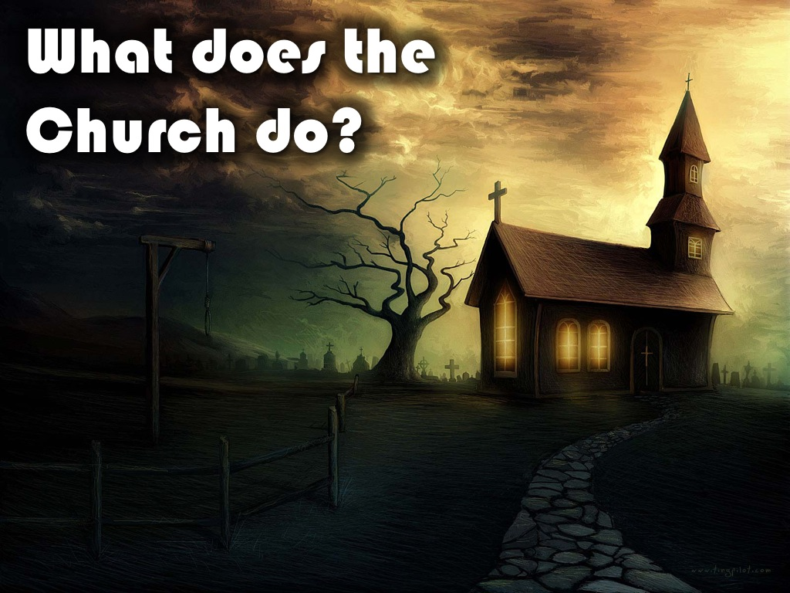
Notes:
2. What Does the Church Do? As we look at the early Church in the New Testament we discover that Christians gathered together to:

Slide 16
Notes:
A. Study God’s Word, Fellowship, Break Bread, Pray - They met in small groups to engage in practises that would help to sustain their relationship with Jesus.
They devoted themselves to the apostles’ teaching and to the fellowship, to the breaking of bread and to prayer. Acts 2:42

Slide 17
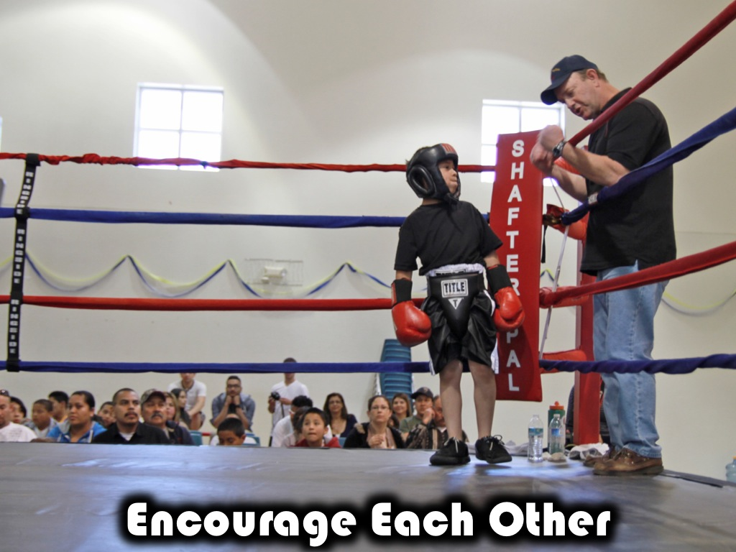
Notes:
B. Encourage Each Other - They met together to encourage each other to continue following Jesus and to practise deeds of kindness.
And let us consider how we may spur one another on toward love and good deeds. Let us not give up meeting together, as some are in the habit of doing, but let us encourage one another—and all the more as you see the Day approaching. Hebrews 10:24-25

Slide 18
Notes:
C. Practise Spiritual Gifts - They used the spiritual gifts God gave them to build the body:
Now you are the body of Christ, and each one of you is a part of it. And in the church God has appointed first of all apostles, second prophets, third teachers, then workers of miracles, also those having gifts of healing, those able to help others, those with gifts of administration, and those speaking in different kinds of tongues. 1 Corinthians 12:27-28

Slide 19
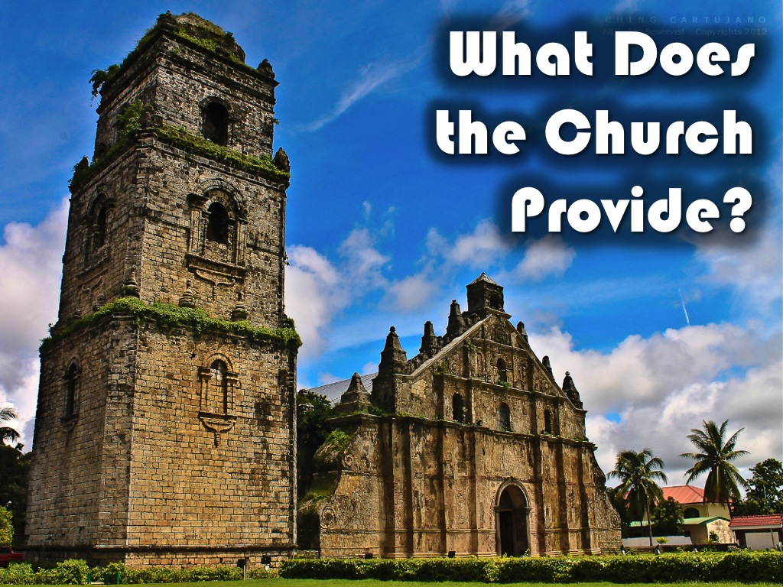
Notes:
3. What Does the Church Provide? There are many benefits for those who are a part of the church:

Slide 20
Notes:
A. Friendship - True friends encourage us to become more like Jesus.
A man of many companions may come to ruin, but there is a friend who sticks closer than a brother. Proverbs 18:24

Slide 21
Notes:
B. Fellowship - As you connect with other believers you will stay on fire for God.
But if we walk in the light, as he is in the light, we have fellowship with one another, and the blood of Jesus, his Son, purifies us from all sin. 1 John 1:7

Slide 22
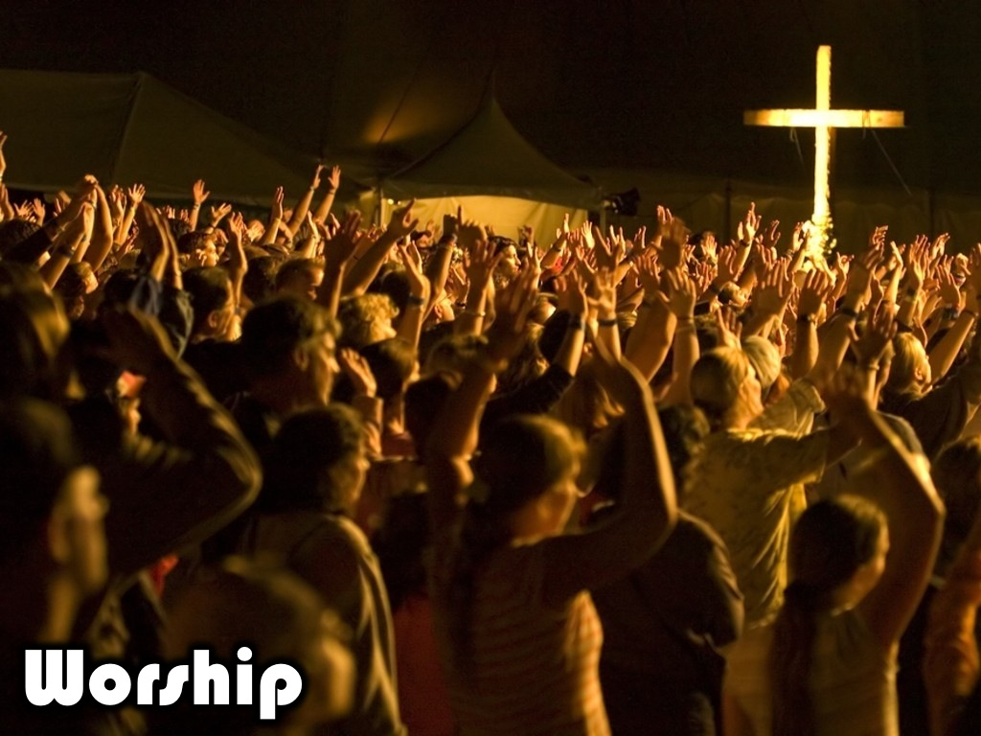
Notes:
C. Worship - You gather together with other believers to express your love, devotion and commitment to God.
Every day they continued to meet together in the temple courts. They broke bread in their homes and ate together with glad and sincere hearts, praising God and enjoying the favor of all the people. Acts 2:46-47

Slide 23
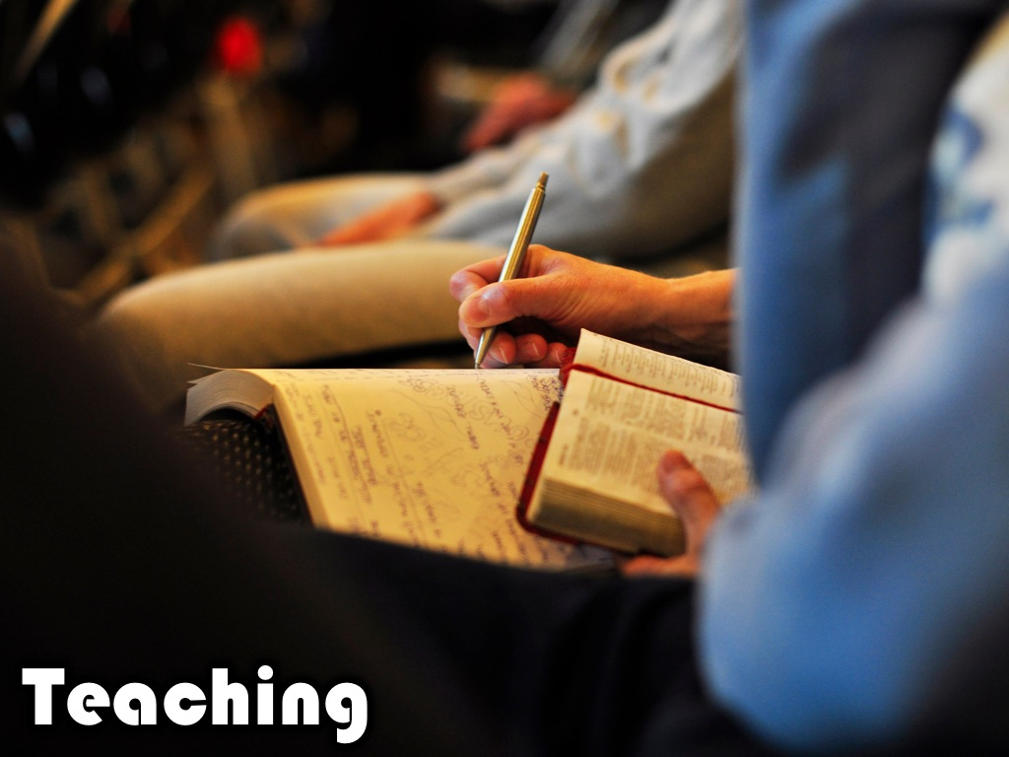
Notes:
D. Teaching - As a follower of Jesus you must teach others to follow Jesus.
And the things you have heard me say in the presence of many witnesses entrust to reliable men who will also be qualified to teach others. 2 Timothy 2:2

Slide 24
Notes:
So, are you part of a church or are you a lone ranger?

Slide 25
Notes:
4. Who are your Christian Friends?

Slide 26
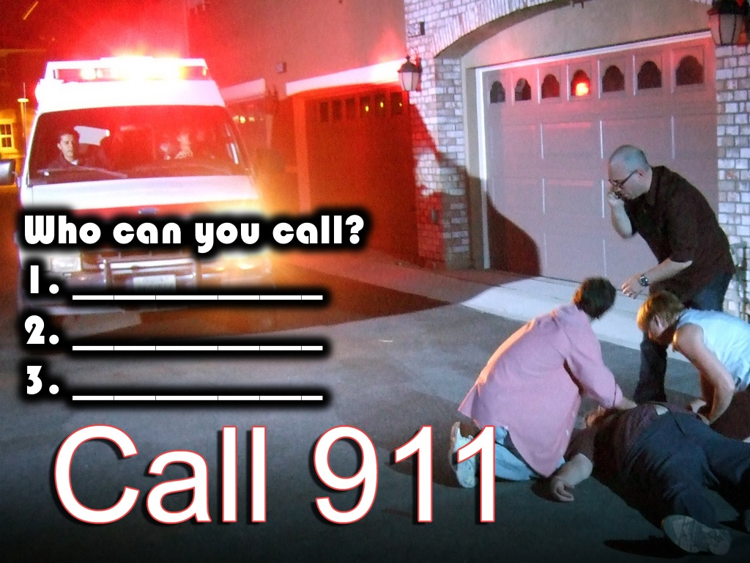
Notes:
Name 3 Christians you can call in case of a spiritual emergency: (1) ____________, (2) ____________, (3) ____________.

Slide 27
Notes:
5. What church are you a part of? If you don’t belong to a church then pray and ask God to lead you to one!

Slide 28
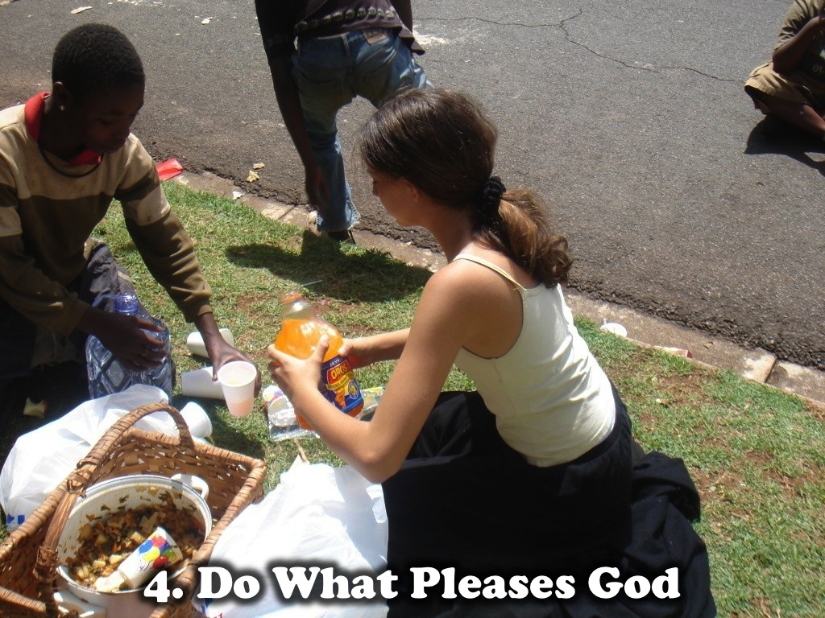
Notes:
Next week we will look at how to grow our relationship with Jesus by doing what pleases God!

