Slide 1

Notes:
A few weeks ago we gave you each a booklet that will help you on your journey – the Engage Book.

Slide 2
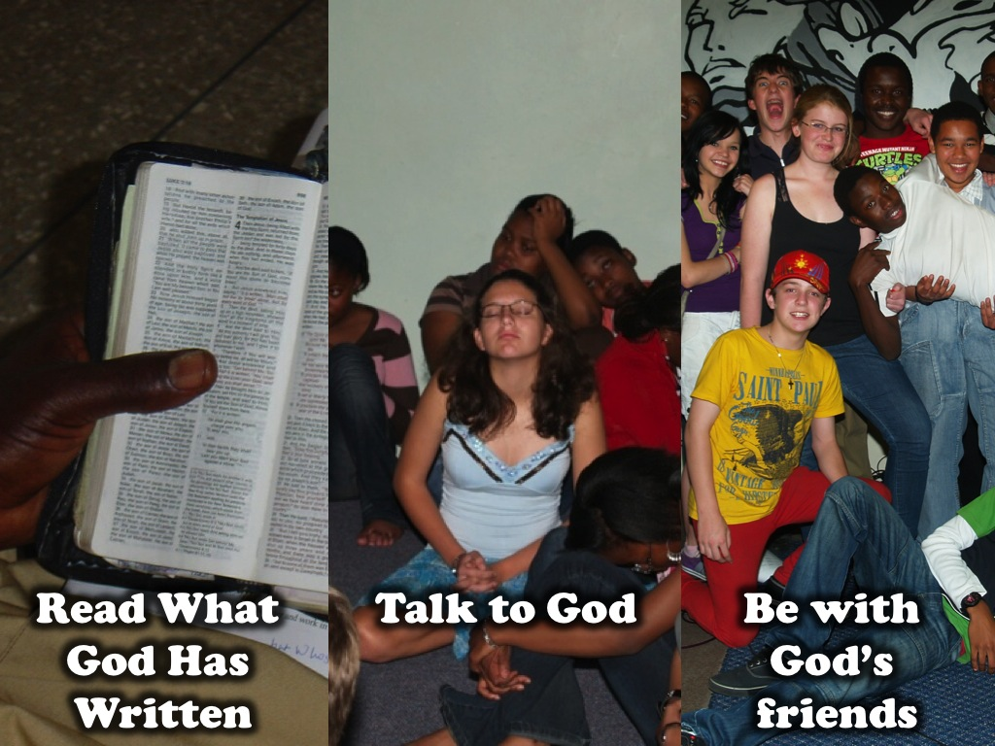
Notes:
In week 1 we looked at how to read what God has written. In week 2 we looked at how to talk to God. In week 3 we looked at how to be with God’s friends.

Slide 3
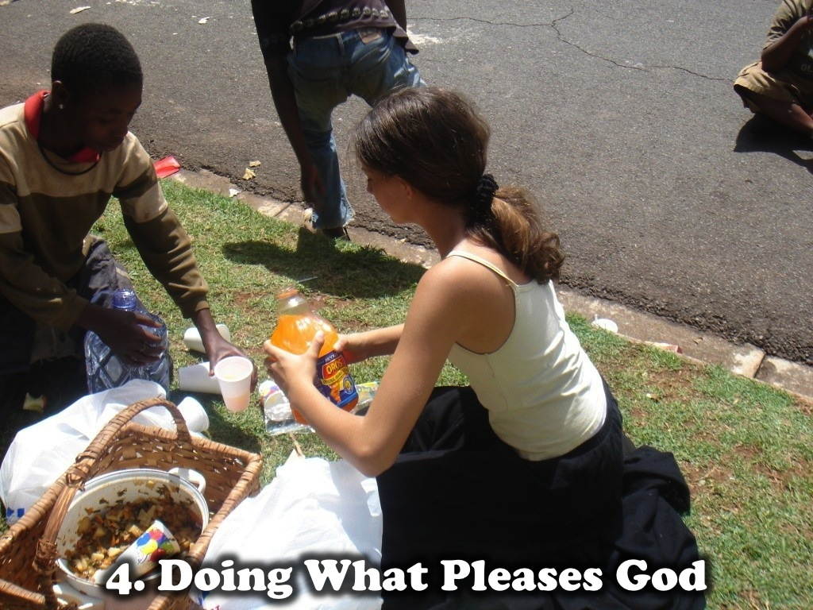
Notes:
Today we’re going to look at Chapter 4 of the Engage booklet and we’ll be talking about “Doing what pleases God”.

Slide 4
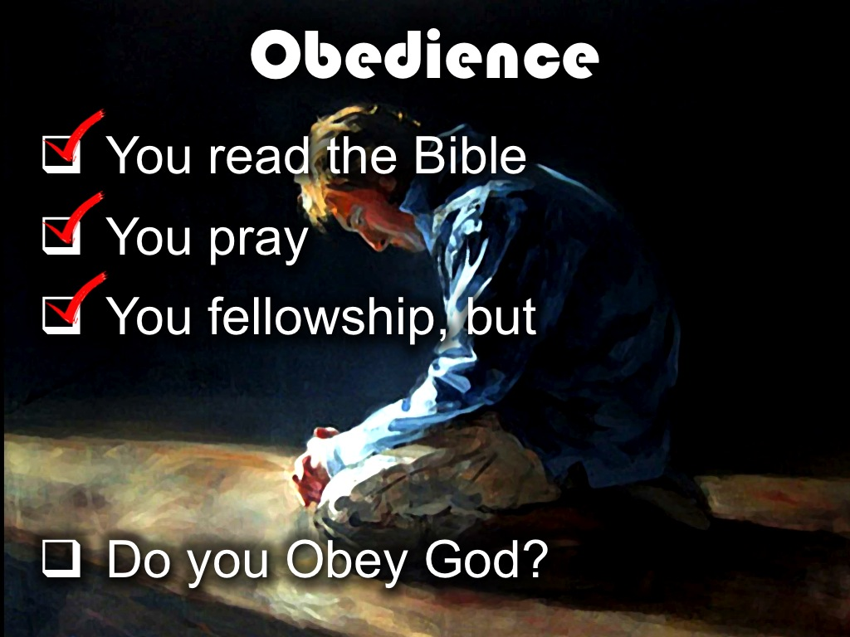
Notes:
Obedience. So you’ve read God’s word, you know how to pray and fellowship with other believers but how do you Obey God?

Slide 5
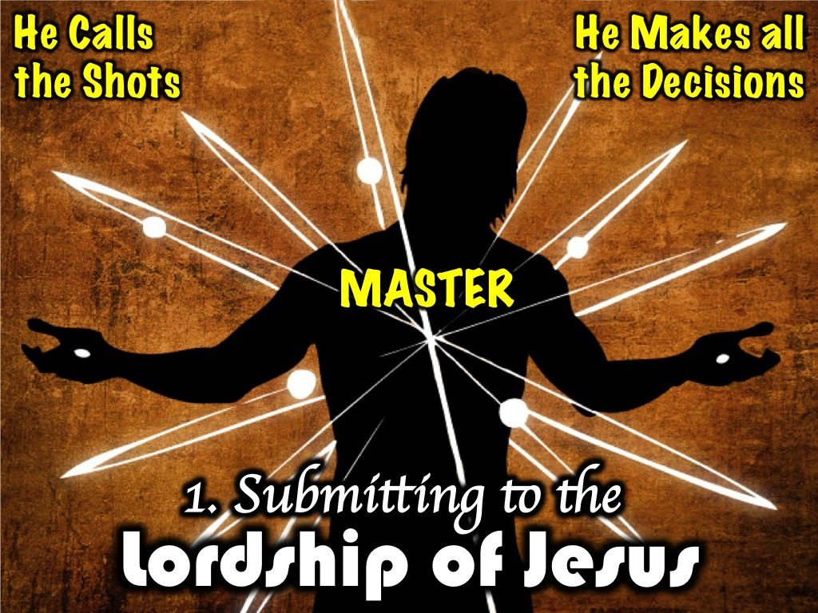
Notes:
1. Submitting to the Lordship of Jesus. The first way in which we can do this is by submitting to the Lordship of Jesus. The word Lord means Master – the man in charge. The man who calls the shots, who makes all the decisions.

Slide 6
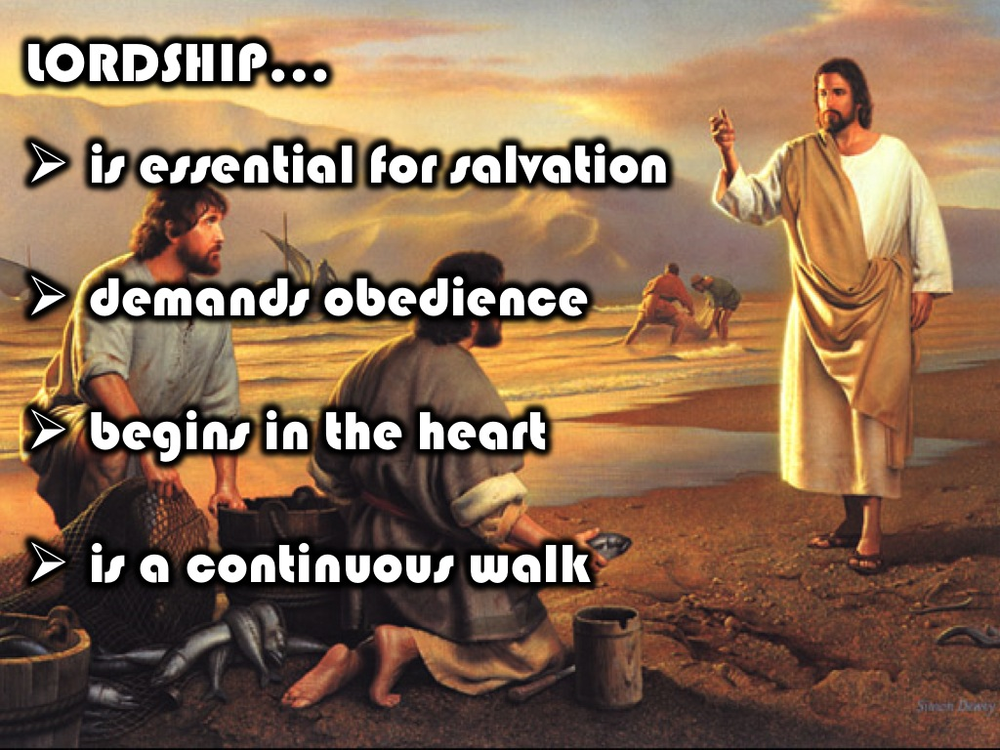
Notes:
A. Lordship is essential for salvation: When you accepted Christ as your personal saviour, “you confessed with your mouth “Jesus is Lord” and believed in your heart that God raised him from the dead (Romans 10:9). That choice to accept Christ as your personal saviour also means you accepted him as “Lord “ of your life. As the one who calls the shots.
B. Lordship demands obedience: That simply means that now that he’s in charge and making all the decisions, we must obey what he says. Your choices and the way you live your life must reflect that you are a follower of Christ.
C. Lordship begins in the heart: The choice for you to obey Christ must come from your heart. It’s not about following a set of rules and traditions; it’s about making the choice to follow him because “He” is the master of your life.
D. Lordship is a continuous walk: and as you follow him you walk with him continuously. Daily in each and every one of the choices you make. Lordship is not a onetime thing. It’s choosing to continually walk with Christ.

Slide 7

Notes:
2. Living a life of Faith.

Slide 8

Notes:
A. Faith is essential for Salvation: In addition to Lordship, Obedience is also about living a life of faith. Salvation would not be possible without Faith. The definition of faith in the book of Hebrews is - Faith is the being sure of what we hope for and certain of what we do not see – Hebrews 11:1

Slide 9
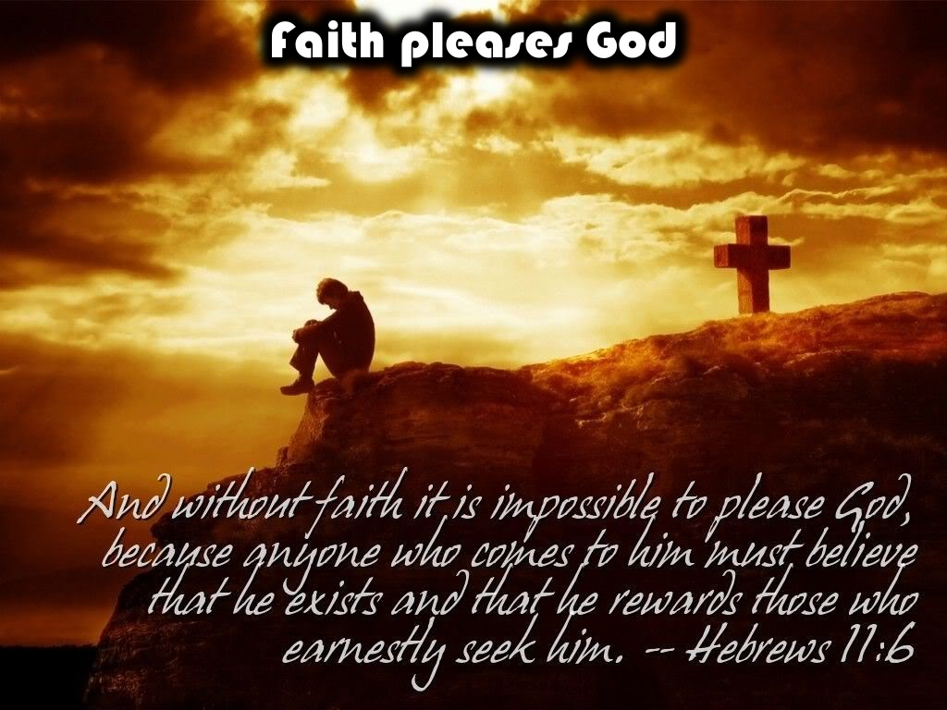
Notes:
B. Faith Pleases God: Without Faith it is impossible to please God. The bible says: Without Faith it is impossible to please God because anyone who comes to him must believe that he exists and that he rewards those who earnestly seek him. (Hebrews 11:6)

Slide 10

Notes:
C. Faith Obeys God: And once we have Faith we can obey God. We can trust him to deliver on his promises.

Slide 11

Notes:
D. Faith overcomes the world: It gives us the courage to stand in the midst of the reality of life and trust in God to give us victory. If Moses didn’t have faith do you think he’d have had the courage to stand before the sea and watch God part the waters before the Israelites?

Slide 12
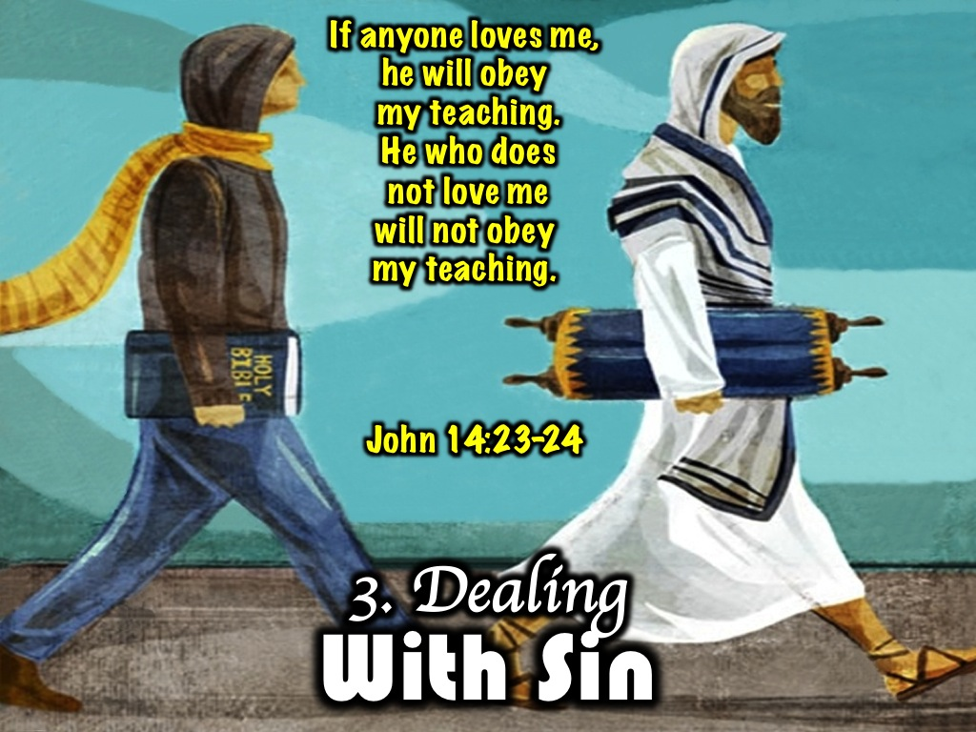
Notes:
3. Dealing with sin. When we start this journey of growing in Christ God begins to show us the things in our lives, in our character that do not reflect the identity of a child of God. Whether we love God or not is determined by whether or not we Obey him.. If we’re willing to let him change us. John 14:23-24 If anyone loves me, he will obey my teaching. He who does not love me will not obey my teaching.

Slide 13

Notes:
An easy way to do this is by asking “What Would Jesus Do?” Whenever you encounter a situation that requires a decision.

Slide 14

Notes:
4. Engaging in Spiritual Warfare.

Slide 15
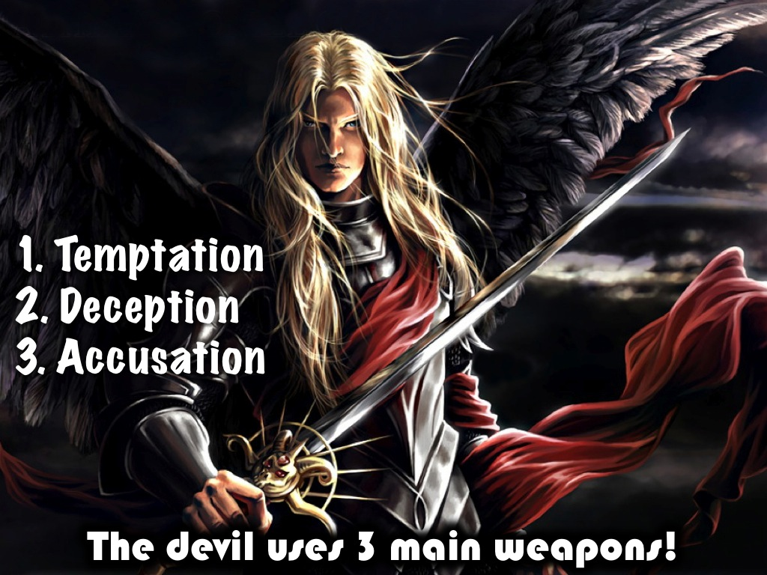
Notes:
The devil our number one enemy uses three main weapons:
(1) Temptation: Trying to persuade us or get us to do what doesn’t please God
(2) Deception: misleading us or uses false information to trick us
(3) Accusation: wrongly charging us for things we have not done

Slide 16
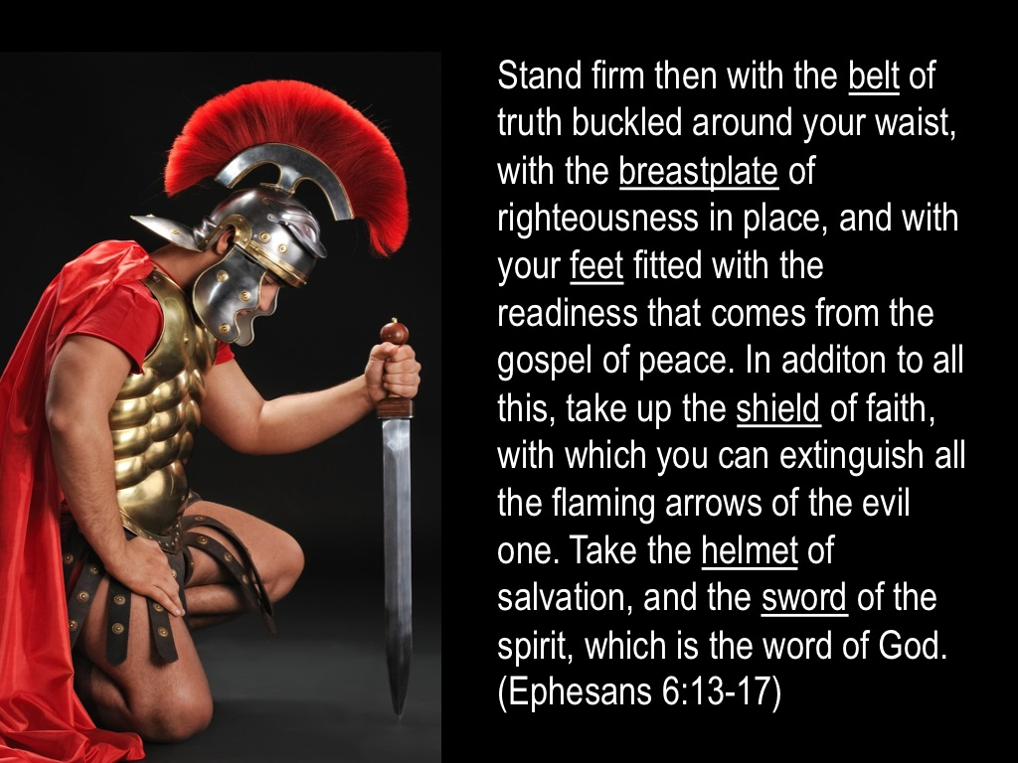
Notes:
The bible encourages us to be ready to engage in spiritual warfare: Eph 6:13-17 – Stand firm then with the belt of truth buckled around your waist, with the breastplate of righteousness in place, and with your feet fitted with the readiness that comes from the gospel of peace. In addition to all this, take up the shield of faith, with which you can extinguish all the flaming arrows of the the evil one. Take the helmet of salvation, and the sword of the spirit, which is the word of God. (NIV)

Slide 17
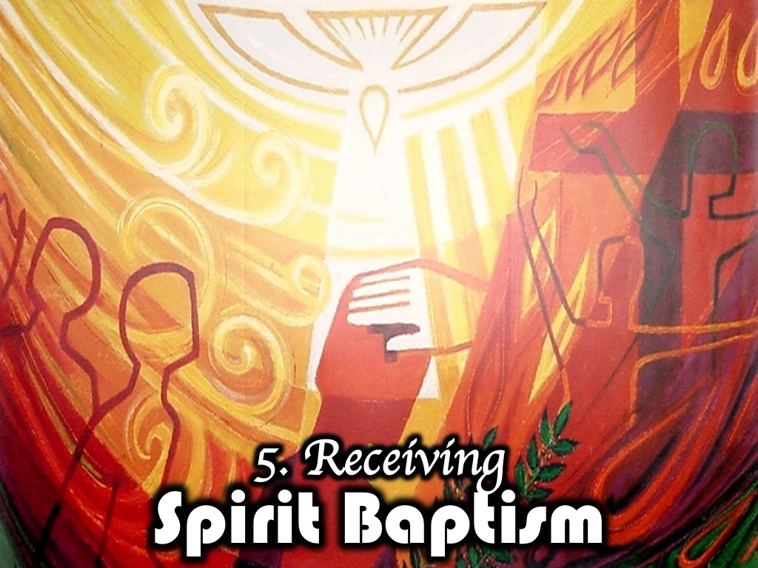
Notes:
5. Receiving Spirit Baptism.

Slide 18

Notes:
Before Jesus was crucified he told his disciples that he would leave them a helper. Someone to help them in his absence – The Holy Spirit. The Holy Spirit is a “Promise” that we all have access to if we simply “Request” and God has promised that we will “Receive” his Holy Spirit if we ask.

Slide 19
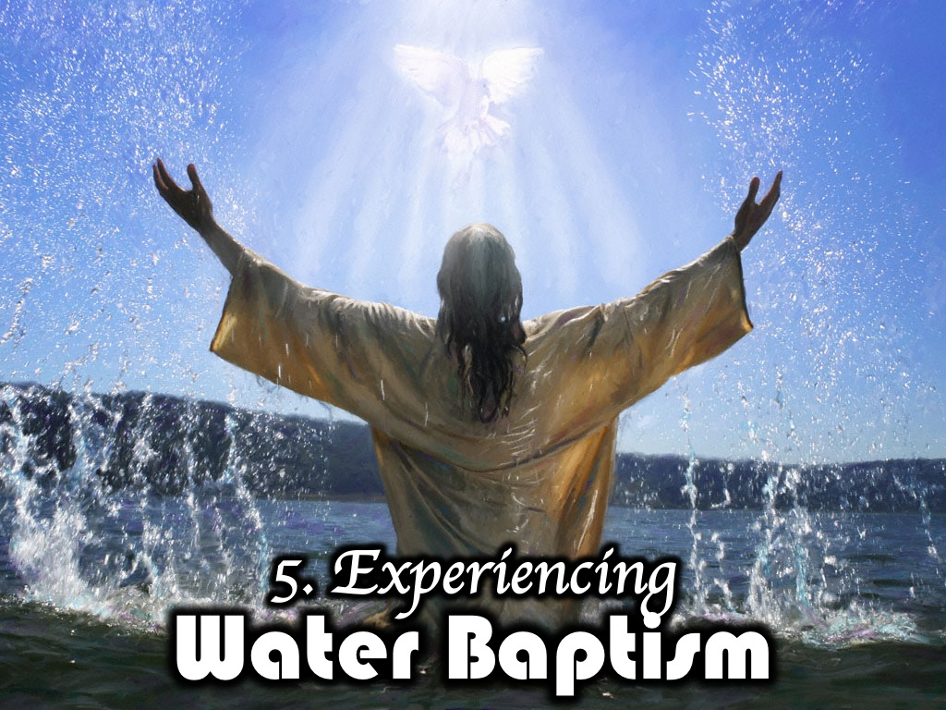
Notes:
6. Experiencing Water Baptism. Baptism is an outward symbol of an inward commitment. It’s a reflection of of Christ’s burial and resurrection and in the same way we have died to our sin and have been raised into new life with Christ as our Lord and savior.

Slide 20
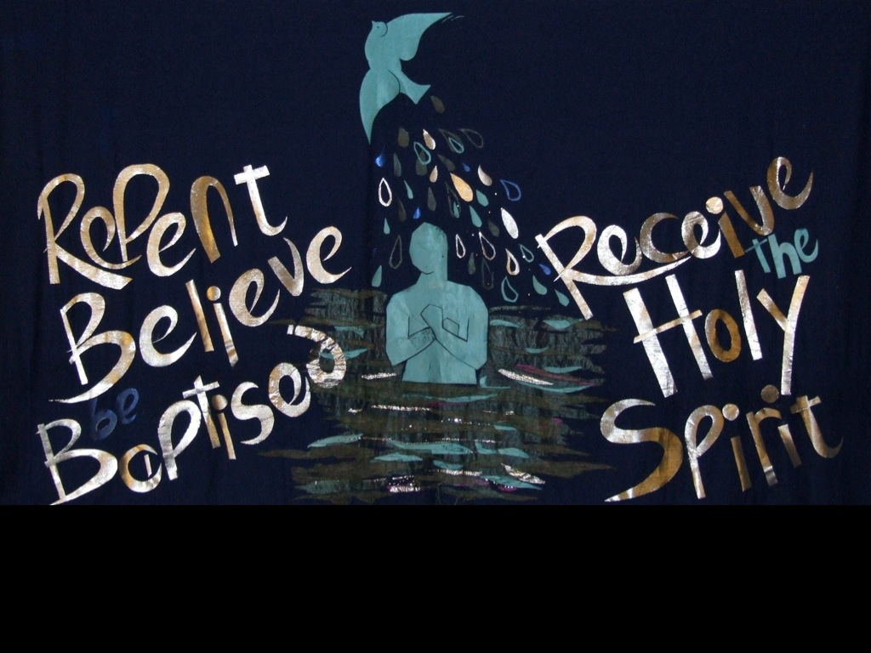
Notes:
In the New Testament here is what becoming a Christ-follower looked like: repent, believe, be baptised and receive the Holy Spirit.

Slide 21
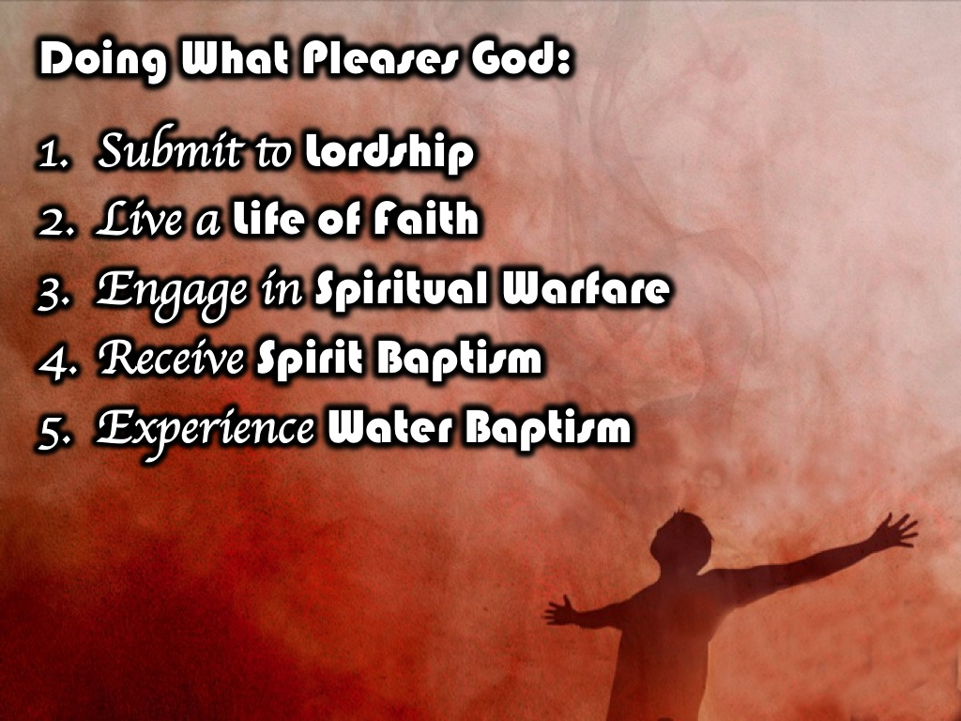
Notes:
So in summary doing what please God means that you: Submit to Lordship, Live a Life of Faith, Engage in Spiritual Warfare, Receive Spirit Baptism and Experience Water Baptism.

Slide 22
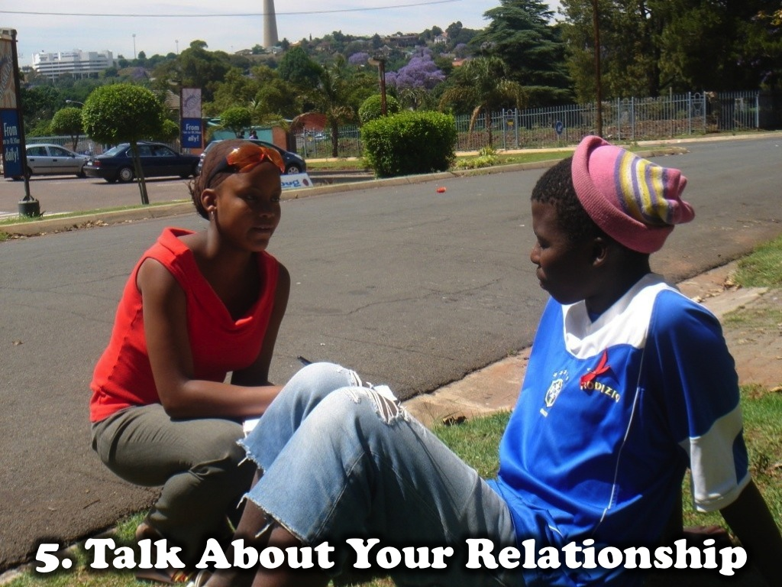
Notes:
Next week we will see how to grow our relationship with Jesus by Talking About Our Relationship with Jesus.

