Slide 1
Notes:
The Establish Series. This series has been designed to help you deepen your walk with Jesus as you continue on your discipleship journey. You will explore seven practises that will help you grow spiritually. The practises are:
1. Making Jesus Lord
2. Having Daily Devotions
3. Practising God’s Presence
4. Living by Faith
5. Handling Money Wisely
6. Becoming a Disciplemaker
7. Developing Spiritual Family

Slide 2
Notes:
Session 1 is all about Making Jeus Lord.

Slide 3
Notes:
Sharing: (1) Who has made the biggest influence on your life? (2) How did they influence you?

Slide 4
Notes:
Read: Then Jesus came to them and said, "All authority in heaven and on earth has been given to me. Therefore go and make disciples of all nations.” (Matthew 28:18-19)
Reflect: (1) How much authority has God given Jesus? (2) Where does Jesus have authority?(3) Does Jesus have authority over: The Police? Presidents? Satan? Angels?

Slide 5
Notes:
Read: “God exalted him to the highest place and gave him the name that is above every name, that at the name of Jesus every knee should bow, in heaven and on earth and under the earth, and every tongue confess that Jesus Christ is Lord, to the glory of God the Father.“ (Philippians 2:9-11)
Reflect: (1) Who exalted Jesus? (Verse 9). (2) What did God give Jesus (Verse 9). (3) Who will one day bow before Jesus? (Verse 10). (4) What will every tongue confess? (verse 11)

Slide 6
Notes:
Read: “For by him all things were created: things in heaven and on earth, visible and invisible, whether thrones or powers or rulers or authorities; all things were created by him and for him. He is before all things, and in him all things hold together. And he is the head of the body, the church; he is the beginning and the firstborn from among the dead, so that in everything he might have the supremacy.” (Colossians 1:16-18)
Reflect: (1) What did Jesus create? (2) What holds together in Jesus?

Slide 7
Notes:
You have probably heard a kid say: “You are not the boss of me!’

Slide 8
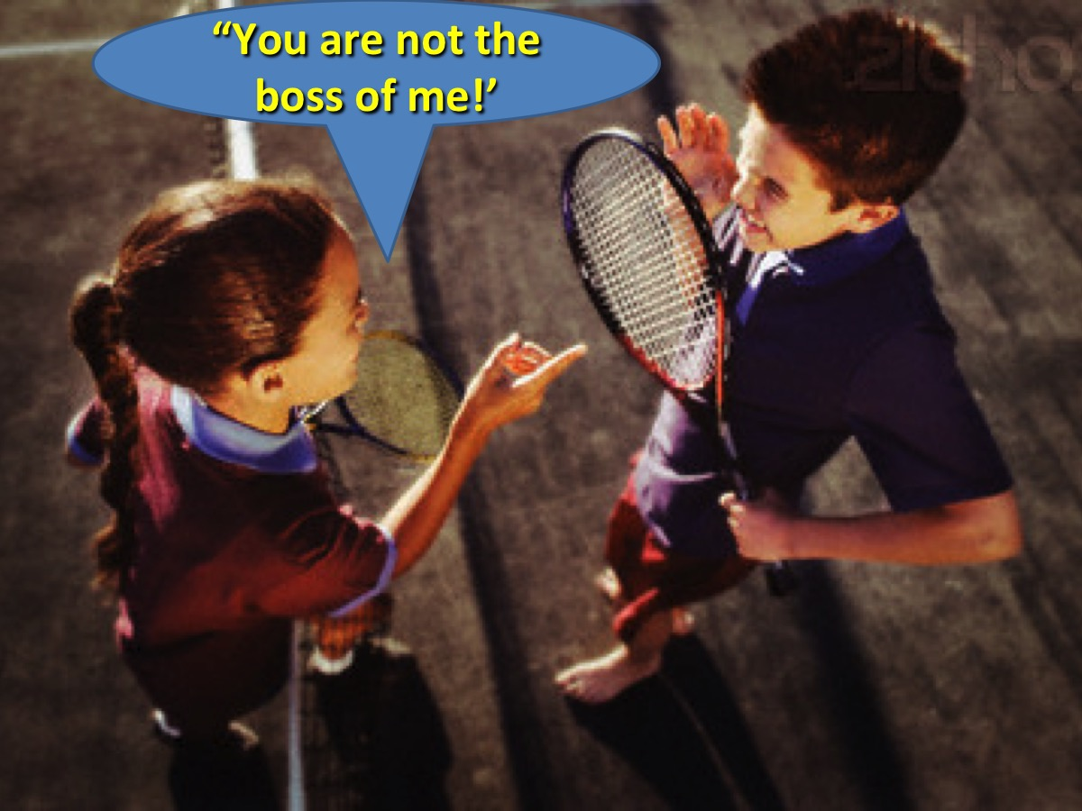
Notes:
Well, Lordship is letting Jesus be the boss of me!

Slide 9
Notes:
These cars have something in common…

Slide 10
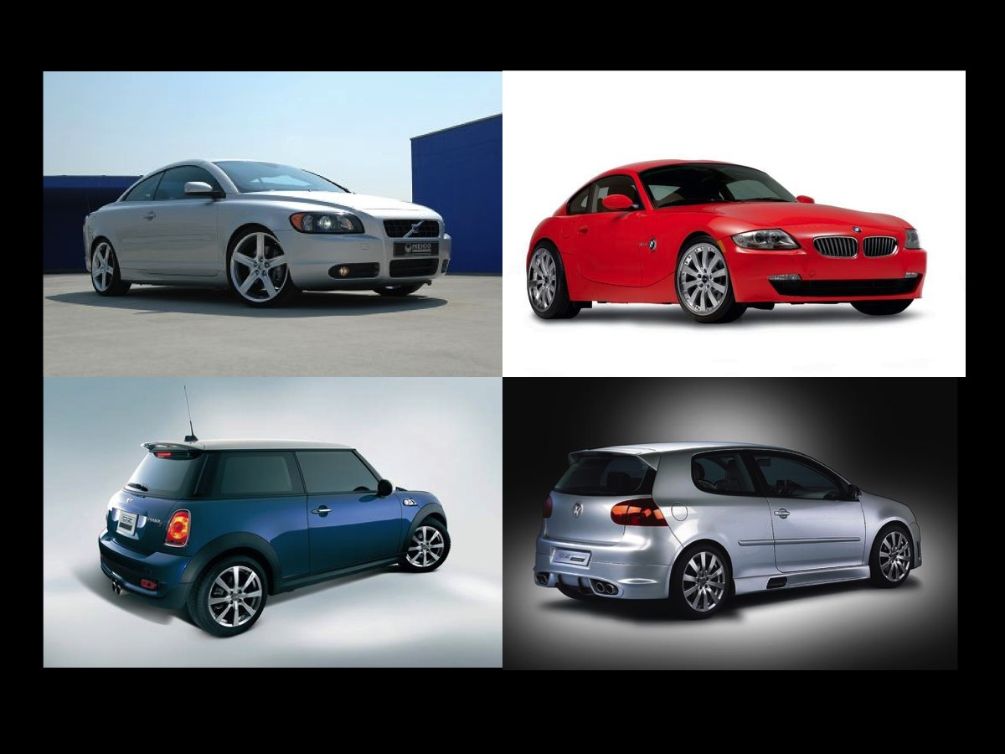
Notes:
Very special rims! O-Z Michelangelo rims.

Slide 11
Notes:
Our lives have spokes like the rim - different parts that need to be held together!

Slide 12
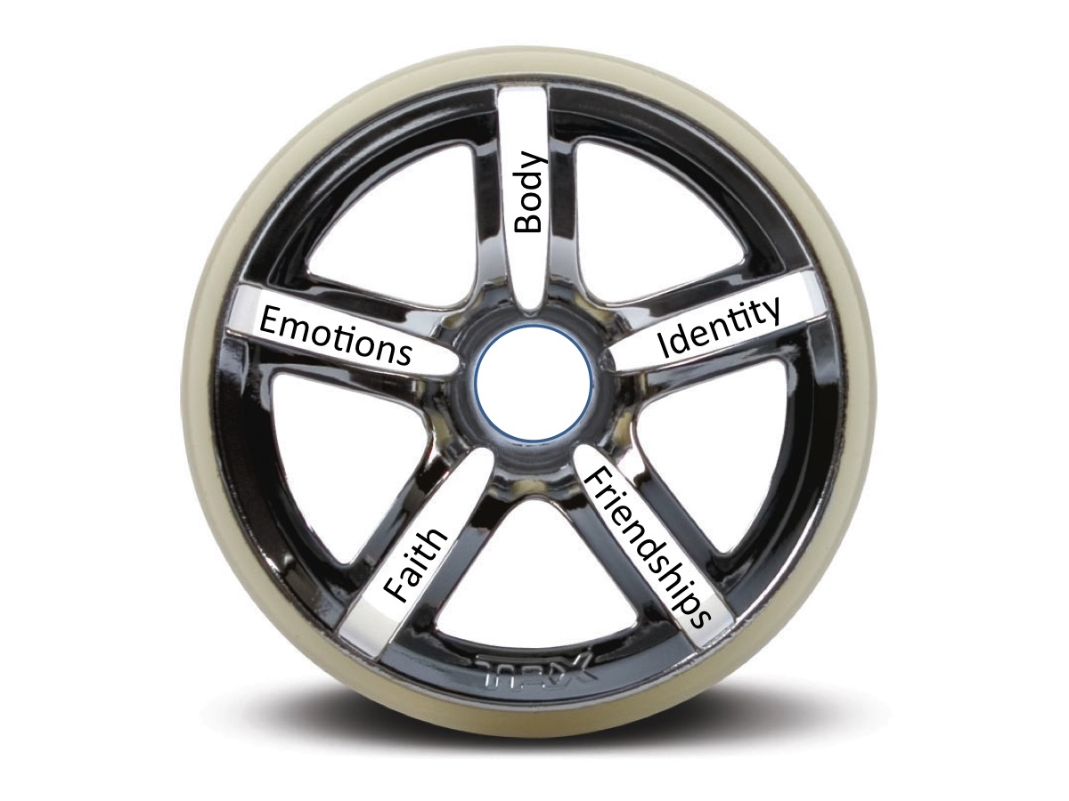
Notes:
We need to put Jesus at the center of our lives!

Slide 13
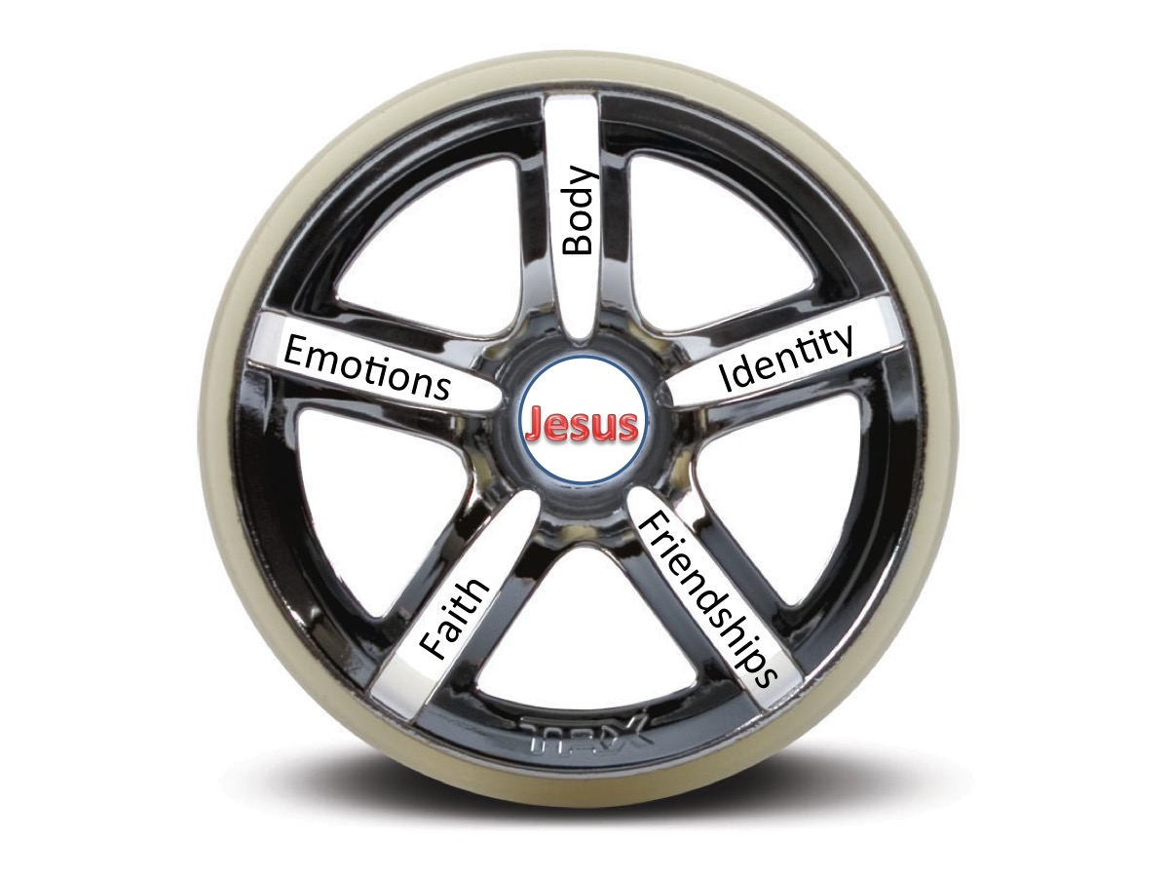
Notes:
We need to put Jesus at the center of our lives!

Slide 14
Notes:
Lordship is making Jesus the centre of my life

Slide 15
Notes:
Do you know how to catch a monkey? (1) Make a hole in the ground the size of a small hand.

Slide 16
Notes:
(2) Fill the hole with treats and wait for a monkey to arrive.

Slide 17
Notes:
(3) Watch the monkey grab the bait and refuse to let go!

Slide 18
Notes:
(3) Watch the monkey grab the bait and refuse to let go!

Slide 19
Notes:
Lordship is a voluntary act

Slide 20
Notes:
Salvation is a one time thing! Lordship is a daily thing! "If anyone would come after me, he must deny himself and take up his cross daily and follow me.” (Luke 9:23)

Slide 21
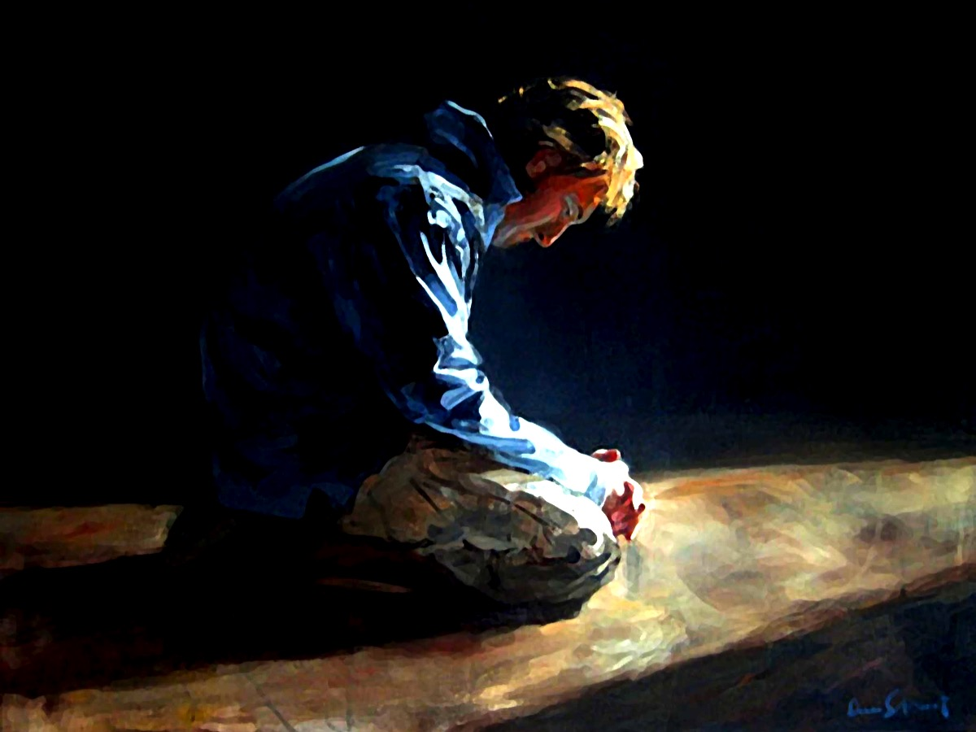
Notes:
Prayer

