Slide 1
Notes:
Today we are going to explore the practise of having daily devotions!

Slide 2
Notes:
Discuss in Pairs: If you could schedule an appointment with anyone in the world – who would you choose, and why?

Slide 3
Notes:
Questions on Mark 1:35 – When did Jesus get up? Where did he go? What did he do?

Slide 4
Notes:
What is the state of your daily time with God. How regular are they? How many times in the last week did you set aside time to meet with God during the day?

Slide 5
Notes:
During the early days of the gospel coming to East Africa where people were living in small villages…

Slide 6
Notes:
People would wear a path from their hut in the village to a spot in the jungle where they would meet with God each day to have daily devotions.

Slide 7
Notes:
The villagers developed a gentle rebuke for their peers: “The grass grows long on your path”. How short is the grass on your path to God? Are you wearing a regular path to meet with God?

Slide 8
Notes:
I want to challenge you to take your time with God seriously for two reasons:

Slide 9
Notes:
(1) God wants to have a love relationship with you.

Slide 11
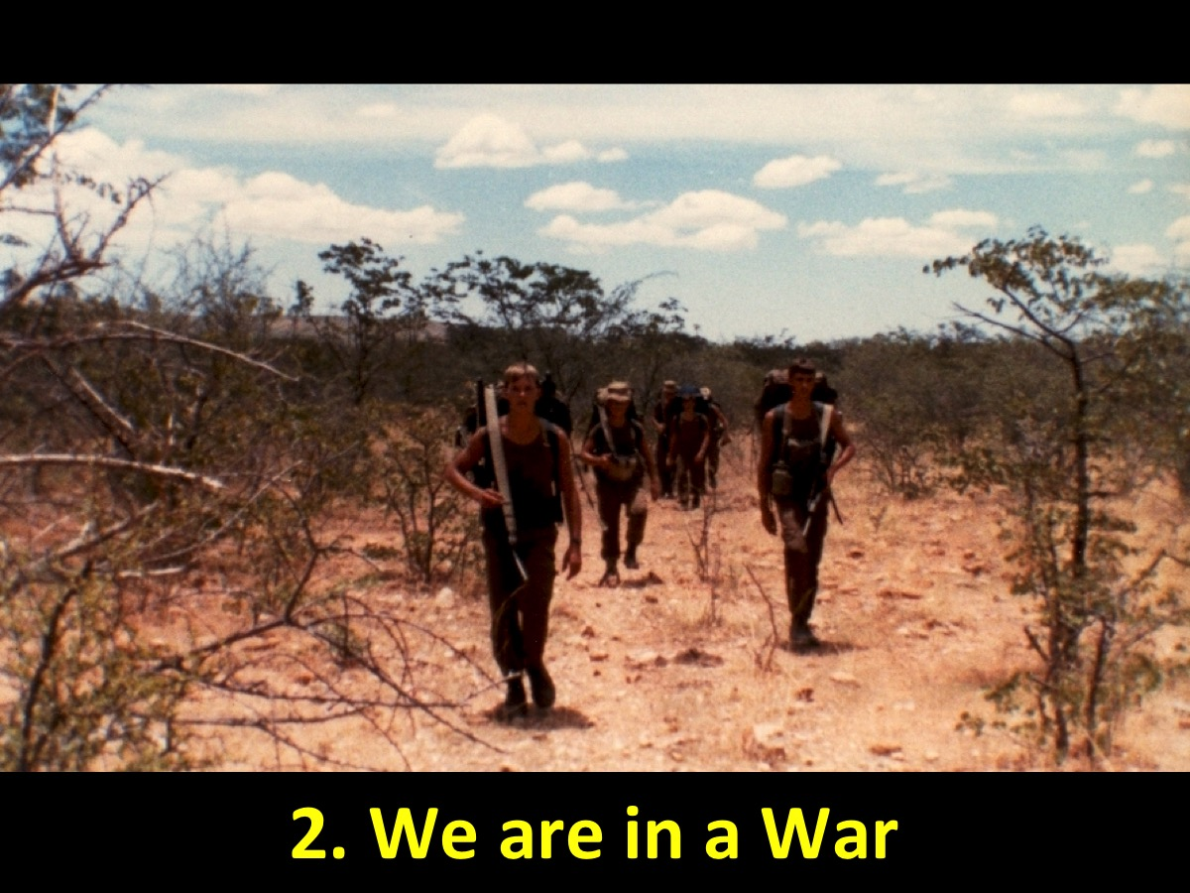
Notes:
(2) We are in a war! We need to put on our armour to be able to overcome the attacks of the evil one!

Slide 12
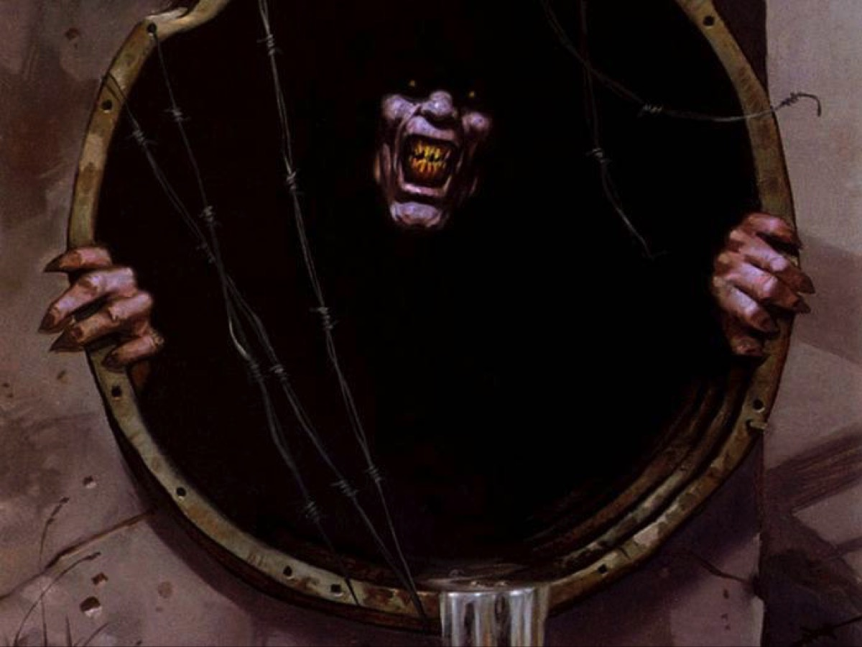
Notes:
The evil one is alive and well on planet earth!

Slide 13
Notes:
So, how do we actually go about having a time each day with God? Here are five things you should do to get going…

Slide 14
Notes:
It is too dangerous to stay in a warm bed on a cold winter morning – you need to get up, wash your face and maybe get a cup of coffee.

Slide 15
Notes:
Find a place that you can use on a regular basis to meet with God. Make sure there are no distractions in the room.

Slide 16
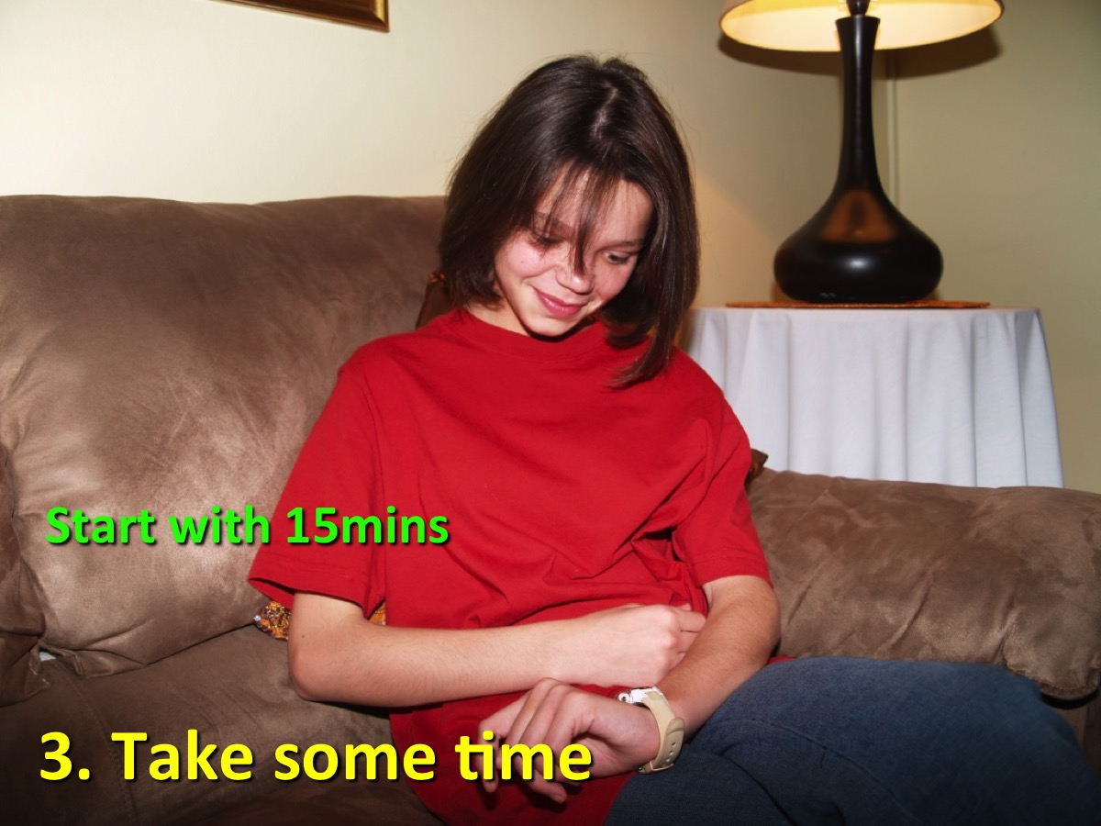
Notes:
Don’t start out by aiming for an hour or more – just start with something doable, like 15 minutes.

Slide 17
Notes:
Make sure you have all you need for your time with God – a modern translation of the Bible is essential, a notebook in which you can journal your thoughts and a pen you can use to write down what you learn from your time with God.

Slide 18
Notes:
Before your launch in to your reading, spend a few minutes settling down in God’s presence then express your desire to meet with God in this time and then you can use your SOAP! What???

Slide 19
Notes:
SOAP is a structure for your daily devotions

Slide 20
Notes:
Here is an example page from my daily devotions – it was done on Friday morning this week.

Slide 21
Notes:
I want to lead you in a commitment before God – that you will put aside 15mins each day to meet with God!

