Slide 1
Notes:
Today we are going to talk about our fourth practise – living by faith.

Slide 2
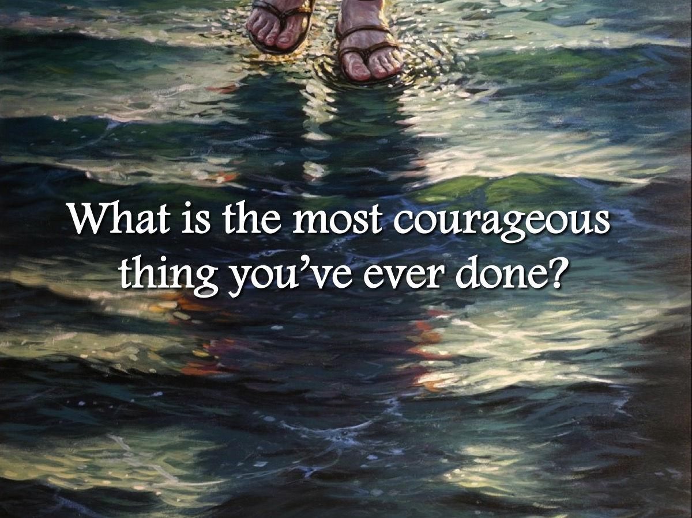
Notes:
Turn to someone next to you and talk about the most courageous thing you have ever done!

Slide 3
Notes:
Faith is the lifestyle of the Righteous: (1) The righteous will live by faith (Rom 1:17); (2) My righteous one will live by faith (Heb10:38); (3) We live by faith nor by sight (2 Cor 5:7); (4) I live by faith in the Son of God (Gal 2:20).

Slide 4
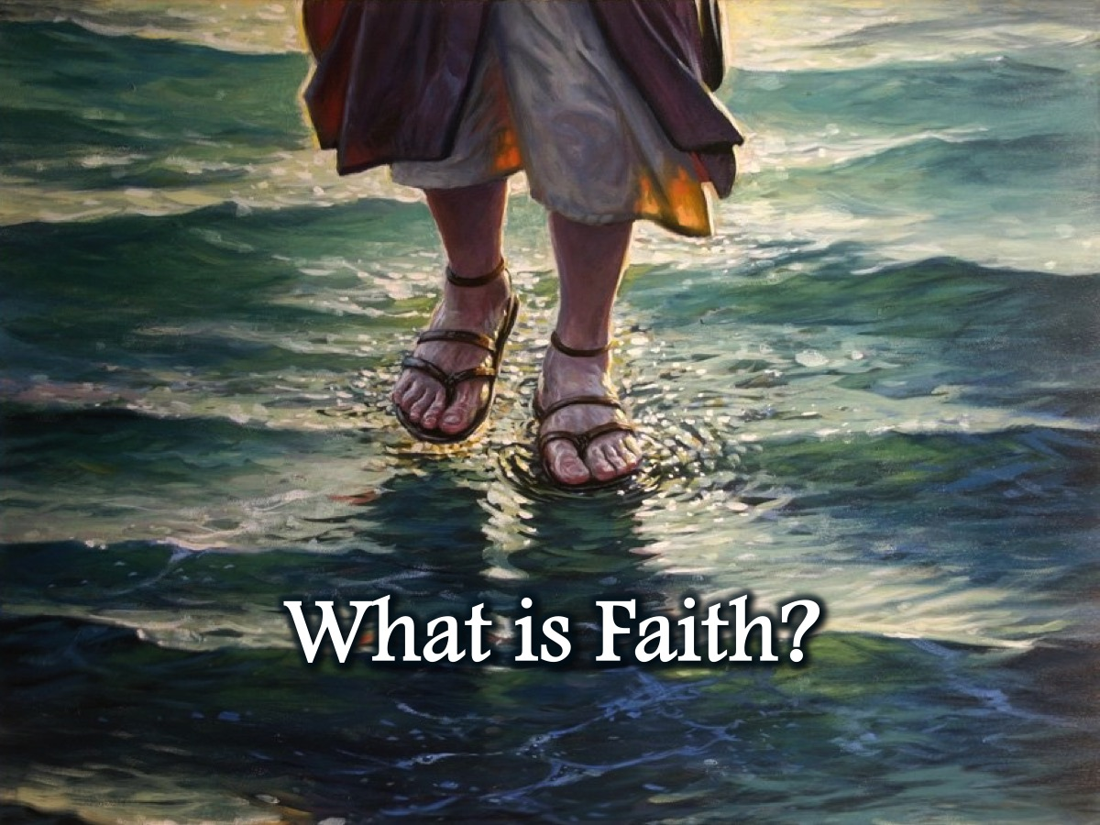
Notes:
What is Faith?

Slide 5
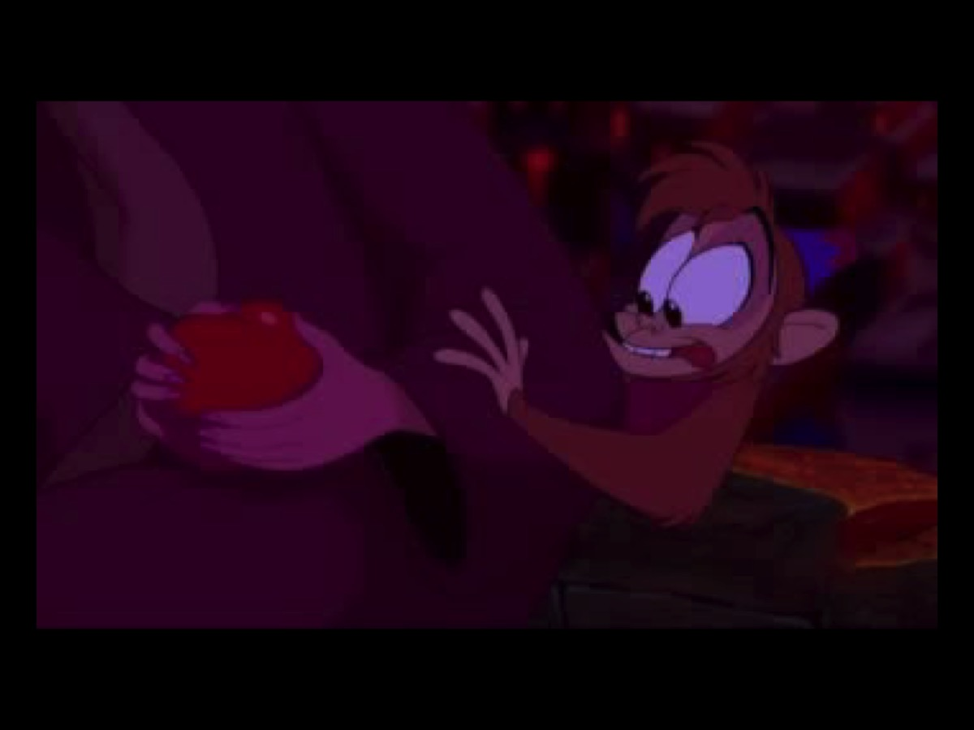
Notes:
Video: Alladin – To escape danger, Alladin asks Jasmine to take his hand and trust him as they leap off the balcony and later he asks her to trust him as he takes her on a ride on his magic carpet. And each time she demonstrates faith in him.

Slide 6
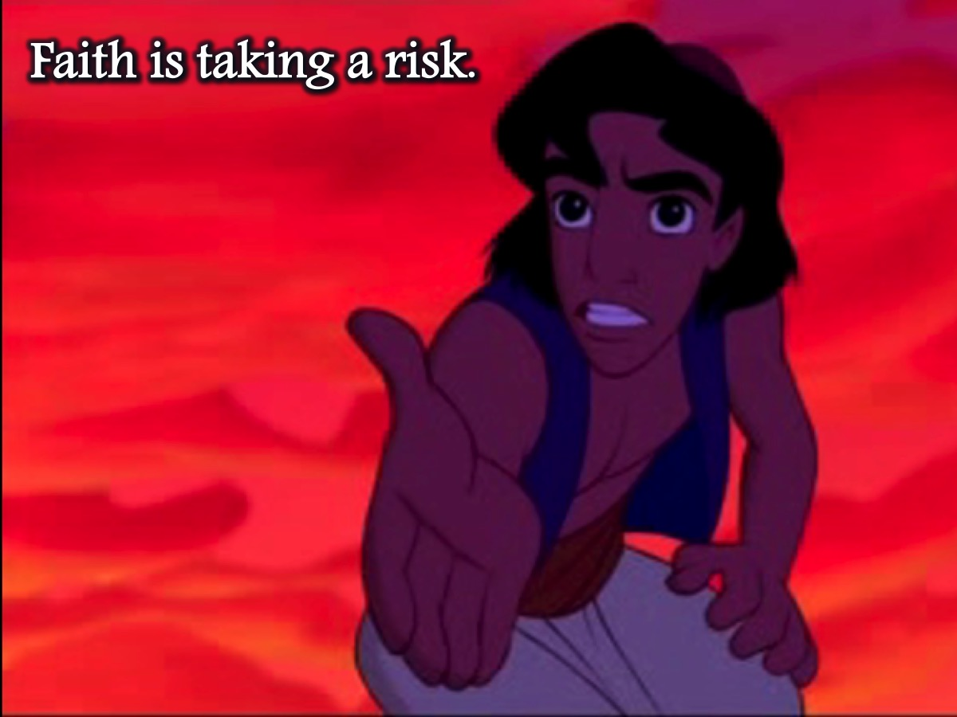
Notes:
What is faith? Faith is taking a risk.

Slide 7
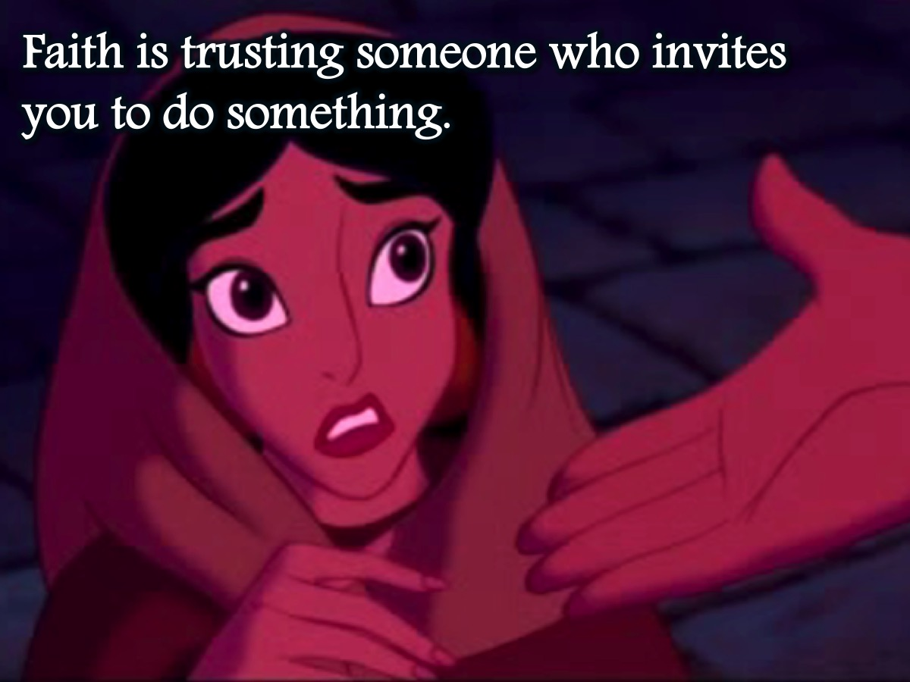
Notes:
What is faith? Faith is trusting someone who invites you to do something.

Slide 8
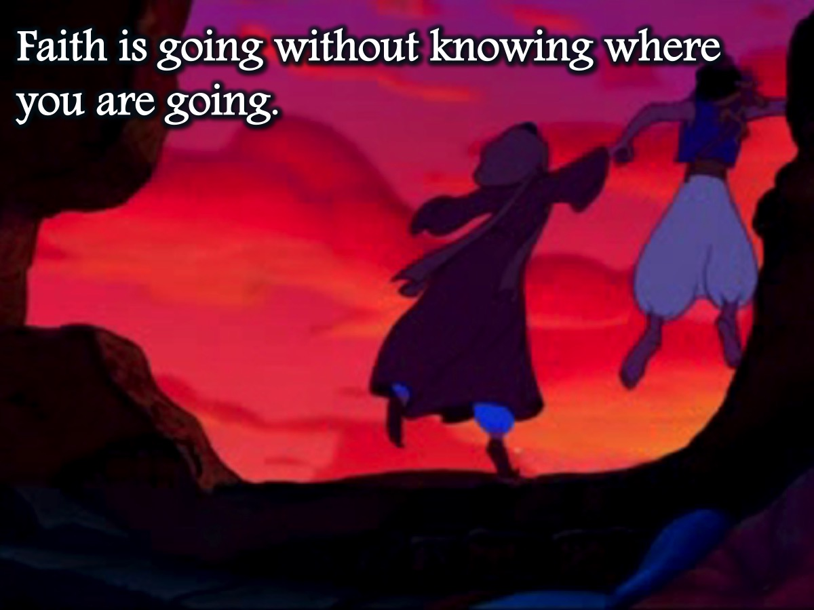
Notes:
What is faith? Faith is going without knowing where you are going.

Slide 9
Notes:
What is faith? Faith is believing God’s Word, obeying it and watching God fulfil it.

Slide 10
Notes:
What is faith? Faith is believing and trusting in the character and ability of God.

Slide 11
Notes:
Sick Woman: Faith is knowing the heart of God and acting from a position of relationship. Luke 8:43-48.

Slide 12
Notes:
Ostrich! Faith is not sticking your head in the sand hoping the horrible world will go away. It does not deny reality but believes that God is able to change circumstances by His promises and power.

Slide 13
Notes:
How Do We Grow Our Faith? (1) Feed on the Word, (2) Speak out the Word, and (3) Act on the Word.

Slide 14
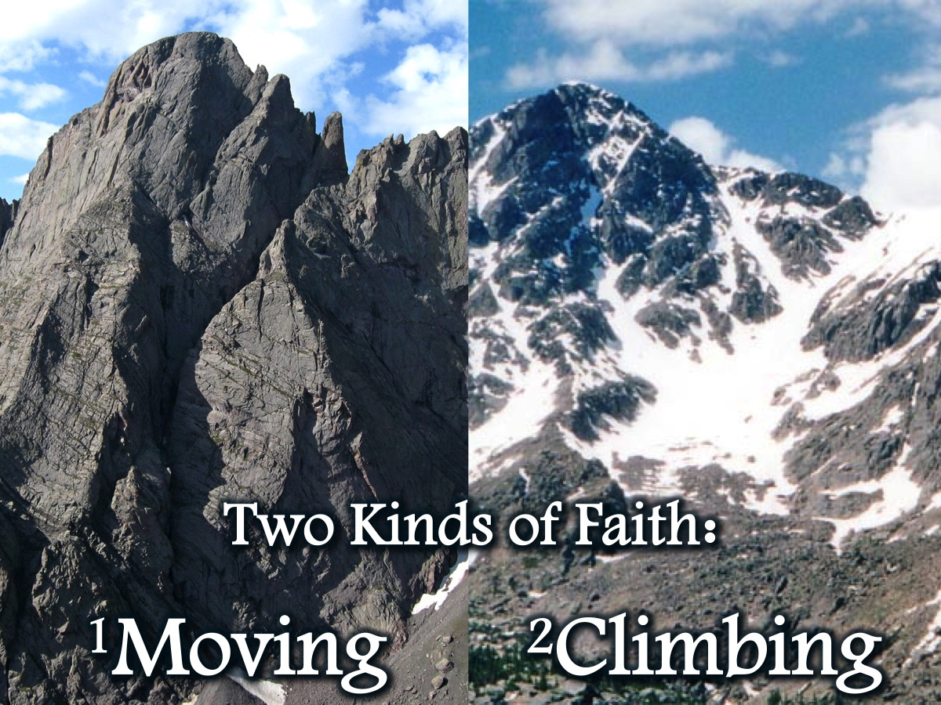
Notes:
Two Kinds of Faith: There are two kinds of faith that we need in our lives: faith to move mountains and faith to climb mountains.

Slide 15
Notes:
1. Mountain Moving Faith: One kind of faith is called mountain-moving faith.

Slide 16
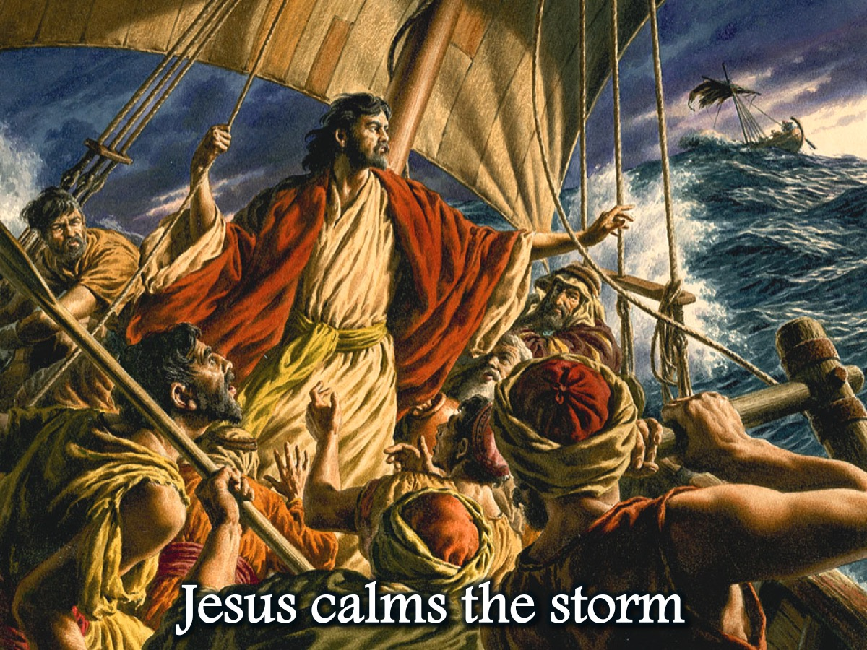
Notes:
Jesus calms the storm: Jesus showed faith that moves mountains when he calmed the storm.

Slide 17
Notes:
We are called to have mountain-moving faith: If you have faith as small as a mustard seed, you can say to this mountain, 'move from here to there' and it will move. nothing will be impossible for you. (Matt 17:17-20)
A mountain is any problem or obstacle – like a financial need or disease.

Slide 18
Notes:
How do we release mountain moving faith? It takes (1) Confession and (2) Action.

Slide 19
Notes:
(1) Confession: Speak To The Mountain. "If you have faith as small as a mustard seed, you can SAY to a tree, ‘be uprooted and planted in the sea,' and it will obey you.” (Luke 17:6). Speak to the mountain - don’t complain about it, wish it was gone, or even pray and ask God to move it. Take authority over it and command it to be moved!

Slide 20
Notes:
(4) Action: Take Action in Line With Faith. “Faith by itself is dead, if it is not accompanied by action…I will show you my faith by what I do.” (James 2:17-26). Faith and actions work together - we have to act on our beliefs:

Slide 21
Notes:
Joshua: Joshua marched his army around a city for 7 days before the walls fell down. (Joshua 6:16)

Slide 22
Notes:
David: David picked up five smooth stones, walked up to Goliath and use his sling to slay the giant. (1 Samuel 17:49)

Slide 23
Notes:
What do you do when faith doesn’t move the mountain? Put on your hiking shoes! That’s where mountain climbing faith comes in!

Slide 24
Notes:
# 2 - Mountain Climbing Faith: The second kind of faith is mountain-climbing faith.

Slide 25
Notes:
Jesus invites Peter to walk on water: Mountain climbing faith is what Peter showed when he walked on the water – and even though he got a bit wet – he still showed faith to actually walk on water!

Slide 26
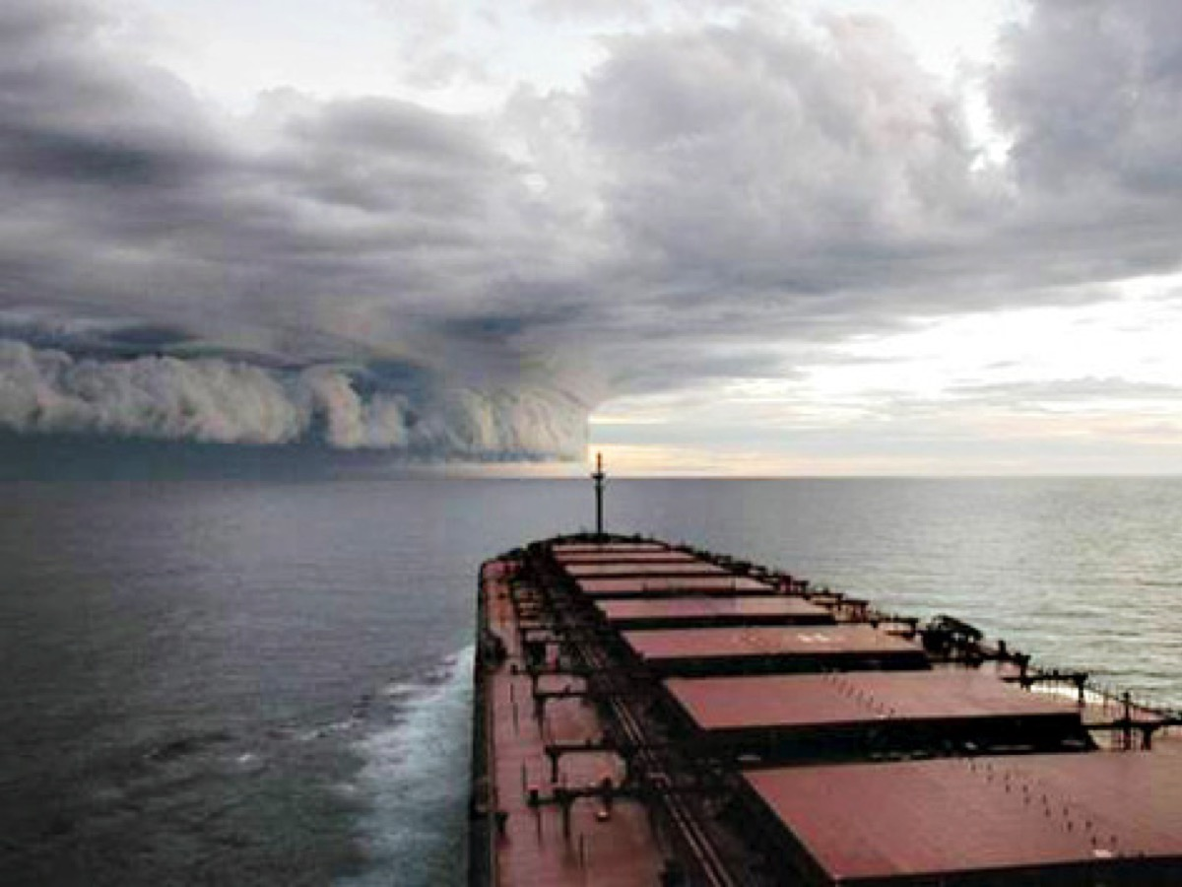
Notes:
Boat heading into a storm: Mountain climbing faith is the ability to head into a storm with confidence – knowing that Jesus will be with you and he will do whatever is needed to bring you through it safely.

Slide 27
Notes:
What do you do when your faith doesn’t move the mountain? (1) Persevere. (2) Get others to believe with you. (3) Climb the mountain instead of trying to move it.

Slide 28
Notes:
Daniel : God did not stop Daniel getting thrown into the den with the hungry lions – but he did keep him safe throughout the night and protected him from harm! (Daniel 6:23)

Slide 29
Notes:
Peter: Peter got out of the boat and walked on the water. (Matthew 14:29)

Slide 30
Notes:
Get Out Of The Boat: If you want to walk on water you have to get out of the boat.

Slide 31
Notes:
Ministry Time: (1) Faith to move mountains – ask teens to think of a mountain in their life and to speak to it and decide on action they need to take. (2) Faith to climb mountains – ask teens to think of a mountain that won’t move and ask God for grace to endure the climb!

