Slide 1
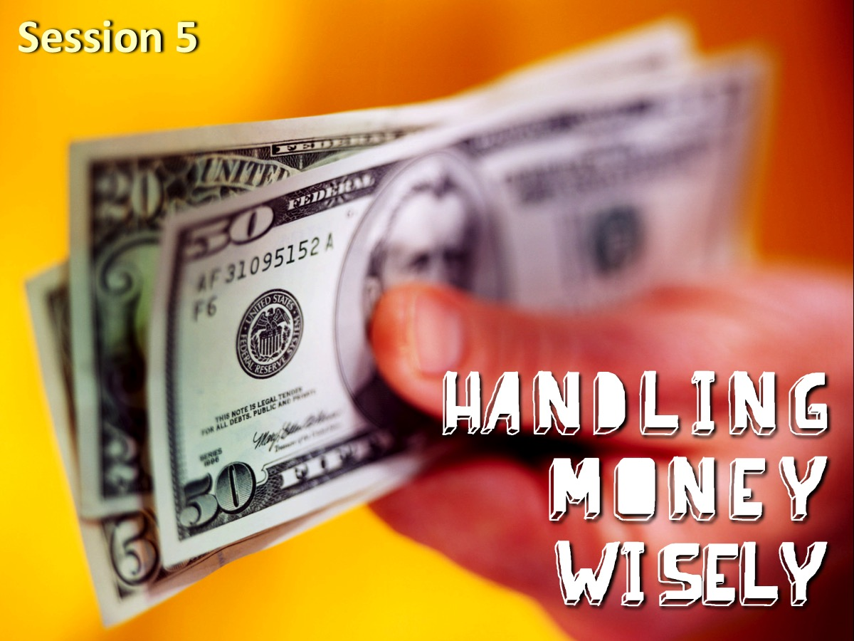
Notes:
Session 5: This week we are looking at the fifth practise: Handling Money Wisely!

Slide 2
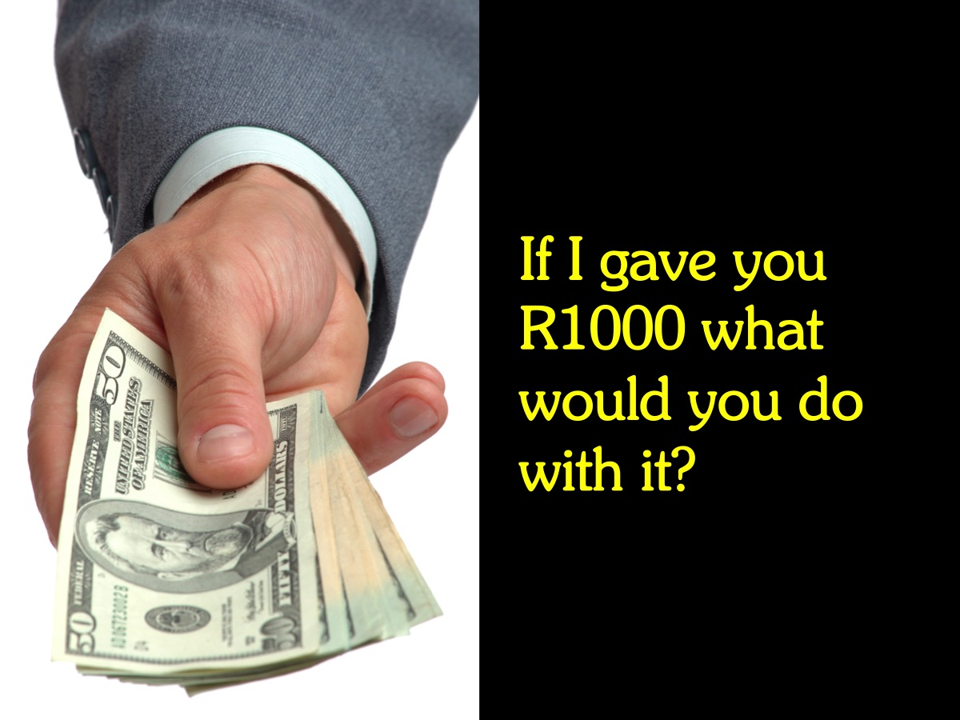
Notes:
Discuss: If I gave you R1000 what would you do with it?

Slide 3
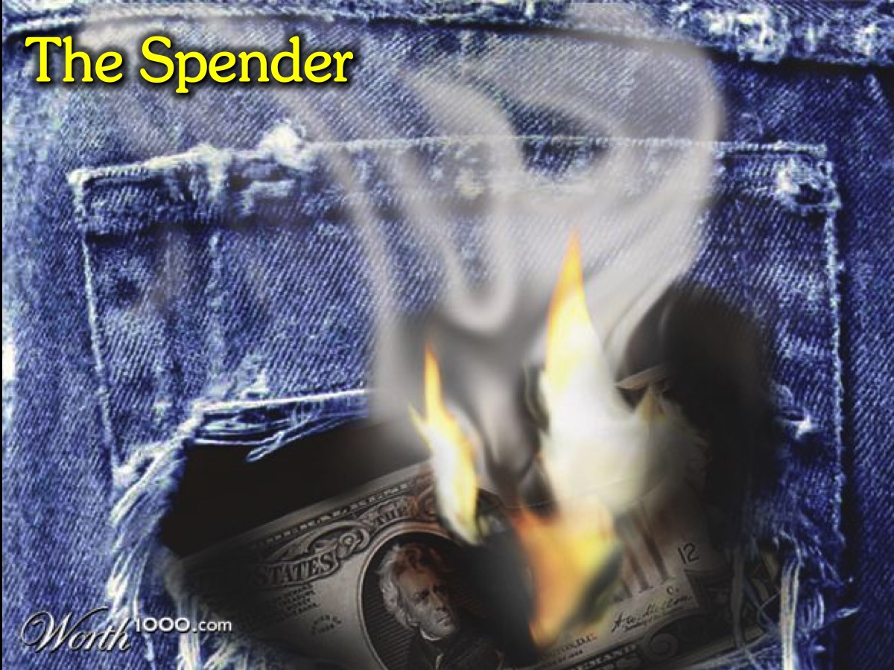
Notes:
The Spender: There are two kinds of people in the world – for one money burns a hole their pocket and they have to spend it as soon as they get it.

Slide 4
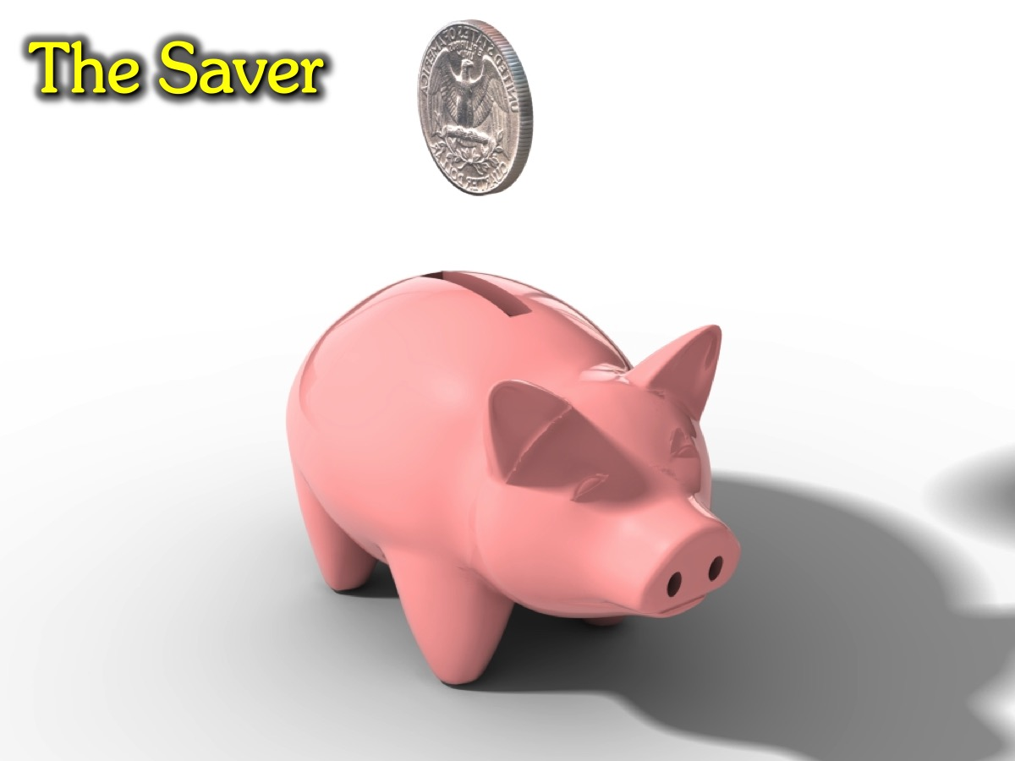
Notes:
The Saver: For the other, money is something to put away and let it build into a sizeable amount so they can buy something they really want that costs more.

Slide 5
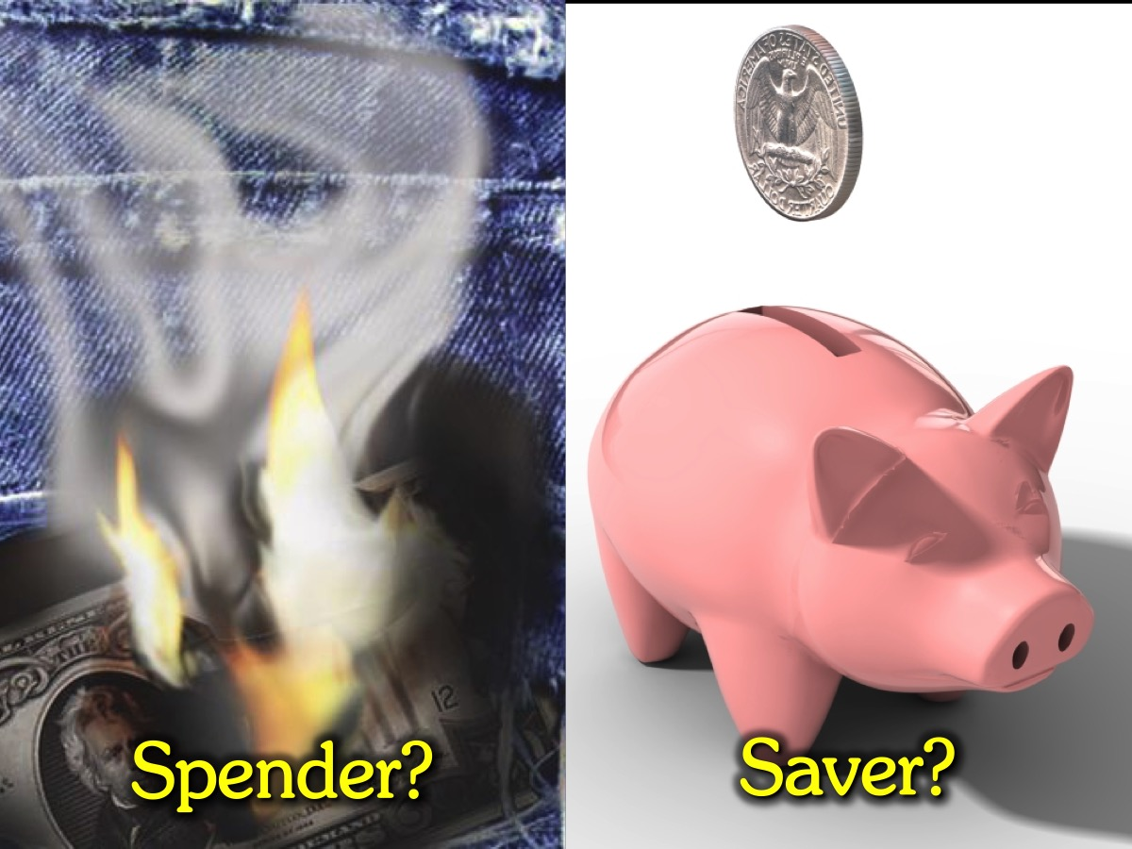
Notes:
Discuss: So are you a spender or a saver?

Slide 6
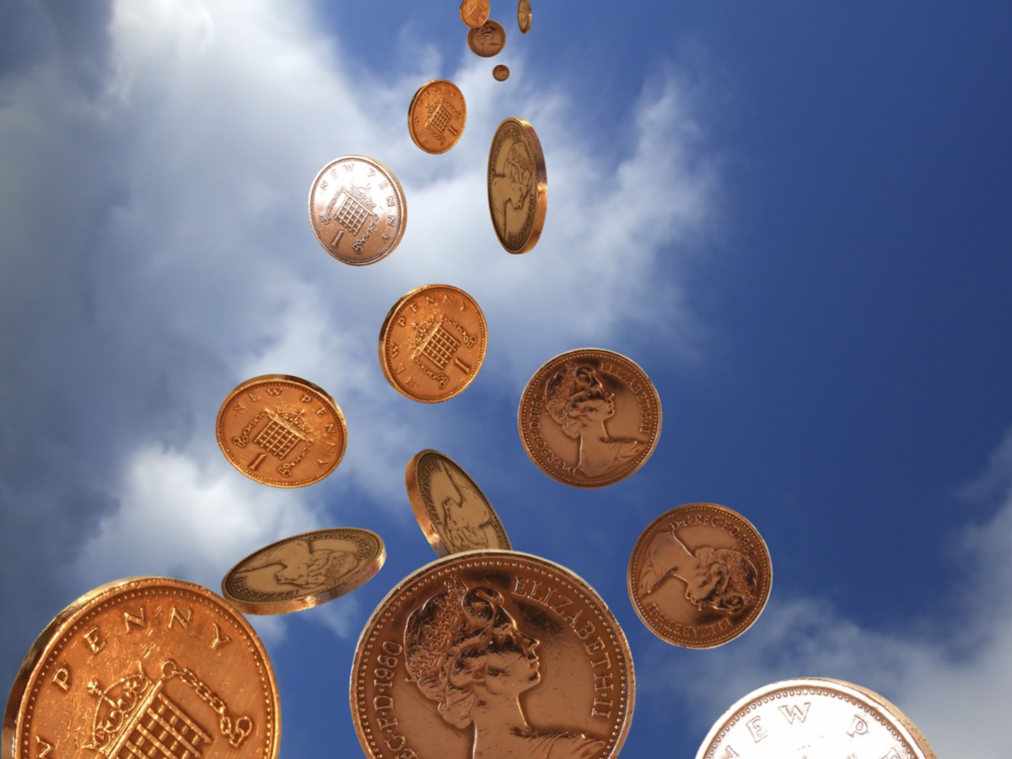
Notes:
Money From the Sky: I grew up with a mom who believed that her ship would come in one day and we would be rich – she entered all kinds of competitions – Edgars use to run a luck draw competition that and a big payout – she never won a cent and we are still waiting for her ship to arrive in the Durban harbour!

Slide 7
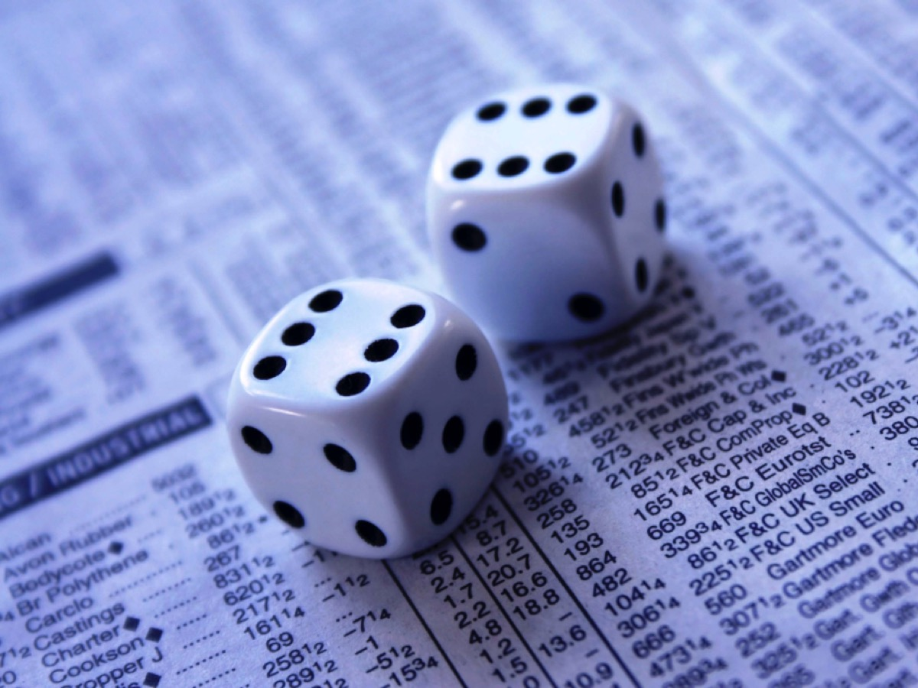
Notes:
Luck is not the Answer: You can’t live your life hoping that the roll of a dice will bring your wealth. We play a dice game at home called Farkle – and it is all about greed – you will either get a lot more points or go bust depending on whether you choose to roll again or stick. 95% of the time we end up with a Farkle – a bust!

Slide 8
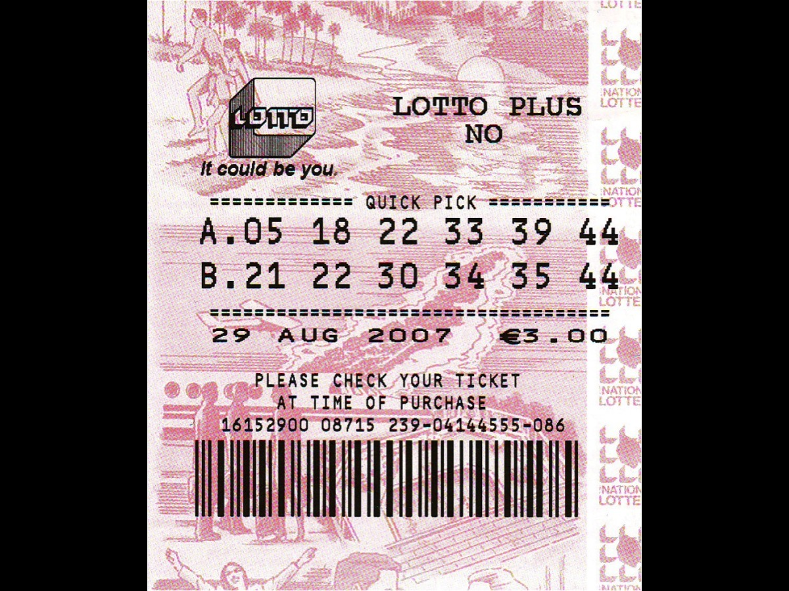
Notes:
Lotto is not the Answer: It has even less odds than playing dice!

Slide 9
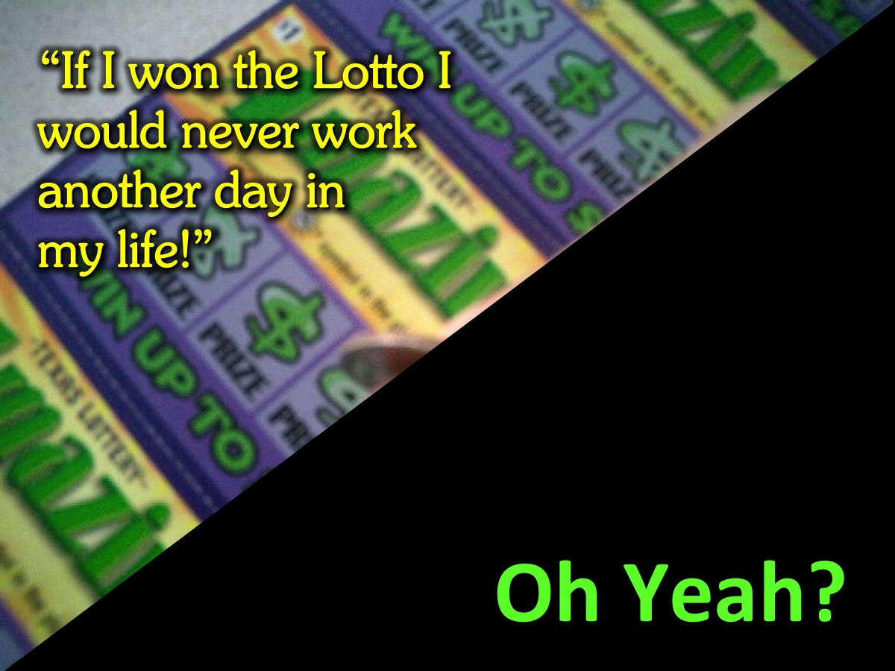
Notes:
You May Say: “If I won the Lotto I would never work another day in my life.” – Oh yeah?

Slide 10
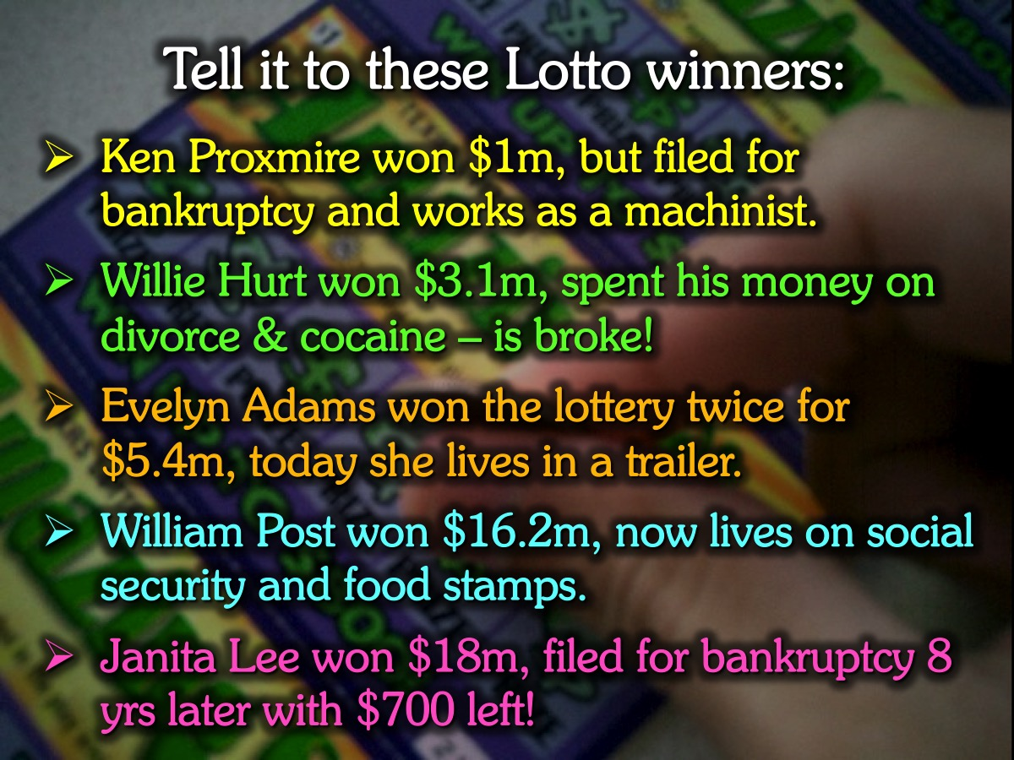
Notes:
Tell it to these Lotto winners: (1) Ken Proxmire won $1m, but filed for bankruptcy and works as a machinist. (2) Willie Hurt won $3.1m, spent his money on divorce and cocaine – is now broke! (3) Evelyn Adams won the lottery twice for $5.4m, today she lives in a trailer. (4) William Post won $16.2m, now lives on social security and food stamps. (5) Janita Lee won $18m, filed for bankruptcy 8 yrs later with $700 left!

Slide 11

Notes:
You May Say: “If I was a millionaire I would be really, really happy!” Oh yeah?

Slide 12
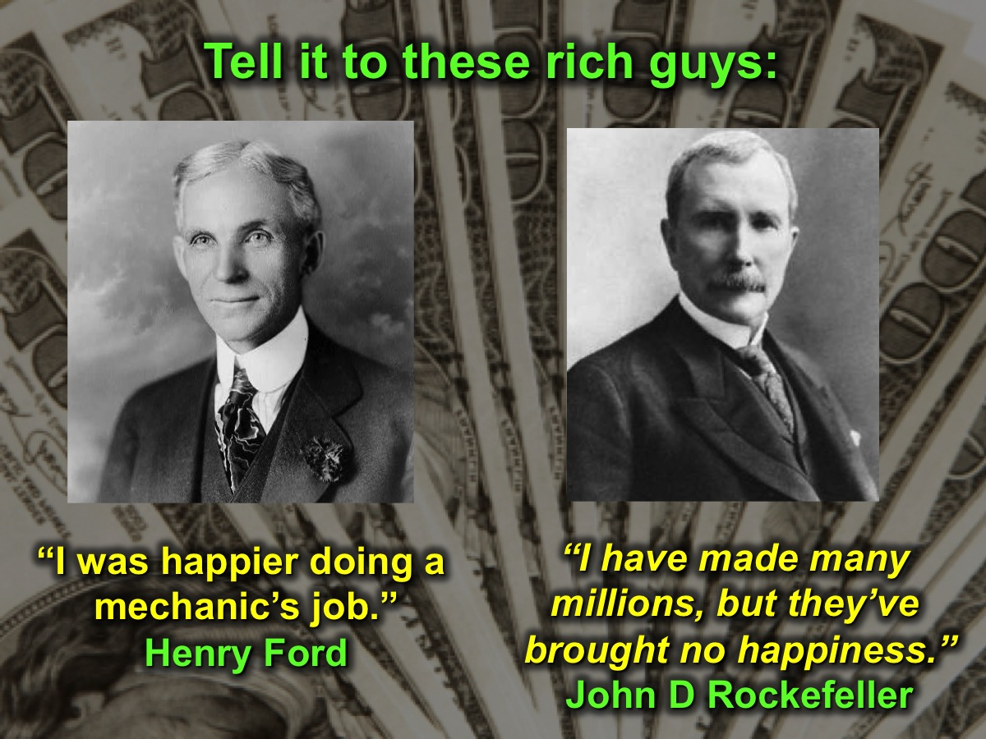
Notes:
Tell it to these rich guys: “I was happier doing a mechanic’s job.” (Henry Ford); “I have made many millions, but they have brought me no happiness.” (John D Rockefeller) - The wealth they dreamed would bring them happiness brought them nothing but misery. We think we own our possessions, but too often they end up owning us!

Slide 13

Notes:
You May Say: “If I can just go shopping I’ll feel great!” Oh Yeah!

Slide 14

Notes:
Until Buyers Remorse Hits! That unhappiness you feel after you have made the purchase.

Slide 15
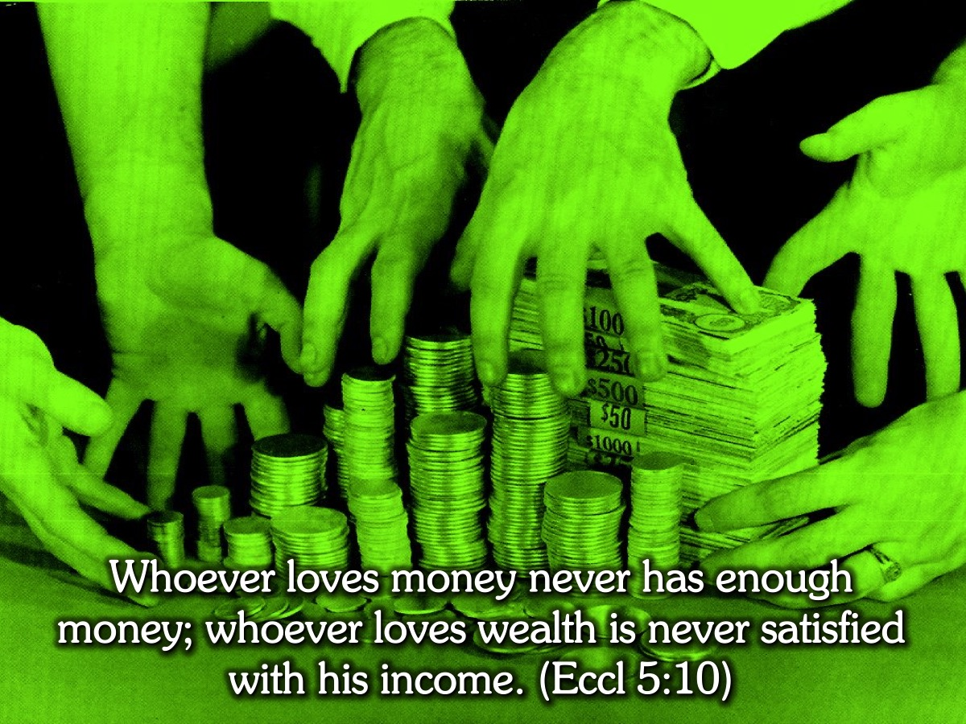
Notes:
The Bible says: “Whoever loves money never has enough money; whoever loves wealth is never satisfied with his income.” (Eccl 5:10)

Slide 16
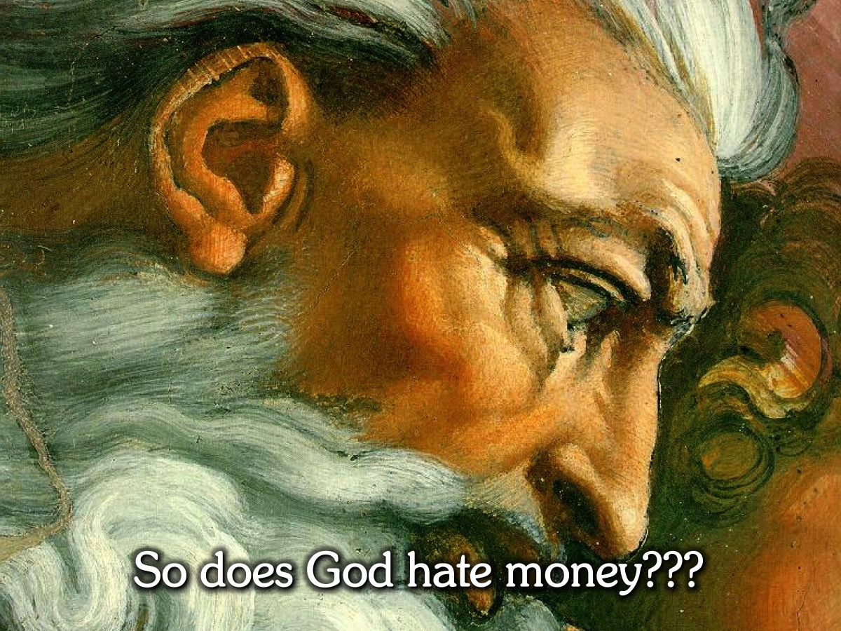
Notes:
God and Money: So does God hate money and does he want us to be poor???

Slide 17

Notes:
Blessed to be a Blessing: God wants to bless you – so you can be a blessing to others!

Slide 18
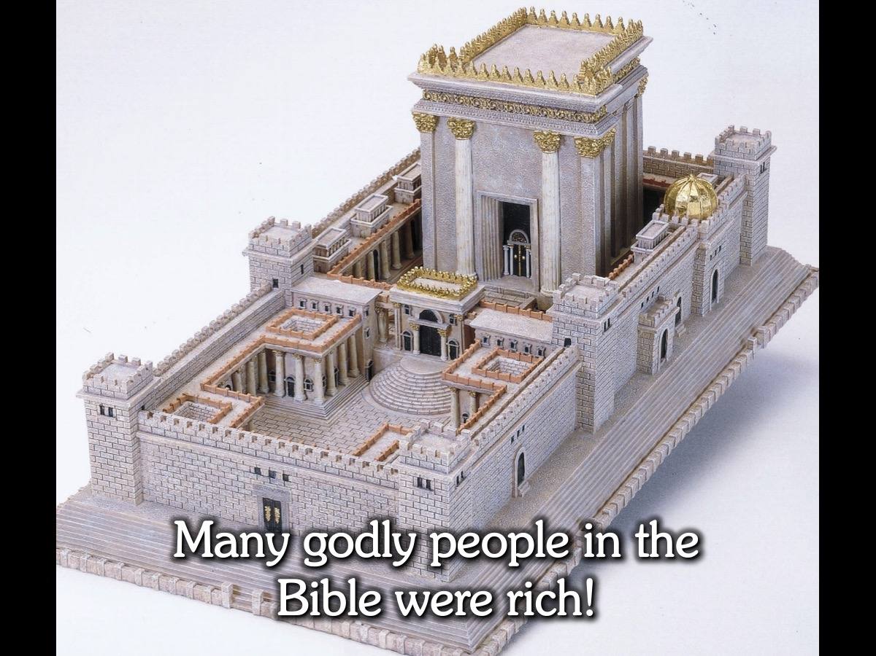
Notes:
Godly Rich People: Many godly people in the Bible were rich: David, Solomon, Job!

Slide 19
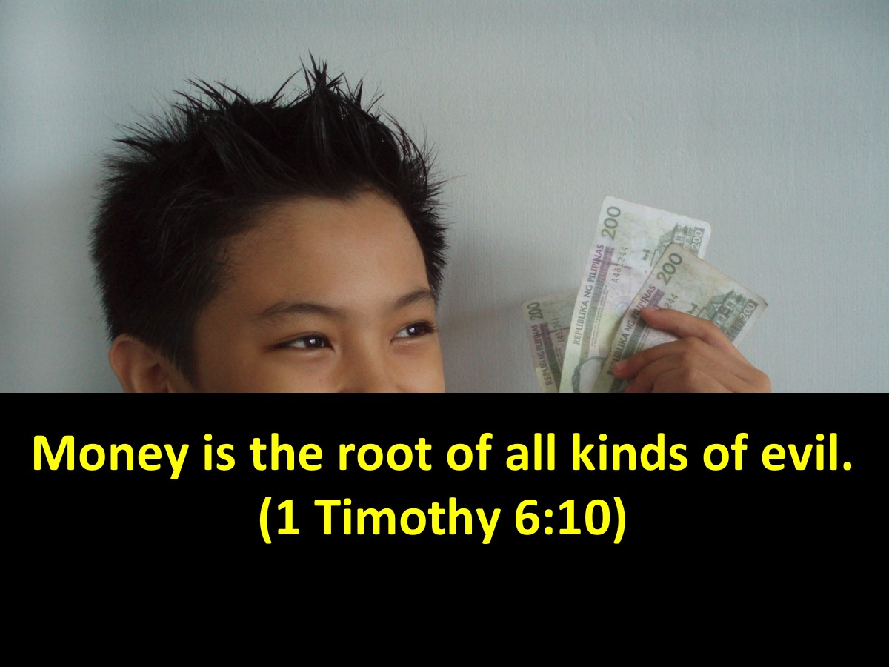
Notes:
What About Money and the Root of Evil? But hang on, doesn’t the Bible say that money is the root of evil. (1 Timothy 6:10)

Slide 20
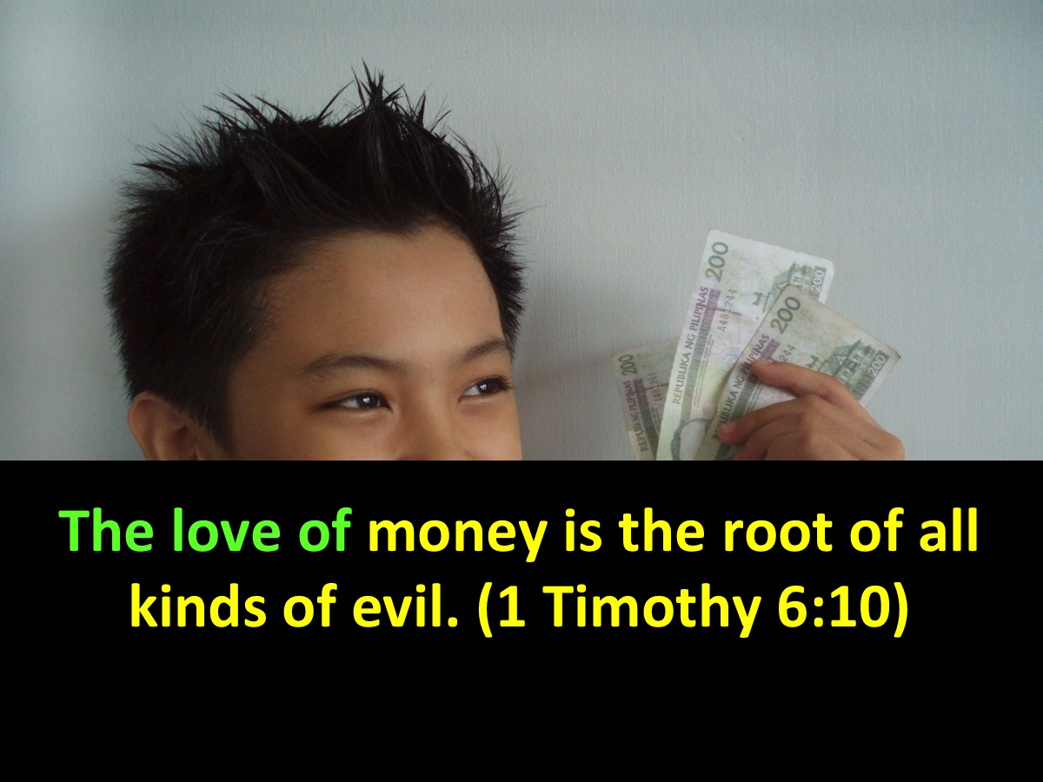
Notes:
Actually it says that the LOVE OF money is the root of evil – and not money itself!.

Slide 21
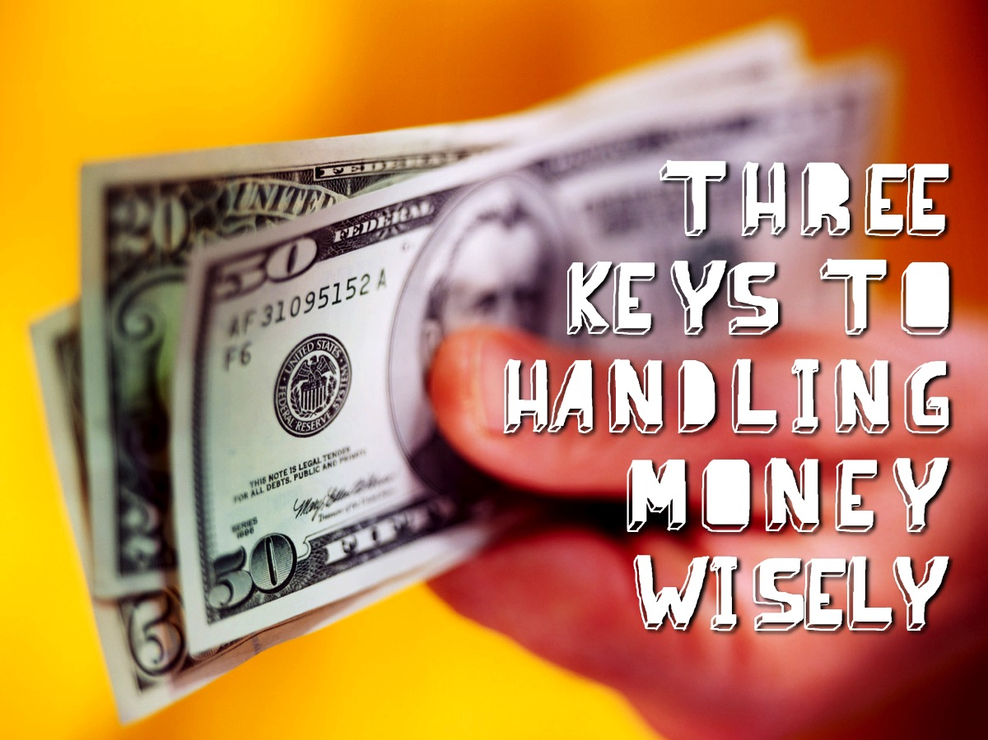
Notes:
We are going to look at three keys to handling money wisely!

Slide 22

Notes:
1. God Owns Every Thing

Slide 23
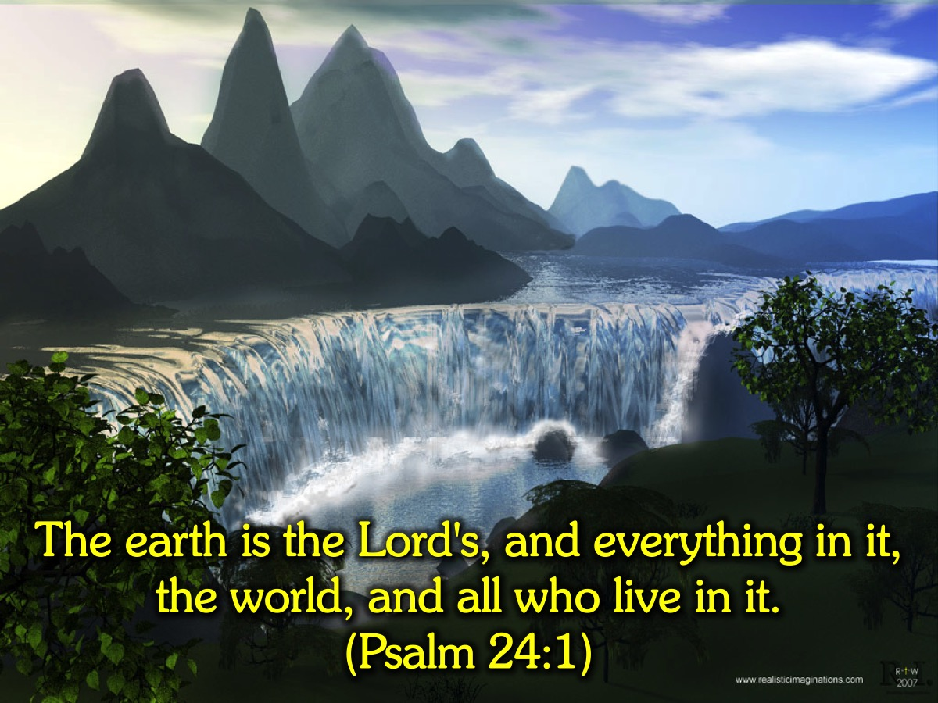
Notes:
The Bible says: “The earth is the Lord's, and everything in it, the world, and all who live in it.” (Psalm 24:1)

Slide 24
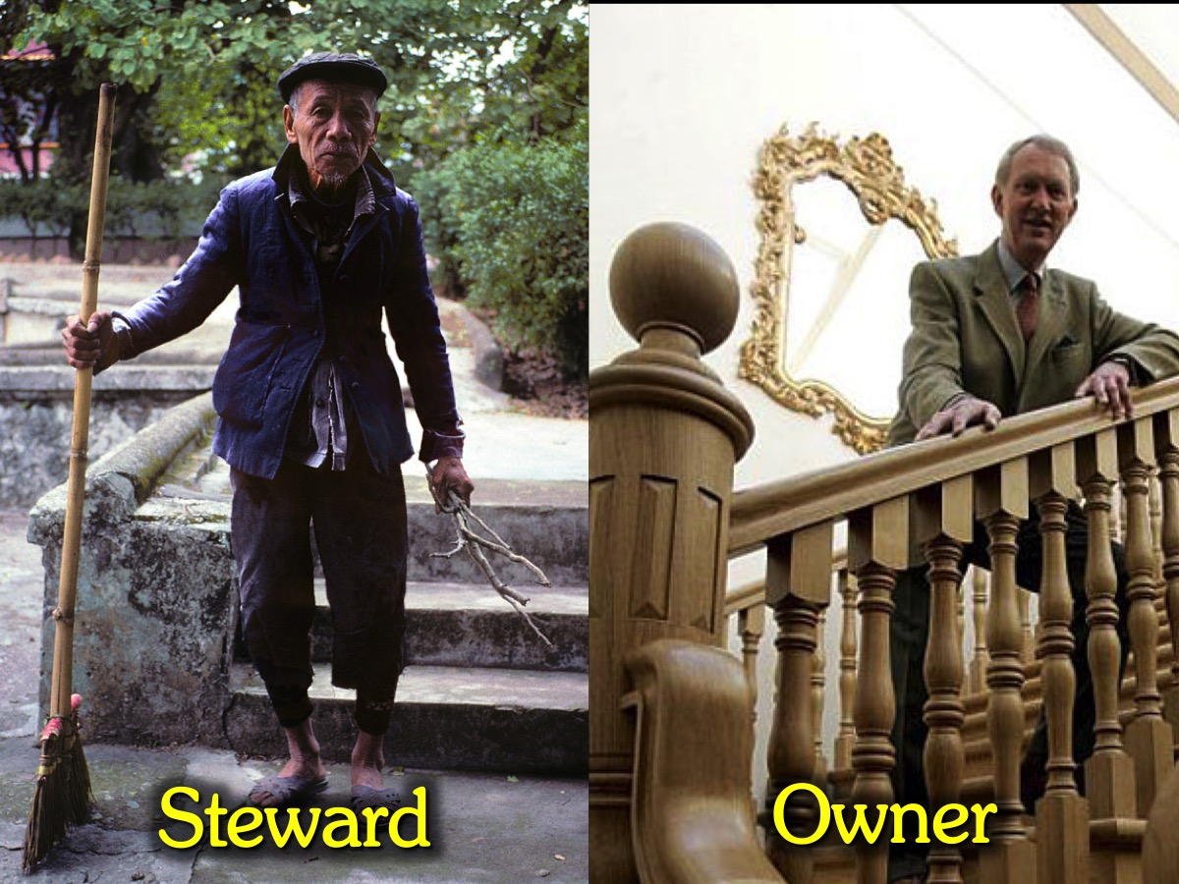
Notes:
There is a difference between a steward and an owner. The word steward is not a common word today, but it is an important word to know.

Slide 25
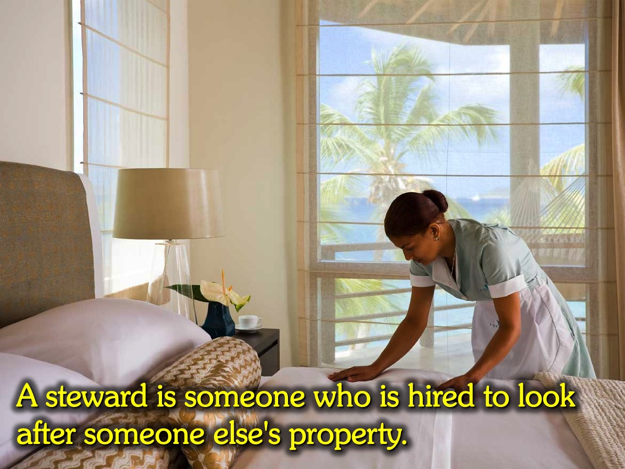
Notes:
What is a Steward? A steward is someone who is hired to look after someone else's property. It could be a butler, a domestic worker, a maintenance guy (like Frank at church), a gardener, etc. In Harry Potter, Hagrid is a steward.

Slide 26
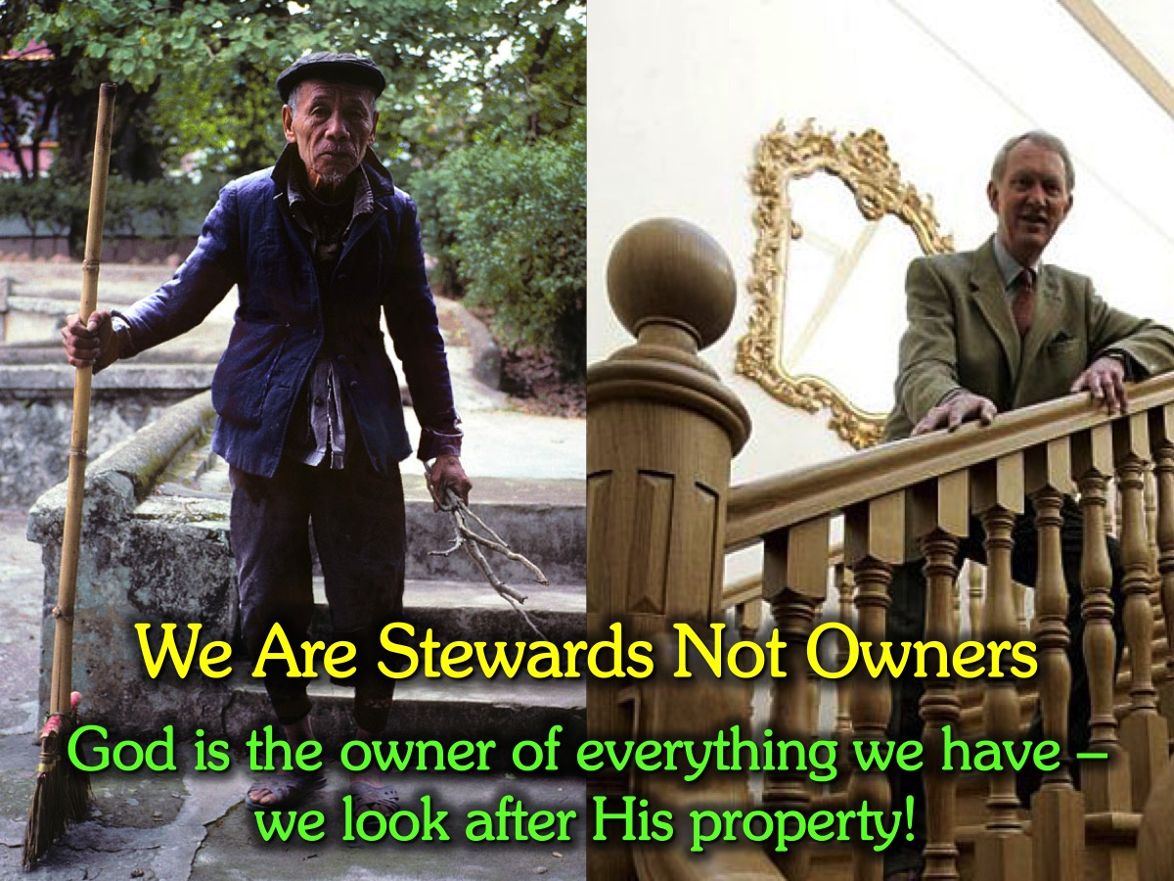
Notes:
We Are Stewards Not Owners! God is the owner of everything we have – we manage His property!

Slide 27
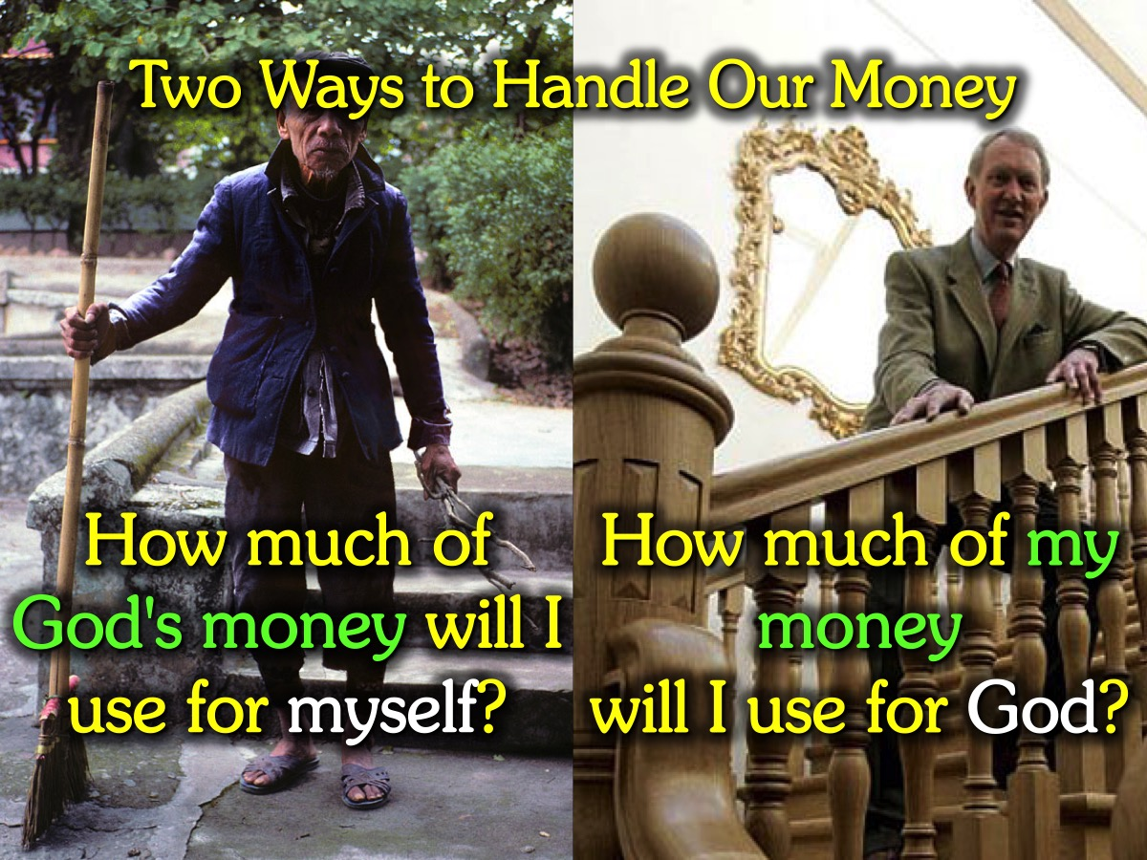
Notes:
Two Ways to Handle Our Money: (1) How much of God's money will I use for myself? or (2) How much of my money will I use for God.

Slide 28
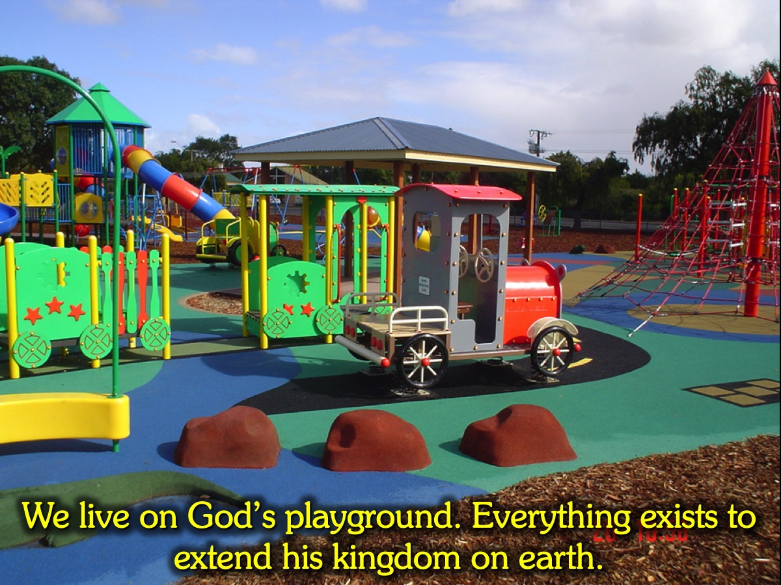
Notes:
The Playground 1: We live on God’s playground. Everything exists to extend his kingdom on earth.

Slide 29
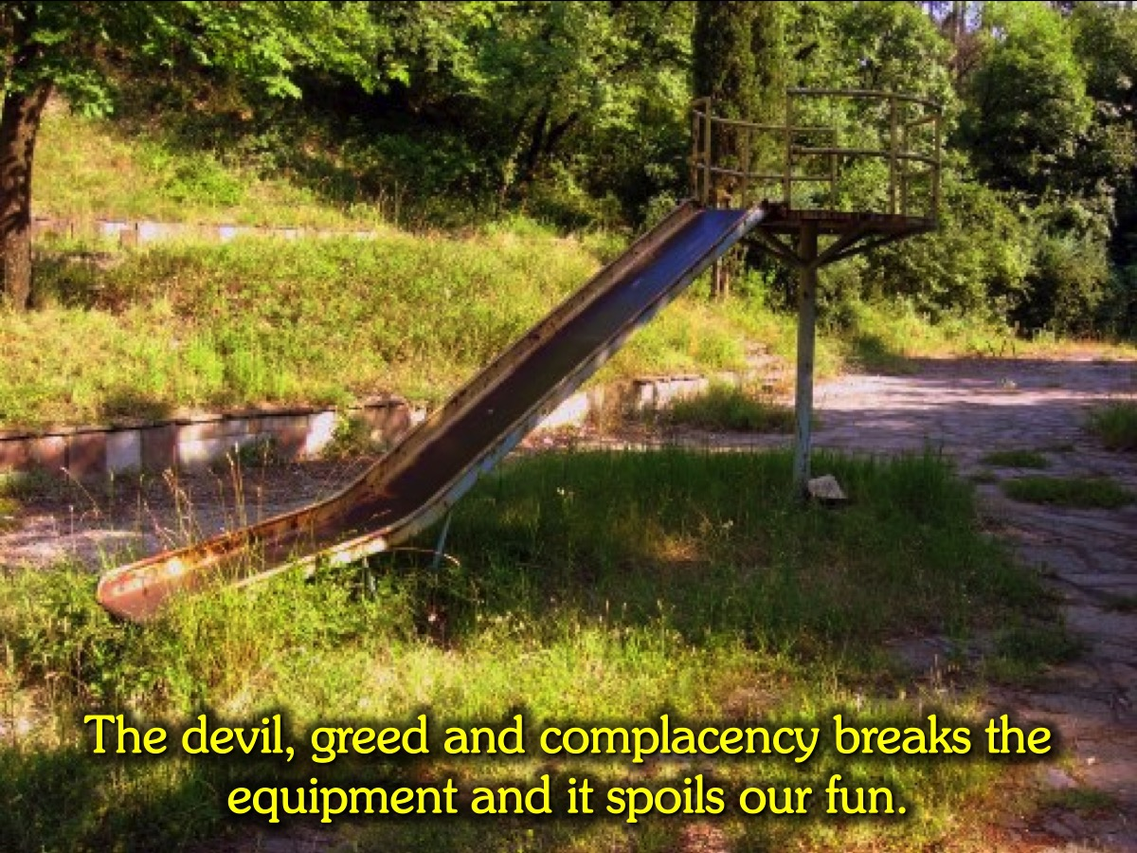
Notes:
The Playground 2: The devil, greed and complacency breaks the equipment and it spoils our fun.

Slide 30
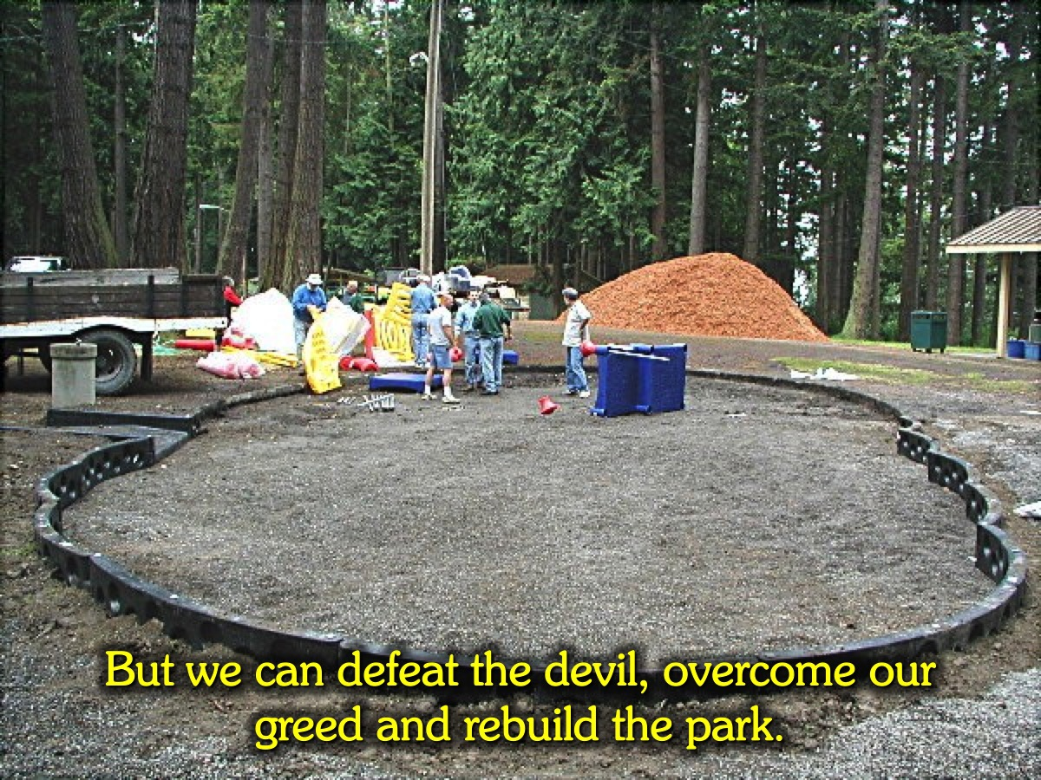
Notes:
The Playground 3: But we can defeat the devil, overcome our greed and rebuild the park.

Slide 31
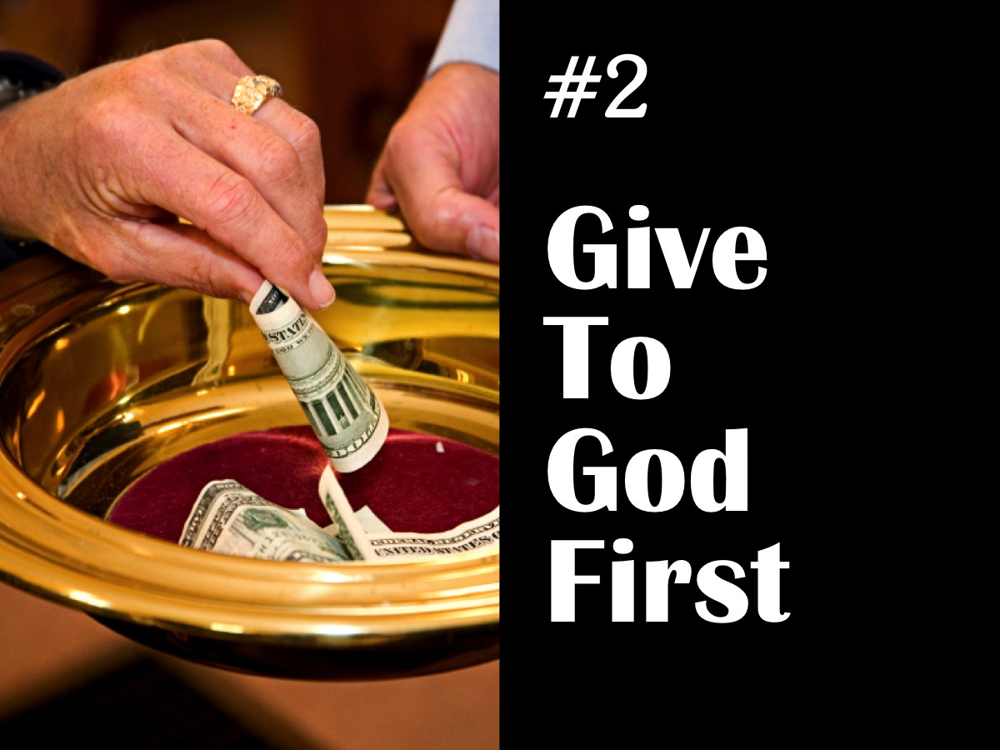
Notes:
2. Give To God First

Slide 32
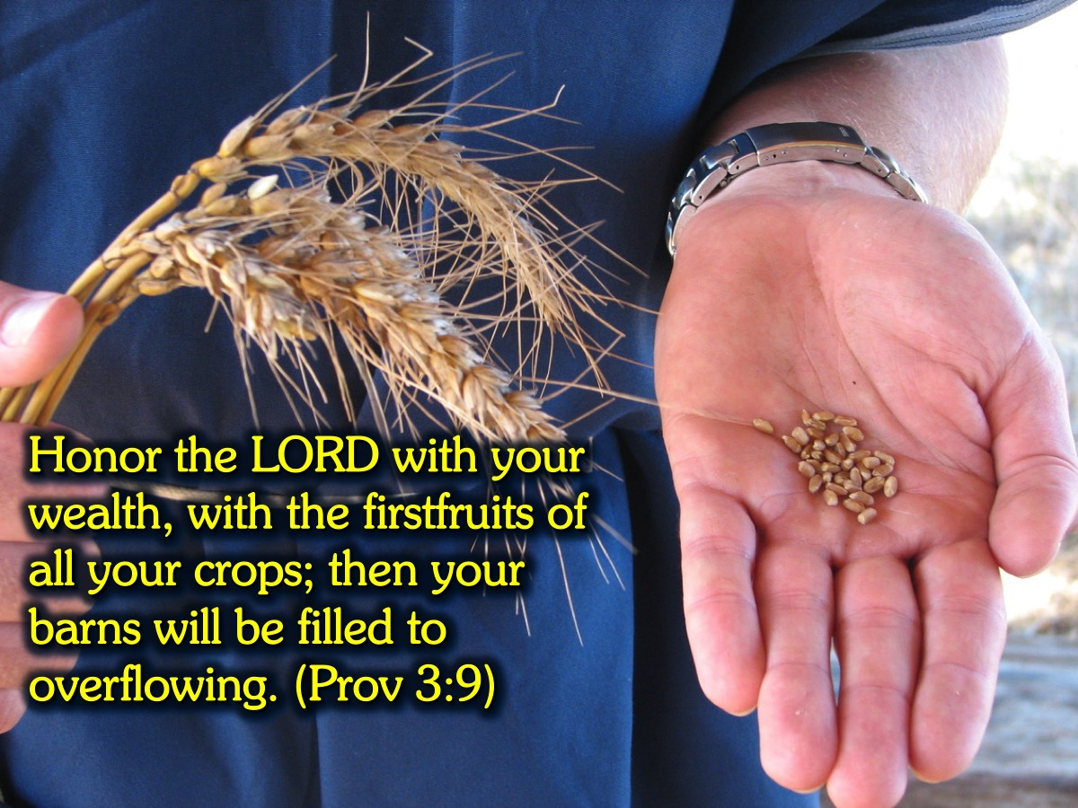
Notes:
The Bible says: “Honor the LORD with your wealth, with the firstfruits of all your crops; then your barns will be filled to overflowing.” (Proverbs 3:9)

Slide 33
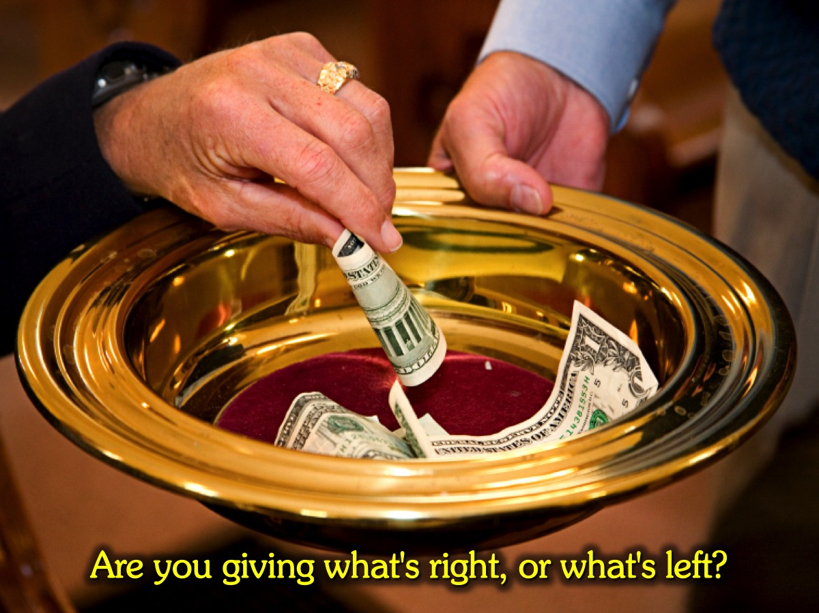
Notes:
Challenge: Are you giving what's right, or what's left? (2 Corinthians 8-9)

Slide 34
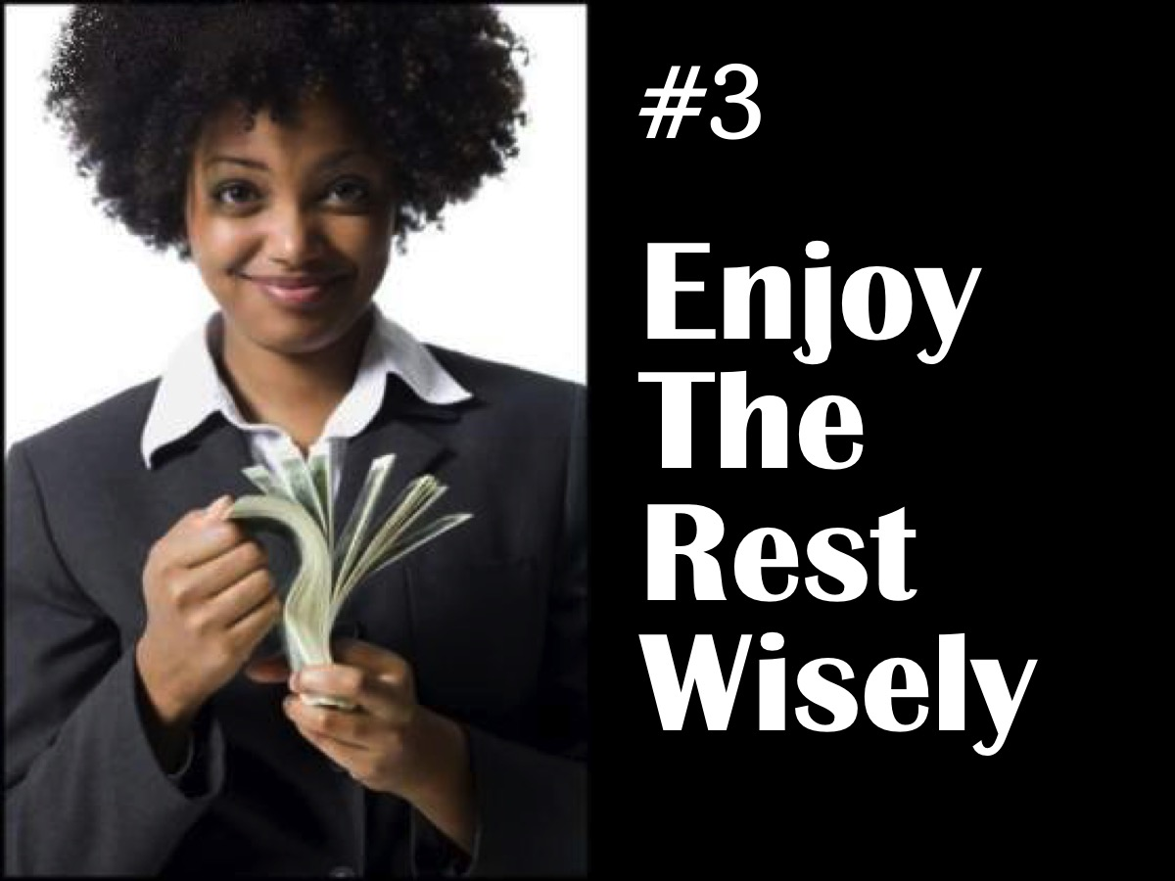
Notes:
3. Enjoy the Rest Wisely

Slide 35
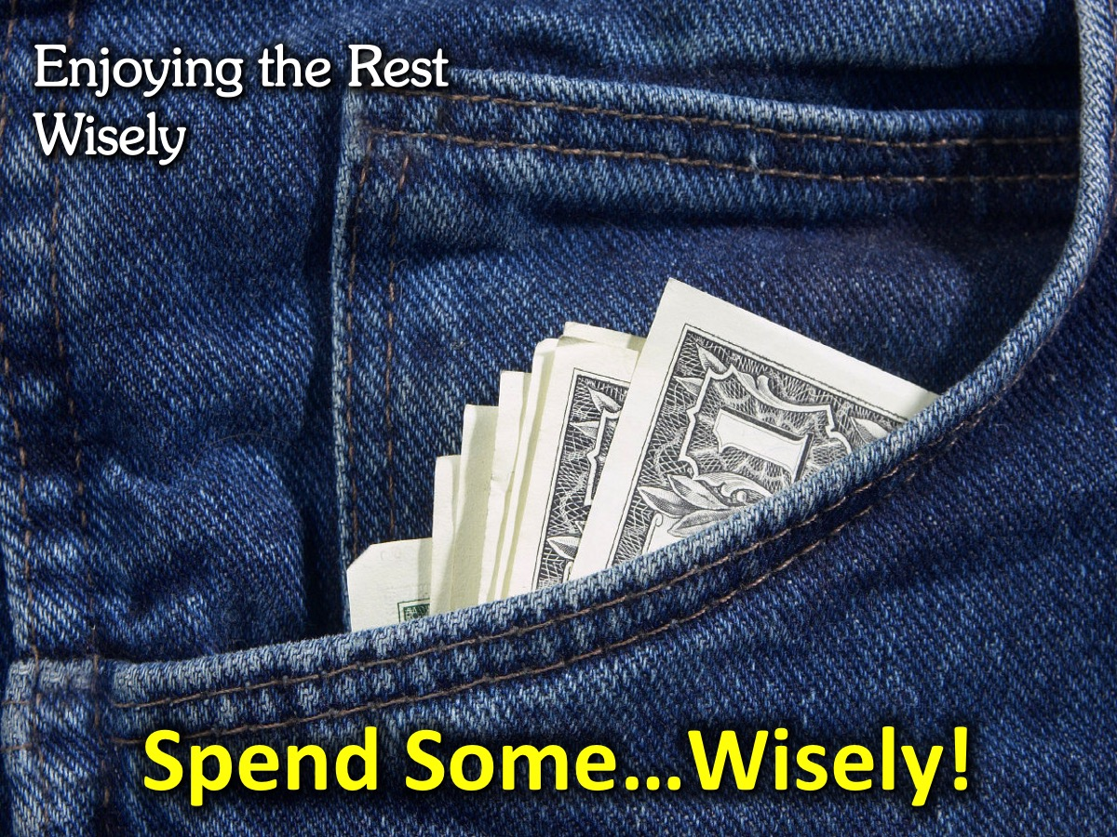
Notes:
Spend Some…Wisely! Is that really what I want to spend my money on. Is money controlling me? Is God cool with this purchase?

Slide 36
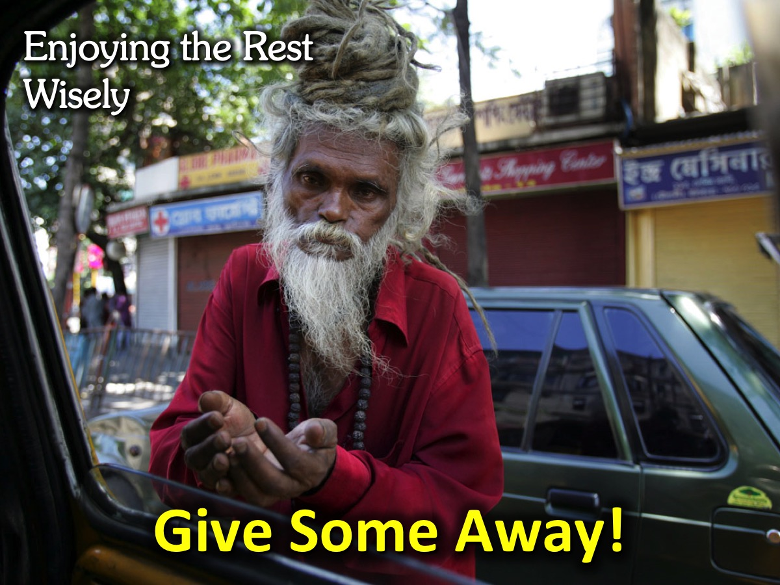
Notes:
Give Some Away: Give to people who are in need!

Slide 37
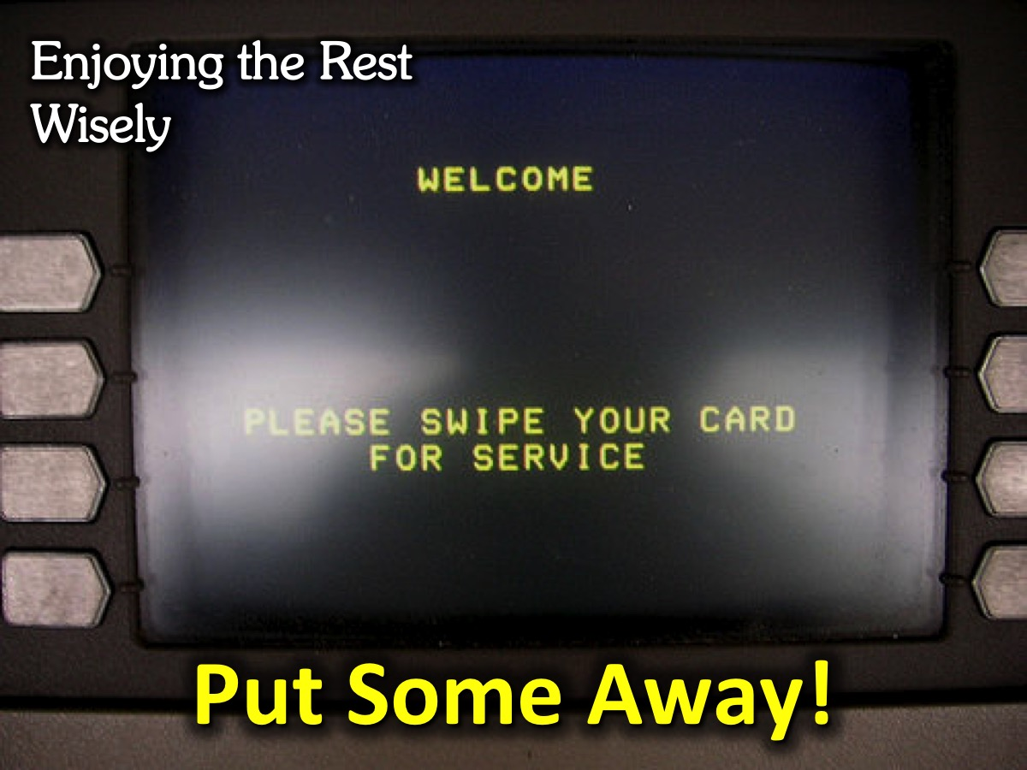
Notes:
Put Some Away: Keep some for bigger purchases that you can’t afford right away! It is called delayed gratification!

Slide 38
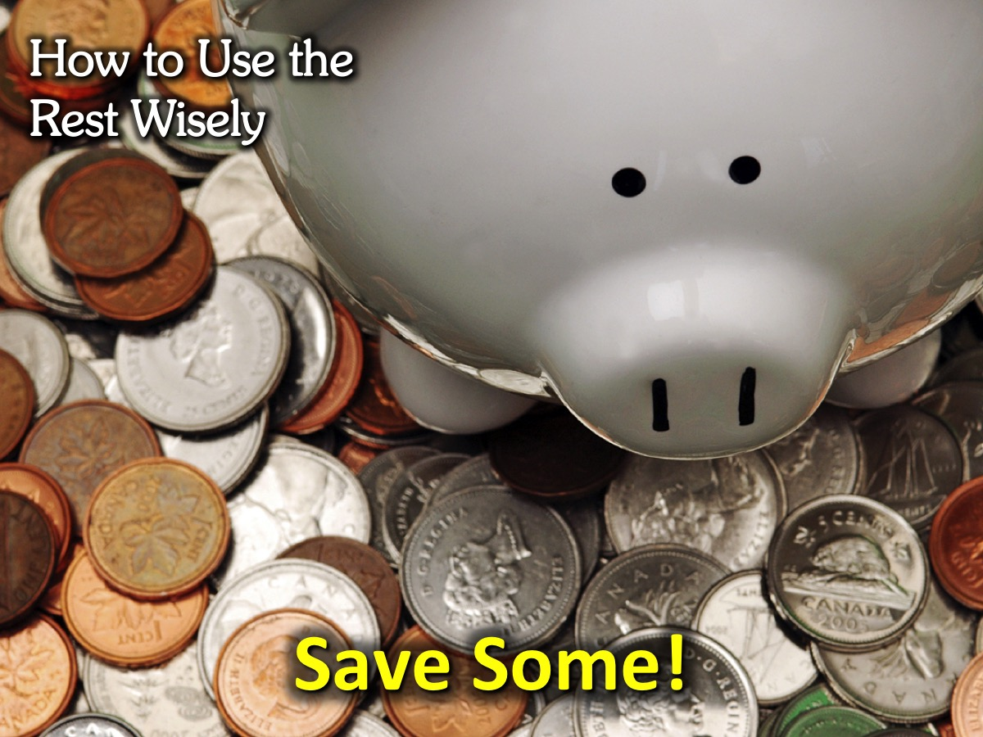
Notes:
Save Some: To live on later!

