Slide 1
Notes:
This week we are looking at the sixth practise: Becoming a Disciplemaker!

Slide 2
Notes:
P.Diddy has been looking for an apprentice!

Slide 3
Notes:
Discuss: If you could be an apprentice to anyone in the world who would you choose and why?

Slide 4
Notes:
Jesus wants you to work for him, be his apprentice, be his disciple. No matter what job you do in life – doctor, lawyer, bank manager, movie star – Jesus wants you to be his apprentice (his disciple or his follower).

Slide 5
Notes:
The Apprentice: The Original Show – let’s look back at what being a disciple meant for the first group of people that Jesus called to work with him.

Slide 6
Notes:
(1) He invited people to follow him and learn from him: Come follow me, and I will make you fishers of men. (Mark 1:17)

Slide 7
Notes:
(2) He spent time growing them to spiritual maturity: He appointed twelve that they might be with him and that he might send them out to preach. (Mark 3:14)

Slide 8
Notes:
(3) He sent them out to reach others: Go into all the world and preach the good news to all creation. (Mark 16:15)

Slide 9
Notes:
As Christians we are Disciples!

Slide 10
Notes:
(1) We Copy Jesus: They want to be like Jesus. Everyone who is well-trained will be like his teacher. (Luke 6:40)

Slide 11
Notes:
(2) We Grow Spiritually: They want to be like Jesus so they practise disciplines that help them grow to maturity: making Jesus Lord, having daily devotions, practising God’s presence, living by faith, handling money wisely and developing spiritual family!

Slide 12
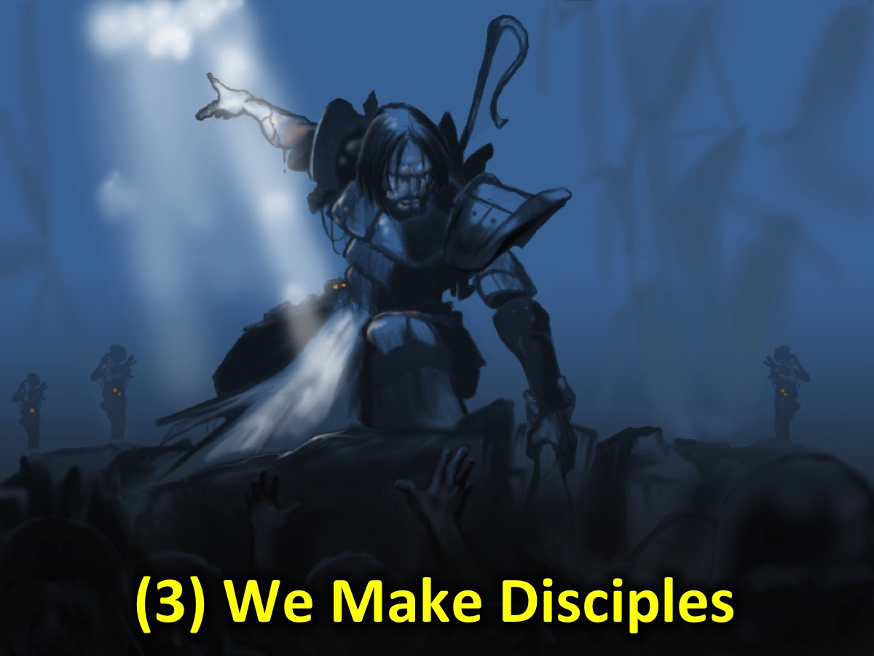
Notes:
(3) We Make Disciples: We cannot be a Christian without becoming disciplemakers! We have to reach out to people who have not been reached with the gospel.

Slide 13
Notes:
The Great Commission is our call to make disciples!

Slide 14
Notes:
No matter what job we have - we are called to make disciples

Slide 15
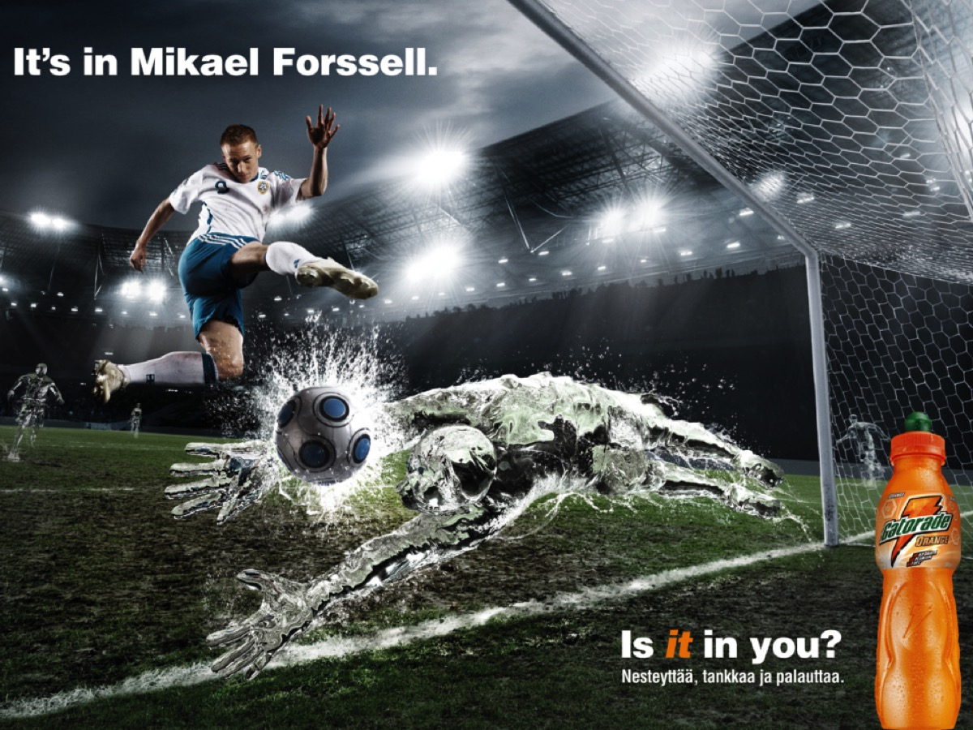

Slide 16
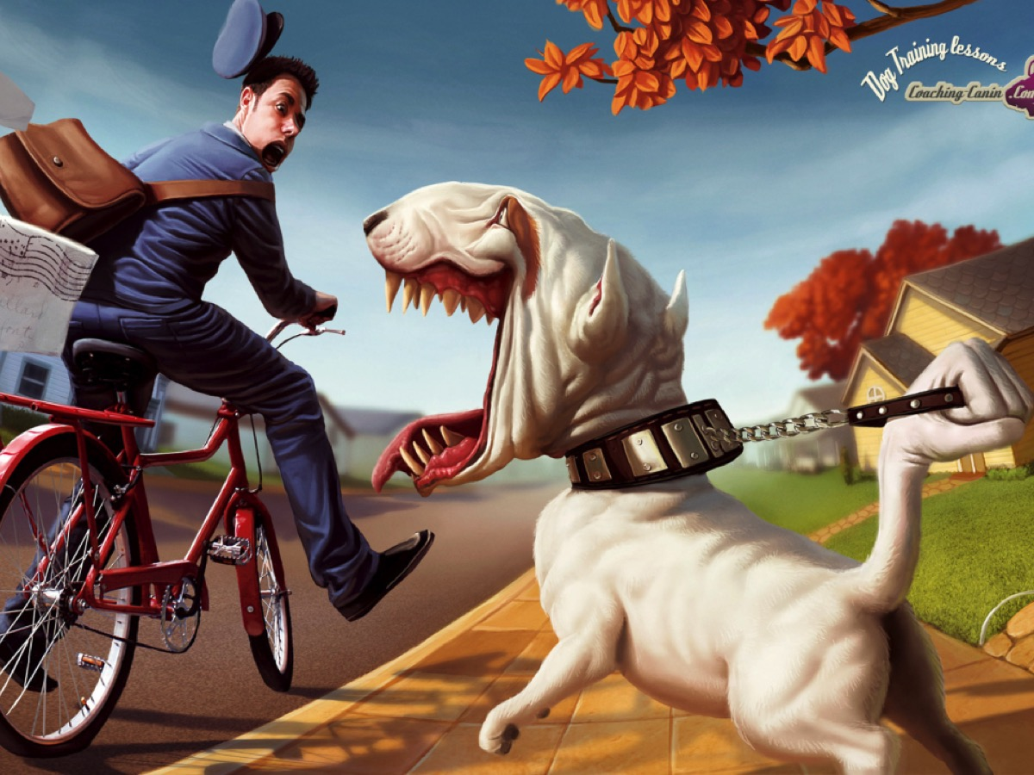

Slide 17
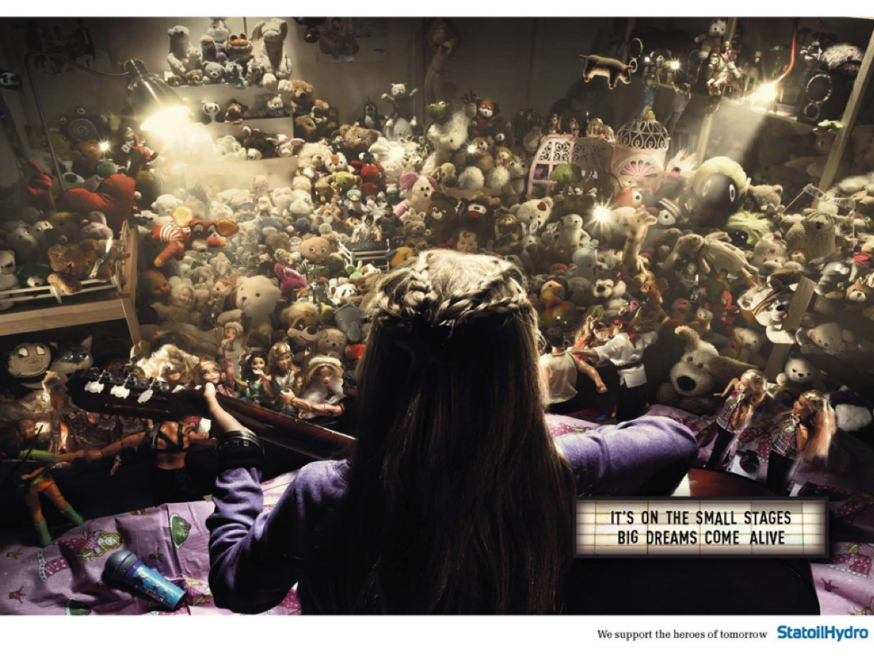

Slide 18
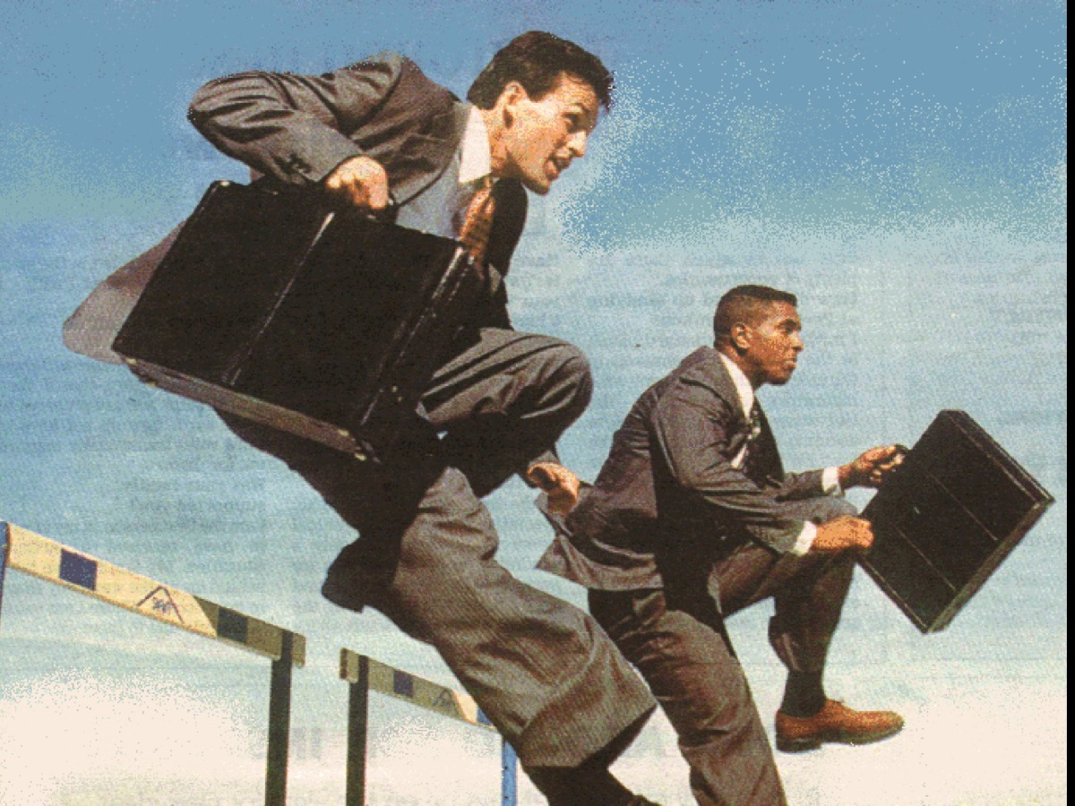

Slide 19
Notes:
We are called to make disciples!!!

Slide 20
Notes:
We make disciples by helping someone: Encounter Jesus as Saviour,

Slide 21
Notes:
Connect with other believers,

Slide 22
Notes:
Grow to maturity in Jesus

Slide 23
Notes:
Reach their friends for Jesus, and

Slide 24
Notes:
Influence their world for Jesus.

Slide 25
Notes:
Reflection: Who are you helping on their faith journey?

Slide 26
Notes:
How do we make disciples of all nations? What is our strategy? We have two options: Addition and Multiplication. Activity: The Addition vs. Multiplication exercise. We cannot fulfil the Great Commission of making disciples of all nations through addition – we have to use multiplication.

Slide 27
Notes:
Addition: If I preach to 1000 people every day, it will take 16,435 years to reach the world.
Multiplication: If I reach 2 people in 1 year and send them out to reach and grow 2 disciples each and so on we will reach the world in 33 years.

Slide 28
Notes:
Poem: I Stay Near The Door by Dr Sam Shoemaker

Slide 29
Notes:
I stay near the door. I neither go too far in, nor stay too far out. The door is the most important door in the world. It is the door through which people walk when they find God. There's no use my going way inside, and staying there. When so many are still outside and they crave to know where the door is. So I stay near the door.

Slide 30
Notes:
The most tremendous thing in the world is for people to find that door - the door to God. The most important thing any one can do is take hold of one of those blind, groping hands, and to put it on the latch. Nothing else matters compared to helping them find it, and open it, and walk in and find God. So I stay near the door.

Slide 31
Notes:
Go in, great saints, go all the way in - go way down into the cellars, and way up into the attics - it is a vast, roomy house, this house where God is. Go into the deepest hidden places of withdrawal and silence. But realise that the people too far in do not see they are preoccupied with the wonder of it all. So I stay near the door.

Slide 32
Notes:
I admire the people who go way in. But wish they would not forget how it was before they got in. Then they would be able to help the people who have not yet even found the door. You can go in too deeply, and stay in too long, and forget the people outside the door.

Slide 33
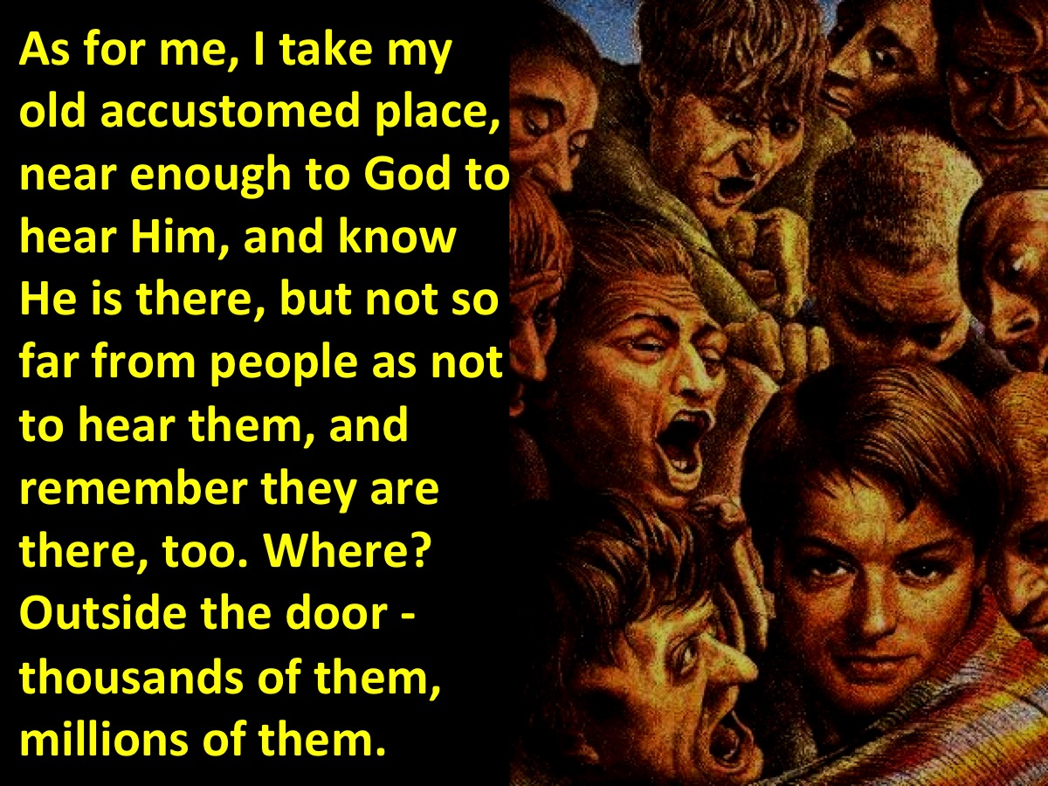
Notes:
As for me, I take my old accustomed place, near enough to God to hear Him, and know He is there, but not so far from people as not to hear them, and remember they are there, too. Where? Outside the door - thousands of them, millions of them.

Slide 34
Notes:
But, more important for me, one of them, two of them, ten of them, whose hands I am intended to put on the latch. So I stay by the door and wait for those who seek it. I would rather be a doorkeeper. So I stay near the door.

Slide 35
Notes:
Challenge: Jesus has called me to be a disciple who makes disciples!

Slide 36
Notes:
Let’s get really practical: Here are some tools for disciplemaking that you can use:

Slide 37
Notes:
(1) Prayer: you can pray for your disciple.

Slide 38
Notes:
(2) Friendship: you can build a genuine friendship with your disciple.

Slide 39
Notes:
(3) Technology: you can use different forms of technology to connect with your disciple: SMA, Mxit, email, Facebook, etc.

Slide 40
Notes:
(4) Kindness: you can look for ways to meet the needs of your disciple.

Slide 41
Notes:
(5) Testimony: you can use your story - how you came to know Jesus and how he changed your life.

Slide 42
Notes:
(6) Booklets: you can use a booklet with your disciple suited to where they are at spiritually.

Slide 43
Notes:
(7) Events: you can bring your disciple to an event that is suited to where they are at spiritually.

Slide 44
Notes:
Becoming a Disciplemaker: (1) Accept the call, (2) Find a disciple, (3) Start to disciple, (4) Use the tools.

