Slide 1

Notes:
Today we are looking at the practise of Developing Spiritual Family.

Slide 2
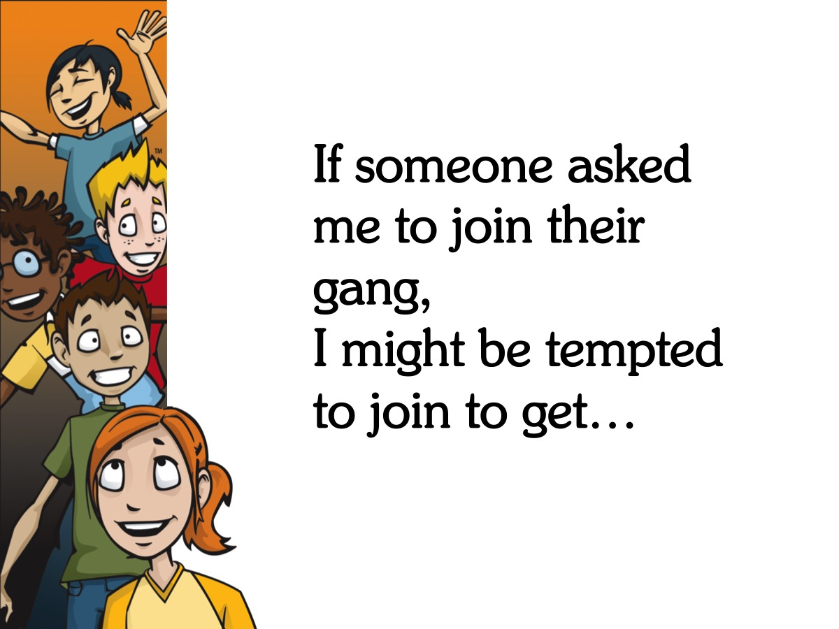
Notes:
Discuss: If someone asked me to join their gang, I might be tempted to join to get…

Slide 3

Notes:
Lesson about Family from Space: Dan the Astronaut

Slide 4
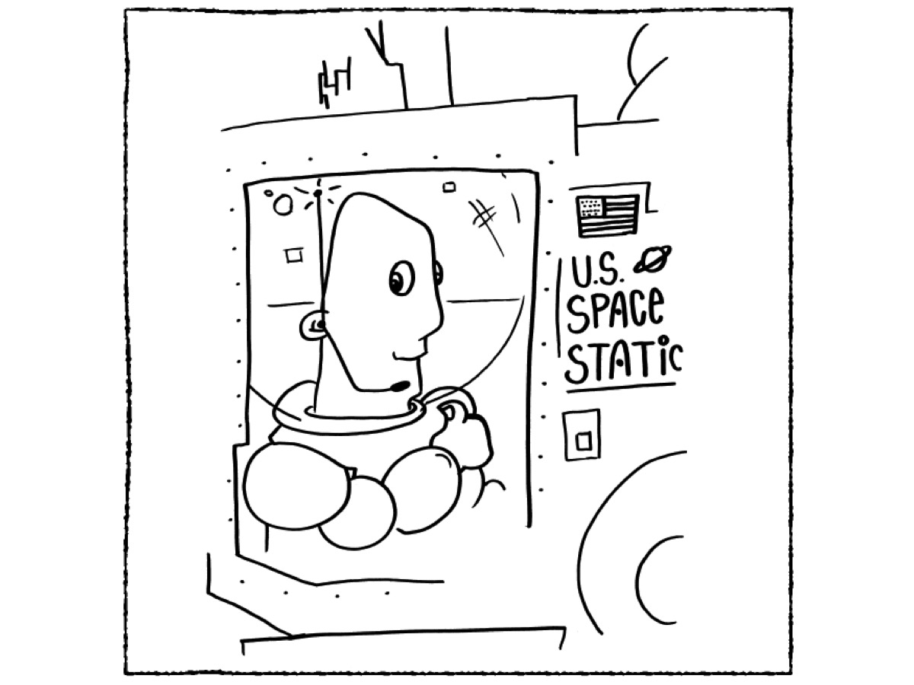
Notes:
There was once a man name Don Astronaut.

Slide 5
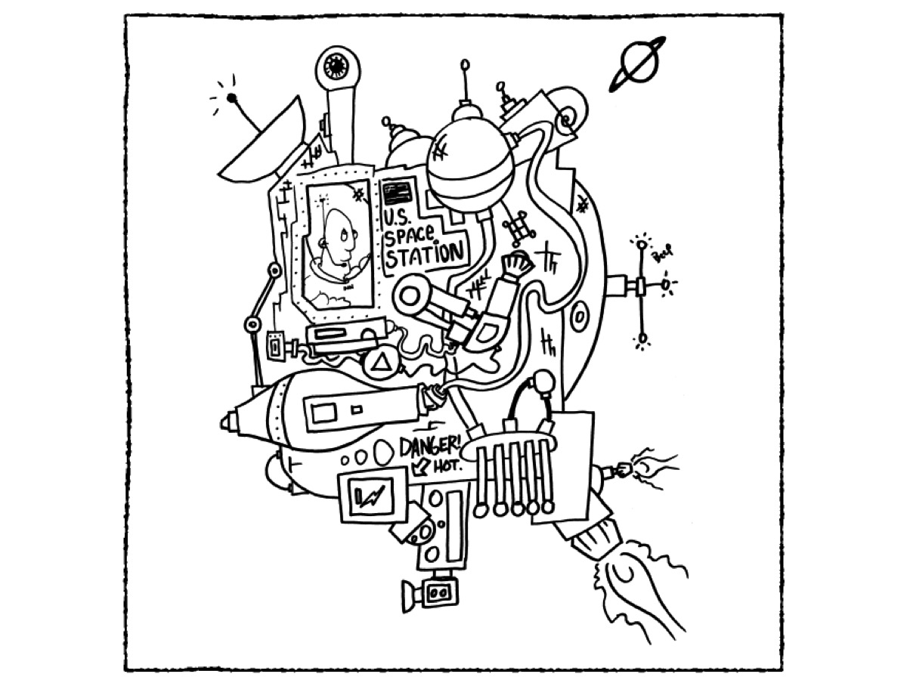
Notes:
Don Astronaut lived on a space station in space.

Slide 6
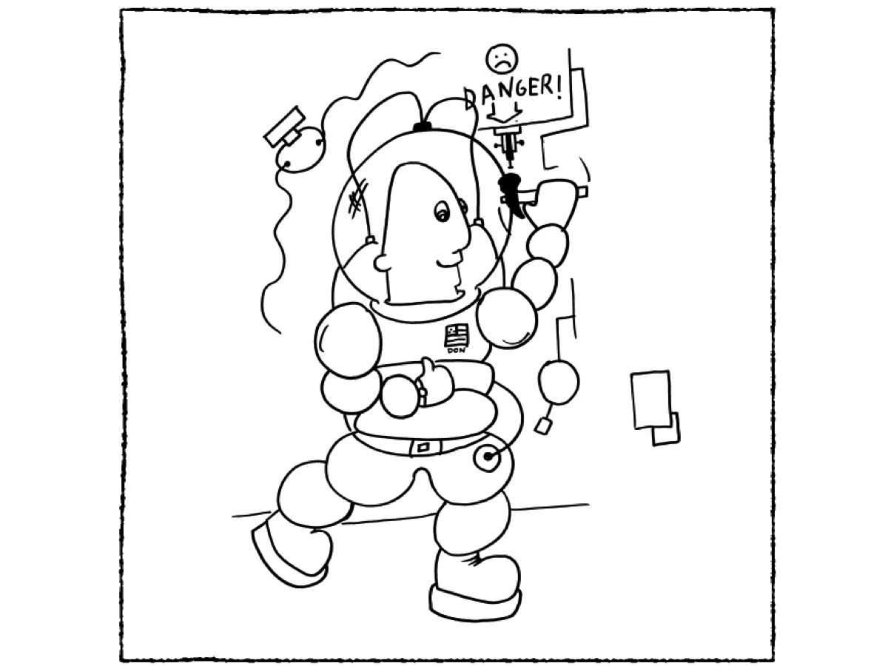
Notes:
Don Astronaut had a special space suit that kept him alive without water or oxygen.

Slide 7
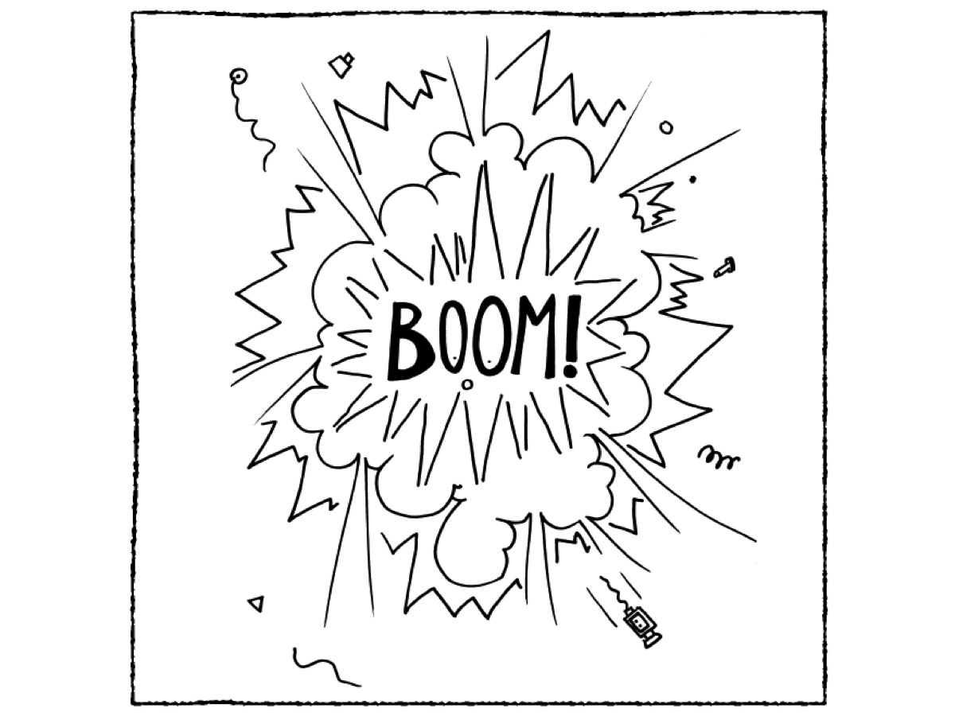
Notes:
One day there was an accident.

Slide 8
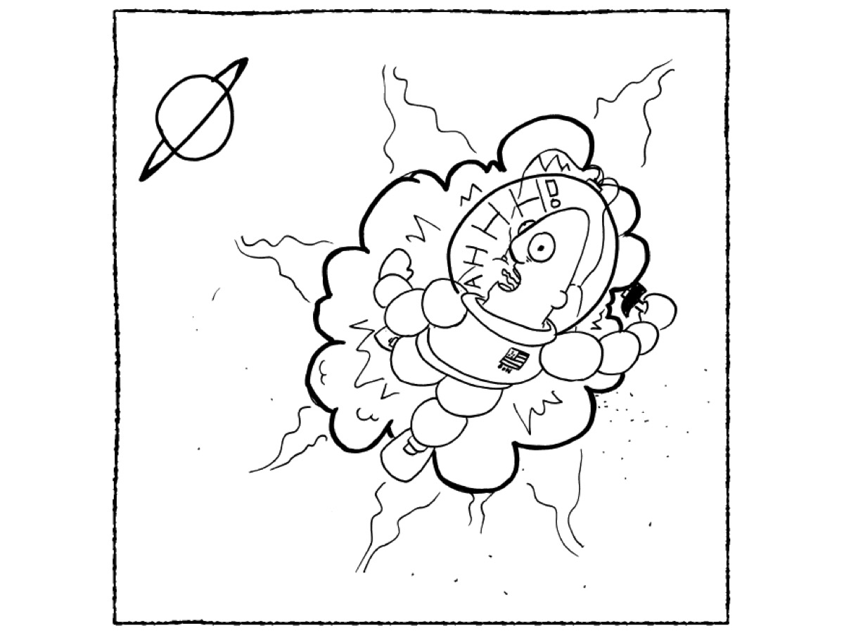
Notes:
And Don Astronaut was cast out into space.

Slide 9
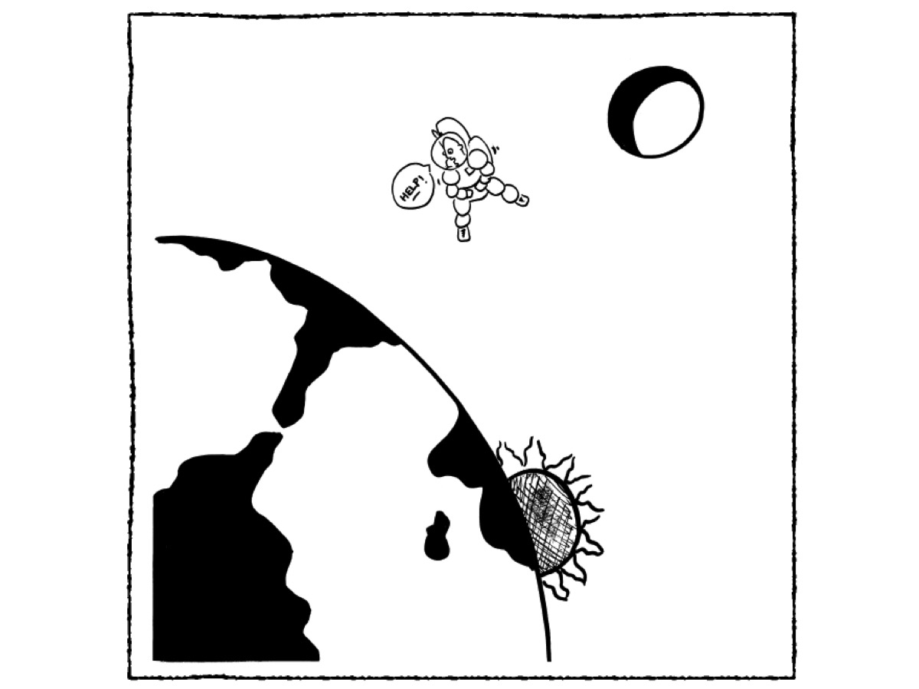
Notes:
Don Astronaut orbited the earth and was very scared.

Slide 10
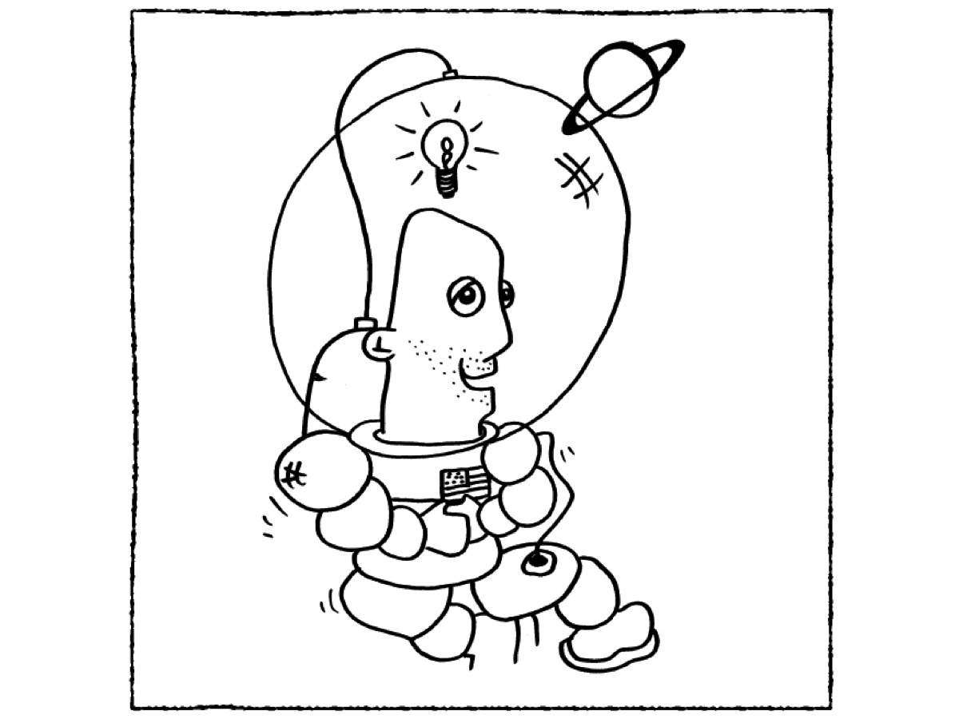
Notes:
Until he remembered his special suit that kept him alive.

Slide 11
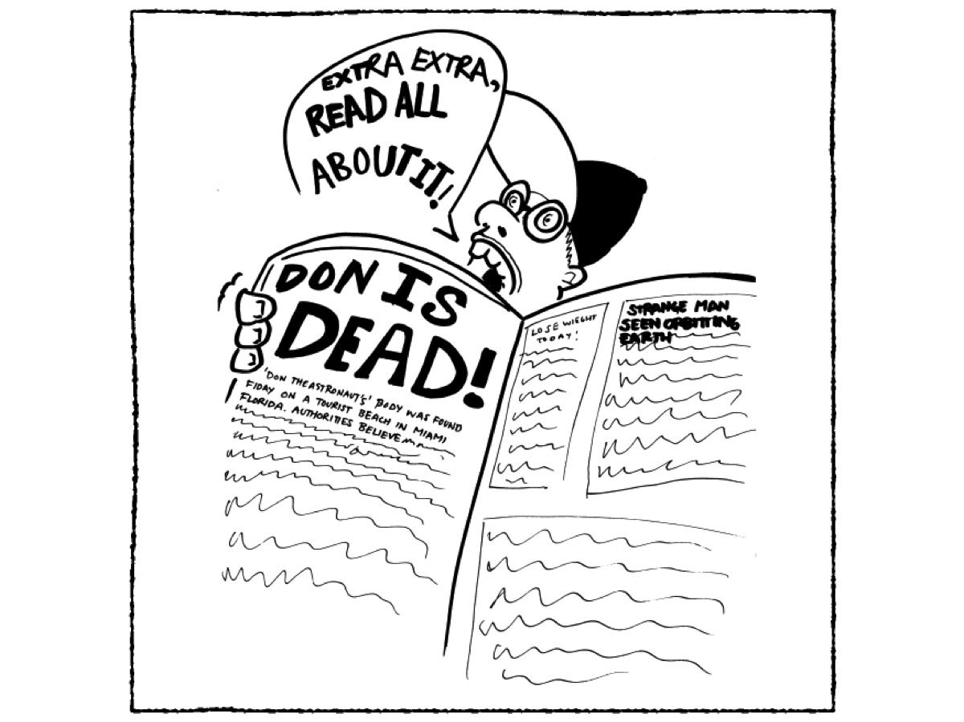
Notes:
But nobody’s government came to rescue Don Astronaut because it would cost too much money.

Slide 12
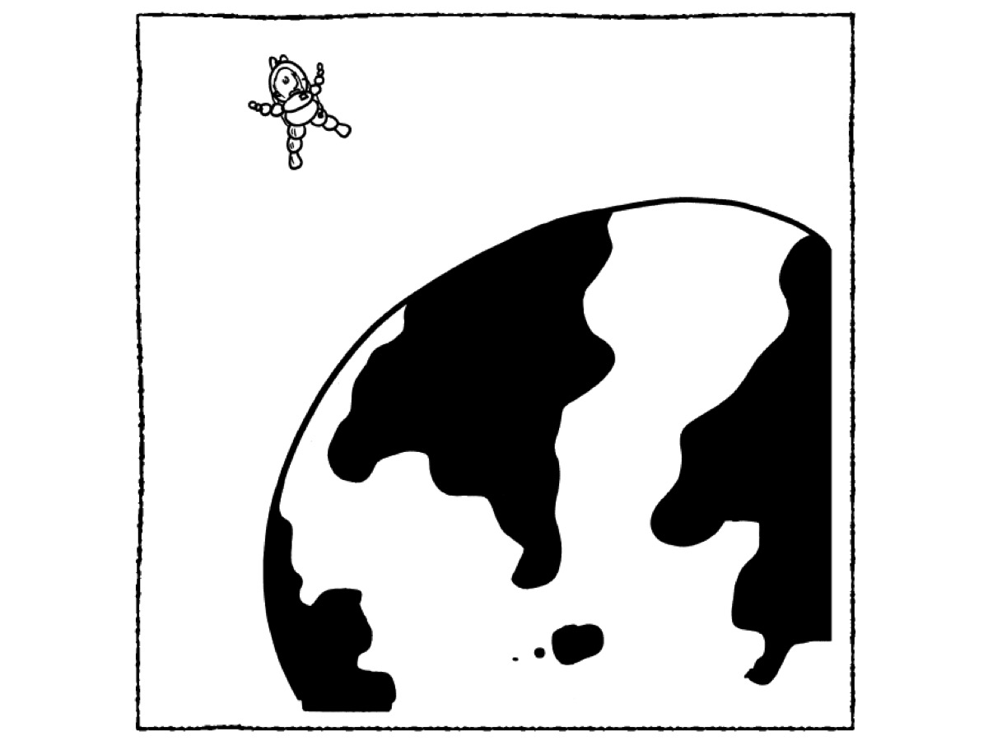
Notes:
So Don Astronaut orbited the earth again and again, fourteen times each day.

Slide 13
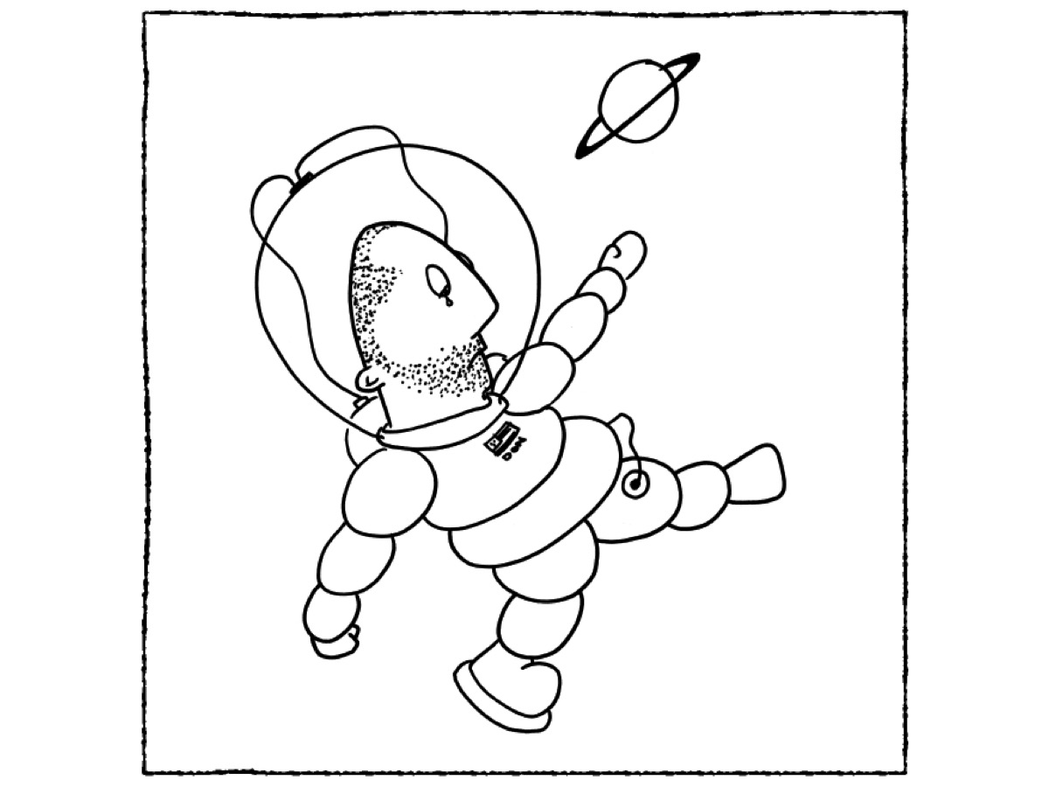
Notes:
And Don Astronaut orbited the earth for months.

Slide 14
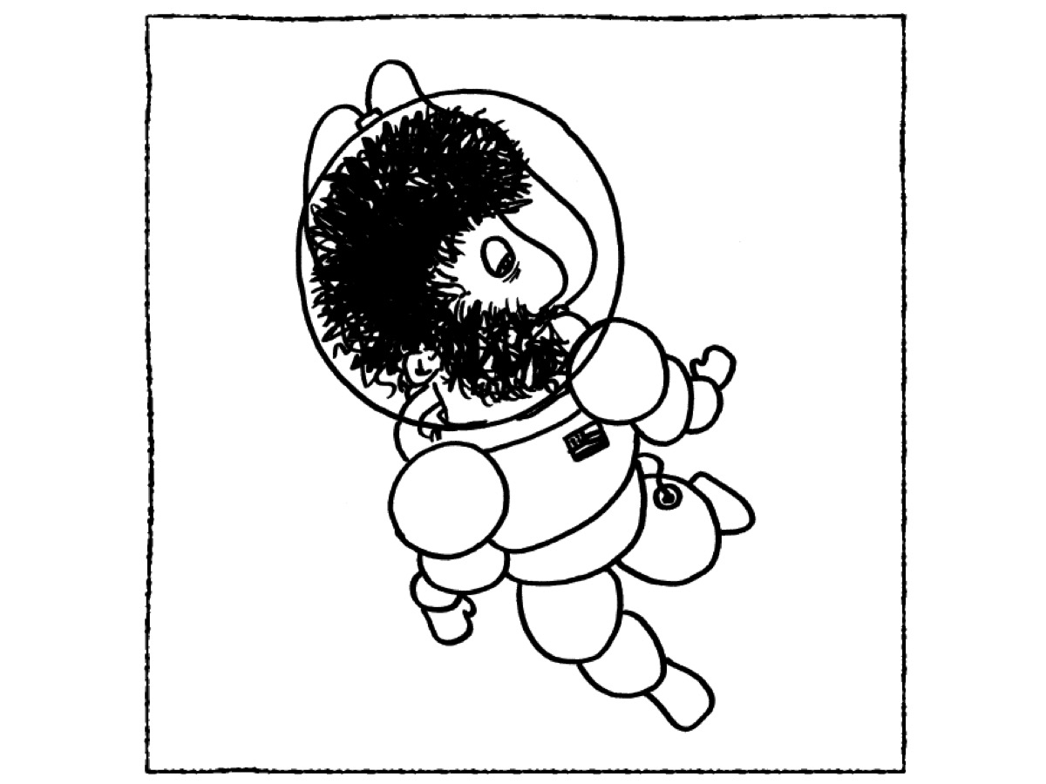
Notes:
And Don Astronaut orbited the earth for decades.

Slide 15
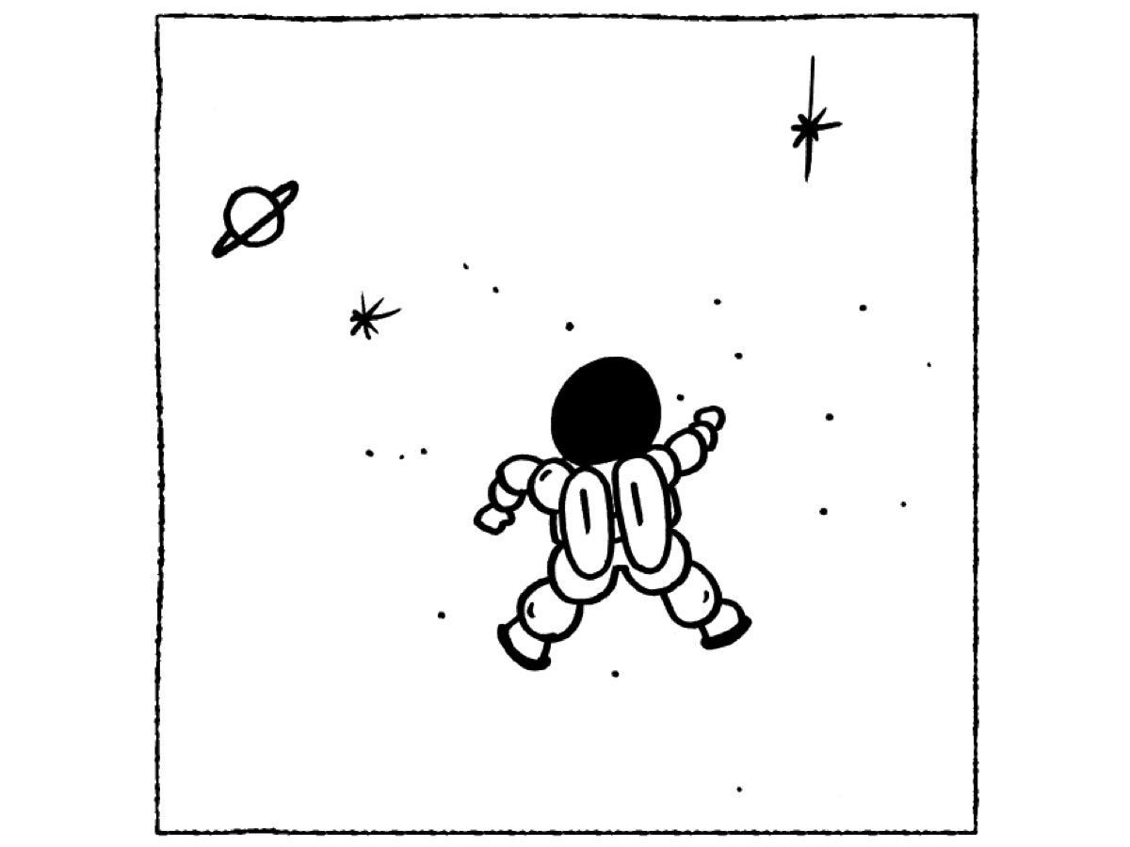
Notes:
And Don Astronaut orbited the earth for fifty-three years before he died a very lonely and crazy man – just a shell of a thing with hardly a spark for a soul.

Slide 16
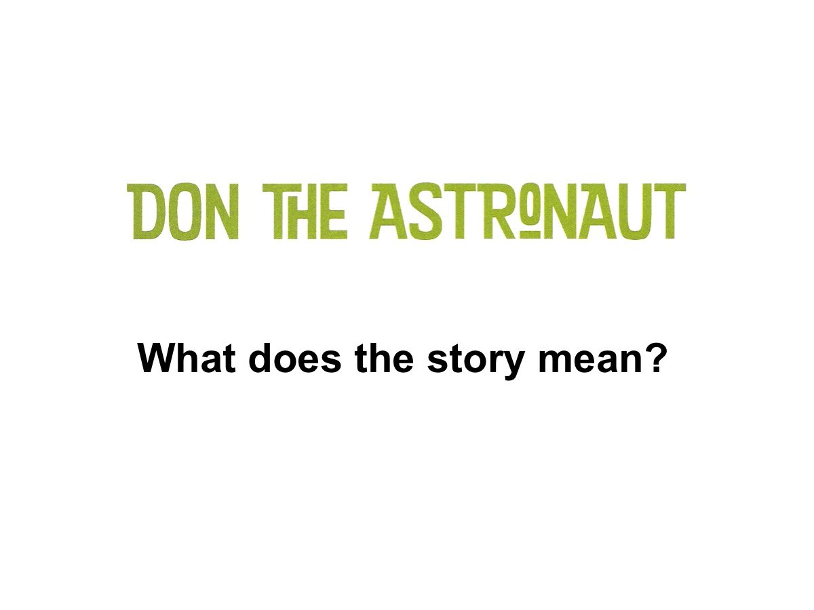
Notes:
What does the story mean?

Slide 17
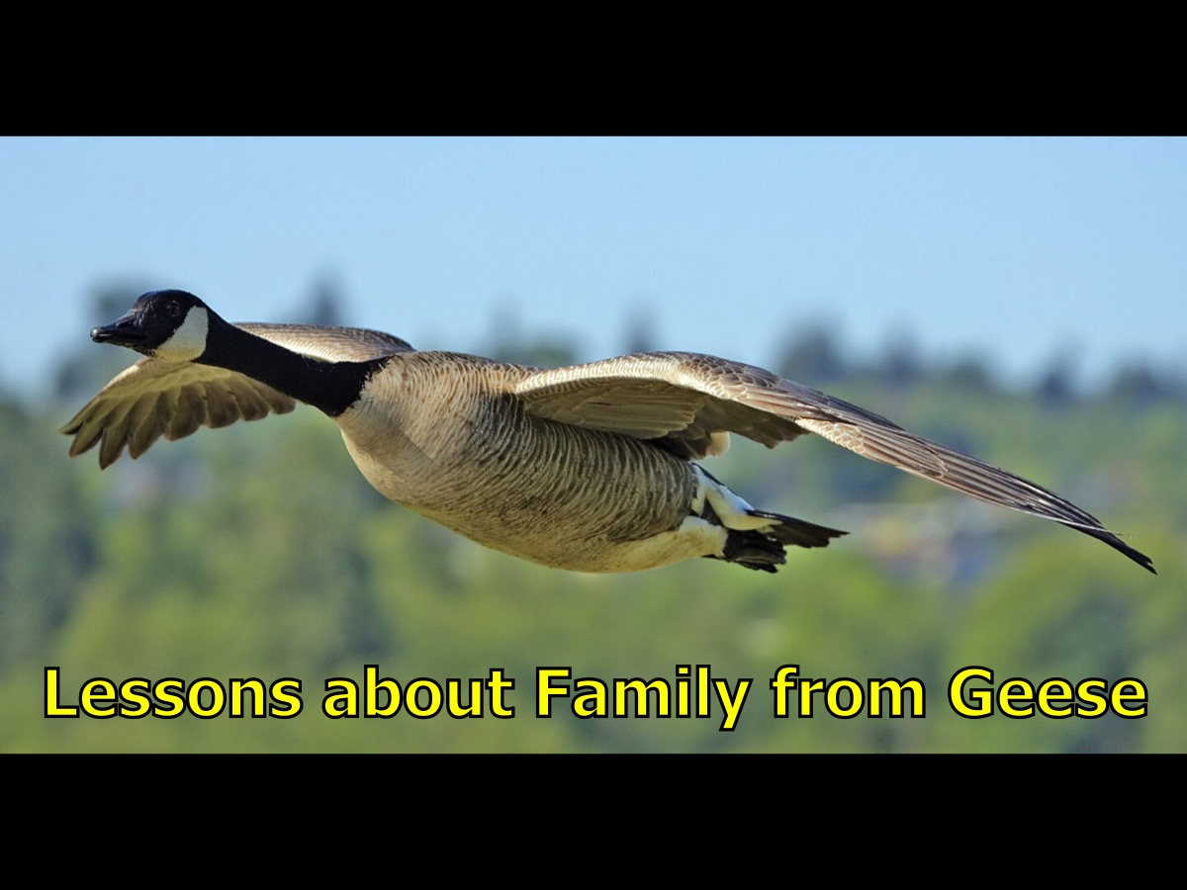
Notes:
Lesson about Family from Geese: What Geese teach us about creating a family at church.

Slide 18
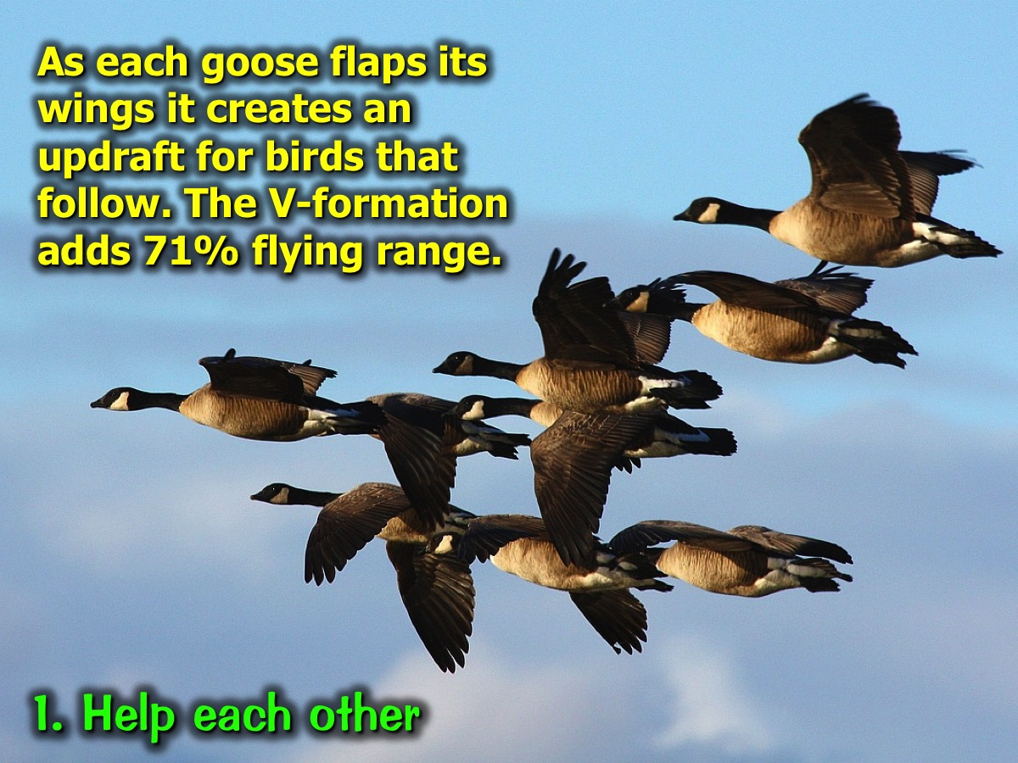
Notes:
1. Help each other: As each goose flaps its wings it creates an updraft for birds that follow. The V-formation adds 71% flying range.

Slide 19
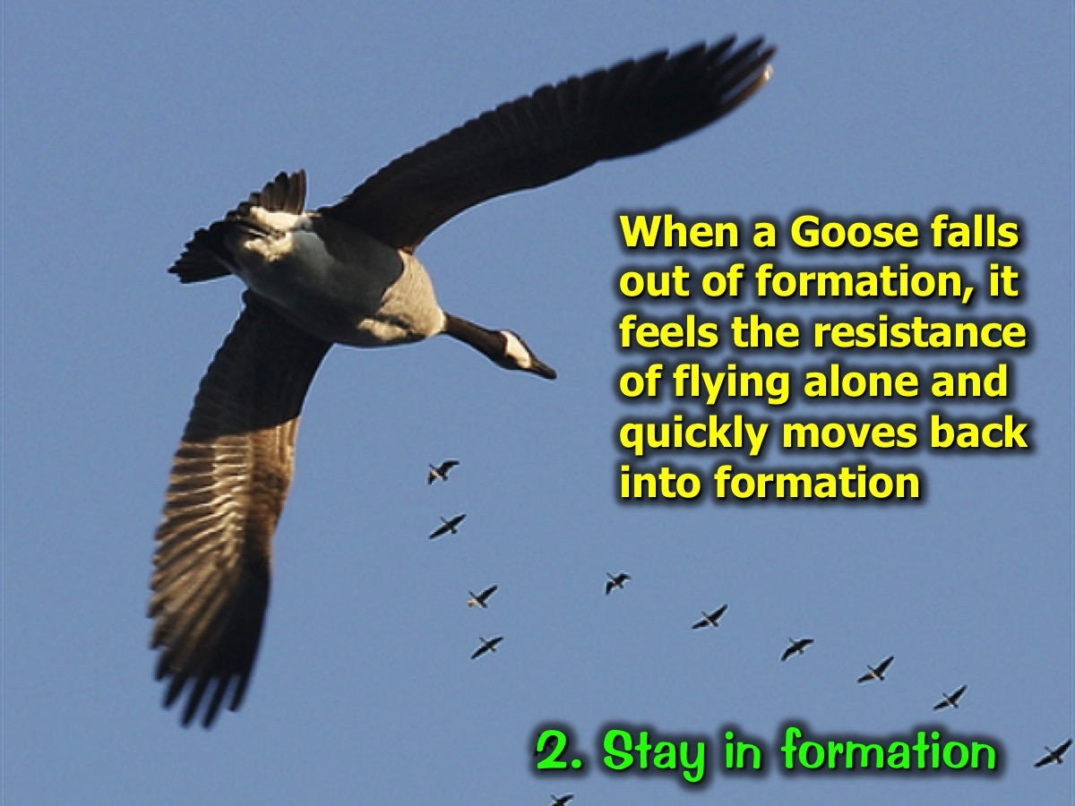
Notes:
2. Stay in formation: When a Goose falls out of formation, it feels the resistance of flying alone and quickly moves back into formation.

Slide 20
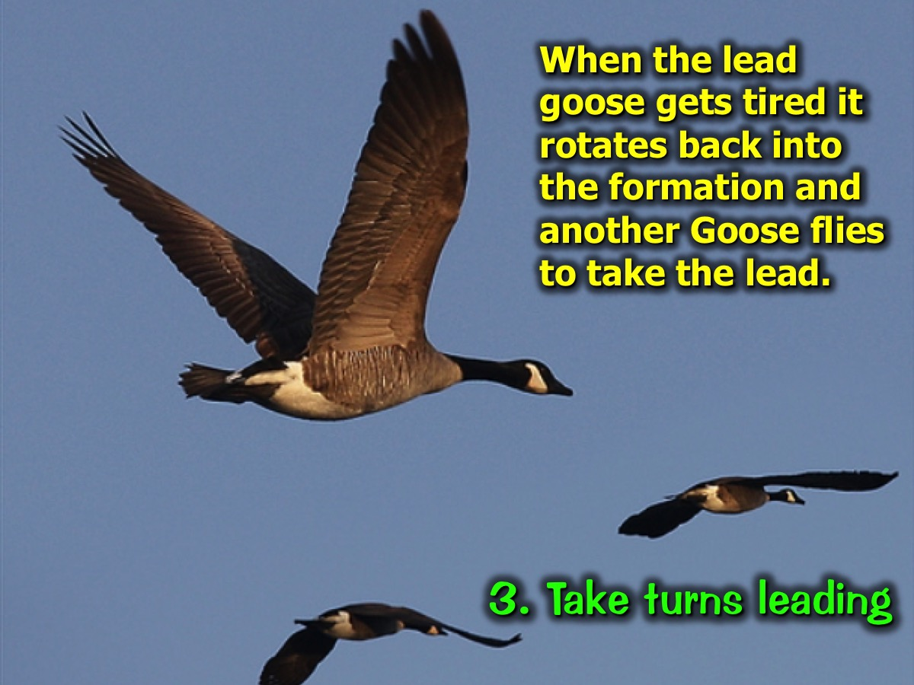
Notes:
3. Take turns leading: When the lead goose gets tired it rotates back into the formation and another Goose flies to take the lead.

Slide 21
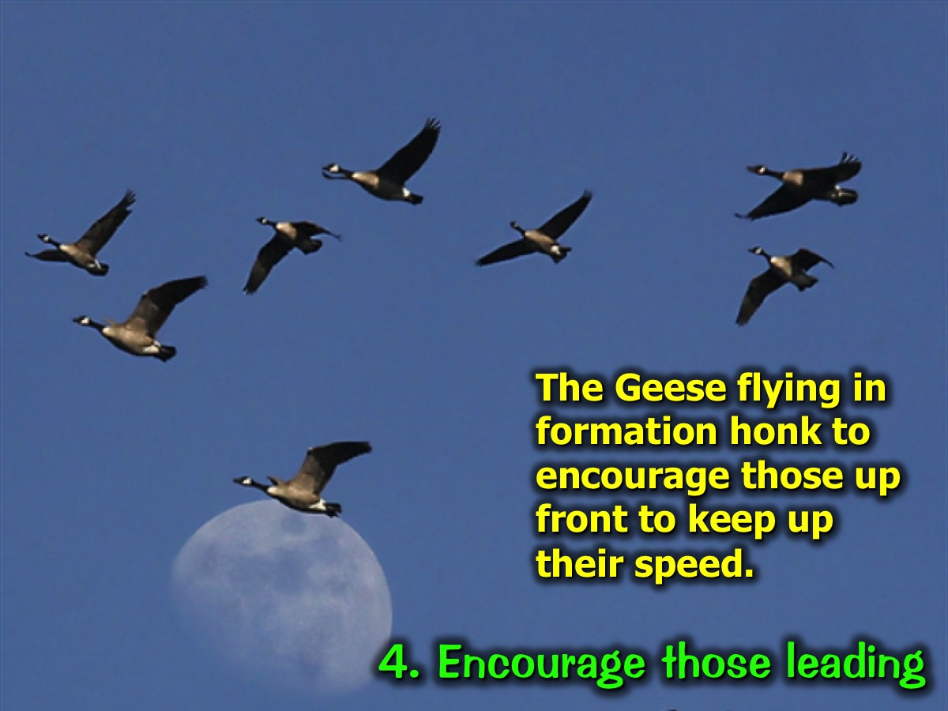
Notes:
4. Encourage those leading: The Geese flying in formation honk to encourage those up front to keep up their speed.

Slide 22
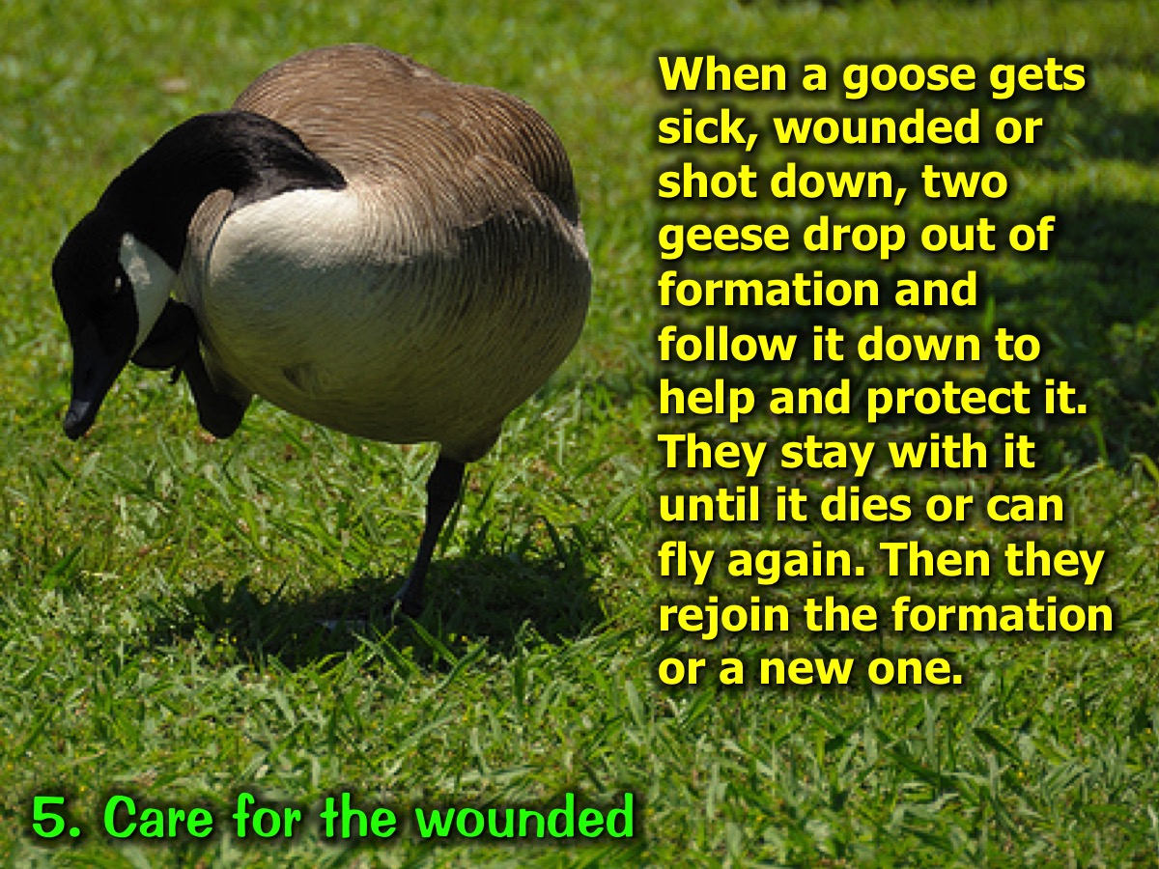
Notes:
5. Care for the wounded: When a goose gets sick, wounded or shot down, two geese drop out of formation and follow it down to help and protect it. They stay with it until it dies or can fly again. Then they rejoin the formation or a new one.

Slide 23
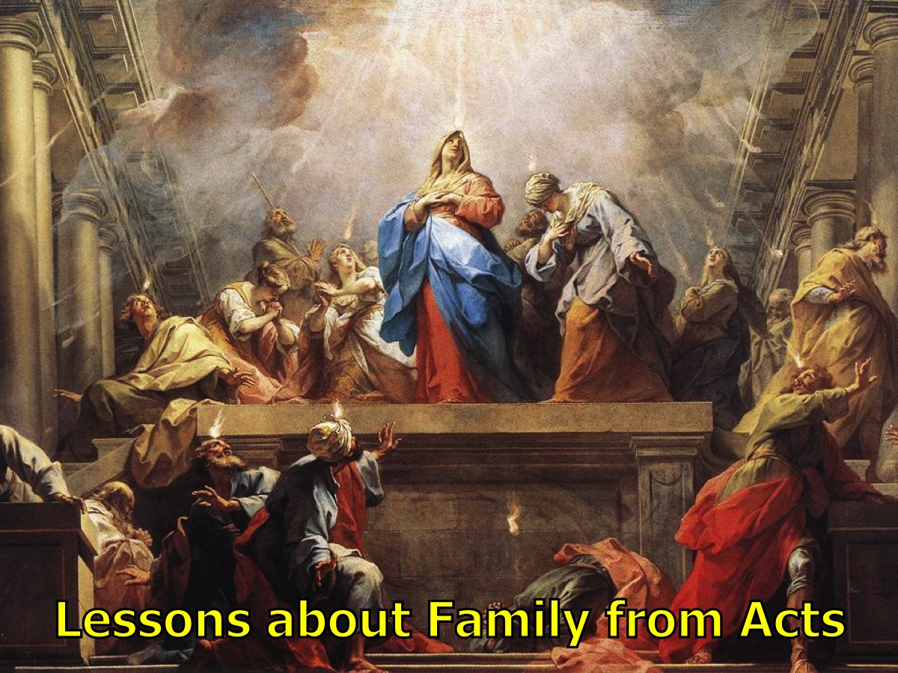
Notes:
Lessons about Family from Acts: Let’s take a closer look at the first church in the New Testament to see what we can learn about spiritual family.

Slide 24
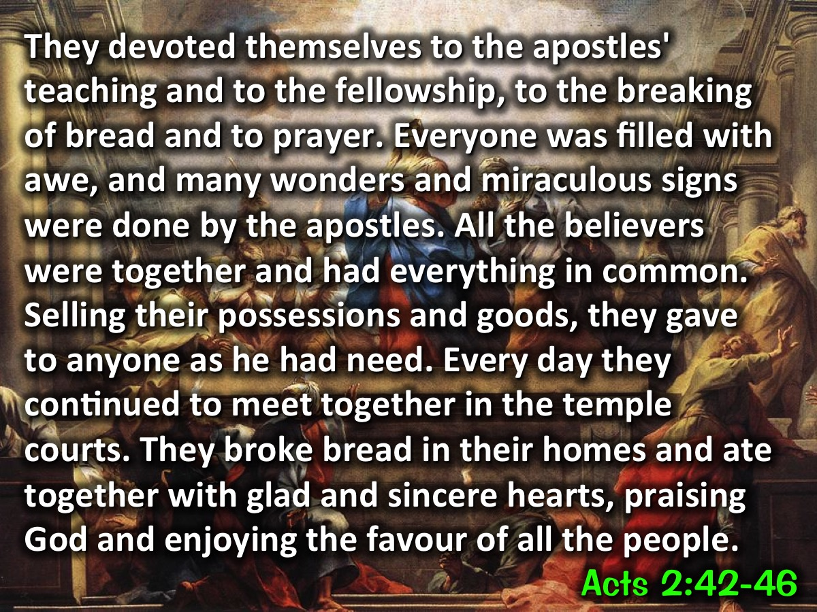
Notes:
Acts 2:42-47 - They devoted themselves to the apostles' teaching and to the fellowship, to the breaking of bread and to prayer. Everyone was filled with awe, and many wonders and miraculous signs were done by the apostles. All the believers were together and had everything in common. Selling their possessions and goods, they gave to anyone as he had need. Every day they continued to meet together in the temple courts. They broke bread in their homes and ate together with glad and sincere hearts, praising God and enjoying the favour of all the people.

Slide 25
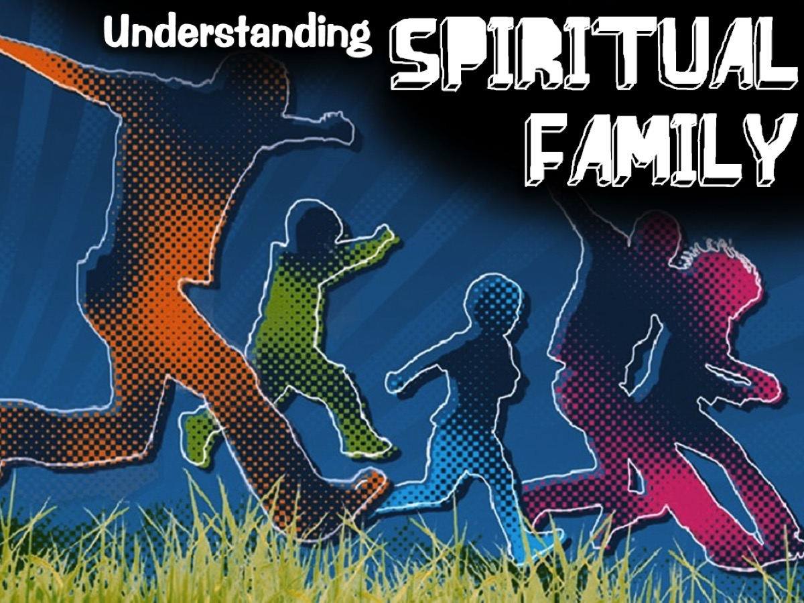
Notes:
Understanding Spiritual Family

Slide 26
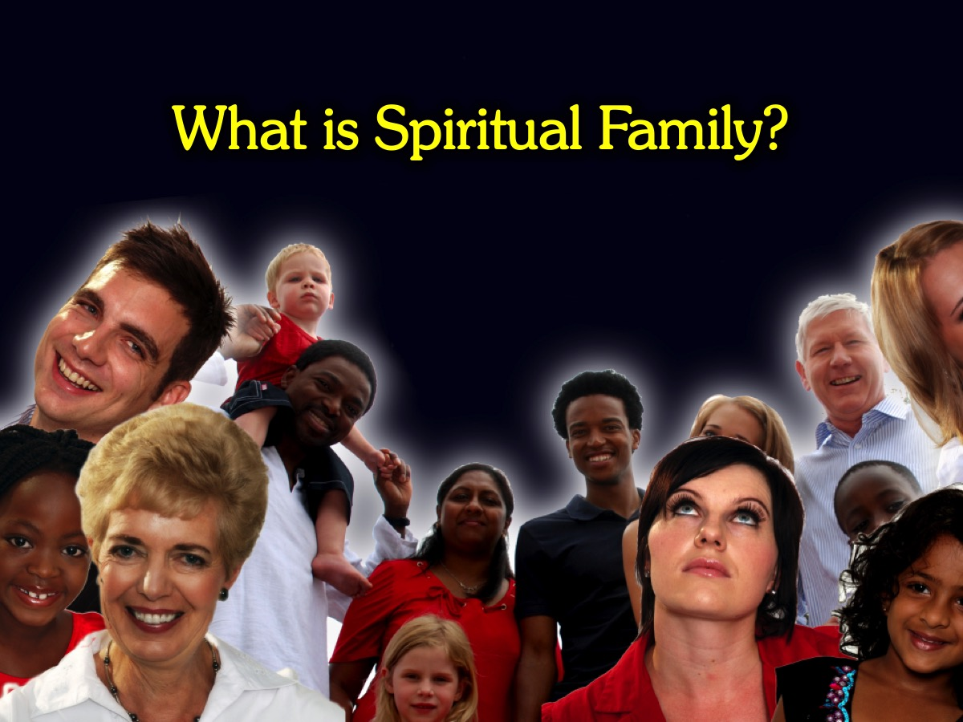
Notes:
What is Spiritual Family?

Slide 27
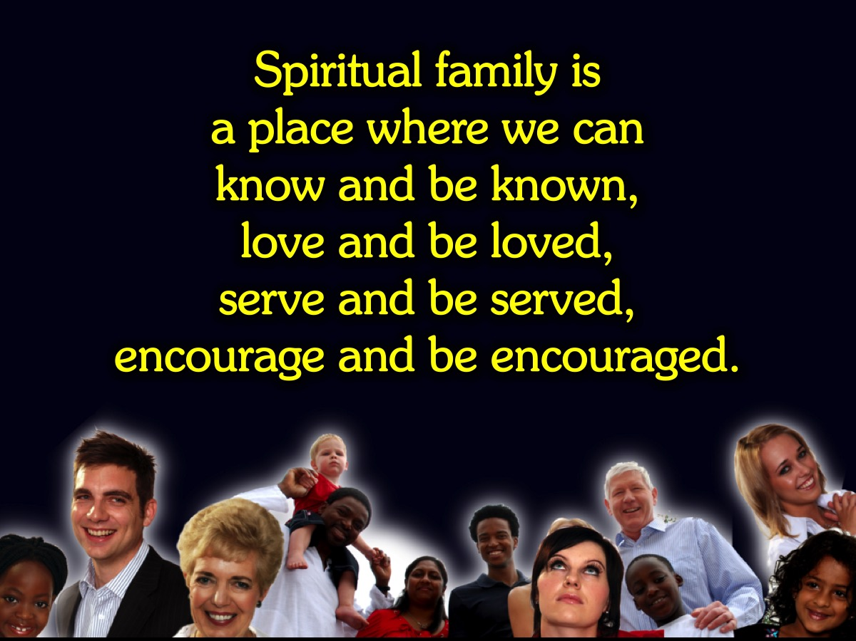
Notes:
Spiritual Family Defined: Spiritual family is a place where we can know and be known, love and be loved, serve and be served, encourage and be encouraged.

Slide 28
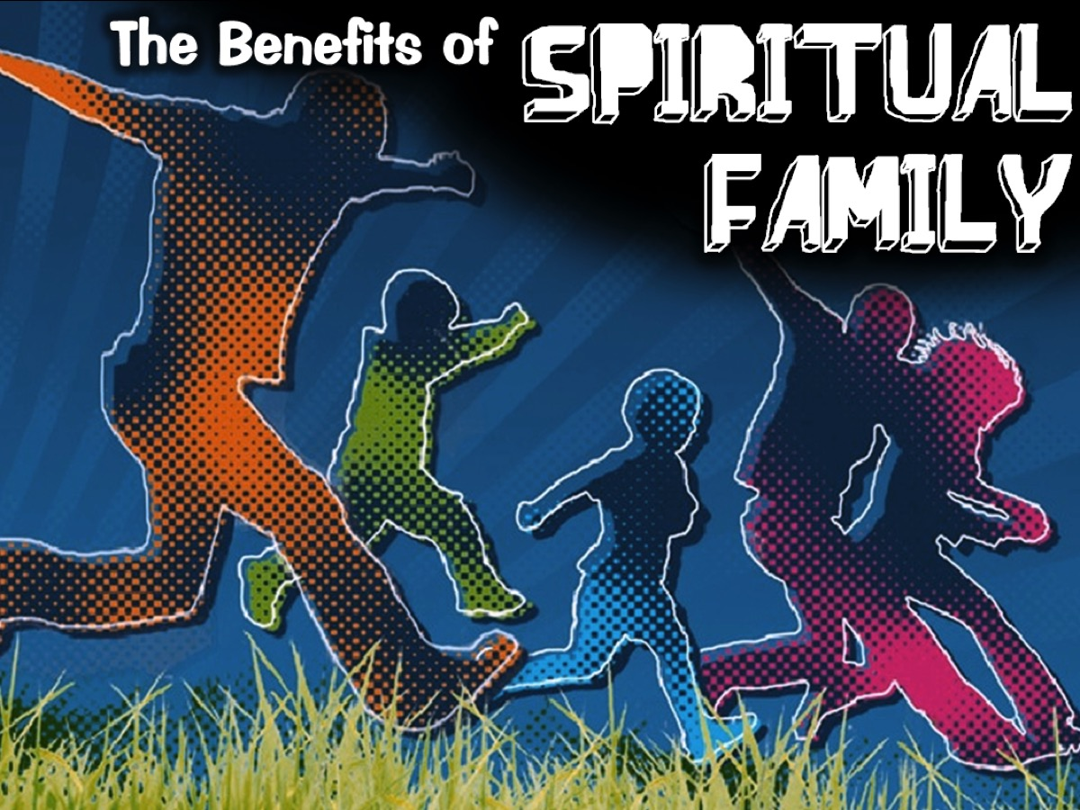
Notes:
The Benefits of Spiritual Family

Slide 29
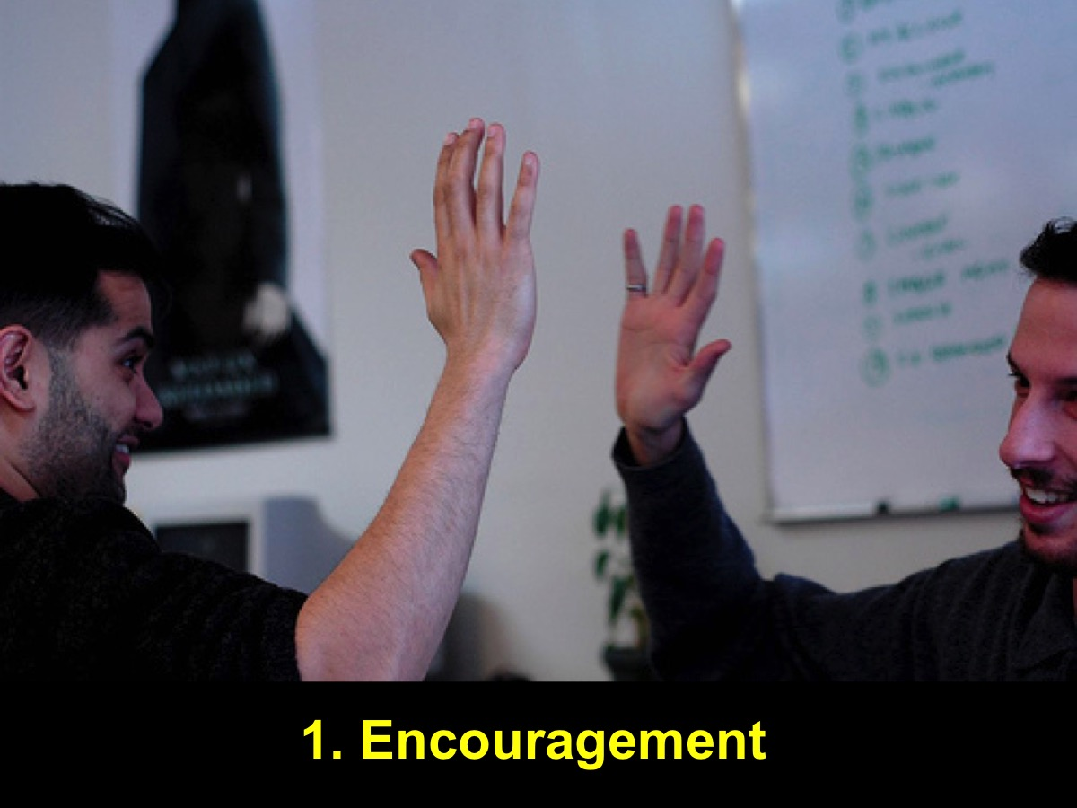
Notes:
1. Encouragement: Spiritual family means that we are encouraged to become all that we can become in Christ. This is a place where we have cheer leaders who encourage us to carry on!

Slide 30
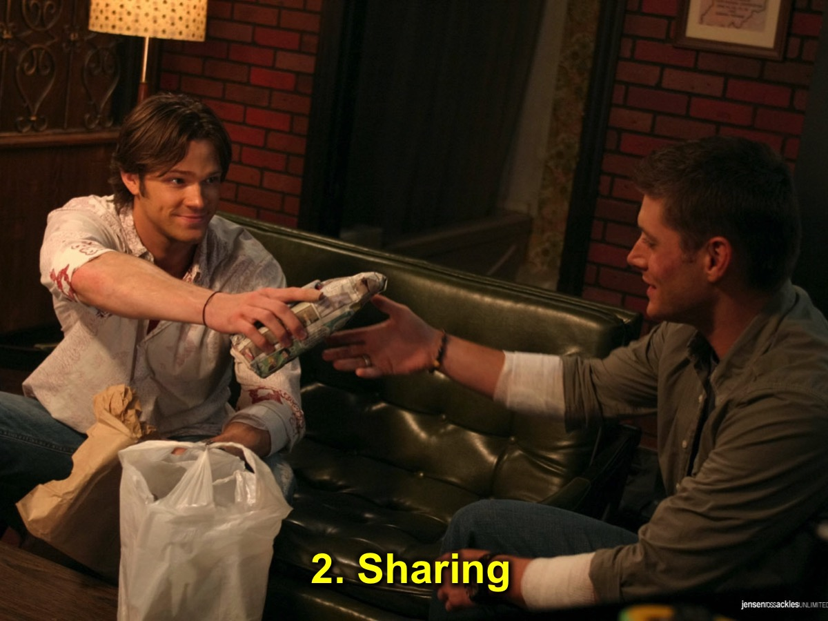
Notes:
2. Sharing: Spiritual family means that we share what we have with each other. Sometimes we share and other times we are on the receiving end of others sharing with us.

Slide 31
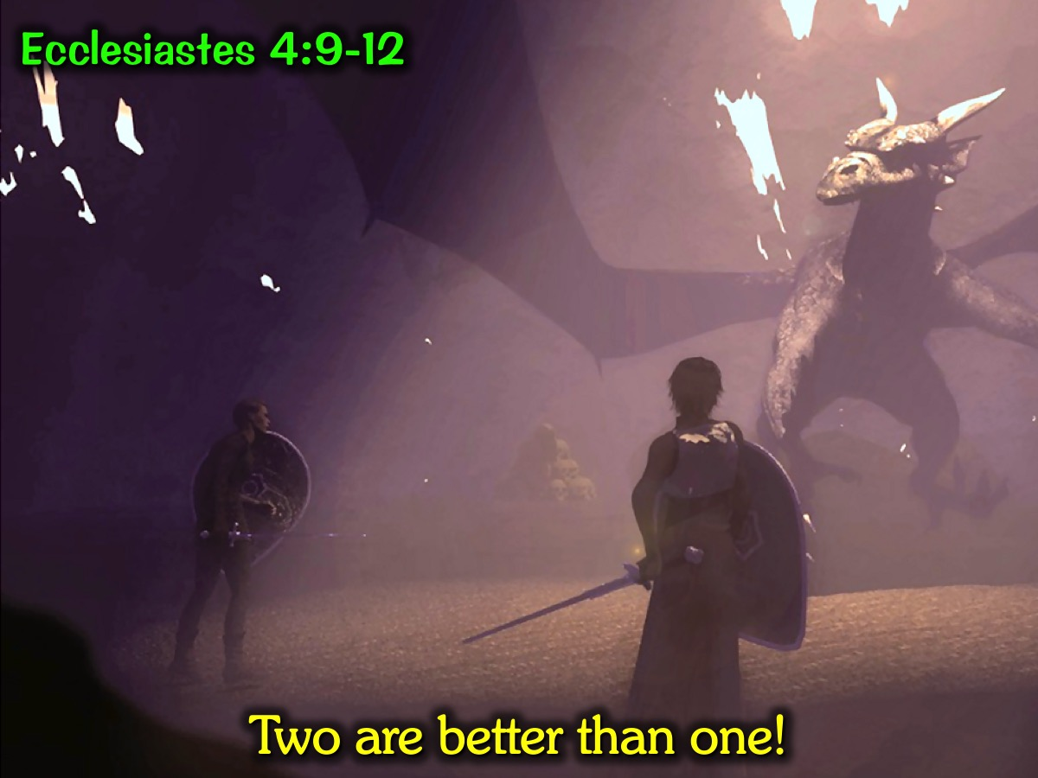
Notes:
Two Are Better Than One: Ecclesiastes 4:9-12 - Two people are better than one because together they have a good reward for their hard work. If one falls, the other can help his friend get up. But how tragic it is for the one who is all alone when he falls. There is no one to help him get up. Again, if two people lie down together, they can keep warm, but how can one person keep warm? Though one person may be overpowered by another, two people can resist one opponent. A triple-braided rope is not easily broken.

Slide 32
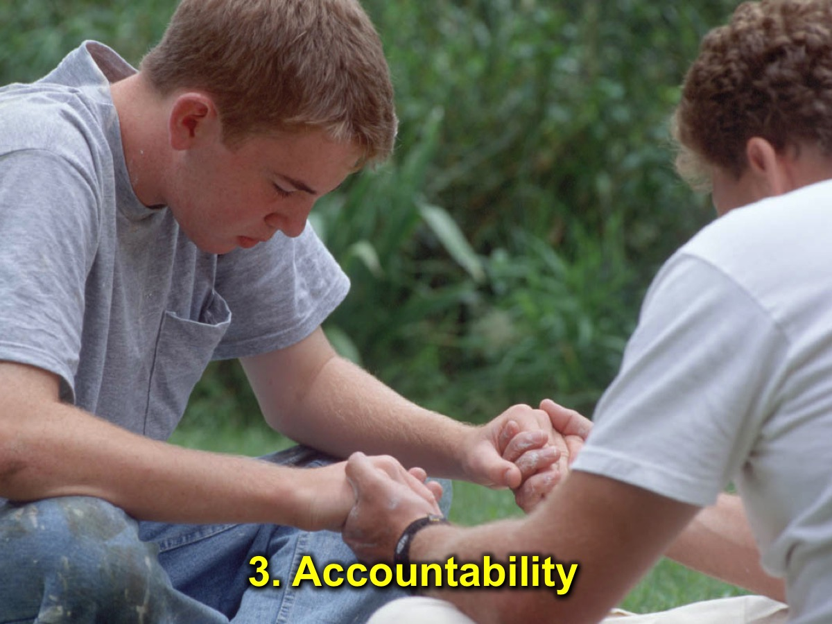
Notes:
3. Accountability: Spiritual family means that we have people who help us overcome sins and struggles in our lives by keeping us accountable to live better lives.

Slide 33
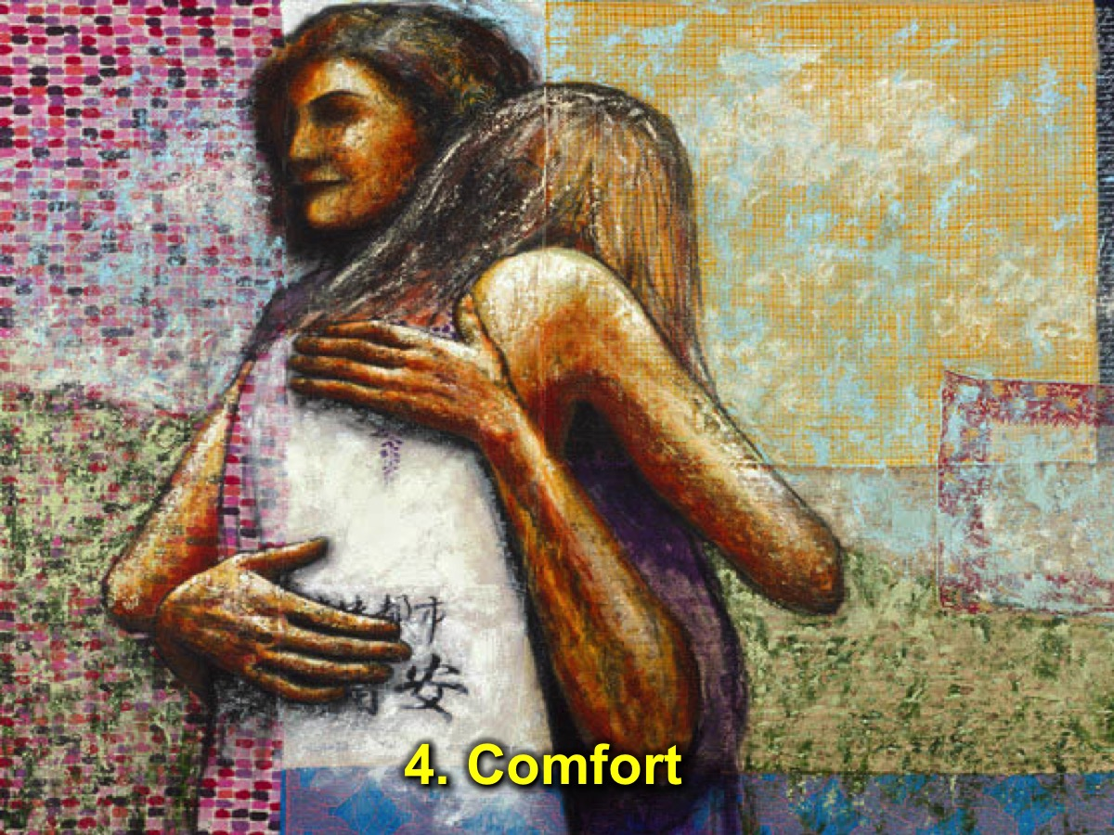
Notes:
4. Comfort: Spiritual family means that we receive comfort when we go through tough times. We all need a shoulder to cry on at times!

Slide 34
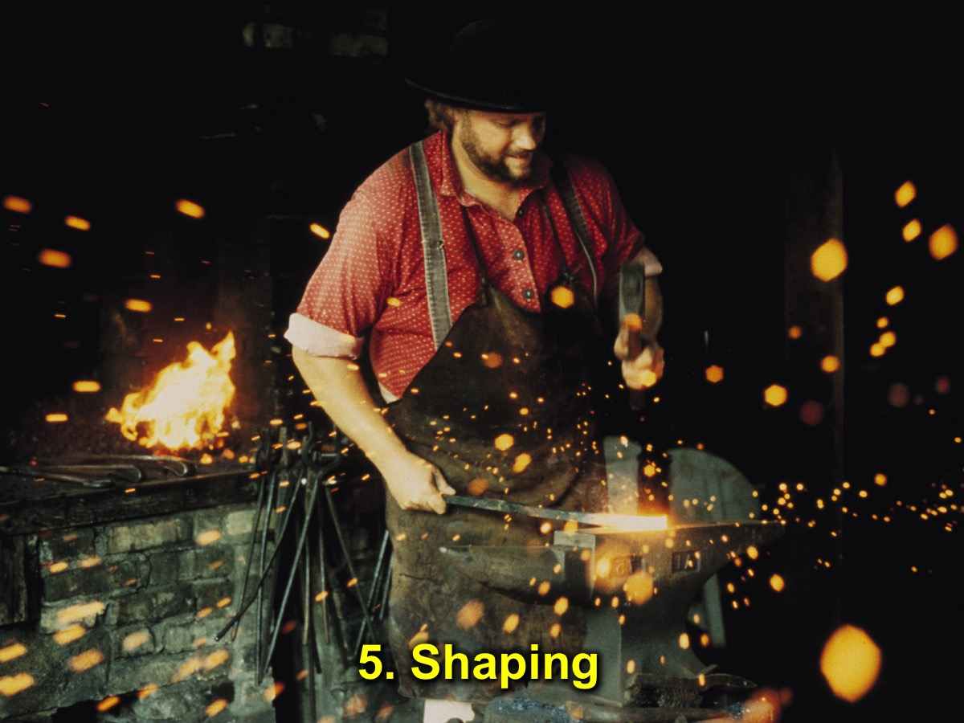
Notes:
5. Shaping: Spiritual family also means that we have people who help to shape us into the likeness of Jesus – it is a process that is not always pleasant (it is like iron sharpening iron) but it is necessary.

Slide 35
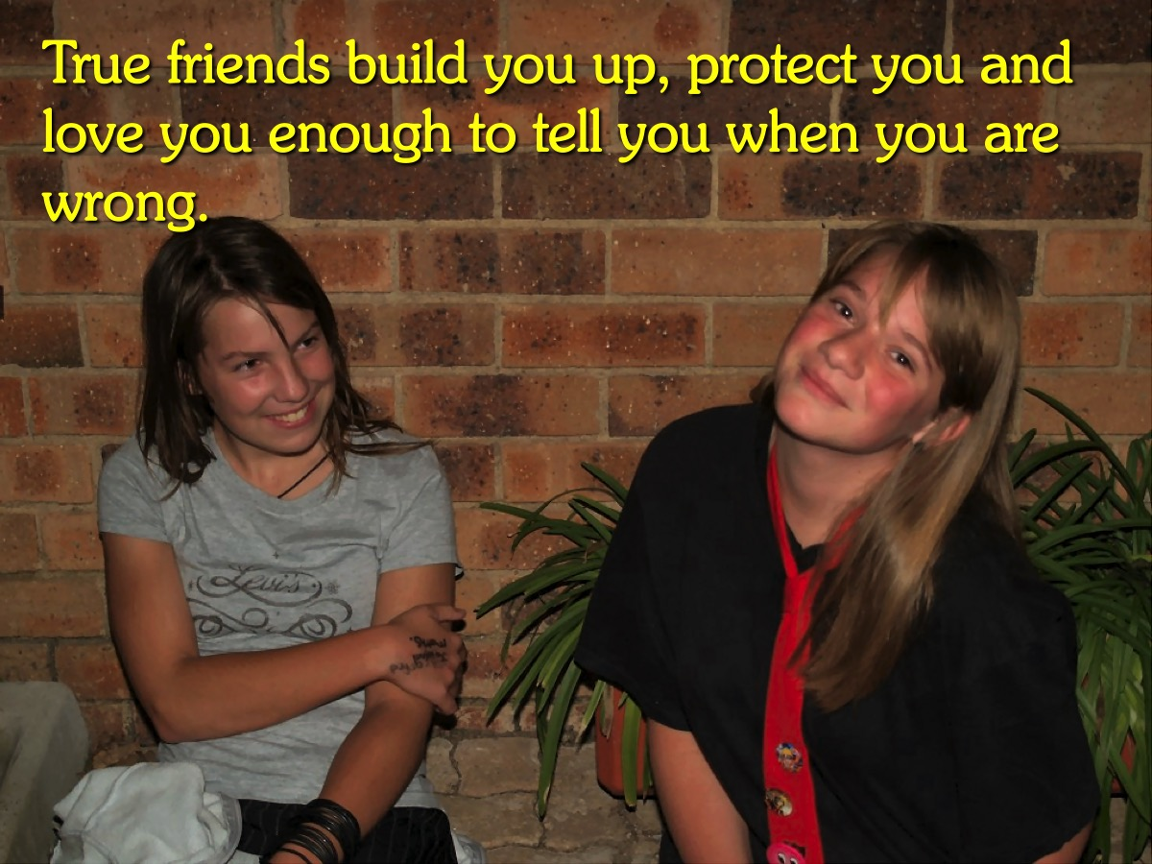
Notes:
True Friends: True friends build you up, protect you and love you enough to tell you when you are wrong.

Slide 36

Notes:
Ideas for Developing Spiritual Family

Slide 37
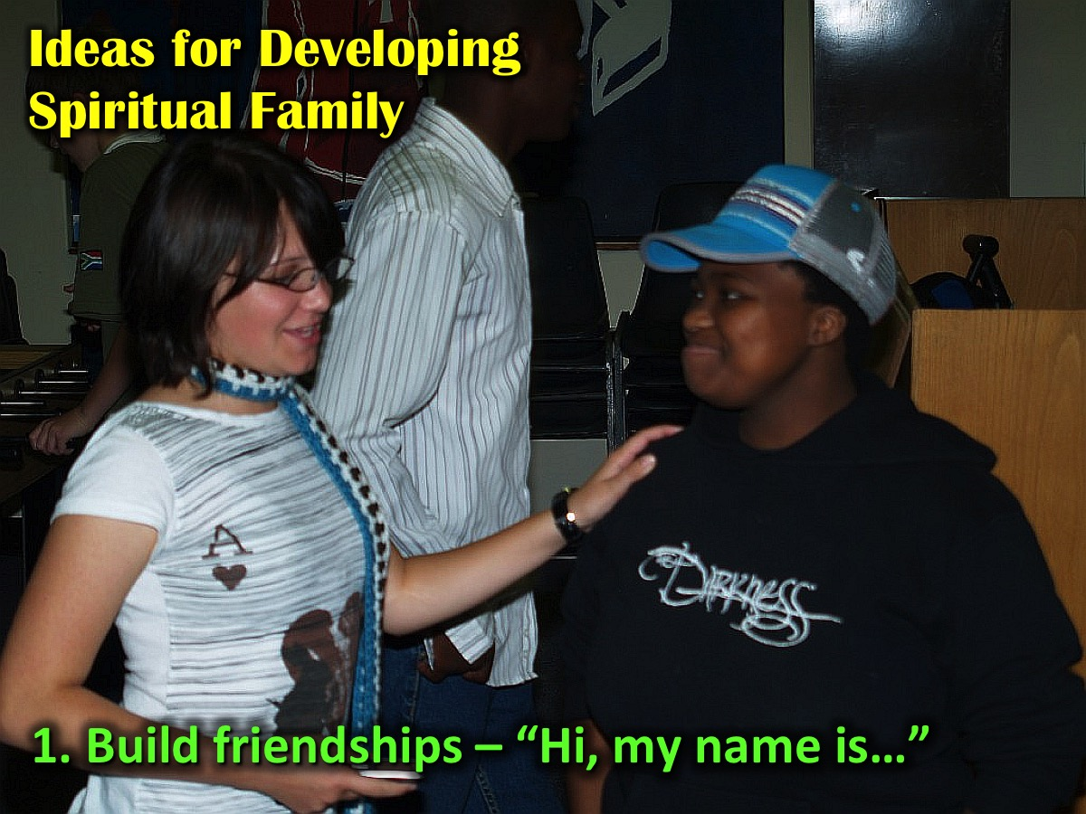
Notes:
1. Build friendships – it starts with a simple: “Hi, my name is…”

Slide 38
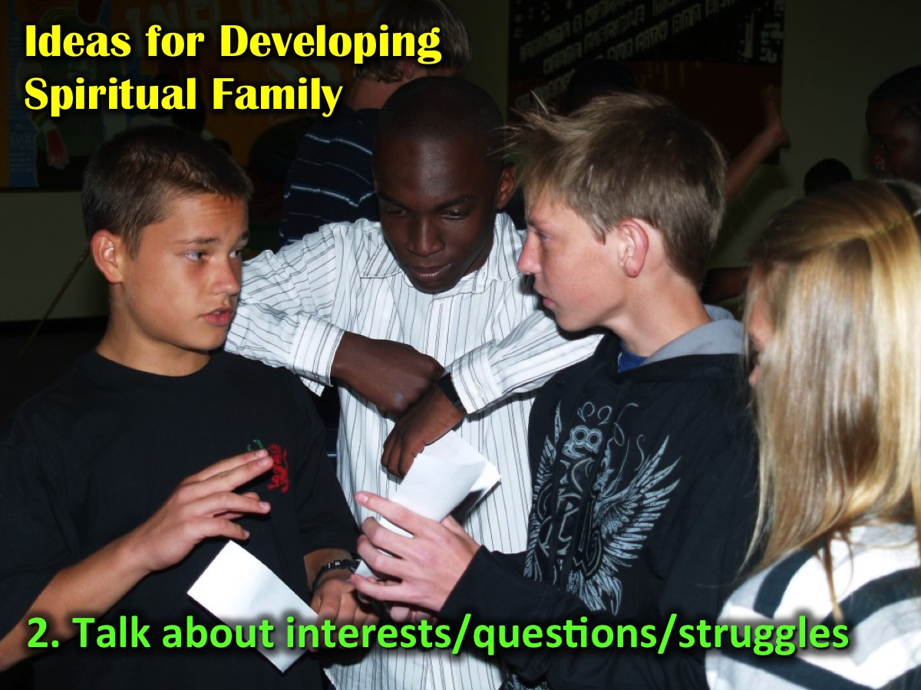
Notes:
2. Talk about interests, life questions and struggles

Slide 39
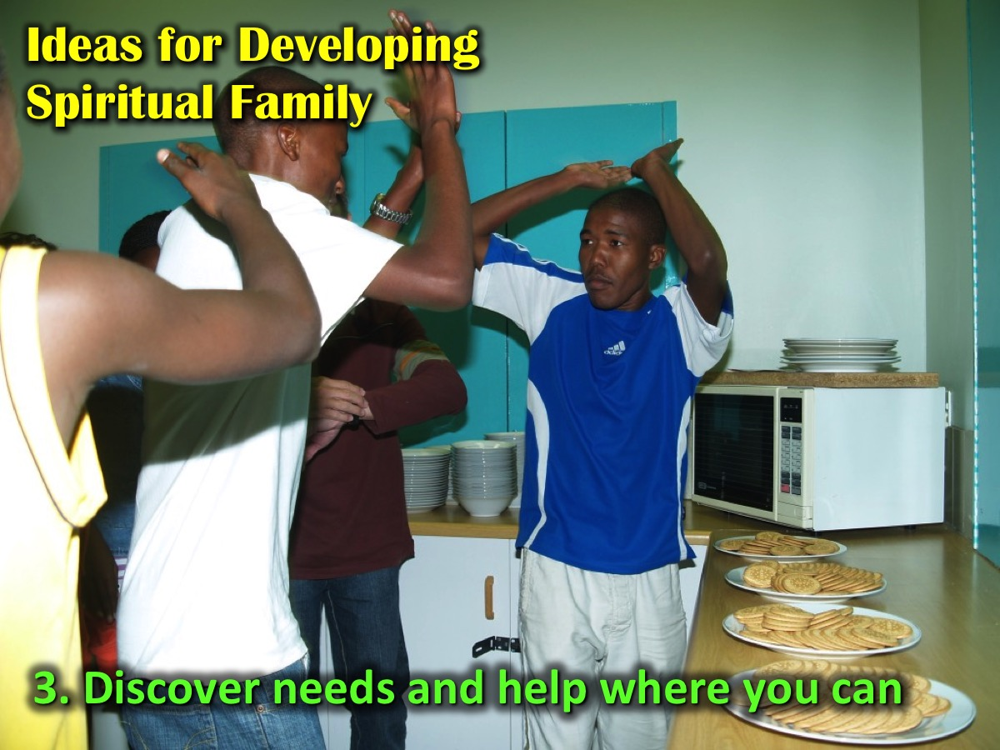
Notes:
3. Discover needs and help where you can

Slide 40
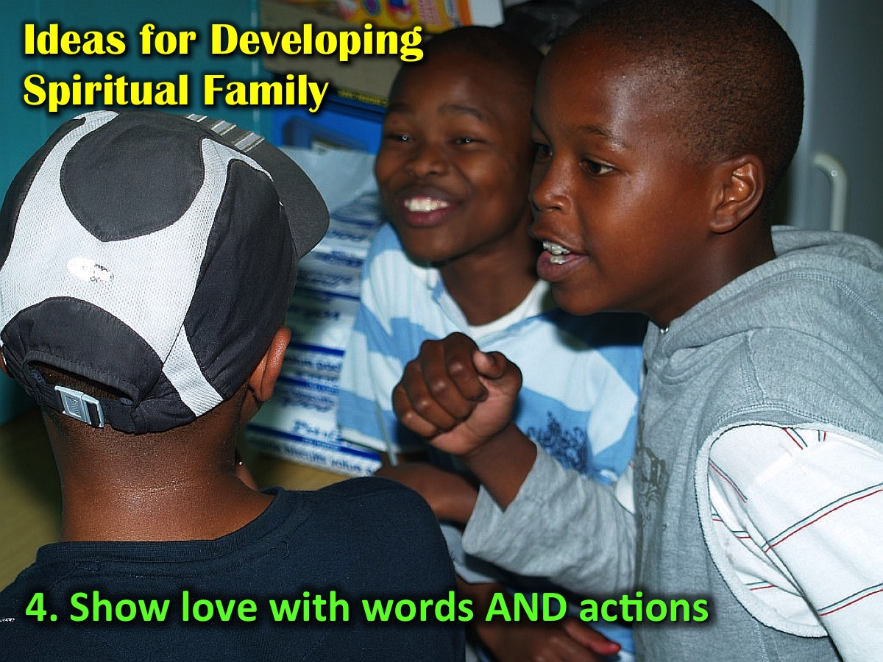
Notes:
4. Show love with words AND actions

Slide 41
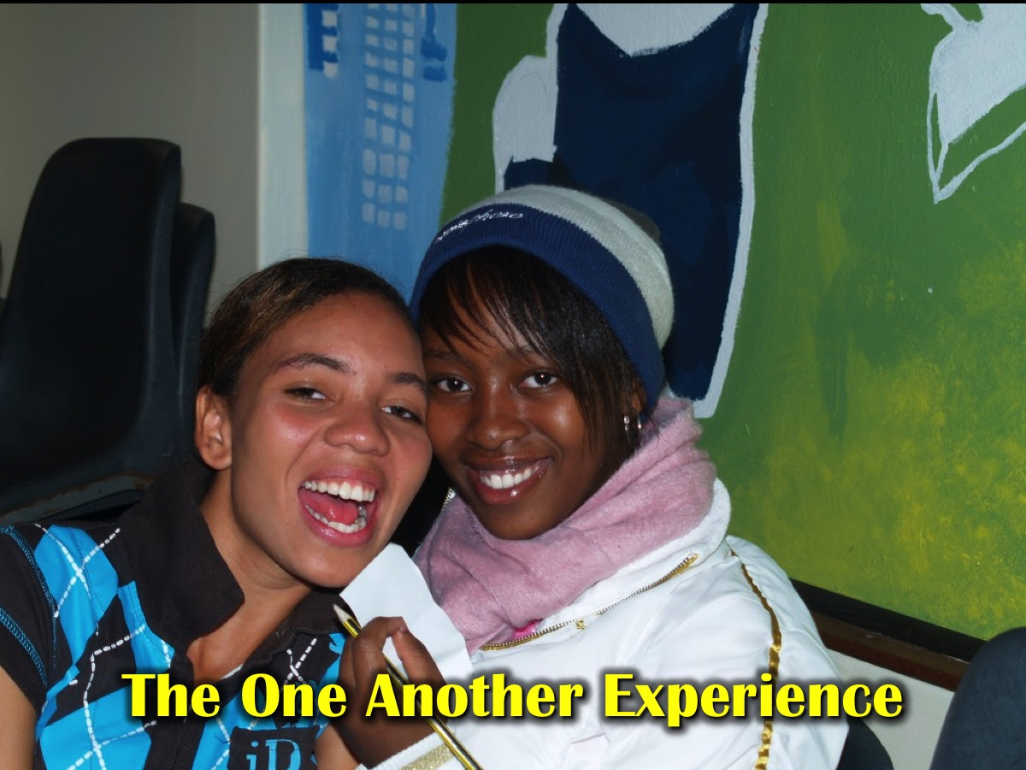
Notes:
The One Anothering Experience: Hand out slips of paper with a one another command from the New Testament typed on it. Have youth thinking about how they can act out the command. Then give five minutes for youth to mix and carry out the commands.

Slide 42
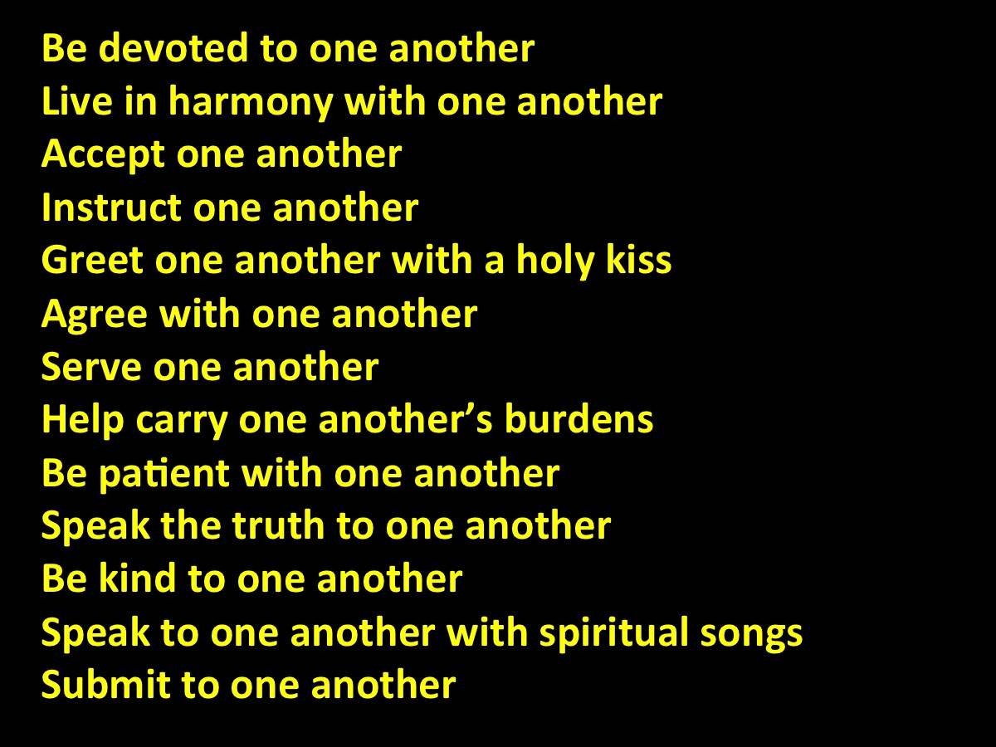
Notes:
The One Another Commands: Group 1 - Be devoted to one another; Live in harmony with one another; Accept one another; Instruct one another; Greet one another with a holy kiss; Agree with one another; Serve one another; Help carry one another’s burdens; Be patient with one another; Speak the truth to one another; Be kind to one another; Speak to one another with spiritual songs; Submit to one another.

Slide 43
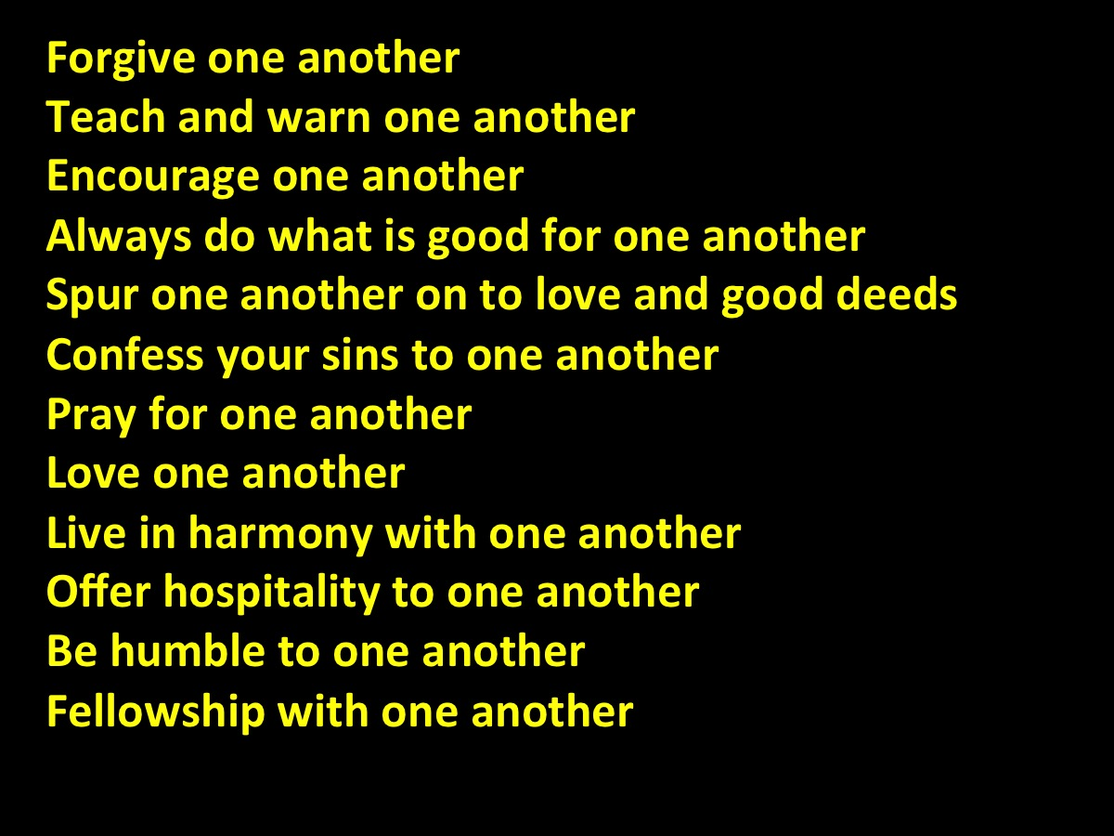
Notes:
The One Another Commands: Group 2 - Forgive one another; Teach and warn one another; Encourage one another; Always do what is good for one another; Spur one another on to love and good deeds; Confess your sins to one another; Pray for one another; Love one another; Live in harmony with one another; Offer hospitality to one another; Be humble to one another; Fellowship with one another.

Slide 44
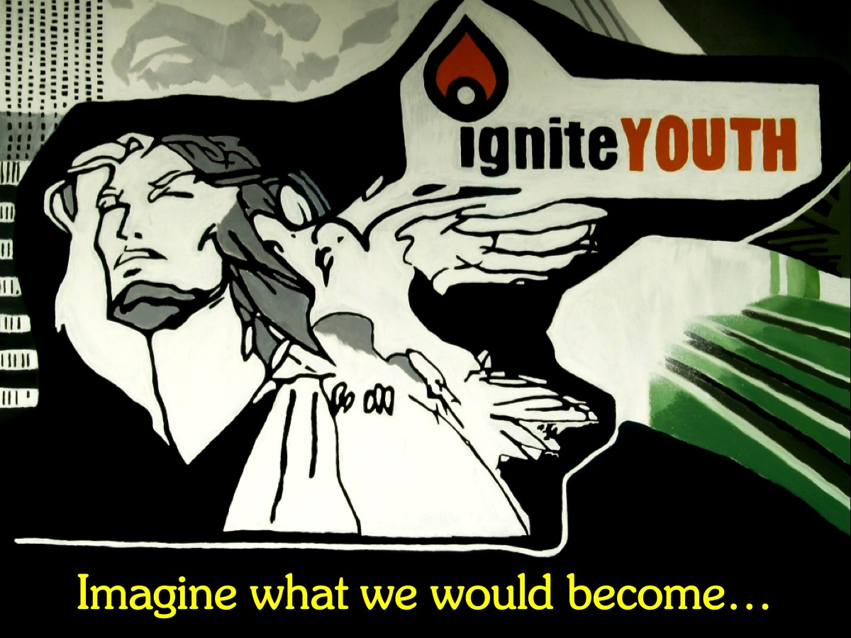
Notes:
Imagine what we would become if we practised the one another commands!

