Slide 1
Notes:
Do you have a best friend? How did you develop the friendship?

Slide 2
Notes:
Here are my 5 secrets to building a friendship with someone: (1) Listen to them. (2) Talk to Them. (3) Hang with their friends. (4) Try please them. (5) Tell others about them.

Slide 3
Notes:
Greater love has no one than this: to lay down one’s life for one’s friends. You are my friends if you do what I command. I have called you friends, for everything that I learned from my Father I have made known to you. (John 15:13-15)

Slide 4
Notes:
Are you friends With Jesus? What could you do to develop a friendship with Jesus?

Slide 5
Notes:
I am going to share with you my five secrets to friendship with Jesus.

Slide 6
Notes:
1. Read His Word. The first way to grow your relationship with Jesus is to spend time reading what He has written to you.

Slide 7
Notes:
Read the passage again and look for:
S = A Sin to Avoid?
P = A Promise to Claim?
E = An Example to Follow?
C = A Command to Obey?
K = A Knowledge to Gain?
Write something for each one.

Slide 8
Notes:
2. Talk to Him. The second way to grow your relationship with Jesus is to talk to him – we call this prayer and it involves expressing your love to Him, confessing your sins, thanking Him and asking Him for help.

Slide 9
Notes:
There are different ways to pray: Here is a method based on the prayer that Jesus used to teach his disciples to pray.
* Praise: “Our father in heaven, hallowed be your name.”
* Request: “Your kingdom come, your will be done, on earth as it is in heaven. Give us today our daily bread.”
* Admit: “And forgive us our debts as we have also forgiven our debtors.”
* Yield: “And lead us not into temptation but deliver us from the evil one.”

Slide 10
Notes:
Write a letter to God using the outline PRAY (or use this outline when you pray):
* Praise: Thank and praise God for who he is, how great He is and how you love him.
* Request: Ask God to work in your life, to bring his kingdom to earth and to meet needs.
* Admit: Admit that you need God in your life and that you need his help to make disciples.
* Yield: Tell God that you surrender to Him and want to be used by Him to reach your friends.

Slide 11
Notes:
3. Hang With Believers. The third way to grow your relationship with Jesus is to spend time with God’s friends at church. You need to develop a habit of meeting together regularly with other believers.

Slide 12
Notes:
Name 3 Christians you can call in case of a spiritual emergency: (1) ____________, (2) ____________, (3) ____________.

Slide 13
Notes:
4. Obey His Teaching. The fourth way to grow your relationship with Jesus is to find out how you can please him and avoid things that he does not approve of.

Slide 14
Notes:
If you claim to follow Jesus you have to make him Lord of your life. He wants to help you decide what to do and where to go - basically how to live your life.

Slide 15
Notes:
You can experience his Lordship by asking yourself the question: What Would Jesus Do?

Slide 16
Notes:
5. Share His Story. The fifth way to grow your relationship with Jesus is to talk about your new relationship with your friends and family members.

Slide 17
Notes:
Here are the 6 words that help us understand the Gospel - each word stands for a letter of the word GOSPEL to help you remember the words: God Our Sins Paying Everyone Life. This is based on a great video called Life in 6 Words. Get it on YouTube at:

Slide 18
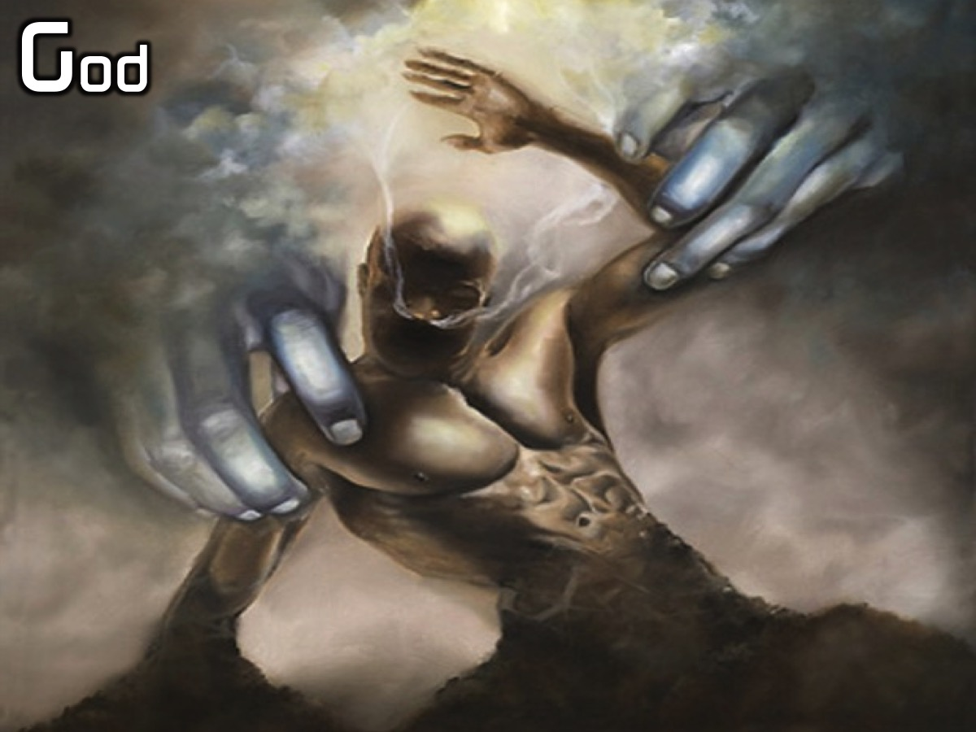
Notes:
God

Slide 19
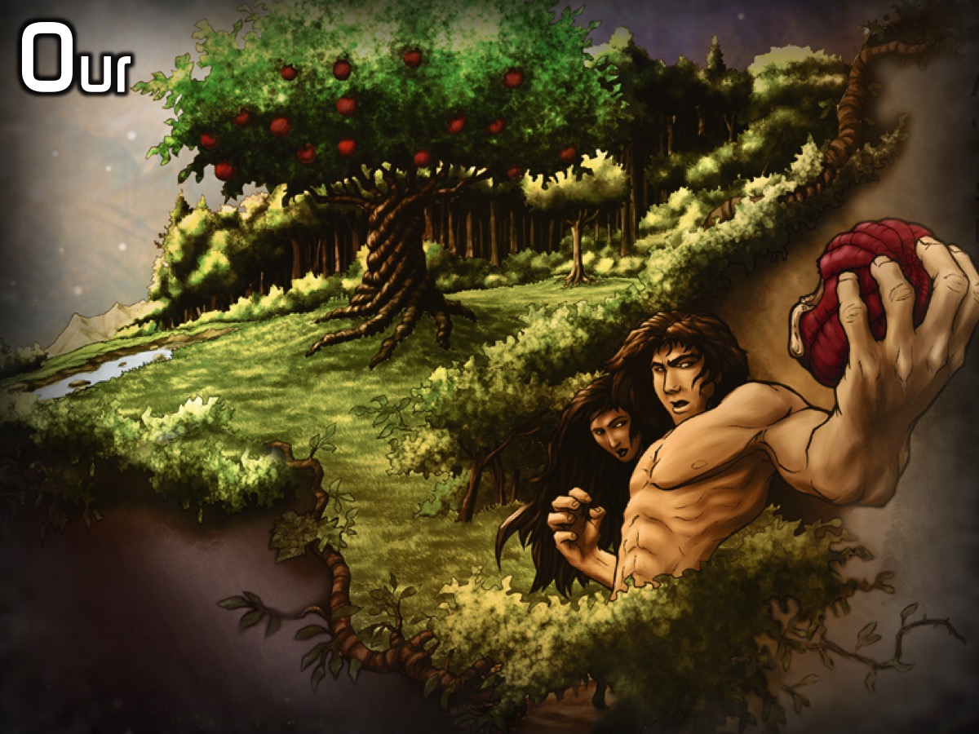
Notes:
Our

Slide 20
Notes:
Sins

Slide 21
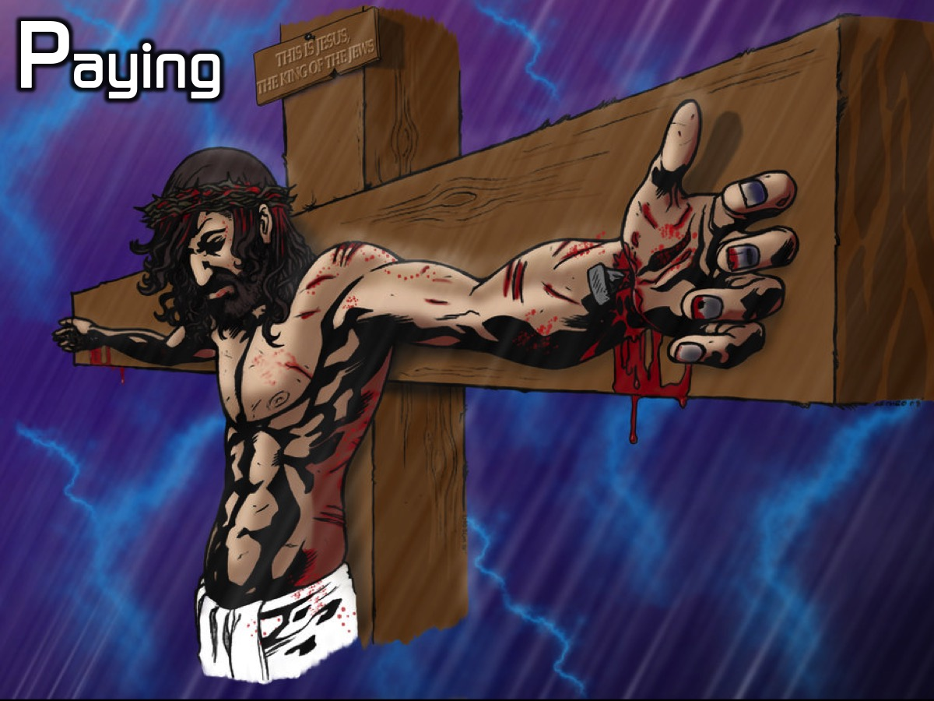
Notes:
Paying

Slide 22
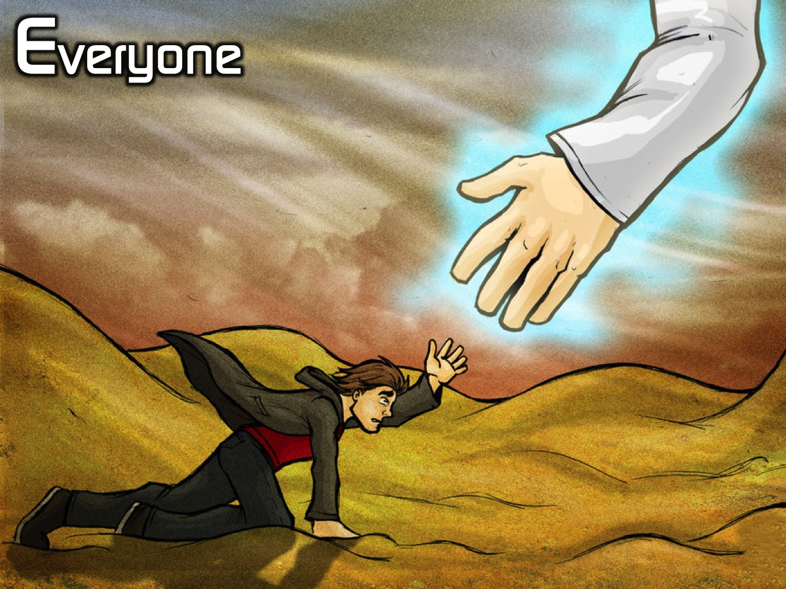
Notes:
Everyone

Slide 23
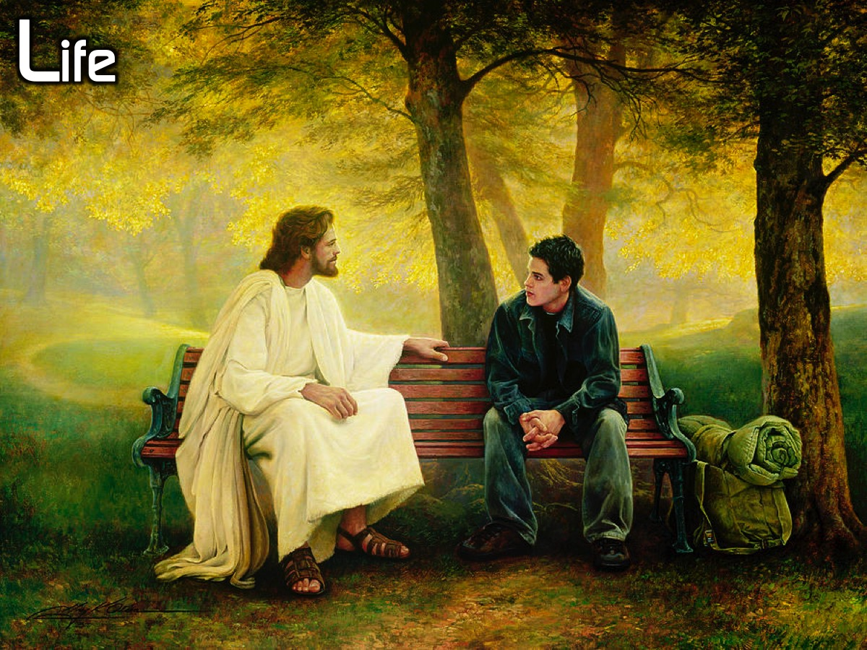
Notes:
Life

Slide 24
Notes:
Say them all at your own pace: God Our Sins Paying Everyone Life

Slide 25
Notes:
Say the words with me this time: God

Slide 26
Notes:
Our

Slide 27
Notes:
Sins

Slide 28
Notes:
Paying

Slide 29
Notes:
Everyone

Slide 30
Notes:
Life

Slide 31
Notes:
One more time, all together: God Our Sins Paying Everyone Life.

Slide 32
Notes:
These six words actually stand for six sentences: God created us to be with him.

Slide 33
Notes:
Our sins separate us from God.

Slide 34
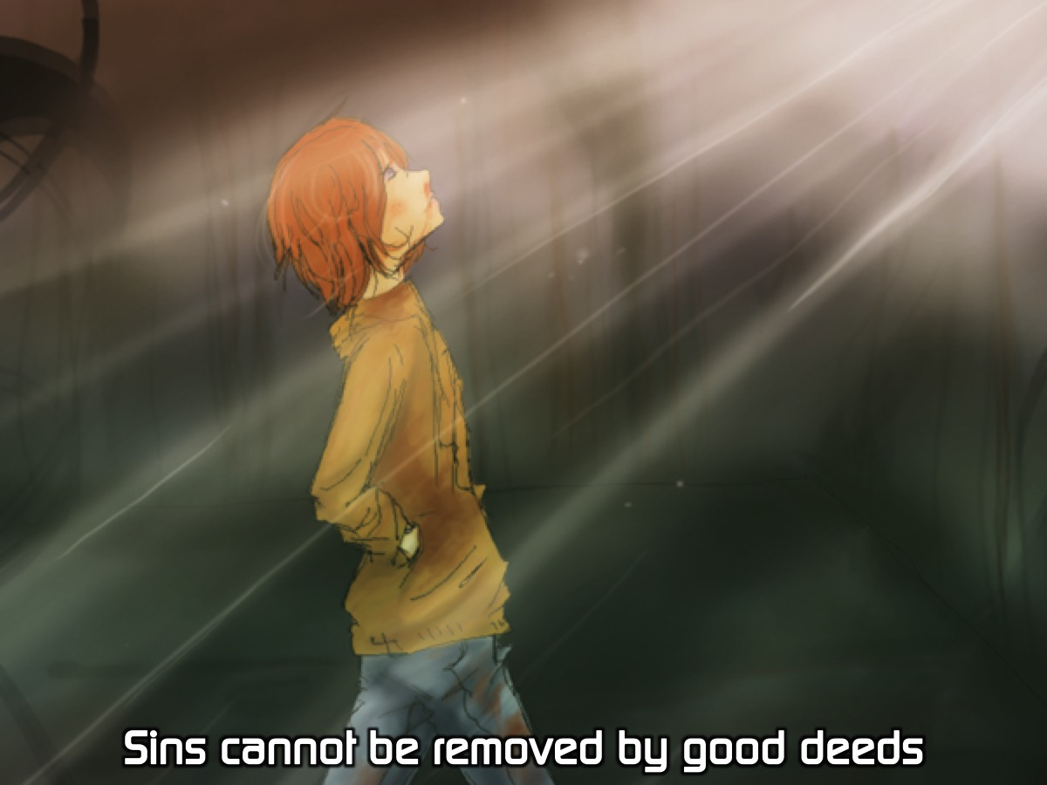
Notes:
Sins cannot be removed by good deeds.

Slide 35
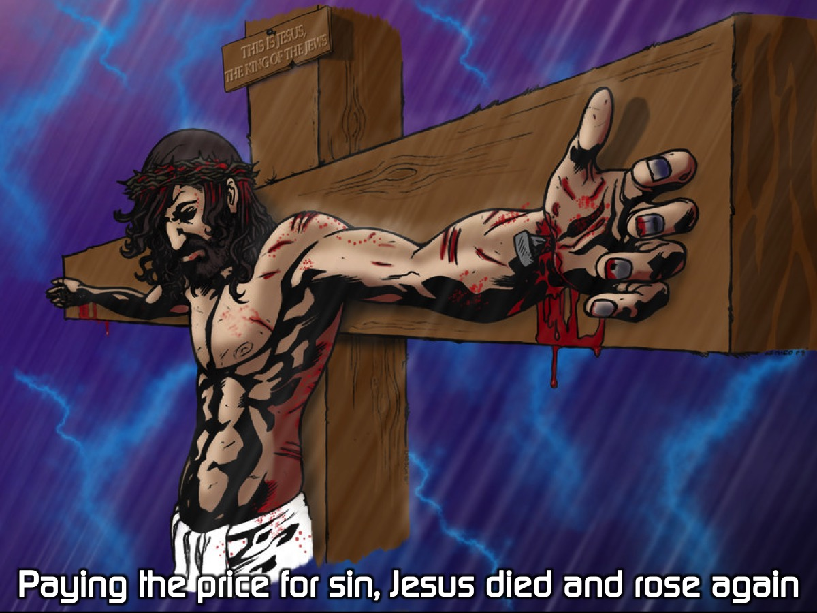
Notes:
Paying the price for sin, Jesus died and rose again.

Slide 36
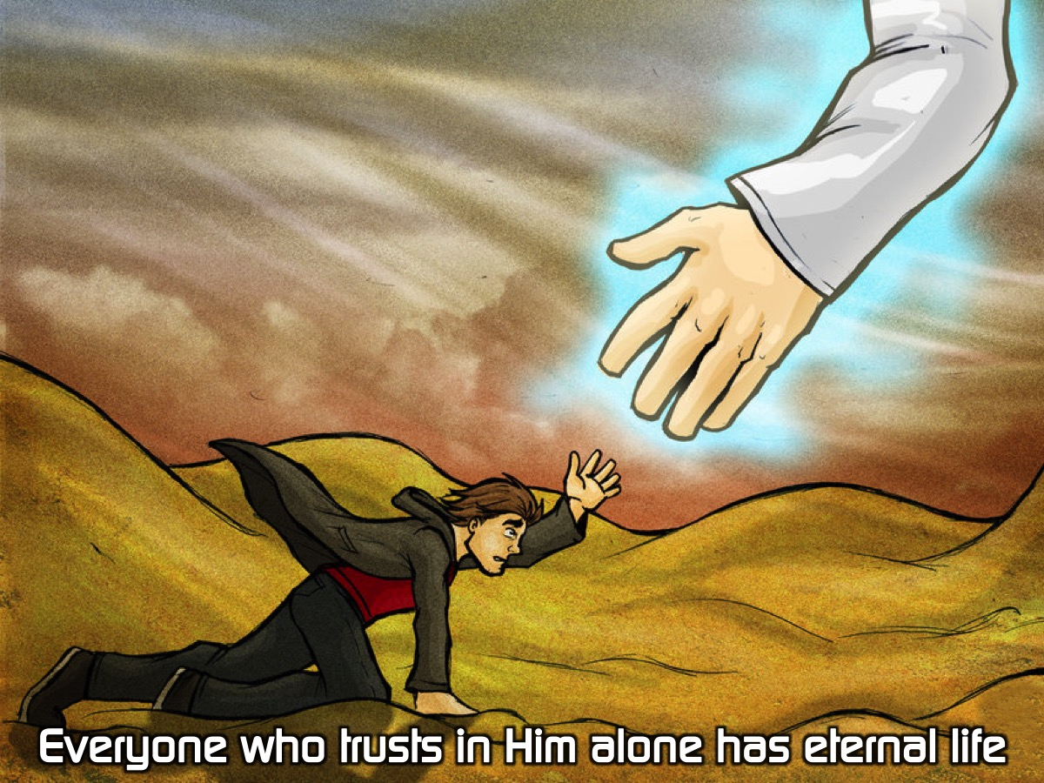
Notes:
Everyone who trusts in Him alone has eternal life.

Slide 37
Notes:
Life with Jesus starts now and lasts forever.

Slide 38
Notes:
God created us to be with him.

Slide 39
Notes:
Our sins separate us from God.

Slide 40
Notes:
Sins cannot be removed by good deeds.

Slide 41
Notes:
Paying the price for sin, Jesus died and rose again.

Slide 42
Notes:
Everyone who trusts in Him alone has eternal life.

Slide 43
Notes:
Once you have shared the GOSPEL with your lost friend, ask them if they understand what you have shared, if they don’t then go over it again, and if they do, then ask them if they are ready to trust in Jesus for salvation. If they say yes, then lead them in a prayer to receive Jesus as their Saviour. Here is an example that I have created based on the G.O.S.P.E.L. outline - it is not a magic formula to get someone saved, but a chance for them to express their trust in what Jesus did on the cross to remove their sin and bring them into a relationship with God and to receive eternal life as a free gift: Dear God, thank you that you created me to enjoy a close relationship with you. I now realise that my sins separated me from you and that I cannot remove my sins through good deeds. Thank you that Jesus died and rose again to pay for my sins and right now I put my trust in you alone and I receive your free gift of eternal life. Thank you that eternal life starts now and lasts forever. Amen.

Slide 44
Notes:
Life with Jesus starts now and lasts forever.

Slide 45
Notes:
In summary, here are my five secrets for developing a friendship with Jesus:
(1) Read His Word
(2) Talk To Him
(3) Hang With Believers
(4) Obey His Teachings
(5) Share His Story

Slide 46
Notes:
Let’s Pray

