Slide 1
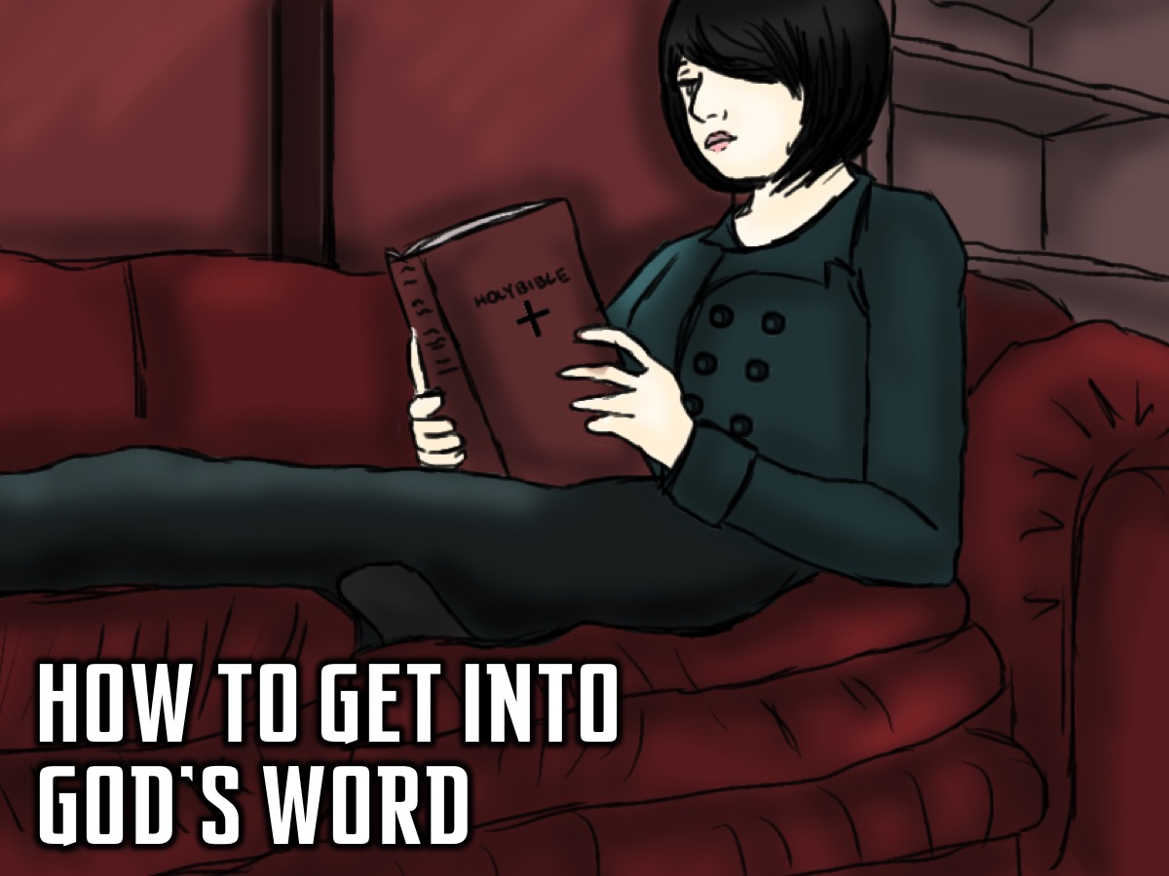
Notes:
How to Get Into God’s Word: Today I am going to show you a way you can use to help you get into God’s Word. This is a way of getting into the word so that reading the Bible is not like trying to do math.

Slide 2
Notes:
Read a Bible Passage. We suggest that you consider starting with a book of the Bible and each day move on to the next section. Some options: Psalms; Proverbs, one of the Gospels; or a Letter.

Slide 3
Notes:
1. Reflect. Write or summarise the passage in your own words:

Slide 4
Notes:
2. Apply. Read the passage again and look for:
S = A Sin to Avoid?
P = A Promise to Claim?
E = An Example to Follow?
C = A Command to Obey?
K = A Knowledge to Gain?

Slide 5
Notes:
3. Think. Write down what you have learnt about God.

Slide 6
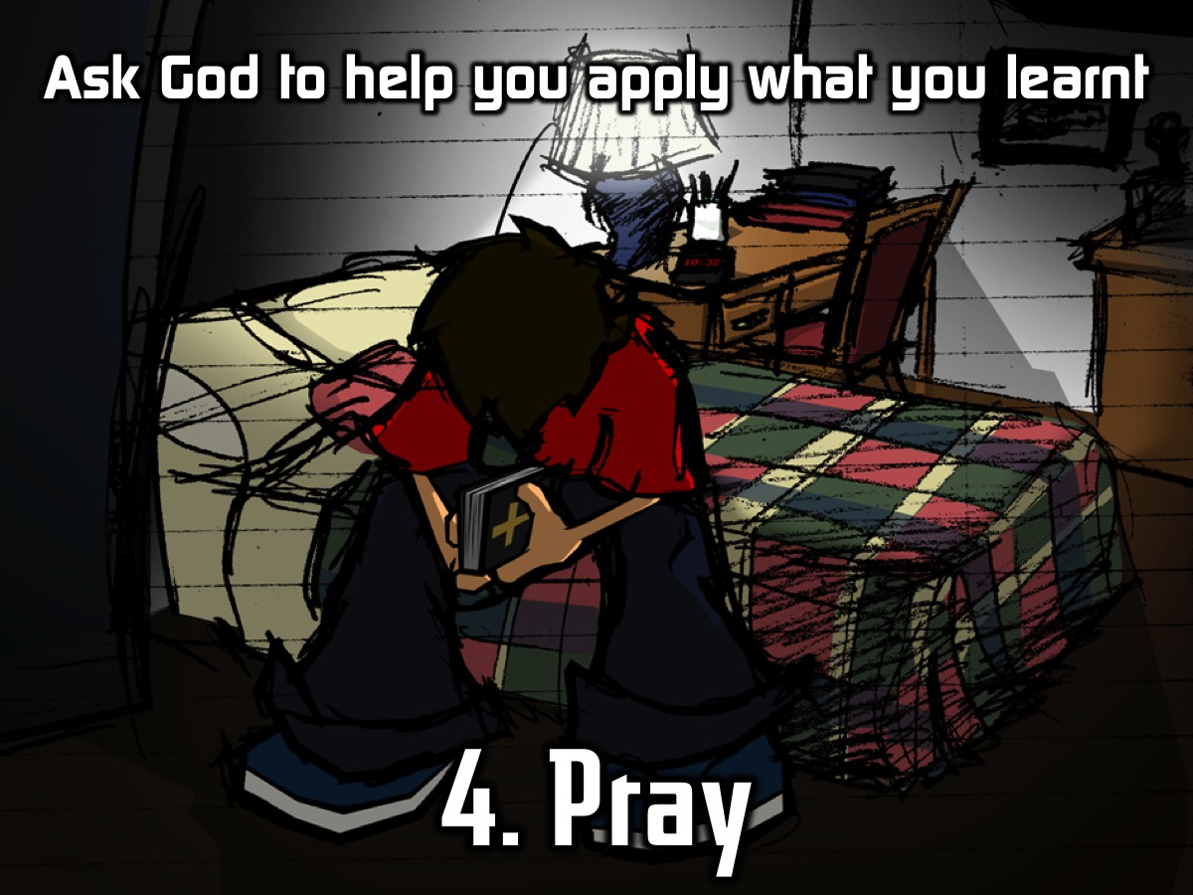
Notes:
4. Pray. Ask God to help you apply what you have learnt.

Slide 7
Notes:
Let’s try appying what we read to our lives using the five questions we learnt to ask about what we read: Is there a Sin to Avoid, a Promise to Claim, an Example to Follow, a Command to Obey, and Knowledge to Gain?

Slide 8
Notes:
Practise: It is time for you to Get Into God’s Word. We are going to give you each a copy of a handout to work through – using Psalm 1.

Slide 9
Notes:
Sharing: This is your chance to come to the microphone and share what you got out of your time in the Word and with God.

Slide 10
Notes:
Challenge: Do it every day for the next week! And then for the rest of your life!

Slide 11
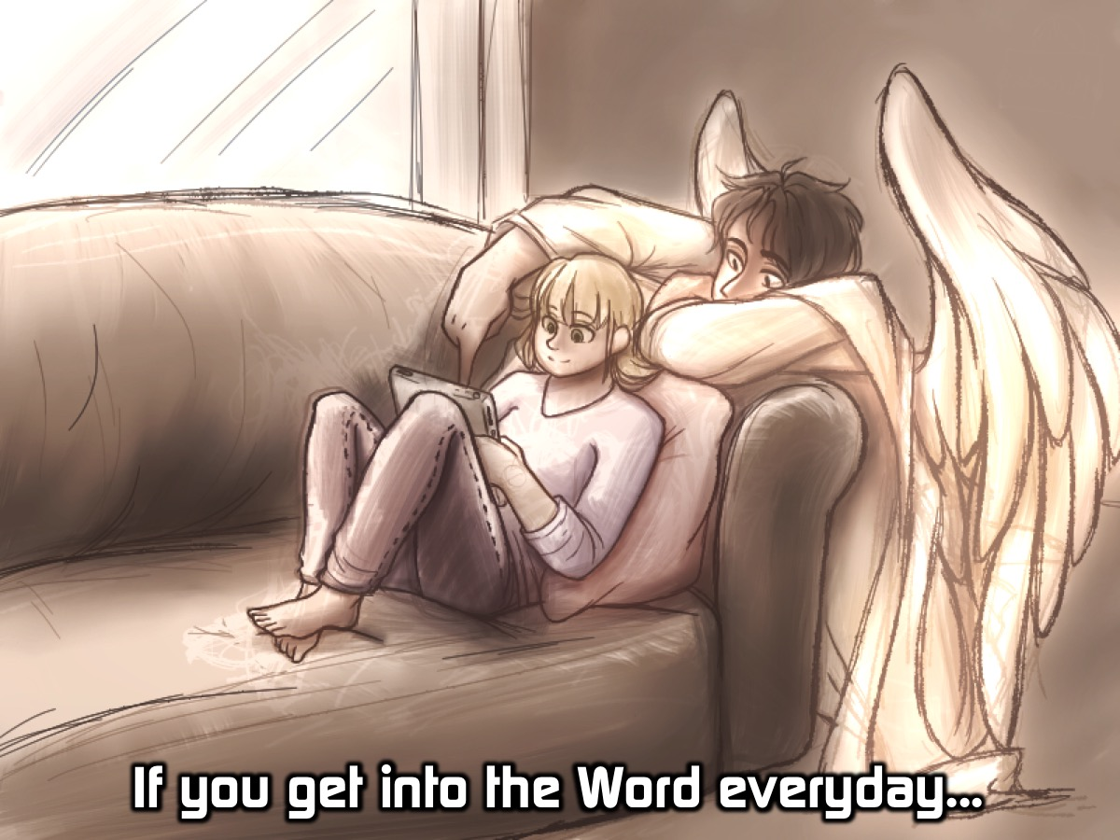
Notes:
If you get into the Word everyday…

Slide 12
Notes:
(1) You Will Hear God (and he will speak through you). “Oh how I love your words. I think about them all day long. They make me wiser than my enemies because they are my constant guide.” (Psalm 119:97-98)

Slide 13
Notes:
(2) You Will Stay Salty. “How can a young person stay pure? By obeying your word. I have hidden your word in my heart, that I might not sin against you.” (Psalm 119:9,11)

Slide 14
Notes:
(3) You Will Understand Truth. “I will have an answer for the one who insults me since I trust your word. I will speak about your written instructions in the presence of kings and not feel ashamed.” (Psalm 119:42,46)

Slide 15
Notes:
Prayer

