Slide 1
Notes:
This week is our Heaven or Hell. We start at the bottom of the stairwell and use 2 venues - His Diz room for Hell and His Youth room for Heaven. Teens get to choose which doorway they will go through - one is wide and the other is narrow. On the way up the stairwells there will be posters on the walls with verses about either heaven or hell.
Hell:
* Setting the scene: Screams, hot air conditioning, flashing lights (preferably red lights), fog machine,
* Drink - Vinegar in Coke
* Food - Pilchards
* Activities - Get them to do some exercises. Scream abuse at them. Bump into them. Have obstacles to hinder them walking around. Have a stick that is trying to trip them up.
* Don't let them speak to each other
* Characters - Satan, demons
Heaven
* Setting the scene - pillows to lounge on. Worship music, and maybe a video with scenery
* Food - marshmallow, candy floss
* Something to drink - milkshakes
* Characters - Peter, Angels.
* Activities - chat freely, eat
When teens are finished with their venue they return downstairs and this time they switch and go through the other door.
After teens have visited each venue they return to the bottom of the stairs for a gospel message.
After the gospel message they return to the youth room for small groups, refreshments and hang time.

Slide 2
Notes:
Everyone is going to make their way downstairs.

Slide 3
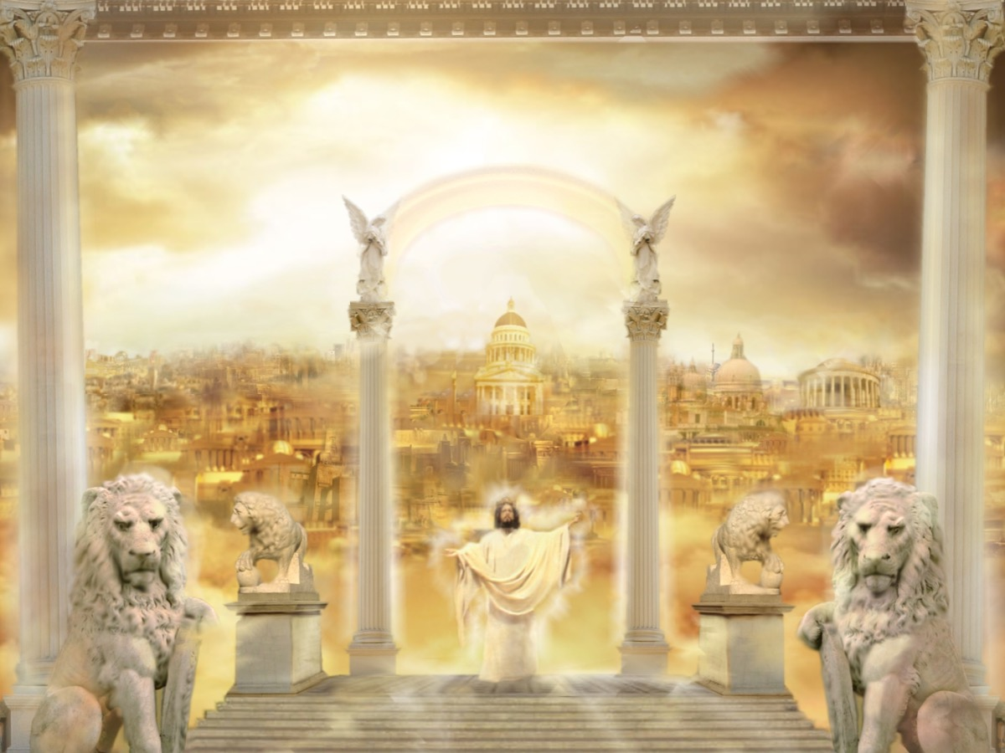
Notes:
Welcome to Heaven

Slide 4
Notes:
Video: Grace Williams Sacred Mountain, I Bow My Heart. Get it on YouTube at: https://www.youtube.com/watch?v=Wy0CuZeE0vA

Slide 5
Notes:
Video: Never Forsaken - River Wild - Hillsong Worship. Get it on YouTube at: https://www.youtube.com/watch?v=YSQYPoM2D38

Slide 6
Notes:
Welcome to Heaven

Slide 7
Notes:
Small Groups. Here are the small group questions: (1) How did you feel experiencing Heaven and Hell tonight? (2) If you had to die tonight and were asked why you should be let into heaven, what would you say? (If the person says anything about being good enough to get into heaven or because they have done some righteous acts like going to church, then you will know that they have probably not received the free gift of grace from Jesus and they are ready for step 3). (3) Do you remember a time when you repented of your sins and asked Jesus to save you? If not, would you like to do that now? Here is what you need to do: Admit you are a sinner and can’t save yourself. Believe that Jesus died to give you eternal life. Confess that Jesus is Lord of your life. Decide to follow Jesus as his disciple. (Pray with the person so they can follow the A-B-C-D plan of salvation - lead them in a prayer through each of the four points - with them praying after you line by line - something like: "Dear Lord Jesus, I admit that I am a sinner and that I cannot save my self. I believe that Jesus died so that I can have eternal life and don’t need to spend eternity in hell. I confess that Jesus is the lord of my life and I decide to follow Jesus as one of his disciples. Amen." Then welcome them into the family of God - maybe mentioning John 1:12: “To as many as received him - Jesus - he gave the right to become children of God"). (4) Pray for each other to be faithful followers of Jesus.

Slide 10
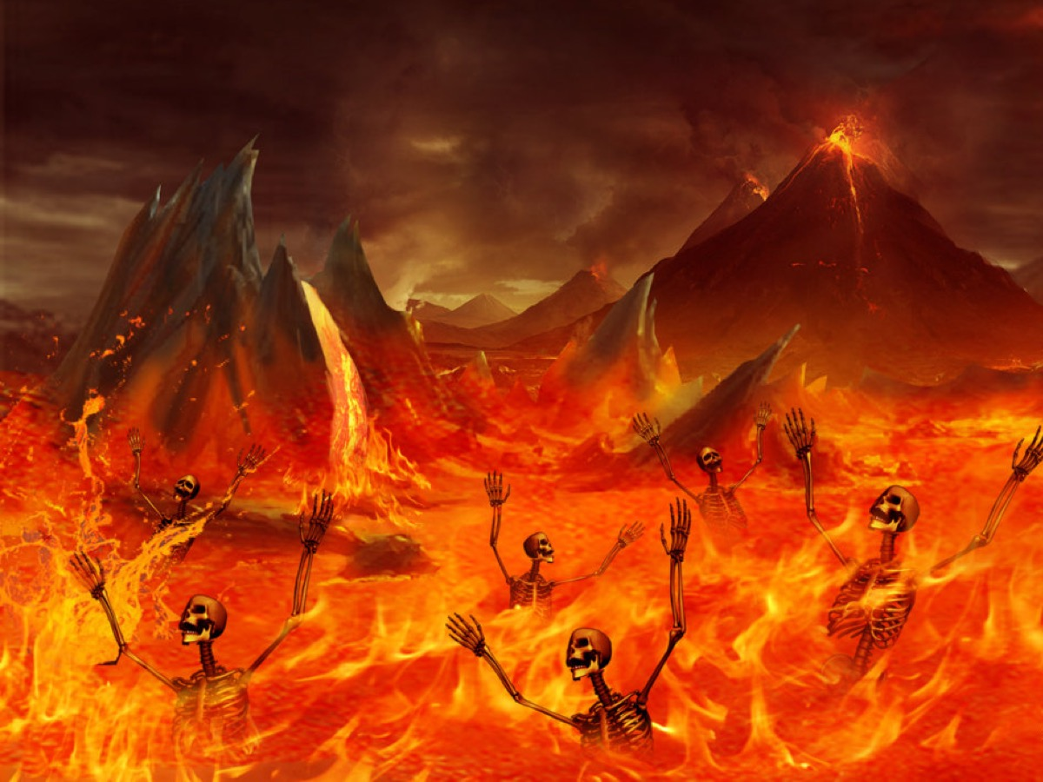

Slide 11
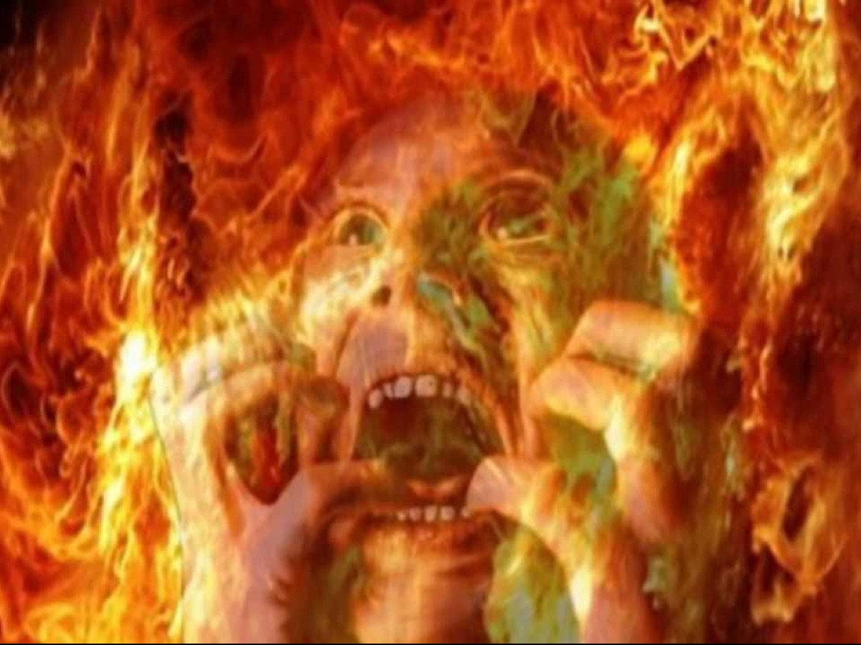

Slide 13
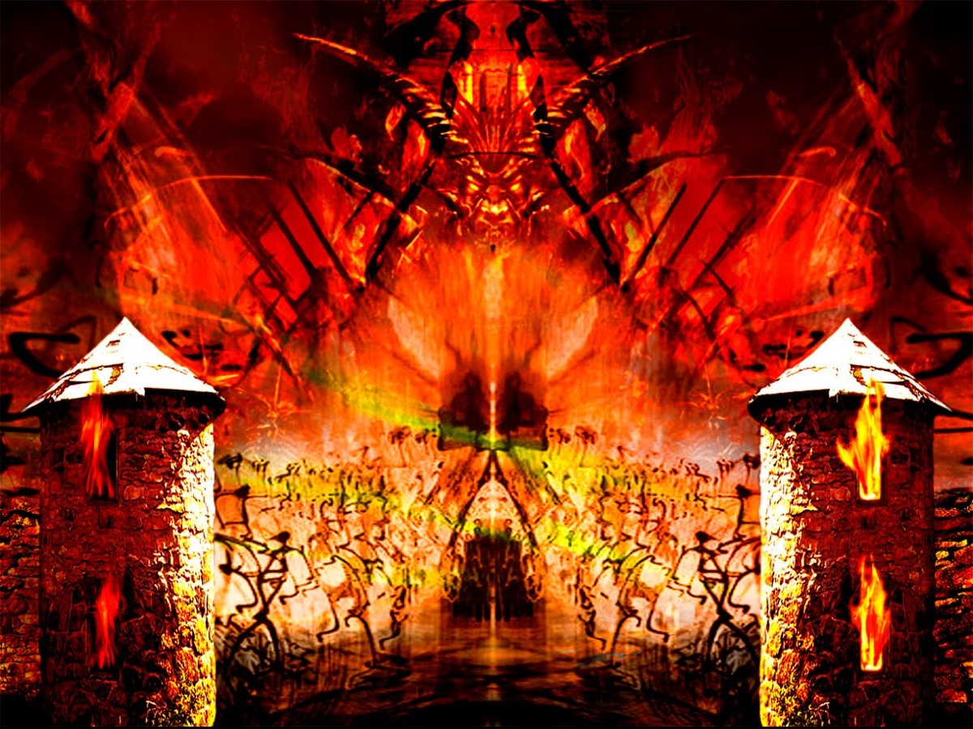

Slide 14
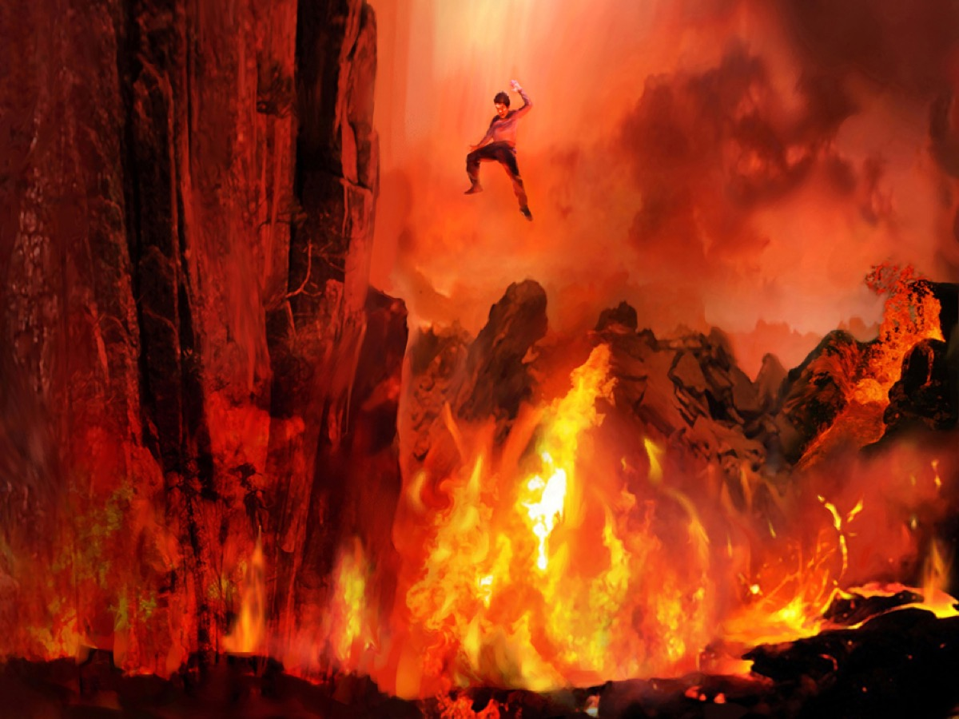

Slide 15
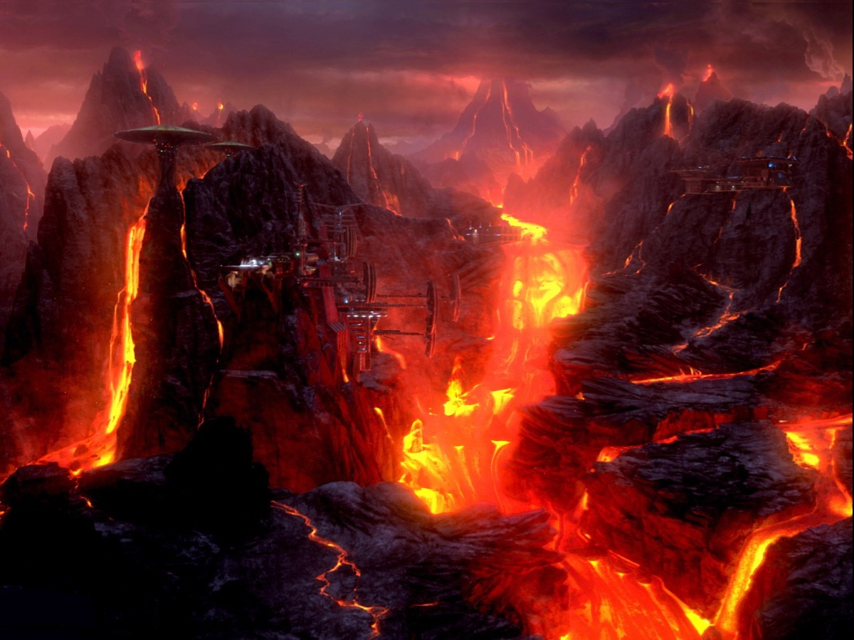

Slide 16
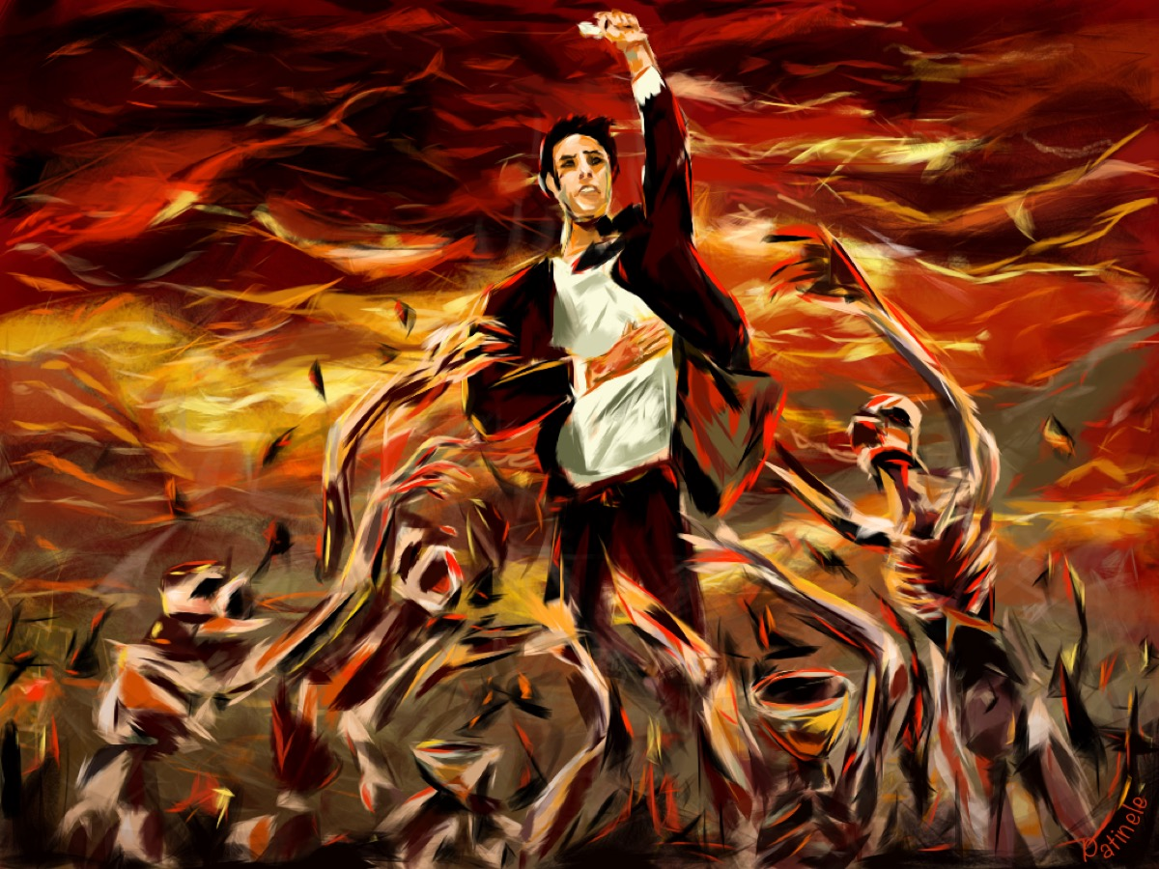

Slide 17
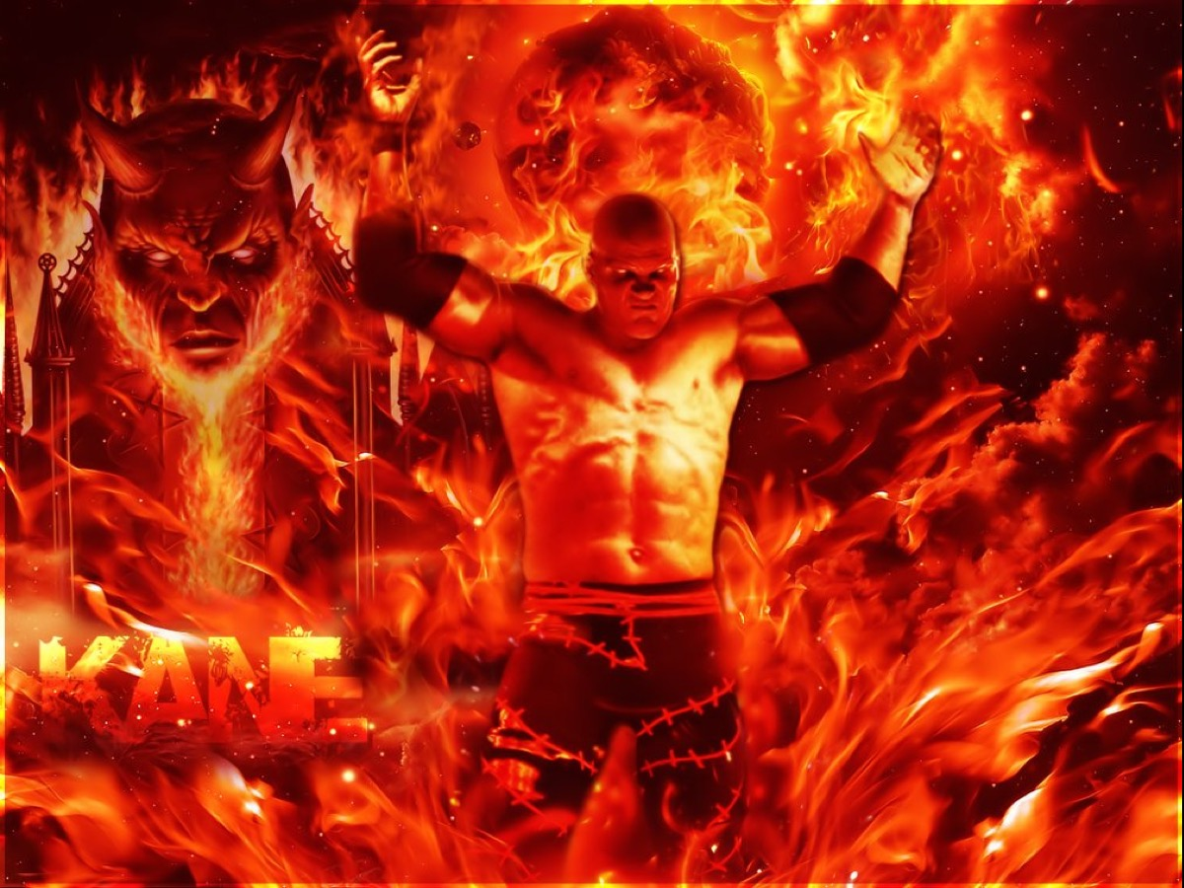

Slide 18
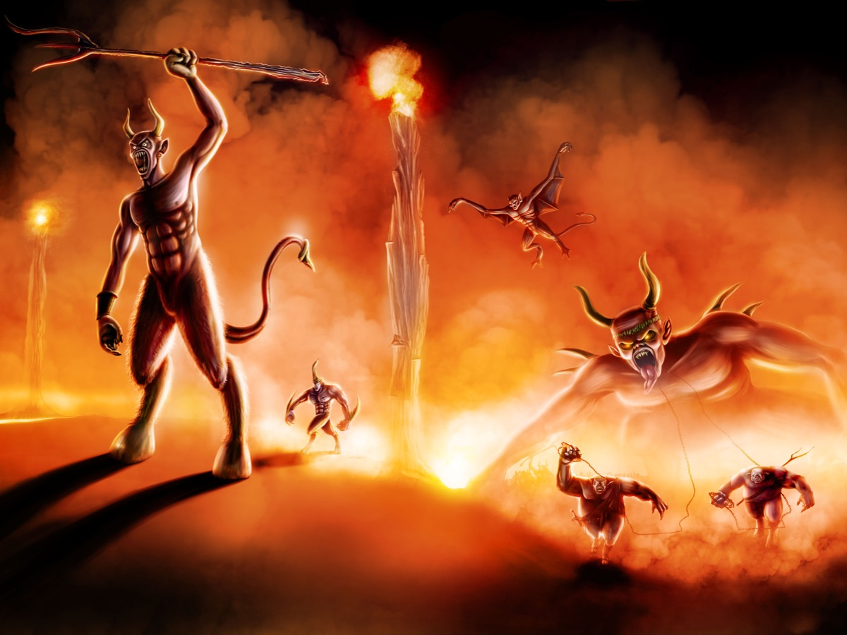

Slide 20
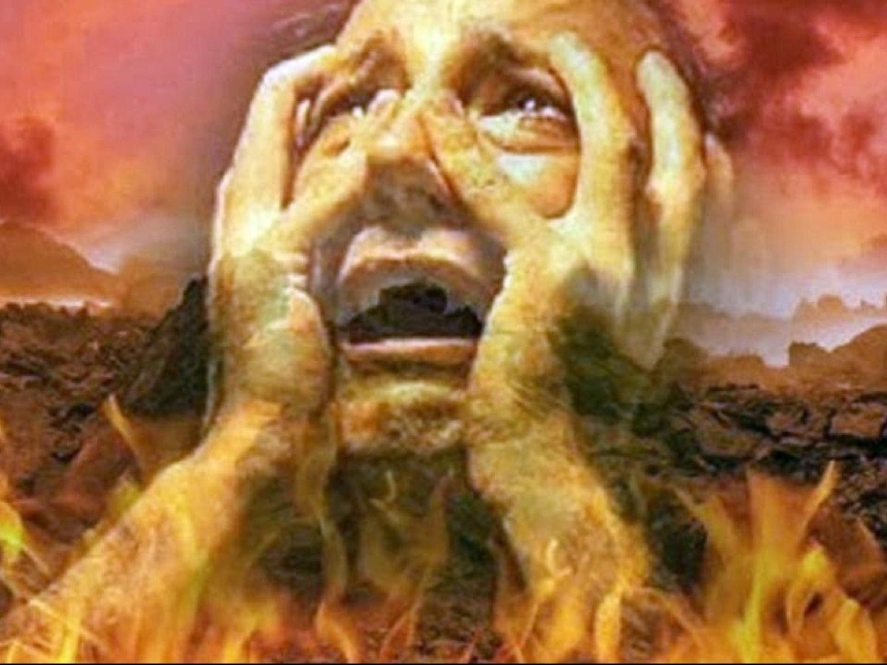

Slide 21
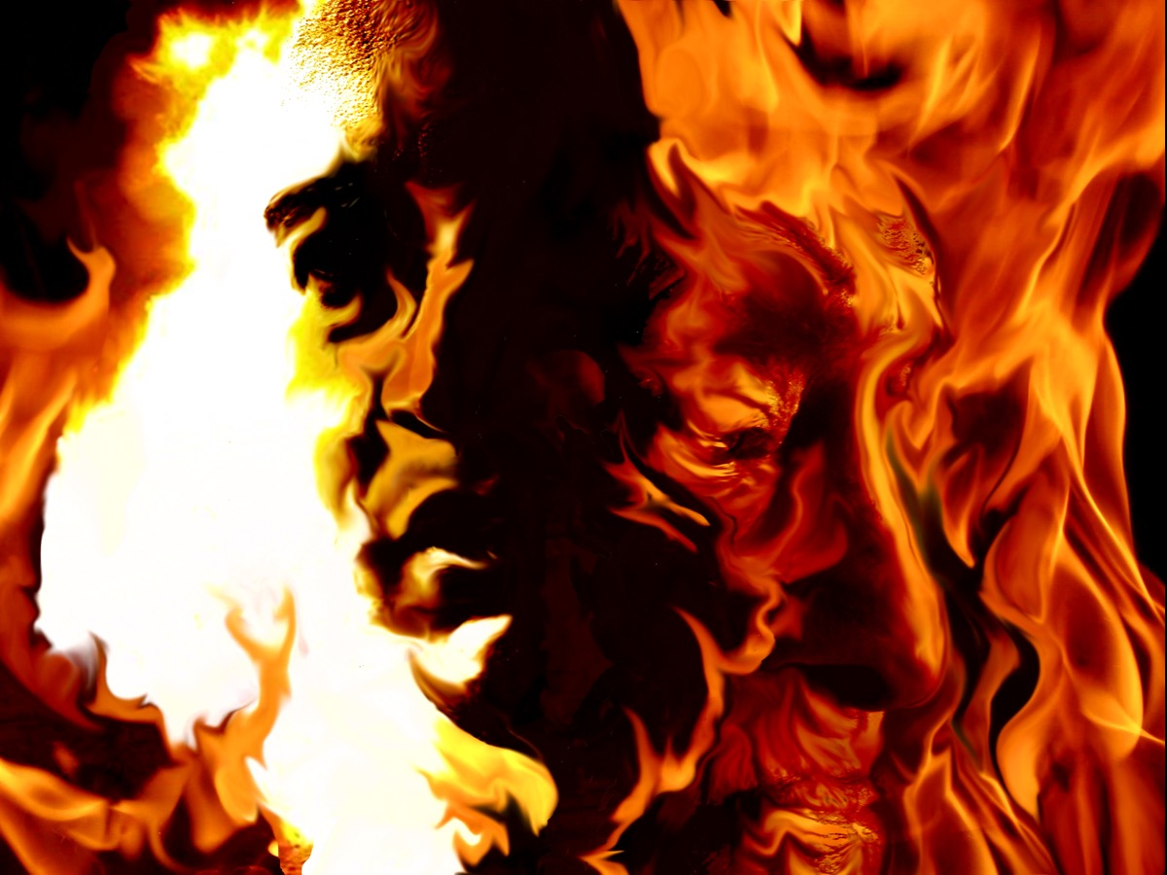

Slide 22
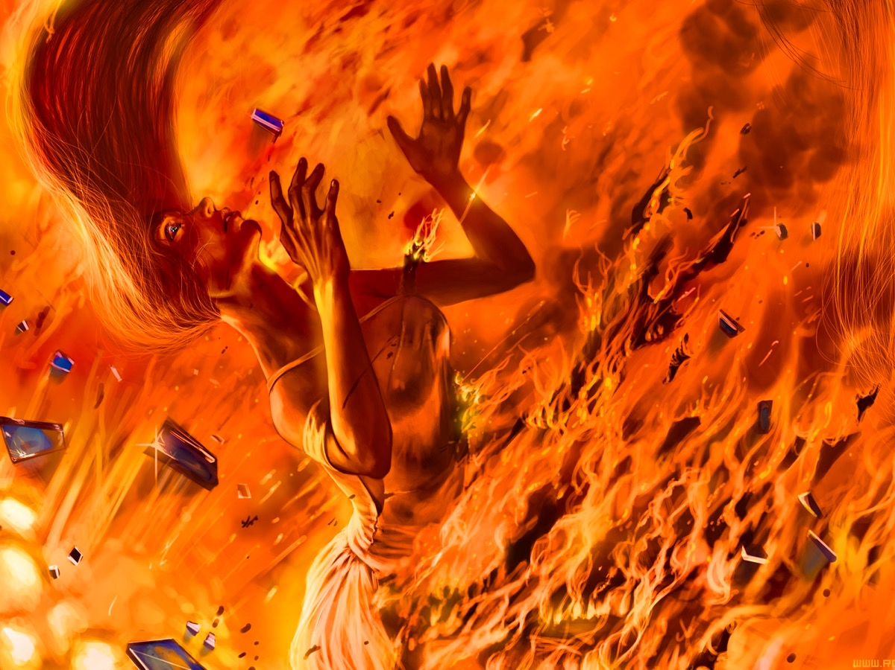

Slide 23
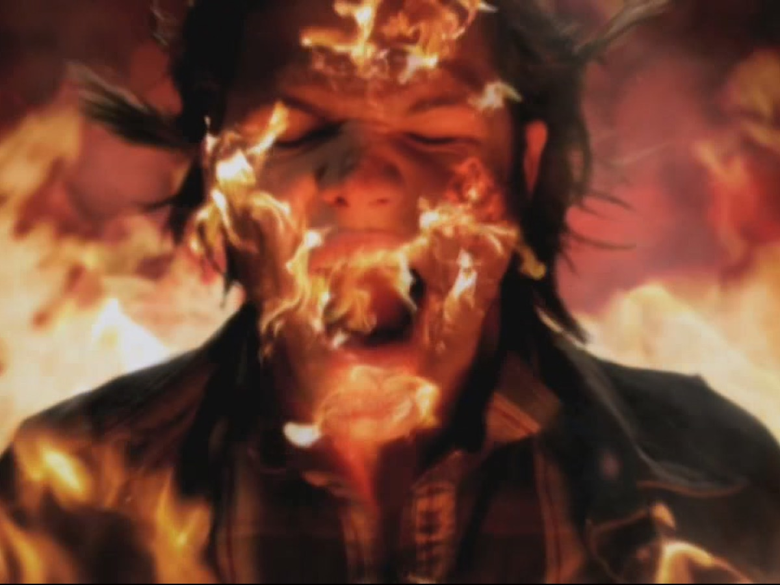

Slide 24
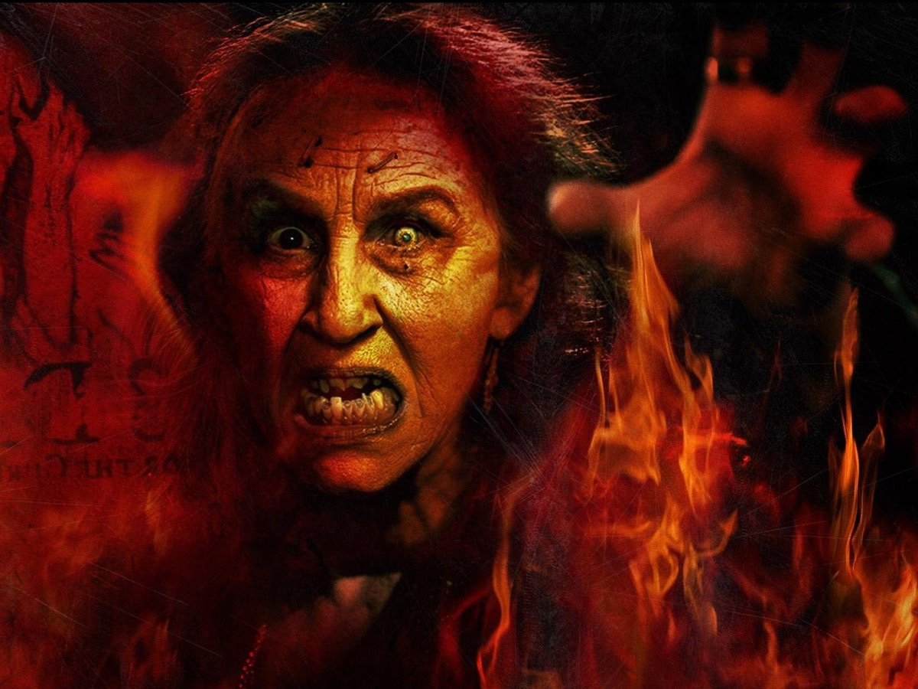

Slide 26
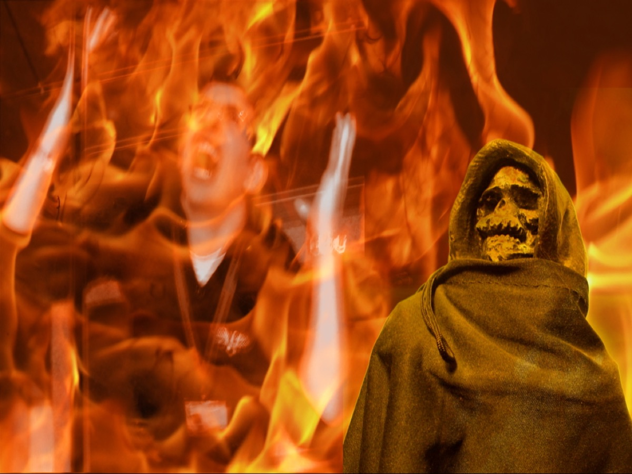

Slide 28
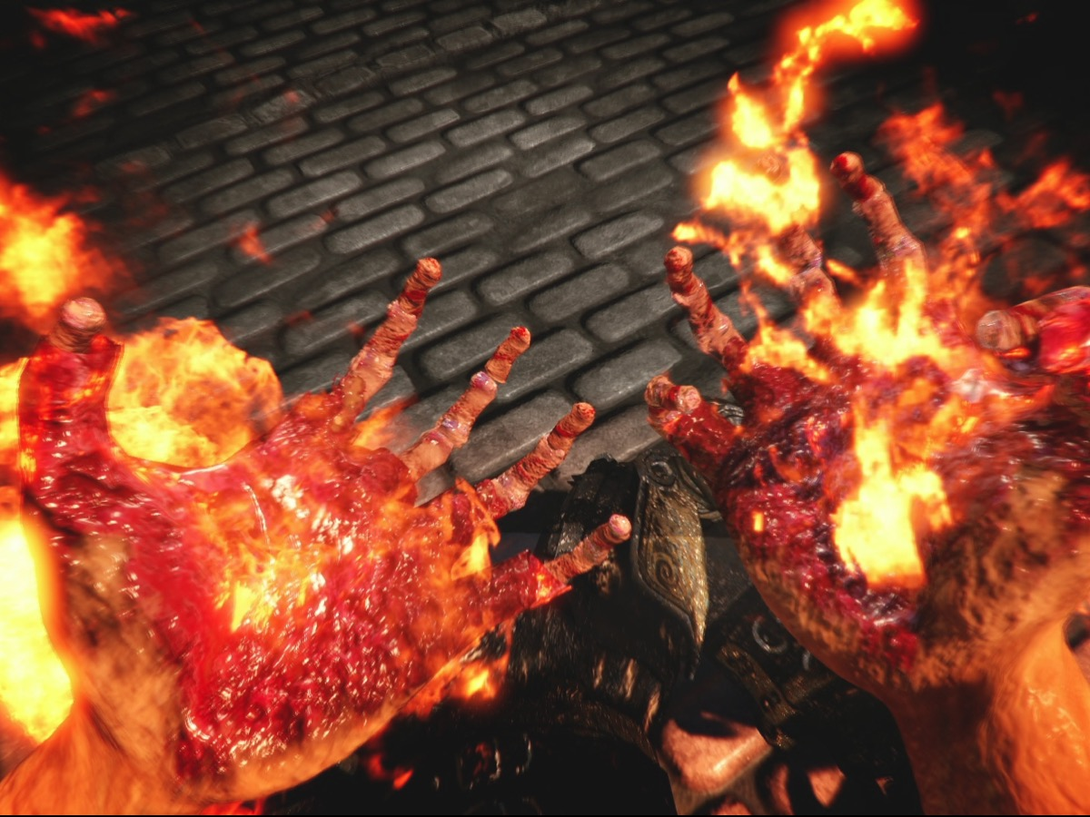

Slide 30
