Slide 1
Notes:
The Jericho Journey.

Slide 2
Notes:
Action: Teens enter the youth room and cannot get to the far side of the room close to the airconditioners – as the way is blocked.
On the stage there is a couch with a chair next to it – and a dad is reading a bed time story to his son.

Slide 3
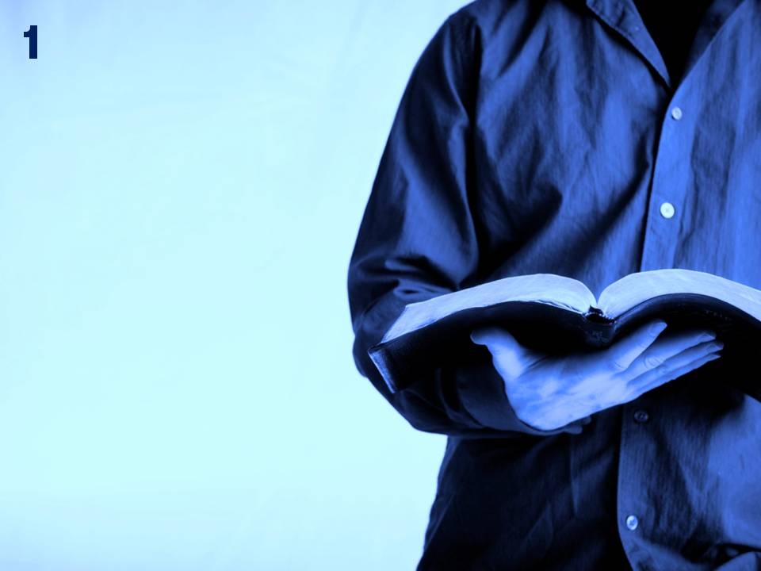
Notes:
Bible Reading 1: After the death of Moses, GOD spoke to Joshua, Moses' assistant: “Moses my servant is dead. Get going. Cross this Jordan River, you and all the people. Cross to the country I'm giving to the People of Israel. I'm giving you every square inch of the land you set your foot on - just as I promised Moses. (Joshua 1:1-3)

Slide 4
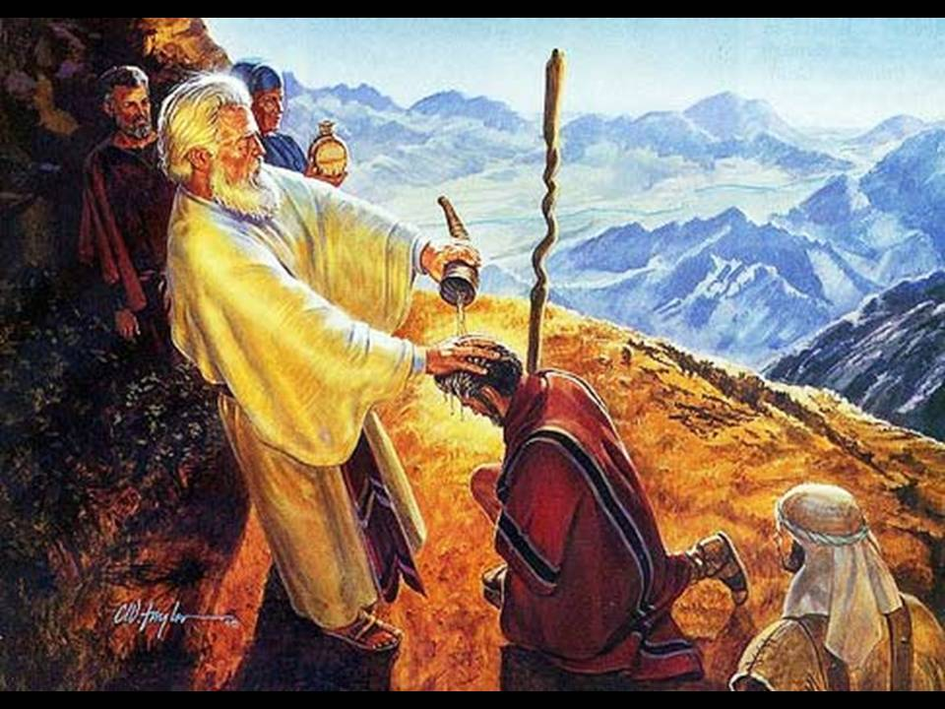

Slide 5
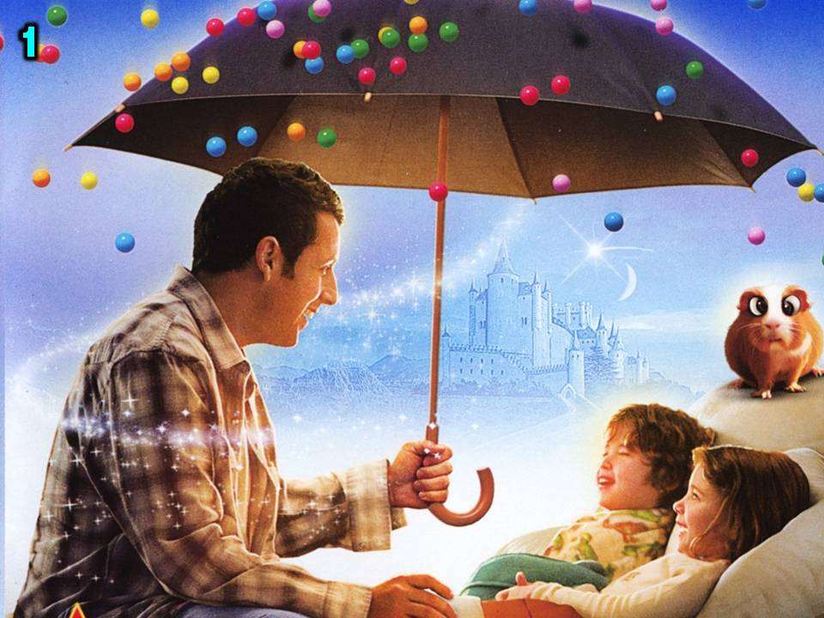
Notes:
Bedtime Story 1:
Dad: I will never forget the day when Moses told Joshua that he was going to die and that Joshua had to lead the people into the Promised Land. Poor old Joshua, he was scared spitless. I thought he was going to have a heart attack on the spot.
Kid: So what happened? I thought you were stuck on the other side of a wide and strong flowing river?
Dad: Well, Joshua knew that God had promised the land to them, so somehow God would have to do something miraculous to get them across the Jordan River.
Kid: What happened next?

Slide 6
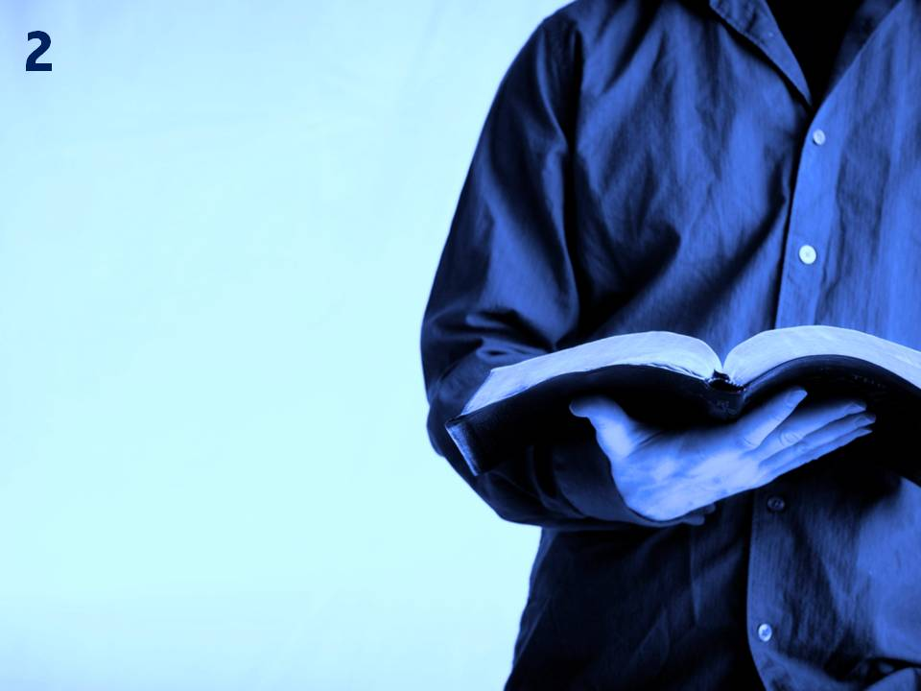
Notes:
Bible Reading 2: When the priests got to the Jordan and their feet touched the water at the edge (the Jordan overflows its banks throughout the harvest), the flow of water stopped. It piled up in a heap and the river went dry all the way down to the Salt Sea. And the people crossed, facing Jericho. (Joshua 3:15-16)

Slide 7
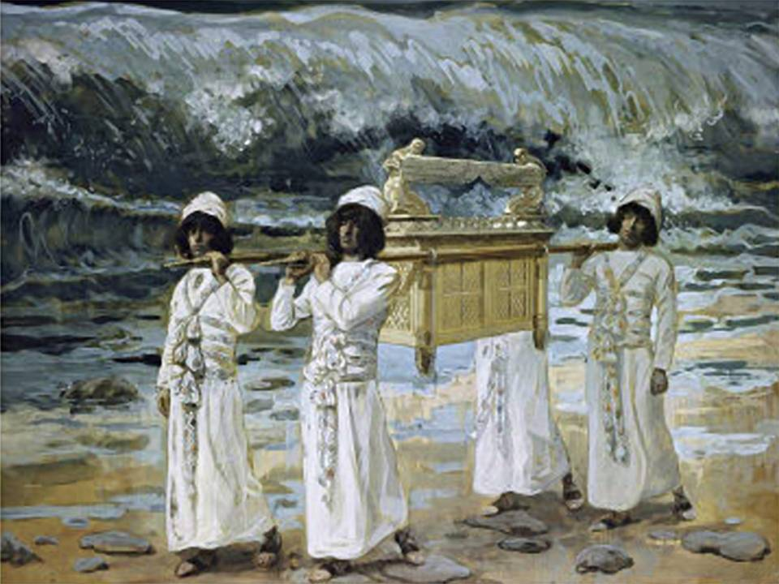

Slide 8
Notes:
Bedtime Story 2:
Kid: Are you serious, the river just stopped flowing and you walked across on dry ground!
Dad: Exactly, it was so cool. Well, Joshua knew that God had promised the land to them, so somehow God would have to do something miraculous to get them across the Jordan River.

Slide 9
Notes:
Bible Reading 3: Joshua said: “Your God, dried up the Jordan's waters for you until you had crossed, just as GOD did at the Red Sea, which had dried up before us until we had crossed. This was so that everybody on earth would recognize how strong GOD's rescuing hand is and so that you would always hold GOD in solemn reverence.“ (Joshua 4:23-24)

Slide 10
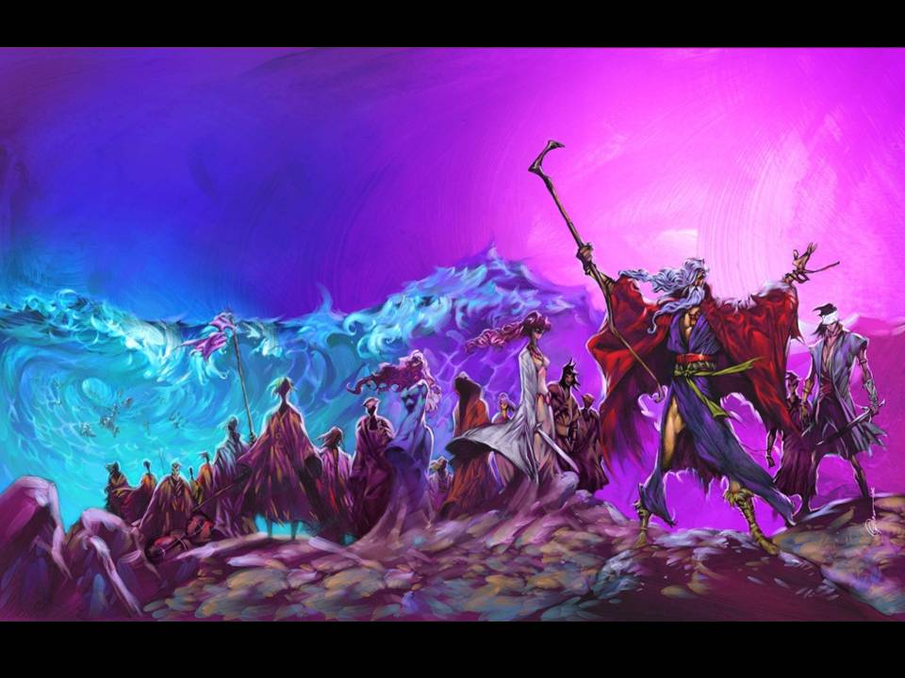

Slide 11
Notes:
Action: Write down one thing that God has done for you in the past – or something you have heard that He has done.

Slide 12
Notes:
Action: The barrier is removed and the teens move to the other side of the room!

Slide 13
Notes:
Bible Reading 4: Now Jericho was shut up tight as a drum because of the People of Israel: no one going in, no one coming out. (Joshua 6:1)

Slide 14
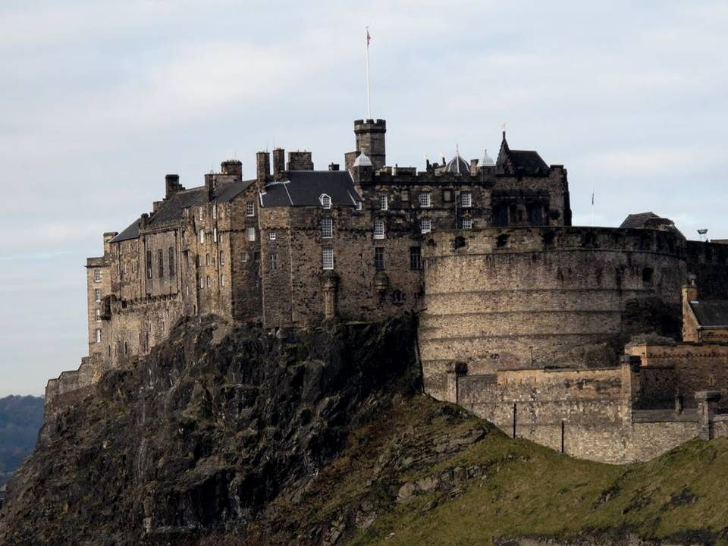

Slide 15
Notes:
Bedtime Story 3:
Kid: You must have been so happy to get across the river!
Dad: Well kinda! There we stood and in front of us was this massive city surrounded by the biggest walls we had ever seen – you could have chariot races on the top of the walls they were so thick! How were we going to capture the city that stood in our way.
Kid: But God promised you would take the land – so you knew He was going to use his power!!!
Dad: I wish we had your faith as we stood in front of Jericho!

Slide 16
Notes:
Action: Each teen is given a piece of paper and they write down a Jericho in their life on the paper – one really tough issue they are facing right now. Something that looks impossible for them to cope with! The pieces of paper are placed in a box on the top of a “wall” – a pile of boxes.

Slide 17
Notes:
Bible Reading 5: GOD spoke to Joshua, “Look sharp now. I've already given Jericho to you, along with its king and its crack troops.” (Joshua 6:2)

Slide 18
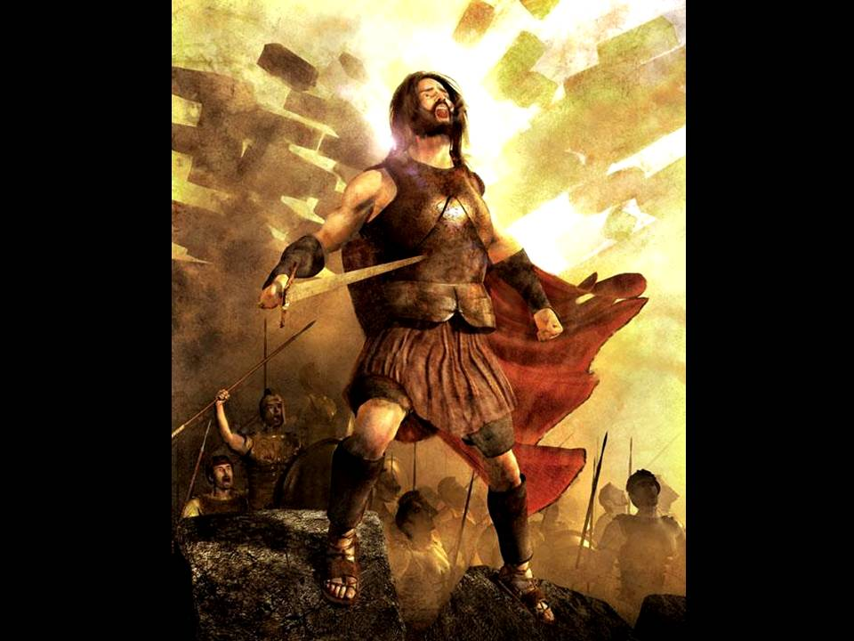
Notes:
Bible Reading 5: GOD spoke to Joshua, “Look sharp now. I've already given Jericho to you, along with its king and its crack troops.” (Joshua 6:2)

Slide 19
Notes:
Bedtime Story 4:
Son: Wow, Dad. Did God actually speak to Joshua!
Dad: Yes He did. God promised him that the city would be captured by the Israelites.
Son: So how did you know what to do?
Dad: God gave us specific instructions.

Slide 20
Notes:
Bible Reading 6: Here's what you are to do: March around the city, all your soldiers. Circle the city once. Repeat this for six days in silence. Have seven priests carry seven ram's horn trumpets in front of the Ark of God’s Presence. (Joshua 6:3-4)

Slide 21
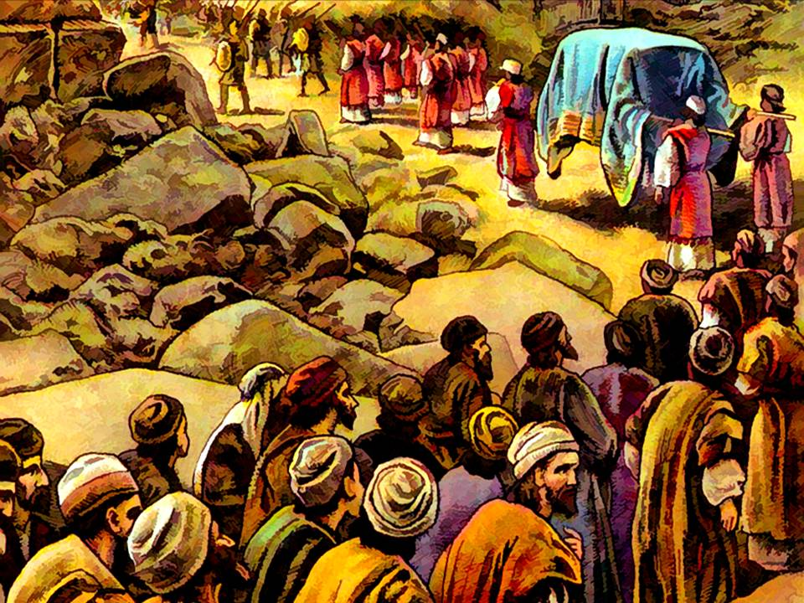

Slide 22
Notes:
Bedtime Story 5:
Son: March around the city for six days! That’s like forever! Didn’t the people get tired?
Dad: Sure we did, but that is what God told us to do. It sounded silly, but it made us realise that we were not going to be the ones fighting this battle. God was fighting on our behalf!

Slide 23
Notes:
Action: Teen walks around the boxes in total silence 6 times. Say: You are going to walk around your “Jericho” seven times in total silence. As you walk I want you to remember all that God has done in the past and how he has promised to help you destroy your Jericho.

Slide 24
Notes:
Bedtime Story 6:
Son: Did anything happen on the sixth day?
Dad: No, nothing at all – but God wanted us to walk around Jericho again on the seventh day!
Son: Dad, that is so much walking – it’s making me tired.
Dad: Don’t worry, son, the story is getting to the most exciting part!

Slide 25
Notes:
Bible Reading 7: When the seventh day came, they got up early and marched around the city – the priests blew the trumpets and Joshua signaled the people, "Shout! GOD has given you the city! When the people heard the blast of the trumpets, they gave a thunderclap shout. The wall fell at once. The people rushed straight into the city and took it. (Joshua 6:15,16,20)

Slide 26
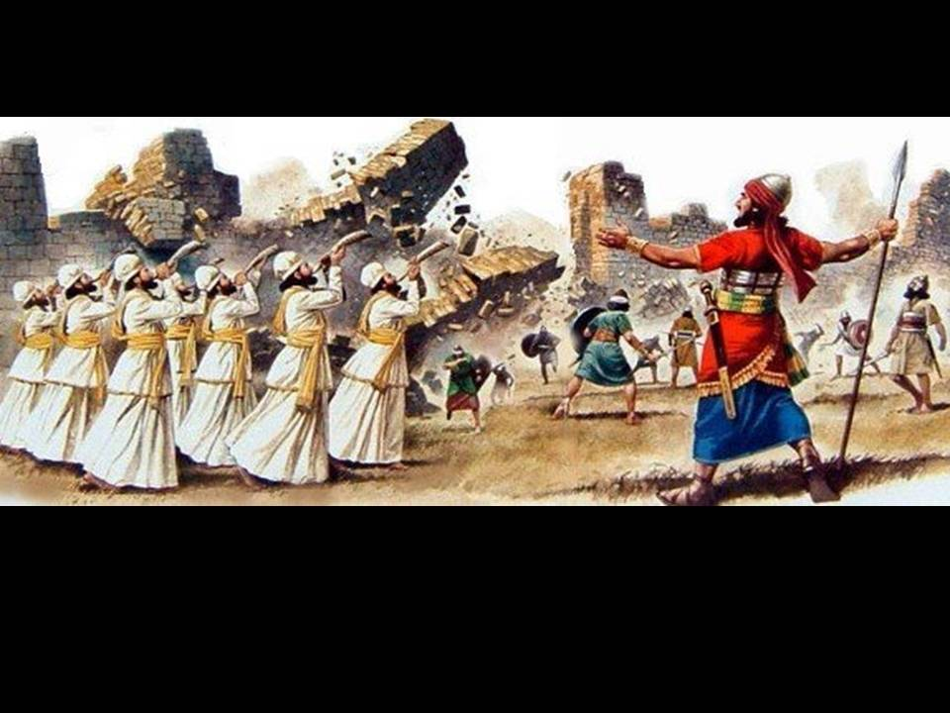

Slide 27
Notes:
Bedtime Story 7:
Dad: As we marched around the city on the 7th day we all suddenly shouted at the top of our voices – we shouted things like: “God is great”, or “Victory”, or “Walls come tumbling down”.
Son: And what happened next?
Dad: You won’t believe this but the walls collapsed into a pile of rubble and the city was defenceless.

Slide 28
Notes:
Action: You are going to walk around your Jericho one last time and when I give the signal we are going to shout at the top of our voices.

Slide 29
Notes:
Bedtime Story 8:
Son: Is that the end of the story, Dad!
Dad: No – there’s one more thing that happened – God had told us to do something very strange – we had to burn the whole city and not keep anything for our selves as a sign that he had destroyed it completely.
Son: Cool!

Slide 30
Notes:
Bible Reading 8: They burned down the city and everything in it, except for the gold and silver and the bronze and iron vessels--all that they put in the treasury of GOD's house. (Jos 6:24)

Slide 31
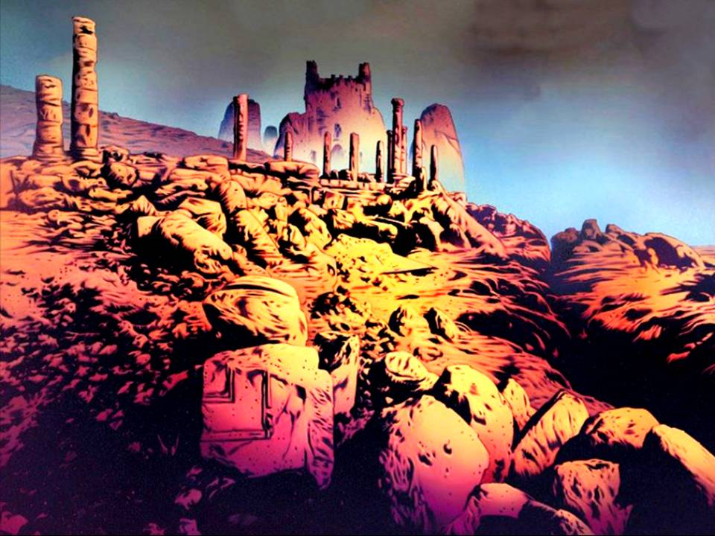

Slide 32
Notes:
Action: You are going to walk downstairs and watch your Jericho’s go up in smoke.

