Slide 1
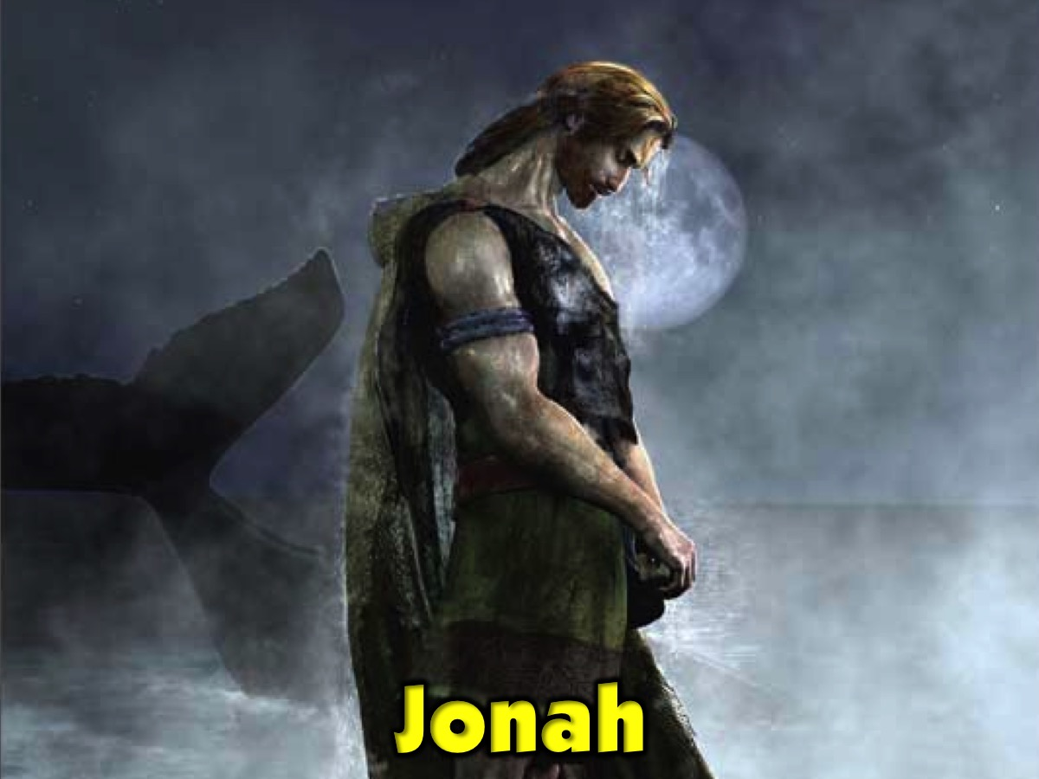
Notes:
Journey: Jonah

Slide 2
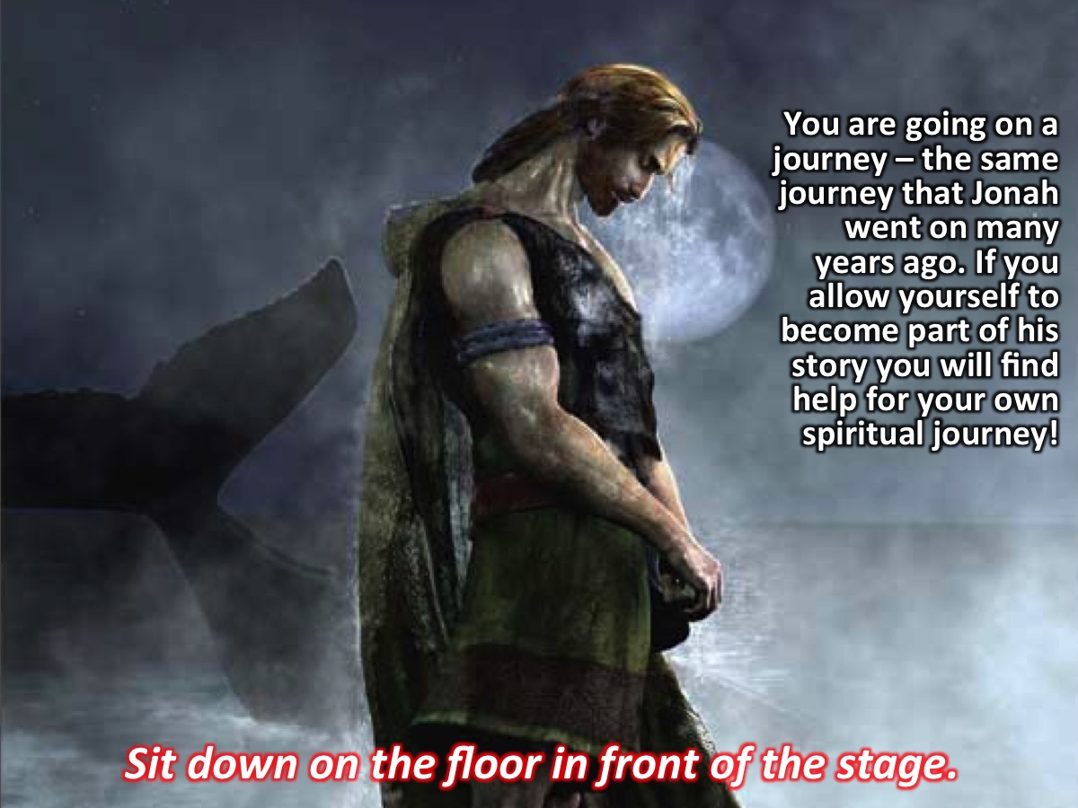
Notes:
You are going on a journey – the same journey that Jonah went on many years ago. If you allow yourself to become part of his story you will find help for your own spiritual journey!
Activity: Sit down on the floor in front of the stage.

Slide 3
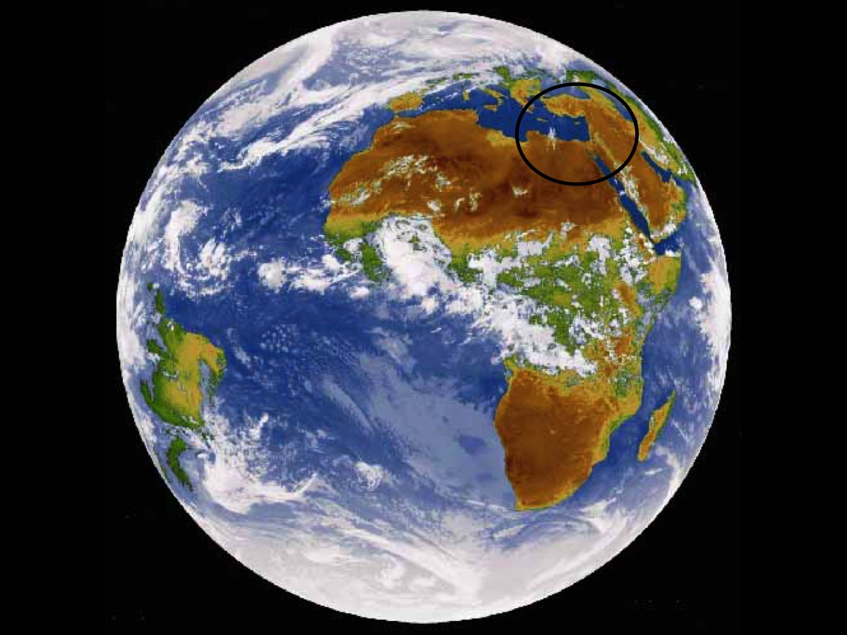
Notes:
So to orientate you – this is the world from outer space – and you can see the middle east in the circle above the continent of Africa.

Slide 4
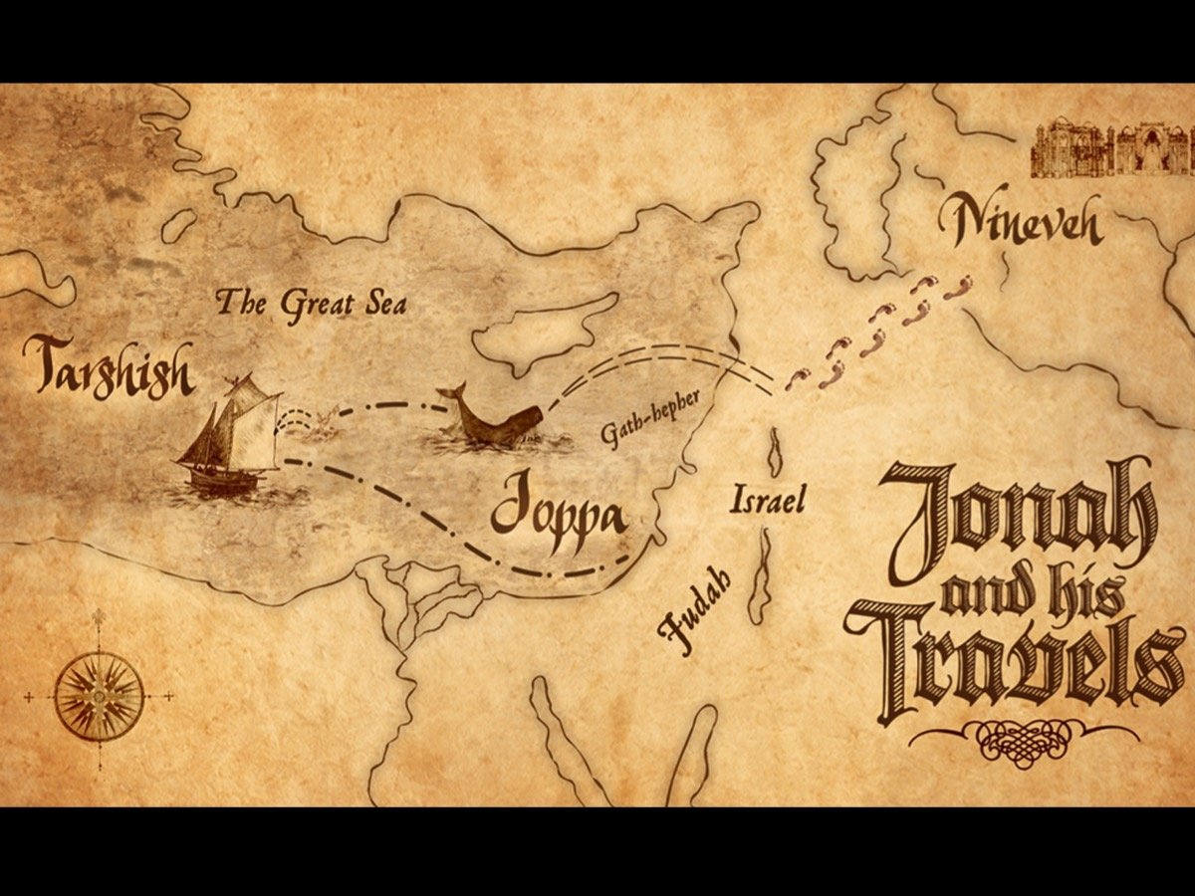
Notes:
And here is a map of the Middle East. If you look around you on the floor – you will see that the map has been marked out for our journey.

Slide 5
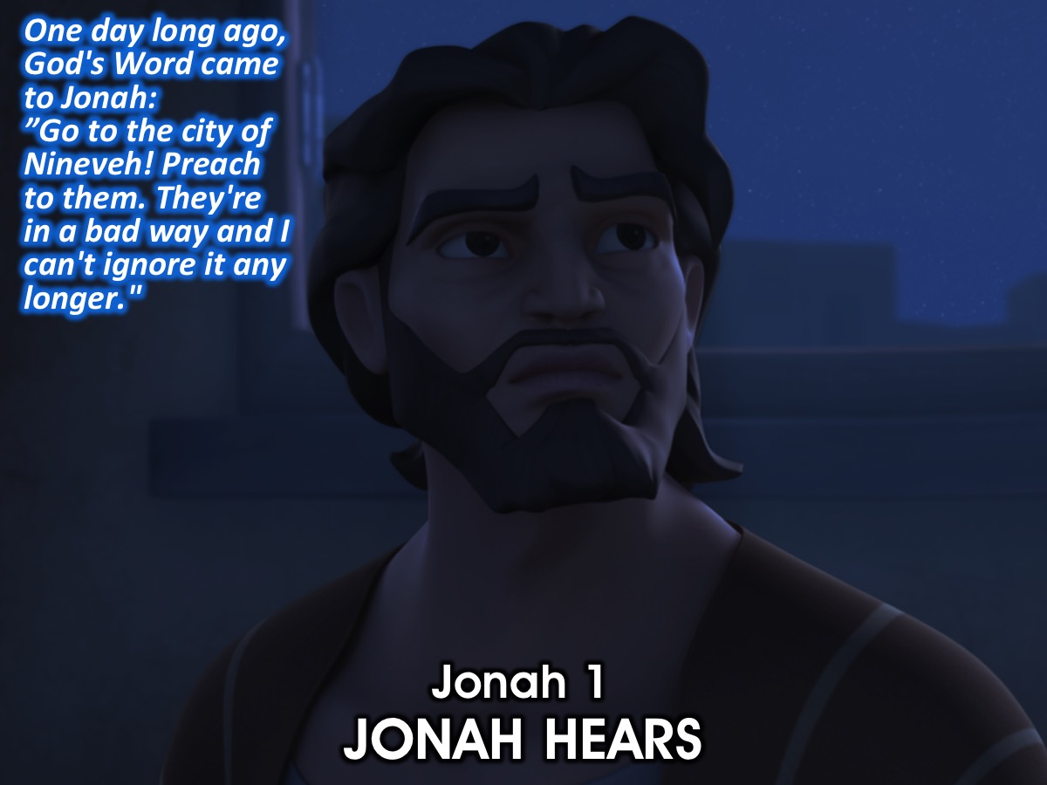
Notes:
Jonah 1: JONAH HEARS
¹One day long ago, God's Word came to Jonah: ”Go to the city of Nineveh! Preach to them. They're in a bad way and I can't ignore it any longer.”

Slide 6
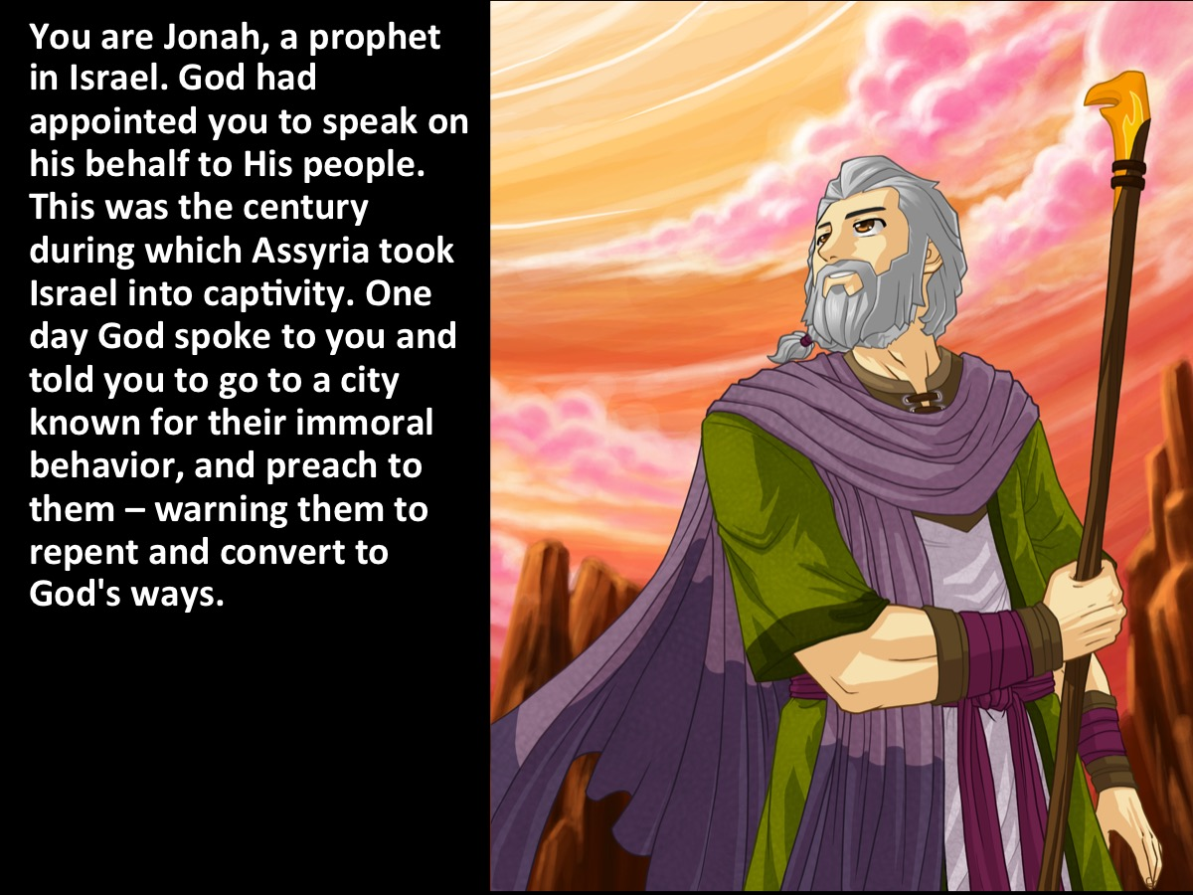
Notes:
You are Jonah, a prophet in Israel. God had appointed you to speak on his behalf to His people. This was the century during which Assyria took Israel into captivity. One day God spoke to you and told you to go to a city known for their immoral behavior, and preach to them – warning them to repent and convert to God's ways.

Slide 7
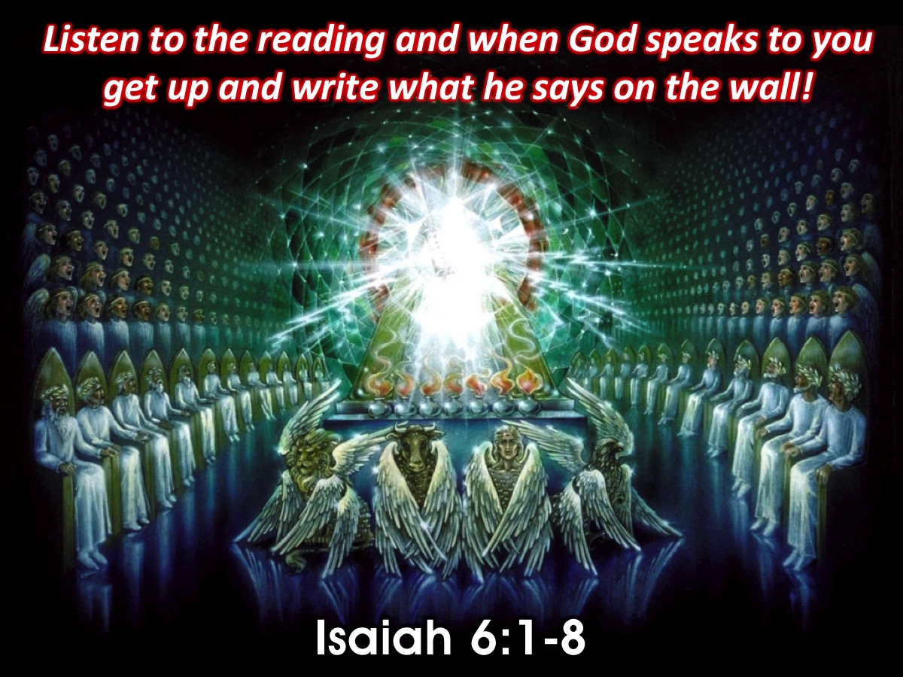
Notes:
Reading: Isaiah 6:1-8
Activity: Listen to the reading and when God speaks to you get up and write what he says on the wall!
It was in the year King Uzziah died that I saw the Lord. He was sitting on a lofty throne, and the train of his robe filled the Temple. Attending him were mighty seraphim, each having six wings. With two wings they covered their faces, with two they covered their feet, and with two they flew. They were calling out to each other, “Holy, holy, holy is the Lord of Heaven’s Armies! The whole earth is filled with his glory!” Their voices shook the Temple to its foundations, and the entire building was filled with smoke. Then I said, “It’s all over! I am doomed, for I am a sinful man. I have filthy lips, and I live among a people with filthy lips. Yet I have seen the King, the Lord of Heaven’s Armies.” Then one of the seraphim flew to me with a burning coal he had taken from the altar with a pair of tongs. He touched my lips with it and said, “See, this coal has touched your lips. Now your guilt is removed, and your sins are forgiven.” Then I heard the Lord asking, “Whom should I send as a messenger to this people? Who will go for us?” I said, “Here I am. Send me.” And he said, “Yes, Go!” (Isaiah 6:1-8)

Slide 8
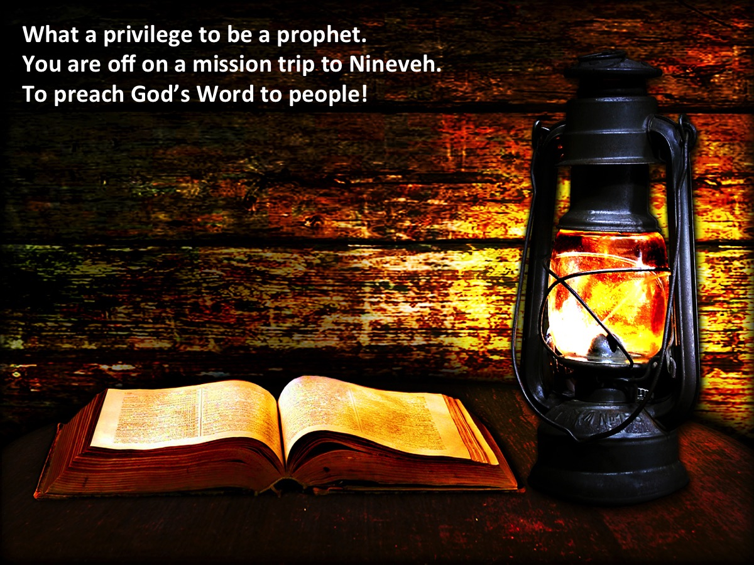
Notes:
What a privilege to be a prophet. You are off on a mission trip to Nineveh to preach God’s Word to people!
Activity: Light a candle while youth write on the wall.

Slide 9
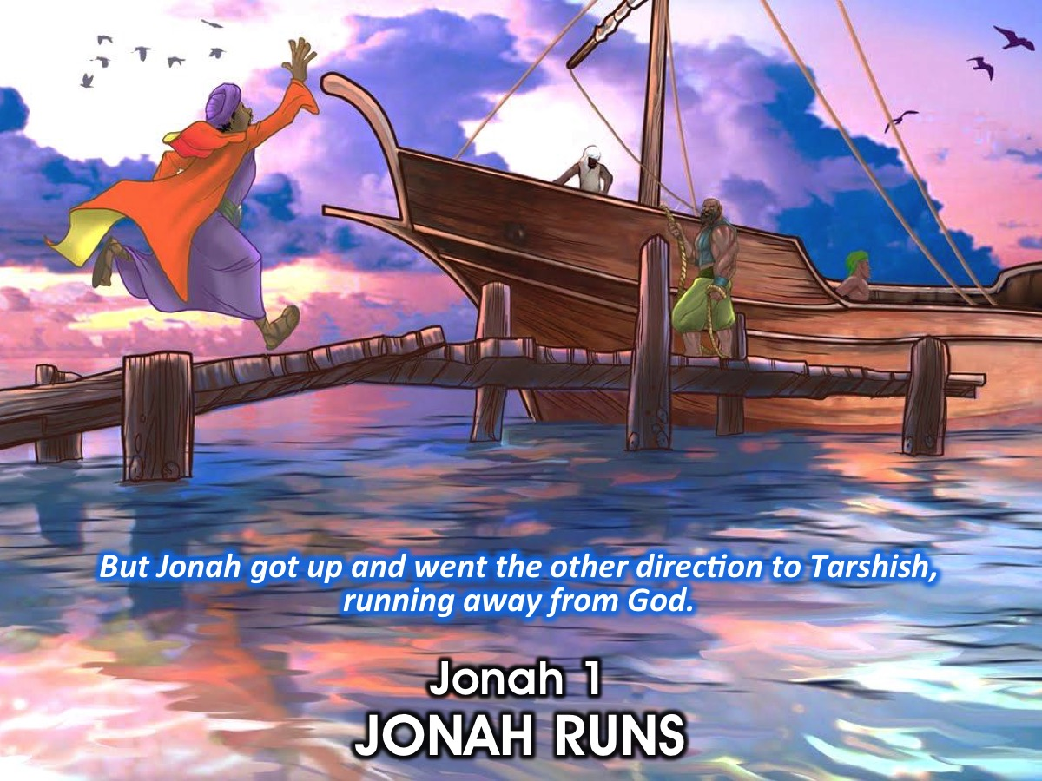
Notes:
JONAH 1: JONAH’S RESPONSE
³But Jonah got up and went the other direction to Tarshish, running away from God.

Slide 10
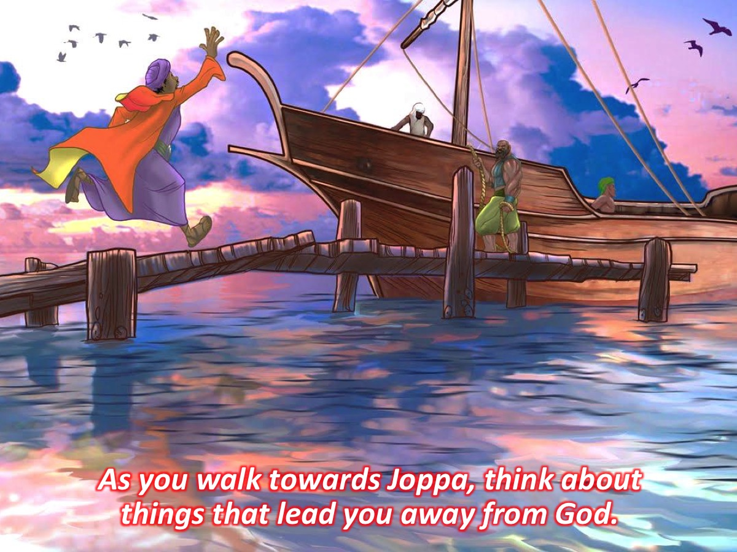
Notes:
Activity: As you walk towards Joppa think about things that lead you away from God.
Activity: Blow out the candle.

Slide 11
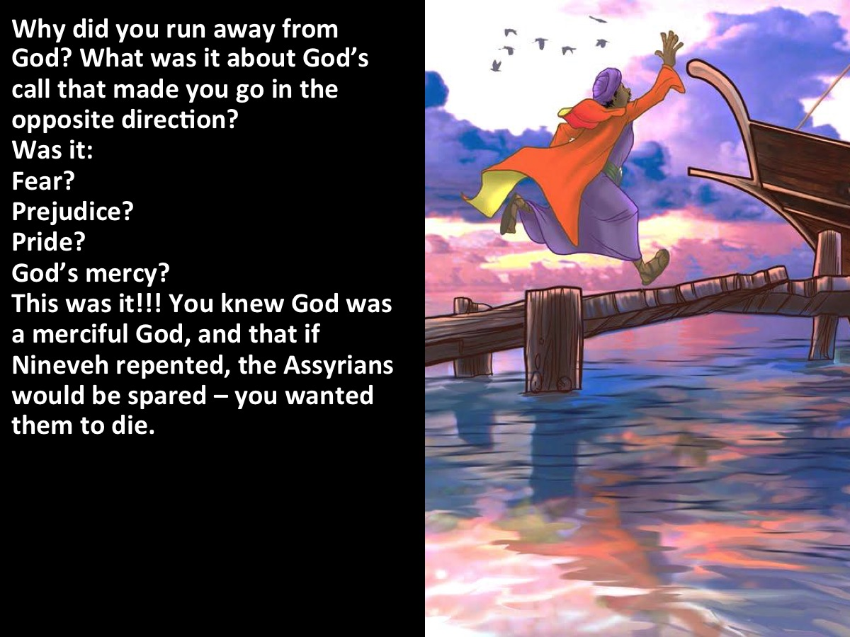
Notes:
Why did you run away from God? What was it about God’s call that made you go in the opposite direction? Was it: Fear? Prejudice? Pride? God’s mercy? This was it!!! You knew God was a merciful God, and that if Nineveh cried to God and repented, the Assyrians would be spared – you wanted them to die.

Slide 12
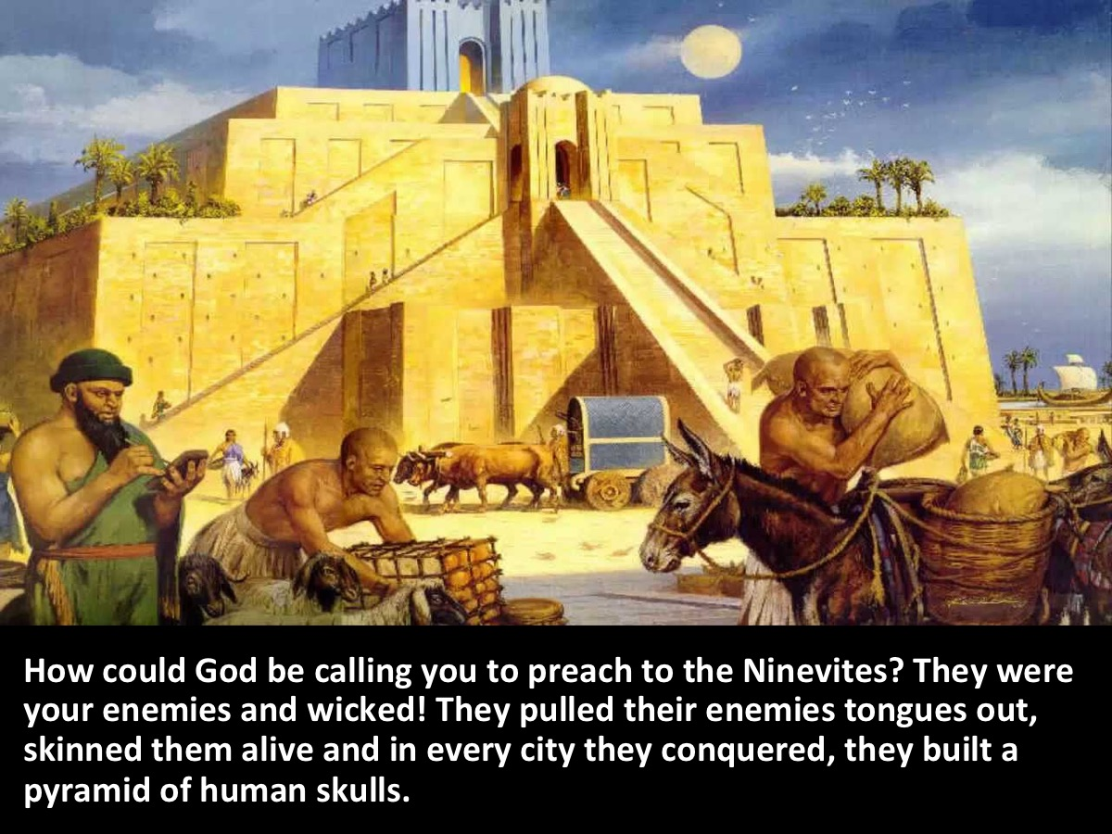
Notes:
How could God be calling you to preach to the Ninevites? They were your enemies and wicked! They pulled their enemies tongues out, skinned them alive and in every city they conquered, they built a pyramid of human skulls.

Slide 13
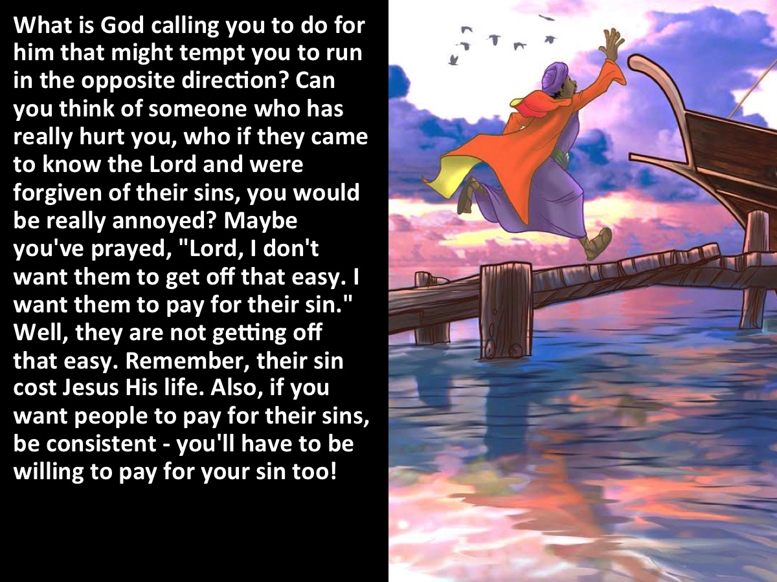
Notes:
What is God calling you to do for him that might tempt you to run in the opposite direction? Can you think of someone who has really hurt you, who if they came to know the Lord and were forgiven of their sins, you would be really annoyed? Maybe you've prayed, "Lord, I don't want them to get off that easy. I want them to pay for their sin." Well, they are not getting off that easy. Remember, their sin cost Jesus His life. Also, if you want people to pay for their sins, be consistent - you'll have to be willing to pay for your sin too!

Slide 14
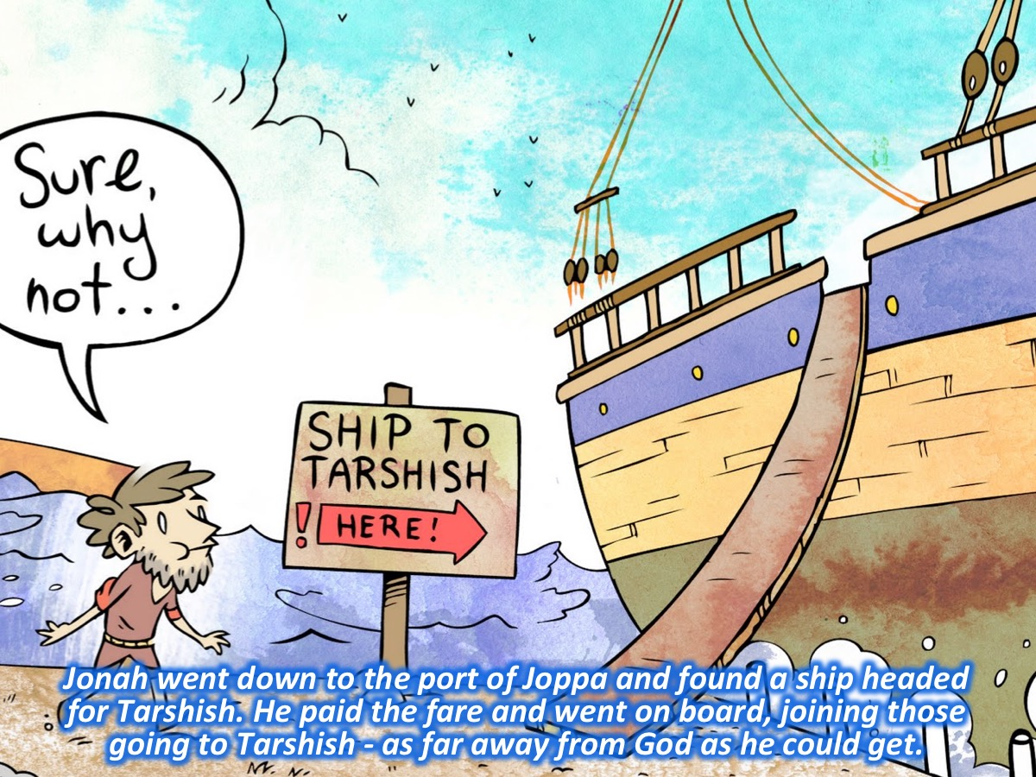
Notes:
³Jonah went down to the port of Joppa and found a ship headed for Tarshish. He paid the fare and went on board, joining those going to Tarshish - as far away from God as he could get.

Slide 15
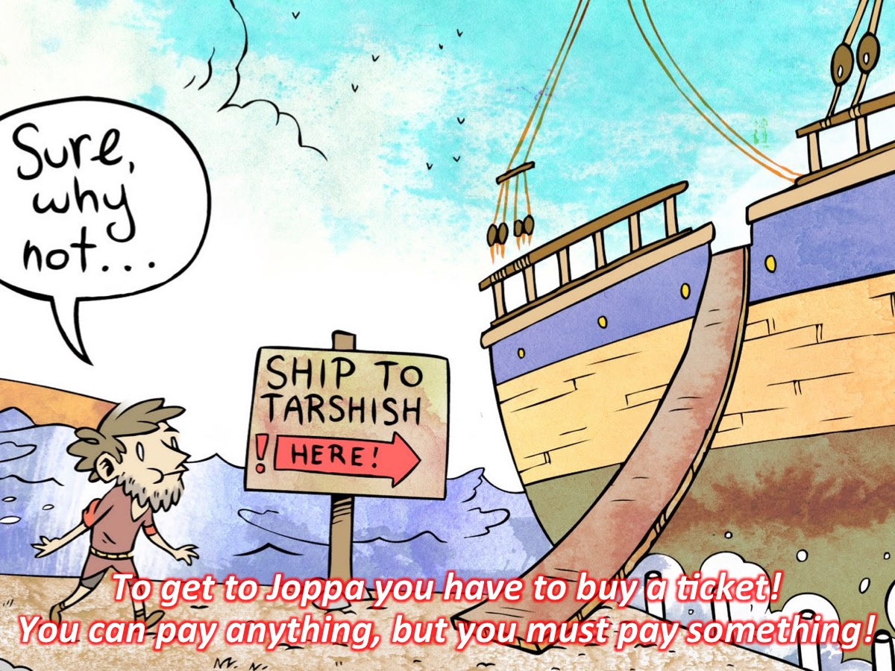
Notes:
Activity: To get to Joppa you have to buy a ticket! You can pay anything, but you must pay something!

Slide 16
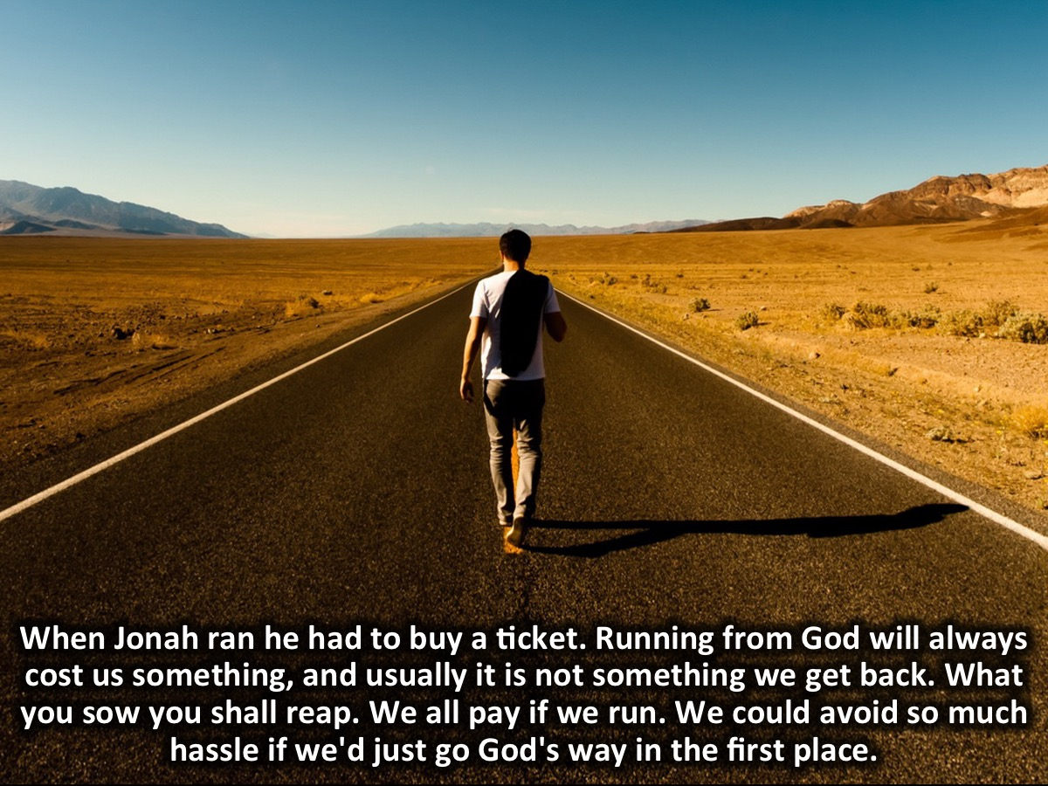
Notes:
When Jonah ran he had to buy a ticket. Running from God will always cost us something, and usually it is not something we get back. What you sow you shall reap. We all pay if we run. We could avoid so much hassle if we'd just go God's way in the first place.

Slide 17
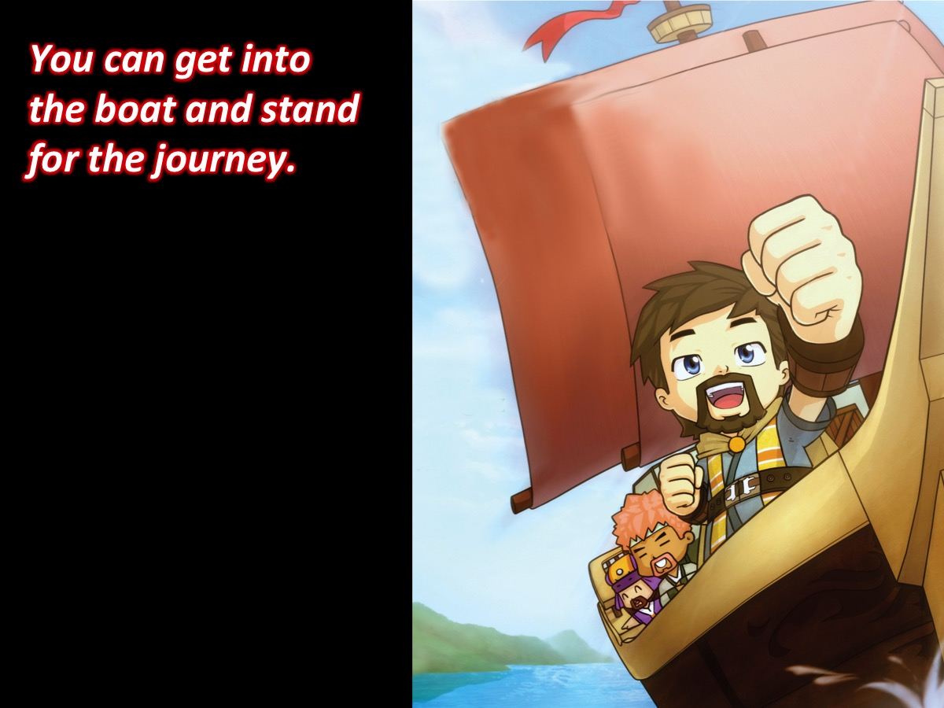
Notes:
Activity: You can get into the boat and stand for the journey.

Slide 18
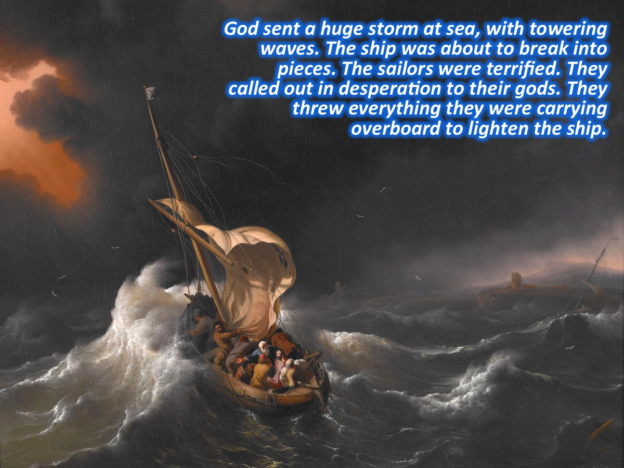
Notes:
⁴God sent a huge storm at sea, with towering waves. The ship was about to break into pieces. The sailors were terrified. They called out in desperation to their gods. They threw everything they were carrying overboard to lighten the ship.

Slide 19
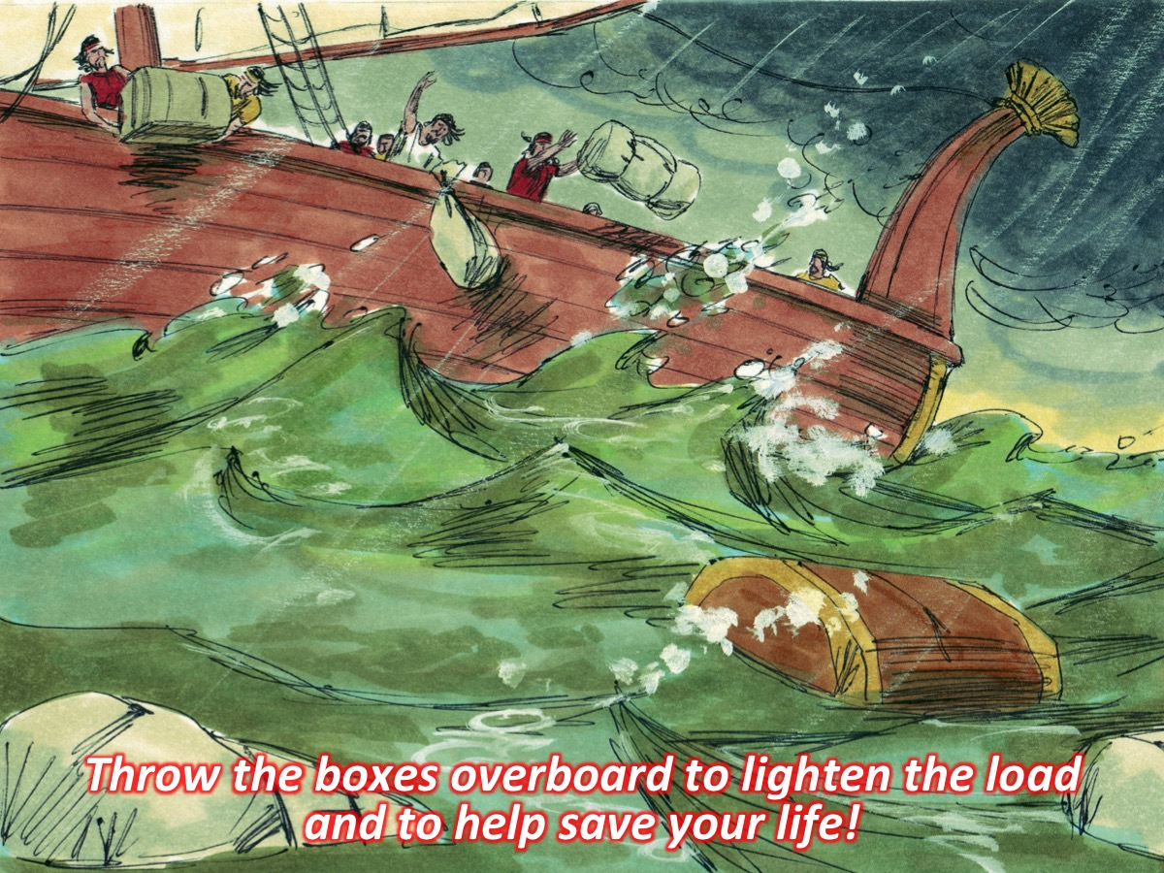
Notes:
Activity: Throw the boxes overboard to lighten the load and to help save your life!

Slide 20
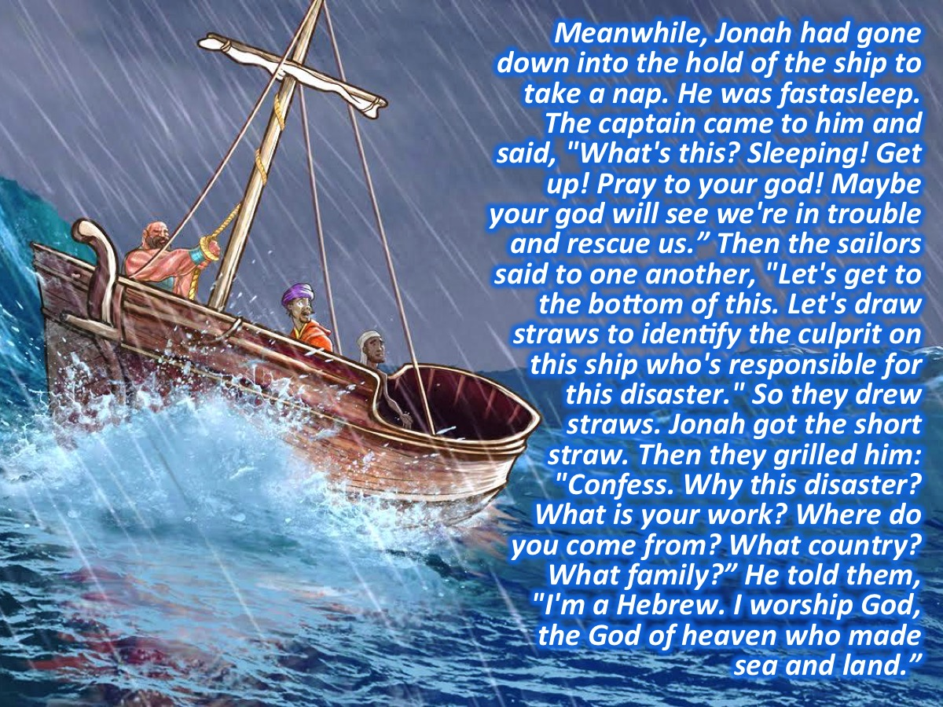
Notes:
⁵Meanwhile, Jonah had gone down into the hold of the ship to take a nap. He was fast asleep. ⁶The captain came to him and said, "What's this? Sleeping! Get up! Pray to your god! Maybe your god will see we're in trouble and rescue us." ⁷Then the sailors said to one another, "Let's get to the bottom of this. Let's draw straws to identify the culprit on this ship who's responsible for this disaster." So they drew straws. Jonah got the short straw. ⁸Then they grilled him: "Confess. Why this disaster? What is your work? Where do you come from? What country? What family?" ⁹He told them, "I'm a Hebrew. I worship God, the God of heaven who made sea and land."

Slide 21
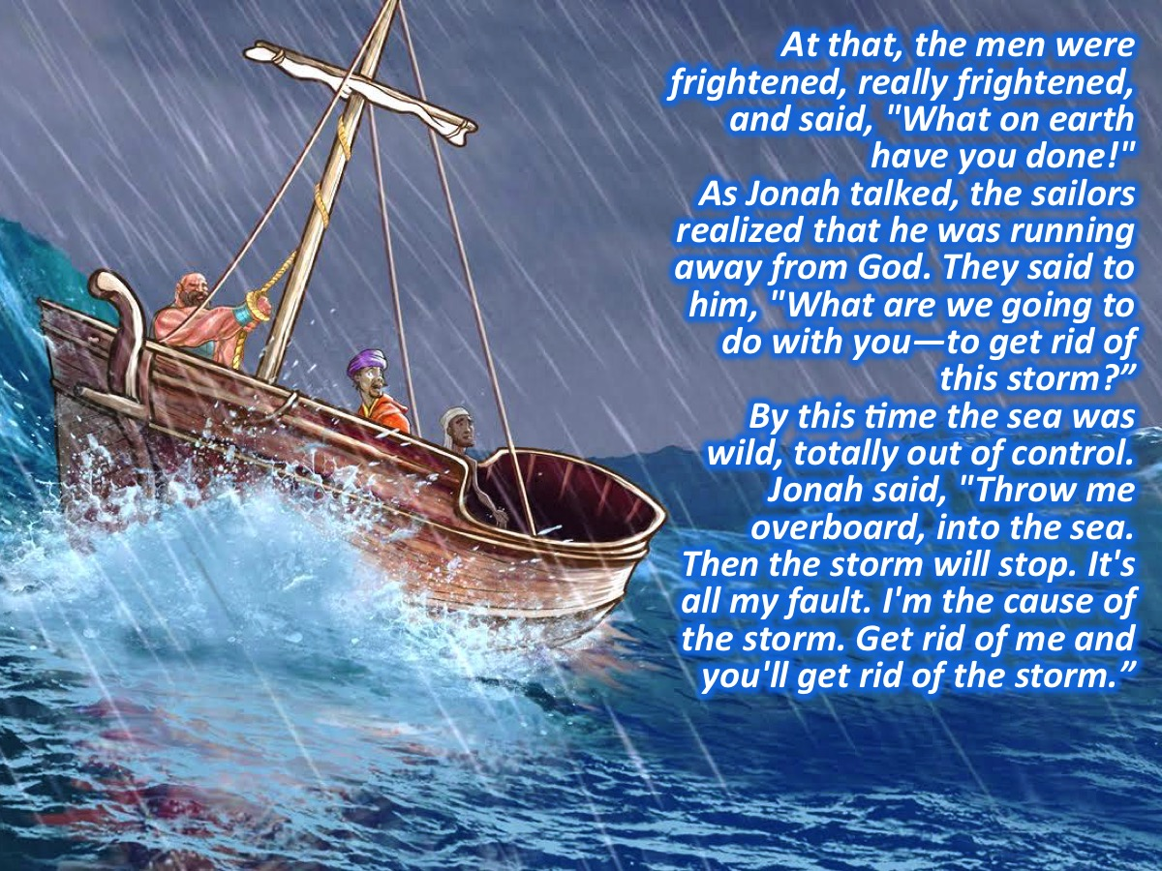
Notes:
¹⁰At that, the men were frightened, really frightened, and said, "What on earth have you done!" As Jonah talked, the sailors realized that he was running away from God. ¹¹They said to him, "What are we going to do with you—to get rid of this storm?” By this time the sea was wild, totally out of control. ¹²Jonah said, "Throw me overboard, into the sea. Then the storm will stop. It's all my fault. I'm the cause of the storm. Get rid of me and you'll get rid of the storm."

Slide 22
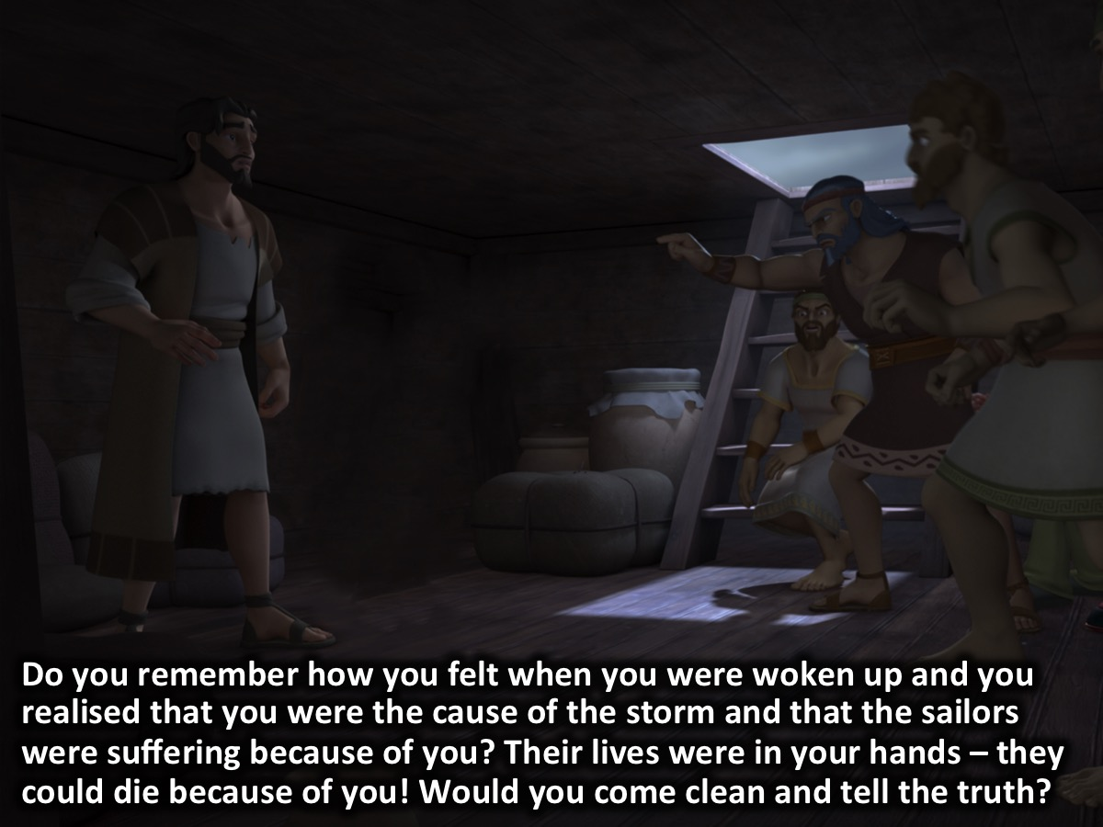
Notes:
Do you remember how you felt when you were woken up and you realised that you were the cause of the storm and that the sailors were suffering because of you? Their lives were in your hands – they could die because of you! Would you come clean and tell the truth?

Slide 23
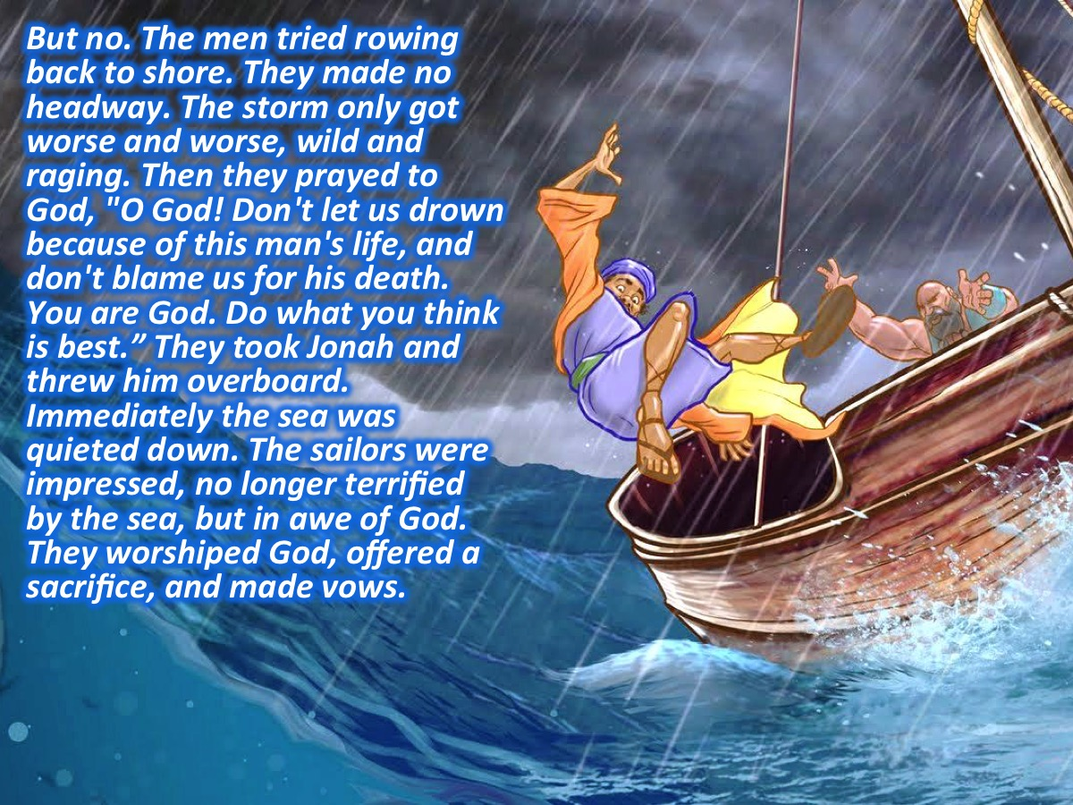
Notes:
¹³But no. The men tried rowing back to shore. They made no headway. The storm only got worse and worse, wild and raging. ¹⁴Then they prayed to God, "O God! Don't let us drown because of this man's life, and don't blame us for his death. You are God. Do what you think is best." ¹⁵They took Jonah and threw him overboard. Immediately the sea was quieted down. ¹⁶The sailors were impressed, no longer terrified by the sea, but in awe of God. They worshiped God, offered a sacrifice, and made vows.

Slide 24
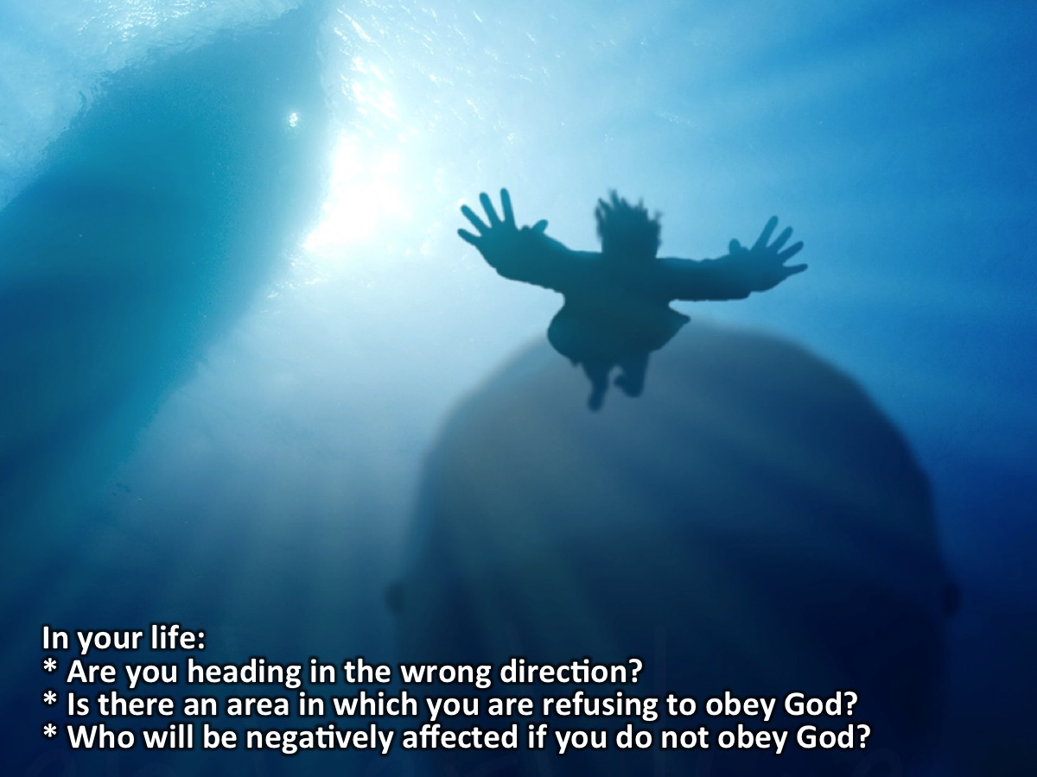
Notes:
In your life:
* Are you heading in the wrong direction?
* Is there an area in which you are refusing to obey God?
* Who will be negatively affected if you do not obey God?

Slide 25
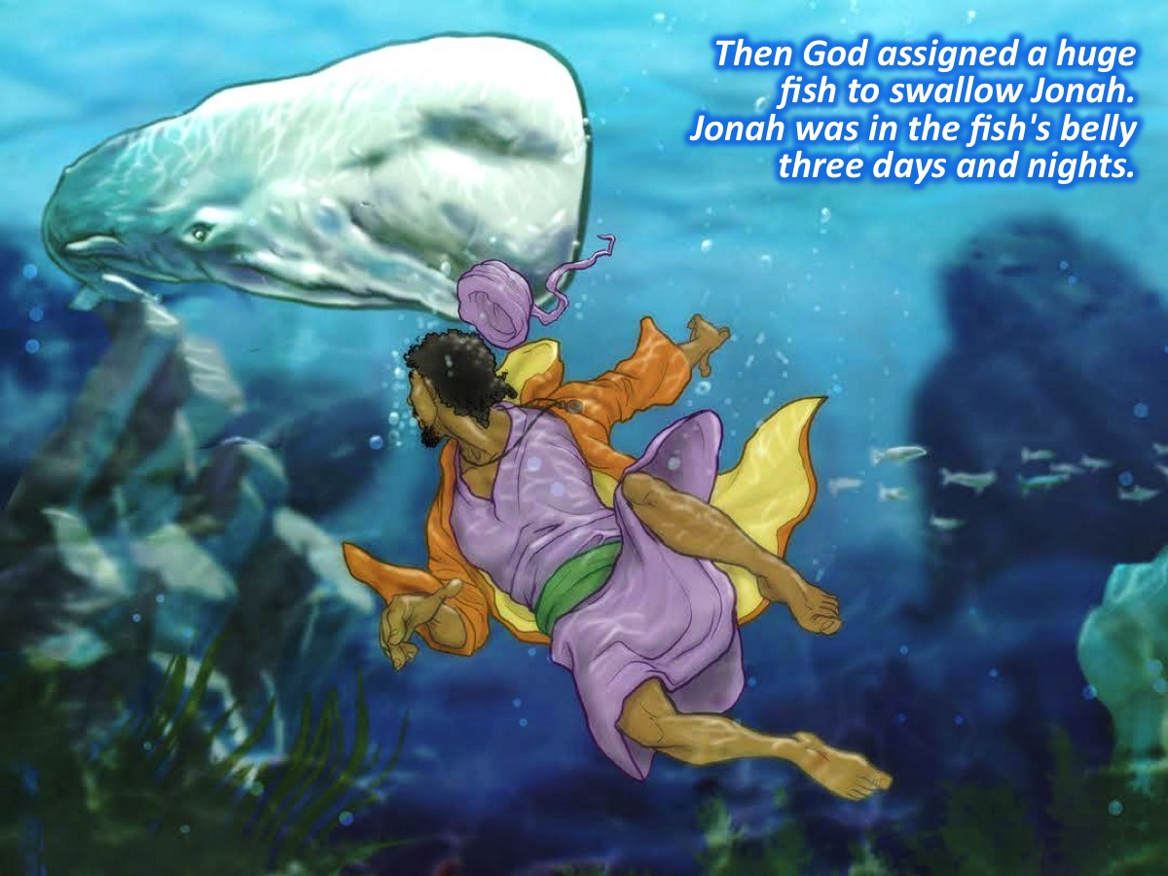
Notes:
¹⁷Then God assigned a huge fish to swallow Jonah. Jonah was in the fish's belly three days and nights.

Slide 26
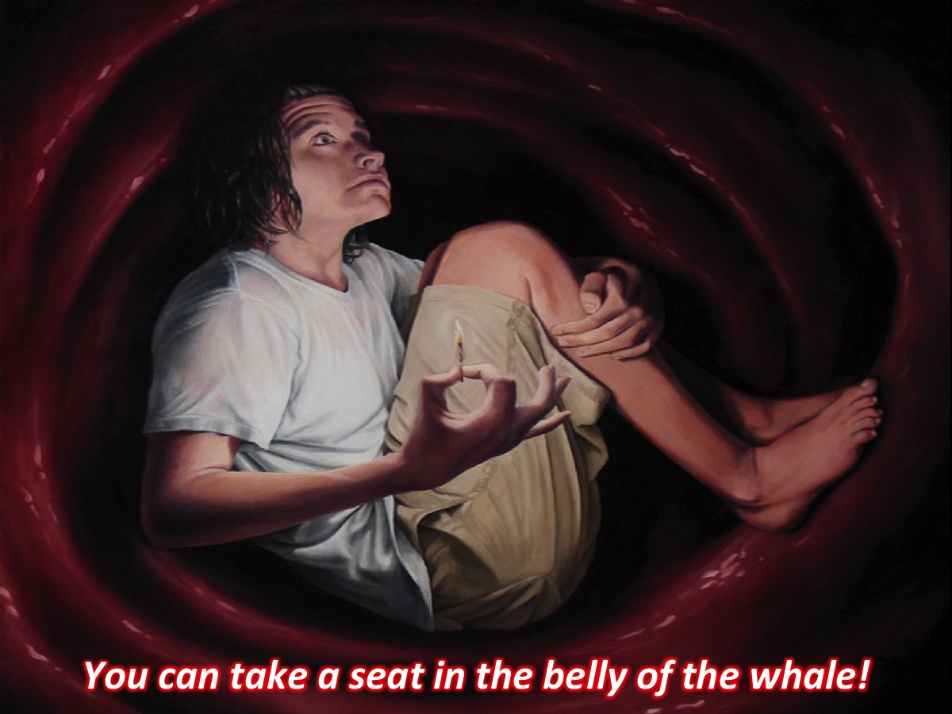
Notes:
Activity: You can take a seat in the belly of the whale.
Activity: Switch off the lights

Slide 27
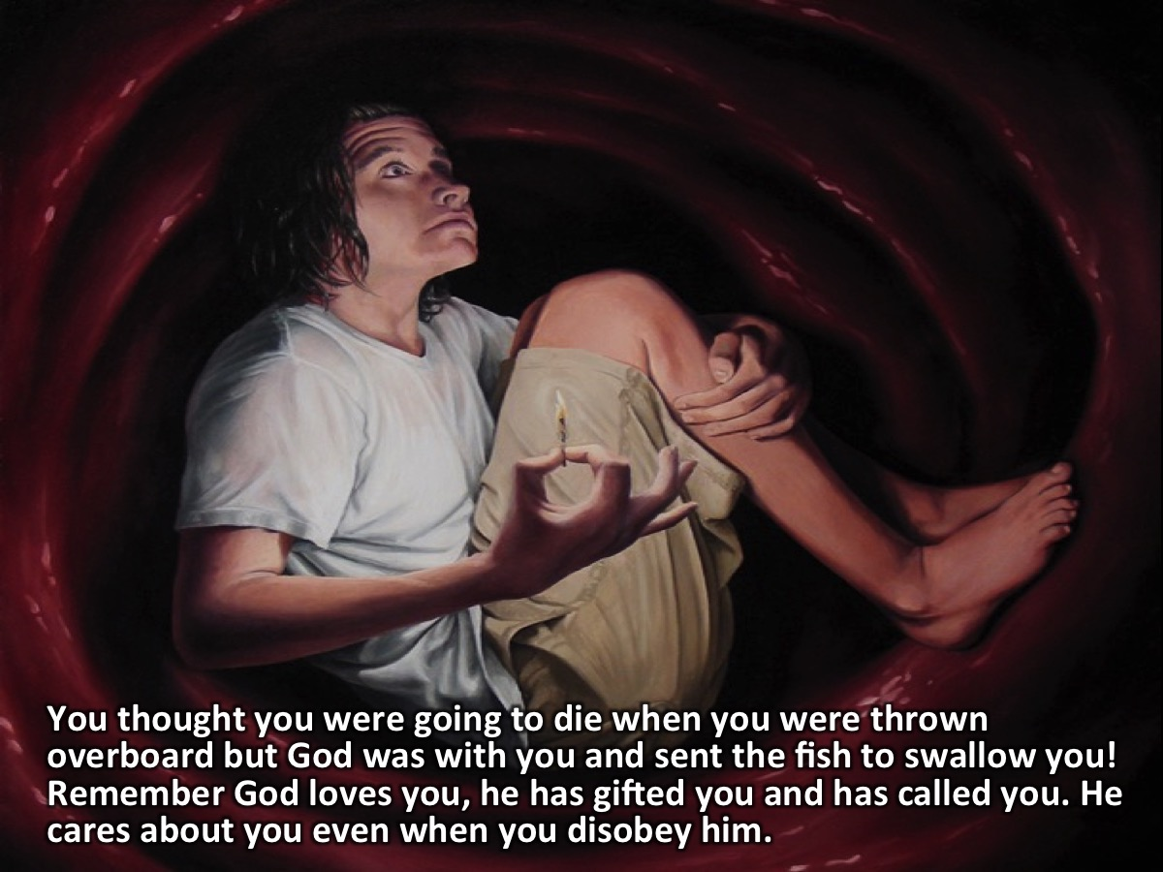
Notes:
You thought you were going to die when you were thrown overboard but God was with you and sent the fish to swallow you! Remember God loves you, he has gifted you and has called you. He cares about you even when you disobey him.

Slide 28
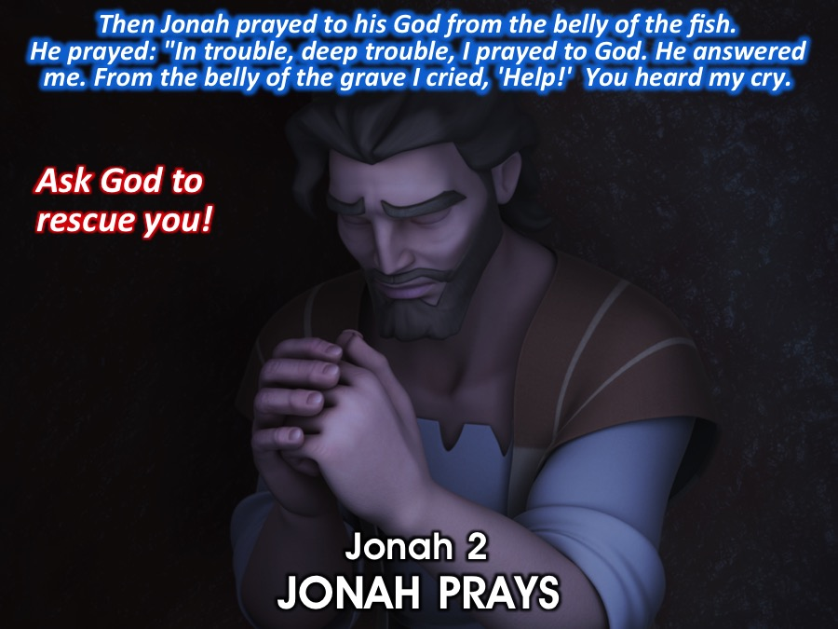
Notes:
Jonah 2: JONAH PRAYS
¹Then Jonah prayed to his God from the belly of the fish. ²He prayed: "In trouble, deep trouble, I prayed to God. He answered me. From the belly of the grave I cried, 'Help!' You heard my cry.
Activity: Ask God to rescue you from this dismal situation!

Slide 29
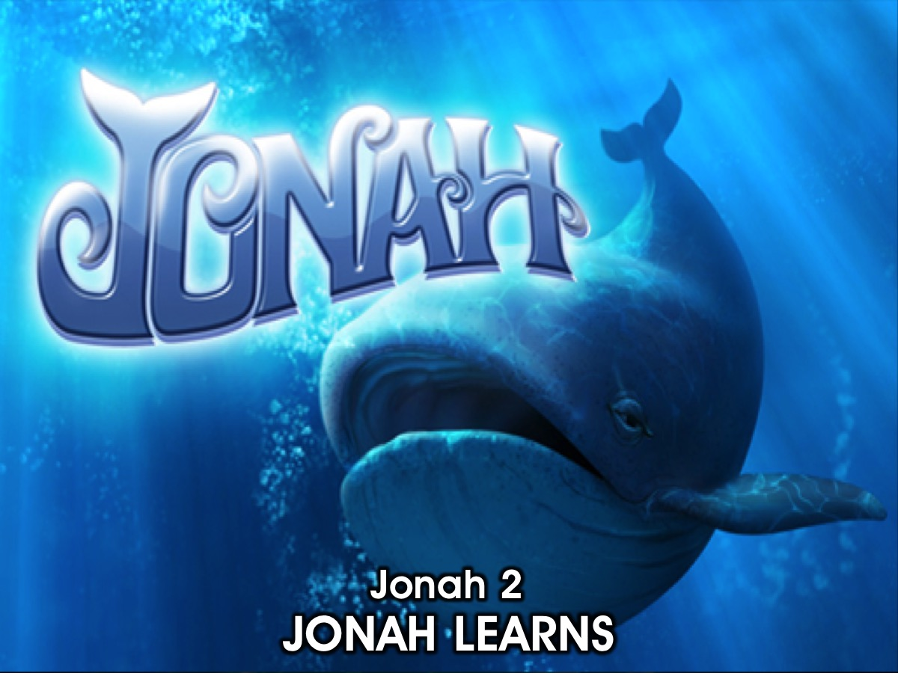
Notes:
Jonah 2: JONAH LEARNS

Slide 30
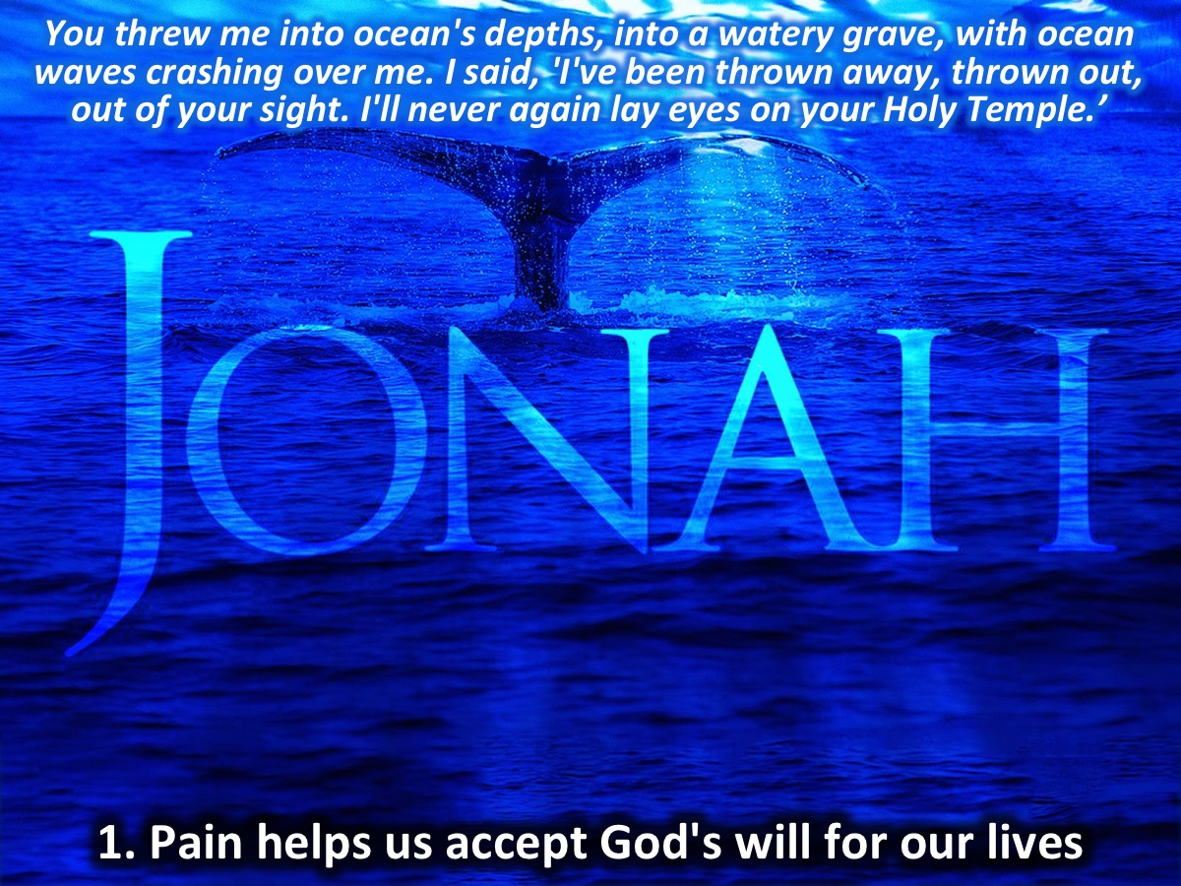
Notes:
³You threw me into ocean's depths, into a watery grave, with ocean waves, ocean breakers crashing over me. ⁴I said, 'I've been thrown away, thrown out, out of your sight. I'll never again lay eyes on your Holy Temple.’
1. Pain makes us accept God's will for us. God will use pain in our lives to bring us in line with what he wants us to do for him.

Slide 31
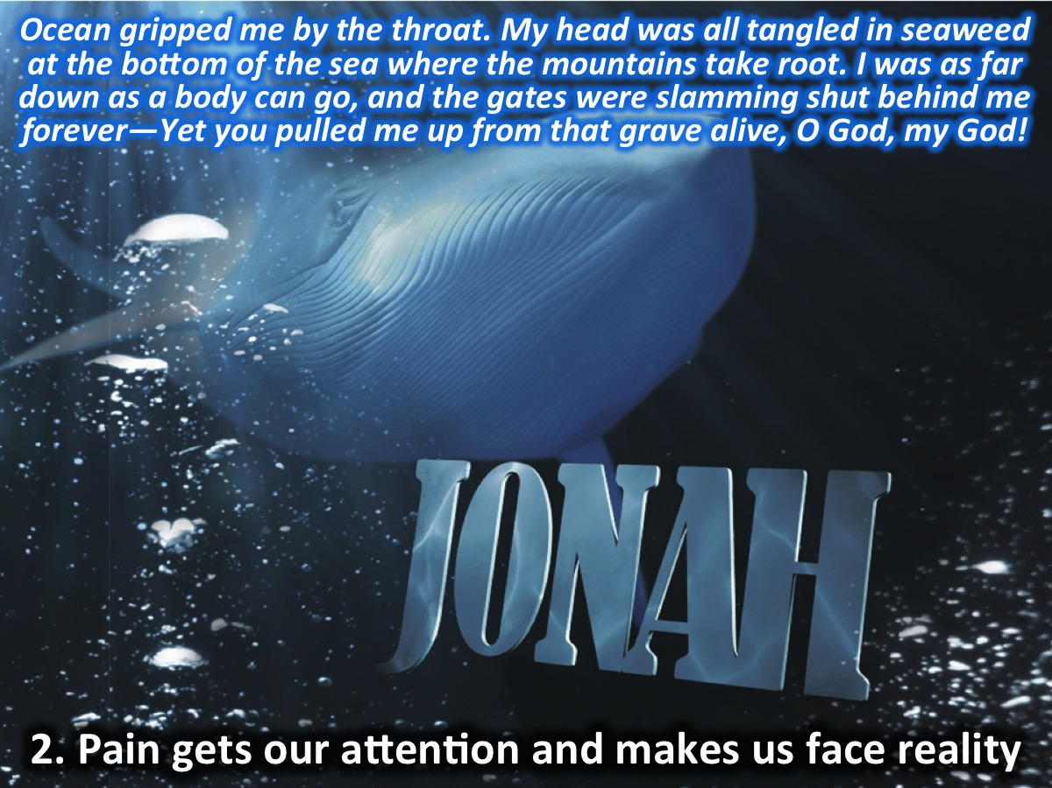
Notes:
⁵Ocean gripped me by the throat. The ancient Abyss grabbed me and held tight. My head was all tangled in seaweed at the bottom of the sea where the mountains take root. ⁶I was as far down as a body can go, and the gates were slamming shut behind me forever—Yet you pulled me up from that grave alive, O God, my God!
2. Pain gets our attention and makes us face reality. God uses pain to wake us up and realise that we need to change our direction.

Slide 32
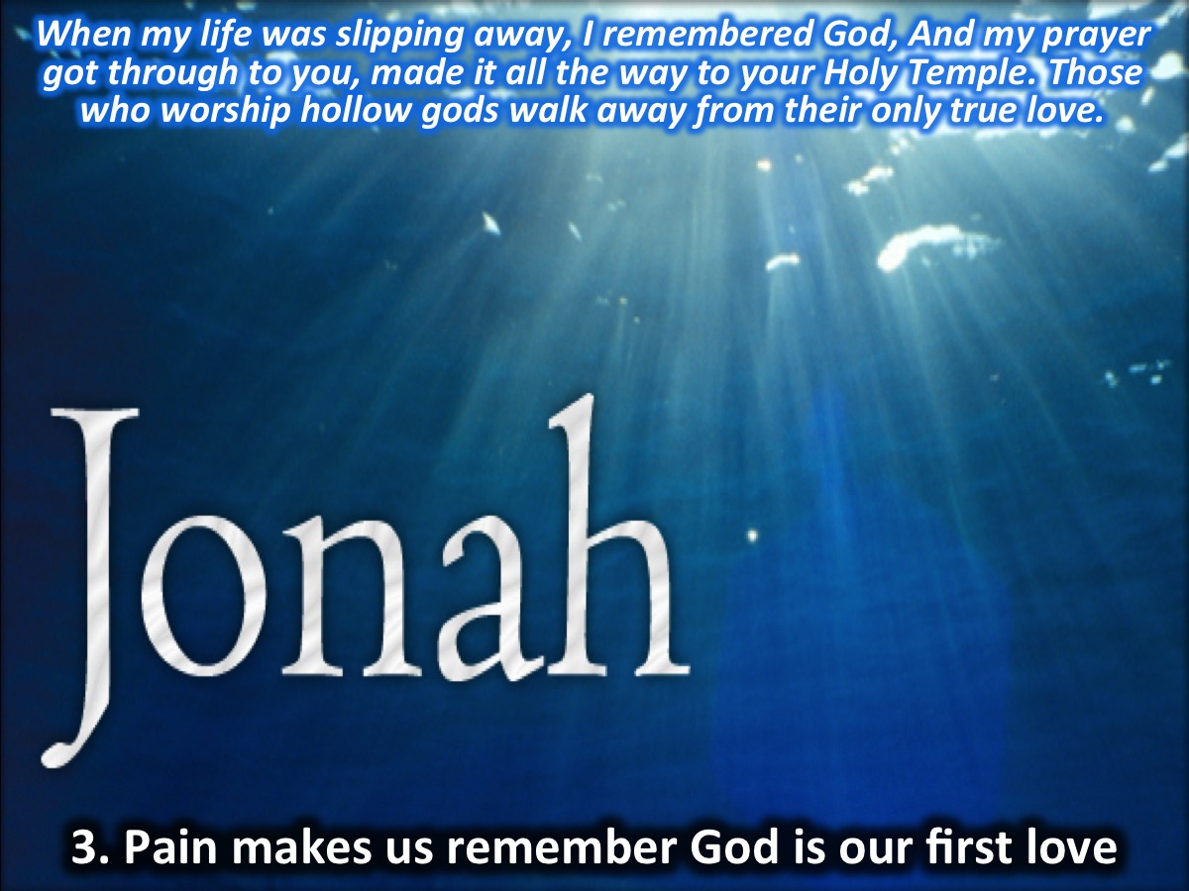
Notes:
⁷When my life was slipping away, I remembered God, And my prayer got through to you, made it all the way to your Holy Temple. ⁸Those who worship hollow gods, god-frauds, walk away from their only true love.
3. Pain makes us remember that God is our first love. We cannot hold onto God's resources and our idols at the same time. Everything else must be secondary to God in our lives.

Slide 33
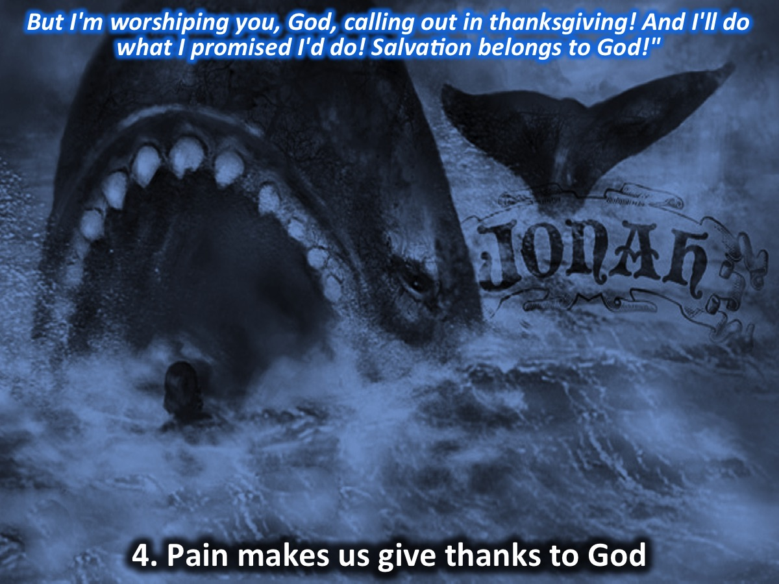
Notes:
⁹But I'm worshiping you, God, calling out in thanksgiving! And I'll do what I promised I'd do! Salvation belongs to God!”
4. Pain makes us give thanks to God for who He is and for what He has done. When we worship God we are ready to do what he wants us to do or what we promised we would do.

Slide 34
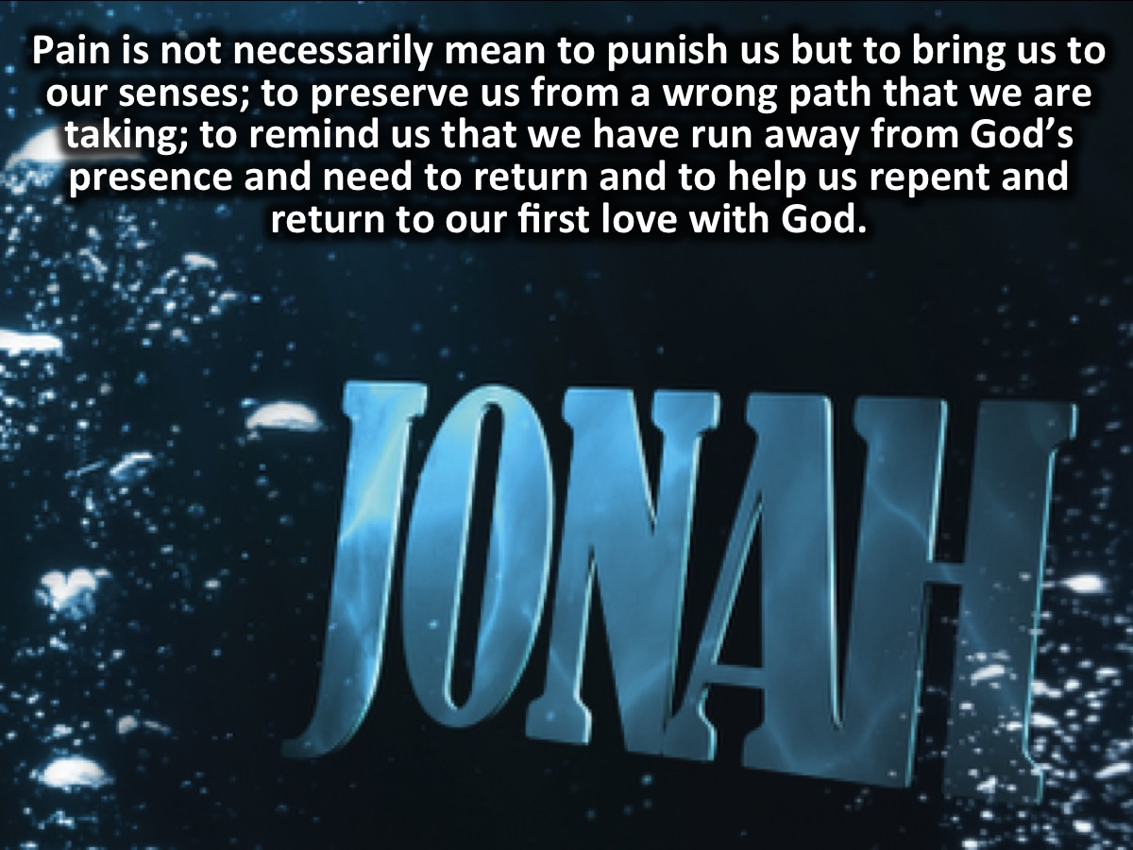
Notes:
Summary: So, pain is not necessarily mean to punish us but to bring us to our senses; to preserve us from a wrong path that we are taking; to remind us that we have run away from God’s presence and need to return and to help us repent and return to our first love with God.

Slide 35
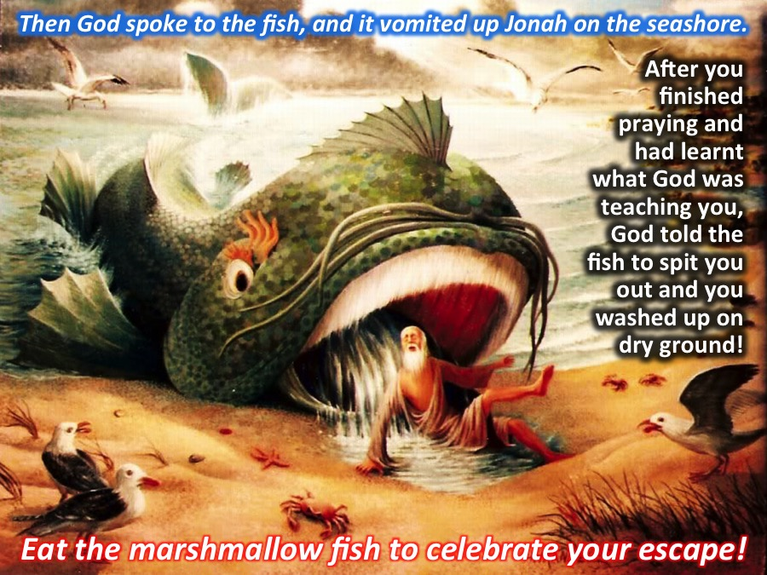
Notes:
¹⁰Then God spoke to the fish, and it vomited up Jonah on the seashore.
After you had finished praying and had learnt what God was teaching you, God told the whale to spit you out and you washed up on dry ground!
Activity: You can eat the marshmallow fish to celebrate your escape.

Slide 36
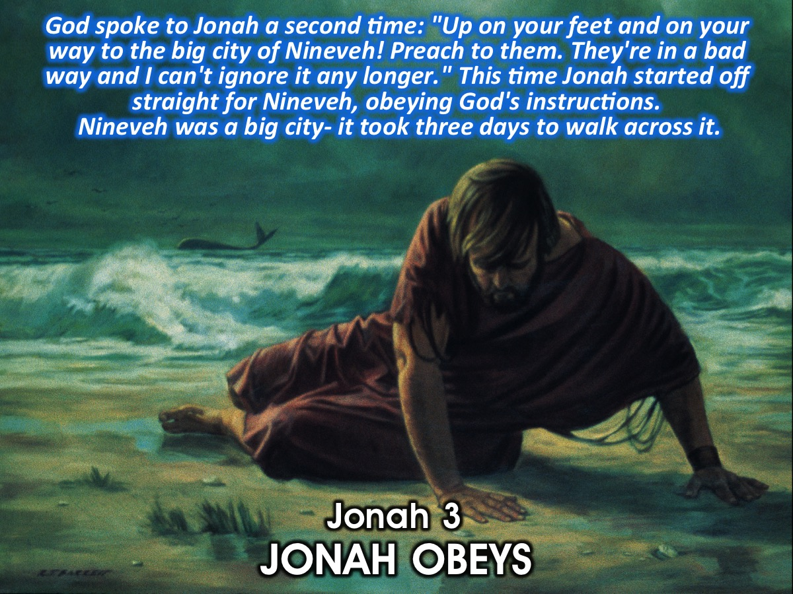
Notes:
Jonah 3: JONAH OBEYS
¹God spoke to Jonah a second time: ²"Up on your feet and on your way to the big city of Nineveh! Preach to them. They're in a bad way and I can't ignore it any longer." This time ³Jonah started off straight for Nineveh, obeying God's instructions. Nineveh was a big city - it took three days to walk across it.

Slide 37
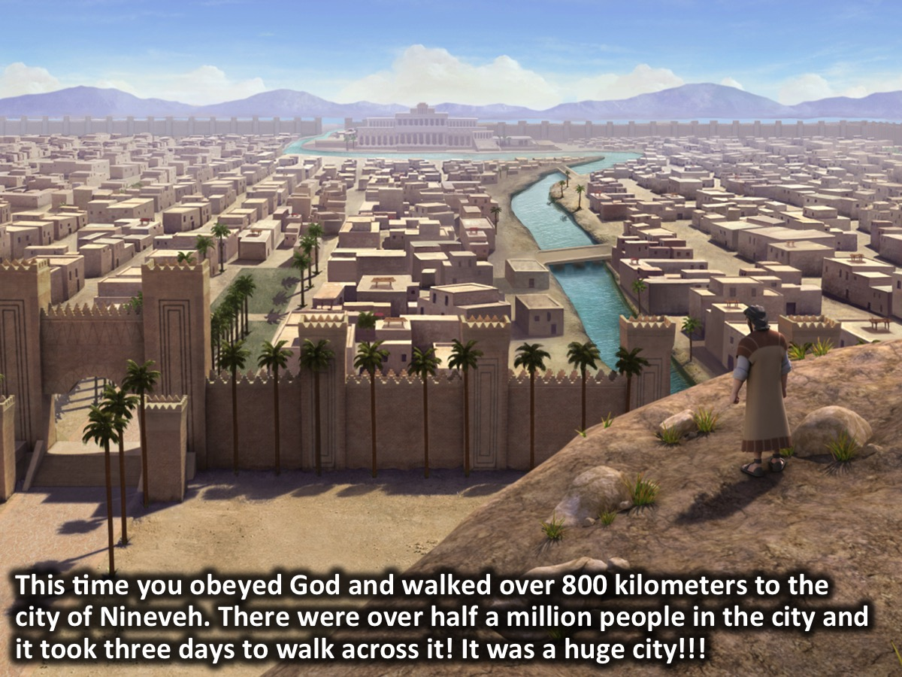
Notes:
This time you obeyed God and walked over 800 kilometers to the city of Nineveh. There were over half a million people in the city and it took three days to walk across it! It was a huge city!!!

Slide 38
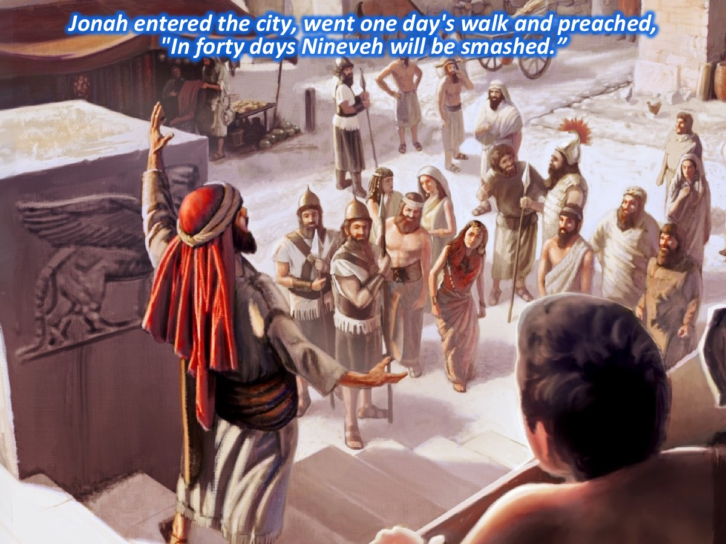
Notes:
⁴Jonah entered the city, went one day's walk and preached, "In forty days Nineveh will be smashed."

Slide 39
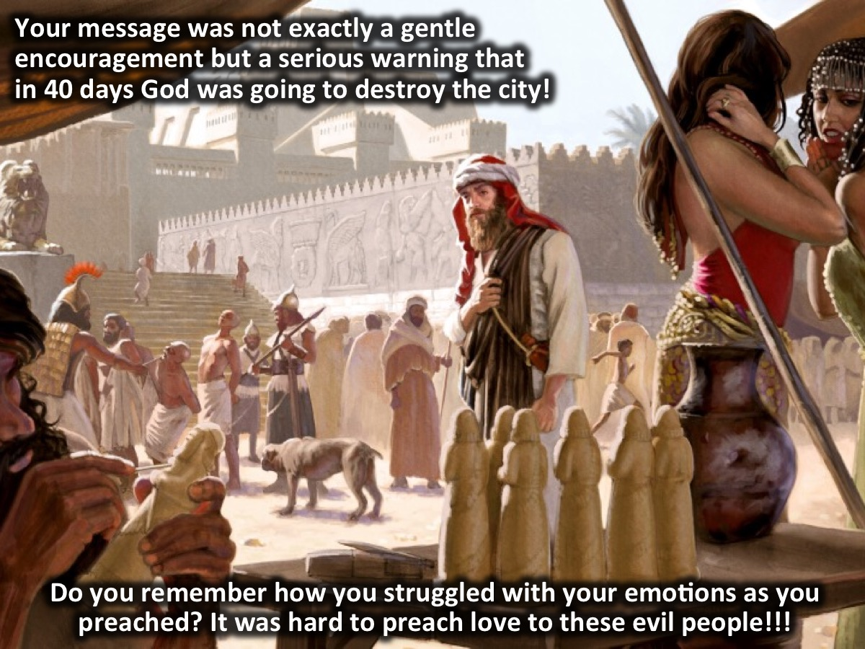
Notes:
Your message was not exactly a gentle encouragement but a serious warning that in 40 days God was going to destroy the city! Do you remember how you struggled with your emotions as you preached? It was hard to preach love to these evil people!!!

Slide 40
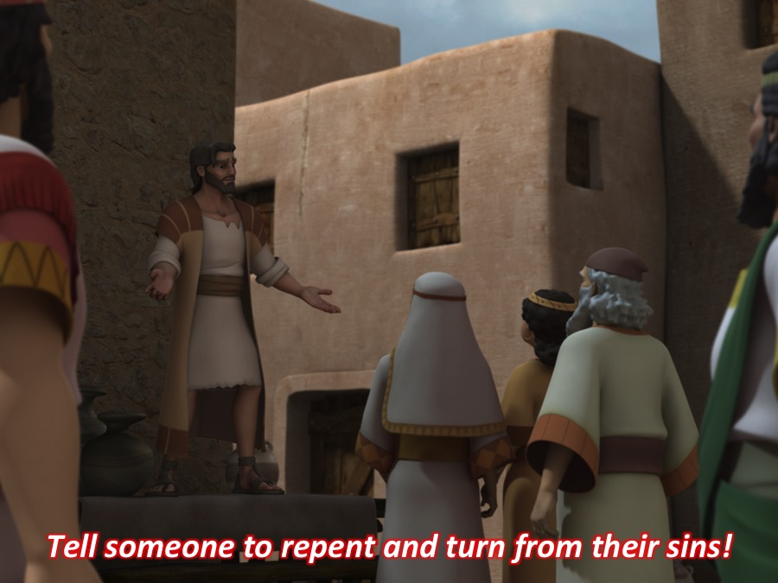
Notes:
Activity: Tell someone to repent and turn from their sins!

Slide 41
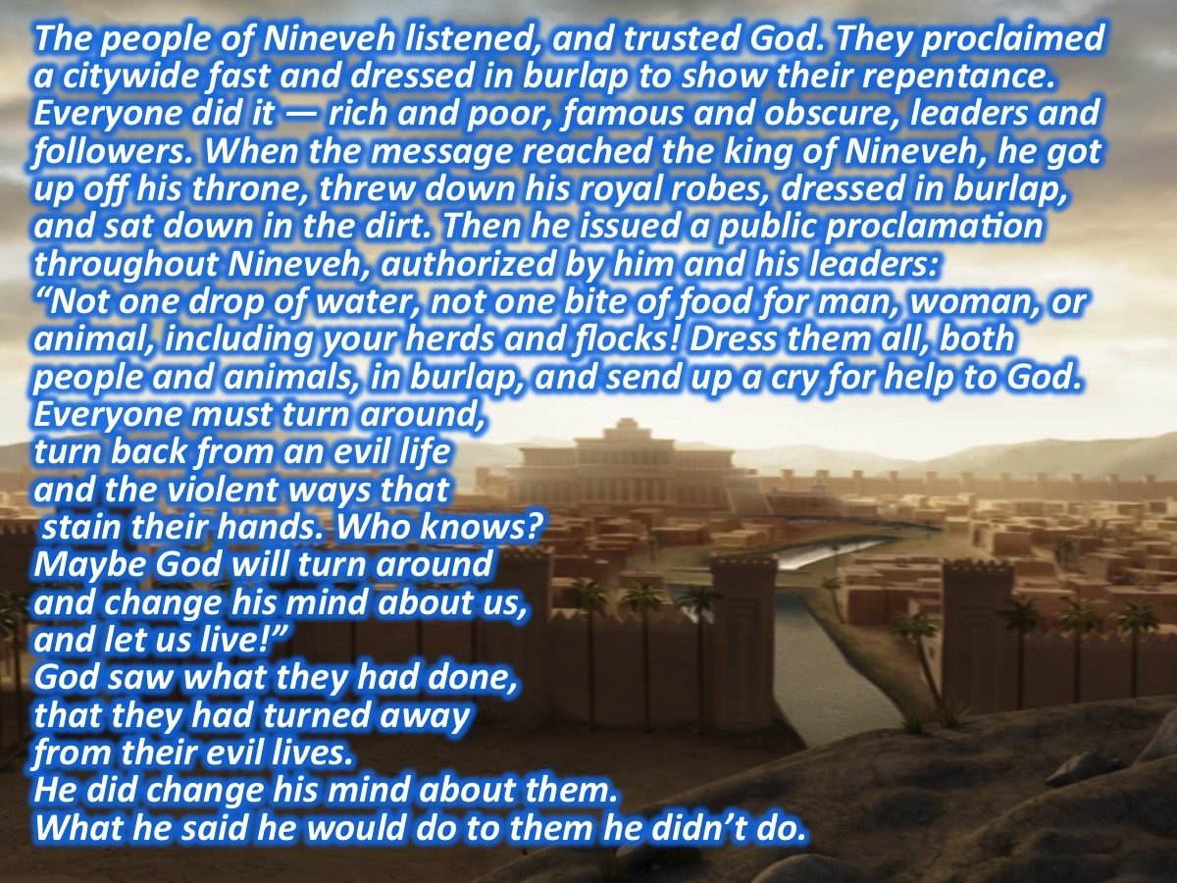
Notes:
The People Repent
⁵The people of Nineveh listened, and trusted God. They proclaimed a citywide fast and dressed in burlap to show their repentance. Everyone did it—rich and poor, famous and obscure, leaders and followers. ⁶When the message reached the king of Nineveh, he got up off his throne, threw down his royal robes, dressed in burlap, and sat down in the dirt. ⁷Then he issued a public proclamation throughout Nineveh, authorized by him and his leaders: "Not one drop of water, not one bite of food for man, woman, or animal, including your herds and flocks! ⁸Dress them all, both people and animals, in burlap, and send up a cry for help to God. Everyone must turn around, turn back from an evil life and the violent ways that stain their hands. ⁹Who knows? Maybe God will turn around and change his mind about us, quit being angry with us and let us live!" ¹⁰God saw what they had done, that they had turned away from their evil lives. He did change his mind about them. What he said he would do to them he didn't do.

Slide 42
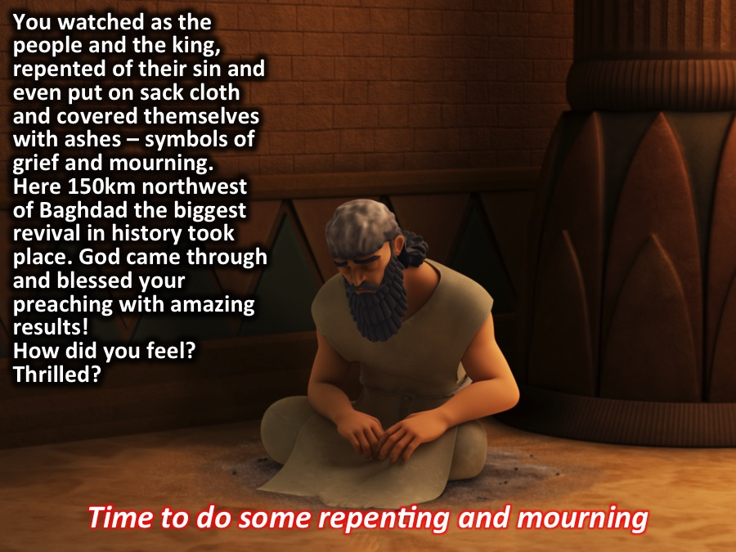
Notes:
You watched as the people and the king, repented of their sin and even put on sack cloth and covered themselves with ashes – symbols of grief and mourning.
Here 150km northwest of Baghdad the biggest revival in history took place. God came through and blessed your preaching with amazing results! How did you feel? Thrilled?
Activity: Time to do some repenting and mourning.
Hand out black bin bags for some teens to wear.

Slide 43
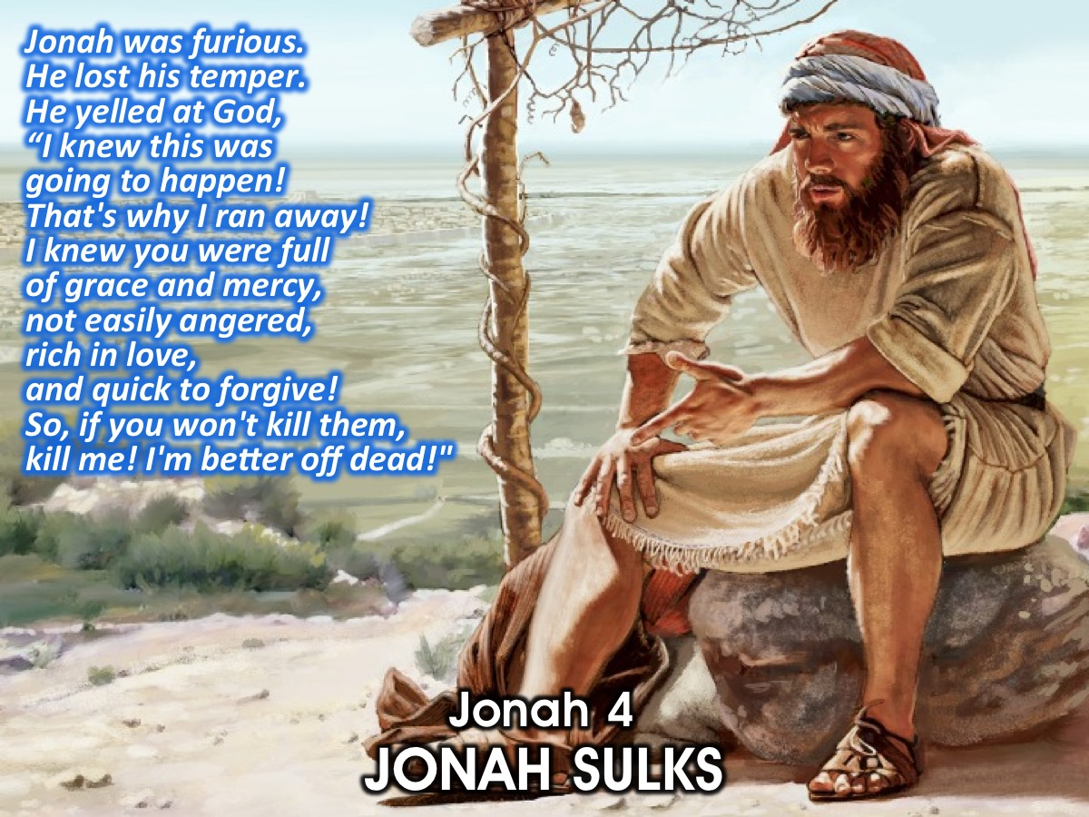
Notes:
Jonah 4: JONAH SULKS
¹Jonah was furious. He lost his temper. ²He yelled at God, "God! I knew it—when I was back home, I knew this was going to happen! That's why I ran off to Tarshish! I knew you were full of grace and mercy, not easily angered, rich in love, and ready at the drop of a hat to turn your plans of punishment into a program of forgiveness! ³"So, God, if you won't kill them, kill me! I'm better off dead!”

Slide 44
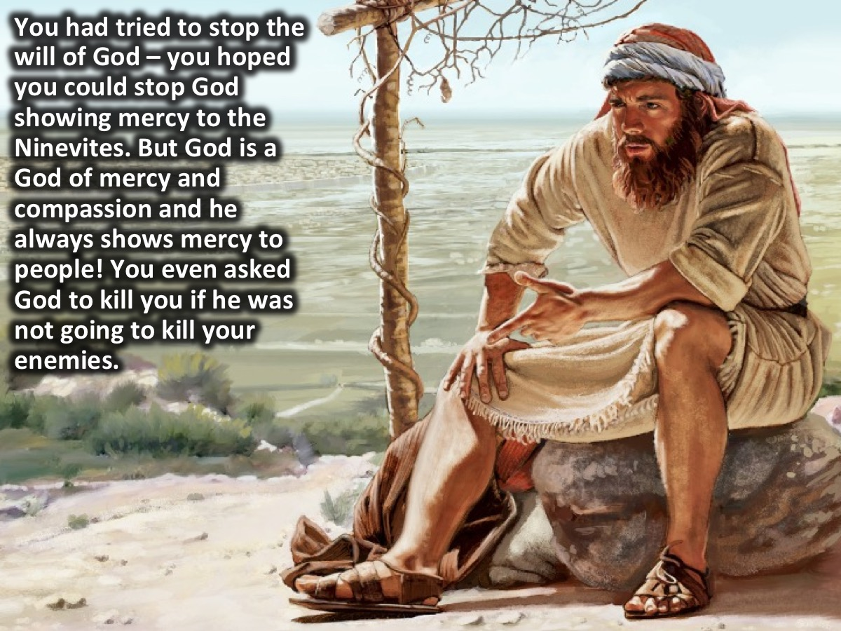
Notes:
You had tried to stop the will of God – you hoped you could stop God showing mercy to the Ninevites. But God is a God of mercy and compassion and he always shows mercy to people! You even asked God to kill you if he was not going to kill your enemies.

Slide 45
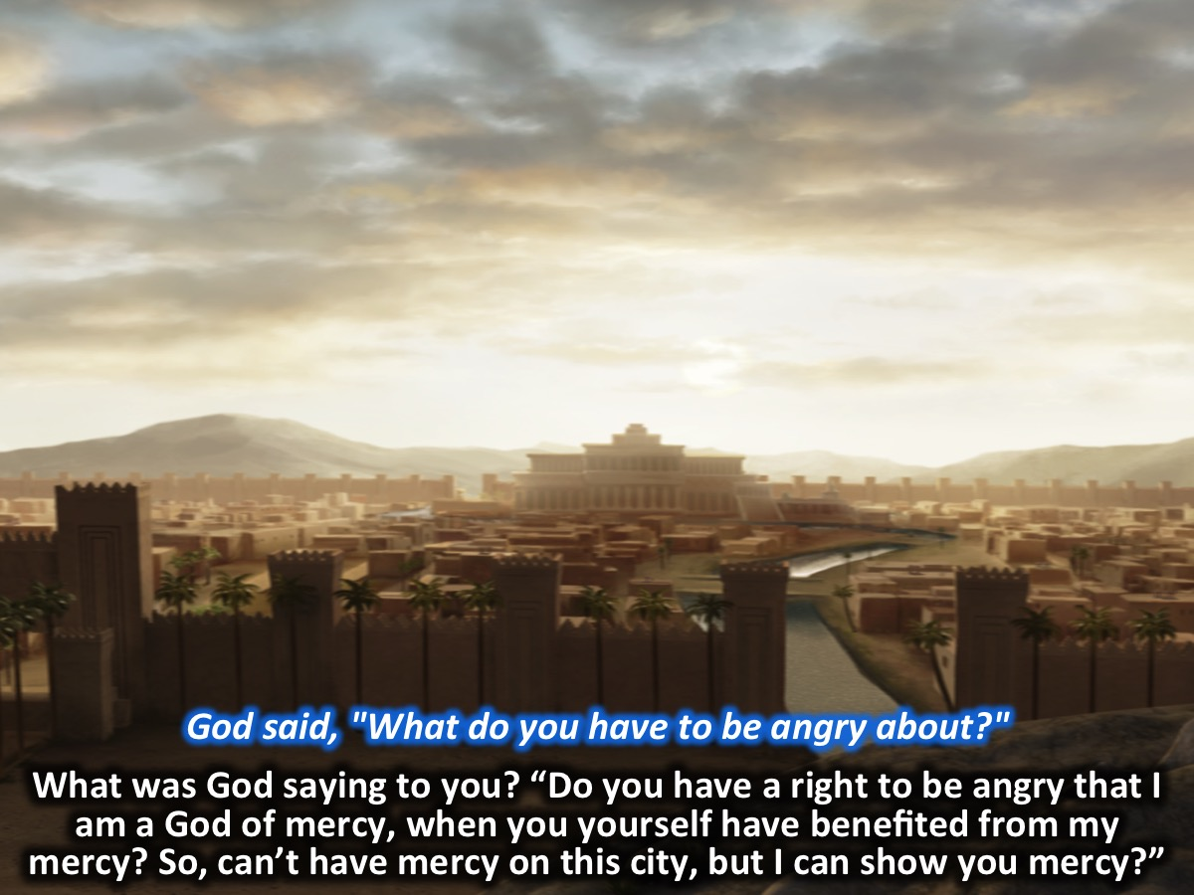
Notes:
⁴God said, "What do you have to be angry about?”
What was God saying to you? “Do you have a right to be angry that I am a God of mercy, when you yourself have benefited from my mercy? So, can’t have mercy on this city, but I can show you mercy?”

Slide 46
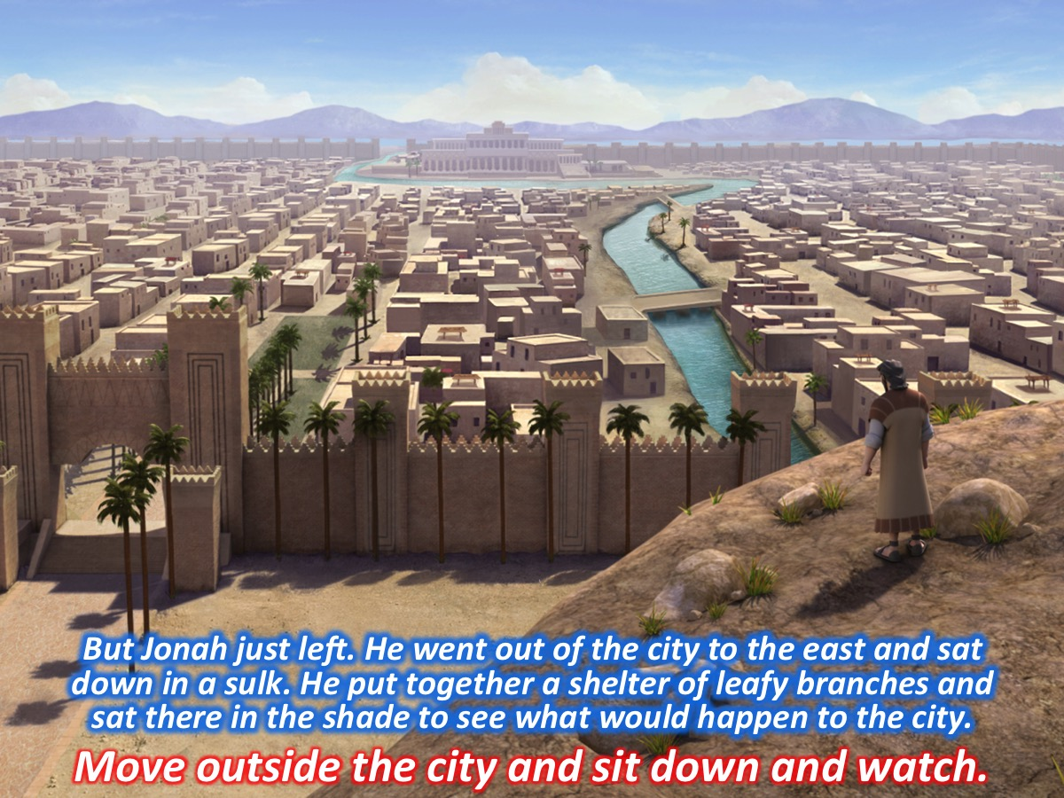
Notes:
⁵But Jonah just left. He went out of the city to the east and sat down in a sulk. He put together a makeshift shelter of leafy branches and sat there in the shade to see what would happen to the city.
Activity: Move outside the city and sit down to watch what will happen.

Slide 47
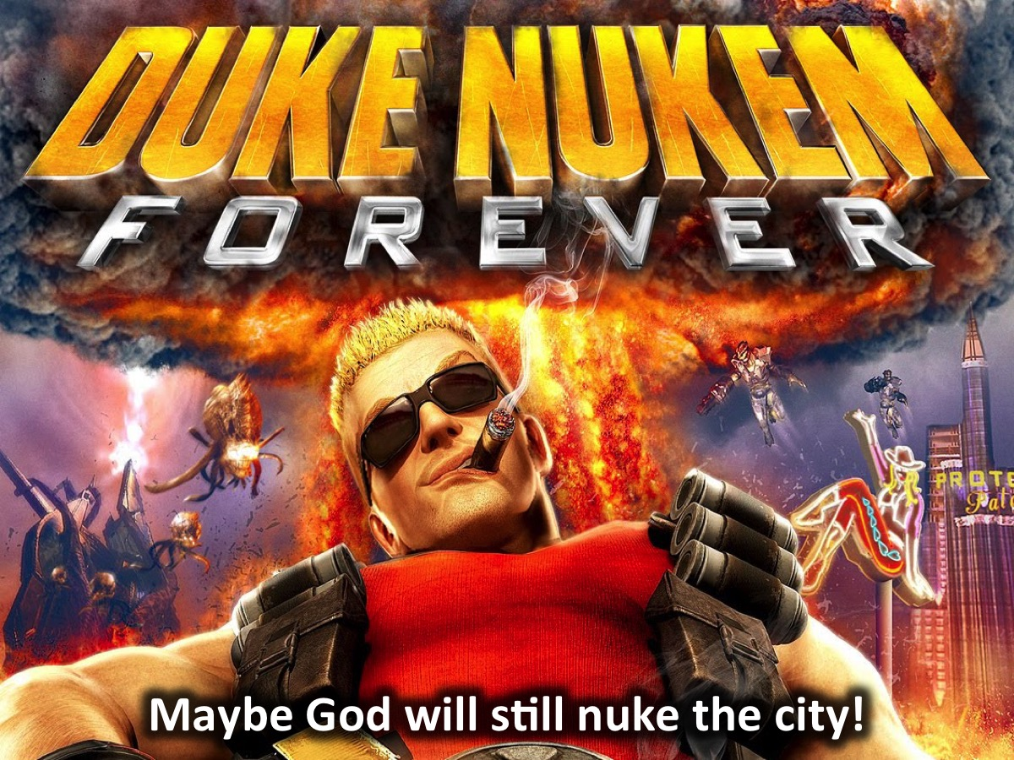
Notes:
Maybe God will still nuke the city!

Slide 48
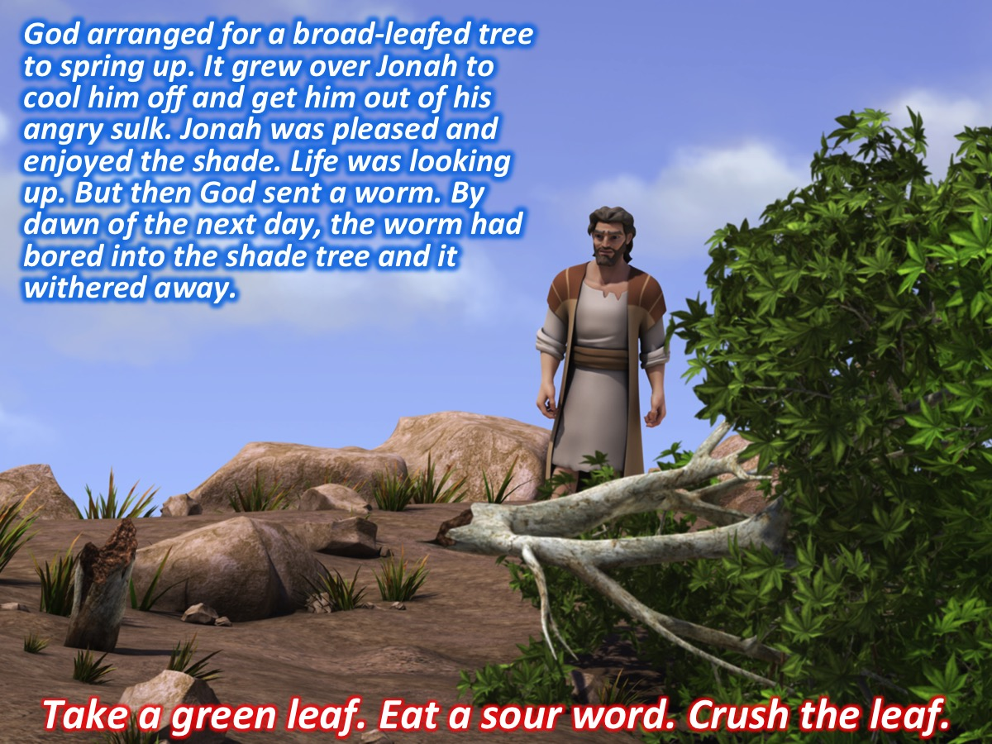
Notes:
⁶God arranged for a broad-leafed tree to spring up. It grew over Jonah to cool him off and get him out of his angry sulk. Jonah was pleased and enjoyed the shade. Life was looking up. But then God sent a worm. ⁷By dawn of the next day, the worm had bored into the shade tree and it withered away.
Activity: Take a green leaf. Eat a sour word. Crush the leaf and throw it in the bin!

Slide 49
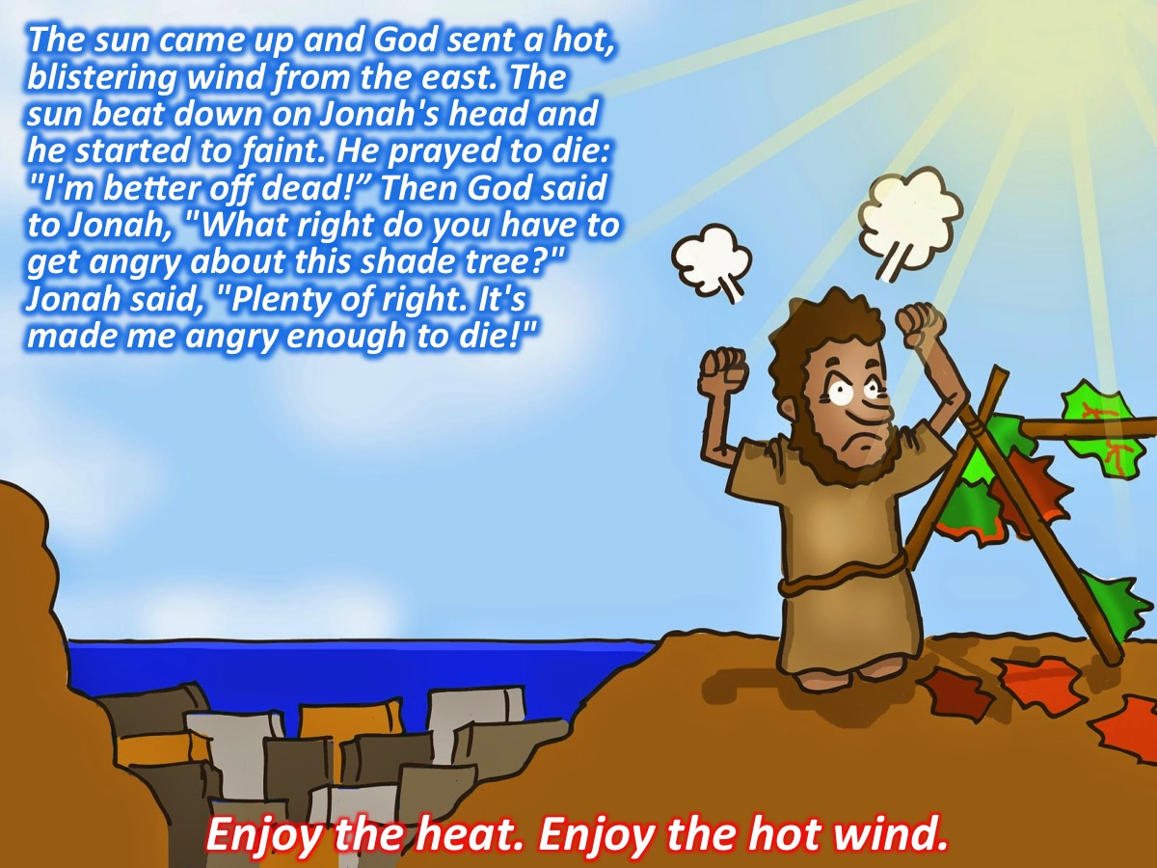
Notes:
⁸The sun came up and God sent a hot, blistering wind from the east. The sun beat down on Jonah's head and he started to faint. He prayed to die: "I'm better off dead!" ⁹Then God said to Jonah, "What right do you have to get angry about this shade tree?" Jonah said, "Plenty of right. It's made me angry enough to die!"
Activity: Enjoy the heat and the hot wind!
Activity: Switch on the room heater and get a fan aimed at teens to symbolise the hot wind.

Slide 50
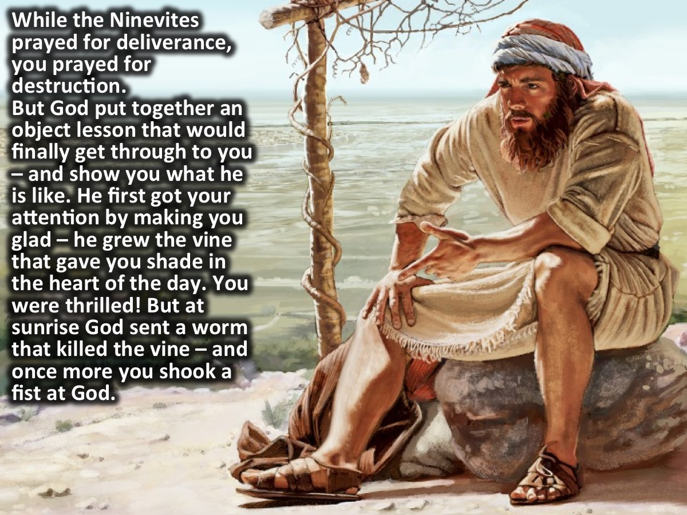
Notes:
While the Ninevites were praying for deliverance, you were praying for destruction. You made your way outside the city and found a great seat to watch it get destroyed. But God was about to put together an object lesson that would finally get through to you – and show you what he is like. God got your attention first by making you glad – he grew the vine that gave you shade in the heart of the day. You were thrilled! But at sunrise God sent a worm that killed the vine – and once more you shook a fist at God.

Slide 51

Notes:
¹⁰God said, "What's this? How is it that you can change your feelings from pleasure to anger overnight about a mere shade tree that you did nothing to get? You neither planted nor watered it. It grew up one night and died the next night. ¹¹So, why can't I change what I feel about Nineveh from anger to pleasure, this big city of more than 120,000 childlike people who don't yet know right from wrong, to say nothing of all the innocent animals?”

Slide 52

Notes:
It took you a while but you finally learnt that:
1. God loves His creation and he looks after it and makes it grow. (10)
2. God loves people whether they please Him or not. (11)

Slide 53

Notes:
This is the heart of God – He is kind and loving and wants everyone to come to know him and experience his love and his perfect plan for their lives. What has God said to you today? (1) Will you tell others about God? (2) Will you tell people you don’t like that Jesus loves them?

Slide 54

Notes:
Closing Prayer

