Slide 1
Notes:
My Heart, Christ’s Home: This is a contemplative journey based on a classic book of the same title. I recreated the experience for high schoolers in my home and had them walk through the various locations explored in the book and re-created the experience as creatively as possible.

Slide 2
Notes:
At the Front Door: There is a knock on the front door and when you open the door Christ is standing there and you welcome him in. Jesus said to his disciples, "If a man loves me, he will keep my word, and my Father will love him, and we will come to him and make out home with him." (Jn 14:23). When we give our lives to Jesus he enters our heart, settles down and makes him home there. I will never forget the evening I invited him into my heart. What an entrance he made! It was not a spectacular, emotional thing, but very real, occurring at the very center of my soul. He came into the darkness of my heart and turned on the light. He built a fire in the fire place and banished the chill. He started music where there had been stillness and harmony where there had been discord. He filled the emptiness with his own loving fellowship. I have never regretted opening the door to Christ and I never will. This is the first step in making the heart Christ's home. He has said, "Behold, I stand at the door and knock; if any one hears my voice and opens the door, I will come in to eat with him, and he with me" (Rev 3:20). If you want to know the reality of God and the personal presence of Jesus Christ simply open wide the door and ask him to come in and be your Savior and Lord. After Christ entered my heart, in the joy of that new‑found relationship I said to him, "Lord, I want this heart of mine to be yours. I want you to settle down here and be fully at home. I want you to use it as your own. Let me show you around and make you comfortable. I want you to enjoy our time together."

Slide 3
Notes:
In the Study: The first room we looked at together was the study ‑ the library. It is the study of the mind. It is an important room because it is the control room of the house. He entered with me and looked around at the books in the bookcase, the magazines on the table, the pictures on the walls. As I followed his gaze, I became uncomfortable. Strangely enough, I had not felt badly about this room before, but now that he was there with me looking at these things, I was embarrassed. There were some books on the shelves his eyes were too pure to look at. On the table were a few magazines a Christian has no business reading. As for the pictures on the walls - some of these were shameful. Red‑faced I turned to him and said, "Master, I know this room really needs to be cleaned up and made over. Will you help me shape it up and change it to the way it ought to be?” “Certainly," he replied. "I'm glad to help you! I've come to handle things like this! First of all, take all the material you are reading and viewing which are not true, good, pure and helpful, and throw them out! Now put on the empty shelves the books of the Bible. Fill the library with the Scriptures and meditate on them day and night. As for the pictures on the walls, you will have difficulty controlling these images, but I have something that will help." He gave me a full‑sized portrait of himself. "Hang this centrally," he said, "on the wall of the mind." I did, and I have discovered through the years that when my thoughts focus on Christ, the awareness of his presence, purity and power causes wrong and impure thoughts to flee. So he has helped me to bring my thoughts under his control, but the struggle remains. If you have difficulty with this little room of the mind, let me encourage you to bring Christ there. Pack it full with the Word of God, study it, meditate on it and keep clearly before you the presence of the Lord Jesus.

Slide 4
Notes:
Video: The Study – Get Videos from YouTube:
Part 1: http://www.youtube.com/watch?v=0qY36c9TIAM
Part 2: http://www.youtube.com/watch?v=sY7vPt9HygQ
Sadly these videos are not of a decent quality but could still be helpful for prep even if they are not shown.

Slide 5
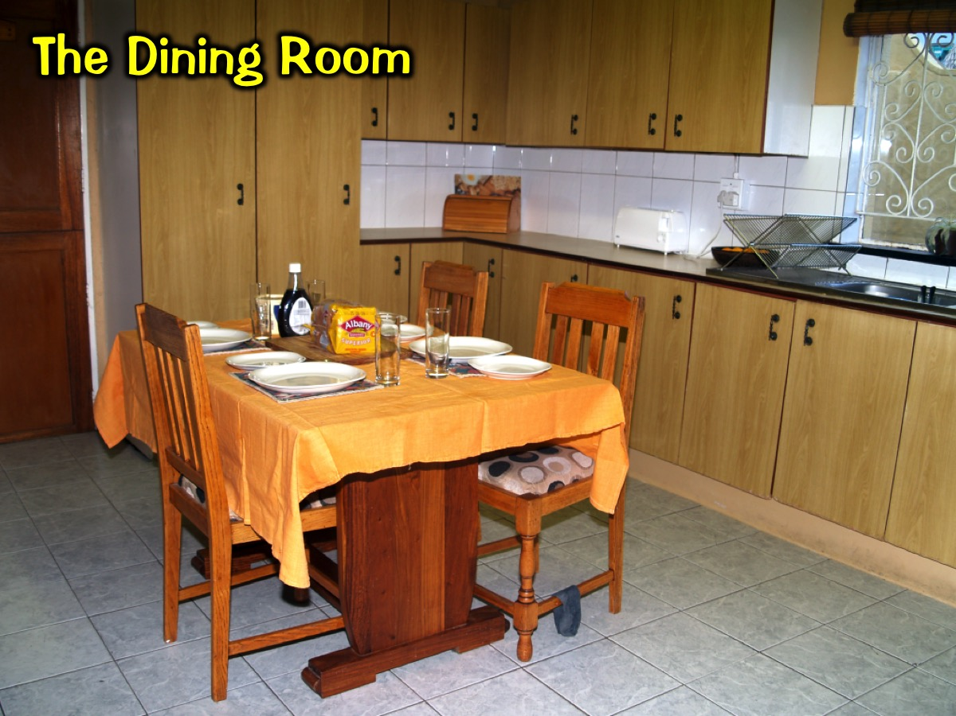
Notes:
In the Dinning Room: From the study we went into the dining room, the room of appetites and desires. Now this was a large room, a most important place to me. I spent a lot of time and hard work trying to satisfy all my wants. I told him, "This is my favorite room. I'm sure you will be pleased with what we serve here." He seated himself at the table and inquired, "What is on the menu for dinner tonight?" “Well," I said, "my favorite dishes: money, academic degrees, stocks, with newspaper articles of fame and fortune as side dishes." These were the things I liked. There was nothing so very bad in any of them, but it was not really the kind of food which would feed the soul and satisfy true spiritual hunger. When the plates were placed before my new friend, he said nothing. However, I observe that he did not eat. I asked, somewhat disturbed, "Savior, don't you like this food? What is the trouble?" He answered, "I have food to eat you do not know of. My food is to do the will of him that sent me." He looked at me again and said, "If you want food that really satisfies you, do the will of your heavenly Father. Put his pleasure before your own. Stop striving for your own desires, your own ambitions, your own satisfactions. Seek to please him. That food will really satisfy you. Try a bit of it!" And there at the table he gave me a taste of doing God's will. What flavor! There is no food like it in all the world. It alone satisfies. At the end everything else leaves you hungry. What's the menu in the dining room of your desires? What kind of food are you serving your divine companion and yourself? Do you focus on the lusts of the flesh, the lust of the eyes or the pride of life" (Jn 2:16)? Or is finding and doing God's will the meat and drink that satisfies your souls?

Slide 6
Notes:
Video: The Dining Room – Get Video From YouTube: http://www.youtube.com/watch?v=fZnhT-1LTFs

Slide 7
Notes:
In the Lounge: We moved next into the lounge. This was a quiet, comfortable room with a warm atmosphere. I liked it. It had a fireplace, sofa, overstuffed chairs, a bookcase and an intimate atmosphere. He also seemed pleased with it. He said, "Indeed, this is a great room. Let's come here often. It's secluded and quiet, and we can have good talks and fellowship together." Well, naturally, as a young Christian I was thrilled. I couldn't think of anything I would rather do than have a few minutes alone with Christ in close companionship. He promised, "I will be here every morning early. Meet me here and we will start the day together." So, morning after morning, I would go downstairs to the living room. He would take a book of the Bible from the bookcase, open it, and we would read it together. He would share with me the wonder of God's saving truth and make my heart sing as he shared all he had done for me and would be to me. Those times together were wonderful. Through the Bible and his Holy Spirit he would talk to me and I would respond in prayer. Our friendship deepened in these quiet times of personal conversation. However, under the pressure of many responsibilities, little by little, this time began to be shortened. I was just got too busy to give special, regular time to be with Jesus. Eventually not only was the period shortened, but I began to miss days now and then, such as during exams. Matters of urgency demanding my attention were continually crowding out the quiet times of conversation with Jesus. Often I would miss two days in a row or more. One morning, I remember rushing down the steps in a hurry to be on my way to an important appointment. As I passed the living room, the door was open. Glancing in I saw a fire in the fireplace and Jesus sitting there. Suddenly, in dismay, it came to me, "He is my guest. I invited him into my heart! He has come as my Savior and Friend to live with me. Yet here I am neglecting him." I stopped, turned and hesitantly went in. "Master, I'm sorry! Have you been here every morning?" “Yes," he said, "I told you I would be here to meet you." I was even more ashamed! He had been faithful in spite of my faithlessness. I asked him to forgive me and he did. He said, "The trouble is that you have been thinking of the quiet time, of Bible study and prayer, as a means for your own spiritual growth. This is true, but you have forgotten that this time means something to me also. Remember, I love you. At a great cost I have redeemed you. I value your fellowship. Just to have you look up into my face warms my heart." You know, the truth that Christ wants my fellowship, that he loves me, wants me to be with him and waits for me, has done more to transform my quiet time with God than any other single fact. Don't let Christ wait alone in the living room of your heart, but every day find a time and place when, with the Word of God and in prayer, you may be together with him.

Slide 8
Notes:
Video: The Lounge – Get Video from YouTube: http://www.youtube.com/watch?v=2u1ZrNgEZzg

Slide 9
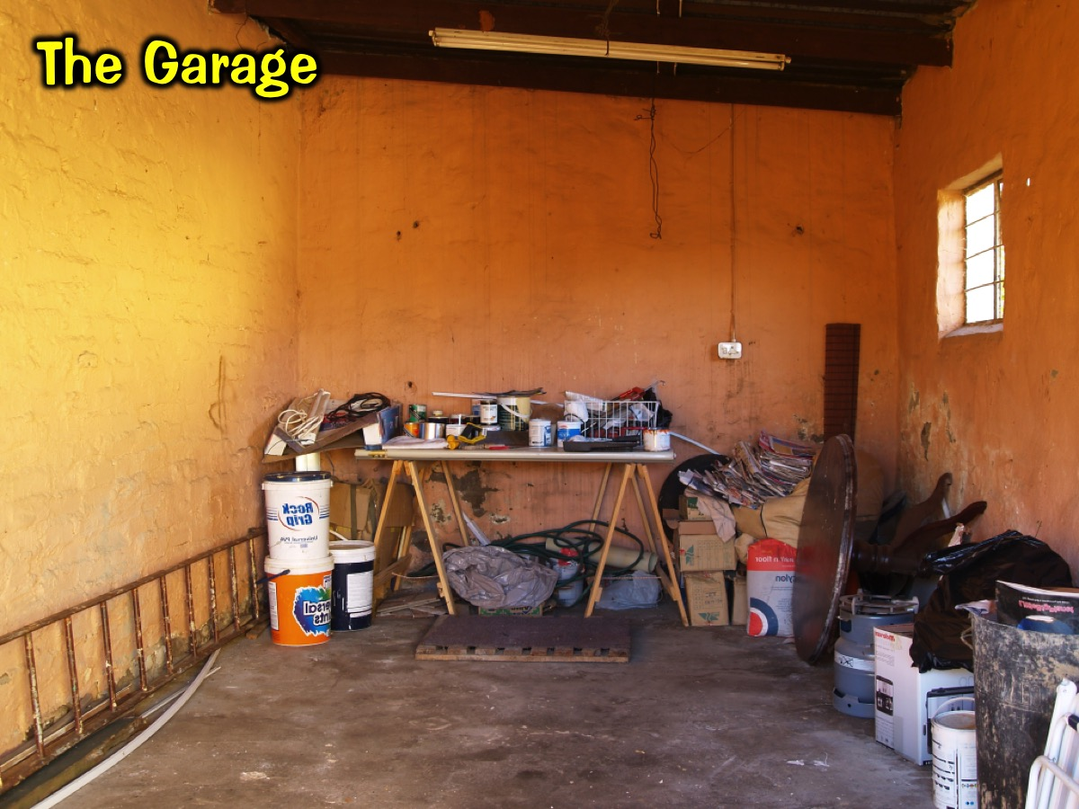
Notes:
In the Garage: Before long he asked, "Do you have a workroom in your house?" Out in the garage of the home of my heart I had a workbench and some equipment, but I would play around at making a few little gadgets, but I wasn't producing anything substantial. I took him out there. He looked over the workbench and the few talents and skills I had. He said, "What are you producing with your life for the kingdom of God?" He looked at one or two of the little toys that I had thrown together on the bench and he held one up to me. "Is this the sort of thing you are doing for others in your Christian life?" I felt terrible! "Lord, that's the best I can do. I know it isn't much. I'm ashamed to say that I don't think I'll ever do much more." “Would you like to do better?" he asked. “You know I would!" I replied. “Well, first remember what I taught you: 'Apart from me you can do nothing' (Jn 15:5). “Come relax in me and let my Spirit work through you. I know you are unskilled, clumsy and awkward, but the Spirit is the Master worker. If he controls your heart and your hands, he will work through you. Now turn around." Then putting his great strong arms around me, and his hands under mine he picked up the tools and began to work through me. "Relax. You are still too tense. Let go ‑ let me do the work!" It amazed me what his skilled hands can do through mine if I only trust him and let him have his way. I am very far from satisfied with the product that is being turned out. I still get in his way at times. There's much more that I need to learn. But I do know that whatever has been produced for God has been through him and through the power of his Spirit in me. Don't be discouraged because you cannot do much for God. It's not our ability but our availability that's important. Give what you are to Christ. Be sensitive and responsive to what he wants you to do. Trust him. He will surprise you with what he can do through you!

Slide 10
Notes:
Video: Garage – Get Video from YouTube: http://www.youtube.com/watch?v=Pj1wLBL_fWc

Slide 11
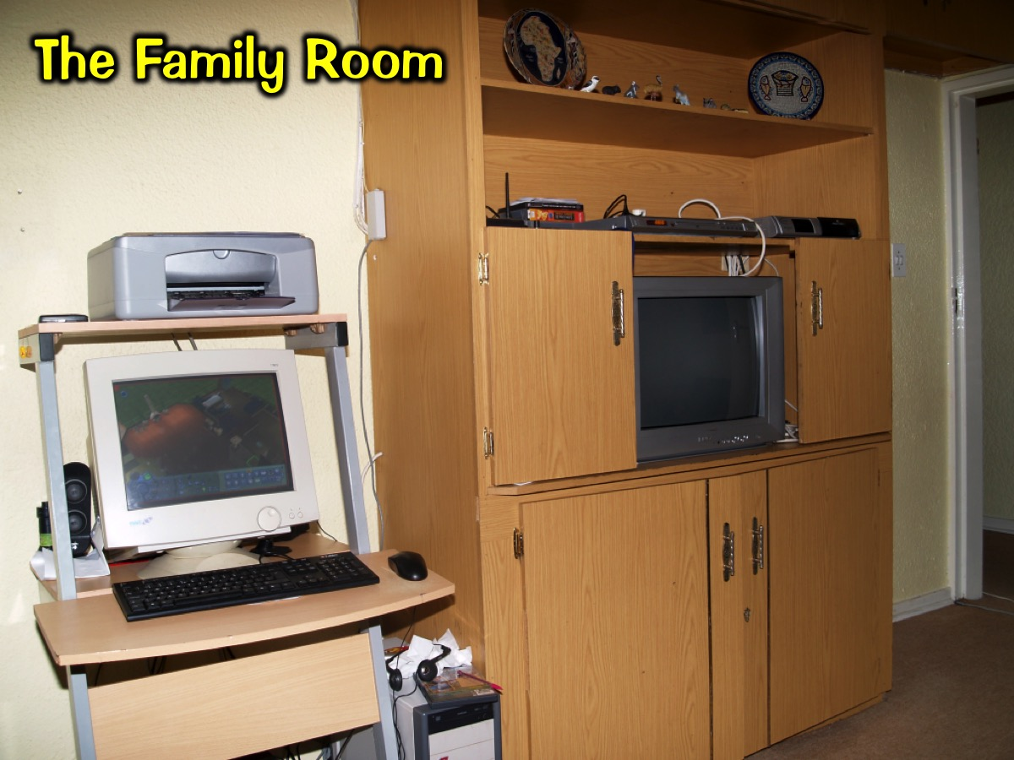
Notes:
In the Family Room: I remember the time he inquired about the family room, where I went for fun and fellowship. I was hoping he would not ask me about that. There were certain associations and activities I wanted to keep for myself. I did not think Jesus would enjoy or approve of them. I evaded the question. However, one evening when I was on my way out with some of my buddies for a night on the town, he was at the door and stopped me with a glance. "Are you going out?" I answered, "Yes." “Good," he said, "I would like to go with you." “Oh," I replied rather awkwardly. "I don't think, Lord, that you would really enjoy where we are going. Let's go out together tomorrow night. Tomorrow night we can go to a Bible class or a social at the church, but tonight I have another engagement." “As you wish," was his comment. "Only I thought when I came into your home we were going to do everything together‑‑be close companions! Just know that I am willing to go with you!" “Well," I said, "we'll go someplace together tomorrow night!" That evening I spent some miserable hours. I felt rotten! What kind of a friend was I to Jesus? Deliberately leaving him out of part of my life, doing things and going places that I know very well he would not enjoy? When I returned that evening, there was a light in his room and I went up to talk it over with him. I acknowledged, "Lord, I have learned my lesson. I know now I can't have a good time if you are not along. From now on we will do everything together!" Then we went down together in the family room of the house. He transformed it. He brought new friendships, new excitement, new joys. Laughter and music have been ringing in the house ever since. With a twinkle in his eye, he smiled, "You thought that with me around you wouldn't have much fun, didn't you? Remember, I have come 'that my joy may be in you, and that your joy may be full'" (Jn 15:11).

Slide 12
Notes:
Video: The Family Room – Get Video from YouTube: http://www.youtube.com/watch?v=Y_Me9Du9tRk

Slide 13
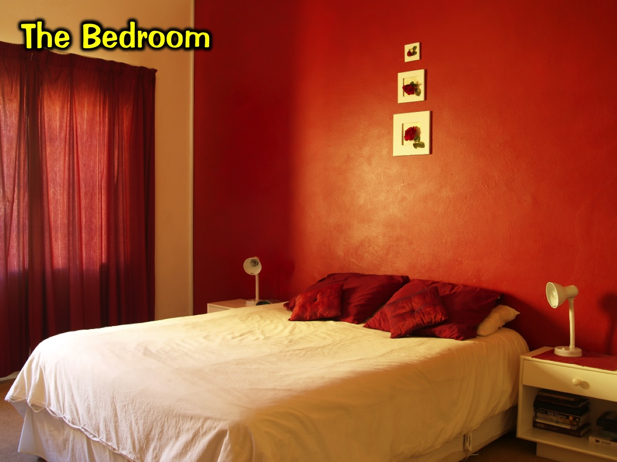
Notes:
In the Bedroom: One day when we were in my bedroom he asked me about the pictures next to my bed. “That's a picture of my girlfriend," I told him. Though I knew my relationship with my girlfriend was a good one, I felt funny talking to him about it. She and I were struggling with some issues and I didn't want to discuss them with him. I tried to change the subject. But Jesus must have known what I was thinking. "You are beginning to question my teaching on sex, aren't you? That intercourse is only for those who are joined in the covenant of marriage? You're feeling I may be asking something unnatural if not impossible for you. You're afraid my will on this will limit the full enjoyment of life and love. Isn't that true?" “Yes," I confessed. “Then listen carefully to what I am saying," he continued. "I forbid adultery and premarital sex not because sex is bad but because it is good. Beyond the physical ecstasy it is a means of bonding two lives in deepening love. It has the creative power to bring human life into being. Sex is powerful. Used properly sex has tremendous potential for good. Used improperly, it destroys the good. For this reason God intends it to be expressed only within the commitment of a loving life partnership. There is far more to love than just sex. “Let me help you in your relationship with the opposite sex. If you should fail and feel shame and guilt, know I still love you and will remain with you. Talk to me about it! Acknowledge the wrong! Take steps to avoid it happening again! Rely on my strength to keep you from falling and to lead you into a relationship of love in marriage where two truly become one in me."

Slide 14
Notes:
In the Passage Cupboard: One day I found him waiting for me at the front door. As I entered, he said to me, "There's a peculiar odor in the house. Something must be dead around here. I think it is in the passage cupboard." As soon as he said this I knew what he was talking about. Indeed there was a small cupboard in the passage, just a metre square. In that cupboard behind lock and key I had one or two personal things I did not want anybody to know about. Certainly I did not want Christ to see them. They were dead and rotting things left over from the old life ‑ not wicked, but not right and good to have in a Christian life. Yet I loved them. I wanted them so much for myself that I was really afraid to admit they were there. Reluctantly I went towards the cupboard with him and as we got closer the odor became stronger and stronger. He pointed at the door and said, "It's in there! Some dead thing!" It made me angry! That's the only way I can put it. I had given him access to the study, the dining room, the living room, the workroom, the family room, the bedroom and now he was asking me about a little cupboard. I said to myself, "This is too much! I am not going to give him the key." “Well," he responded, reading my thoughts, "if you think I am going to stay at your house with that up smell, you are mistaken. I will take my bed out on the back veranda or somewhere else. I'm certainly not going to stay around that." And I saw him start to walk out the house. When you have come to know and love Jesus Christ, one of the worst things that can happen is to sense him withdrawing his face and fellowship. I had to give in. "I'll give you the key," I said sadly, "but you'll have to open the cupboard and clean it out. I haven't the strength to do it." “I know," he said. "I know you haven't. Just give me the key. Just authorize me to handle that cupboard and I will." So, with trembling fingers, I passed the key over to him. He took it from my hand, walked over to the door, opened it, entered it, took out the putrefying stuff that was rotting there and threw it all away. Then he cleansed the cupboard, painted it and fixed it up all in a moment's time. Immediately a fresh, fragrant breeze swept through the house. The whole atmosphere changed. What release and victory to have that dead thing out of my life! No matter what sin or what pain there might be in my past, Jesus is ready to forgive, to heal and to make whole.

Slide 15
Notes:
Video: Passage Cupboard – Get Video from YouTube: http://www.youtube.com/watch?v=BMIDQHQVBRQ

Slide 16
Notes:
Transferring the Title Deed: Then a thought came to me. "I have been trying to keep this heart of mine clean and available for Christ but it is hard work. I start on one room and no sooner have I cleaned it than I discover another room is dirty. I begin on the second room and the first one is already dusty again. I'm getting tired trying to maintain a clean heart and obedient life. I just am not up to it!" Suddenly I asked, "Lord, is there a possibility you would be willing to manage the whole house and operate it for me just as you did that cupboard? Could I give you the responsibility of keeping my heart what it ought to be and myself doing what I ought to be doing?" I could see his face light up as he replied, "I'd love to! This is exactly what I came to do. You can't live out the Christian life in your own strength. That is impossible. Let me do it for you and through you. That's the only way it will really work! But I am not the owner of this house. Remember, I'm here as your guest. I have no authority to take charge since the property is not mine." In a flash it all became clear. Excitedly I said, "Lord, you have been my guest, and I have been trying to play the host. From now on you are going to be the owner and master of the house. I'm going to be the servant!" Running as fast as I could to the strongbox, I took out the title deed to the house describing its assets and liabilities, its condition, location and situation. Than rushing back to him, I eagerly signed it over giving title to him alone for time and eternity. Dropping to my knees, I presented it to him, "Here it is, all that I am and have forever. Now you run the house. Just let me stay with you as houseboy and friend." He took my life that day and I can give you my word, there is no better way to live the Christian life. He knows how to keep it and use it. A deep peace settled down on my soul that has remained. I am his and he is mine forever!

Slide 17
Notes:
May Christ settle down and be at home as Lord of your heart also.

Slide 18
Notes:
Activities and Resource Needed:
The Front Door
Print scriptures on cardboard and stick them on the front door:
"If a man loves me, he will keep my word, and my Father will love him, and we will come to him and make out home with him." (John 14:23).
"Behold, I stand at the door and knock; if any one hears my voice and opens the door, I will come in to eat with him, and he with me" (Revelation 3:20).
Props: Travel bag and toothbrush as objects to communicate that Jesus is moving in!
The Study
Dodgy magazines/books/pictures on the wall – of a sexual nature or hate speech
Bible and study books
The Dinning Room
Set the table and put out some “dishes”: money, academic degrees, stocks, newspaper articles of fame
Good food – the will of God – love, friendships, family, values
The Lounge
Fireplace
Sofas
A bookcase
Candle
Bible
The Garage
A workbench and some equipment, some things that have been made
Something that Jesus makes with me – spiritual gifts
The Family Room
Pictures of friends hanging out.
The Bedroom
Pictures next to the bed – girlfriend - sex
The Passage Cupboard
Odor in a cupboard – Chopped up onions in a container
Bucket and deodorant spray to get rid of the smell
A key to hand over to Jesus
Cleaning stuff for Jesus to use
Transferring the Title Deed
Title deed of a home
Broom and a mop
Pen to sign the title deed

