Slide 1
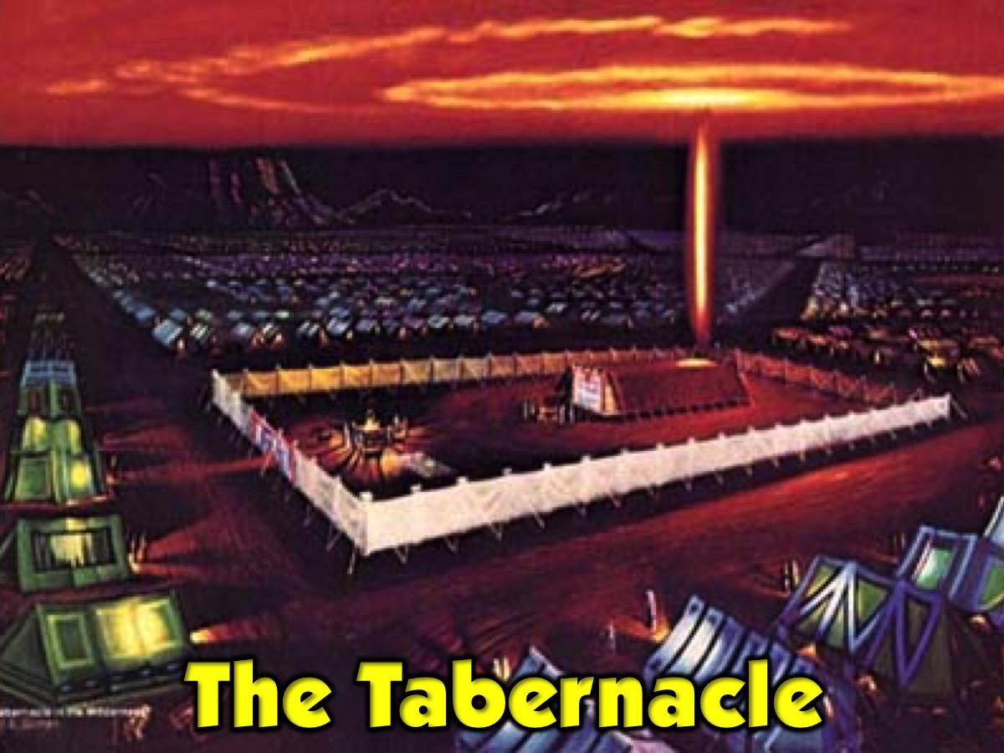

Slide 2
Notes:
Video: A 3D Walk through of the Tabernacle.

Slide 3
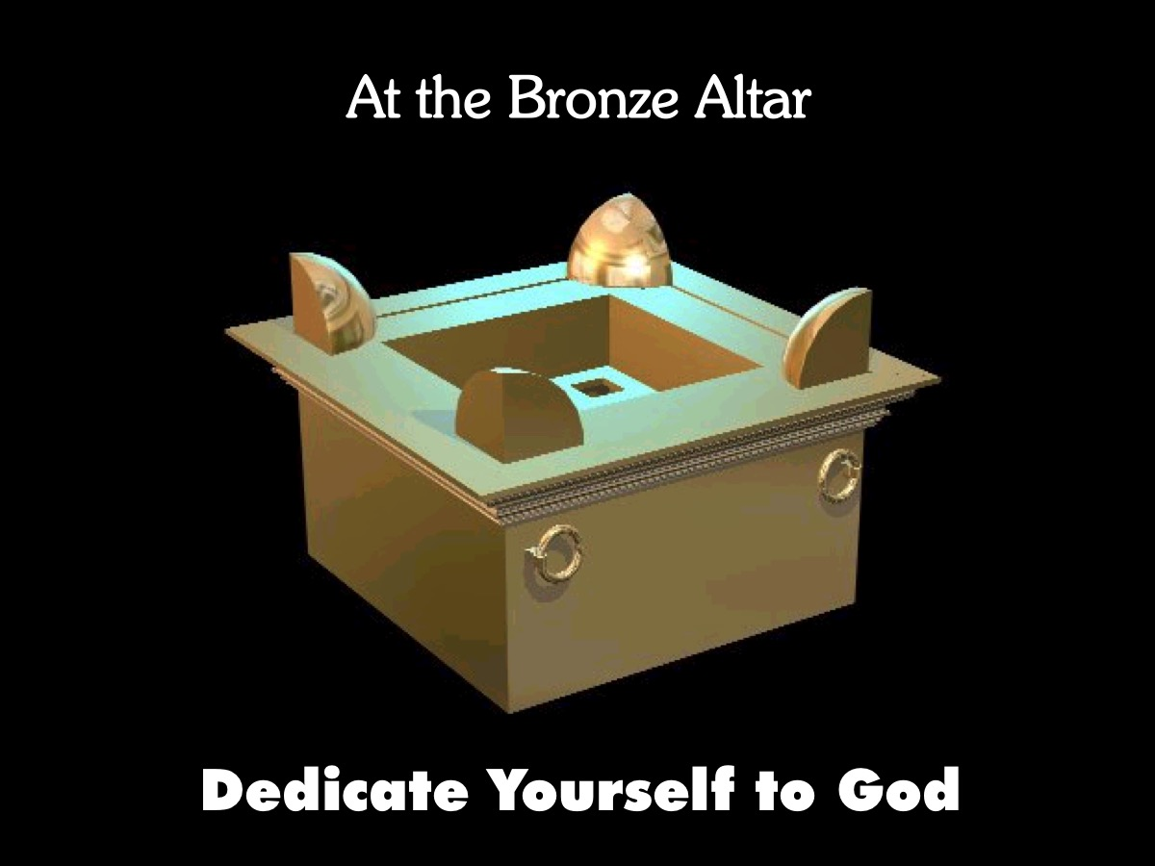

Slide 4
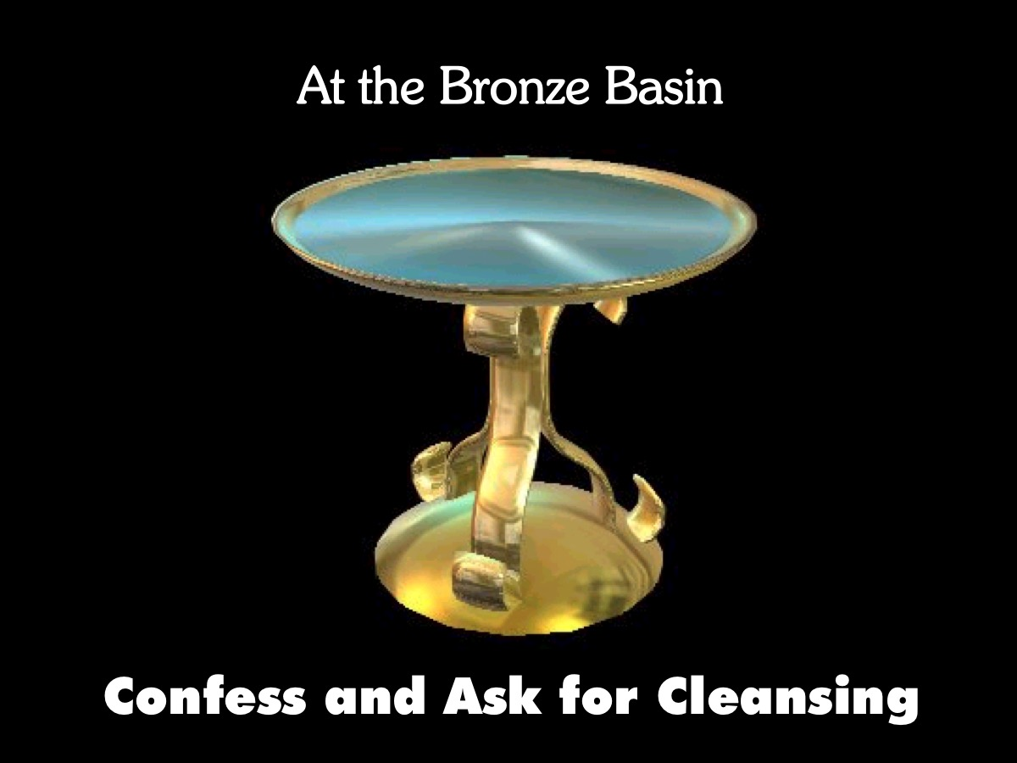

Slide 5
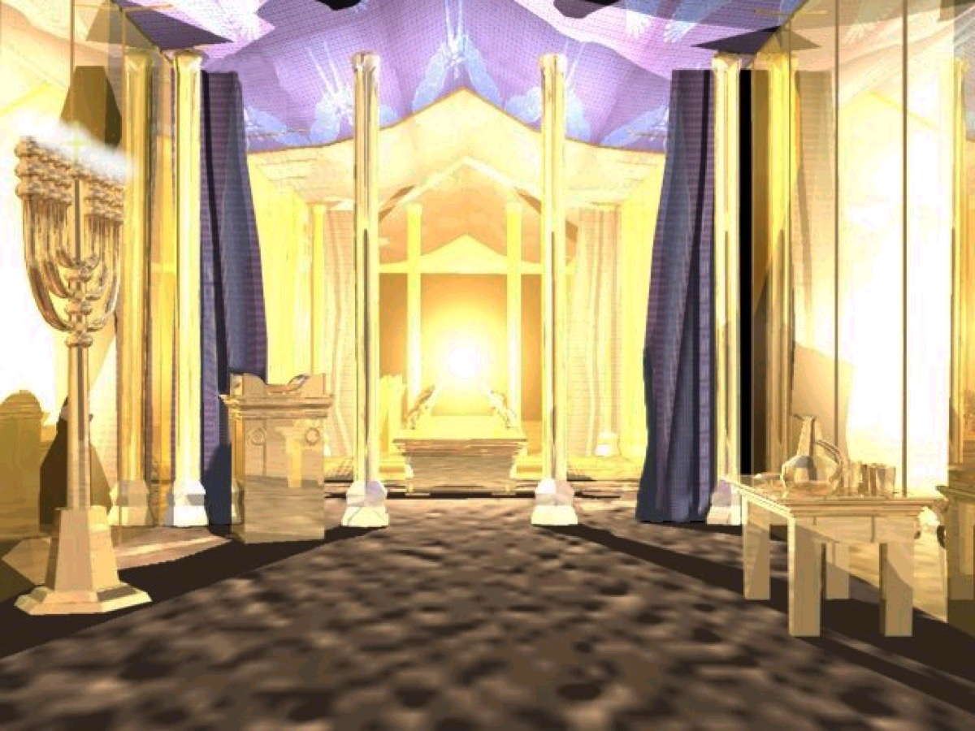

Slide 9
