Slide 1
Notes:
The Dangers of Running on Empty

Slide 2
Notes:
Anyone who has faith in me will do what I have been doing. He will do even greater things than these, because I am going to the Father. And I will do whatever you ask in my name, so that the Son may bring glory to the Father. You may ask me for anything in my name, and I will do it. (John 14:12-14)

Slide 3
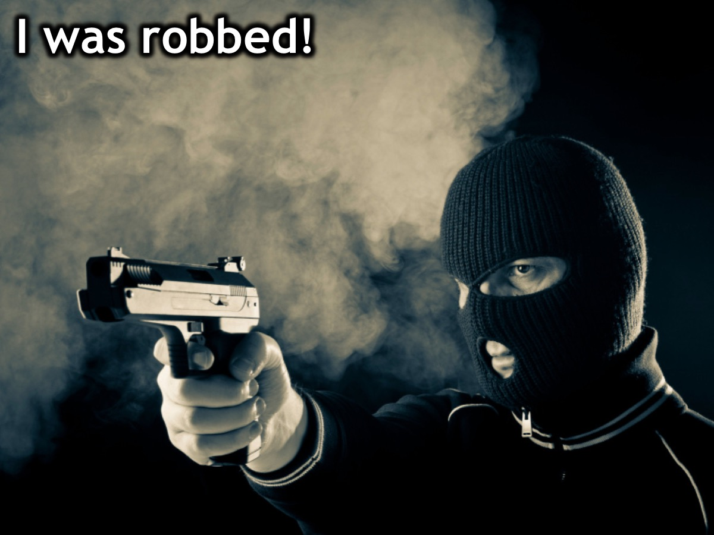
Notes:
I was Robbed: Growing up I was robbed of God’s power. I don’t recall seeing miracles – no blind person ever got their sight back, no lame person ever got up and walked, and God never shook the place in which we were meeting. Oh, we spoke much about God’s mighty acts in the Bible and preached often about them, but apart from the miracle of salvation I do not recall having a first-hand experience of the power of God! But wait I do recall being miraculously healed as a young boy of 7 years from an incurable disease so maybe the problem was not on God’s side!!! But no one spoke about it or expected it to happen again.

Slide 4
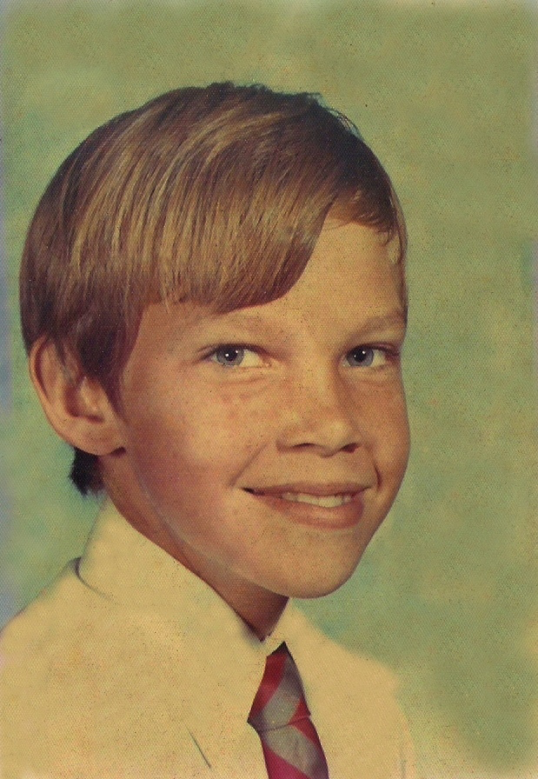
Notes:
When I was just 7 years of age, I got TB and was dying. The leader of our church movement flew down from Johannesburg to visit me in the hospital and he prayed for me and I was totally healed and discharged from hospital the next day. I suffered no consequences of the lung infection and have been fine ever since.

Slide 5
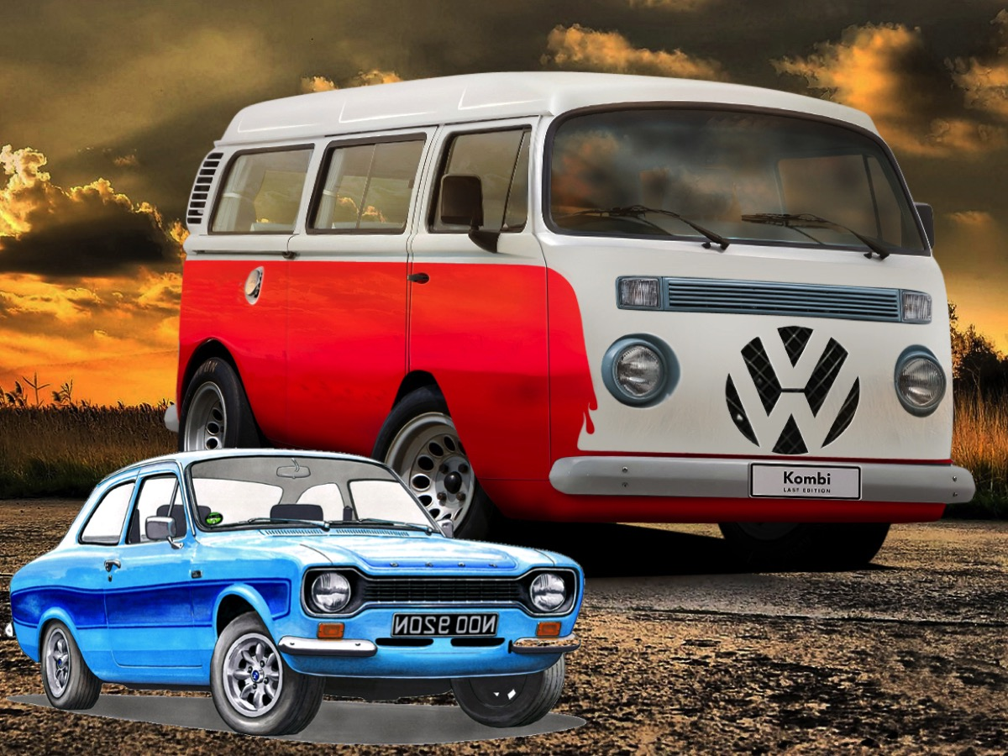
Notes:
One day in ministry I was hosting a ministry team and we were booked to take an assembly at a local high school in Durban. We met at our church and prayed that God would use the music and drama team and when we went to the mini-bus we found that someone had locked the keys in the van. We knew that the ministry leader would be furious if we broke the window to get into the van - but we had to do something because it was our only transport and all the equipment was in the van. So we said a prayer for God to help us in the impossible situation and I took the key from my Ford Escort and stuck it in the lock of the VW Mini-van and miraculously it opened the door first time and we headed off to the school for a powerful time of ministry. For the rest of that week I tried to replicate the miracle using that key but not once did it open the lock!

Slide 6
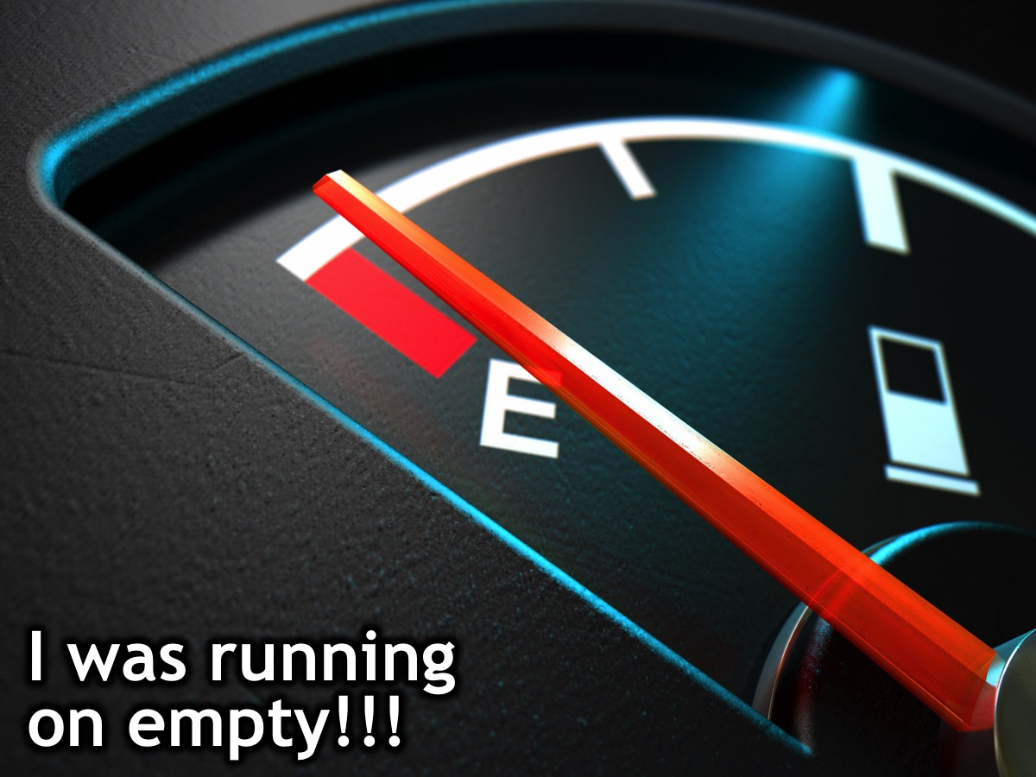
Notes:
It was like we were running on empty!

Slide 7
Notes:
We are supposed to be filled with God – with his presence and His power but we end up doing life and ministry in our own strength!

Slide 8
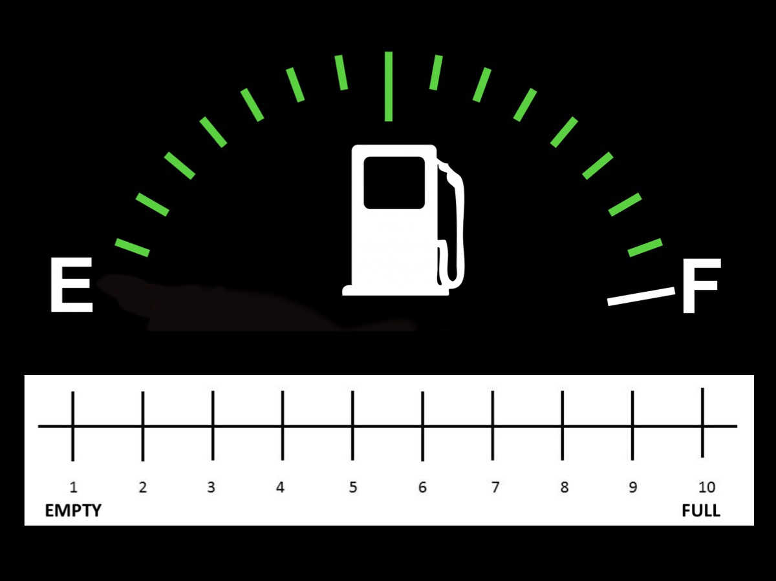
Notes:
Reflect and Share: Indicate where you find yourself living and ministering at the moment and share it with your neighbour:

Slide 9
Notes:
The Power of God

Slide 10
Notes:
1. Jesus and the Power of God

Slide 11
Notes:
Jesus announced the coming of God's reign and backed up his claim by doing wonders (Mark 1:21-2:12): (1) He drove out an unclean spirit. (2) He healed Peter's mother-in-law and others. (3) He cast out demons throughout Galilee. (4) He cleansed a leper and healed a paralytic.

Slide 12
Notes:
Jesus spent the night in prayer before choosing the apostles and then went on to heal all the people. “Power was coming from him and healing them all.” (Luke 6:12-19)

Slide 13
Notes:
God’s power was a key feature of Jesus as the Messiah. When John the Baptist wanted to know if Jesus was the promised one, Jesus answered: "Go back and report to John what you have seen and heard: The blind receive sight, the lame walk, those who have leprosy are cured, the deaf hear, the dead are raised, and the good news is preached to the poor." (Luke 7:22).

Slide 14
Notes:
The book of John says that Jesus did many more miracles than what were recorded. (John 20:30-31)

Slide 15
Notes:
2. The Disciples and the Power of God

Slide 16
Notes:
(1) Jesus gave his disciples authority to drive out demons, heal the sick, raise the dead and cleanse lepers. “He called his twelve disciples to him and gave them authority to drive out evil spirits and to heal every disease and sickness. Heal the sick, raise the dead, cleanse those who have leprosy, drive out demons.” (Matthew 10:1,7-8)

Slide 17
Notes:
(2) The disciple drove out demons and healed sick people. “They went out and preached that people should repent. They drove out many demons and anointed many sick people with oil and healed them.” (Mark 6:12-13)

Slide 18
Notes:
(3) The disciples healed the sick and the demons submitted to them. “After this the Lord appointed seventy-two others and sent them two by two ahead of him to every town and place where he was about to go. He told them, "The harvest is plentiful, but the workers are few. Ask the Lord of the harvest, therefore, to send out workers into his harvest field. Heal the sick who are there and tell them, 'The kingdom of God is near you.' The seventy-two returned with joy and said, "Lord, even the demons submit to us in your name.” (Luke 10:1-2,9,17)

Slide 19
Notes:
(4) Jesus commissioned his disciples drive out demons, speak in new tongues, pick up snakes unharmed, and to heal sick people. “Go into all the world and preach the good news to all creation. Whoever believes and is baptized will be saved, but whoever does not believe will be condemned. And these signs will accompany those who believe: In my name they will drive out demons; they will speak in new tongues; they will pick up snakes with their hands; and when they drink deadly poison, it will not hurt them at all; they will place their hands on sick people, and they will get well.” (Mark 16:15-18)

Slide 20
Notes:
Jesus said that his followers would: (1) Do greater things than he did (John 14:12). (2) Heal sick people (Mark 16:18). (3) Cast out demons (Luke 9:1-2). (4) Receive power to be witnesses (Acts 1:8).

Slide 21
Notes:
3. The Early Church and the Power of God - we are going to walk through the book of Acts to see some of the ways in which the Power of God worked in and through the local church.

Slide 22
Notes:
Acts 1:8: They would receive power to be witnesses.

Slide 23
Notes:
Acts 2:1-4: They were filled with the Holy Spirit and spoke in tongues as the Spirit enabled them.

Slide 24
Notes:
Acts 2:42-47 - The apostles did many wonders and miraculous signs.

Slide 25
Notes:
Acts 3:1-10 - Peter and John headed a man who had been crippled from birth.

Slide 26
Notes:
Acts 4:23-24,29-31 - God shook the place where they were meeting and they were filled with the Spirit spoke the Word of God boldly. These were the same group of people who were filled in Acts 2.

Slide 27
Notes:
Acts 5:1-5 - Peter knew that Ananias and Sapphira had lied and they saw God take the lives of both of them.

Slide 28
Notes:
Acts 5:12-16 - Peter’s shadow healed people and the sick and tormented were healed.

Slide 29
Notes:
Acts 6:8 - Stephen did great wonders and miraculous signs among the people.

Slide 30
Notes:
Acts 8:5-8 - Philip did miraculous signs, drove out evil spirits and healed people who were cripple.

Slide 31
Notes:
Acts 9:36-43 - Peter healed Tabitha.

Slide 32
Notes:
Acts 12:6-7 - Peter is freed from prison.

Slide 33
Notes:
Acts 14:1-4 - God proved their message was true by giving them power to do miracles.

Slide 34
Notes:
Acts 14:8-10 - Paul healed the lame man.

Slide 35
Notes:
Acts 16:16-18 - Paul cast an evil spirit out of a slave girl.

Slide 36
Notes:
Acts 19:11-12 - God did extraordinary miracles through Paul.

Slide 37
Notes:
Acts 20:9-12 - Paul raised Eutychus from the dead.

Slide 38
Notes:
Some other instances outside of the book of Acts:
1 Corinthians 2:4-5 - Paul’s preaching was followed by a demonstration of the Spirit’s power.

Slide 39
Notes:
1 Corinthians 2:4-5 - Paul’s preaching was followed by a demonstration of the Spirit’s power.

Slide 40
Notes:
James 5:14-18 - Elders are given power to pray for the sick and they recover.

Slide 41
Notes:
Summary: The church was born through a mighty demonstration of God’s power and continued to manifest the miraculous, which was an overflow of the power of the Holy Spirit in the lives of the disciples and other believers.

Slide 42
Notes:
4. Your Journey in the Power of God. Reflection: (1) How have you experienced God’s power in your life? (2) How do you want to experience God’s power in your life?

Slide 43
Notes:
5. My Journey in the Power of God: Here are some of the ways that I have experienced God’s power in recent years:

Slide 44
Notes:
(1) Healing the Sick: While doing Sonlife training in Malawi some years back God’s power healed a young boy name Paul of malaria when a friend and I climbed a mountain to pray for him after a long day of training. Since then I have seen God heal people as I have taken the time to actually pray for healing with the person rather than just committing to pray for them.

Slide 45
Notes:
(2) Raising the Dead: About 6 years back a young man stopped breathing during one of our youth services and after trying to get a doctor from the main sanctuary, I realised the only option left was to pray that God would raise him from the dead. As I prayed on the microphone for God to send his power and raise him to life, Neo lifted up his upper body and took a massive gulp of air. He spent a few days in hospital for some tests to be run but he is very much alive and was at church a few weeks back.

Slide 46
Notes:
(3) Driving out Demons: I have had two recent experiences where demons have manifested – one in our youth room where I prayed for a high schooler who was clearly manifesting and he was set free and now sings in the worship band at church. On another occasion I was attending a Victory Weekend and I had the privilege of praying for one of our car guards who was experiencing violent demon activity and he was delivered – that experience was a little scary but God’s power is always greater than the devils!

Slide 47
Notes:
(4) Praying for People: There have been countless time in youth or during our main services at church where I have had the privilege of praying for people to either be filled with the Holy Spirit, or to be set free from something that has them in bondage and there has been clear signs that God’s power has flowed through me - including a strange manifestation where my hand shakes as God’s power flow through me to the person.

Slide 48
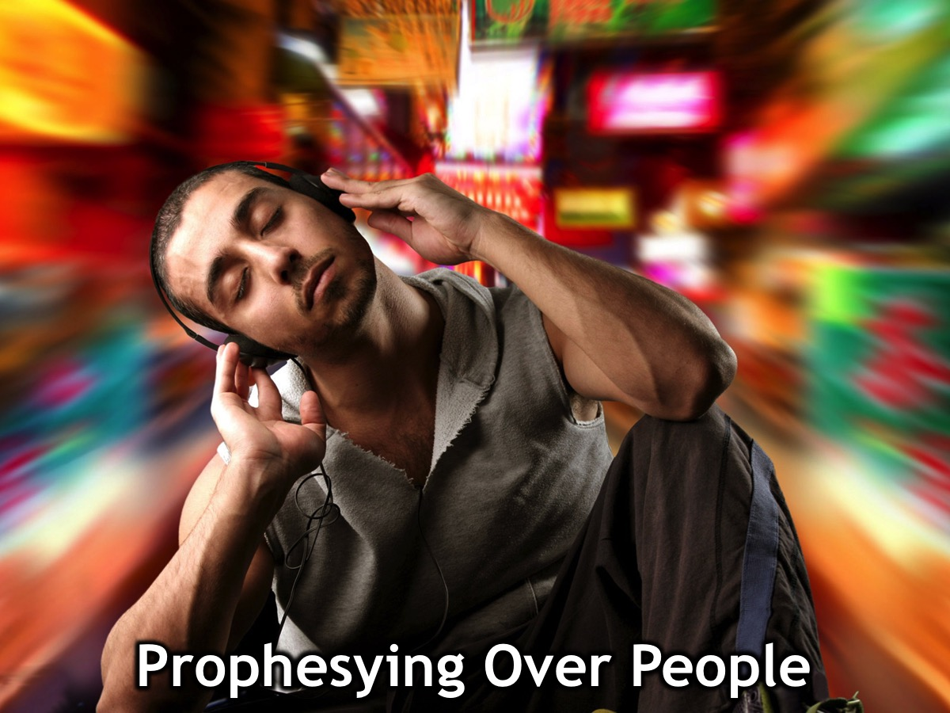
Notes:
(5) Prophesying Over People: On many occasions I have received words of knowledge for people or have shared personal prophecies for people. One example was speaking over our previous lead pastor where I saw a vision of a rod that he had taken up that was inscribed with two words (Integrity and Truth) and these words have clearly reflected his ministry over the past ten years. I have also been on the receiving end of numerous prophecies that has spoken accurately into my life and where God has subsequently led me.

Slide 49
Notes:
(6) Facilitating God Encounters: I have had the privilege of setting up on two occasions a unique experience of God’s power among youth in our ministry - something we called The Power Stations experiences - and have seen youth receive an infilling of power, power to witness, healing from a sickness, miracles for themselves or others, as well as deliverance from something that was keeping them in bondage.

Slide 50
Notes:
(7) Facilitating Victory Experiences: I have also had the privilege of leading one of the key interventions designed by our movement to help people gain victory in their lives. I have done it in the context of a youth camp, presented it over a weekend, presented it on four occasions over a 10 week Sunday morning journey and also got to lead it as a camp fro youth from Namibia and Botswana in Ghanz, Botswana in July 2017. On each occasions in these various formats the power of God was been clearly evidence as breakthrough is experienced by youth or adults.

Slide 51
Notes:
Guided Reflection: Leaving the Boat. As I read this story, I want you to place yourself in the story and hear what Jesus is saying to you: During the fourth watch of the night Jesus went out to them, walking on the lake. When the disciples saw him walking on the lake, they were terrified. "It's a ghost," they said, and cried out in fear. But Jesus immediately said to them: "Take courage! It is I. Don't be afraid." "Lord, if it's you," Peter replied, "tell me to come to you on the water." "Come," he said. Then Peter got down out of the boat, walked on the water and came toward Jesus. But when he saw the wind, he was afraid and, beginning to sink, cried out, "Lord, save me!" Immediately Jesus reached out his hand and caught him. "You of little faith," he said, "why did you doubt?" And when they climbed into the boat, the wind died down. Then those who were in the boat worshiped him, saying, "Truly you are the Son of God." (Matthew 14:25-33)

Slide 52
Notes:
Questions for Reflection: (1) How has Jesus challenged you in this session to step out of your boat – your comfort zone? (2) What do you think Jesus is calling you to do as he calls you to “walk on water”? (3) As you consider the risks of a life of faith, what do you believe Jesus will do for you?

Slide 53
Notes:
Video: The walking on water scene from The Shack.

Slide 54
Notes:
For this reason [grasping the greatness of this plan by which Jews and Gentiles are joined together in Christ] I bow my knees [in reverence] before the Father [of our Lord Jesus Christ], from whom every family in heaven and on earth derives its name [God--the first and ultimate Father]. May He grant you out of the riches of His glory, to be strengthened and spiritually energized with power through His Spirit in your inner self, [indwelling your innermost being and personality], so that Christ may dwell in your hearts through your faith. And may you, having been [deeply] rooted and [securely] grounded in love, be fully capable of comprehending with all the saints (God’s people) the width and length and height and depth of His love [fully experiencing that amazing, endless love]; and [that you may come] to know [practically, through personal experience] the love of Christ which far surpasses [mere] knowledge [without experience], that you may be filled up [throughout your being] to all the fullness of God [so that you may have the richest experience of God’s presence in your lives, completely filled and flooded with God Himself]. (Ephesians 3:14-19 AMP)

Slide 55
Notes:
What we should seek is that God pour his Spirit out upon us so completely that we are filled with joy, victorious over sin, and bold to witness. And the ways he brings us to that fullness are probably as varied as people are. It may come in a tumultuous experience of ecstasy and tongues. It may come through a tumultuous experience of ecstasy and no tongues. It may come through a crisis of suffering when you abandon yourself totally to God. Or it may come gradually through a steady diet of God's Word and prayer and fellowship and worship and service. However it comes, our first experience of the fullness of the Spirit is only the beginning of a life-long battle to stay filled with the Spirit. (John Piper)

Slide 56
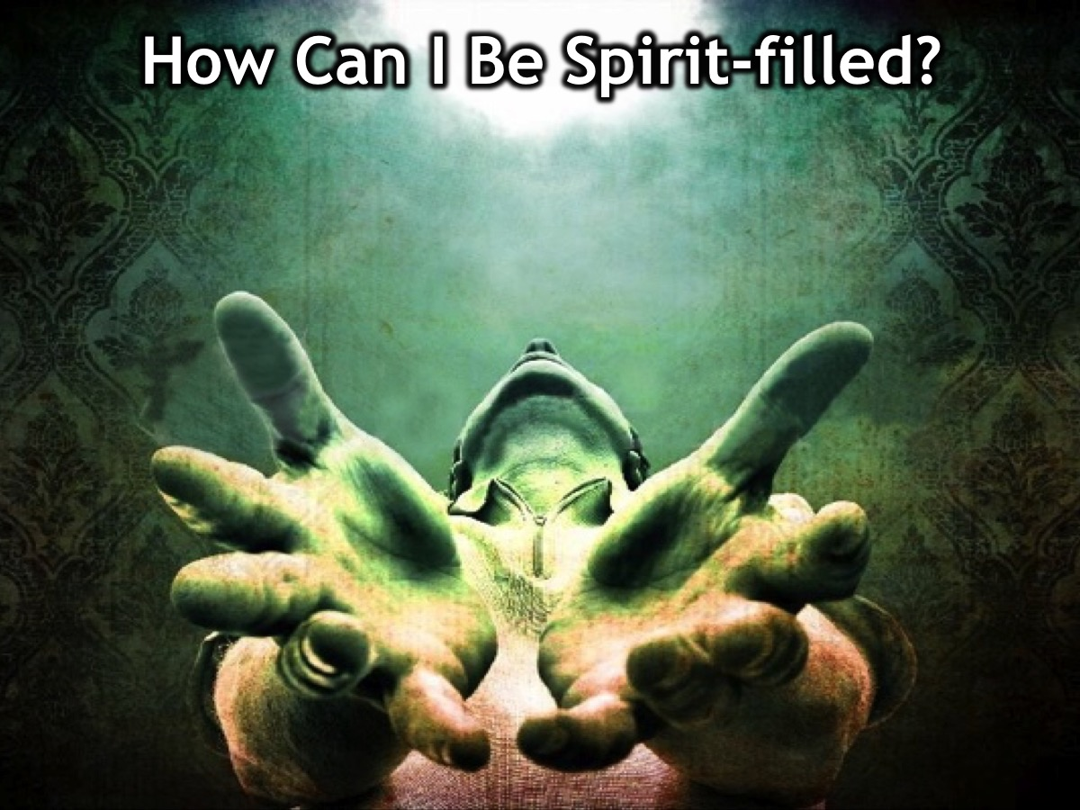
Notes:
So, how can we be Spirit-filled?

Slide 57
Notes:
John Piper says there are 2 ways: (1) Use God’s Means and (2) Ask God to Fill You.

Slide 58
Notes:
There are a number of means that God uses to fill us - here are three important ones:
1. Drink the Word: Get into the Word every day and you will be topped up.

Slide 59
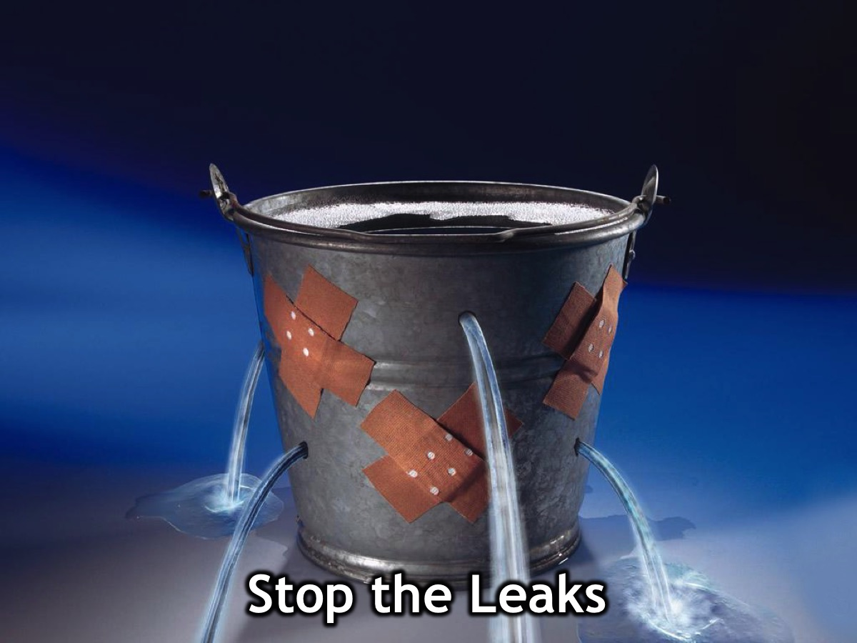
Notes:
2. Stop the Leaks. Avoid temptation, walk in the light and confess sin quickly! Sin makes us leak and we will soon become empty if we don’t stop the leaks.

Slide 60
Notes:
3. Receive from Others: Hang around refreshing people so they can keep you filled!

Slide 61
Notes:
Let’s ask God to fill us with his Holy Spirit. If you are feeling empty or if it has been a while since you asked God to fill you, then come forward and our leaders from various churches will pray for you.

Slide 62
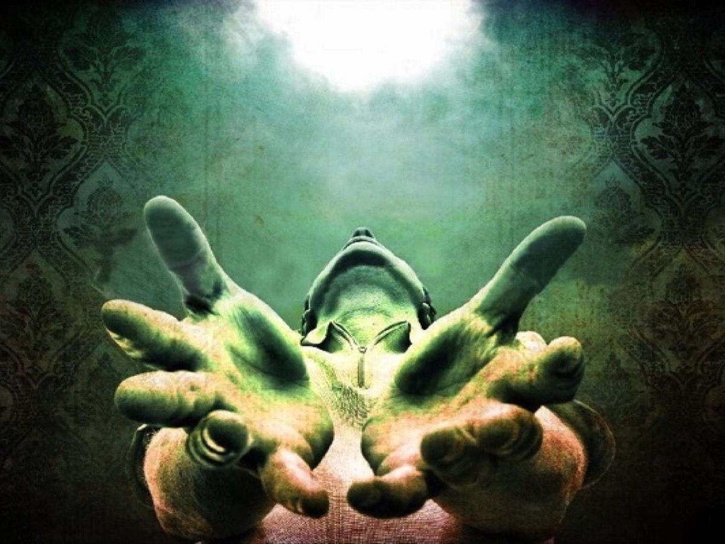
Notes:
Prayer

Slide 63
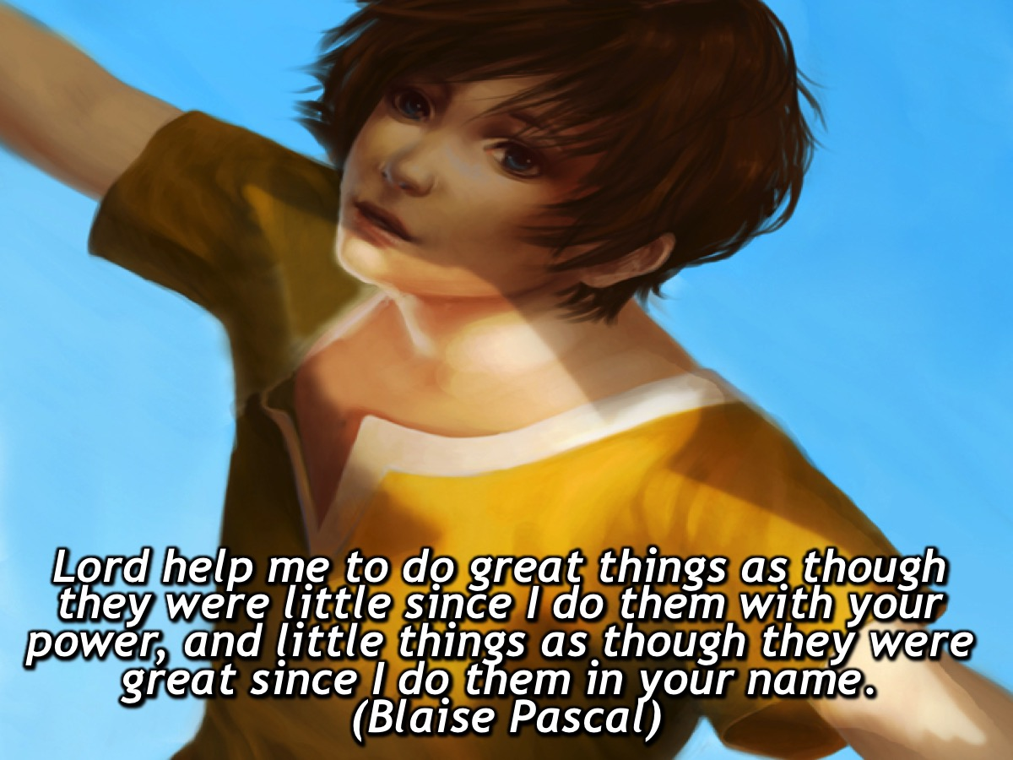
Notes:
Lord help me to do great things as though they were little since I do them with your power, and little things as though they were great since I do them in your name. (Blaise Pascal)

