Slide 1
Notes:
Leading a Spirit-filled Ministry: In our last session we looked at the New Testament to explore how God wants us to live filled with his Spirit and to experience His power in our lives. In this session we will explore how to lead a Spirit-filled ministry.

Slide 2
Notes:
Many of us who are here today from Every Nation Rosebank had an amazing experience on a mission we ran to Botswana in the July school holidays.

Slide 3
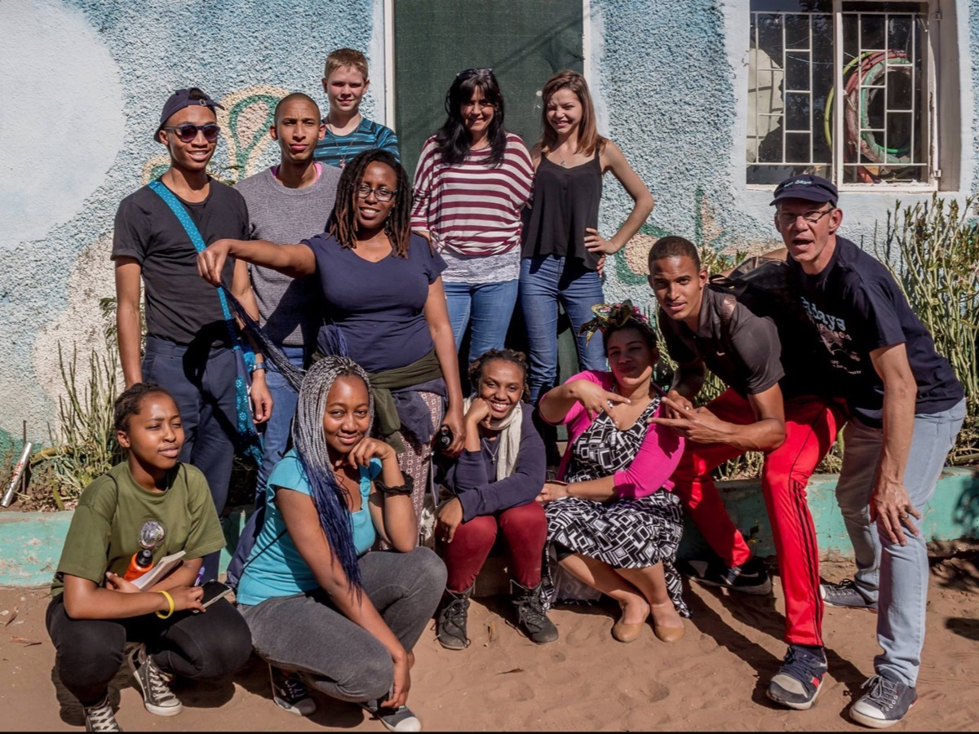
Notes:
Here is a pic that was taken at the church were we were based.

Slide 4
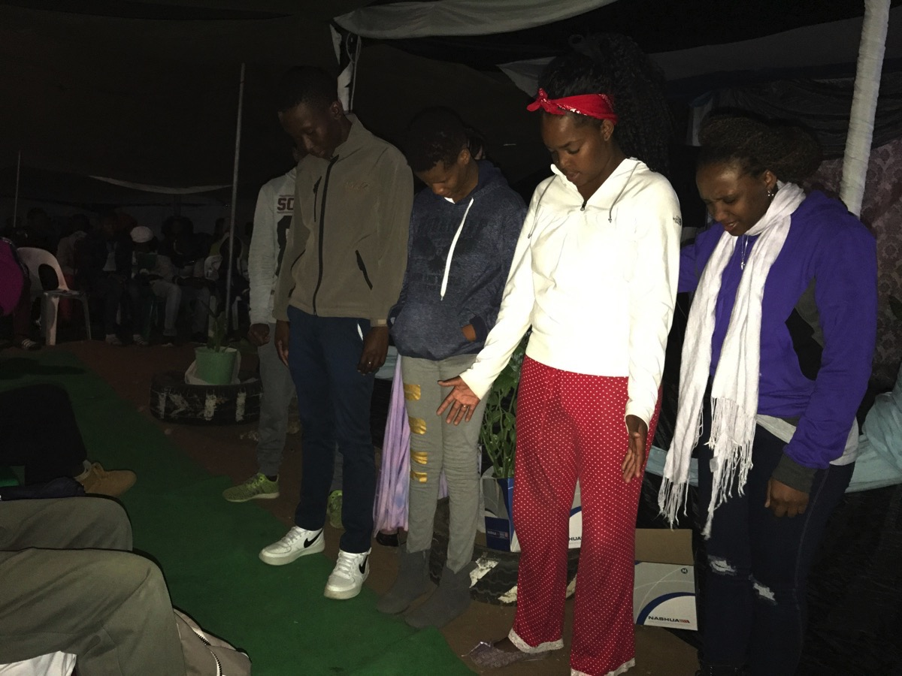
Notes:
We saw people get saved…

Slide 5
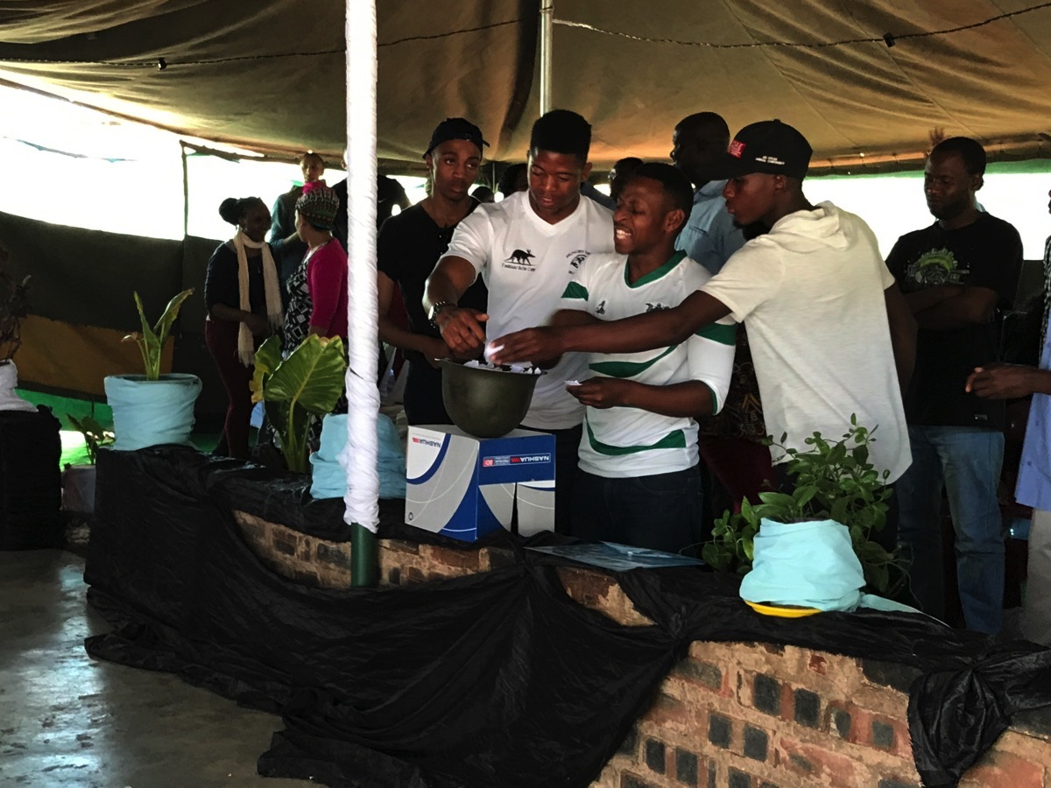
Notes:
People were delivered from issues that had kept them in bondage

Slide 6
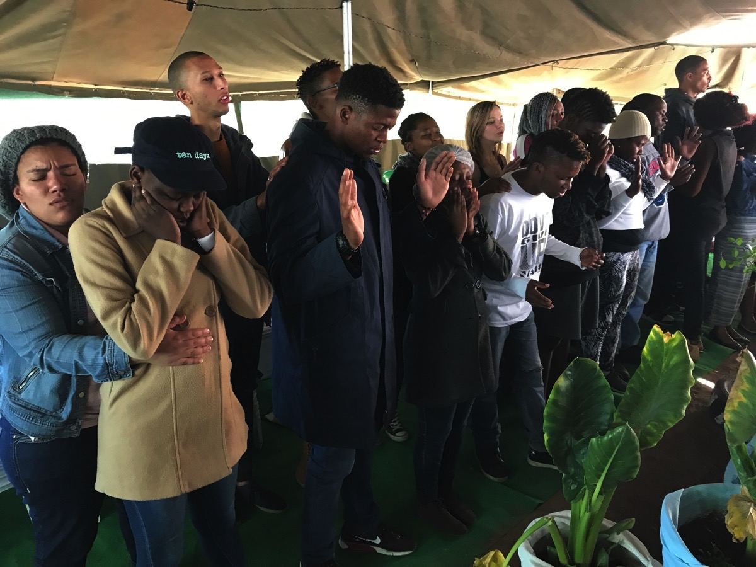
Notes:
And many were filled with the Holy Spirit.

Slide 7
Notes:
But one of the highlights of our team was our 28 day journey through the book of Acts that we started on the 1st of July and ended on the 28th of July (a week after we returned from Botswana). We used a devotion based on the book of Acts written by Terran Williams from Common Ground in Cape Town.

Slide 8
Notes:
1. The Power of God and the Gospel: In the book of Acts we discover a close connection between the power of God and the spread of the Gospel:

Slide 9
Notes:
1. The SIGNS, Gift of Tongues and Preaching at Pentecost (Acts 2): When they heard this sound, a crowd came together in bewilderment, because each one heard them speaking in his own language. (6) Those who accepted his message were baptized, and about three thousand were added to their number that day. (41)

Slide 10
Notes:
2. The HEALING of the Lame Man (Acts 3 and 4): When all the people saw him walking and praising God, they recognized him as the same man who used to sit begging at the temple gate called Beautiful, and they were filled with wonder and amazement at what had happened to him. (3:9-10) But many who heard the message believed, and the number of men grew to about five thousand. (4:4)

Slide 11
Notes:
3. The DEATH of Ananias and Other Miracles (Acts 5): When Ananias heard this, he fell down and died. And great fear seized all who heard what had happened. (5) The apostles performed many miraculous signs and wonders among the people. (12) More and more men and women believed in the Lord and were added to their number. (14-15).

Slide 12
Notes:
4. The MIRACULOUS Signs Performed by Philip (Acts 8): Philip went down to a city in Samaria and proclaimed the Christ there. When the crowds heard Philip and saw the miraculous signs he did, they all paid close attention to what he said. With shrieks, evil spirits came out of many, and many paralytics and cripples were healed. So there was great joy in that city. (5-8)

Slide 13
Notes:
5. The HEALING of the Paralytic Man (Acts 9): There he found a man named Aeneas, a paralytic who had been bedridden for eight years. "Aeneas," Peter said to him, "Jesus Christ heals you. Get up and take care of your mat." Immediately Aeneas got up. All those who lived in Lydda and Sharon saw him and turned to the Lord. (33-35)

Slide 14
Notes:
6. The RAISING of Tabitha From the Dead (Acts 9): Peter sent them all out of the room; then he got down on his knees and prayed. Turning toward the dead woman, he said, "Tabitha, get up." She opened her eyes, and seeing Peter she sat up. He took her by the hand and helped her to her feet. Then he called the believers and the widows and presented her to them alive. This became known all over Joppa, and many people believed in the Lord. (40-43)

Slide 15
Notes:
7. The BLINDING of the Sorcerer (Acts 13): Then Saul, who was also called Paul, filled with the Holy Spirit, looked straight at Elymas and said, "You are a child of the devil and an enemy of everything that is right! You are full of all kinds of deceit and trickery. Will you never stop perverting the right ways of the Lord? Now the hand of the Lord is against you. You are going to be blind, and for a time you will be unable to see the light of the sun." Immediately mist and darkness came over him, and he groped about, seeking someone to lead him by the hand. When the proconsul saw what had happened, he believed, for he was amazed at the teaching about the Lord. (9-12)

Slide 16
Notes:
8. The Preaching with Signs and WONDERS (Acts 14): At Iconium Paul and Barnabas went as usual into the Jewish synagogue. There they spoke so effectively that a great number of Jews and Gentiles believed. But the Jews who refused to believe stirred up the Gentiles and poisoned their minds against the brothers. So Paul and Barnabas spent considerable time there, speaking boldly for the Lord, who confirmed the message of his grace by enabling them to do miraculous signs and wonders. (1-4)

Slide 17
Notes:
2. How to Personally Minister in God’s Power

Slide 18
Notes:
1. Believe that Jesus has commissioned you and given you power to minister.

Slide 19
Notes:
2. Step out in faith and trust that God will work through you in power.

Slide 20
Notes:
3. Overcome the fear that God won’t show up and you will look foolish – do your part and God will do his.

Slide 21
Notes:
4. Prepare to operate in power: fast, pray, and learn to discern what God is doing in the situation.

Slide 22
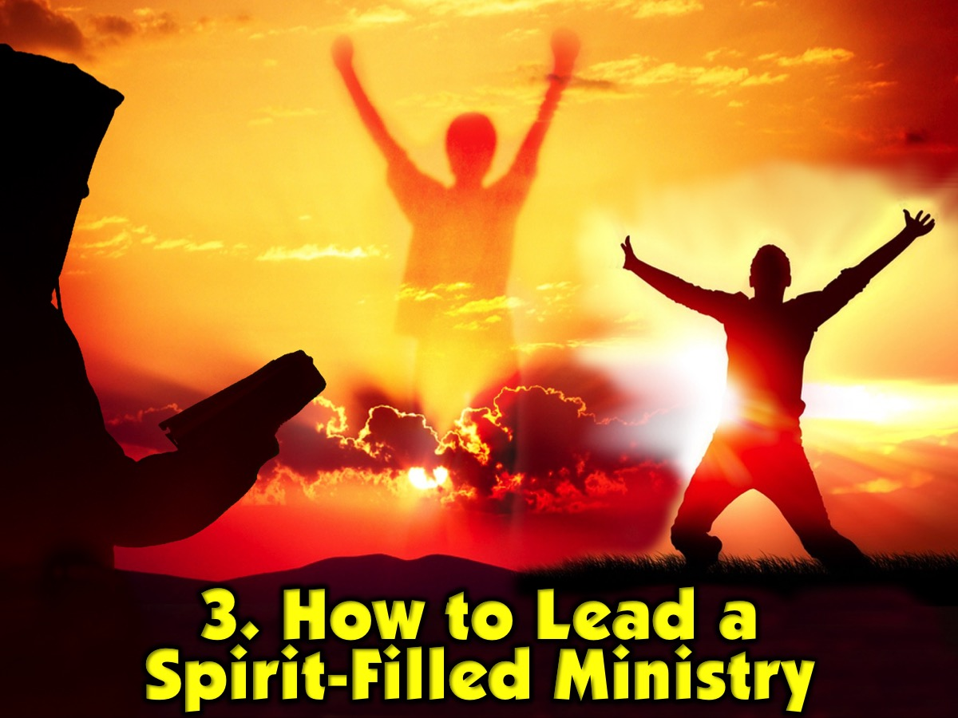
Notes:
3. How to Lead a Spirit-Filled Ministry

Slide 23
Notes:
(1) Expect God to Move in Power. Create an environment of expectation that God will move.

Slide 24
Notes:
(2) Ask God to Move in Power. Pray before, during and at the end of your meetings.

Slide 25
Notes:
(3) Allow God to Move in Power. Create space for miracles and ministry to happen in your events.

Slide 26
Notes:
(4) Teach about the Person of the Holy Spirit. Preach about the person and work of the Spirit.

Slide 27
Notes:
(5) Teach about the Fruit of the Holy Spirit. Define and describe the Fruit from Galatians 5:22-23.

Slide 28
Notes:
(6) Operate in the Gifts of the Holy Spirit. Explore the following Scripture that list the gifts: Romans 12:6-8, 1 Corinthians 12:8-10; 28-30; Romans 12:3-8; Ephesians 4:11-16 and 1 Peter 4:9.

Slide 29
Notes:
(7) Pray for the Move of the Holy Spirit: Filling, Healing, Deliverance, Miracles, etc.

Slide 30
Notes:
Group Sharing: (1) In what ways is your ministry experiencing the power of God? (2) How is God calling your ministry to experience a greater expression of His power? (3) How are we creating space for God to move in power?

Slide 31
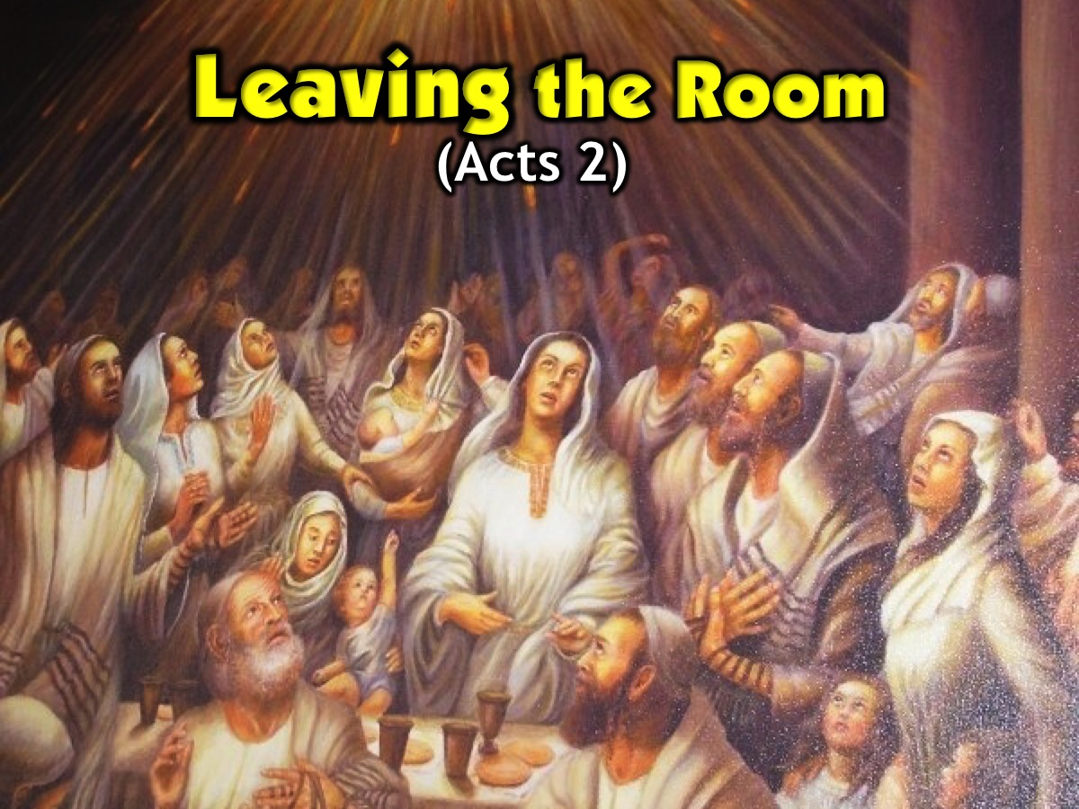
Notes:
Guided Reflection: Leaving the Room
As I read this passage, I want you to hear what Jesus is saying to you about your ministry.
When the day of Pentecost came, they were all together in one place. Suddenly a sound like the blowing of a violent wind came from heaven and filled the whole house where they were sitting. They saw what seemed to be tongues of fire that separated and came to rest on each of them. All of them were filled with the Holy Spirit and began to speak in other tongues as the Spirit enabled them. Now there were staying in Jerusalem God-fearing Jews from every nation under heaven. When they heard this sound, a crowd came together in bewilderment, because each one heard them speaking in his own language. Then Peter stood up with the Eleven, raised his voice and addressed the crowd: "Fellow Jews and all of you who live in Jerusalem, let me explain this to you; listen carefully to what I say. These men are not drunk, as you suppose. It's only nine in the morning! No, this is what was spoken by the prophet Joel… “In the last days, God says, I will pour out my Spirit on all people…and everyone who calls on the name of the Lord will be saved.”…When the people heard this, they were cut to the heart and said to Peter and the other apostles, ‘Brothers, what shall we do?’ Peter replied, ‘Repent and be baptised, every one of you, in the name of Jesus Christ for the forgiveness of your sins. And you will receive the gift of the Holy Spirit. The promise is for you and your children and for all who are far off – for all whom the Lord our God will call.’ With many other words he warned them; and he pleaded with them, ‘Save yourselves from this corrupt generation.’ Those who accepted his message were baptised, and about three thousand were added to their number that day. (Selected verses from Acts 2)
The death of Jesus was a terrible experience for you and the rest of the disciples but Jesus had risen from the dead and even appeared to you personally. When he ascended he promised to send his Holy Spirit to empower you to be his witnesses. And it finally happened! You have been filled with power right in that upper room where you have been hiding out for 40 days. You recall that Jesus said that you would be his witness when the Holy Spirit had come on you – now is the time! Would you stay in that upper room or would you leave the comfort of the room and move onto the streets to be a witness for Jesus?

Slide 32
Notes:
Reflecting on our Ministries: (1) What does leaving the room mean for our ministry? (2) What dangers may we face as we leave the room? (3) What will happen when people see God’s power?

Slide 33
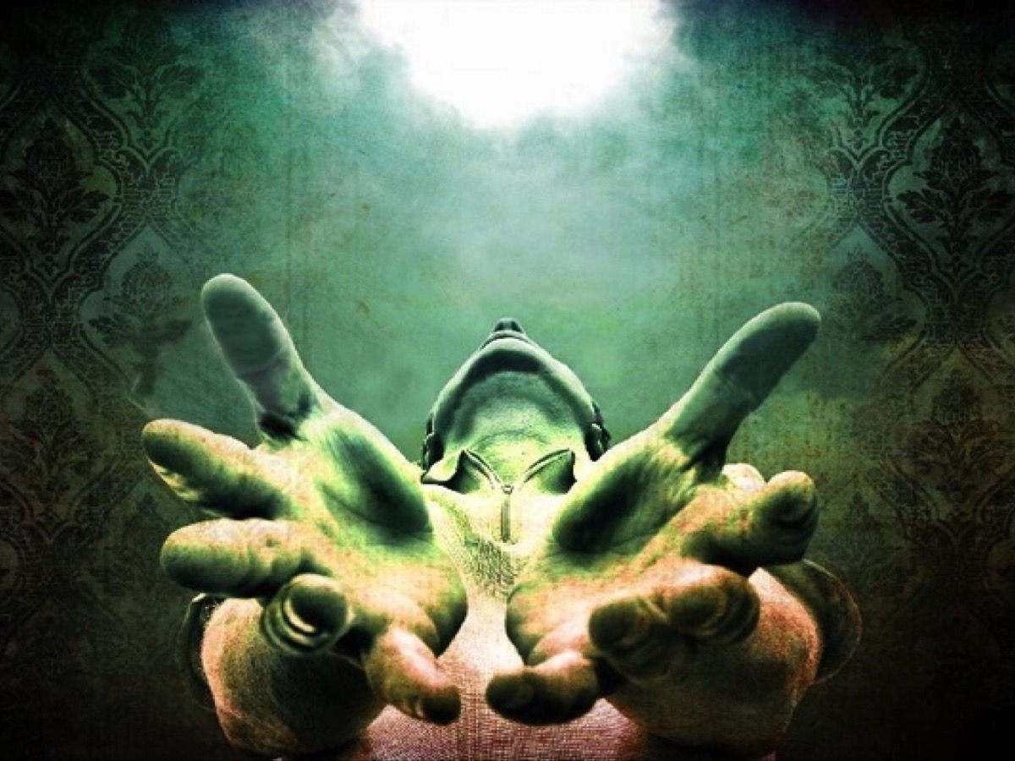
Notes:
Prayer

Slide 34
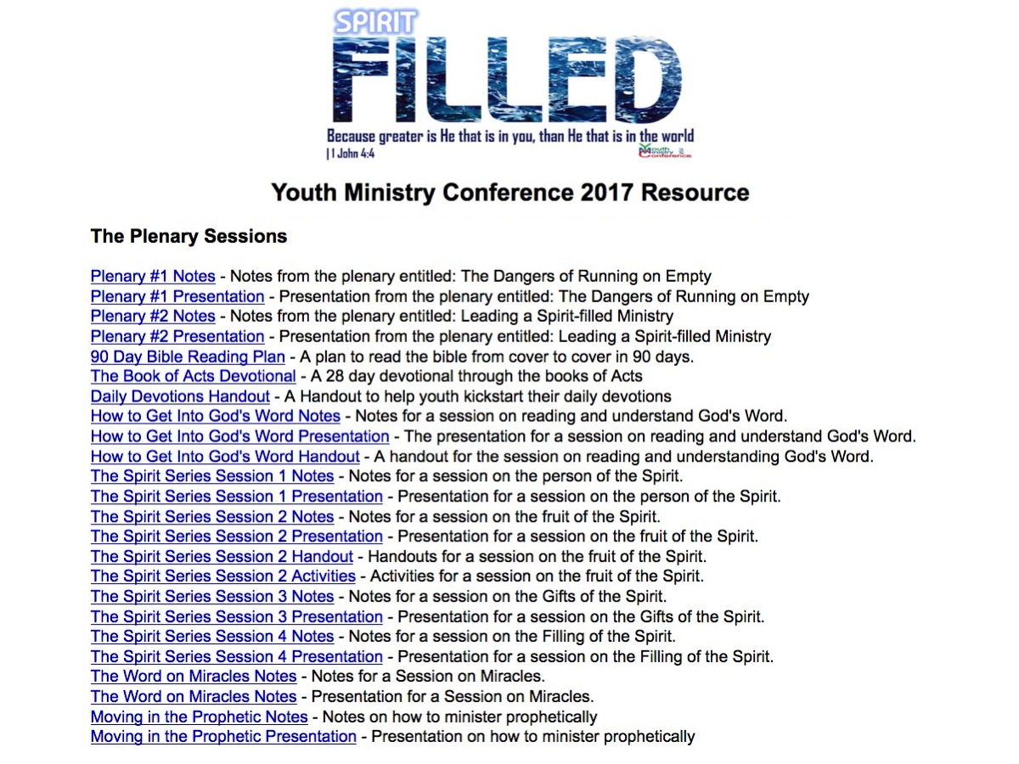
Notes:
Check out the web page created to provide you with resources linked to the plenary and workshop sessions presented by Mark Tittley at the Youth Ministers Conference in 2017: bit.ly/YMC2017

