Slide 1
Notes:
This session is about Practising the Presence of God. I believe that the unifying theme of the Bible is The Presence of God. It is at least one of the themes – or maybe even one of the most important.

Slide 2
Notes:
So what does the Bible have to say about God’s Presence?

Slide 3
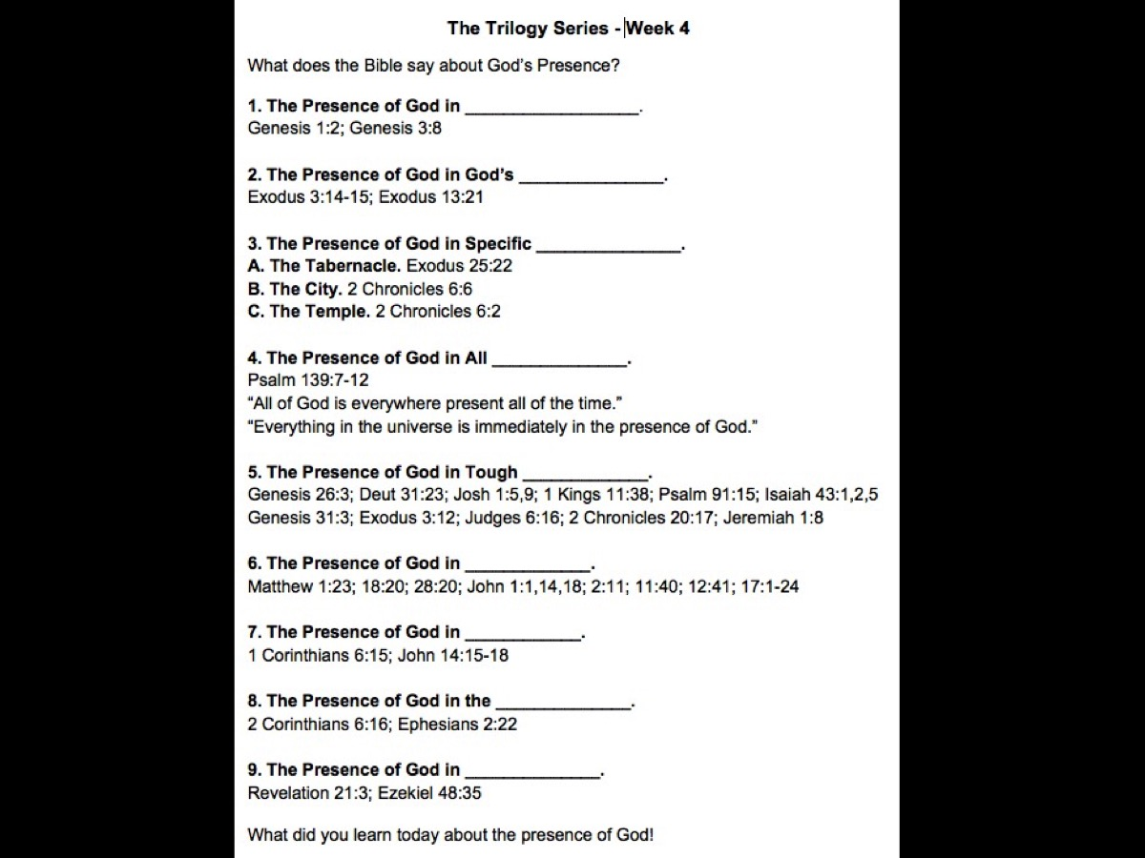
Notes:
We are going to give each of you a pen and a handout so you can keep track of all that the Bible says about God's Presence.

Slide 4
Notes:
1. The Presence of God in Creation. We are going to start in the book of Genesis and make our way to the the book of Revelation at the end of the book! We read in Genesis 1:2 that “The Spirit of God was hovering over the waters”. So right at the very beginning – before the world was made - there is God and in the person of His Spirit He is hovering over the water – We get the sense from the original words that he is brooding over the waters and is about to bring forth something really special.

Slide 5
Notes:
Shortly after the 7 days of Creation (where God made the world and Adam and Eve) we read in Genesis 3:8 that “God walked in the garden with Adam and Eve.” It seems like this was Gods normal practise to walk up to them in the afternoon and have a conversation with them.

Slide 6
Notes:
2. The Presence of God in God’s Name. A few years later God appears to Moses because his people are crying out for his help as they are slaves in Egypt and God tells Moses what his name is: God said to Moses, “I am who I am. This is what you are to say to the Israelites: ‘I am has sent me to you.’” God also said to Moses, “Say to the Israelites, ‘The Lord, the God of your fathers—the God of Abraham, the God of Isaac and the God of Jacob—has sent me to you.’ “This is my name forever, the name you shall call me from generation to generation.” (Ex 3:14-15). God introduces himself as Yahweh – a word that has at it’s root a Hebrew verb haya which means “to be” – it is the word for existence or being. This is the God who exists, the God who is – He is present! He is the God who has always existed – will always exists – and exists now among us! So Moses is afraid to speak to Pharaoh to get God’s people released from slavery but God tells him to remember his name which will help Moses remember that God is with him!

Slide 7
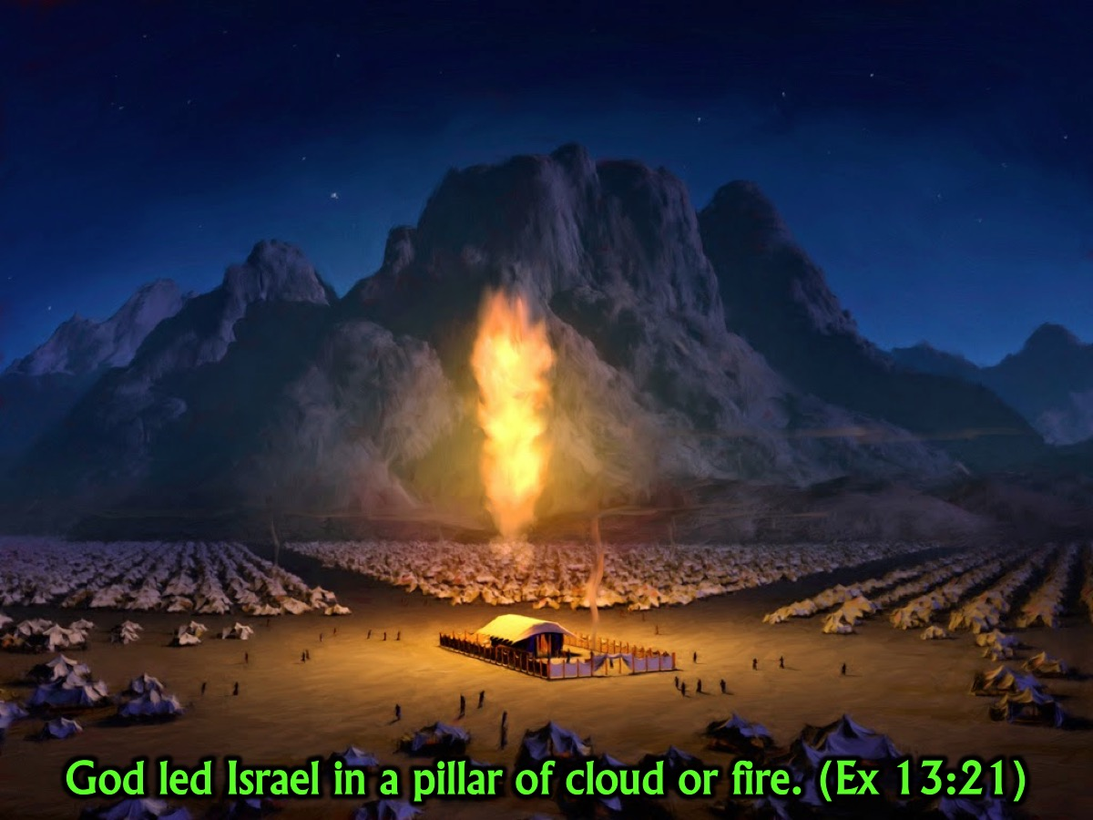
Notes:
God symbolised his presence among his people by appearing as a pillar of fire by night and a cloud by day. “By day the Lord went ahead of them in a pillar of cloud to guide them on their way and by night in a pillar of fire to give them light, so that they could travel by day or night.” (Exodus 13:21)

Slide 8
Notes:
3. The Presence of God in Specific Places. God chose to localise himself and his presence was associated with specific places in the Old Testament:

Slide 9
Notes:
A. The Tabernacle. When the children of Israel left Egypt under the leadership of Moses – God gave Moses a pattern for a tent structure that would move with them as they made their way from Egypt to the Promised Land of Canaan where they would eventually settle down. This camp was set up in the middle of the Israelites and included a system of sacrifice that allowed a Holy God to come and meet with sinners. There was an inner tented area known as the Holy of Holies and God’s presence was like a bright light that appeared over the Ark of the Covenant. We read in “I will meet with you above the ark of the covenant.” (Exodus 25:22). So wherever the people went on their journey which took over 40 years, they knew that God was among them because they could see the glory shining over the tent in the middle of their camp.

Slide 10
Notes:
B. The City. As the people made their way into the Promised Land, God chose a city, Jerusalem, and he made that a place that was known for his presence. We read in 2 Chronicles 6:6 “But you are to seek the place the LORD your God will choose from among all your tribes to put his Name there for his dwelling.” Do you remember what God’s name symbolised? His Presence! Jerusalem was a city known for God’s presence.

Slide 11
Notes:
C. The Temple. King Solomon built a beautiful temple that God could live in – in the middle of the city of Jerusalem. This was the place where people could got to meet with God. “I have built a magnificent temple for you, a place for you to dwell forever.” (2 Chronicles 6:2)

Slide 12
Notes:
4. The Presence of God in All Places. Some people began to think that you could only find God if you were in Jerusalem so they had to be reminded that even though God could be found in the temple in Jerusalem that not mean that he only lived there. In fact, the Psalmist in Psalm 139:7-12 suggests that there is no spacial dimentions in the universe where you can do and not find God: “Where can I flee from your presence? If I go up to the heavens, you are there. If I make my bed in the depths you are there. If I settle on the far side of the sea you are there. If I say the darkness will hide me even the darkness will be as light to you for YOU ARE THERE!”

Slide 13
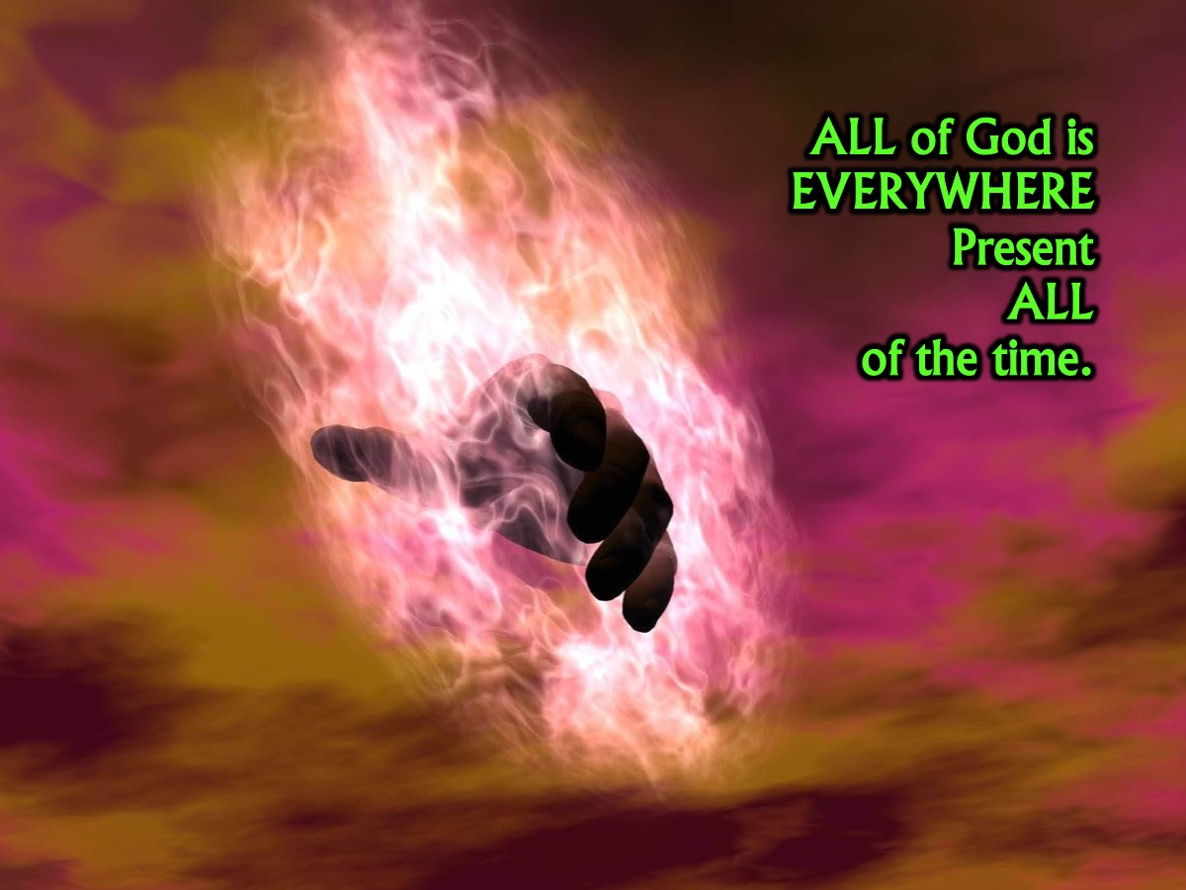
Notes:
I had a lecturer at Bible College many years ago who said: “All of God is everywhere present all of the time.”

Slide 14
Notes:
You can’t play hide and go seek with God – because he is in every hiding place before you get there! Jonah tried to run away from God and even in the belly of the whale he could not get away from God!

Slide 15
Notes:
My lecturer also said this: “Everything in the universe is immediately in the presence of God.”

Slide 16
Notes:
5. The Presence of God in Tough Times. Throughout the Bible we are promised that no matter what difficulties we face we can be sure that God is with us. For example we read in Psalm 91:15 “I will be with you when you are in trouble.” Over 50 times in the Old Testament we read this promise of God, "I will be with you" (Genesis 26:3; Deuteronomy 31:23; Joshua 1:5,9; 1 Kings 11:38; Isaiah 43:1,2,5; etc). The God who is present has promised to be with His people. It is interesting to note that each time one of God's people was facing a difficult situation, they heard God promising His presence to them. Some examples include: Isaac worrying about survival (Genesis 26:3); Jacob afraid of Laban (Genesis 31:3); Moses afraid of Pharaoh (Exodus 3:12); Joshua overwhelmed at his task of leading the people into the promised land (Joshua 1:5); Gideon afraid of the enemy (Judges 6:16); Jeroboam afraid of ruling (1 Kings 11:38); Jehoshaphat afraid of the enemy (2 Chronicles 20:17) and Jeremiah overwhelmed at his calling (Jeremiah 1:8).
You probably know the poem called Footprints: This popular text describes a dream in which the person is walking on a beach with God. They leave two sets of footprints in the sand behind them. Looking back, the tracks are stated to represent various stages of this person's life. At some points, the two trails dwindle to one, especially at the lowest and most hopeless moments of the character's life. When questioning God, believing that God must have abandoned his follower during those times, God gives the explanation: "During your times of trial and suffering, when you see only one set of footprints, it was then that I carried you.”
The Poem:
One night I had a dream. I dreamed I was walking along the beach with the Lord. Across the sky flashed scenes from my life.
For each scene, I noticed two sets of footprints in the sand, one belonging to me, and the other to the Lord..
When the last scene of my life flashed before me, I looked back at the footprints in the sand. I noticed that many times along the path of my life there was only one set of footprints. I also noticed that it happened at the very lowest and saddest times in my life.
This really bothered me and I questioned the Lord about it: "Lord, you said that once I decided to follow you, you'd walk with me all the way. But I have noticed that during the most troublesome times in my life there is only one set of footprints. I don't understand why when I need you most you would leave me."
The Lord replied: "My precious child, I love you and would never leave you. During your times of trial and suffering, when you see only one set of footprints, it was then that I carried you.”

Slide 17
Notes:
6. The Presence of God in Jesus. Eventually the time came for God to step into our human existance in the person of His son, Jesus Christ – so that he could save us from our sins – we discover that Jesus was not just a good little human who grew up in Palestine – but he was God among us.

Slide 18
Notes:
The Gospel of Matthew presents Jesus as the King who is God present with us. Matthew begins with Jesus' birth where Jesus is presented as "Emmanuel," which means "God with us" (1:23). In the middle of his book he recalls Jesus words, "Where two or three come together in my name, there am I with them" (18:20). He concludes his gospel with the Great Commission and Jesus' words, "And surely I am with you always, to the very end of the age" (28:20).

Slide 19
Notes:
The Gospel of John introduces Jesus as the Word, who is God (1:1), who became flesh (1:14), who is the only begotten God (1:14) and who reveals the Father (1:18). For John, the presence of God is clearly revealed in Jesus as he often speaks of the Glory connected with Jesus, reminding his readers of the Glory of God that was revealed in the Temple (1:14; 2:11; 11:40; 12:41; 17:1-24).

Slide 20
Notes:
7. The Presence of God in Believers. Okay, this may just blow your mind – but we read in 1 Corinthians 6:15 that “Your body is a temple of the Holy Spirit who is in you.” In the Old Testament God lived in the portable temple that Moses made and then in the brick one that Solomon made but in these days, God we are the temple in which God lives!

Slide 21
Notes:
Jesus introduced the concept of God living in people. He said, "If anyone loves me, he will obey my teaching. My Father will love him, and we will come to him and make our home with him" (John 14:15-18).

Slide 22
Notes:
8. The Presence of God in the Church. While the individual is called a temple in the New Testament, the church is also spoken of as the Temple of God. "For we are the temple of the living God.” (2 Corinthians 6:16).

Slide 23
Notes:
Paul says that God's people are "being built together to become a dwelling in which God lives by his Spirit" (Ephesians 2:22).

Slide 24
Notes:
9. The Presence of God in Eternity. We read in the book of Revelation that in the new heaven and new earth God's presence will be known in a much greater measure than at present: "God’s dwelling place is now among the people and he will dwell with them." (Revelation 21:3).

Slide 25
Notes:
We also read in an Old Testament prophecy that the name of the city will be "Yahweh Shammah" (Ezekiel 48:35) which is translated as: "The Lord is There”.

Slide 26
Notes:
Share: Turn to the person next to you and ask them what they learnt today about the presence of God!

Slide 27
Notes:
So what? What difference does the Presence of God make in our lives? If we could live in awareness of Gods presence we would experience:

Slide 28
Notes:
1. Intimacy. When we interact with God we grow closer to him: “On my bed I remember you; I think of you through the watches of the night. Because you are my help, I sing in the shadow of your wings. I cling to you; your right hand upholds me.” (Psalm 63:6-8)

Slide 29
Notes:
2. Security. When we know that God is with us we will not be afraid. “Even though I walk through the darkest valley, I will fear no evil, for you are with me; your rod and your staff, they comfort me.” (Psalm 23:4) See also Psalm 16:8 and Isaiah 43:1f.

Slide 30
Notes:
3. Holiness. When we spend time in God’s presence we are conformed into his likeness. “And so we are transfigured much like the Messiah, our lives gradually becoming brighter and more beautiful as God enters our lives and we become like him.” (2 Corinthians 3:18). See also Acts 4:13.

Slide 31
Notes:
Prayer

