Slide 1
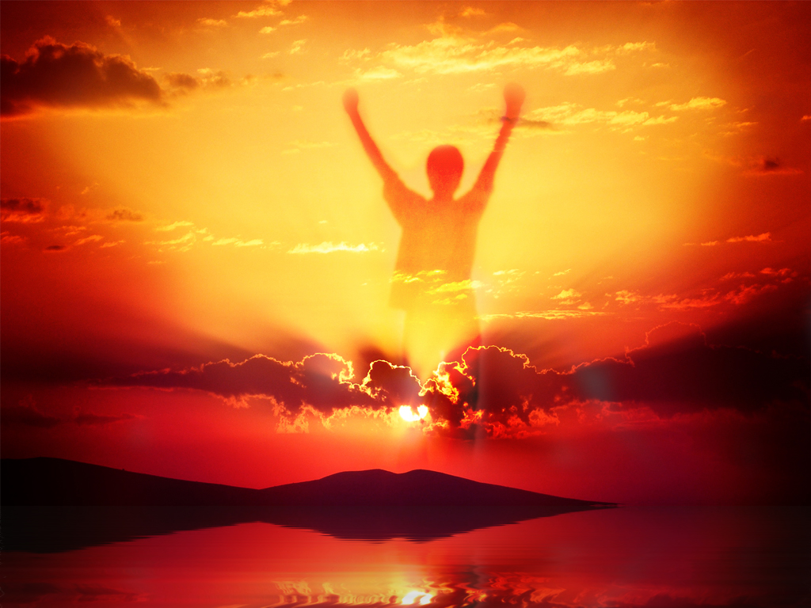
Practising the
PRESENCE
What is the unifying theme of the Bible?
of God in our Lives
Notes:
In the first 3 weeks we looked at how we are discipled by the Word.

Slide 2
Notes:
In our last session week we looked at what the Bible have to say about God’s Presence. We learnt from the Old Testament that God’s Presence was found in Creation, in God’s Name, in Specific Places (like the tabernacle, Jerusalem and the Temple), and it is Everywhere and especially with us when we go through Tough Times.

Slide 3
Notes:
From the New Testament we learnt that God’s Presence was found in Jesus, in individuals believers, in the church (or when we gather to worship) and in eternity.

Slide 4
Notes:
We also learnt that if we could live with an awareness of Gods presence we would experience Intimacy, Security and Holiness.

Slide 5
Notes:
Share: Turn to the person next to you and ask them this question: How much were you aware of God’s presence in your life during this past week? At Home? At School? Etc.

Slide 6
Notes:
So you forget that God is with you… welcome to the club! We all do!

Slide 7
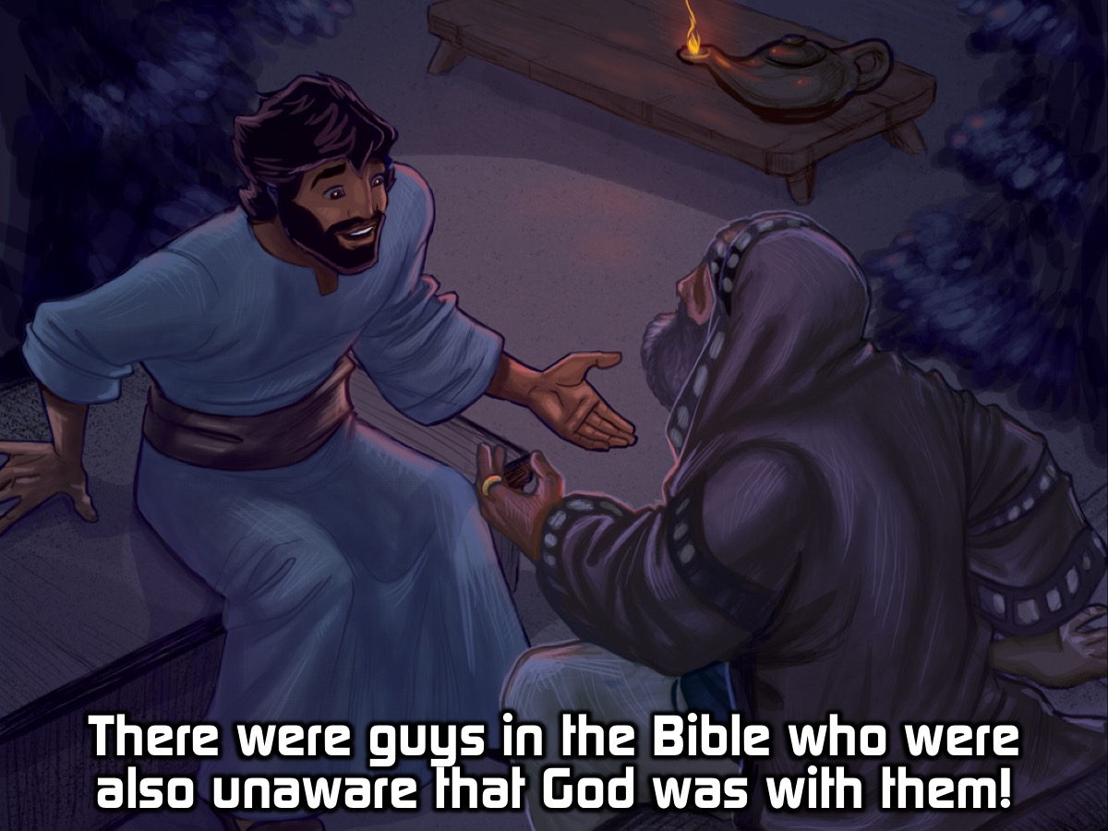
Notes:
There were some guys in the Bible who were unaware that God was with them:

Slide 8
Notes:
1. Jacob - Surely the Lord is in this place and I was not aware of it! (Genesis 28:10-17)

Slide 9
Notes:
2. Jesus’ Disciples - Jesus stood on the shore, but the disciples did not realize that it was Jesus. (John 21:4-7).

Slide 10
Notes:
3. The Emmaus Disciples - Jesus walked with them but they did not recognise him. (Luke 24:13-35).

Slide 11
Notes:
Why do we forget that God is with us?

Slide 12
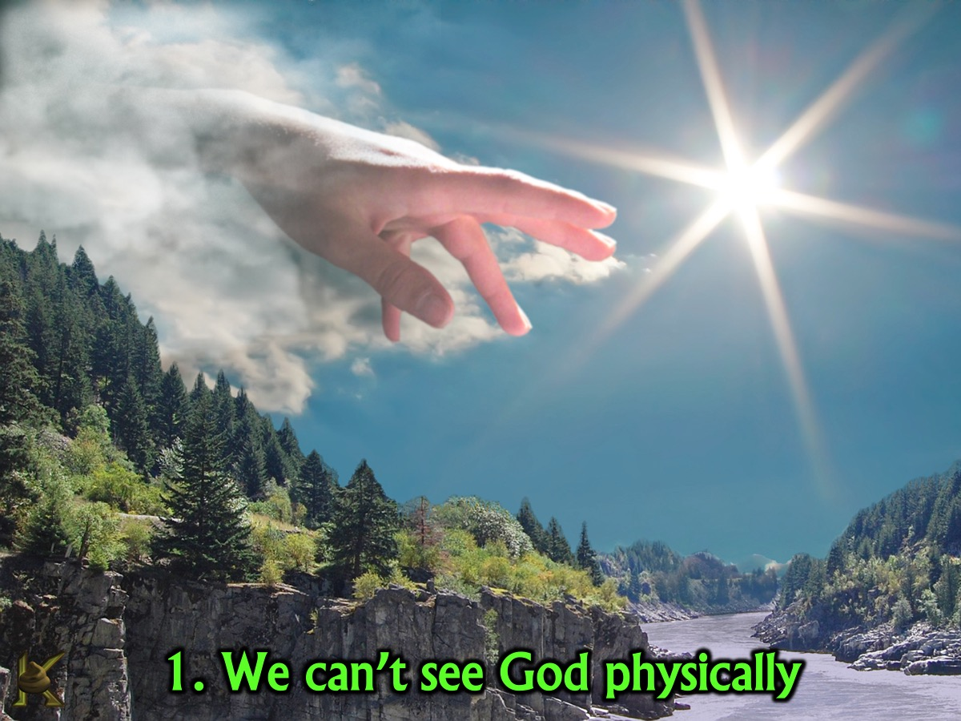
Notes:
1. We can’t see God physically. Because God is invisible we are not easily reminded that he is with us - so we end up forgetting about him and live as if he does not exist.

Slide 13
Notes:
2. We get too busy. We rush around with so much to do that is urgent that we often just don’t get time to include God in our schedule.

Slide 14
Notes:
3. We live through our senses. Sadly we don’t usually use those senses for human living to connect with God.

Slide 15
Notes:
Someone once said: “Sometimes I envy the Catholic priests. They carry a crucifix around all the time. I need a reminder of the cross of Christ because I forget so easily what Jesus did for me through his death for us.” (James Denney, The Death of Christ)

Slide 16
Notes:
Video: Notice God More. Get it on Vimeo at: https://vimeo.com/56836796

Slide 17
Notes:
So, how can we experience God’s presence more in our daily lives?

Slide 18
Notes:
1. Create Reminders - what if we were to get creative and find ways to remind oursleves that God is with us. Write something on our hands, wear a coloured elastic band, put a message on our phone or our computer screens - and let all these things be triggers that help us make a connection with God who is with us.

Slide 19
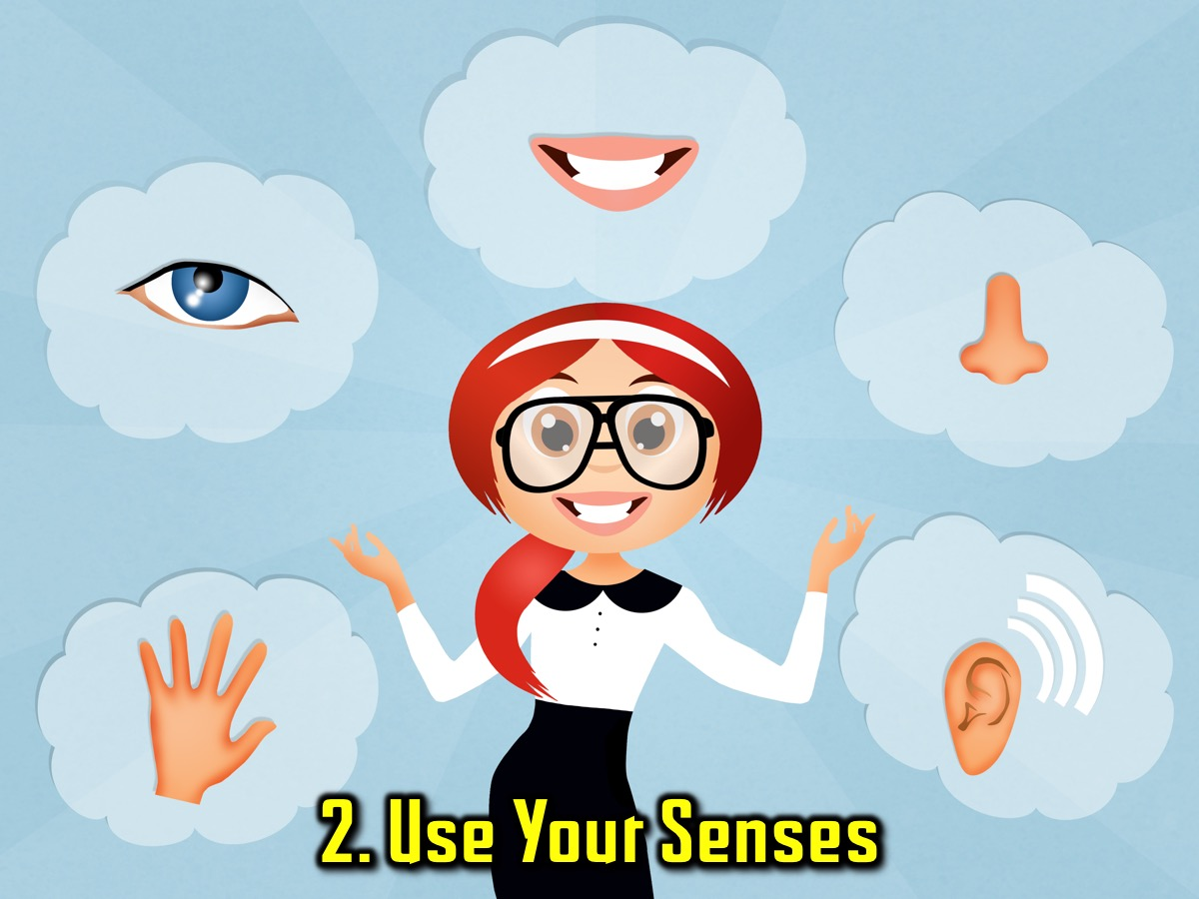
Notes:
2. Use Your Senses. What if we took control of our five senses and let them turn our attention towards God.

Slide 20
Notes:
Activity: You are going to get a handout and on the one side you will write a letter to God and share some of the things that keep you from remembering his presence and on the other side think of some reminders and ways to use your five senses to experience his presence.

Slide 21
Notes:
Do you believe that God is here right now with us? The one thing that God wants from us is to believe. Here is an example: what if I told you that a water Melon is blue on the inside before you cut it open? So you believe me? (Most people will say no) you do not believe me because you haven't seen it. It is difficult to believe in what you haven't seen. That is the faith that God wants us to have in him, that even if we do not see him, we still know that he is there.

Slide 22
Notes:
Going back to the letters that you wrote. I want you personally to pray over them. Ask God to help you take away all the things that hinder you from experiencing His Presence, and for him to make you aware of his presence at all times. Then believe in that prayer that God has heard it.

Slide 23
Notes:
“The God who made the world and everything in it, this Master of sky and land, doesn’t live in custom-made shrines or need the human race to run errands for him, as if he couldn’t take care of himself. He makes the creatures; the creatures don’t make him. Starting from scratch, he made the entire human race and made the earth hospitable, with plenty of time and space for living so we could seek after God, and not just grope around in the dark but actually find him. He doesn’t play hide-and-seek with us. He’s not remote; he’s near. We live and move in him, can’t get away from him! (Acts 17:24-27, The Message)

Slide 24
Notes:
Prayer

