Slide 1
Notes:
Welcome to the The Spirit Series. Today is week 1 of a four week journey in getting to know and experience the Holy Spirit in our lives.

Slide 2
Notes:
In week 1 we are going to answer the question: Who is the Holy Spirit?

Slide 3
Notes:
In Week 2 we are going to answer the question: What are His Fruits?

Slide 4
Notes:
In Week 3 we are going to answer the question: What are His Gifts?

Slide 5
Notes:
In Week 4 we are going to answer the question: How can I be filled with the Holy Spirit?

Slide 6
Notes:
Today is all about getting to know who the Holy Spirit is.

Slide 7
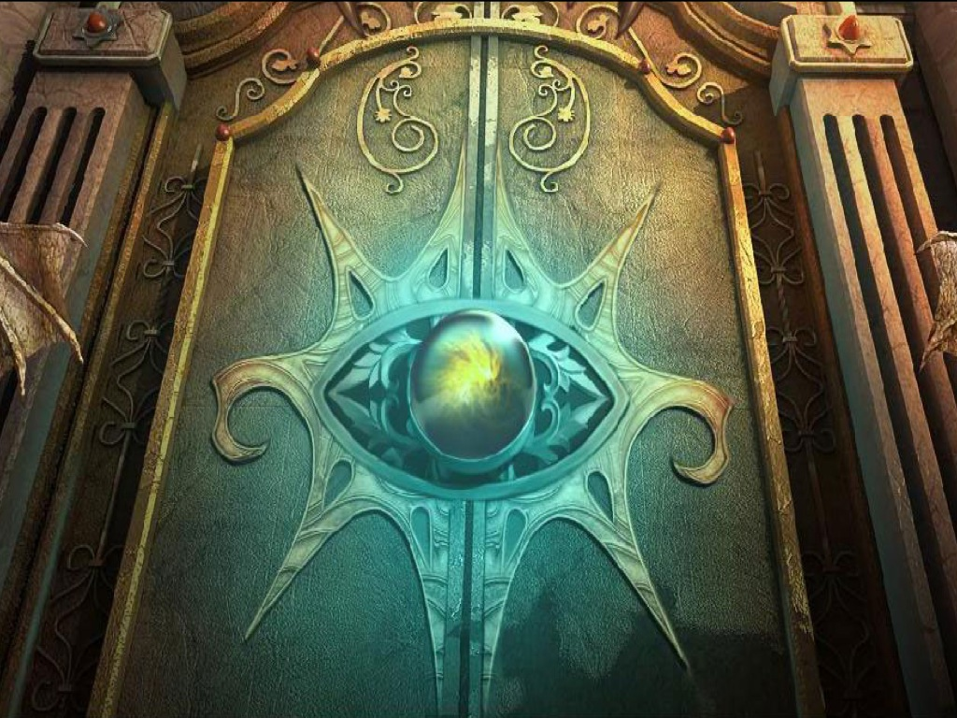
Notes:
Today we are going to be going on a journey to explore a true mystery!

Slide 8
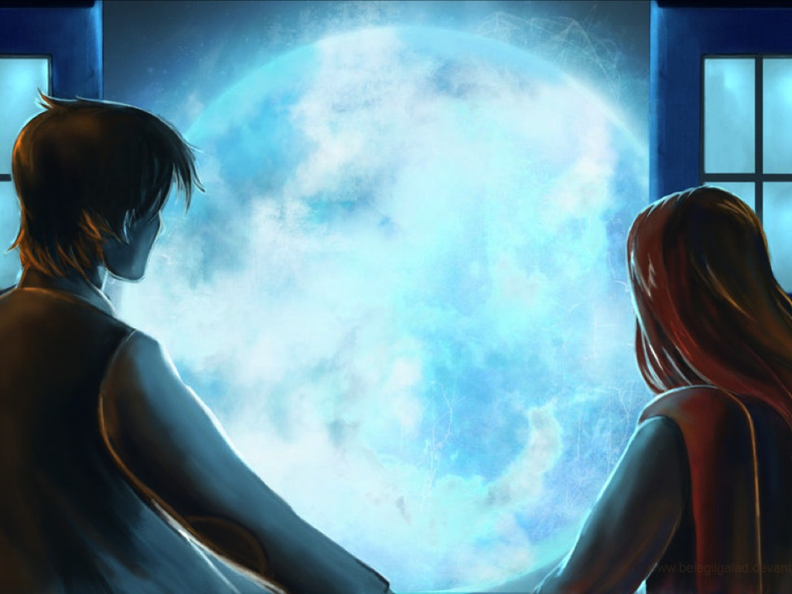
Notes:
Let me give you some clues as to it’s identity…

Slide 9
Notes:
It can’t be seen even though you can feel it’s effect!

Slide 10
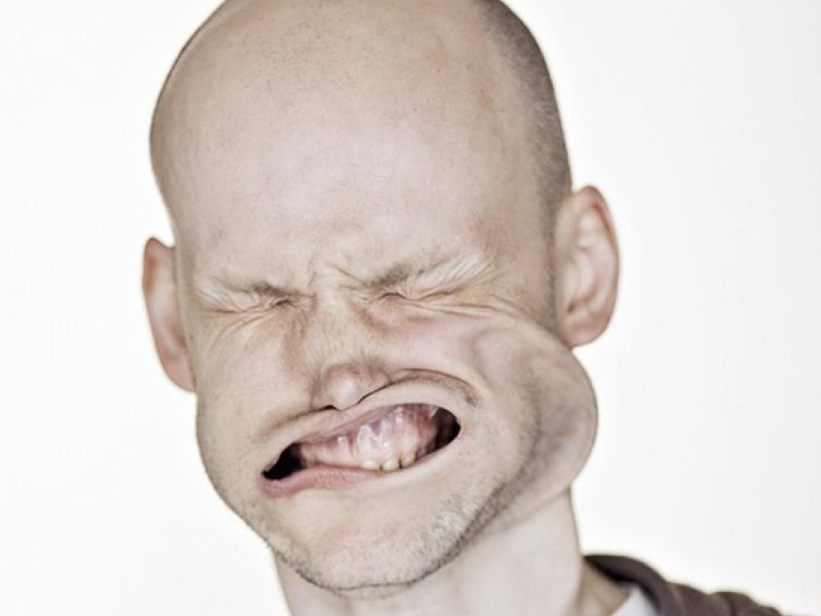

Slide 11
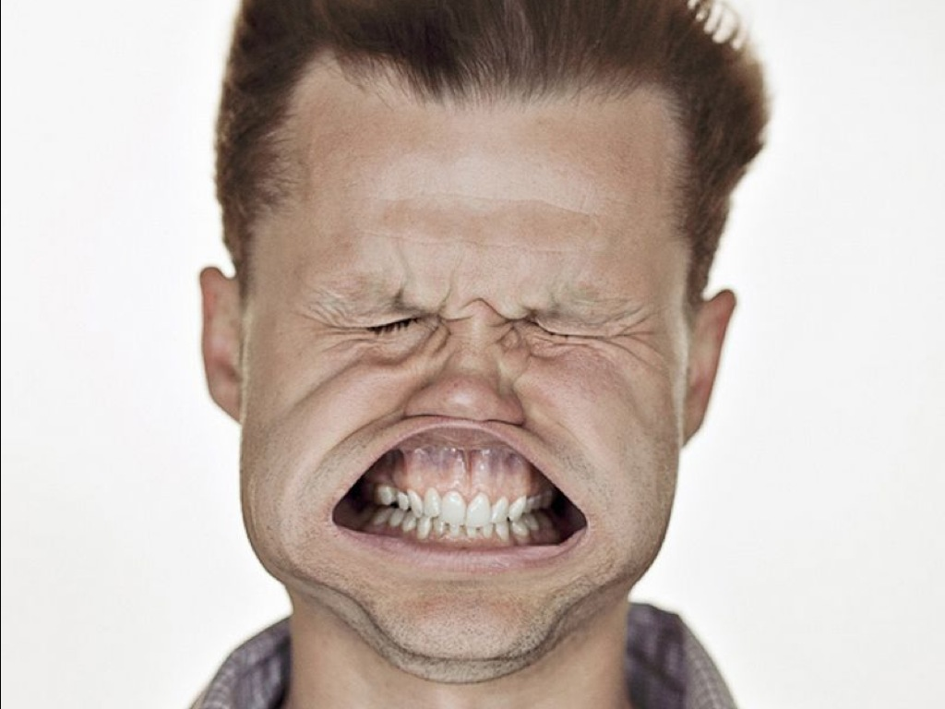

Slide 13
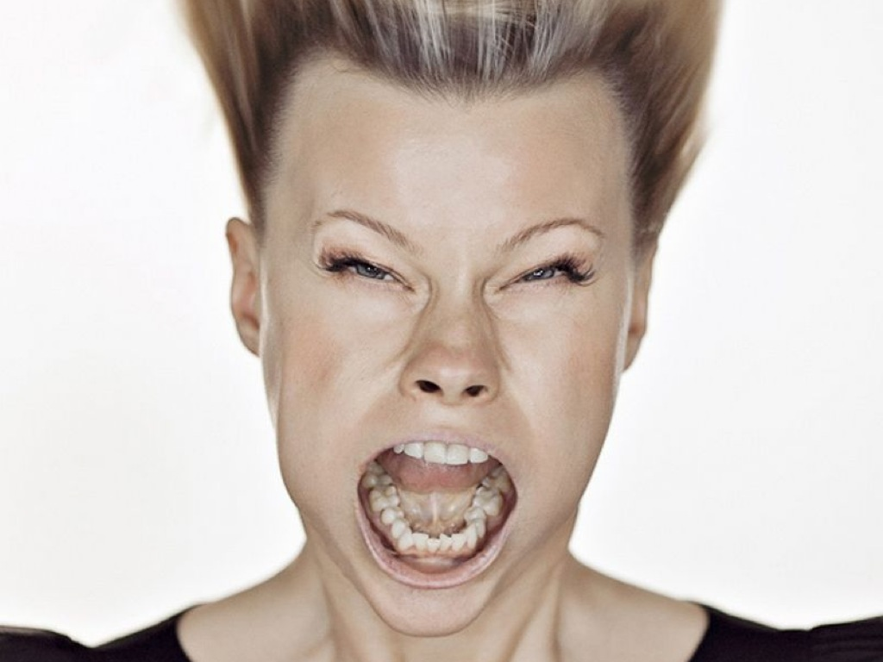

Slide 16
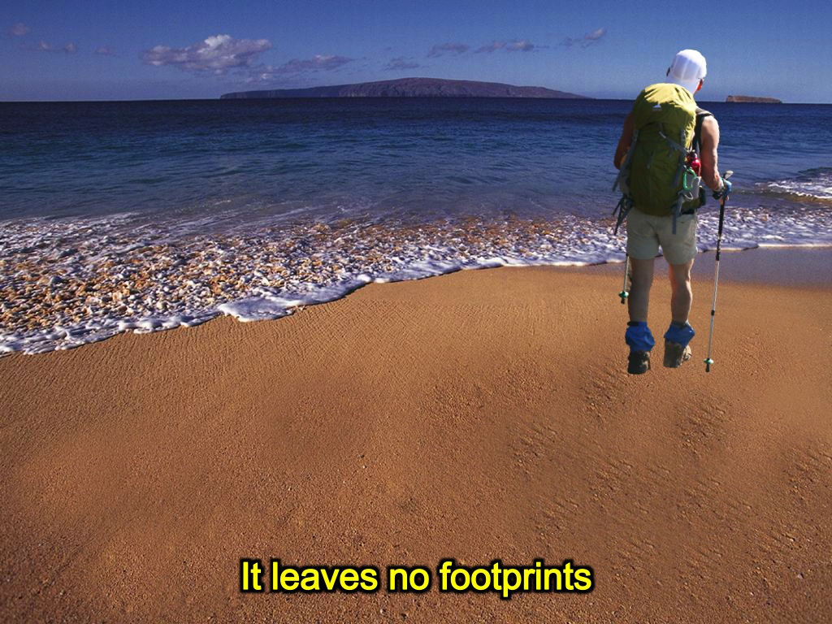
Notes:
It is something that leaves no footprints in the sand.

Slide 17
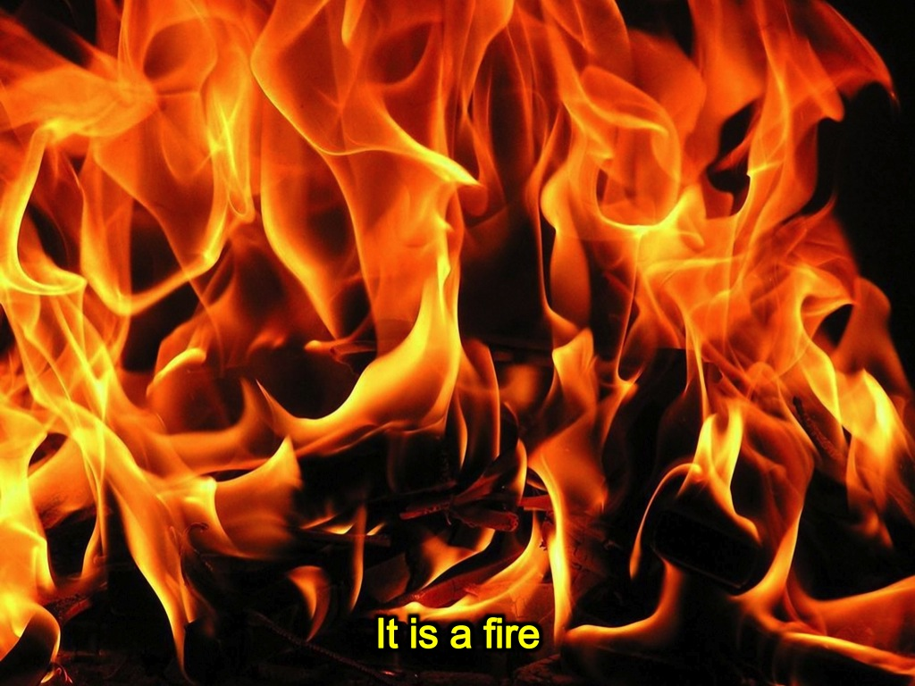
Notes:
It is like fire!

Slide 18
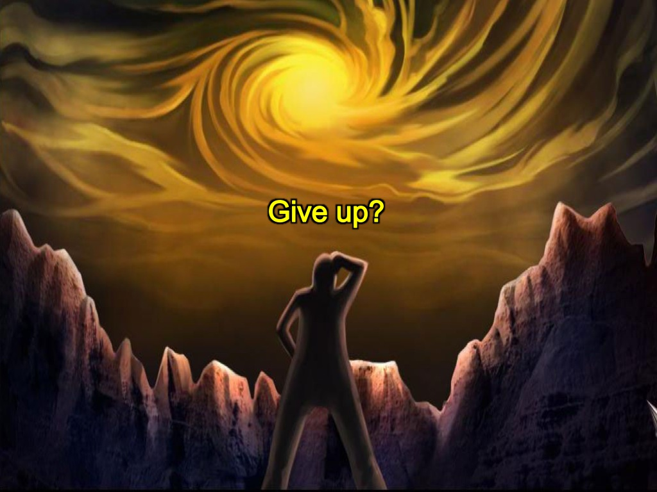
Notes:
Do you get it, or do you give up? Let me give you a few more clues…

Slide 19
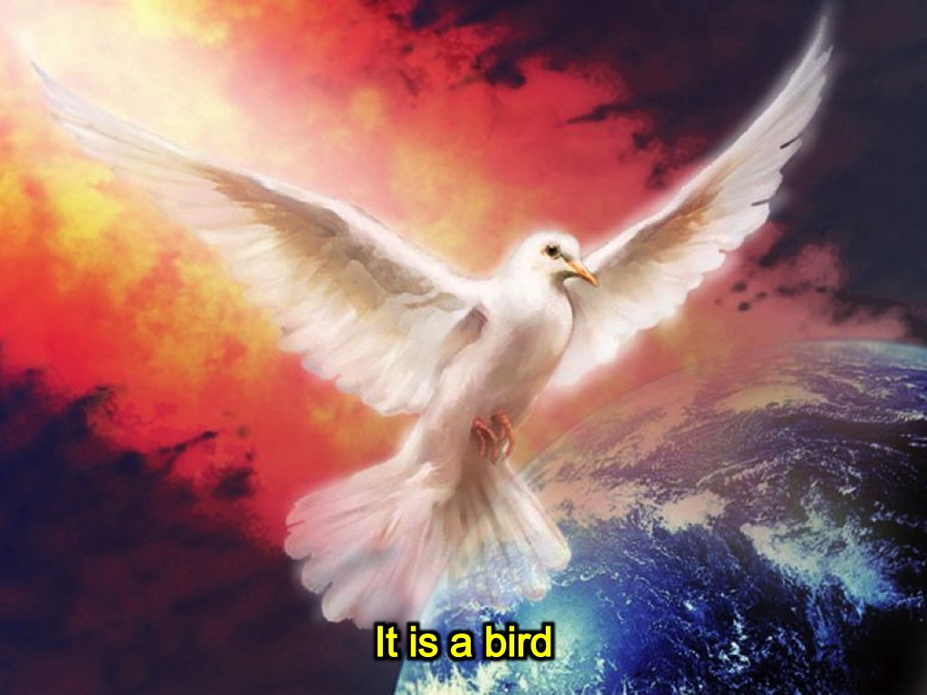
Notes:
It’s a bird…

Slide 20
Notes:
It’s a secret agent….not so much like Johnny English…

Slide 21
Notes:
…more like James Bond

Slide 22
Notes:
It’s God’s secret agent!

Slide 23
Notes:
It’s the person in the empty frame.

Slide 24
Notes:
In fact, it is not an it at all – I did that to mislead you – it is a person!!! The Spirit of God!

Slide 25
the SPIRIT series
Who is the Holy Spirit?
Notes:
Today iwe are looking at the person of the Holy Spirit.

Slide 26
Notes:
So what do we know about the Spirit?

Slide 27
Notes:
1. He Lived Forever: He is called the eternal Spirit in Hebrews 9:14. The earth was without form and void, and darkness was over the face of the deep and the Spirit of God was hovering over the face of the waters. (Genesis 1:2)

Slide 28
Notes:
2. He Gave Life: God breathed the breath of life into Adam and made him a living being. (Genesis 2:7)

Slide 29
Notes:
3. He Energised People: The phrase used is Came Upon – He visited a person so they could complete a task and then He left. Some examples are: (1) Bezalel – Exodus 31:3, 35:31; (2) Elders: Numbers 11:25; (3) Balaam: Numbers 24:2; (4) Samson: Judges 14:6,19; (5) Othniel: Judges 3:10; (6) Gideon: Judges 6:34; (7) Jephthah: Judges 11:29; (8) Saul: 1 Samuel 10:10, 16:13; (9) Amasai: 1 Chronicles 12:18; (10) Azariah: 2 Chronicles 15:1; (11) Jehaziel: 2 Chronicles 20:14; (12) Zechariah: 2 Chronicles 24:20; and (13) Eldad and Medad: Numbers 11:26.

Slide 30
Notes:
4. He Inhabited People: (1) Joseph - So Pharaoh asked them, ‘Can we find anyone like this man, one in whom is the spirit of God? (Genesis 41:38). (2) Joshua - Now Joshua son of Nun was filled with the spirit of wisdom because Moses had laid his hands on him. So the Israelites listened to him and did what the Lord had commanded Moses (Deuteronomy 34:9). (3) David - So Samuel took the horn of oil and anointed him in the presence of his brothers, and from that day on the Spirit of the Lord came upon David in power. (1 Samuel 16:13). (4) Elijah and Elisha - When they had crossed, Elijah said to Elisha, “Tell me, what can I do for you before I am taken from you?” “Let me inherit a double portion of your Spirit,” Elisha replied.… He picked up the cloak that had fallen from Elijah and went back and stood on the bank of the Jordan. Then he took the cloak that had fallen from him and struck the water with it. “Where now is the LORD, the God of Elijah?” he asked. When he struck the water, it divided to the right and to the left, and he crossed over. The company of the prophets from Jericho, who were watching, said, “The Spirit of Elijah is resting on Elisha.” And they went to meet him and bowed to the ground before him (2 Kings 2:9, 13-15).

Slide 31
Notes:
5. He Sent Prophets: (1) Isaiah - And now the Sovereign LORD has sent me, with his Spirit.” (Isaiah 48:16-17). (2) Ezekiel - As he spoke, the Spirit came into me and raised me to my feet, and I heard him speaking to me.” (Ezekiel 2:1-3). (3) Daniel - “I have heard that the spirit of the gods is in you and that you have insight, intelligence and outstanding wisdom.” (Daniel 4:8-9,18, 5:11). (4) Micah - “But as for me, I am filled with power, with the Spirit of the Lord, and with justice and might, to declare to Jacob his transgression, to Israel his sin” (Micah 3:8).

Slide 32
Notes:
6. He Taught People: You gave your good Spirit to instruct them. But it is the Spirit in a man, the breath of the Almighty, that gives him understanding. (Nehemiah 9:20, Job 32:8)

Slide 33
Notes:
7. He Warned People: For many years you were patient with them. By your Spirit you admonished them through your prophets. Yet they paid no attention, so you handed them over to the neighboring peoples. (Nehemiah 9:30)

Slide 34
Notes:
8. He Introduced Jesus: Through people like Elizabeth: John the Baptist’s mother (Luke 1:41-42); Zacharias: John the Baptist’s father (Luke 1:67-79); Simeon: He saw the infant Jesus when presented in the Temple. (Luke 2:25)

Slide 35
Notes:
9. He Impregnated Mary: Mary was pledged to be married to Joseph, but before they came together, she was found to be pregnant through the Holy Spirit. (Matthew 1:18)

Slide 36
Notes:
10. He Anointed Jesus: When all the people were being baptized, Jesus was baptized too. And as he was praying, heaven was opened and the Holy Spirit descended on him in bodily form like a dove. (Luke 3:21)

Slide 37
Notes:
11. He Led Jesus: And Jesus, full of the Holy Spirit, returned from the Jordan and was led by the Spirit in the wilderness. (Luke 4:1)

Slide 38
Notes:
12. He Empowered Jesus: Jesus returned from His temptations in the power of the Spirit to teach in the synagogues. He cast out demons by the power of the Holy Spirit. He went about doing good and healing all who were oppressed by the devil, for God was with him. (Luke 4:14-15, Matthew 12:28, Acts 10:38)

Slide 39
Notes:
13. He Raised Jesus: The Spirit raised Jesus from the dead. (Romans 8:11)

Slide 40
Notes:
14. He Entered Disciples: Jesus breathed on his disciples and said, ‘Receive the Holy Spirit.’ (John 20:22)

Slide 41
Notes:
15. He Fell at Pentecost: When the day of Pentecost arrived, there came heaven a sound like a mighty rushing wind…and tongues as of fire appeared to them…and they were all filled with the Holy Spirit and began to speak in other tongues. (Acts 2:1-47)

Slide 42
Notes:
16. He Fell in Jerusalem: After they prayed, the place where they were meeting was shaken. And they were all filled with the Holy Spirit and spoke the word of God boldly. (Acts 4:31)

Slide 43
Notes:
17. He Fell in Samaria: When the apostles in Jerusalem heard that Samaria had accepted the word of God, they sent Peter and John to Samaria. Peter and John placed their hands on them, and they received the Holy Spirit. (Acts 8:14-17)

Slide 44
Notes:
18. He Fell in Caesarea: While Peter was still speaking these words, the Holy Spirit came on all who heard the message. The circumcised believers who had come with Peter were astonished that the gift of the Holy Spirit had been poured out even on Gentiles. For they heard them speaking in tongues and praising God. (Acts 10:44-46)

Slide 45
Notes:
19. He Fell in Ephesus: When Paul placed his hands on them, the Holy Spirit came on them, and they spoke in tongues and prophesied. (Acts 19:6)

Slide 46
Notes:
20. He Guided Leaders: While they were worshiping the Lord and fasting, the Holy Spirit said, “Set apart for me Barnabas and Saul….”(Acts 13:2)

Slide 47
Notes:
21. He Inspired Scripture: All Scripture is breathed out by God. (2 Tim 3:16)

Slide 48
Notes:
Wait…there’s more! There is so much more I could share about this mystery – you will have to visit our Facebook site this week to get more details…

Slide 49
Notes:
He is called by many different names: (1) The Spirit of God (1 Corinthians 3:16), (2) The Spirit of Christ (Romans 8:9), (3) The Eternal Spirit (Hebrews 9:14), (4) The Spirit of Truth (John 16:13), (5) The Spirit of Grace (Hebrews 10:29), (6) The Spirit of Glory (1 Peter 4:14), (7) The Spirit of Life (Romans 8:2), (8) The Spirit of Wisdom and Revelation (Ephesians 1:17), (9) The Comforter (John 14:26), (10) The Spirit of Promise (Acts 1:4-5), (11) The Spirit of Adoption (Romans 8:15), (12) The Spirit of Holiness (Romans 1:4) and (13) The Spirit of Faith (2 Corinthians 4:13).

Slide 50
Notes:
He is like. Many metaphors are used for the Holy Spirit in the Bible: (1) Dove (Matthew 3:16); (2) Wind – He is unseen, yet His influence and activity can be seen (John 3:8); (3) Water - He is the source of life, ever flowing as fresh, living water (John 7:37-39); (4) Clothing (Acts 1:8); (5) Fire - He purges & refines us and also imparts God’s zeal into us for His work (Acts 2:3); (6) Oil - He anoints us or empowers us to do God’s work (Acts 10:38, 2 Corinthians 1:21), (7) Seal - He spiritually marks us as God’s property (1 Corinthians 1:22, Ephesians 1:13) and (8) Guarantee/Pledge (Ephesians 1:14).

Slide 51
Notes:
He is Personal: (1) He makes choices (1 Corinthians 12:11); (2) He teaches (John 14:26); (3) He convicts (John 16:8); (4) He can be grieved (Ephesians 4:30); (5) He can be blasphemed (Matthew 12:31); (6) He has a rational mind (Romans 8:26-27); (7) He can be lied to (Acts 5:3-4) and (8) He can be resisted (Acts 7:51).

Slide 52
Notes:
Share: What new truth have you learnt today?

Slide 53
Notes:
Can you be a New Man?

Slide 54
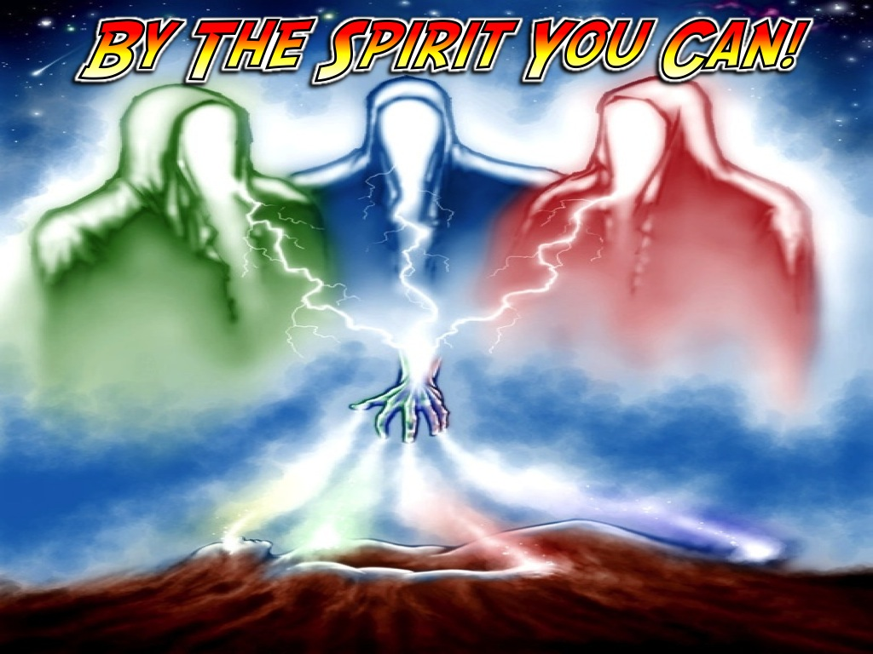
Notes:
By the Spirit You Can!

Slide 55
Notes:
1. Let Him Invade You

Slide 56
Notes:
He is the perfect gentleman so you do need to let him work in you! He does not force himself on you!

Slide 57
Notes:
A. He Will Adopt You: The Spirit you received brought about your adoption to sonship. (Romans 8:15)

Slide 58
Notes:
B. He Will Own You: Do you not know that you are the temple of the Holy Spirit. 1 Corinthians 6:19

Slide 59
Notes:
C. He Will Fill You: Be filled with the Spirit. (Ephesians 5:18)

Slide 60
Notes:
2. Let Him Grow You

Slide 61
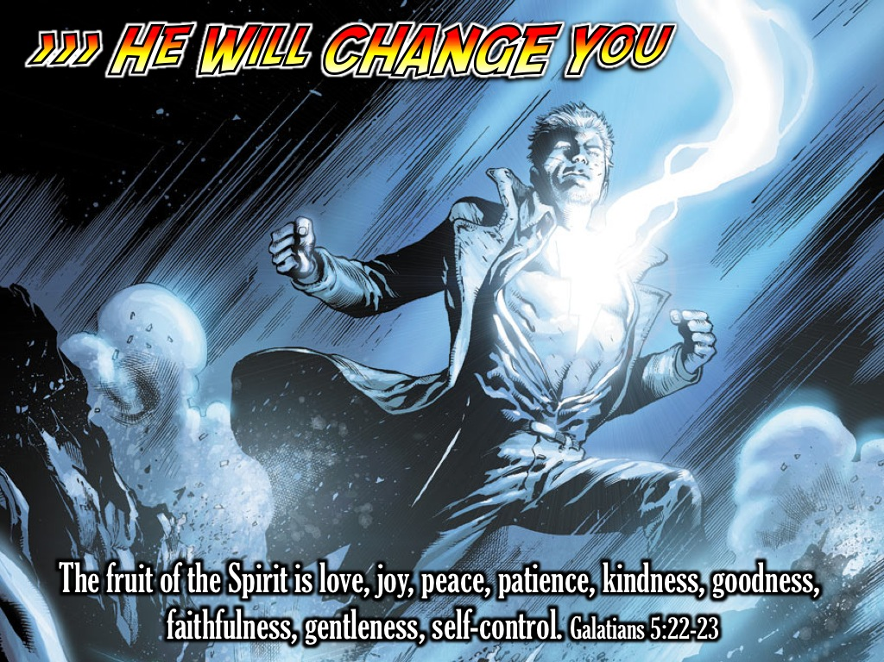
Notes:
A. He Will Change You: But the fruit of the Spirit is love, joy, peace, patience, kindness, goodness, faithfulness, gentleness and self-control. Against such things there is no law. Those who belong to Christ Jesus have crucified the sinful nature with its passions and desires. Since we live by the Spirit, let us keep in step with the Spirit. Let us not become conceited, provoking and envying each other. (Galatians 5:22-26)

Slide 62
Notes:
B. He Will Equip You: There are different kinds of gifts, but the same Spirit distributes them: word of wisdom; word of knowledge, faith, gifts of healing, working of miracles; prophecy, ability to judge between spirits; ability to speak in different kinds of tongues; ability to interpret tongues. (1 Corinthians 12:4,8-10)

Slide 63
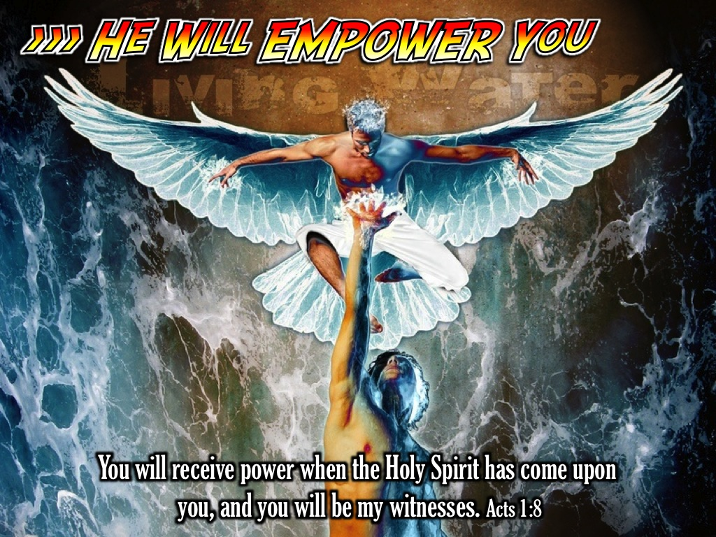
Notes:
C. He Will Empower You: But you will receive power when the Holy Spirit has come upon you, and you will be my witnesses. (Acts 1:8)

Slide 64
Notes:
3. Let Him Help You

Slide 65
Notes:
A. He Will Teach You: The Helper, the Holy Spirit, whom the Father will send in my name, will teach you all things. (John 14:26)

Slide 66
Notes:
B. He Will Guide You: When the Spirit of truth comes, he will guide you into all the truth. (John 16:12)

Slide 67
Notes:
C. He Will Comfort You: But I tell you the truth, it is to your advantage that I go away; for if I don’t go away, the comforting Counselor will not come to you. (John 16:7)

Slide 68
Notes:
I stumbled across an amazing poem that has really inspired me to build an intimate relationship with Holy Spirit:
Some say there is a man who dwells in the invisible,
Whom tens of thousands have testified has been present with them in their darkest hour.
Though others may be present, only those in desperate need have felt his presence.

Slide 69
Notes:
He makes himself known to the lonely, the sad, the oppressed and the dying.
He holds them in his arms and whispers comfort in their ears.
He talks like an old friend, knowing the most secret thoughts.

Slide 70
Notes:
He urges men to push on and not give up.
He gives strength to the weak and hope to the dying.
He stays with them all through the night.
He never gives up and he never tires.
His passion is for the lost and the needy.

Slide 71
Notes:
Others say he doesn’t exist, or that he leaves when the trouble has passed,
but those who know him know that he is always there, urging them forward.

Slide 72
Notes:
He has been felt by dying men on battlefields
and has been with prisoners on death row.
He has been with orphans on street corners
And with widows left alone.

Slide 73
Notes:
He urges the broken back into relationships of trust.
He never condemns, but convinces the redeemed of their right standing with God.
He reminds the oppressed that their enemy now stands condemned and defeated.
He has promised to teach the children of God all things concerning their hope and to remind them of the truth.

Slide 74
Notes:
He testifies of a Saviour to all mankind.
His name is The Comforter.
He is the Holy Spirit

Slide 75
Notes:
Let’s pray

Slide 76
Notes:
In the next session we are going to learn about the fruit that the Holy Spirit wants to produce in our lives.

