Slide 1
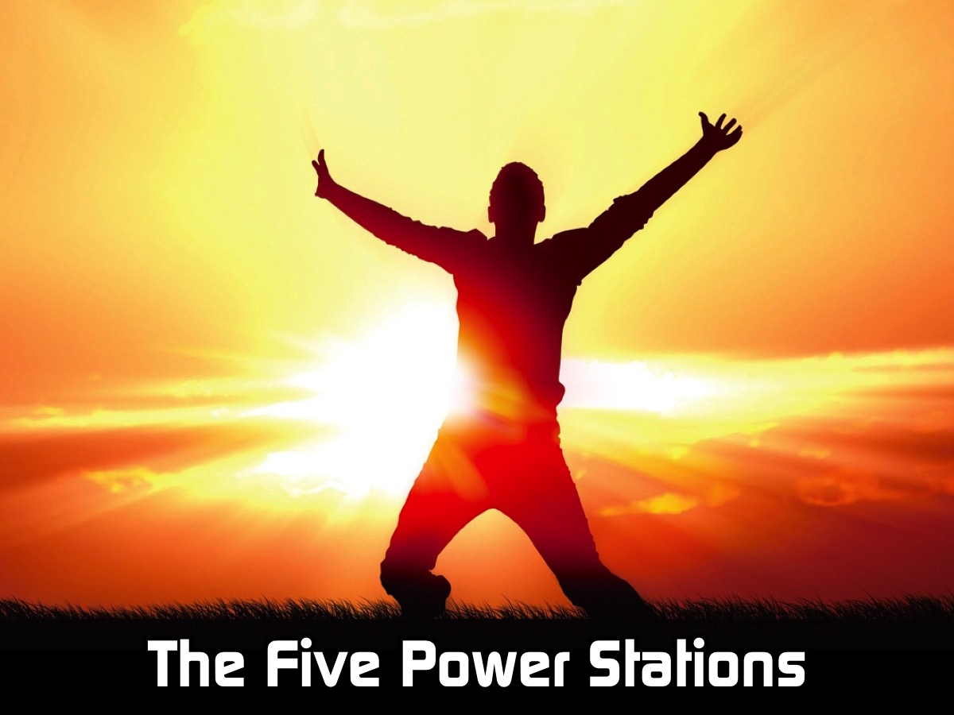
Notes:
The Five Power Stations. We have set up 5 stations around the room - places you can visit and have someone pray for you to experience God’s presence in that area. As I introduce each station - one of our leaders is going to share a brief testimony of God's power in that area.

Slide 2
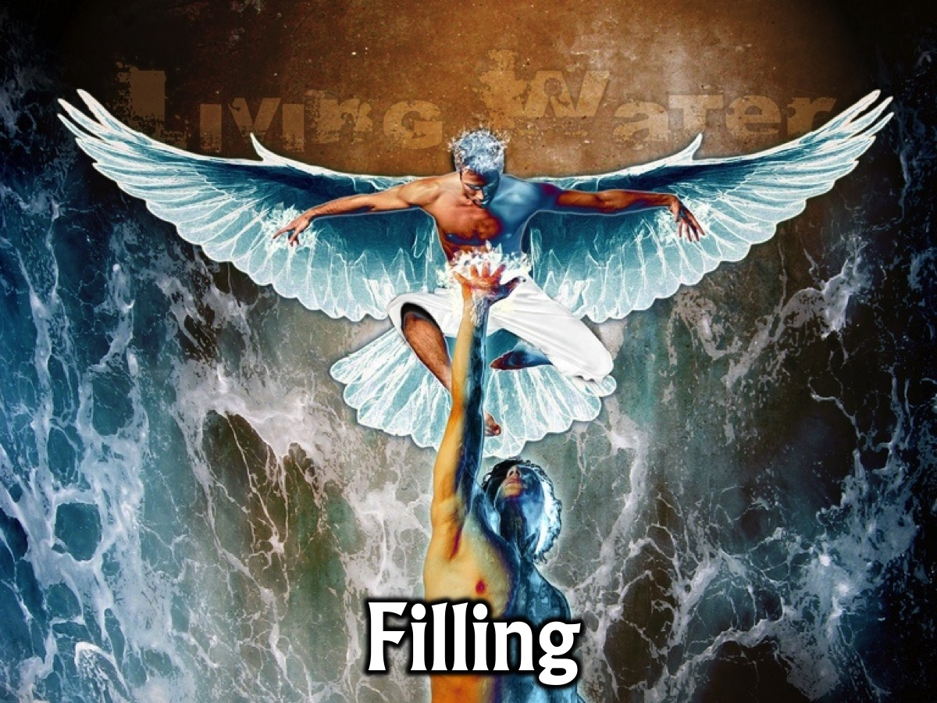
Notes:
1. Filling. At this station someone will pray for God to fill you with his Spirit.

Slide 3
Notes:
2. Deliverance. At this station someone will pray for you to be set from anything that you have struggled to break free from.

Slide 4
Notes:
3. Healing. At this station someone will pray for you to be healed of anything that is afflicting you.

Slide 5
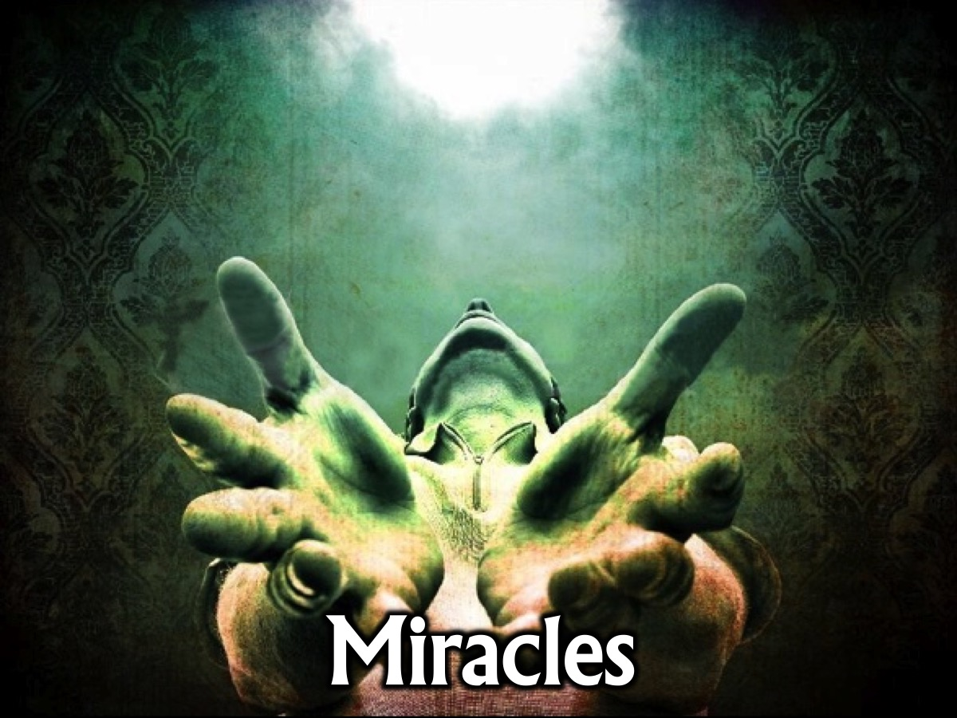
Notes:
4. Miracles. At this station someone will pray for you or someone you know to experience a miracle from God.

Slide 6
Notes:
5. Witnessing. At this station someone will pray for you to have power when you tell people about Jesus.

Slide 7
Notes:
Power Stories: Five leaders are going to come and share a testimony about each station and then you are free to visit the stations and receive prayer and/or pray for others at the stations.

Slide 8
Notes:
Prayer

