Slide 1
Notes:
Spirit-filled Prayer Workshop #2
The Prayer Journey

Slide 2
Notes:
People need help connecting with God in prayer. One of the best ways to get people praying deeply is to facilitate a prayer journey using the Word of God or the place where you are situated. In this workshop we are going to start with a Bible based journey through Psalms and then we are going to leave the room and experience God in the surrounding area.

Slide 3
Notes:
1. Read; As the deer pants for streams of water, so my soul pants for you, O God. My soul thirsts for God, for the living God. When can I go and meet with God? Why are you downcast, O my soul? Why so disturbed within me? Put your hope in God, for I will yet praise him, my Saviour and my God. (Psalm 41:1,2,5)

Slide 4
Notes:
2. Journal
How does this passage connect with my heart?
How does it express my desire to connect with God today?

Slide 5
Notes:
3. Reflect: What a wildly wonderful world, God! You made it all, with Wisdom at your side, made earth overflow with your wonderful creations. Oh, look - the deep, wide sea, brimming with fish past counting, sardines and sharks and salmon. Ships plow those waters, and Leviathan, your pet dragon, romps in them. All the creatures look expectantly to you to give them their meals on time. You come, and they gather around; you open your hand and they eat from it. If you turned your back, they’d die in a minute - Take back your Spirit and they die, revert to original mud; Send out your Spirit and they spring to life - the whole countryside in bloom and blossom. The glory of God - let it last forever! Let God enjoy his creation! He takes one look at earth and triggers an earthquake, points a finger at the mountains, and volcanoes erupt. Oh, let me sing to God all my life long, sing hymns to my God as long as I live! Oh, let my song please him; I’m so pleased to be singing to God. But clear the ground of sinners—no more godless men and women! O my soul, bless God! (Psalm 104:24-34).
Write down any thoughts that come to mind:

Slide 6
Notes:
4. Journey As you embark on the prayer walk you will come across the following landmarks – stop at each one of them and ask God what he wants to say to you through each of the them - journal your thoughts along the way:

Slide 7
Notes:
The Church Building:

Slide 8
Notes:
The Parking Lot:

Slide 9
Notes:
Traffic in the Street:

Slide 10
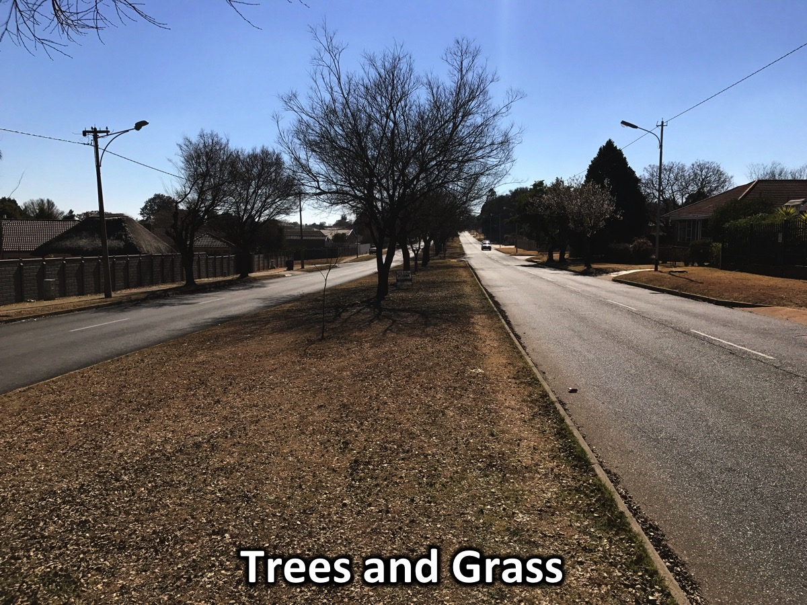
Notes:
Trees and Grass:

Slide 11
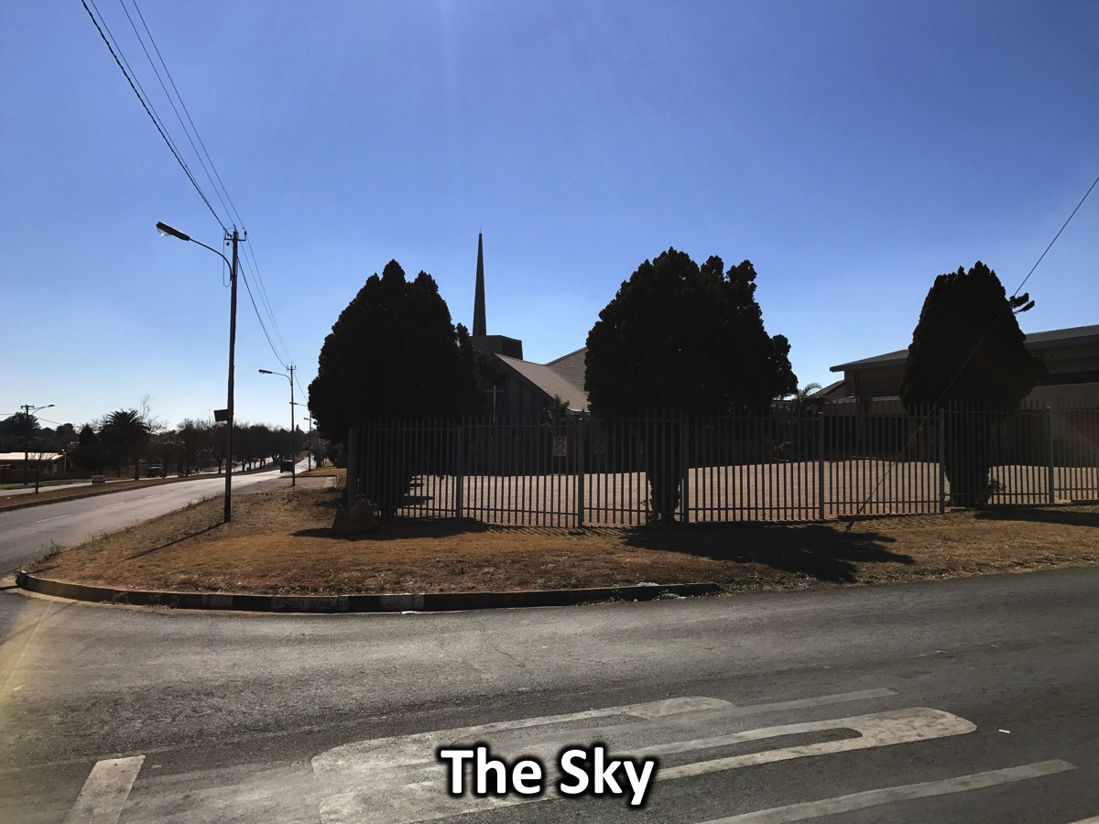
Notes:
The Sky:

Slide 13
Notes:
5. More Journeys: Check out the online resource page at (bit.ly/YMC2017) for more creative journeys to use in your youth ministry.

Slide 14
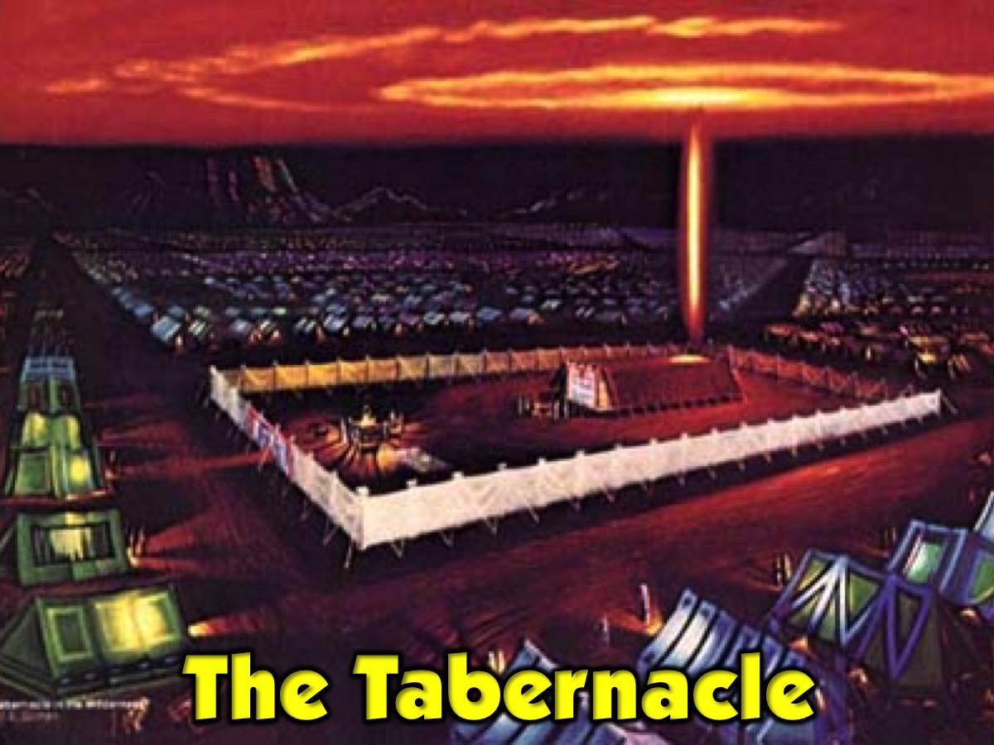
Notes:
The Tabernacle

Slide 15
Notes:
Jericho

Slide 16
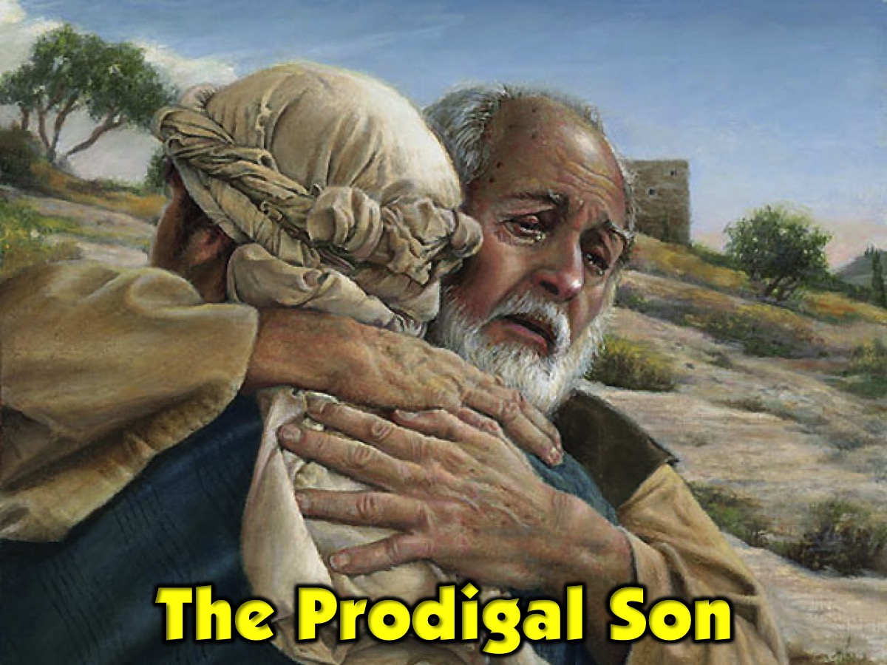
Notes:
The Prodigal Son

Slide 17
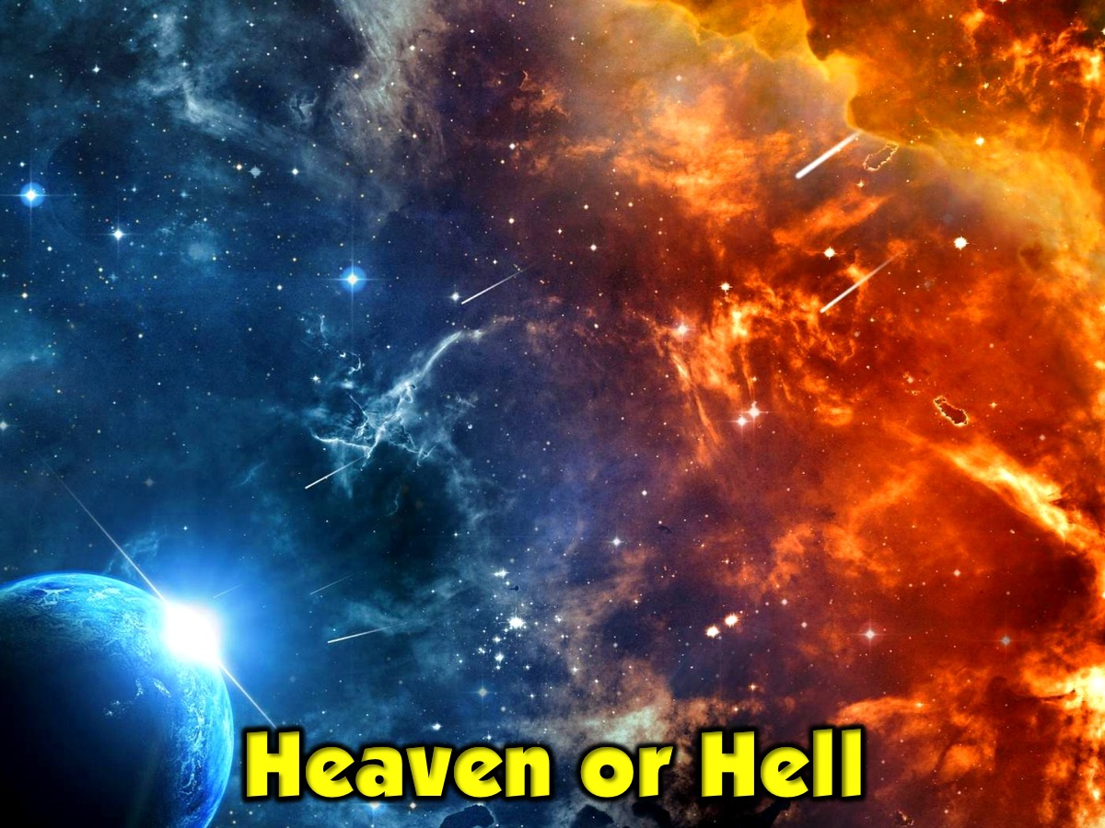
Notes:
Heaven or Hell

Slide 18
Notes:
Relating to Jesus

Slide 19
Notes:
My Heart, Christ’s Home: This is a contemplative journey based on a classic book of the same title. I recreated the experience for high schoolers in my home and had them walk through the various locations explored in the book and re-created the experience as creatively as possible.

Slide 20
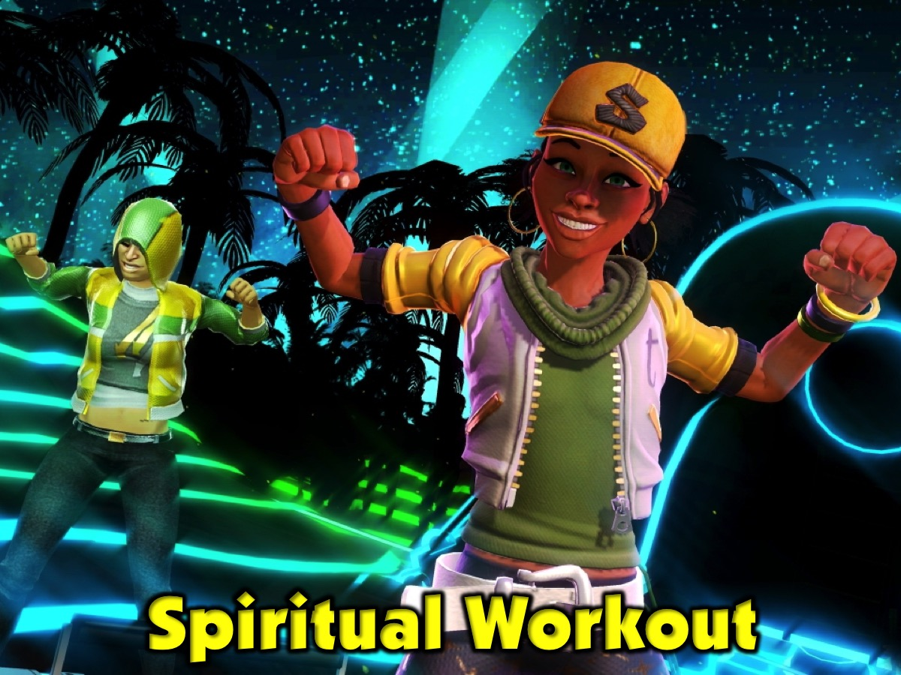
Notes:
Spiritual Workout

