Slide 1
Notes:
Spirit-filled Prayer Workshop #3: The Power Stations

Slide 2
Notes:
In our youth group during a series based on the person and work of the Holy Spirit we created an experience where high schoolers visited five power stations that we set up in the youth room – locations around the room that they visited to have someone pray for them to experience God’s power. Before youth visited the stations, we invited five youth leaders to each share a testimony about one of the stations. Here are the five stations that we created:

Slide 3
Notes:
Let’s open our meeting in prayer.

Slide 4
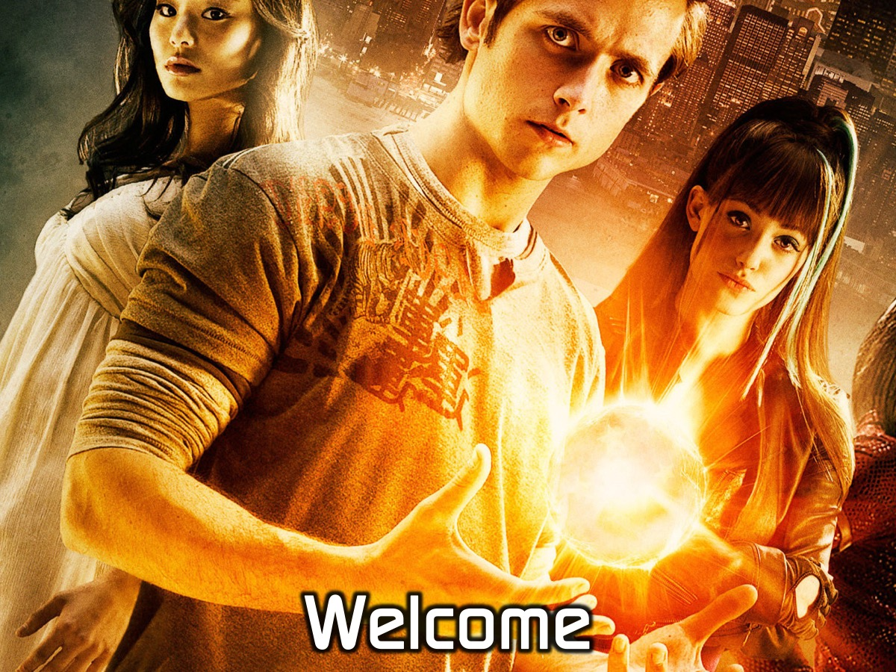
Notes:
Welcome to newcomers and regulars.

Slide 5
Notes:
Tonight is Power Night.

Slide 6
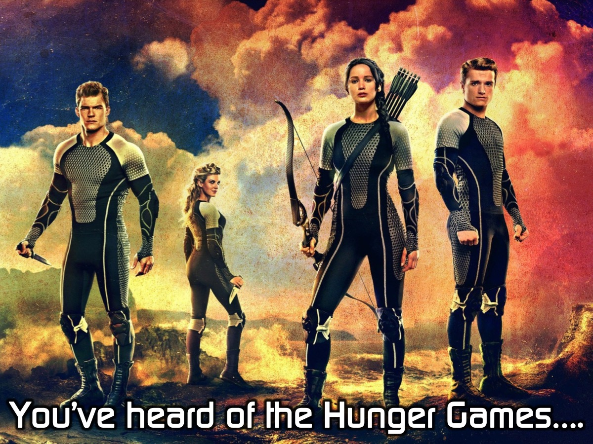
Notes:
You’ve heard of the Hunger Games…

Slide 7
Notes:
Welcome to the Power Games!

Slide 8
Notes:
First we are going to divide into 4 Teams and you need to give your team a name.

Slide 9
Notes:
1. Power Ball: Two teams battle each other at a time. Team members lines up in front of their team area and they have to score points by getting balls into one of three boxes in the middle of the room - the middle basket counts for 20 points while the two outside baskets count for 10 points. The objective is to score as many times as possible within the time limit. When a person drops a ball they have to retreat to their starting line and fetch another ball. There are 3 gladiators who will try and disrupt the teams from scoring by blocking the ball, knocking it out of peoples hands or generally just getting in the way - but they are not allowed to tackle or harm the contestants. Each round lasts for 2 minutes and then scores are counted and the next two teams play each other - with the winners going head to head in a final. Play some gladiator music while the game is going. Choose gladiators who won’t kill the contestants.

Slide 10
Notes:
2. Power Lift: Each of the four teams sends one competitor to the front. They have to hold a chair with arms extended in the air. The person who drops the chair first gets 10 points for their team, the second person out gets 20 points, third gets 30 points and the winner gets 40 points!

Slide 11
Notes:
3. Power Wrestle: Each team sends 1 contestant to compete in an arm wrestling competition. Two teams battle it out, then the next two teams and the two winners play in the final.

Slide 12
Notes:
The Winners are… Well done to our winning team they get a reward for their triumph!

Slide 13
Notes:
Tonight is all about power…

Slide 14
Notes:
Have any of your watched the TV series - The Flash? Here is the trailer for season 1:

Slide 15
Notes:
An ordinary guy gets zapped with electricity

Slide 16
Notes:
When a particle accelerator malfunctions

Slide 17
Notes:
And he experiences a radical transformation

Slide 18
Notes:
Becoming the Flash who runs at incredible speeds

Slide 19
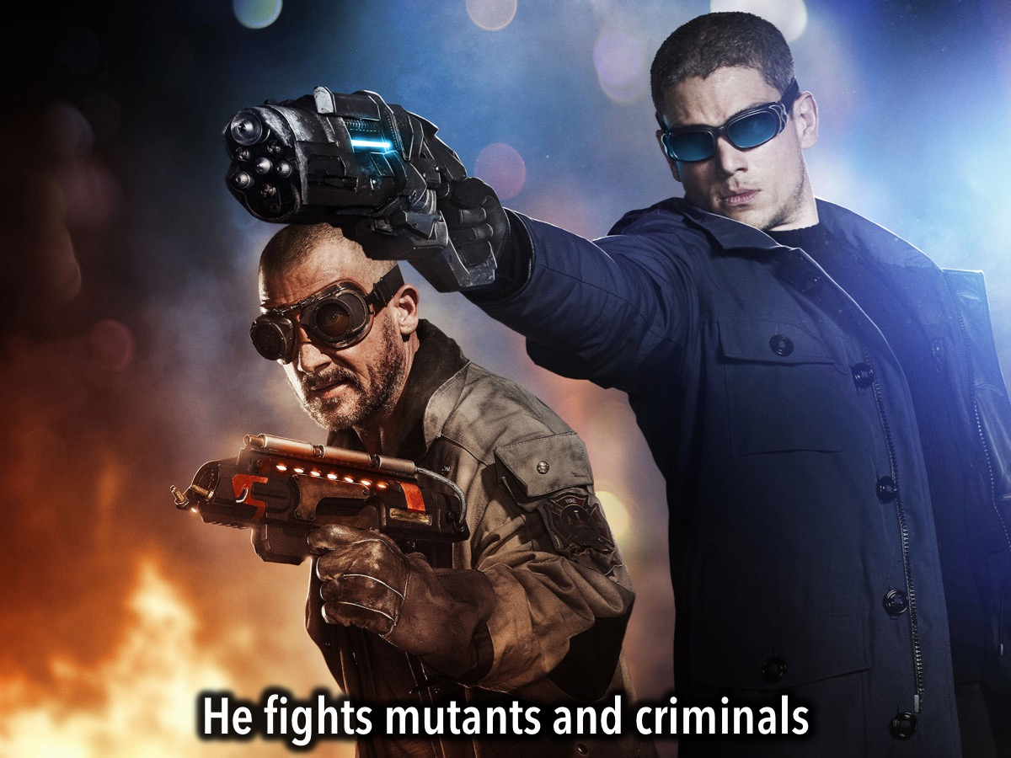
Notes:
And he fights mutants and criminals

Slide 20
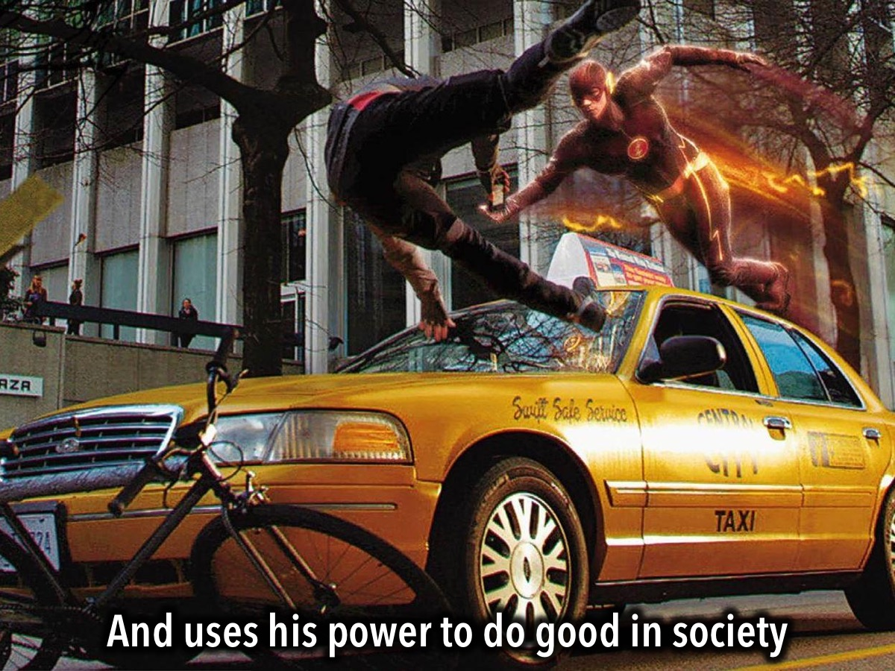
Notes:
And uses his power to do good in society

Slide 21
Notes:
You Can Experience God’s Power! Tonight we have the opportunity to experience God’s power. We have set up 5 Power Stations around the room - places you can visit and have someone pray for you to experience God in that area. The five power stations are:

Slide 22
Notes:
1. Filling. At this station someone will pray for God to fill you with his Spirit.

Slide 23
Notes:
2. Deliverance. At this station someone will pray for God to set you free from something.

Slide 24
Notes:
3. Healing. At this station someone will pray for God to heal you from something.

Slide 25
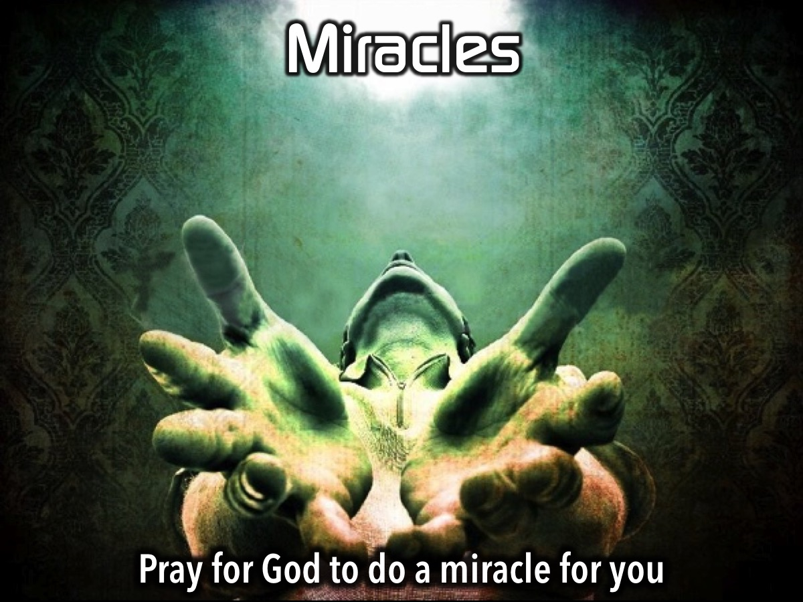
Notes:
4. Miracles. At this station someone will pray for God to do a miracle for you.

Slide 26
Notes:
5. Witnessing. At this station someone will pray for God to help you tell others about him.

Slide 27
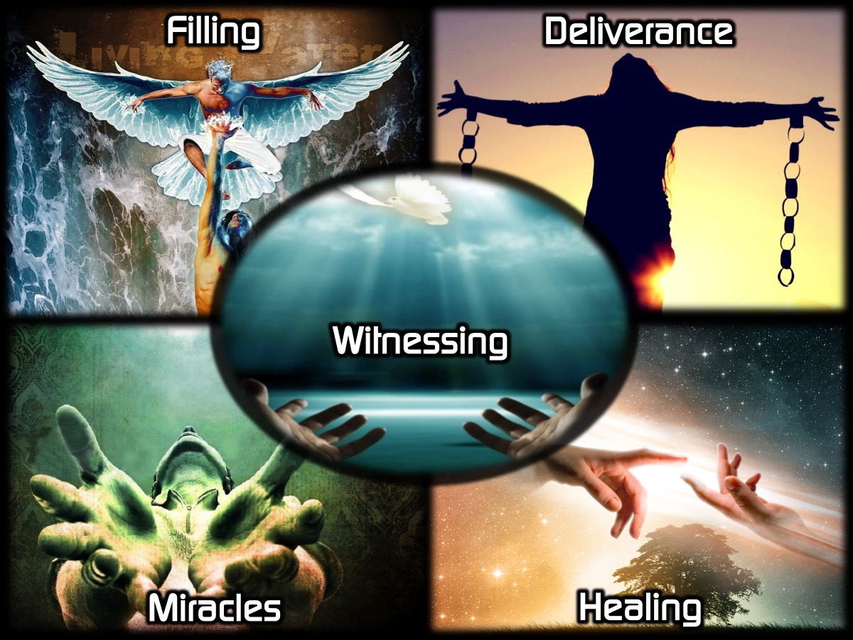
Notes:
Enjoy the Power Stations - you can visit more than one if time allows.

Slide 28
Notes:
Small Groups. Here are the questions for our small group time: (1) What did you most enjoy about the Power Games tonight? (2) How were you touched by God at the Power Stations? (3) Pray for each other to experience God’s Power in their lives!

Slide 29
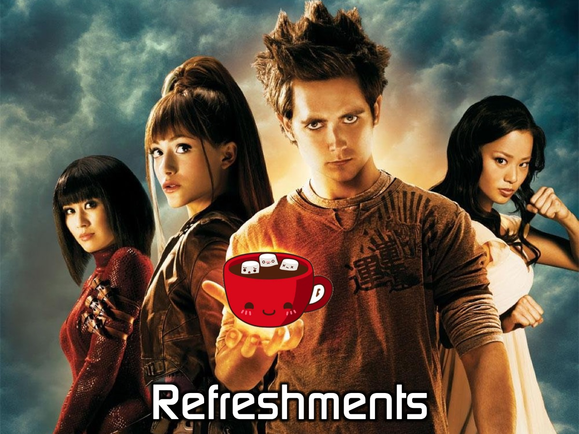
Notes:
It is time for Refreshments.

Slide 30
Notes:
You have the opportunity this afternoon to experience God’s Power at different stations where leaders from our ministry will pray for you - and maybe you will also get to pray for people. Here are the 5 Stations:

Slide 31
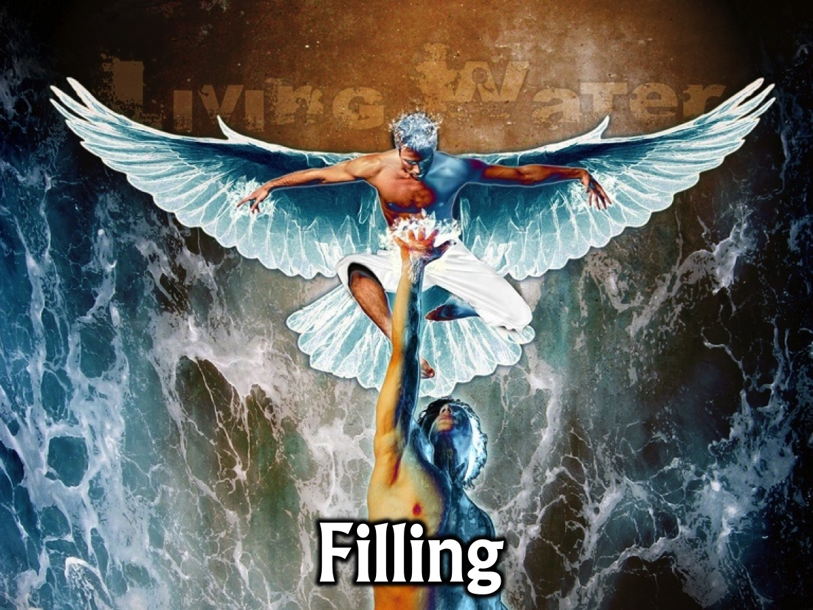
Notes:
1. Filling. At this station someone will pray for God to fill you with his Spirit.

Slide 32
Notes:
2. Deliverance. At this station someone will pray for you to be set from anything that you have struggled to break free from.

Slide 33
Notes:
3. Healing. At this station someone will pray for you to be healed of anything that is afflicting you.

Slide 34
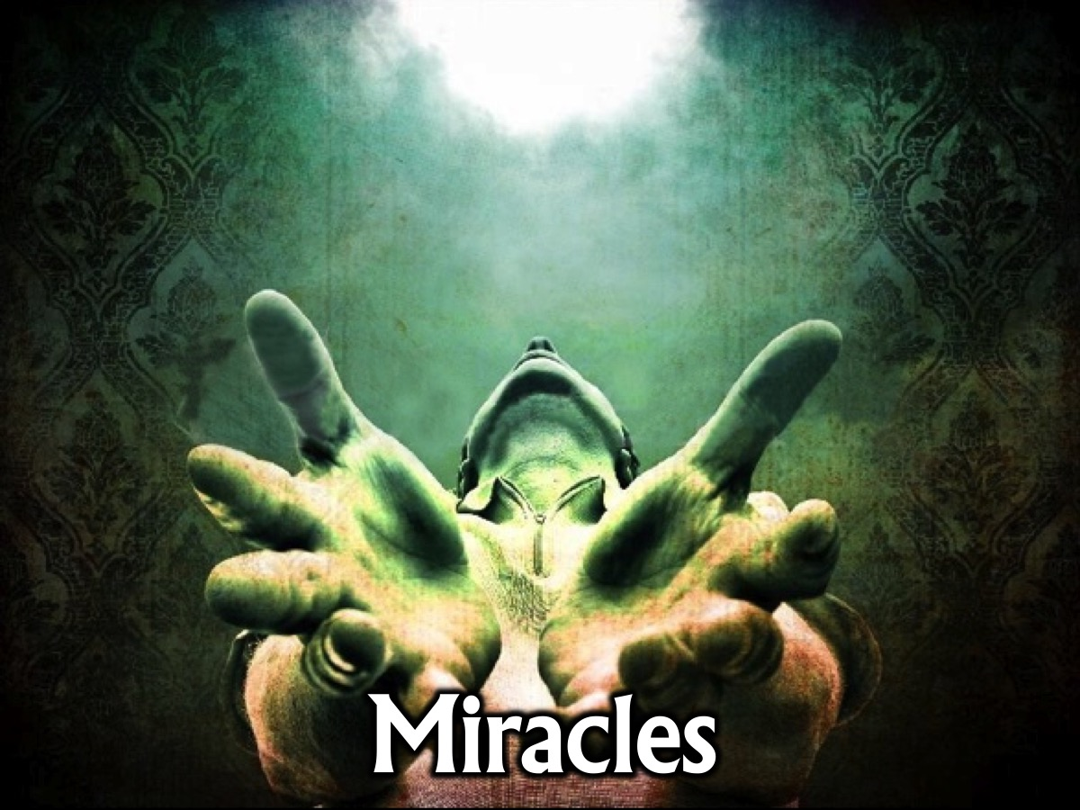
Notes:
4. Miracles. At this station someone will pray for you or someone you know to experience a miracle from God.

Slide 35
Notes:
5. Witnessing. At this station someone will pray for you to have power when you tell people about Jesus.

Slide 36
Notes:
Power Stories: Five leaders are going to come and share a testimony about each station and then you are free to visit the stations and receive prayer and/or pray for others at the stations.

Slide 37
Notes:
Station Time: You have about 20 minutes to visit any stations of your choice.

Slide 38
Notes:
Reflection:
How were you touched by God at the Power Stations?
Which station had the greatest impact on you?

Slide 39
Notes:
The Process of Deliverance
At the Deliverance station we will be using the following process to help people experience deliverance from an issue that they have been struggling with:
1. The first step to victory is to Recognise any issue that God has brought to your attention that you need to deal with.
2. The second step is Repent – where you commit to turn your back on the issue, choose to renew your mind and ask God to help you think differently about it.
3. The third step is to Renounce – which means to fall out of agreement with the issue and renounce its power over your life. If it is a curse you fall out of agreement with the curse and you renounce its power to operate in your life, you renounce its power to operate in your life. If it is sin you have been involved in, you renounce the power of that sin. You close the door on the enemy - he does not have a hold on you anymore! The enemy no longer has authority to operate in your life in the area.
4. The fourth step is Rebuke – when we rebuke the evil one, any demonic spirit that is associated with the issue has to leave – there is no shouting - it just has to go because you have taken its authority away.
5. The fifth step is Receive – now it is time to ask God to replace what has been taken away with His blessing and grace. Where there was unforgiveness and bitterness you pray to receive God’s grace to forgive; where there was a curse you receive the Lord’s blessing to replace the curse – we speak and announce the blessings of God in areas of poverty for example.
This process can be used whenever we are helping a person deal with a situation in their lives.
Here is an example of how you can lead a person through the process of deliverance:
1. Pray for the person: Pray that God will surround them with a sense of His presence.
2. Ask the person to pray out loud by repeating these words after you:
I Recognise the following issue in my life __________ (have them name the issue)
I Repent of my involvement in _________ (have them name the issue) – I turn my back on it, I change my mind about it and ask you to help me think differently in future.
I Renounce it’s power over my life – I break any agreement that I may have made allowing it to be a part of my life. I close the door to the work of the evil one in this area of my life. The devil no longer has authority to operate in that area of my life.
I Rebuke the evil one in the name of Jesus Christ – any demonic spirit that is associated with this issues has to leave because you have no authority over my life.
I Receive God’s grace and blessing in my life to replace the harm that was caused by the issue. Thank you God that you are filling me with your love and grace and mercy.

