Slide 1
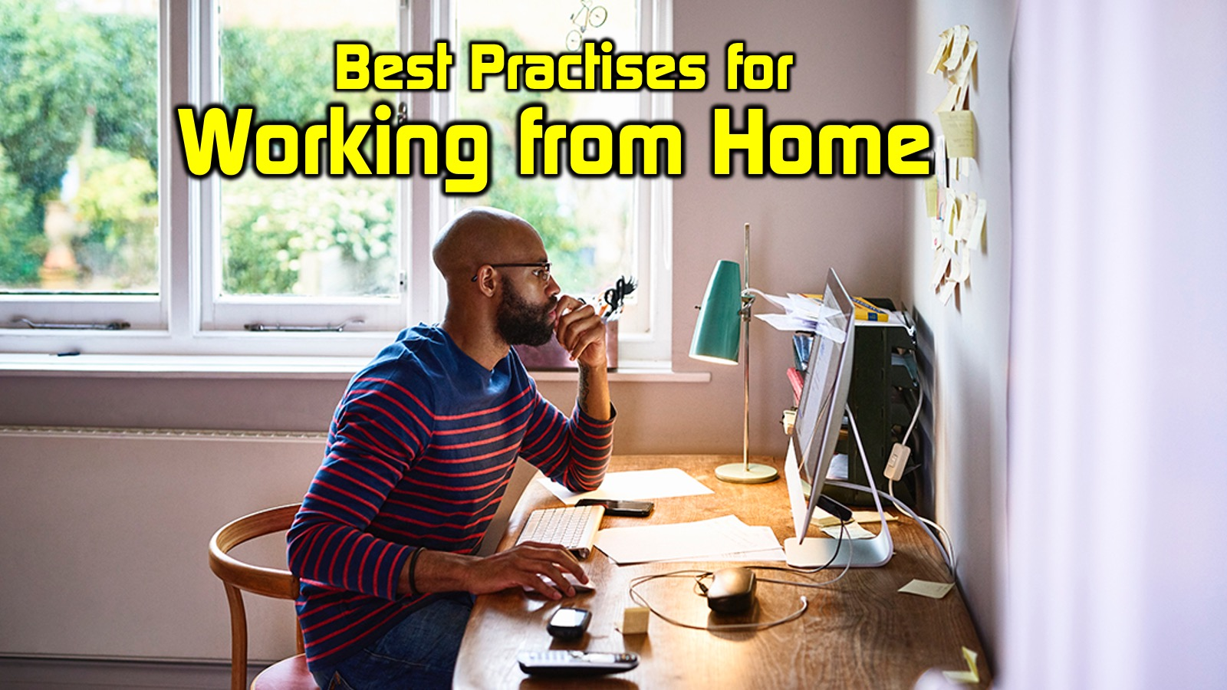
Notes:
Best Practices for Working from Home by Mark Tittley
For the past 25 years I have worked from home and, honestly, my levels of productivity have always been higher when I work from home than in an office away from home. However, for anyone new to working from home they will find that it takes a bit of adjustment to make it work for them.

Slide 2
Notes:
1. Embrace a Working-from-Home Mindset
You must adopt the mindset that you are actually working - you may even need to say to yourself: “I am not off - I am at work”. That requires doing things like dressing appropriately - which doesn't mean you have to work in a suit but dress so you feel like you are at work. Steve Murrell released a video last year in which he stressed the need to get up, shower and get dressed for work - he even suggested driving your car around the block and coming straight home to simulate going to work. Whatever you do to make it real, do something that reminds you that you are “going to work”!

Slide 3
Notes:
1. Embrace a Working-from-Home Mindset
You must adopt the mindset that you are actually working - you may even need to say to yourself: “I am not off - I am at work”. That requires doing things like dressing appropriately - which doesn't mean you have to work in a suit but dress so you feel like you are at work. Steve Murrell released a video last year in which he stressed the need to get up, shower and get dressed for work - he even suggested driving your car around the block and coming straight home to simulate going to work. Whatever you do to make it real, do something that reminds you that you are “going to work”!

Slide 4
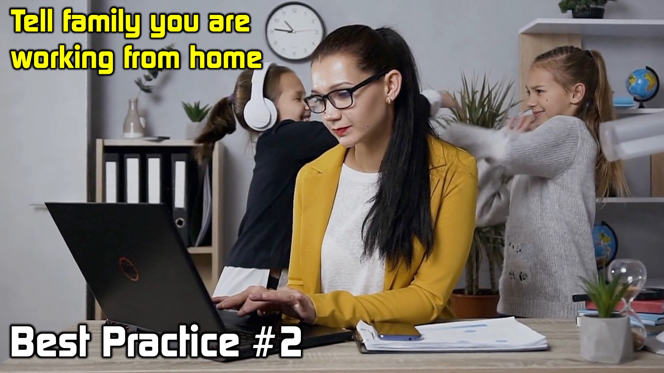
Notes:
2. Tell Family You Are Working From Home
You need to communicate to people in your home that you're actually working or they will think you are off. Let them know that even though you are home you are working from home and that interruptions should be kept to a minimum - especially at certain times when you are doing deep work. If can be really difficult for your family to adapt to the new reality. I have learned along the way to be really gracious with how I let family know that I am working and have learnt to remind them that I am working and not get snappy when interruptions happen. Be sure to discern when an interruption is something that you need to respond to urgently and be there for your family just like you would be if you are at work and need to respond to a crisis that happens at home.

Slide 5
Notes:
3. Set Boundaries To Your Work Day
Set boundaries around the time that you are actually working at home - you can't end up working 24 hours a day because your office has moved to your home. It is a little easier to set limits in an office environment because you go to the office and then you at the end of the day you shut the door and you go home. A lot of the work that we do in the modern world goes beyond the formal work place - social media, instant messaging and email mean you can end up working non-stop. It is really important to set boundaries by letting people know the hours that you are working. And it doesn't have to just be eight to five. You should select two thirds of the day to work: either morning and afternoon, or morning and night, or afternoon and evening but try and not work more than two thirds of your day. This will allow you to be able to say to family: “From “this time to this time” I'm not working, so we can do something together!” Obviously, if something really urgent comes up you may need to break the two-thirds work day rule but make sure the exception does not become the rule by making up for the time that you have “stolen” from your family as soon as possible. And please don't avoid planning because there could be interruptions. Don’t let the chance of the unexpected happening stop you from being purposeful and productive in your life.

Slide 6
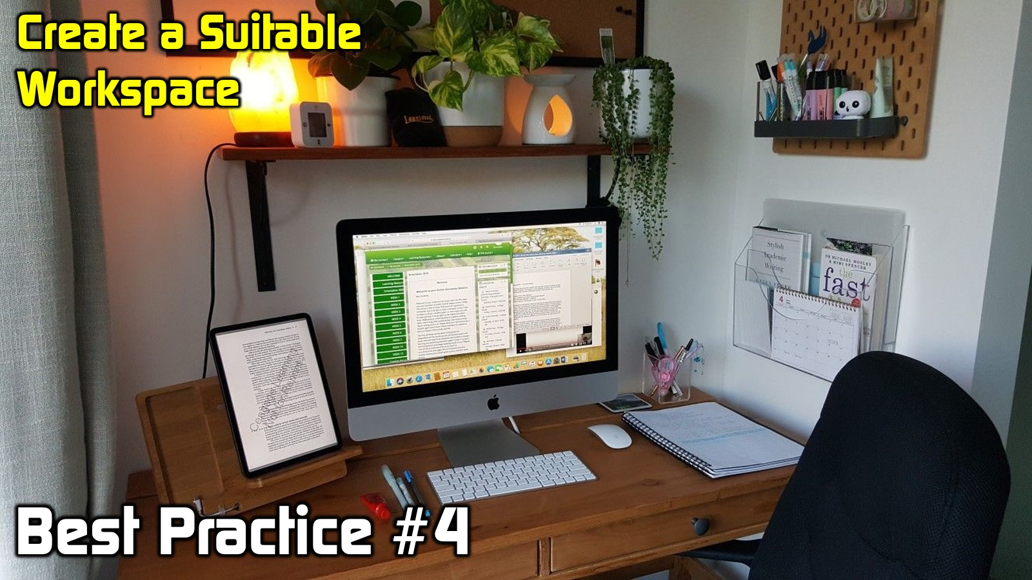
Notes:
4. Create a Suitable Workspace
Choose a place to work in your home that has access to everything you need to get your job done. This involves some practical things like a workspace (whatever works for you as we are all different) and the tools you need to get your job done. You don’t need a huge area or a dedicated room but get it setup so you feel like it is your workspace. You also need to ensure you have decent Wi-Fi access. I invest a significant amount of money each to ensure that our home has the fastest uncapped internet connection that we can afford. For us that is a 100Mbps Fiber line. This enables me and others in the home to do all that we need to do without being limited by connectivity.

Slide 7
Notes:
5. Limit Distractions in Your Environment
You can’t always control your work environment perfectly - there will be interruptions that arise. You neighbour may start to cut down trees or mow the lawn and you will need to focus - despite the distractions. You may need to put your headphones on and play music that helps you focus and avoid distractions in your environment. If your phone is a distraction then be sure to set it to silent or even consider moving it out of the workspace at times.

Slide 8
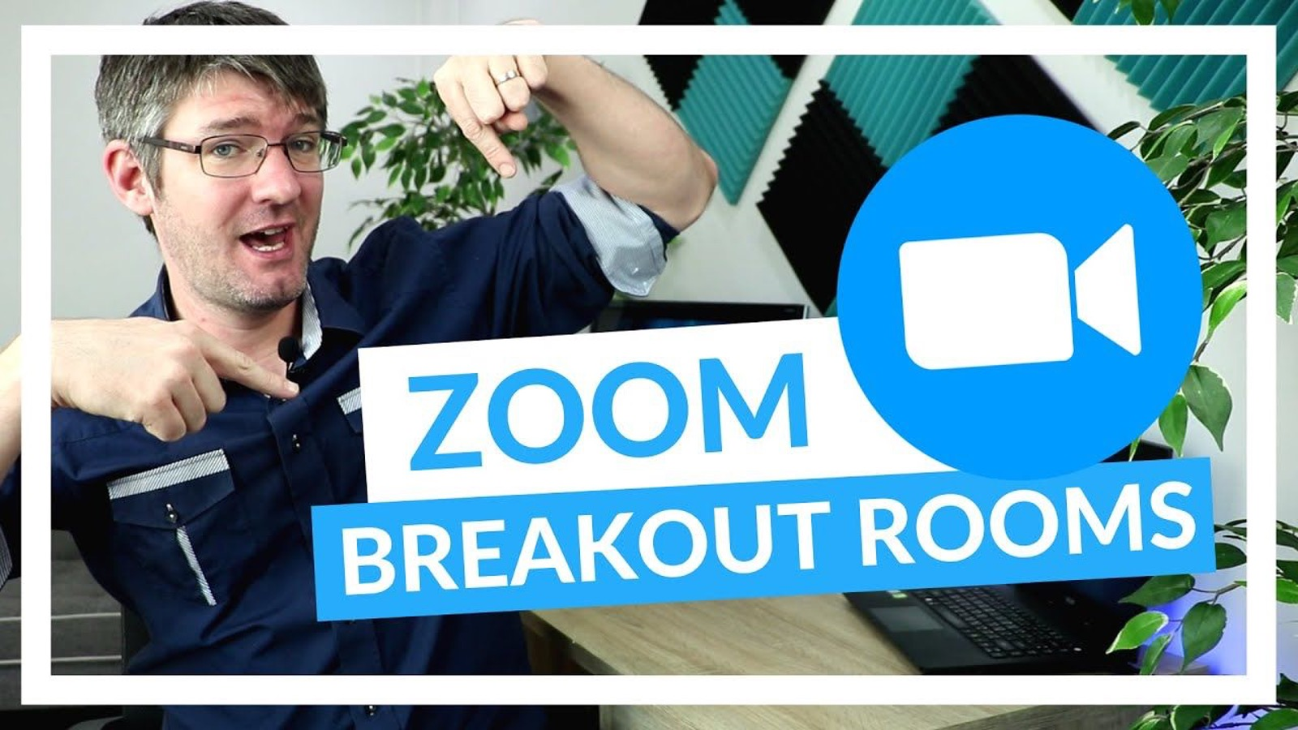
Notes:
We are going to spend 5 minutes in breakout rooms in groups of 3 to reflect on which best practice you are doing well in and which best practice you need to improve in.
Which of the five practices are you doing well in and which do you need to improve?
1. Embrace a Working-from-Home Mindset
2. Tell Family You Are Working From Home
3. Set Boundaries To Your Work Day
4. Create a Suitable Workspace
5. Limit Distractions in Your Environment

Slide 9
Notes:
6. Plan Your Day in Advance
No matter where you are working, it is essential for you to know in advance what you are going to do during the day. I have tools in my Productivity Planner that I've created that force me to pre-determine the following things about my workday:
(1) FOCUS for the day (what I am choosing to focus on during the day or a guiding thought);
(2) PRIORITIES for the day (the top 3 areas of my life that need my attention during the day);
(3) PROJECTS for the day (the top 3 things to do that will take multiple actions to complete);
(4) TASKS for the day (the top 3 things that I absolutely must get done during the day);
(5) HABITS for the day (the top 3 habits that I must track during the day); and
(6) PEOPLE to connect with (the 3 people I need to connect with during the day).
The next step in my planning is to fill out my calendar for the next day which for me has a 5am start with daily devotions, then 30 minutes learning something with my wife; then completing my Planner before starting my morning Habit Stack (my book: The Productive Life - has more information about creating habit stacks). At around 8am it is time to work on my most important tasks (MITs), which would take me to lunch when I complete my lunch habit stack before continuing with the work I have planned for the afternoon. If the evening is free, then a supper habit stack is followed by a walk with my wife, and some restful activity for the evening before completing my night habit stack (which includes reflecting on my day using my Planner and praying before going to bed).

Slide 10
Notes:
6. Plan Your Day in Advance
No matter where you are working, it is essential for you to know in advance what you are going to do during the day. I have tools in my Productivity Planner that I've created that force me to pre-determine the following things about my workday:
(1) FOCUS for the day (what I am choosing to focus on during the day or a guiding thought);
(2) PRIORITIES for the day (the top 3 areas of my life that need my attention during the day);
(3) PROJECTS for the day (the top 3 things to do that will take multiple actions to complete);
(4) TASKS for the day (the top 3 things that I absolutely must get done during the day);
(5) HABITS for the day (the top 3 habits that I must track during the day); and
(6) PEOPLE to connect with (the 3 people I need to connect with during the day).
The next step in my planning is to fill out my calendar for the next day which for me has a 5am start with daily devotions, then 30 minutes learning something with my wife; then completing my Planner before starting my morning Habit Stack (my book: The Productive Life - has more information about creating habit stacks). At around 8am it is time to work on my most important tasks (MITs), which would take me to lunch when I complete my lunch habit stack before continuing with the work I have planned for the afternoon. If the evening is free, then a supper habit stack is followed by a walk with my wife, and some restful activity for the evening before completing my night habit stack (which includes reflecting on my day using my Planner and praying before going to bed).

Slide 11
Notes:
7. Be Flexible With Your Schedule
It may sound like I am rigid and inflexible during my work day but that is not the case. Despite my thorough planning I am able to be flexible (in fact, because I plan, I am able to be flexible). No one is hindering me from shifting things around in my schedule. I am focused on what I have pre-planned to do, but if something that is truly urgent and important comes up I will adjust my schedule accordingly. It helps to know what must be done during the day so that I know what can be safely reschedule to the following day.

Slide 12
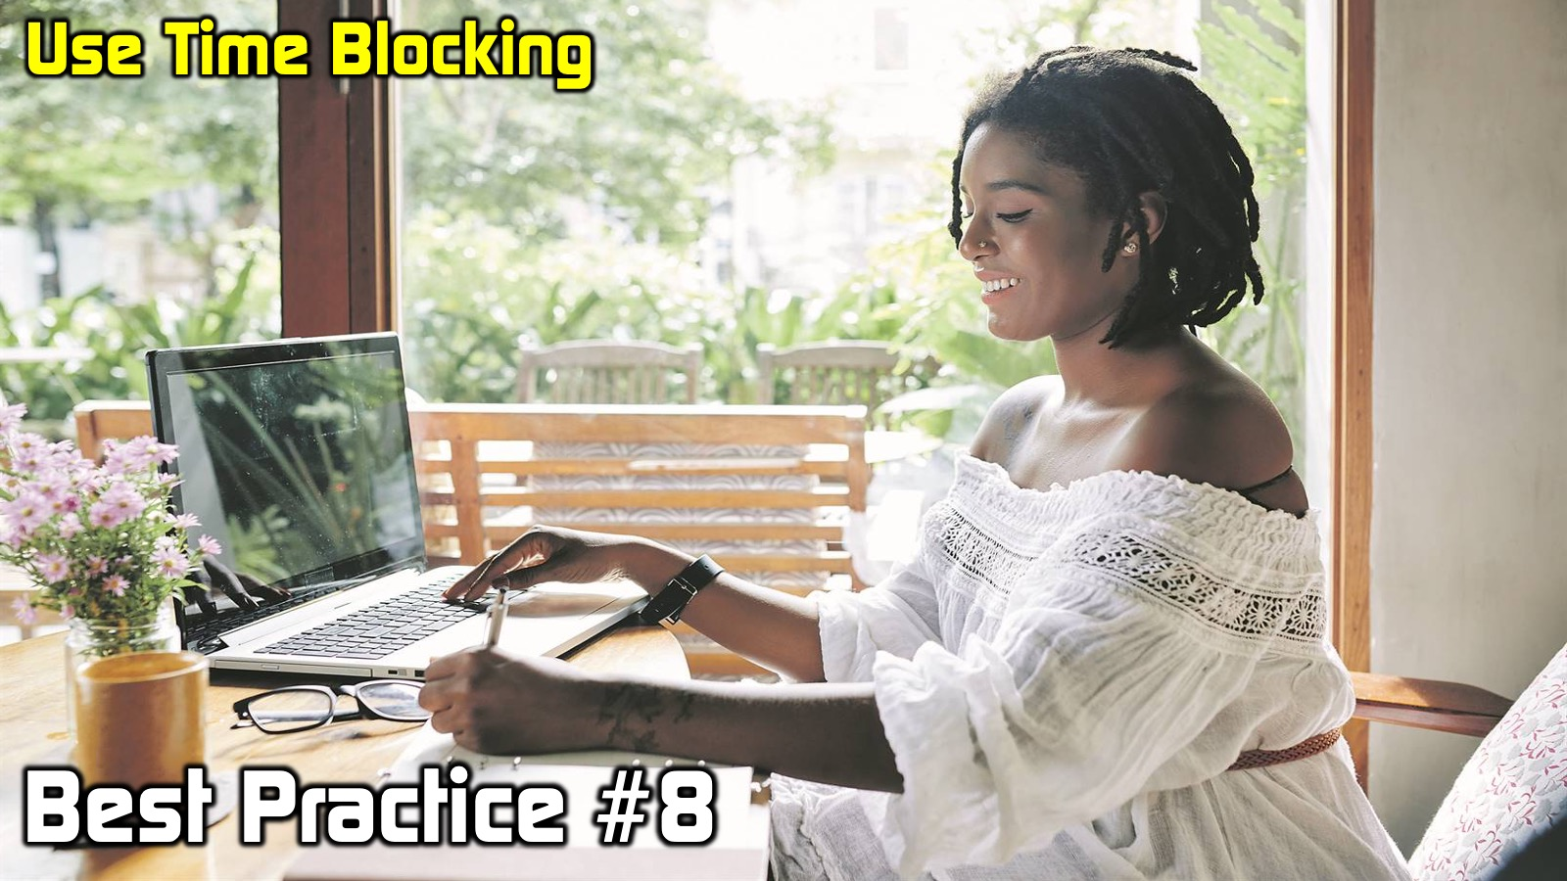
Notes:
8. Use Time Blocking
Time blocking is really helpful. It is a practice where you group tasks that need to get done into blocks of time and then you schedule time in your calendar to work on them - blocking out all other distractions as far as possible. It is best to focus on similar tasks in a time block because it takes time to get going with a task and you lose time and productivity when you switch between different tasks. Apparently, it can take ten to fifteen minutes to get back into what you were doing after just one brief interruption. You should be ruthless with which apps are allowed to show notifications and you should avoid checking your apps every few minutes to see if there is something that needs your attention. Time blocking email and social media is a key to productivity!

Slide 13
Notes:
9. Find Your Ideal Work Times
Do different things at different times of the day. You need to do your best work when you work best. For many that is the morning, but for you it may be during the afternoon or evening. I’ve found that I am most productive and do the best work during the first four hours of my work day. This is where I do “deep work” which is where I can get in the flow and really turn out some of my best thinking and work. This requires undistracted time, and if necessary, you should put a sign on the door that says, “Caution! Deep work in progress!” (Or something like that). In the afternoon I do lighter work - things like filing or doing tasks that require great lower levels of energy or focus.

Slide 14
Notes:
10. Take Breaks During the Day
Another principle of working from home, is to take regular breaks. Make sure that you don't get into the habit of working endlessly. In a face to face workplace you get to interact with other people when you go to the coffee station or to the water cooler or when you deliver something you have created or fetch something you need from someone. When you work from home you need to artificially manufacture social connections. It will help if you have someone to bounce things off at home. When you take a break, you could engage with people online or even call someone to connect. I would recommend that every hour you do something different for at least 10 minutes, like taking a walk outside (sunshine is very important to our health and mindset) or completing a small physical chore around the home. Just make sure you don’t wake up an hour later and realise that you forgot that you were at “work”.

Slide 15
Notes:
We are going to spend 5 minutes in breakout rooms in groups of 3 to reflect on which best practice you are doing well in and which you need to improve.
Which of the five practices are you doing well in and which do you need to improve?
6. Plan Your Day in Advance
7. Be Flexible With Your Schedule
8. Use Time Blocking
9. Find Your Ideal Work Times
10. Take Breaks During the Day

Slide 16
Notes:
Here are my top 10 best practises for working from home:
1. Embrace a Working-from-Home Mindset
2. Tell Family You Are Working From Home
3. Set Boundaries To Your Work Day
4. Create a Suitable Workspace
5. Limit Distractions in Your Environment
6. Plan Your Day in Advance
7. Be Flexible With Your Schedule
8. Use Time Blocking
9. Find Your Ideal Work Times
10. Take Breaks During the Day

Slide 17
Notes:
Working from home is an opportunity to work in an environment in which, with discipline and creativity, you can get a lot done and in the face of a global pandemic it is obviously the safest way to work, provided of course that you practise stringent health protocols along the way.

