Slide 1
Notes:
10 Secrets to Managing Your Time
By Mark Tittley
In this session we are going to explore 10 Secrets to Managing Your Time. Over the past 3 decades I have often found myself asked to help people to get better at time management and along the way I have discovered 10 secrets to managing your time. We can’t change how many hours and minutes we have in our day, but we can manage how we use the time we are given!

Slide 2
Notes:
During our time together we will explore 5 secrets and then spend time in breakout rooms to reflect on what we are learning. Then we will explore the next 5 secrets and jump into Breakout Rooms once again. So let’s start with Secret #1:

Slide 3
Notes:
1. Balance Your Whole Life: Make sure your productivity system covers the whole of your life and not just your work. Your personal life, your family, your work and your hobbies are all important and need to be kept in balance. Make sure all these areas are reflected in your week.

Slide 4
Notes:
There are four steps to balance your life:
(1) Define Your Mission
(2) Identify Your Roles
(3) Create Your Goals
(4) Plan Your Week

Slide 5
Notes:
Step #1: Define Your Mission
The first step to balancing your life is to define your mission. It is critical that you figure out what you want to achieve with your life.

Slide 6
Notes:
A well written mission statement has four parts to it: a lifetime noun, verbs of impact, people groups to impact and the rest of your impact.

Slide 7
Notes:
Here is an example of my mission statement: My mission is to be a Christ-follower who equips family, friends and next generation leaders to be disciplemakers. Notice how it covers all of my life and the diverse groups of people I want to impact and also speaks of an ongoing end result. This is a significant step towards me living a balanced life!

Slide 8
Notes:
Step #2: Identify Your Roles. Roles are the contexts in which you live out your mission.
The second step to balancing your life is to identify your roles. Your mission must be lived through your whole life and one way to ensure that happens is to identify the roles you play in life. These are the contexts in which you live out your mission.

Slide 9
Notes:
There are 3 steps to identifying your roles:
1. List all the roles you play in life: Brainstorm all the possible roles you play in life. Think of every “hat” you wear, every different way in which you show up in life. Keep going until you have identified at least 10 to 15 roles.
2. Group the roles into categories: You may be feeling a little overwhelmed with that long list of roles but don’t give up just yet because the next two steps will help you as to group related roles and reduce them to categories.
3. Select five or six roles to work with: If you choose more than six roles you will struggle to actually lead and balance your life.

Slide 10
Notes:
Step #3: Create Your Goals. Goals are a key to helping you achieve your mission.

Slide 11
Notes:
Now that you have defined the roles you play in life you need to create goals for each role. You could use the SMART goal approach where you ensure that your goals are Specific, Measurable, Attainable, Realistic and Timely. You can create goals by asking yourself: “What is the most important thing I could do this week to have the greatest positive impact on this role.” While many goals may come to mind, you should limit yourself to just a few important goals for each role.

Slide 12
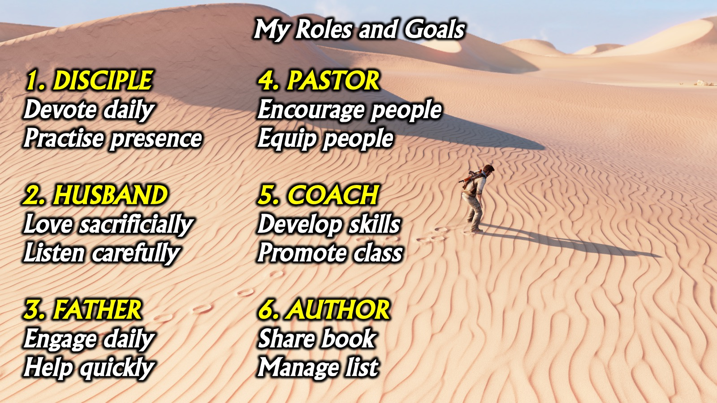
Notes:
Here is an example of my Roles and Goals: (1) DISCIPLE: Devote daily. Practise presence. (2) HUSBAND: Love sacrificially, Listen carefully. (3) FATHER: Engage daily, Help quickly. (4) PASTOR: Encourage people, Equip people. (5) COACH: Develop skills, Promote class. (6) AUTHOR: Share book, Manage list.

Slide 13
Notes:
Step #4: Plan Your Week
The fourth step to balancing your life is to plan your week. So far to help you balance your life, you have defined your mission, identified your roles and created goals for each role. The next step is to actually live your mission during your week.

Slide 14
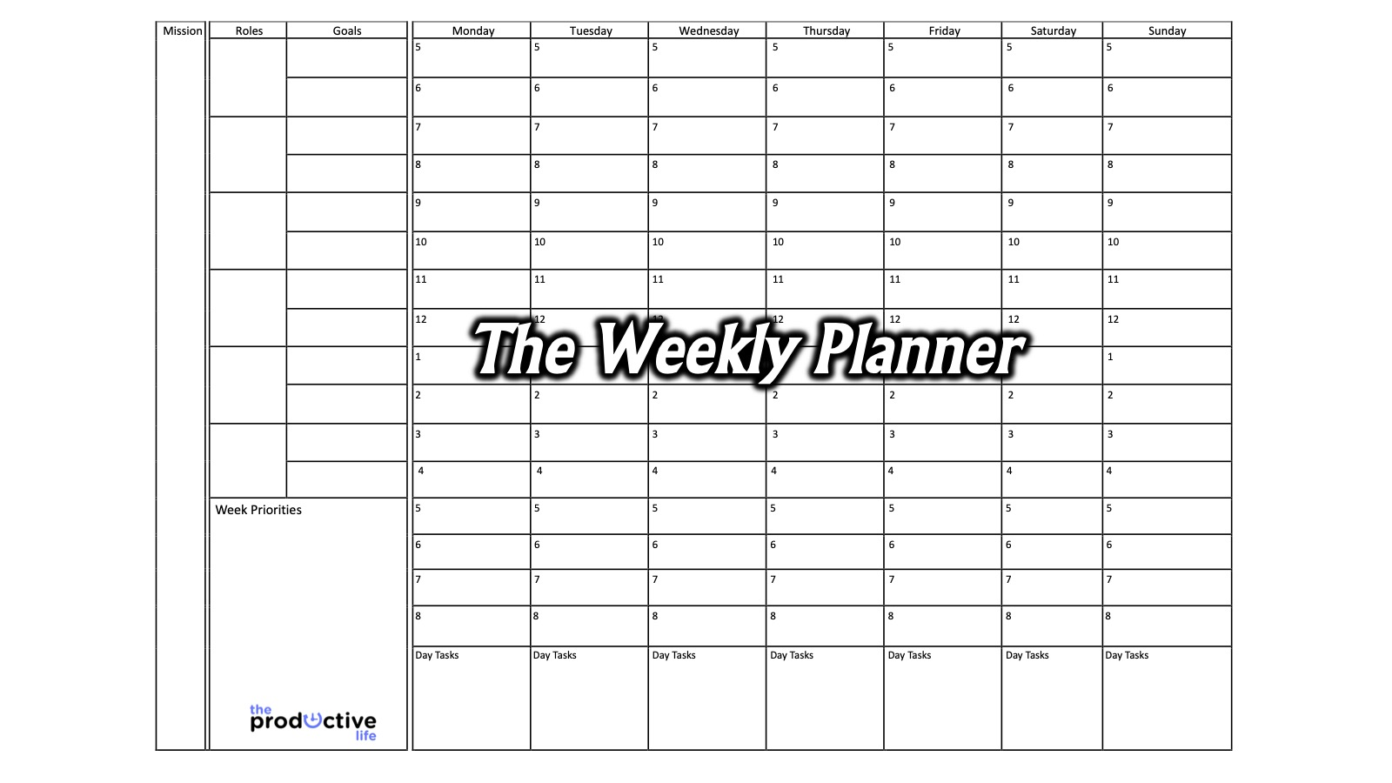
Notes:
The Weekly Planner: Stephen Covey in First Things First explored the idea of a weekly planner.

Slide 15
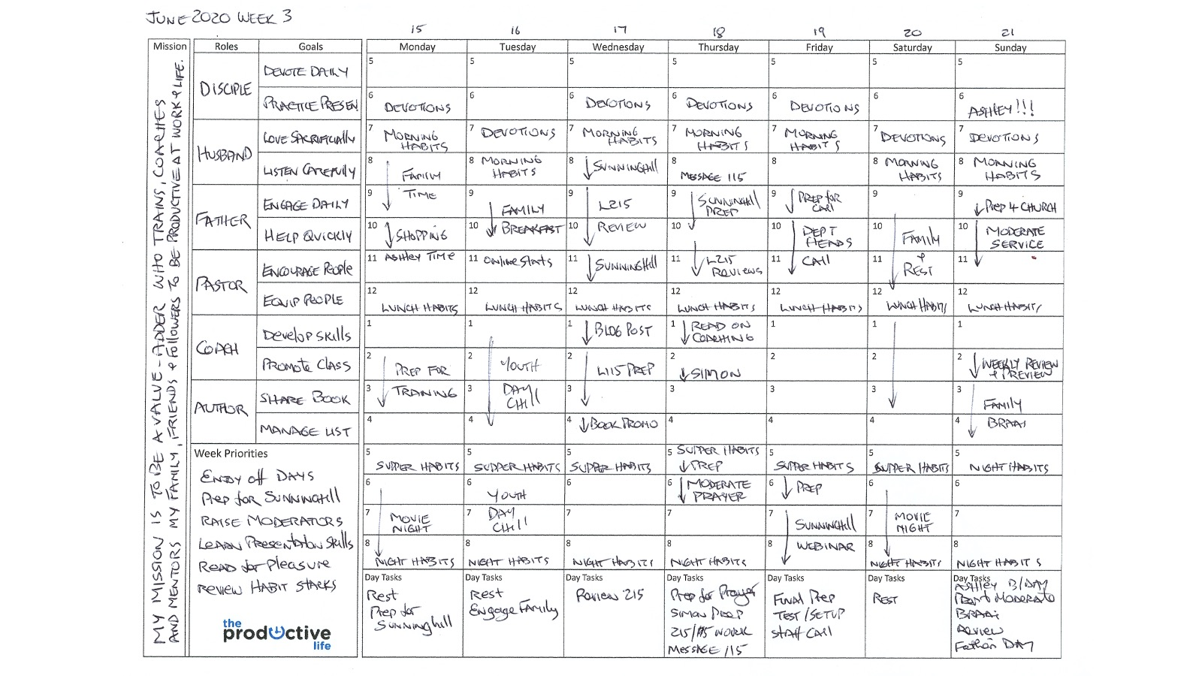
Notes:
Here is an example of a completed weekly planner - this is a lockdown version and is orientated around my rallying cry for this season which is to add value to people!

Slide 16
Notes:
Review: We have explored four steps to Balance Your Life: (1) Define your Mission; (2) Identify your Roles; (3) Create your Goals and (4) Plan your Week.

Slide 17
Notes:
That was the first secret to managing your time – here comes number 2…

Slide 18
Notes:
2. Get Organised: Develop a filing system and keep your working or living spaces tidy.

Slide 19
Notes:
Here are some best practices for filing: (1) Create Your System: It should work for you and allow you to retrieve a document in the quickest amount of time possible. (2) Identify Your Categories: List the categories you could file items under and create a folder or hanging file for each item. (3) Clear Your Backlog: Work though everything on your desk or shelves by picking it up and asking: (a) What is it? (b) Do I need to act on it? (c) Can I file it? (4) Manage Your Filing: Set aside time regularly to file material so you don’t end up with a huge pile of items to file.

Slide 20
Notes:
3. Schedule Think Time in Your Week: Create a weekly appointment with yourself in your calendar where you can think about what is going on in your life, plan ahead and get on top of your workload.

Slide 21
Notes:
4. Work Two Thirds of the Day: Work morning and afternoon or morning and evening or afternoon and evening but don’t work all three parts of the day. There can be exceptions to this rule but don’t let it become a regular habit or other areas of your life will suffer!

Slide 22
Notes:
5. Take Time to Give Time: Don’t accept invitations or requests for your time too quickly. Think about the amount of preparation time you will need to invest if you accept an invitation. Ask the person to give you some time to respond to their request.

Slide 23
Notes:
Breakout Rooms: We are going to spend 5 minutes in Zoom Breakout Rooms in groups of 3 to reflect on the five secrets to managing your time that we just explored – you will mention one area where you are doing well and one area where you need to improve.
Which of the five secrets are you doing well in and which do you need to improve?
1. Balance Your Whole Life.
2. Get Organised.
3. Schedule Think Time in Your Week.
4. Work Two Thirds of the Day.
5. Take Time to Give Time.

Slide 24
Notes:
6. Work with Check Lists: Keep a list of everything you need to get done and cross off tasks when you complete them. We will explore best practices for this area in the next chapter.

Slide 25
Notes:
7. Handle Things Once: Don’t pick up stuff and then put it aside for later - deal with it once! This applies to handling digital material too. David Allen speaks about the 2 Minute Rule where if you can get something done in less than 2 minutes you do it rather than schedule it for later action.

Slide 26
Notes:
8. Keep Information Handy: Develop a good system to keep track of phone numbers, addresses, key information, etc. Reduce the amount of time you spend looking for stuff by getting organised and staying organised.

Slide 27
Notes:
9. Confirm Meetings: Before you leave for a meeting check that the person you are supposed to be meeting is still available to meet. This will often save you from wasting time if they are not available. I am seldom left waiting because I check in to confirm appointments an hour before a meeting and reschedule the appointment if necessary.

Slide 28
Notes:
10. Empower People and Delegate : Don’t do everything yourself – give things to others to do. I heard Andy Stanley in a Podcast say: “Only do what only you can do!”

Slide 29
Notes:
Breakout Rooms: We are going to spend 5 minutes in Zoom Breakout Rooms in groups of 3 to reflect on the five secrets to managing your time that we just explored – you will mention one area where you are doing well and one area where you need to improve.
Question: Which of the five secrets are you doing well in and which do you need to improve?
6. Work with Check Lists.
7. Handle Things Once.
8. Keep Information Handy.
9. Confirm Meetings.
10. Empower People and Delegate.

Slide 30
Notes:
In the notes I have created for this session, I have added 3 bonus secrets for you to check out:
(1) Always Have Something to Do
(2) Automate Regular Tasks
(3) Deal with Interruptions

Slide 31
Notes:
So this is my book…If you want to go deeper into how to live a productive life then grab of copy of my book on Amazing: http://bit.ly/TPL_BOOK

Slide 32
Notes:
In the book I explore 7 keys to living a productive life.

Slide 33
Notes:
That was 10 Secrets to Managing Your Time!

