Slide 1
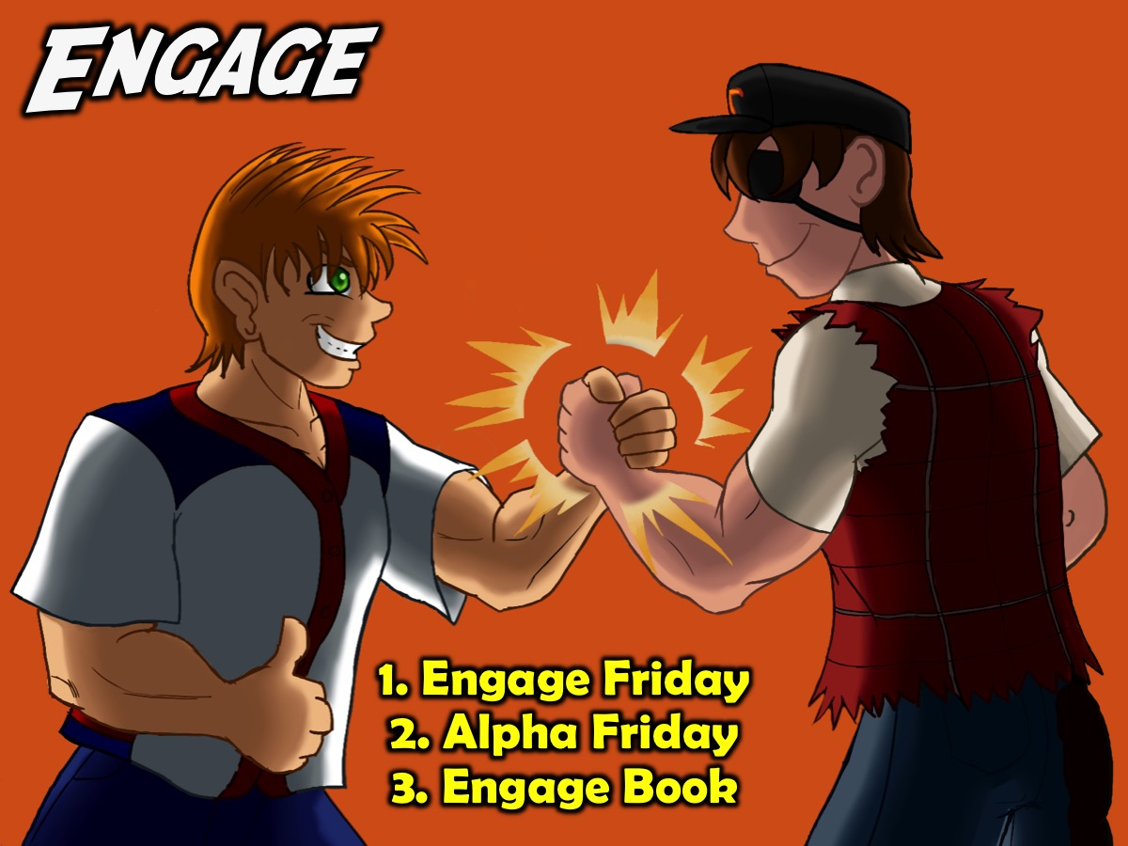
Notes:
A. ENGAGE: The first phase in our disciplemaking strategy is to Engage teens by connecting with them and bringing them to faith in Christ. We have three interventions for this phase of our disciplemaking strategy: (1) Engage Friday. (2) Alpha Friday. (3) Engage Book.

Slide 2
Notes:
(1) Engage Friday. Our Friday night weekly ministry focuses primarily on this phase and is an opportunity for believers to bring teens that they are building relationships with into an event in which they can engage with others believers and with God. Here are some of the key components of our Engage event that takes place on a Friday night: Setup, Prayer. Hang Time, Welcome, Announcements, Main Event, Small Groups and Refreshments.

Slide 3
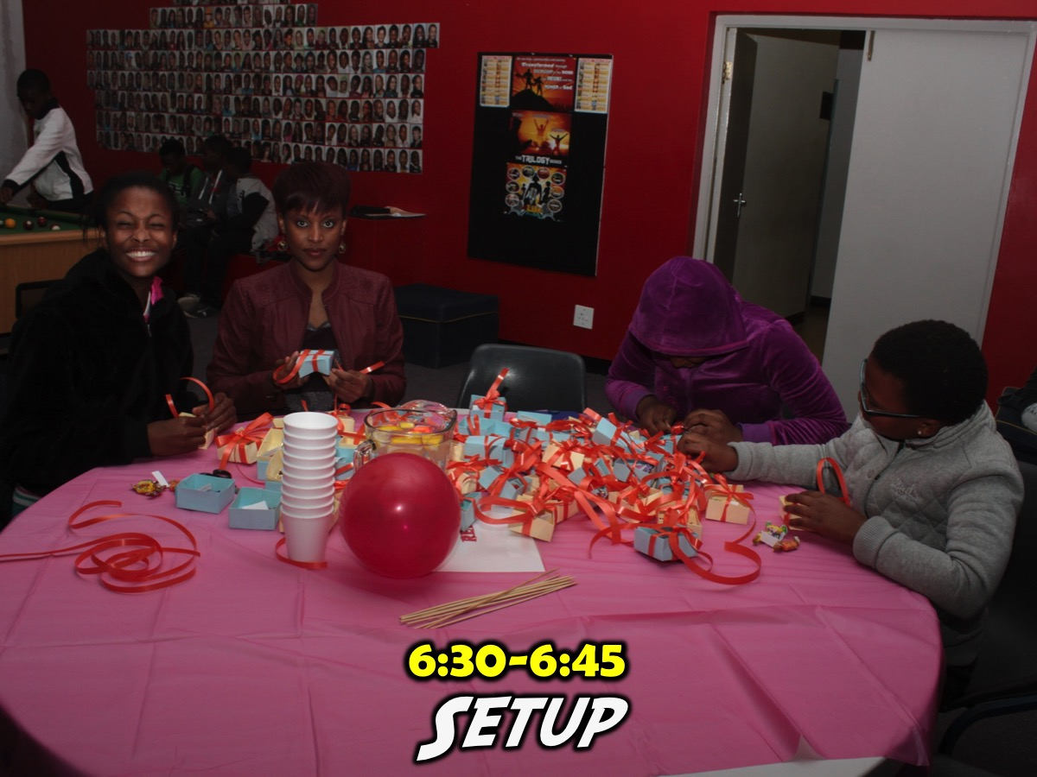
Notes:
6:30-6:45 Setup. Those responsible for the night meet to walk through the night - set up any decor and get all the materials for the night ready. Those presenting the night are walked through the PowerPoint presentation that drives the event.

Slide 4
Notes:
6:45-7:15 Prayer. Our leaders gather for a briefing about the event and what is required from them and we spend time praying that God will move in the lives of the teens.

Slide 5
Notes:
7:15-7:40 Chill. This is our hang time where teens play games like Pool, Table Tennis, Foosball and Darts or just chill. The teen and adult leaders are encouraged to spend this time connecting with teens.

Slide 6
Notes:
7:40-7:45 Welcome. We welcome teens to the night and ask any newcomers to come forward to be introduced. We ask them their name, what school they are from and sometimes a silly question like the colour of their toothbrush or something like that.

Slide 7
Notes:
7:45-7:50 Announcements. This is a key part of the night as it connects newcomers and regulars into our wider ministry. We advertise our Sunday morning topic and the theme for next Friday night.

Slide 8
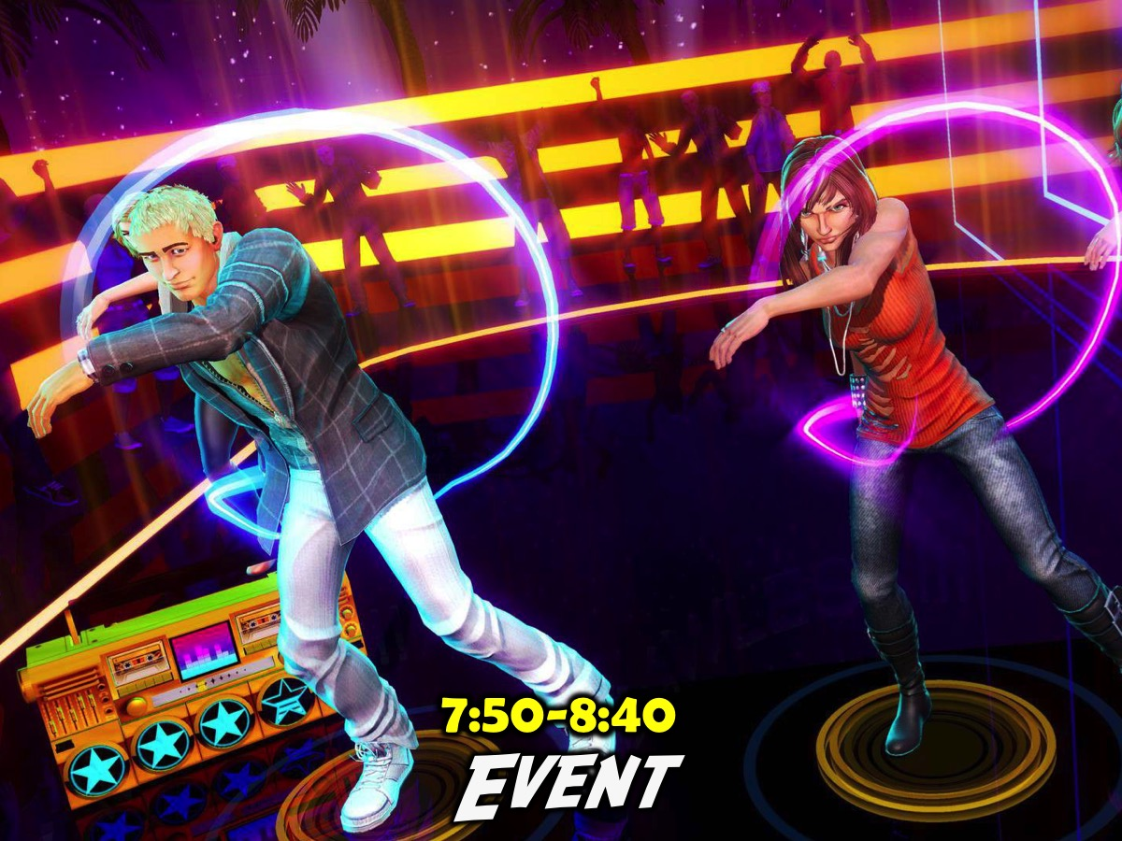
Notes:
7:50-8:40 Event. Next we introduce the theme for the night, often with a video clip, and then we launch into the event. The theme for the term and the night will determine what happens during this time.

Slide 9
Notes:
8:40-9:10 Small Groups. Teens move into small groups and newcomers are assigned to a group. Our small group leaders get the questions on Wednesday night so they can prepare for this time. We currently use 4 to 5 small group question - the first one links to the event they just experienced and the rest take it deeper into spiritual matters. The time ends with prayer in line with what they discussed.

Slide 10
Notes:
9:10-9:15 Refreshments. We serve juice and biscuits in summer and Hot Chocolate and biscuits in winter.

Slide 11
Notes:
9:15-9:30 Hang Time. We allow more time for the teens to hang out or play games in the room but we end promptly at 9:30 so parents are not kept waiting in the parking lot.

Slide 12
Notes:
9:30-9:45 Departure. We spend some time in the parking lot engaging with parents, making sure everyone has a lift home and also have adult leaders drop teens off which is a great way to engage with teens.

Slide 13
Notes:
Here is an example of a Friday night event…

Slide 14
Notes:
It was a Dodge Ball night.

Slide 15
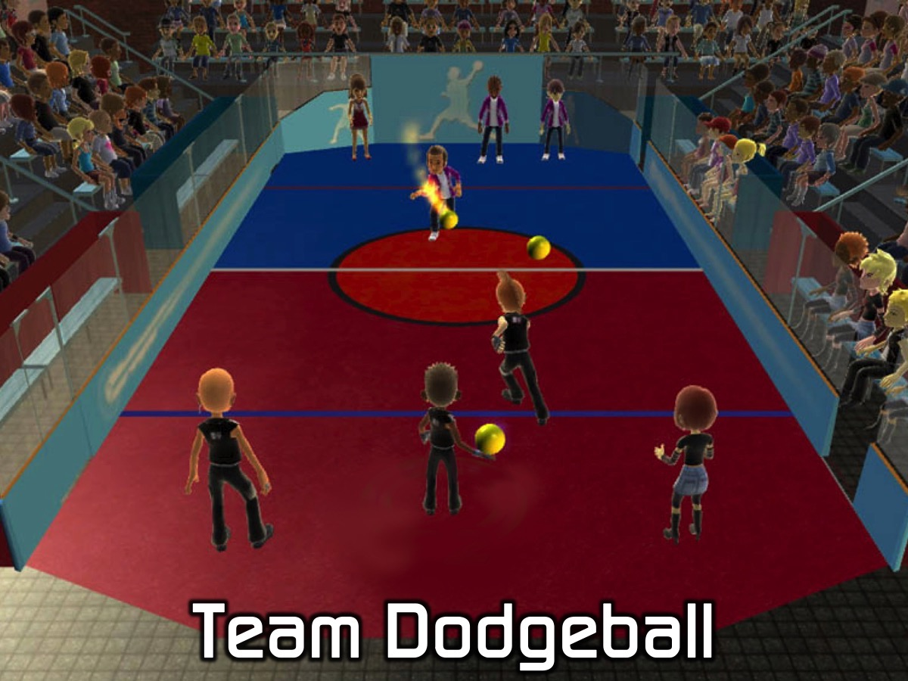
Notes:
Team Dodgeball - we divided into 6 teams and started with a round of friendly games where two team play each other and then the other two teams play each other. Then we had a knockout competition followed by a final game to reward the ultimate winners.

Slide 16
Notes:
Small Group Questions: (1) What was the best part of playing dodgeball? (2) When were you struck by a dodgeball in life? (Leaders Note: Life can be like a game of dodgeball where blows come from friends, family members, bad luck, the Devil, etc. Try and get your group members to talk about actual things that have harmed them in life). (3) What weapons has God given you to fight dodgeballs in life? “Hold up the shield of faith to stop the fiery arrows of the devil. Put on salvation as your helmet, and take the sword of the Spirit, which is the word of God. Pray in the Spirit at all times and on every occasion.” (Ephesians 6:16-18). (4) Pray for each other to use these weapons to defeat the attacks of the evil one.

Slide 17
Notes:
(2) Alpha Friday. We use the Youth Alpha Series as an outreach tool to lead high schoolers into a saving relationship with Jesus!

Slide 18
Notes:
(3) Engage Book. We use the Engage Booklet to follow up with high schoolers who have given their lives to Jesus.

