Slide 1
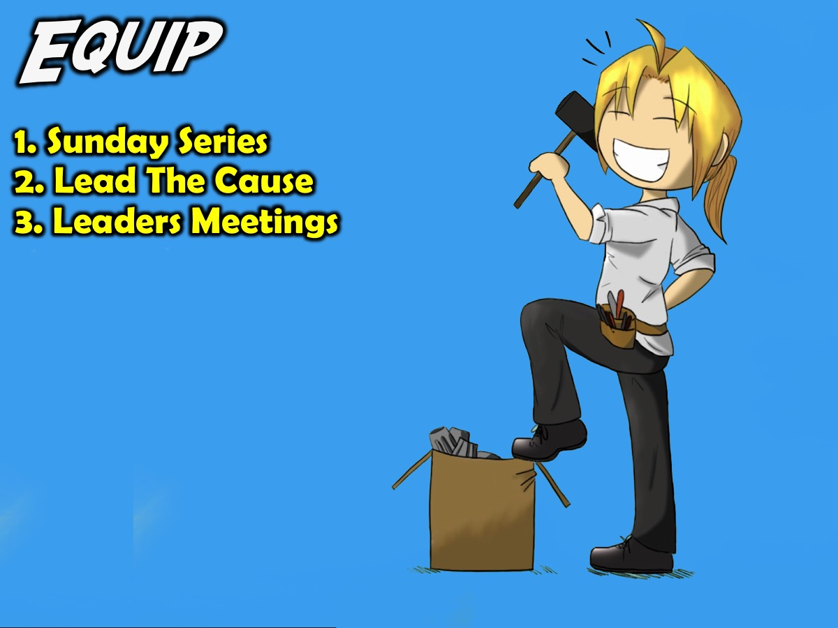
Notes:
EQUIP: The third phase in our disciplemaking strategy is to Equip teens for ministry. As teens are being established in their faith we watch for those who are ready to be equipped to minister among their peers and we equip them through the following initiatives: (1) Sunday Series. (2) Lead The Cause. (3) Leaders Meetings.

Slide 2
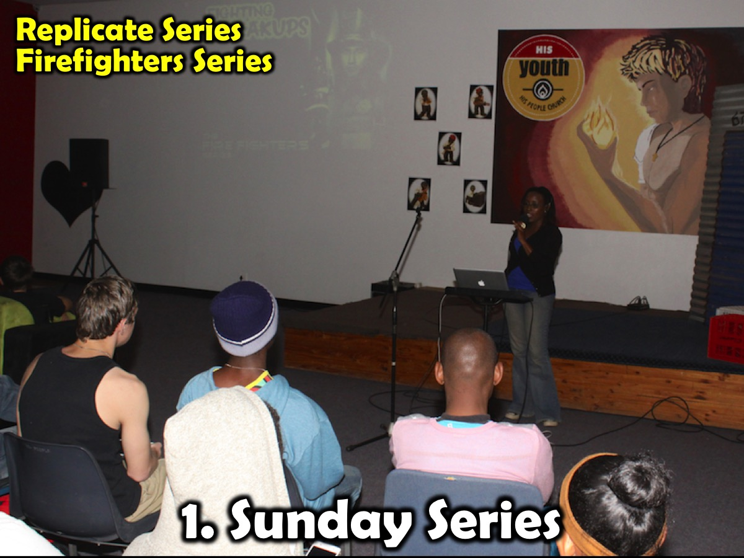
Notes:
(1) Sundays Series: At least once a year our Sunday teaching series is designed to equip teens – either to minister to their peers or to share their faith with their lost friends.

Slide 3

Notes:
Here is an example of an equipping series.

Slide 4
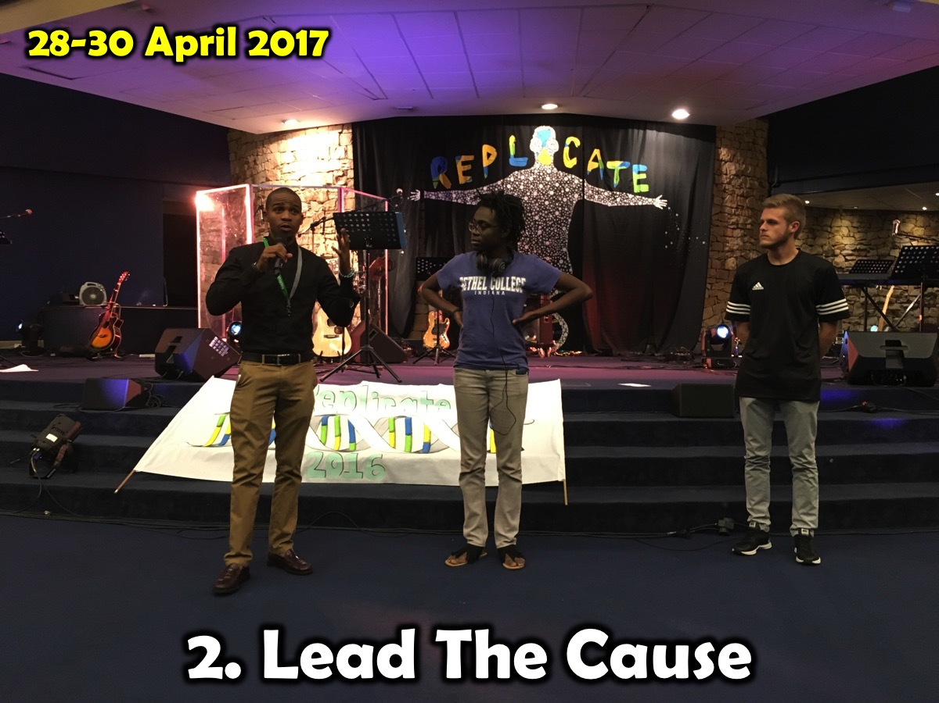
Notes:
(2) Lead The Cause. We either host or attend The annual Lead The Cause peer evangelism equipping event that is run by Go Live Dare.

Slide 5
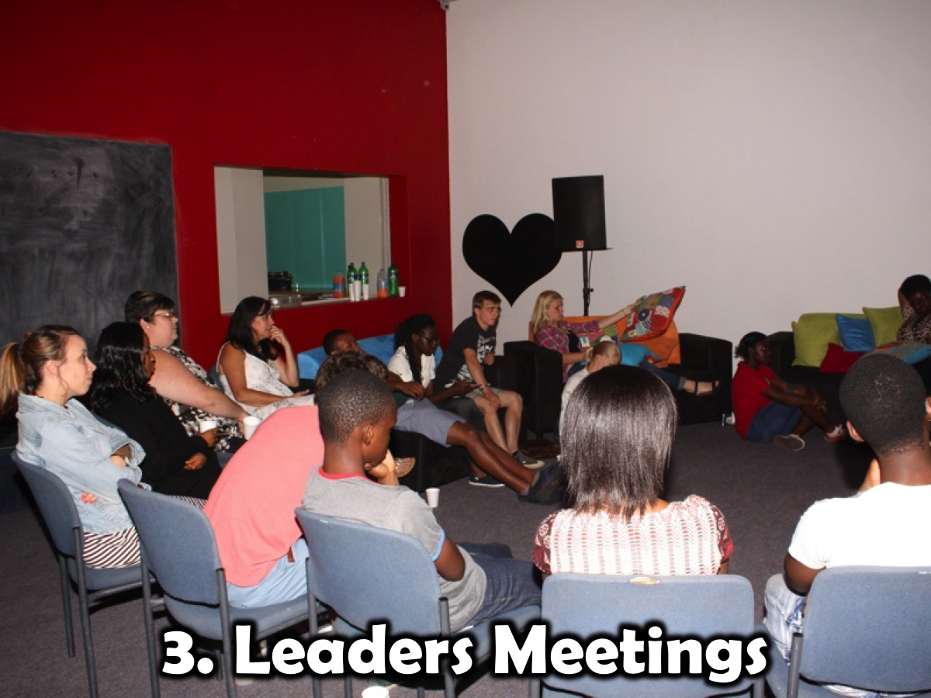
Notes:
(3) Leadership Meetings. Our teen and adult leaders gather once a month on a Sunday afternoon for 2 hours to plan either the upcoming term or the next month’s events. Each leader is responsible for one Friday night a term and work with a small group of Connect Leaders to plan and present Friday night events. These leaders connect with each other via a WhatsApp group.

