Slide 1
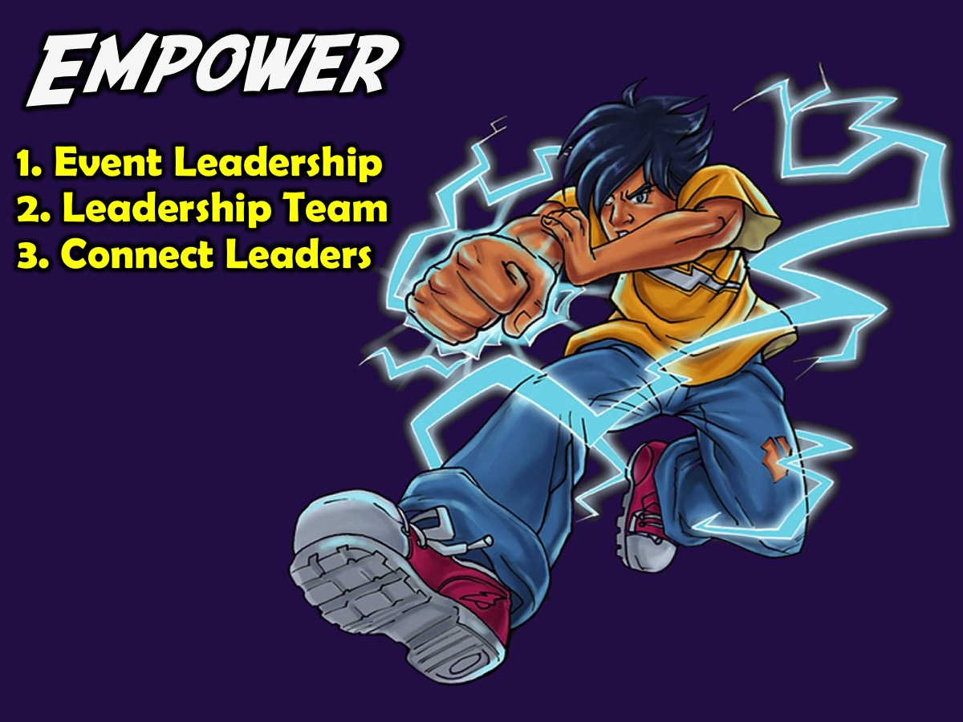
Notes:
EMPOWER: The fourth phase in our disciplemaking strategy is to Empower teens to minister. We have three interventions at this level of our disciplemaking strategy: (1) Event Leadership, (2) Leadership Team and (3) Connect Leaders.

Slide 2

Notes:
(1) Event Leadership. We use the Establish Event on Sunday mornings to empower teens for ministry - by having them do the Welcome, Offering, Announcements and give Testimonies - and even preaching.

Slide 3
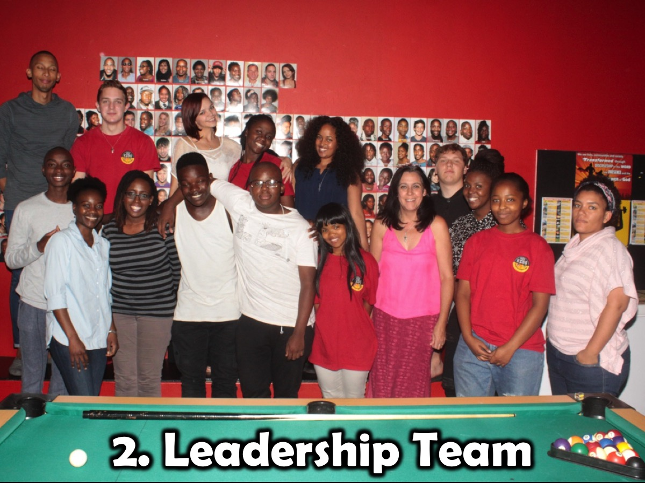
Notes:
(2) Leadership Team. High Schoolers serve on the leadership team and help to shape the direction of the ministry and plan events.

Slide 4
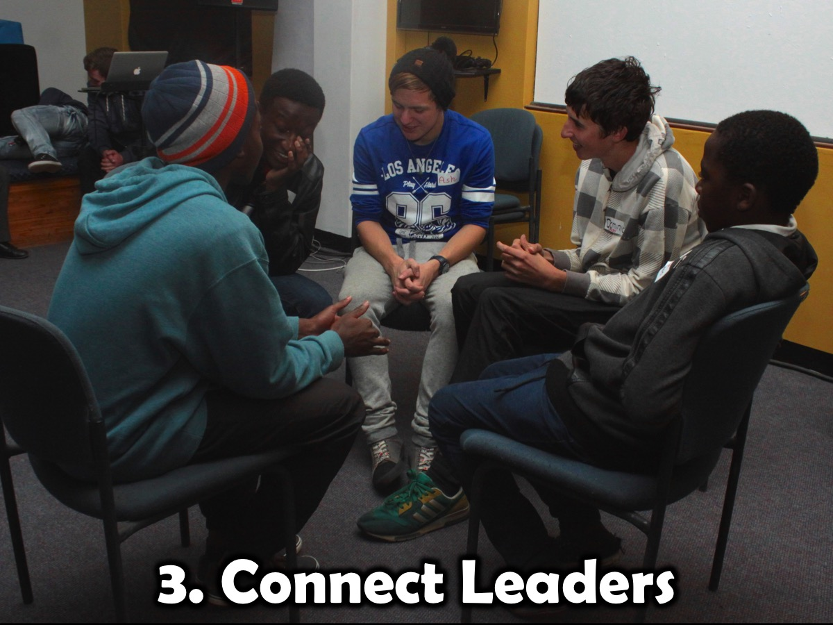
Notes:
(3) Connect Leaders. Teen leaders are each responsible to lead a small group on Friday nights – the groups are no larger than 4 or 5 teens and the leaders are given the small group questions a few days before the event.

