Slide 1

Notes:
Watch_Dogs is a popular game among teens.

Slide 2
Notes:
Pre-Event Video: Watch Dogs Launch Trailer. Get it on YouTube at: https://www.youtube.com/watch?v=CH8HZ0TK5-U

Slide 3
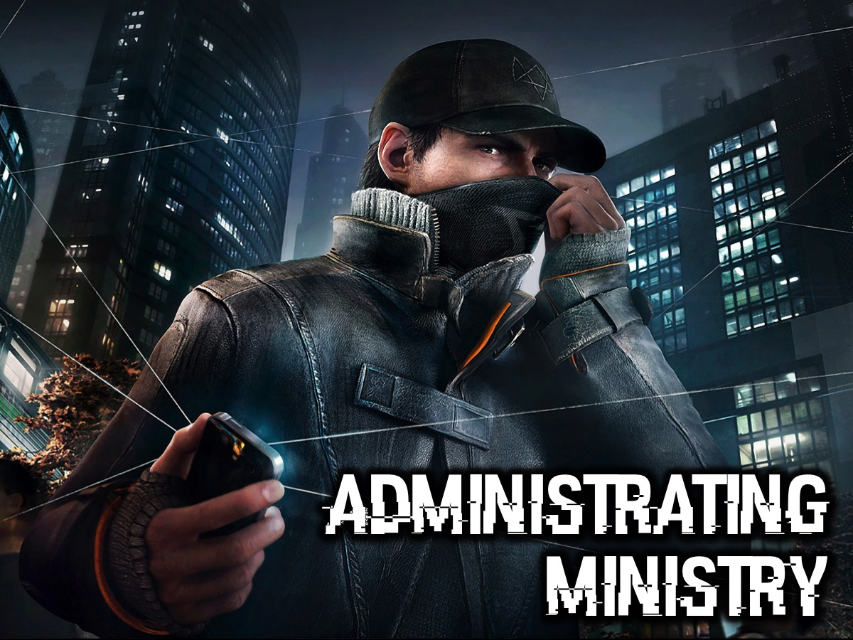
Notes:
Administrating Ministry

Slide 4
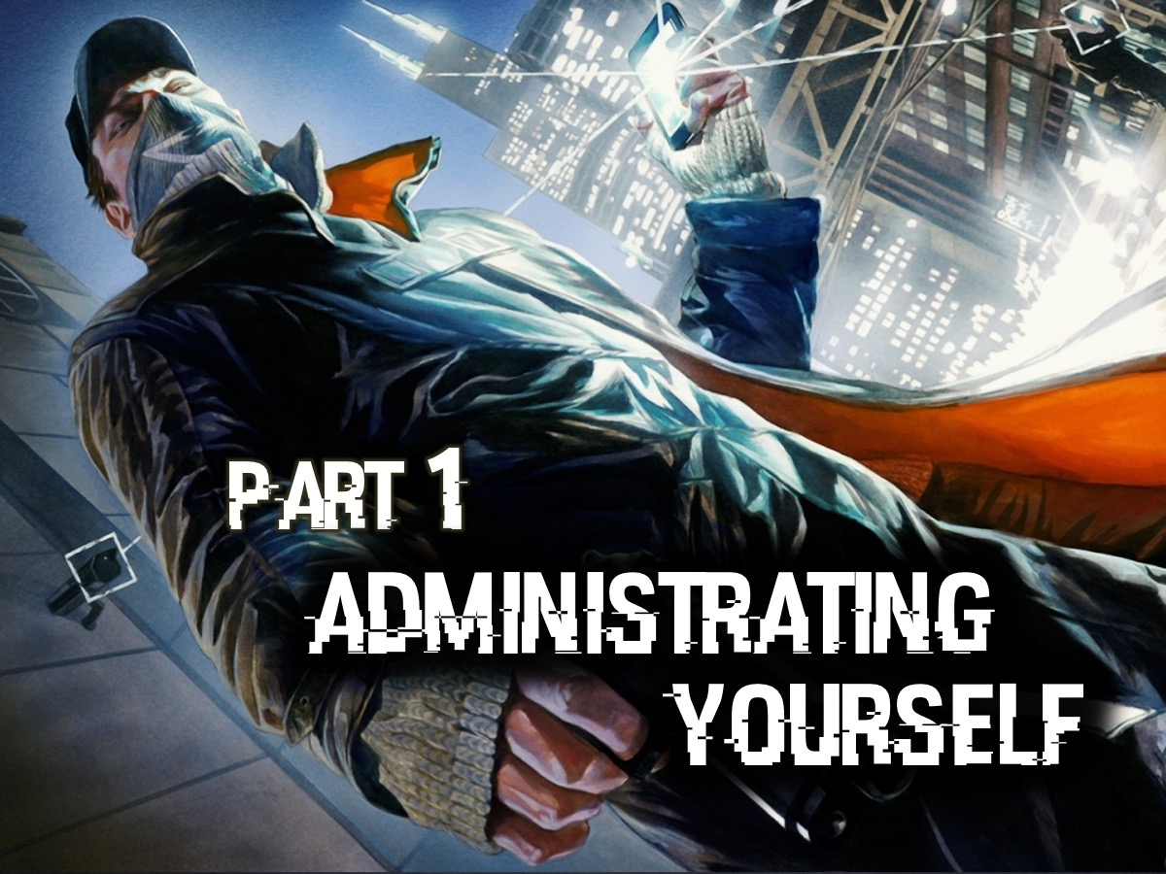
Notes:
Part 1: Administrating Yourself
You wont be able to administrate your ministry unless you “administrate” yourself – you will always be on the back foot, disorganized and struggling to keep your head above water. Here are two key aspects to master if you are going to manage your time and your life:

Slide 5

Notes:
1. Live Your Mission

Slide 6
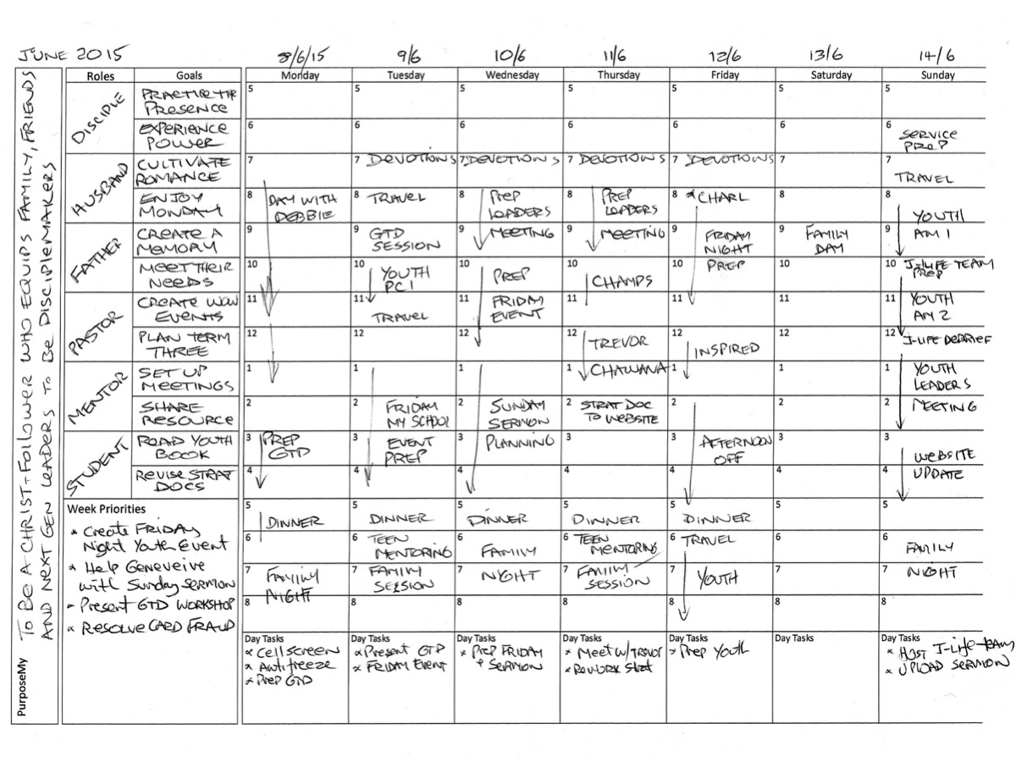
Notes:
Many years ago I was hugely impacted by exposure to the Stephen Covey approach to time management that involves starting with your life mission, then identifying your roles and goals and scheduling activities in your weekly planner. A weekly planner helps you to keep all these aspects in front of you. Here are the details that are displayed on my weekly planner:
* My mission is to be a Christ-follower who equips family, friends and next generation leaders to be disciplemakers.
* I live my mission through six roles: Disciple, Husband, Father, Youth Pastor, Mentor and Student.
* I create two goals for each role each week.
* I make sure an activity or two is scheduling in my diary for the week for each of my goals.

Slide 7
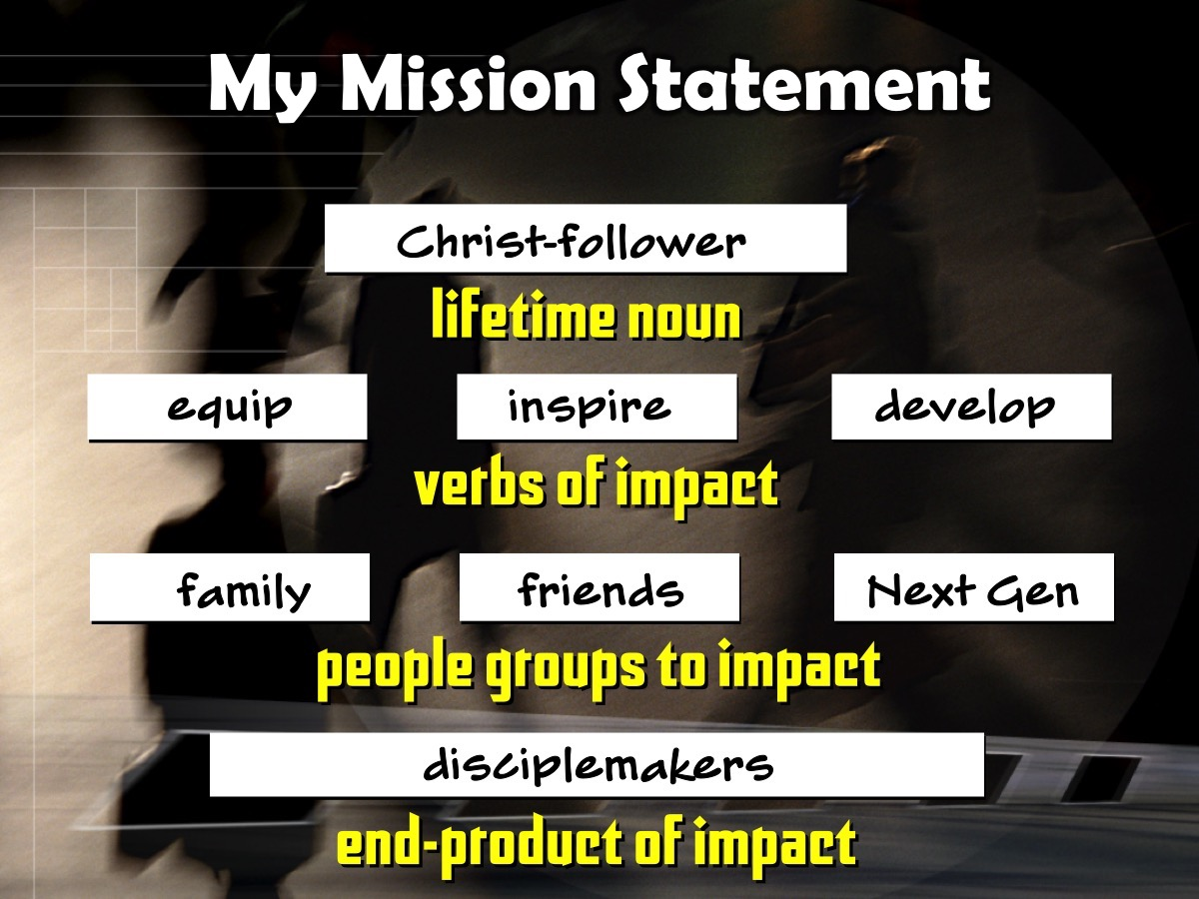

Slide 8
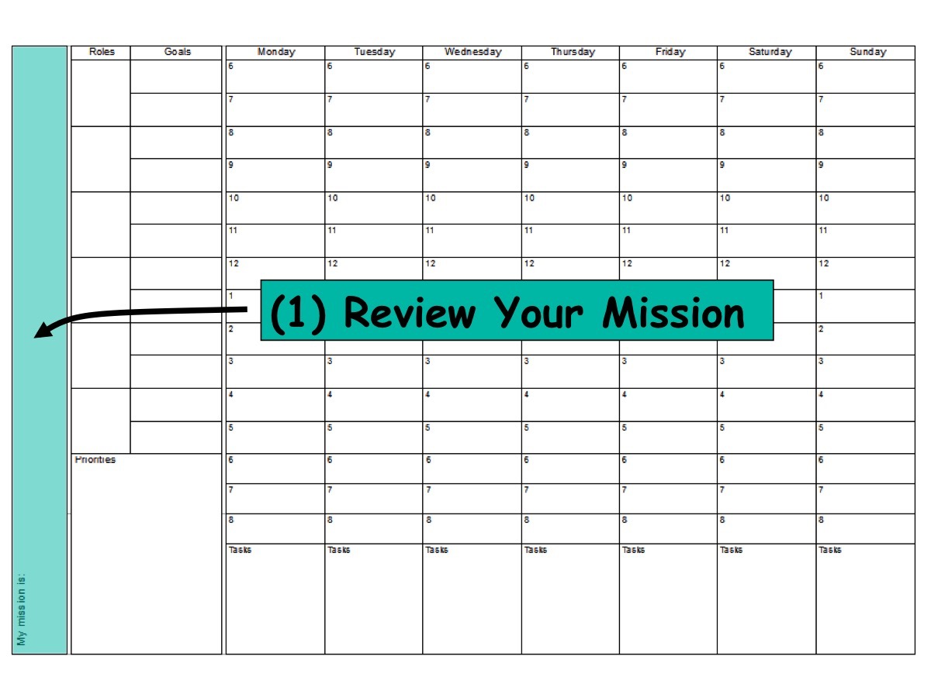

Slide 9
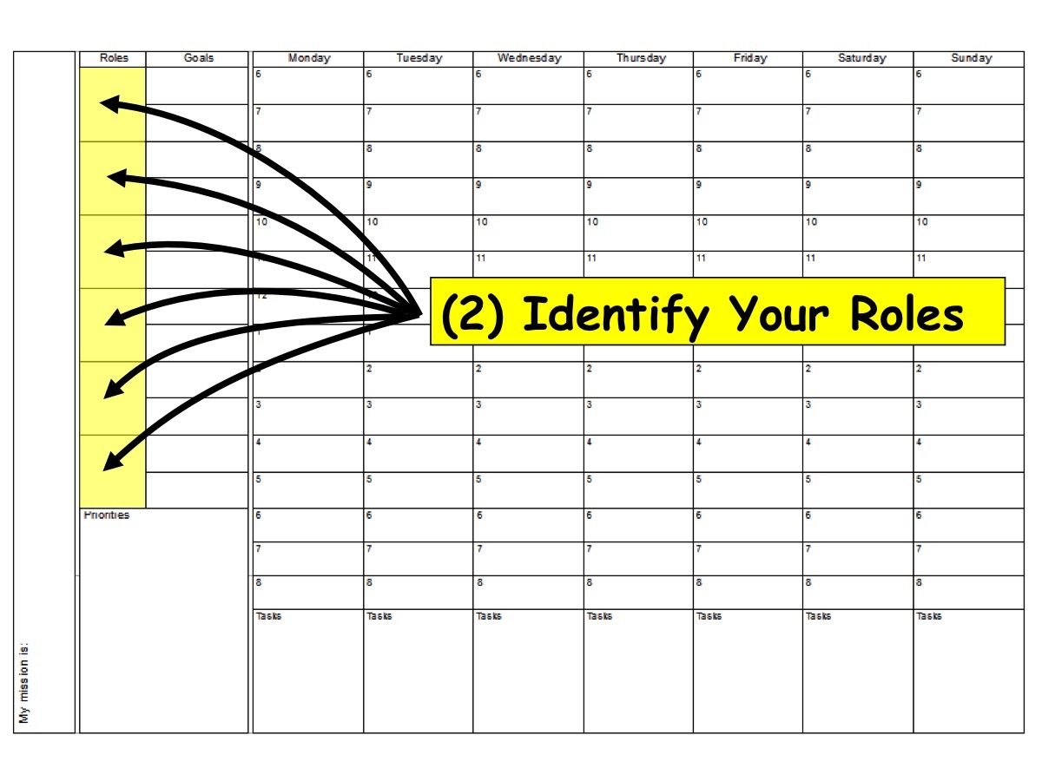

Slide 10
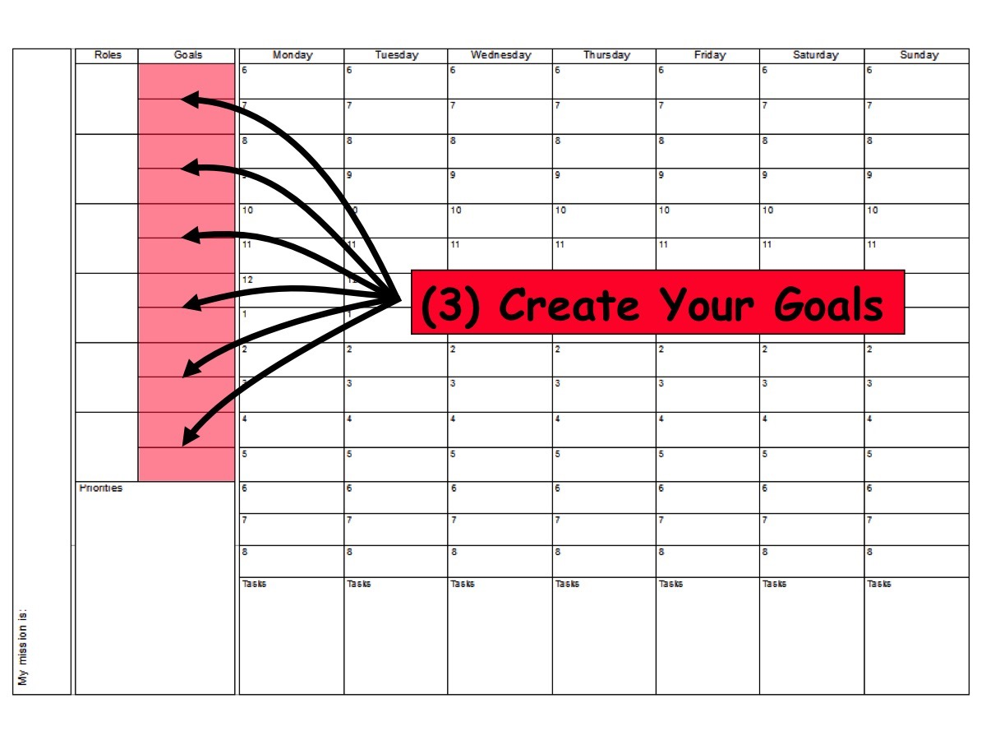

Slide 11
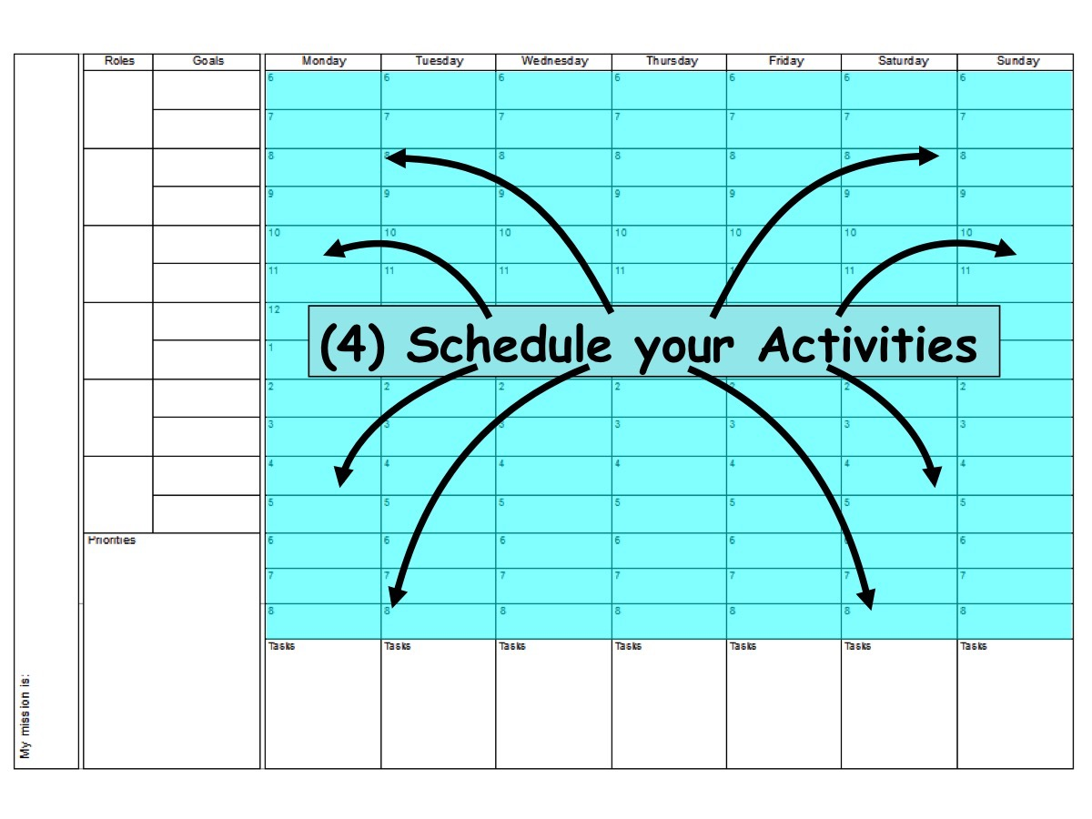

Slide 12
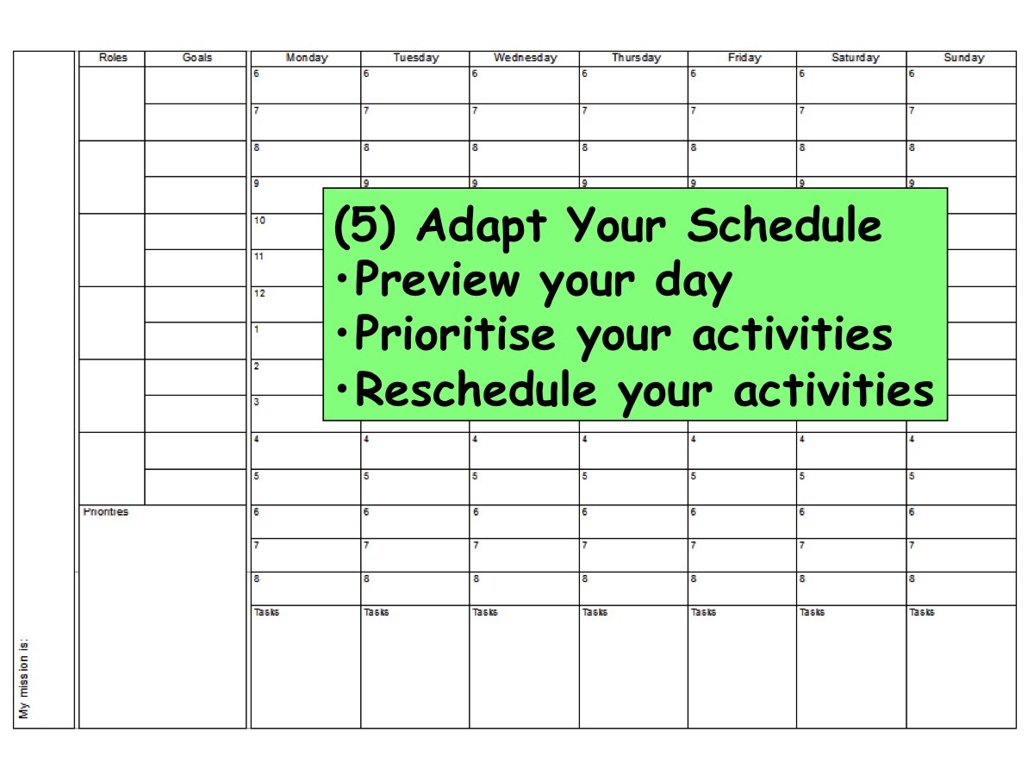

Slide 13
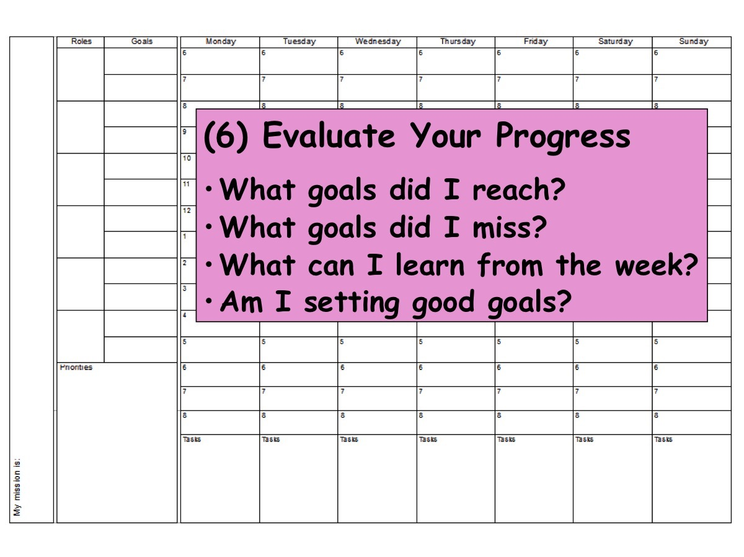

Slide 14

Notes:
2. Manage Your Actions.

Slide 15

Notes:
The second part of my time management system comes from the David Allen approach called Getting Things Done (or GTD for short).

Slide 16
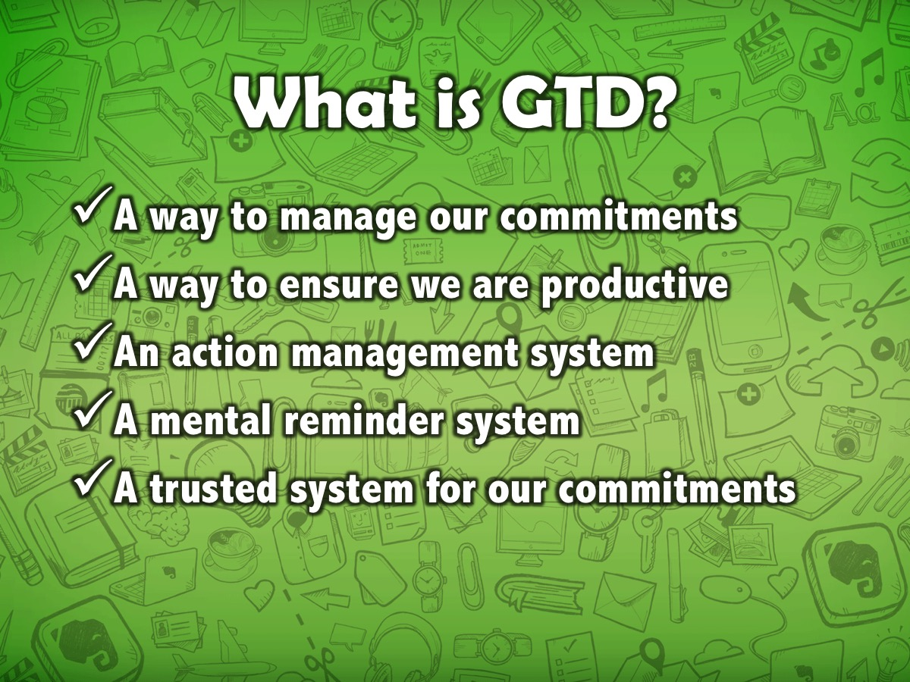
Notes:
GTD is a way to manage our commitments, to ensure we are productive, an action management system, a mental reminder system and a trusted system to track commitments.

Slide 17
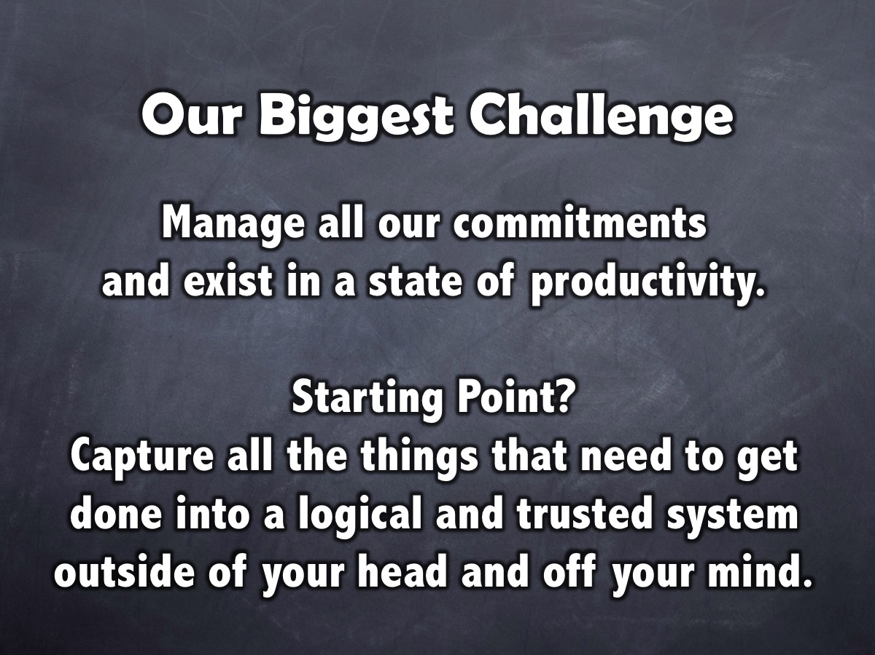
Notes:
Our biggest challenge is to manage all the commitments that we have and ensure that we exist in a state of productivity. David Allen suggests that the starting point is to capture all the things that need to get done into a logical and trusted system outside of your head and off your mind.

Slide 18

Notes:
The brain is better at having thoughts than holding them. We should think about tasks and not of them.

Slide 19

Notes:
To effectively manage commitments we must:

Slide 20

Notes:
(1) Capture all the things that need to get done into a logical and trusted system outside of your head and off your mind. This will ensure that you think about tasks and not of them.

Slide 21

Notes:
(2) Clarify what your commitment to each responsibility is and what you need to do to make progress towards fulfilling it.

Slide 22
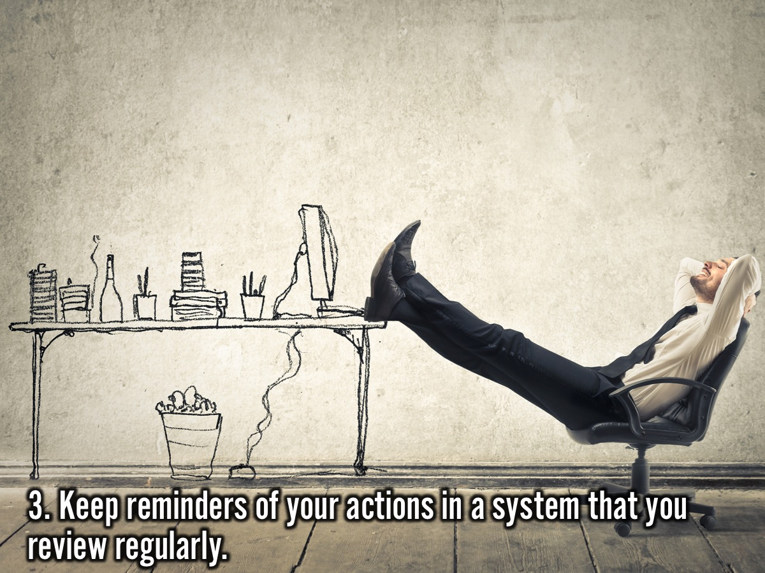
Notes:
(3) Keep reminders of all the actions you need to take in a system that you review regularly.

Slide 23
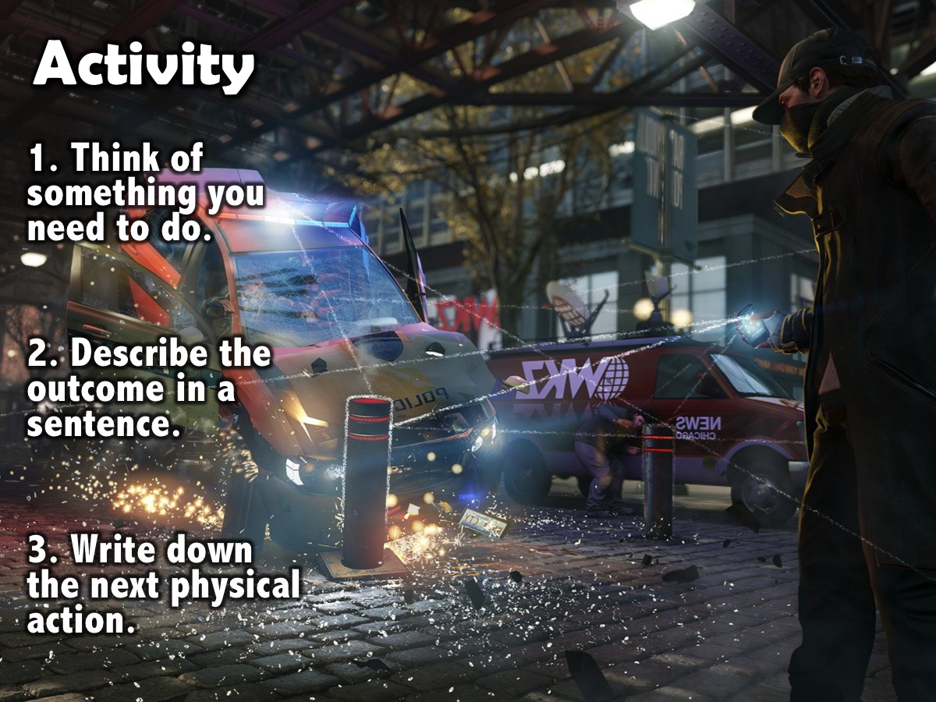
Notes:
Here is an activity to get you started: (1) Think of something that you need to do. (2) Describe in a single sentence the intended successful outcome for the problem or situation. (3) Write down the very next physical action required to move the situation forward.

Slide 24
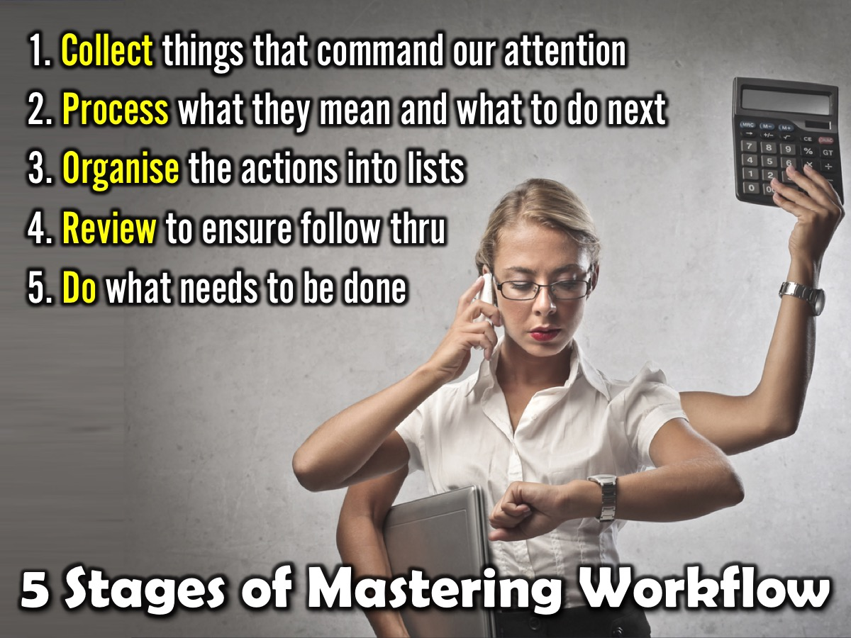
Notes:
THE GTD system uses Five Stages to Master Workflow: (1) Collect things that command our attention. (2) Process what they mean and what to do about them. (3) Organise the results. (4) Review everything on a weekly basis. (5) Do or actually get stuff done.

Slide 25
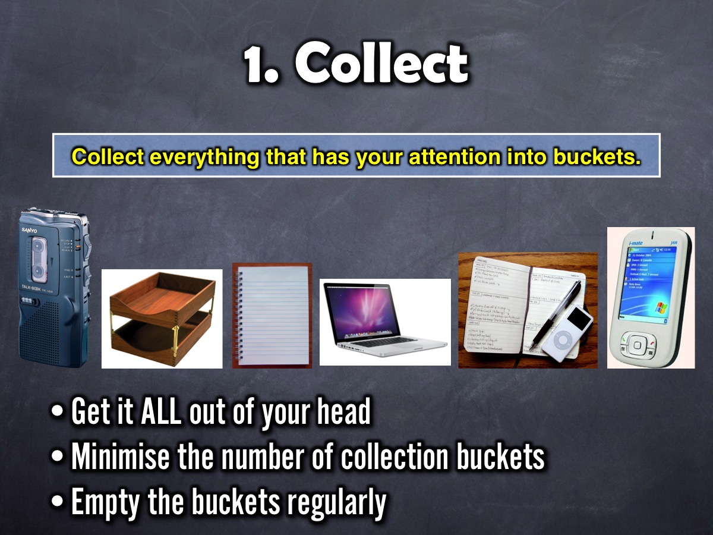
Notes:
A. Collect
We must collect things that command our attention (anything personal or professional, big or little, that you think should be different than it currently is and that you have any level of internal commitment to changing).
(1) Get it all out of your head – nothing should be left in your mind.
(2) Minimize your collection buckets – these could be physical in-baskets; writing paper and pads; electronic note taking; auditory capture (answering machines, voicemail, dictating equipment); email and high-tech devices (like computers or PDA’s).
(3) Empty the buckets regularly – you must process the stuff that you have collected.

Slide 26
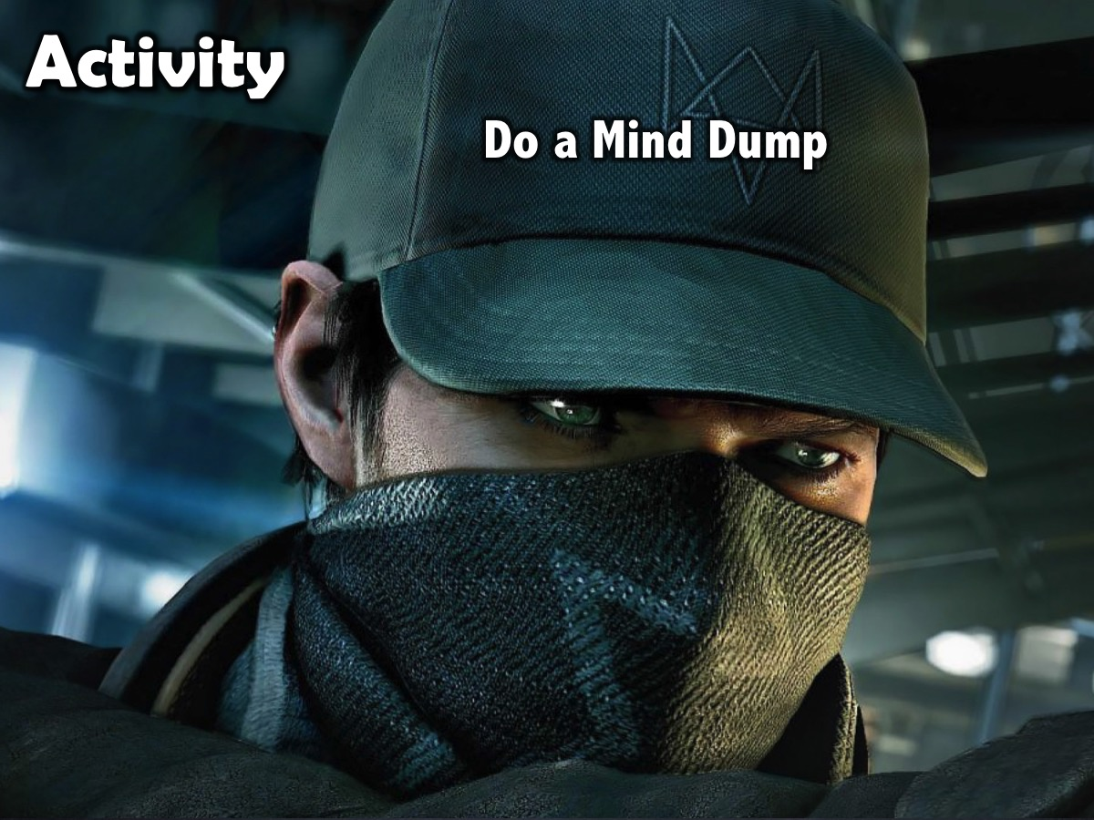

Slide 27
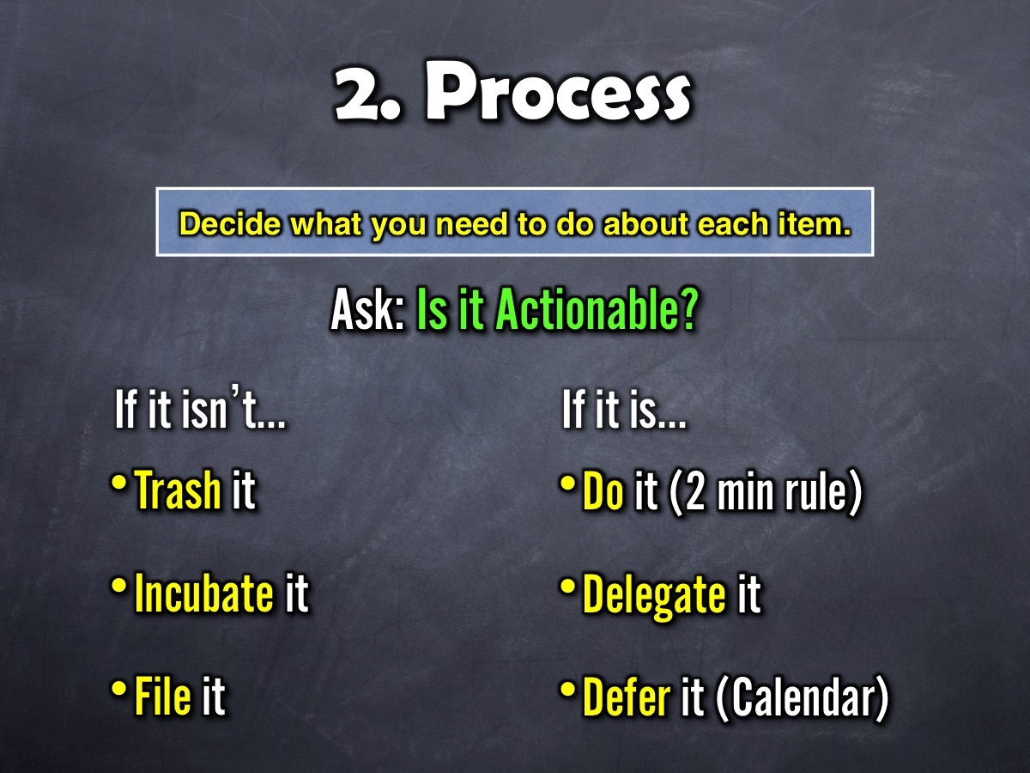
Notes:
A. Collect
We must collect things that command our attention (anything personal or professional, big or little, that you think should be different than it currently is and that you have any level of internal commitment to changing).
(1) Get it all out of your head – nothing should be left in your mind.
(2) Minimize your collection buckets – these could be physical in-baskets; writing paper and pads; electronic note taking; auditory capture (answering machines, voicemail, dictating equipment); email and high-tech devices (like computers or PDA’s).
(3) Empty the buckets regularly – you must process the stuff that you have collected.

Slide 28
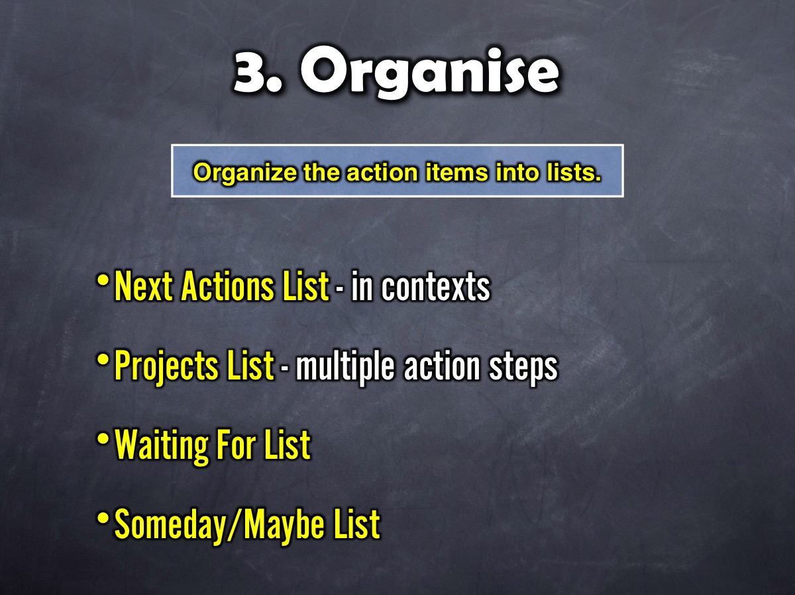
Notes:
C. Organize
The results of your collecting and processing must be organised. For non-actionable items the possible categories are trash, incubation tools and reference storage. For actionable items you will need a list of projects (these are things that require more than one action step), storage or files for project plans and materials, a calendar (time specific actions, day specific actions, day specific information), a list of reminders of next actions and a list of reminders of things you're waiting for (only review as often as they have to be in order to stop wondering about them).

Slide 29


Slide 30
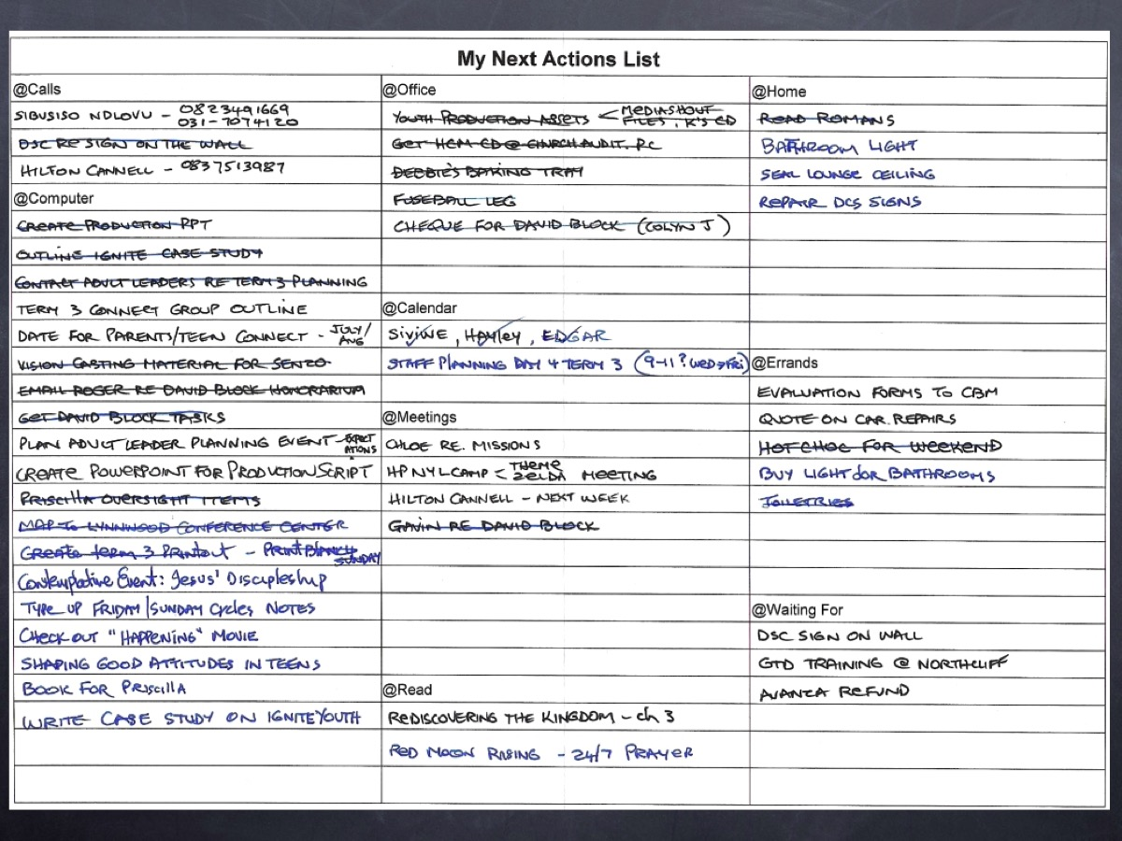

Slide 31
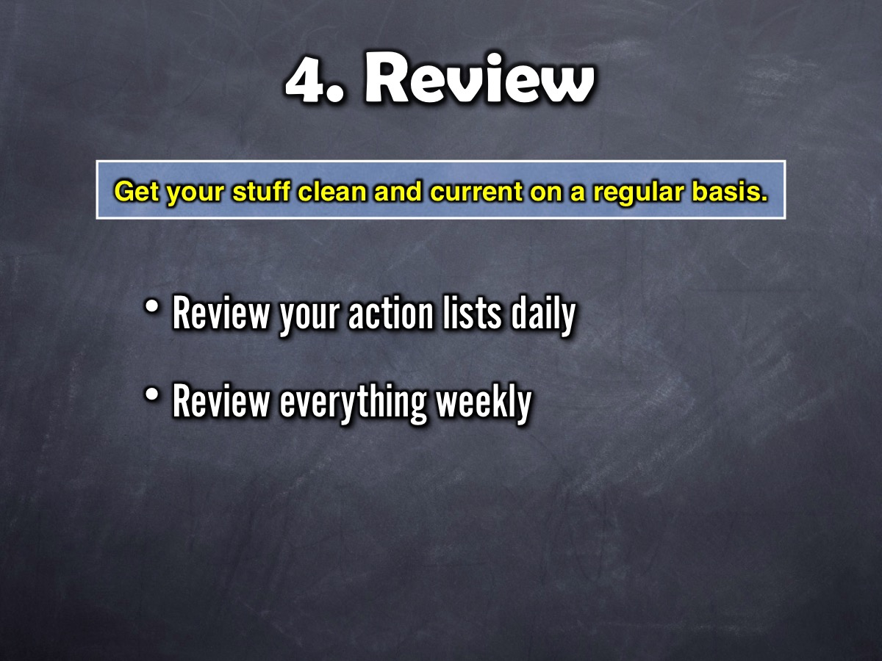
Notes:
D. Review
You must be able to review the whole picture of your life and work at appropriate intervals and appropriate levels. This involves being able to scan all the defined actions and options before you – to increase the effectiveness of the choices you make about what you are doing at any point in time. So what should you review and when? Firstly, your project list, your next action list, your calendar and waiting for list should be reviewed. Secondly, a weekly review must be done - this is where you gather and process all your stuff, review your system, update your lists, and get clean, clear, current and complete.

Slide 32
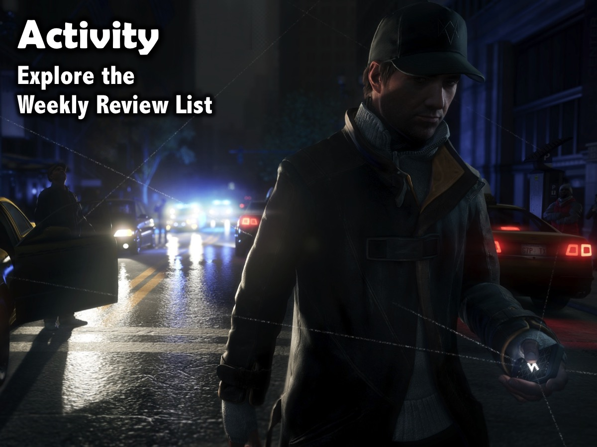

Slide 33
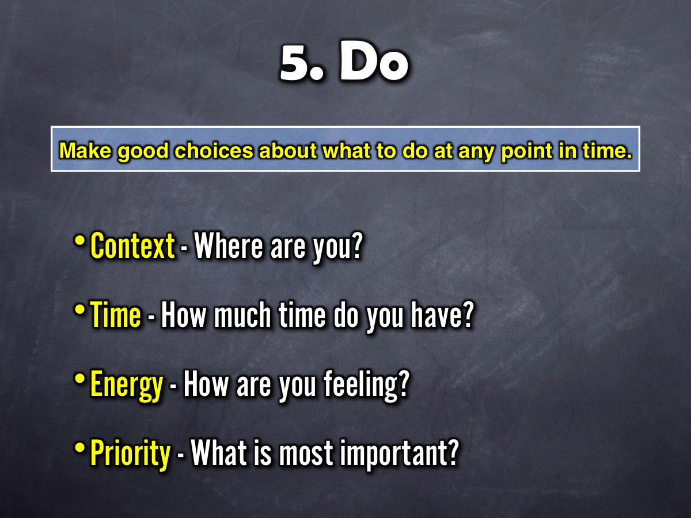
Notes:
E. Do
The whole purpose of this workflow-management process is to help you make good choices about what you are doing at any point in time.

Slide 34
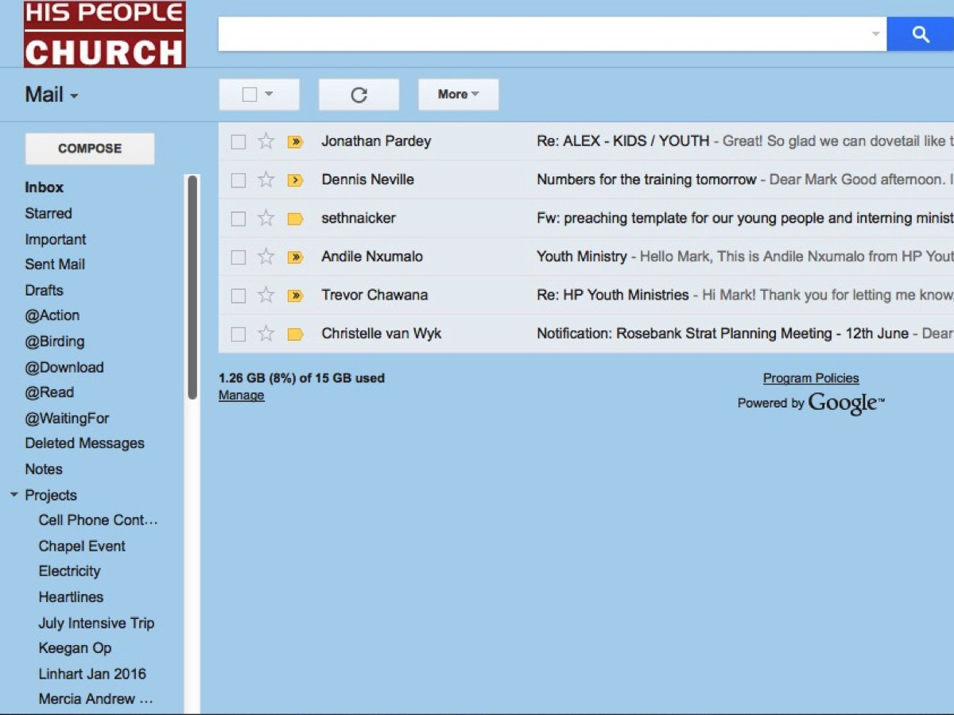
Notes:
Finally, in order to administer your life you need to create an email system that will ensure that you are on top of all the demands that come your way through email. The goal is to get your inbox to Zero by process each email and assigning it to an action folder that you process and don’t forget about. My email system in Gmail uses the following folders to help me deal with emails and get them out of my inbox:
@Action – this is a folder for emails that I need to act on as soon as I get a chance.
@Downloads – this is a folder for emails that contain web links that I need to visit.
@Read – this is a folder for emails that contain information I need to read.
@Waiting For – this is a folder for emails that I cannot act on until I get a response.
Projects – this is a folder with sub-folders for each of the current projects I am tracking.
Reference – this is a folder with sub-folders for groups of emails that need to be archived.

Slide 35
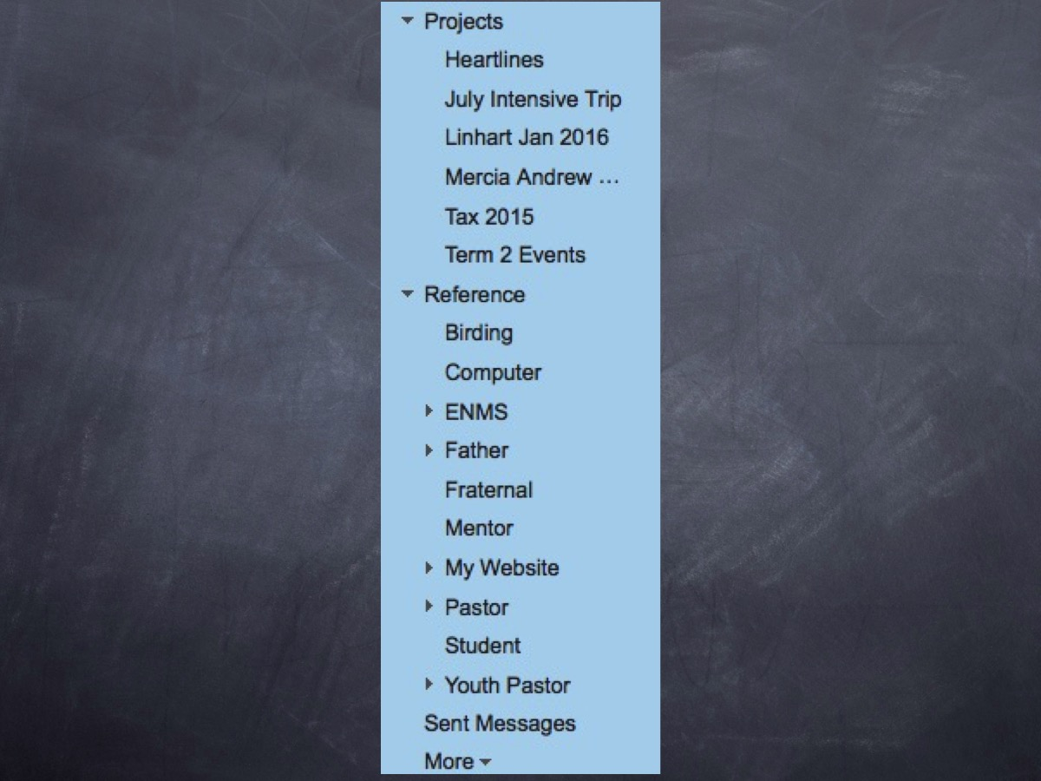

Slide 36
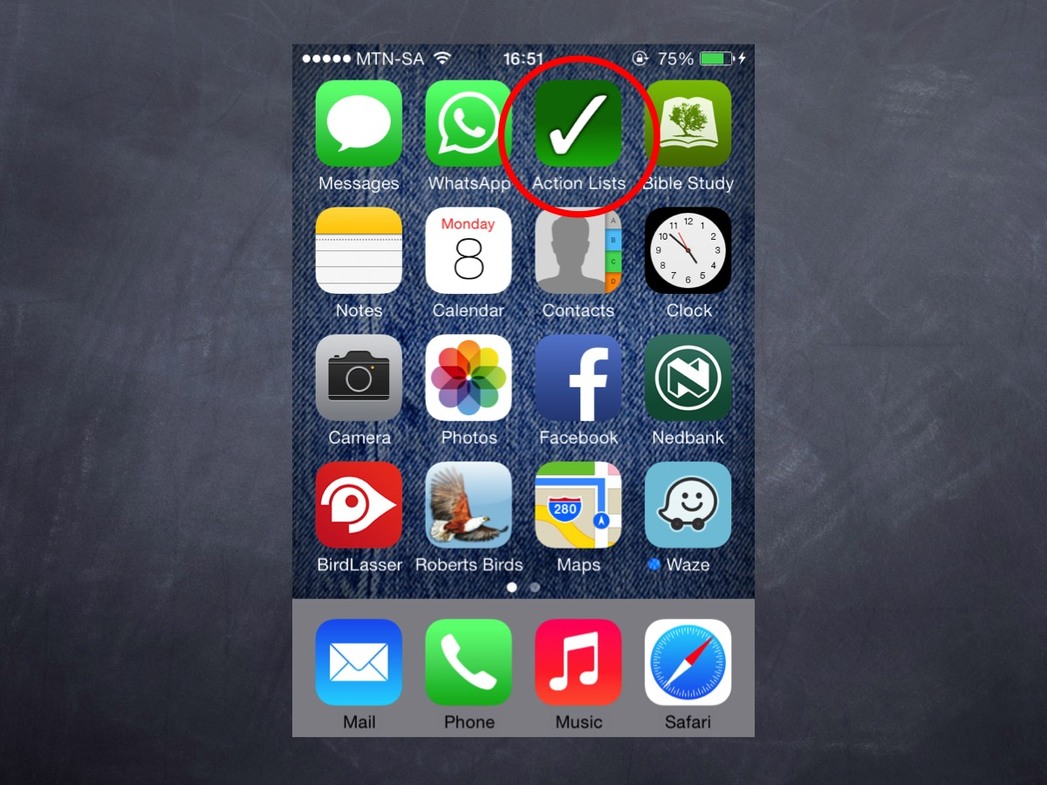

Slide 37
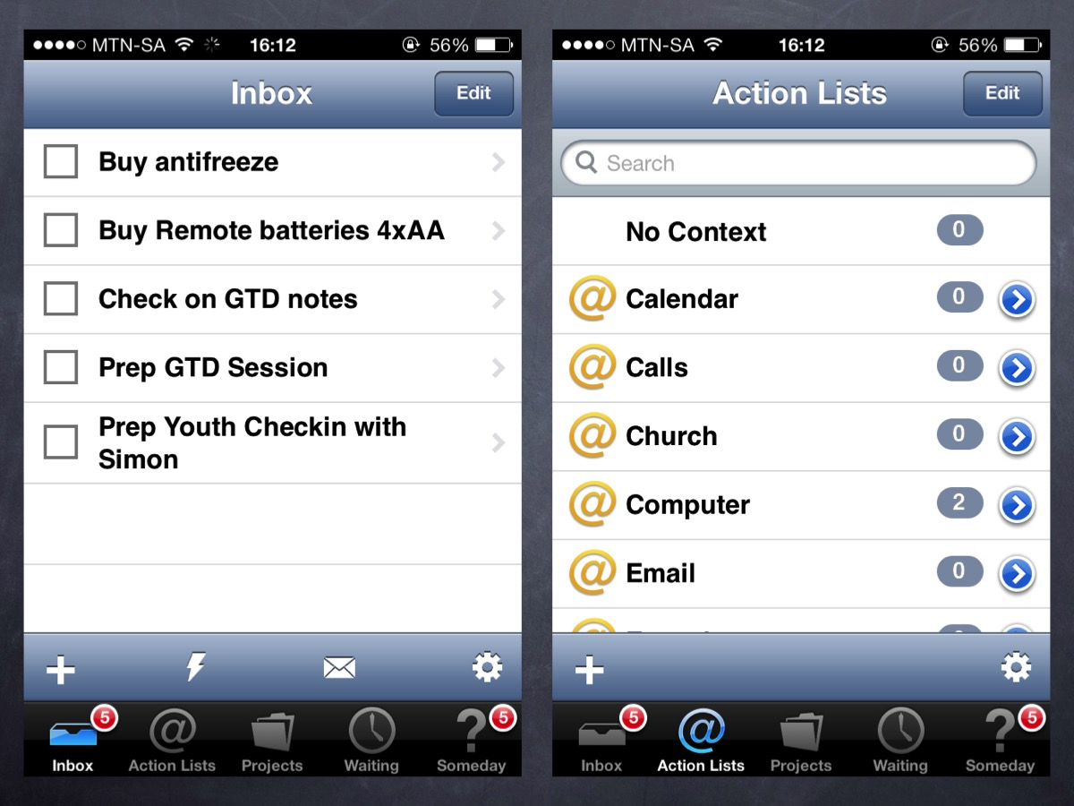

Slide 38
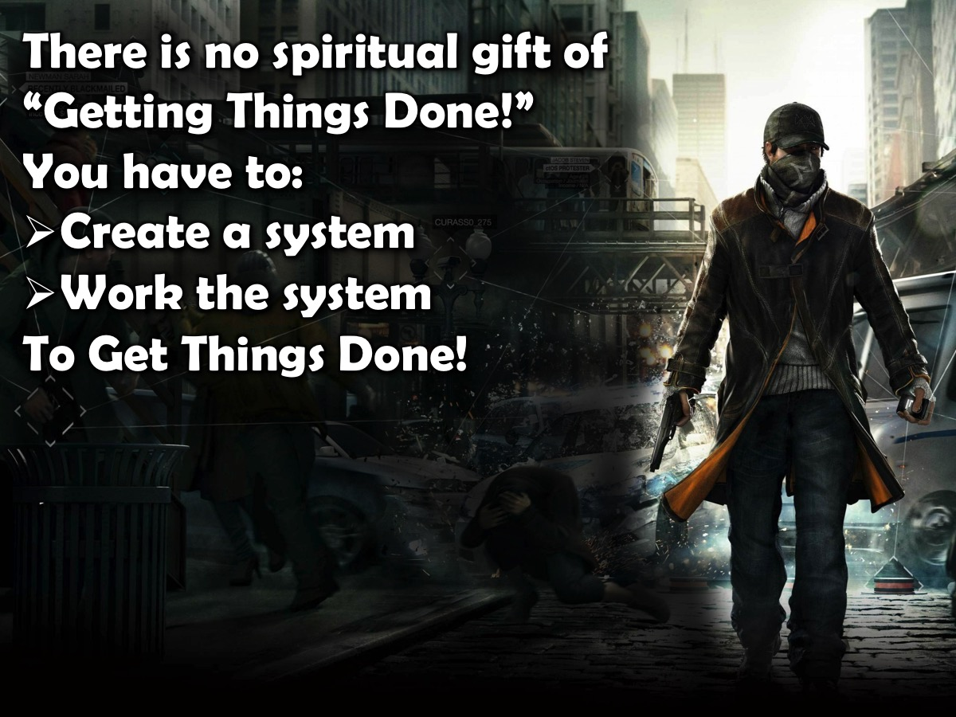

Slide 39
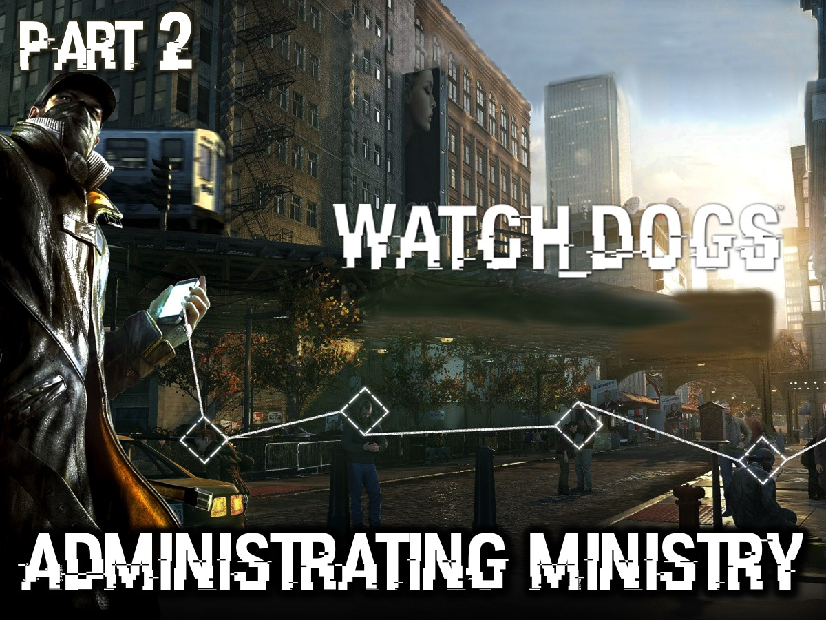
Notes:
Part 2. Administrating Ministry

Slide 40

Notes:
There is a great story that Jesus told in Matthew 25:14-28: The Parable of the Bags of Gold.
“Again, it will be like a man going on a journey, who called his servants and entrusted his wealth to them. To one he gave five bags of gold, to another two bags, and to another one bag each according to his ability. Then he went on his journey. The man who had received five bags of gold went at once and put his money to work and gained five bags more. So also, the one with two bags of gold gained two more. But the man who had received one bag went off, dug a hole in the ground and hid his master’s money. “After a long time the master of those servants returned and settled accounts with them. The man who had received five bags of gold brought the other five. ‘Master,’ he said, ‘you entrusted me with five bags of gold. See, I have gained five more.’ “His master replied, ‘Well done, good and faithful servant! You have been faithful with a few things; I will put you in charge of many things. Come and share your master’s happiness!’ “The man with two bags of gold also came. ‘Master,’ he said, ‘you entrusted me with two bags of gold; see, I have gained two more.’ “His master replied, ‘Well done, good and faithful servant! You have been faithful with a few things; I will put you in charge of many things. Come and share your master’s happiness!’ “Then the man who had received one bag of gold came. ‘Master,’ he said, ‘I knew that you are a hard man, harvesting where you have not sown and gathering where you have not scattered seed. So I was afraid and went out and hid your gold in the ground. See, here is what belongs to you.’ “His master replied, ‘You wicked, lazy servant! So you knew that I harvest where I have not sown and gather where I have not scattered seed? Well then, you should have put my money on deposit with the bankers, so that when I returned I would have received it back with interest. “‘So take the bag of gold from him and give it to the one who has ten bags.”

Slide 41
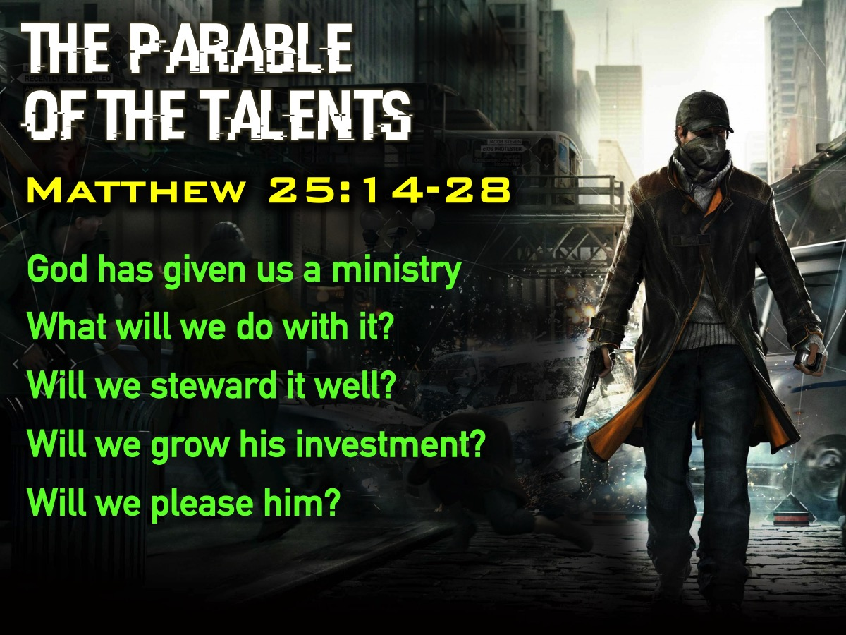
Notes:
God has entrusted the vision (or ministry) we are a part of - or are leading - into our care! What are we going to do with it? Will we look after it in a way that pleases him?

Slide 42
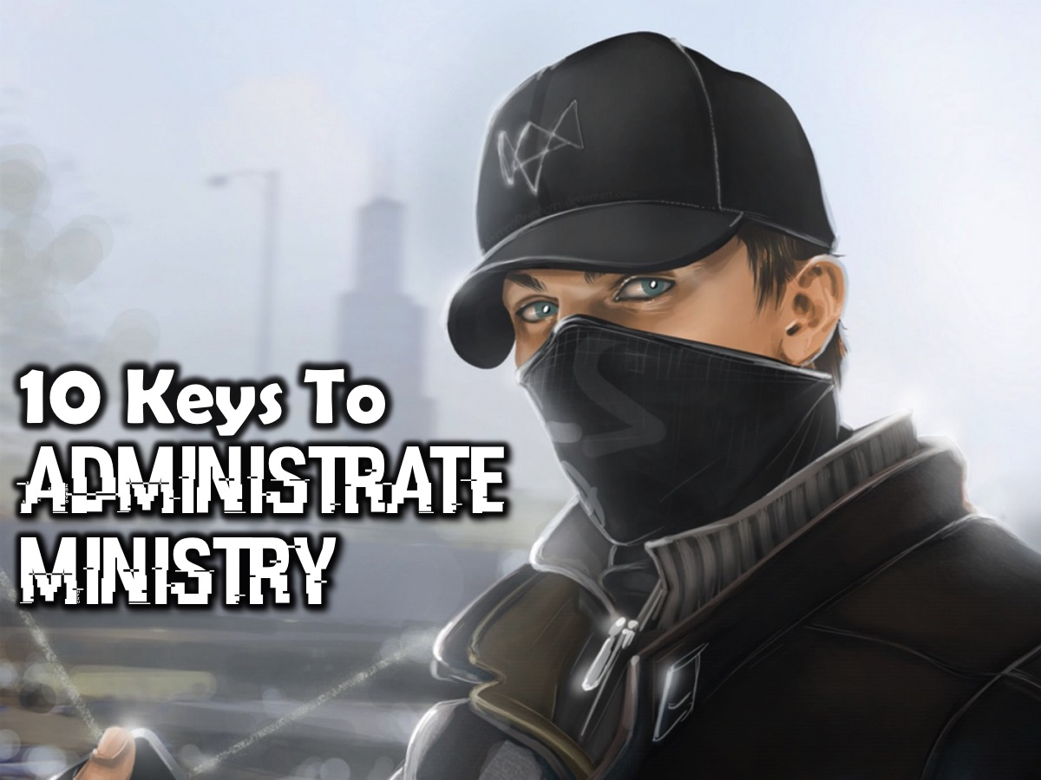
Notes:
Here are 10 keys that will help you administrate the ministry that God has entrusted to you:

Slide 43
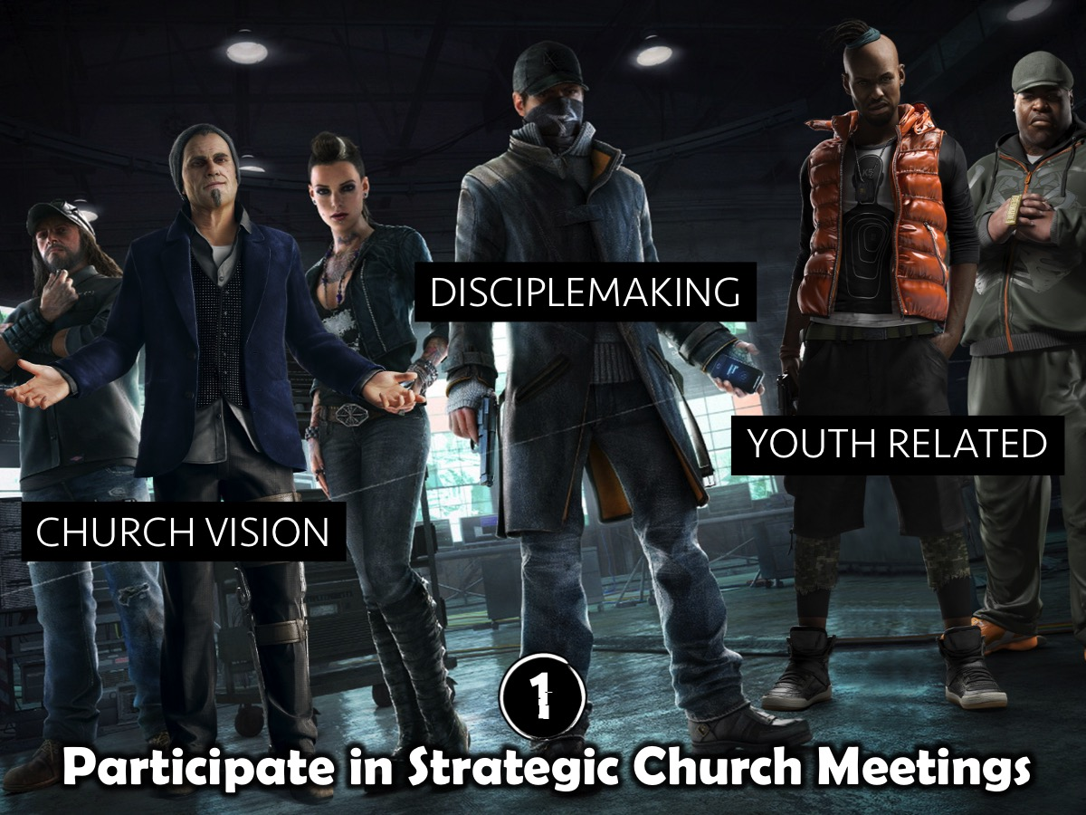
Notes:
1. Participate in Strategic Church Meetings. Time spent in meetings that deal with any of the following aspects of ministry is time well invested: the vision of the wider church, the disciplemaking approach and any events or ministries that have a connection to youth ministry. This will ensure that the youth ministry remains vitally connected to the life of the church.

Slide 44
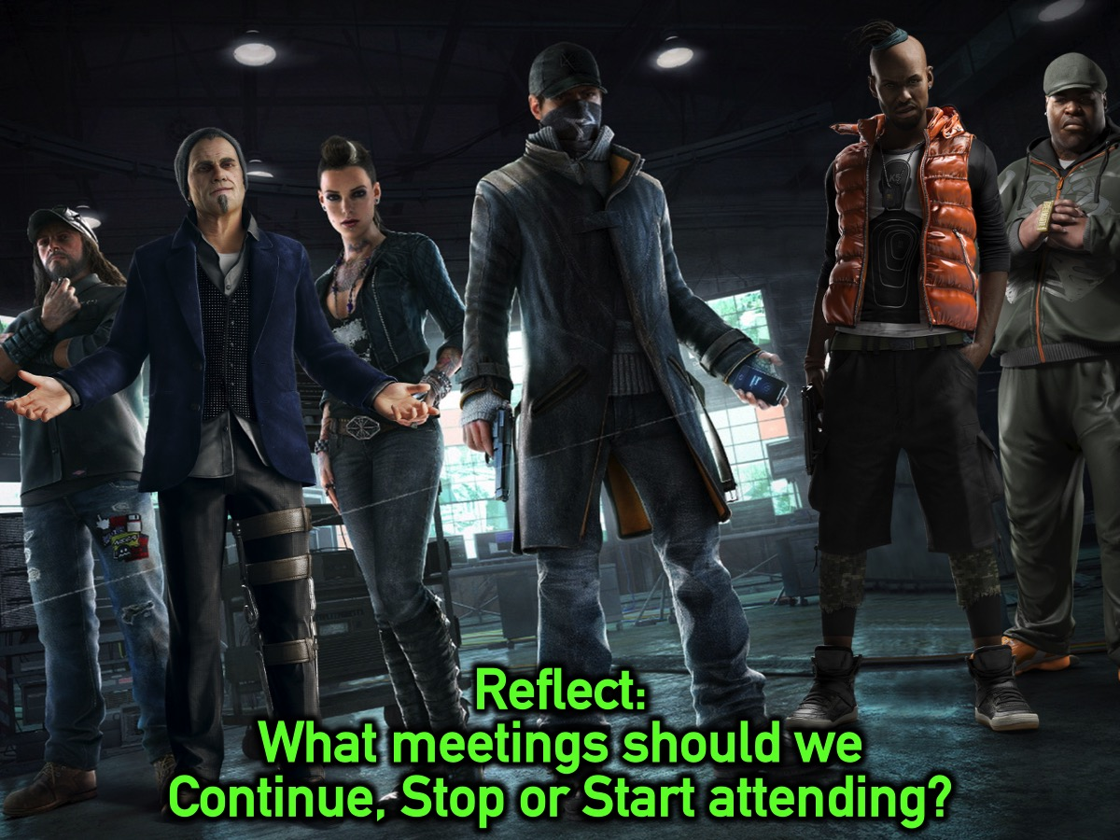
Notes:
Reflect: What meetings should we Continue, Stop, Start attending?

Slide 45

Notes:
2. Meet with Your Ministry Covering. One of our key monthly meetings at HP Rosebank is a meeting with a pastoral couple, Simon and Lindi Lerefolo, who provide the covering for youth ministry from an elder level. My wife and I benefit hugely from this time of sharing of hearts and ministry strategies and any issues that they need to be informed about. We try and ensure that they are not surprised by anything that happens in the youth ministry and generally bounce ideas and plans off them before they are rolled out. They also happen to be responsible for doing our quarterly performance appraisals so they have unlimited access to our lives.

Slide 46
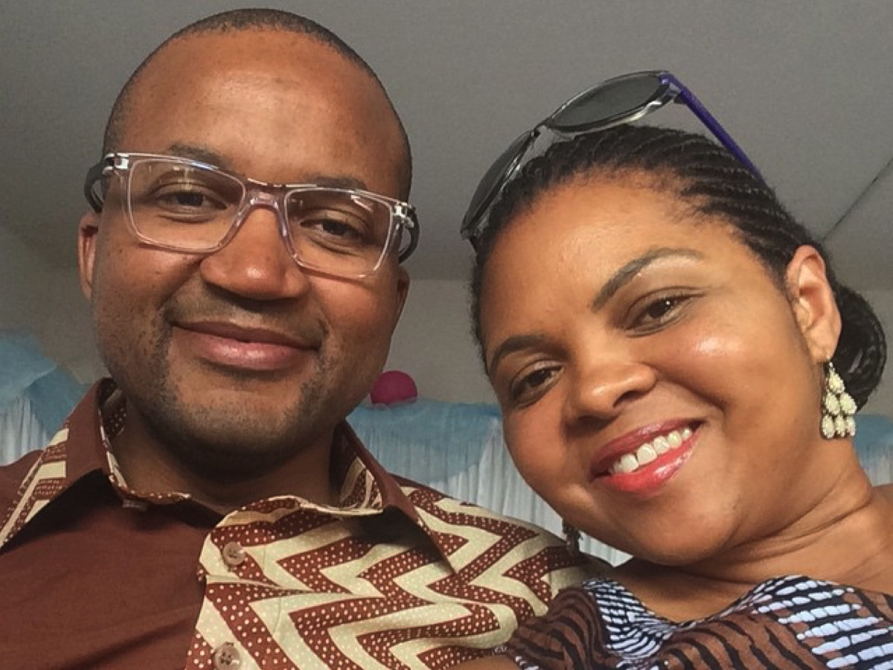
Notes:
Simon and Lindi Lerefolo, who provide the covering for youth ministry from an elder level.

Slide 47
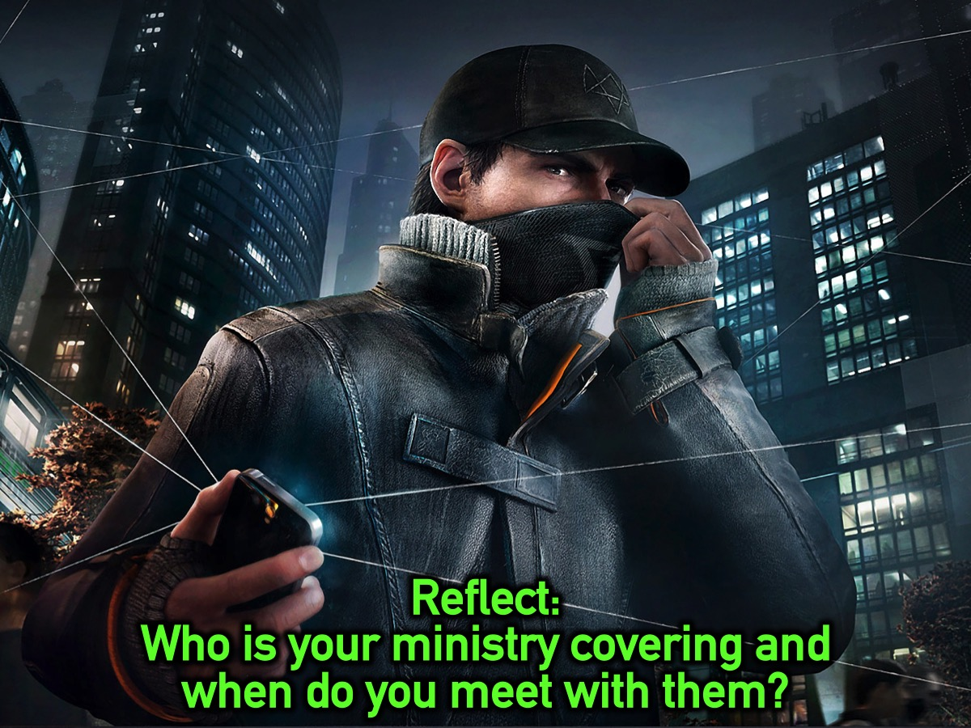
Notes:
Reflect: Who is your ministry covering and when do you meet with them?

Slide 48
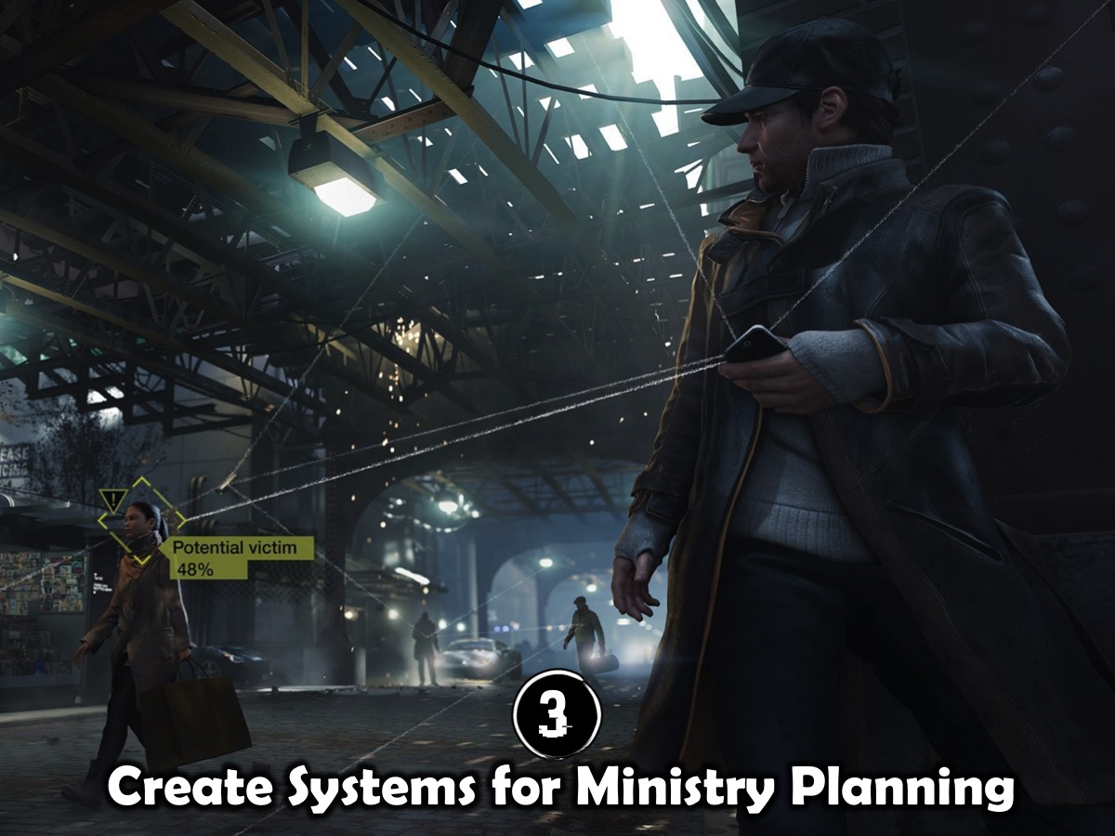
Notes:
3. Create Systems for Ministry Planning. The need for advanced planning in youth ministry cannot be overstated! Here are some dimensions of our planning system:

Slide 49
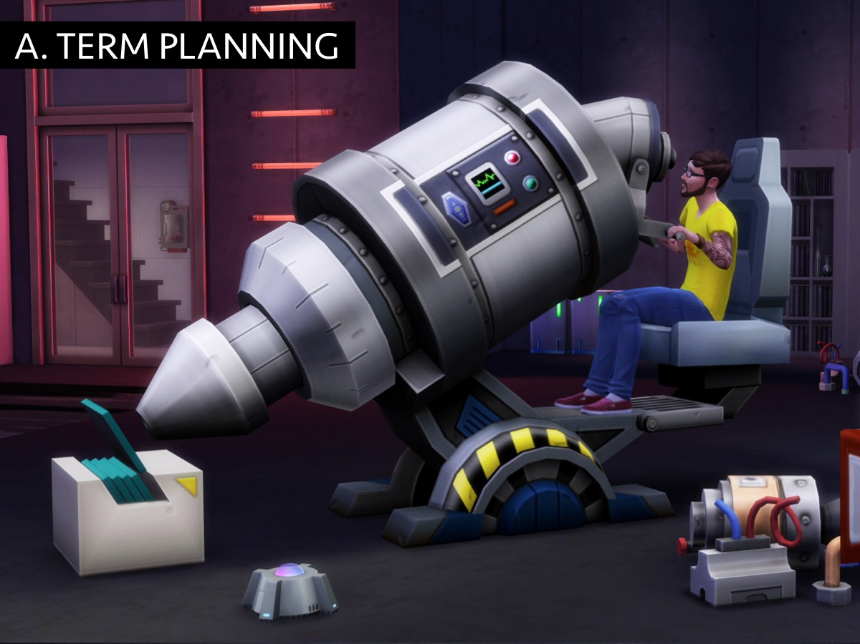
Notes:
A. Term Planning. We currently engage in detailed term-by-term planning (and last year we actually planned the whole year’s preaching schedule in advance). This ensures that we are not scrambling each week or month to figure out what we will preach or what events we will run and it allows us to come up with series that span a few months at a time.

Slide 50
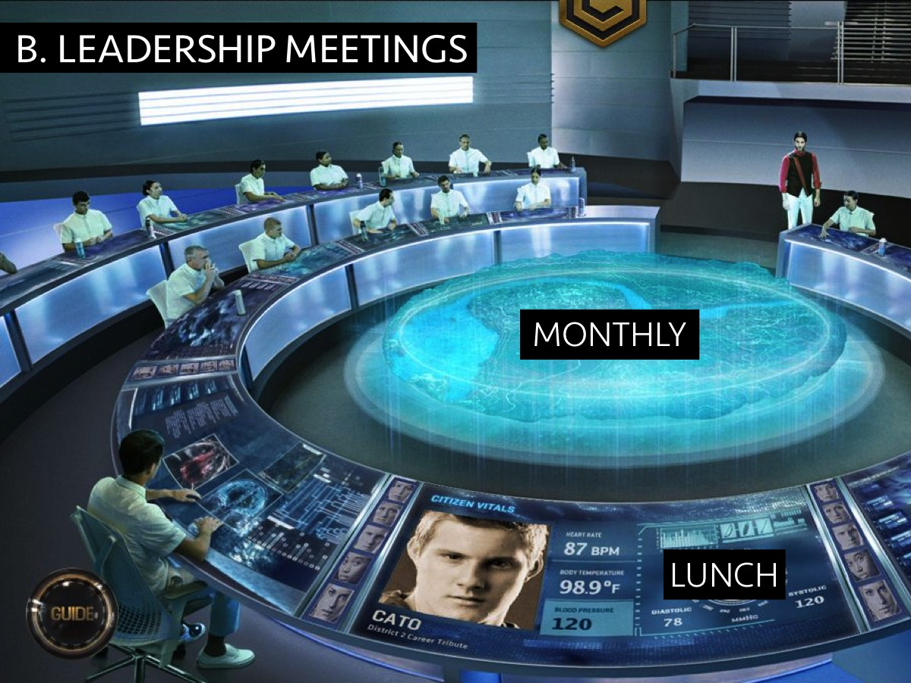
Notes:
B. Leadership Meetings. We meet once a month with our teen and adult leaders (on a Sunday after the second service over lunch) where we plan ahead – either for the upcoming term (this is done once a term) or for the upcoming month. These meetings are scheduled at the start of each term and almost never rescheduled or cancelled.

Slide 51

Notes:
C. Prayer, Review and Preview. Our planning process consists of significant amount of time spent in prayer followed by a period of reviewing everything we have done in the last month or term and then time spent in previewing the upcoming term to discern where God is leading us. As youth pastors, my wife and I will spent a great amount of time behind the scenes working on where we sense God is leading us – and also consult with key teen and adult leaders – and then present our sense to the group of leaders at the meeting for shaping and fleshing out.

Slide 52

Notes:
D. Term Preview Presentation. We make use of a PowerPoint presentation to promote the events in the term. It is structured around our disciplemaking process, namely Engage, Establish, Equip and Empower – and has a slide for each of the events or sermons that is then used in that respective session. The discipline of creating the slides for the whole term/series in advance is one that yields great benefits during the weeks of the term.

Slide 53

Notes:
Friday Night Events for Term 2 in 2015.

Slide 54

Notes:
Cash Friday - Overview slide of the term for Friday nights.

Slide 55

Notes:
Cash Dash

Slide 56

Notes:
Monopoly Millionaire

Slide 57

Notes:
Suburban Millionaire

Slide 58

Notes:
Show Me The Money 1

Slide 59

Notes:
Show Me The Money 2

Slide 60

Notes:
Show Me The Money 3

Slide 61

Notes:
Show Me The Money 4

Slide 62

Notes:
Matric Farewell

Slide 63

Notes:
The Dragon’s Den 1

Slide 64

Notes:
The Dragon’s Den 2

Slide 65

Notes:
Deal or No Deal

Slide 66

Notes:
Cash Friday - Overview slide of the term for Friday nights.

Slide 67

Notes:
Our Sunday mornings in Term 3 will be aimed at Establishing teens in the faith.

Slide 68

Notes:
The Call to Victory Series

Slide 69

Notes:
Call to Victory 1: Preparing for Victory

Slide 70

Notes:
Call to Victory 2: Transformation

Slide 71

Notes:
Call to Victory 3: The Cross

Slide 72

Notes:
Call to Victory 4: Identity

Slide 73

Notes:
Call to Victory 5: Generational Curses

Slide 74

Notes:
Call to Victory 6: Relational Issues

Slide 75

Notes:
Call to Victory 7: Spiritual Issues

Slide 76

Notes:
Call to Victory 8: Sexual Sins

Slide 77

Notes:
Call to Victory 9: Addictions

Slide 78

Notes:
Call to Victory 10: Living in Victory

Slide 79
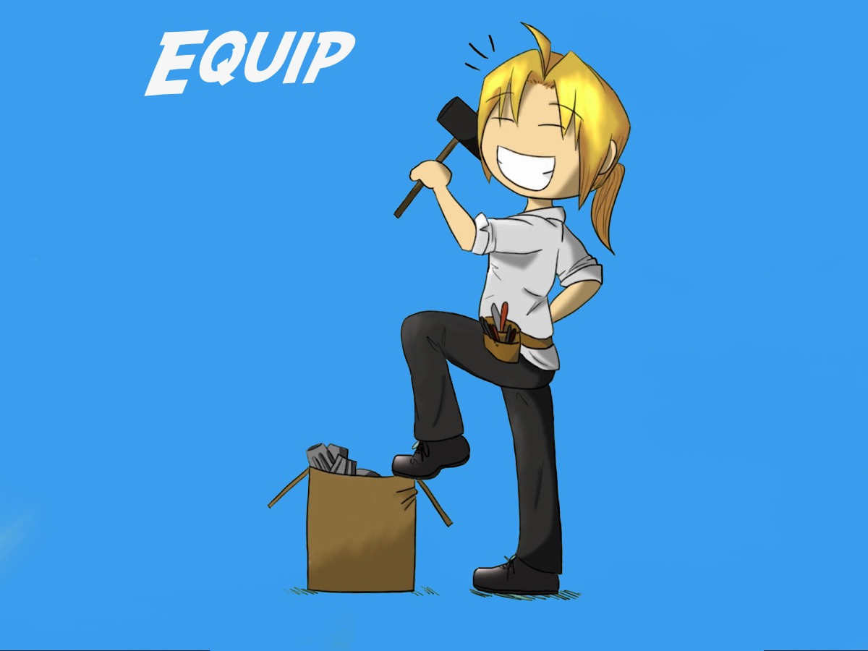

Slide 80


Slide 81

Notes:
All the adult and teen leaders (including Connect leaders) will gather on the 2nd of August from 12:30 to 2.

Slide 82
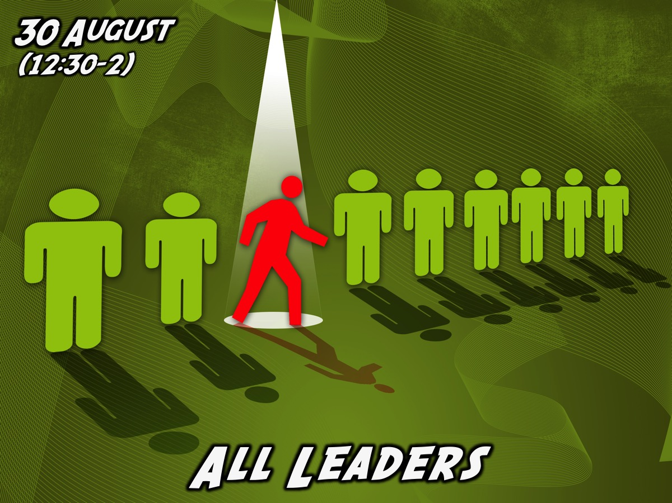
Notes:
All the adult and teen leaders (including Connect leaders) will gather on the 30th August from 12:30 to 2.

Slide 83
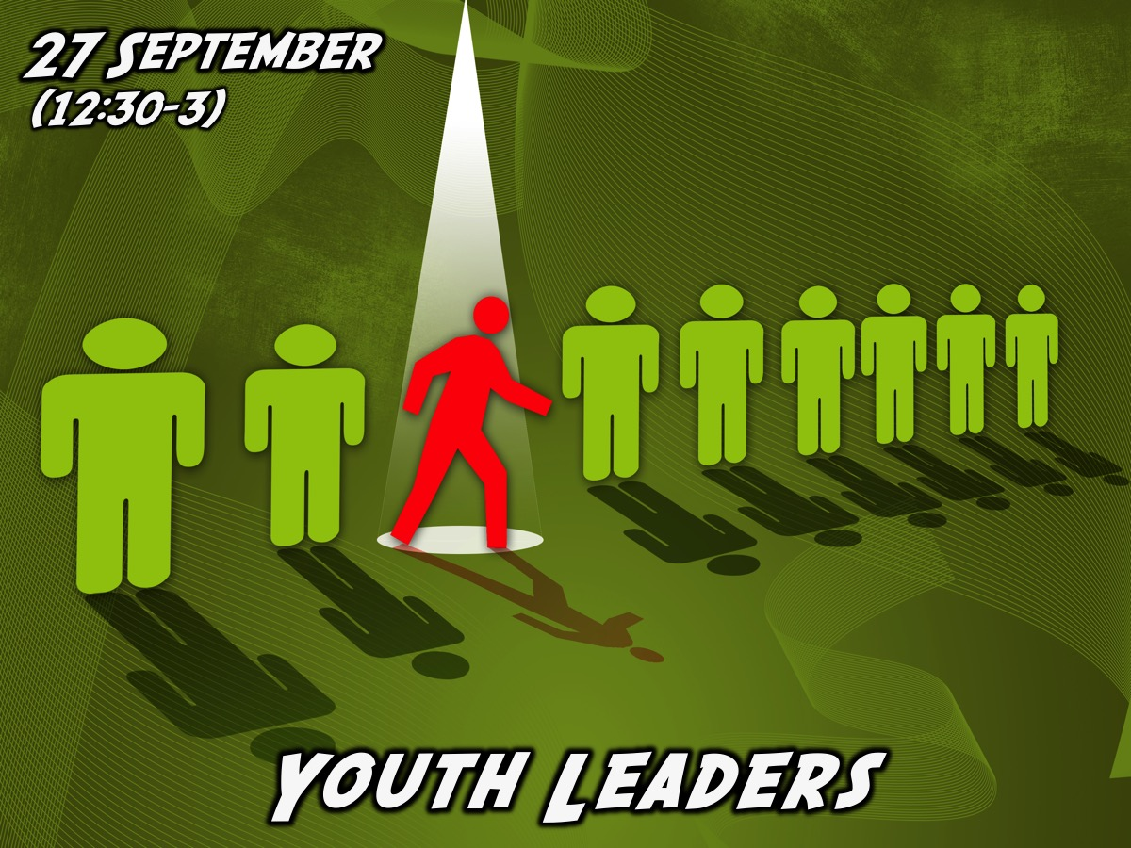
Notes:
The youth leaders will gather to plan Term 4 on the 27th September from 12:30 to 3pm.

Slide 84
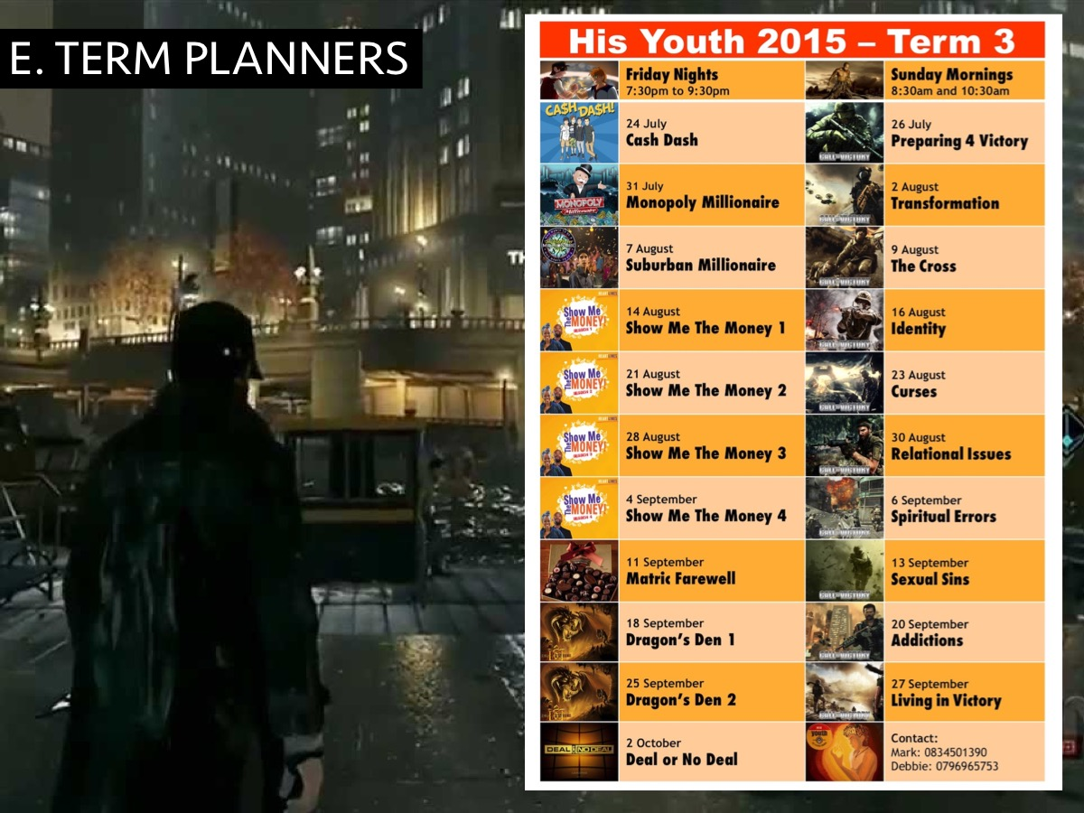
Notes:
E. Term Planners. We create and print a full-colour planner for the term which is handed out to teens at the beginning of the term or when newcomers are welcomed at events. It includes the times of all our events, details of each event and contact numbers for the youth pastors. This planner is uploaded to the Facebook pages and shared on the WhatsApp groups we run.

Slide 85
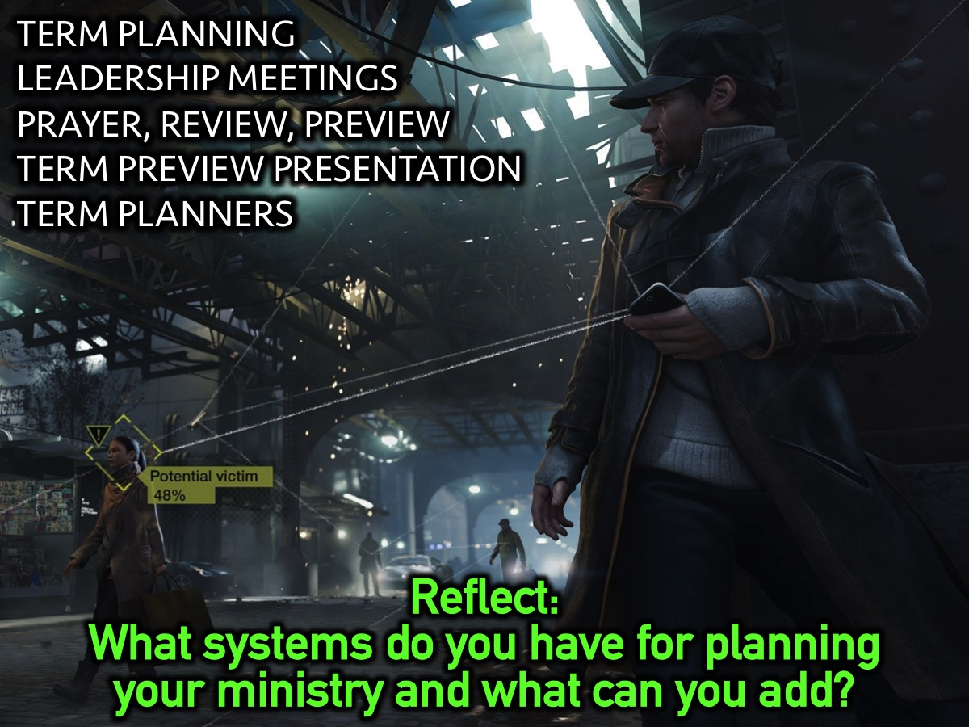
Notes:
Reflect: What systems do you have for planning your ministry and what can you add?

Slide 86
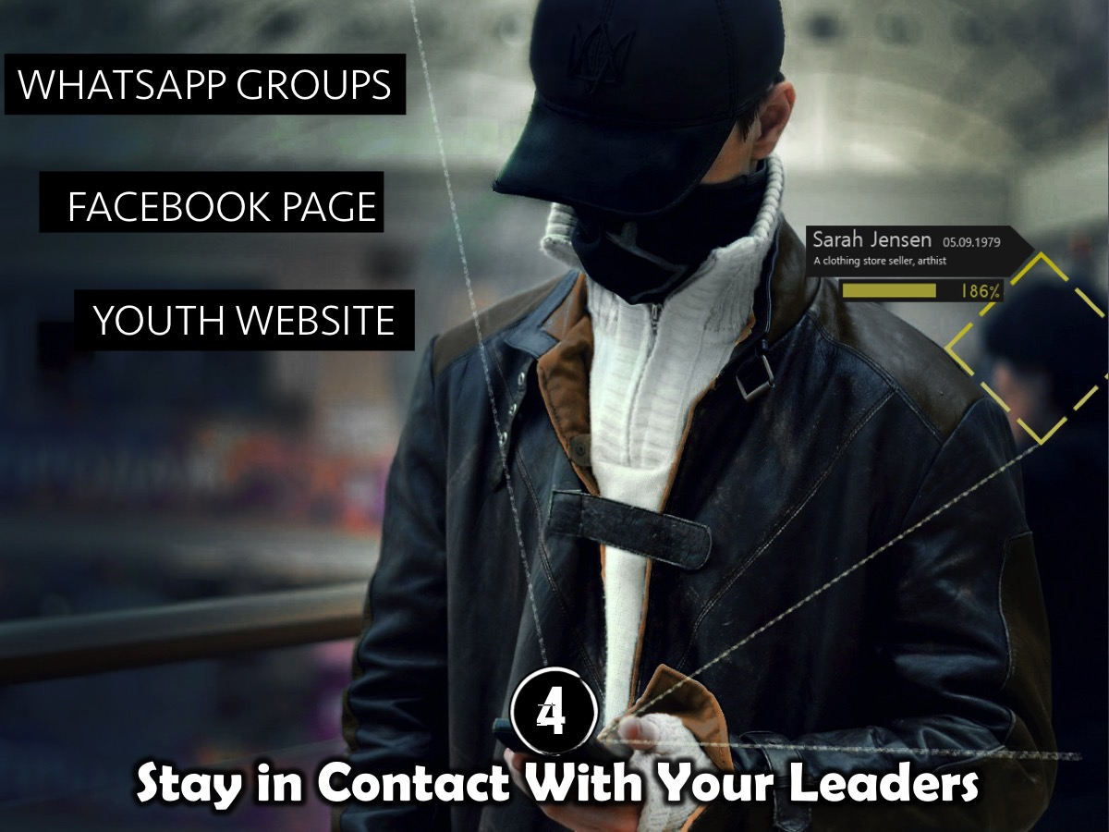
Notes:
4. Stay in Contact With Your Leaders. We have set up a number of different WhatsApp groups to facilitate interaction among the various levels of leadership. We currently have 3 groups: (1) Adult Leaders; (2) Teen and Adult Leaders and (3) Connect Group Leaders. We use our Facebook page to promote upcoming events and also to provide links to download sermon presentations, notes and podcasts. We also have a website that provides links to all our resources.

Slide 87
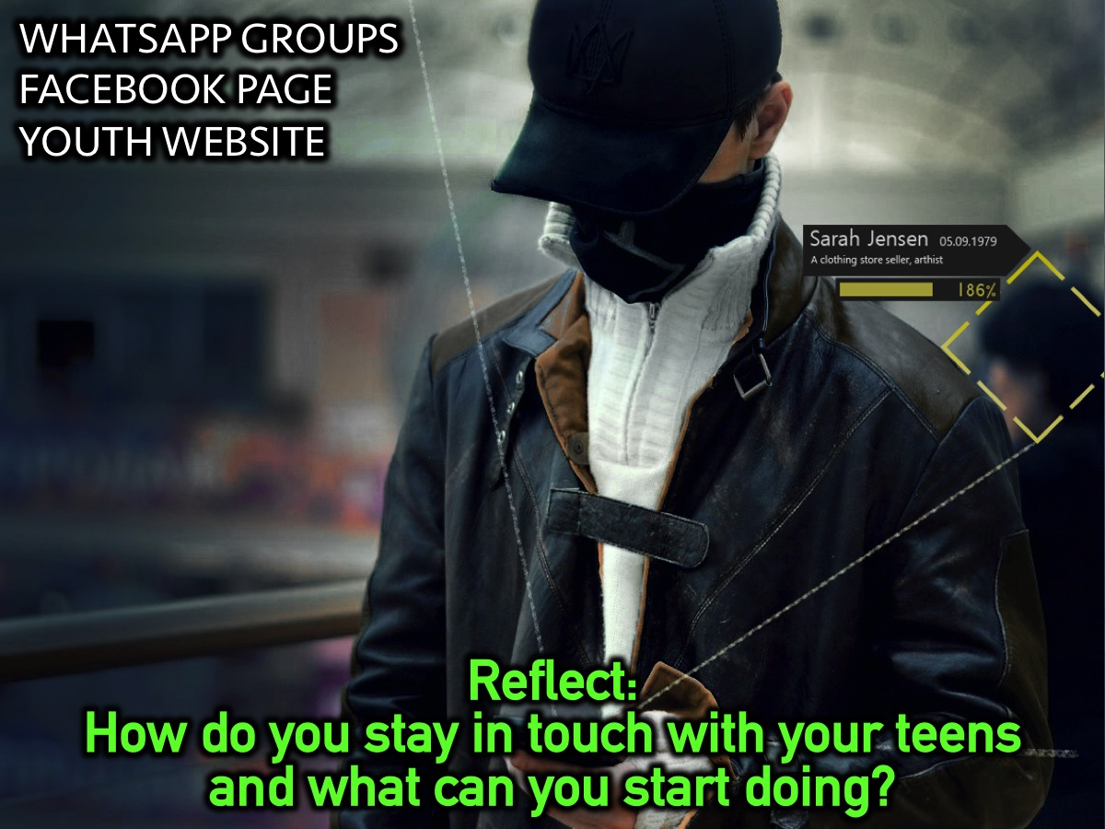
Notes:
Reflect: How do you stay in touch with your teens and what can you start doing?

Slide 88

Notes:
5. Display Your Disciplemaking Strategy. It is helpful to print and display the various aspects of your disciplemaking strategy – this could include your vision statement; the disciplemaking path, your values, etc. We also print a poster for each of our Engage (Friday night) and Establish (Sunday morning) series and display it in the youth group. We also print and display posters each Friday night at our Engage event – and these have even become collectors items for some of our teens.

Slide 89

Notes:
Reflect: How do you display your disciplemaking strategy and what do you need to add ?

Slide 90
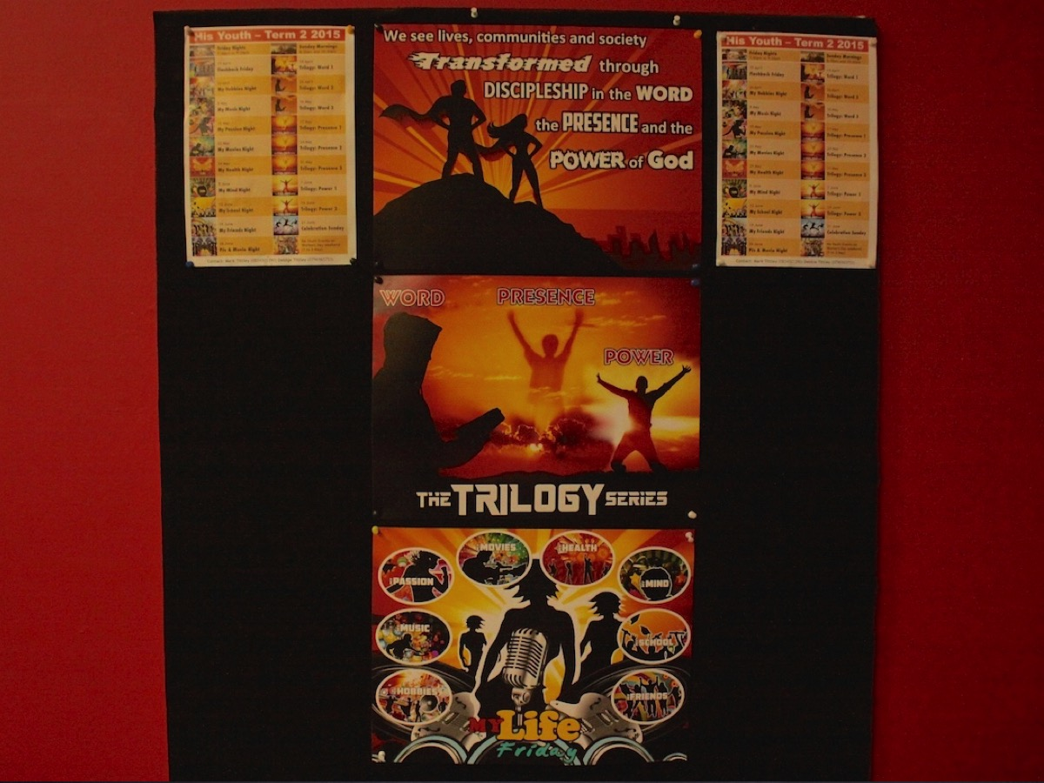
Notes:
Our youth notice board our vision statement and term posters are displayed.

Slide 91
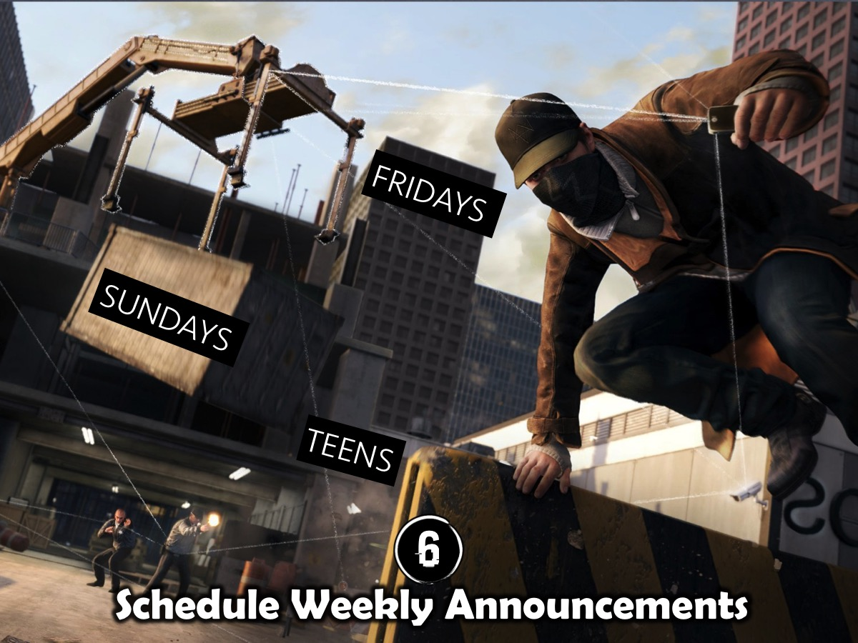
Notes:
6. Schedule Weekly Announcements. All our weekly events include a time of announcements to ensure that teens stay up to date with upcoming events – even though they get the term planner we still link back to the previous event and forward to the upcoming event each week. This is done on Friday nights and on Sunday mornings and we use teenagers to do the announcing rather than adults.

Slide 92


Slide 93
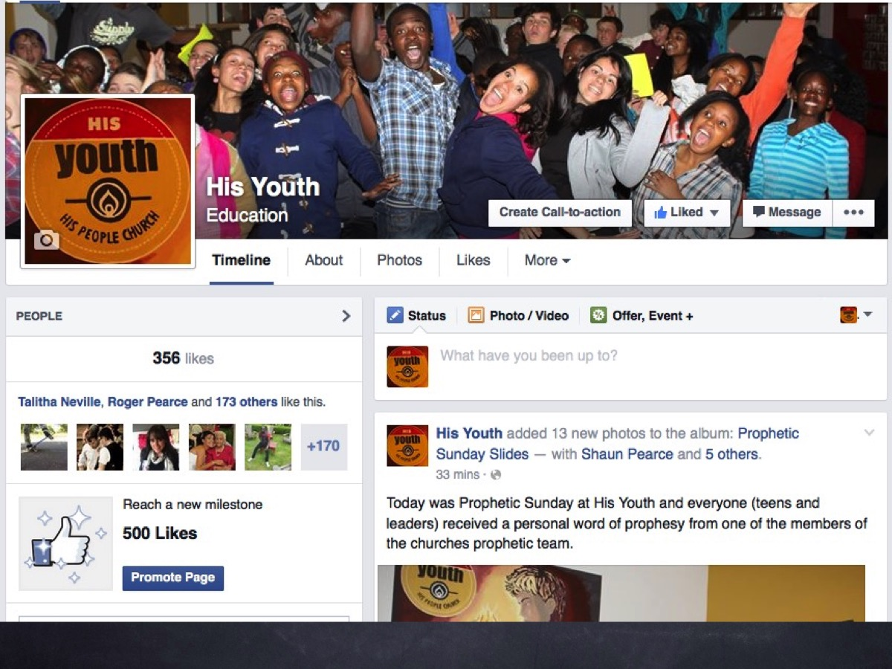

Slide 94


Slide 95


Slide 96
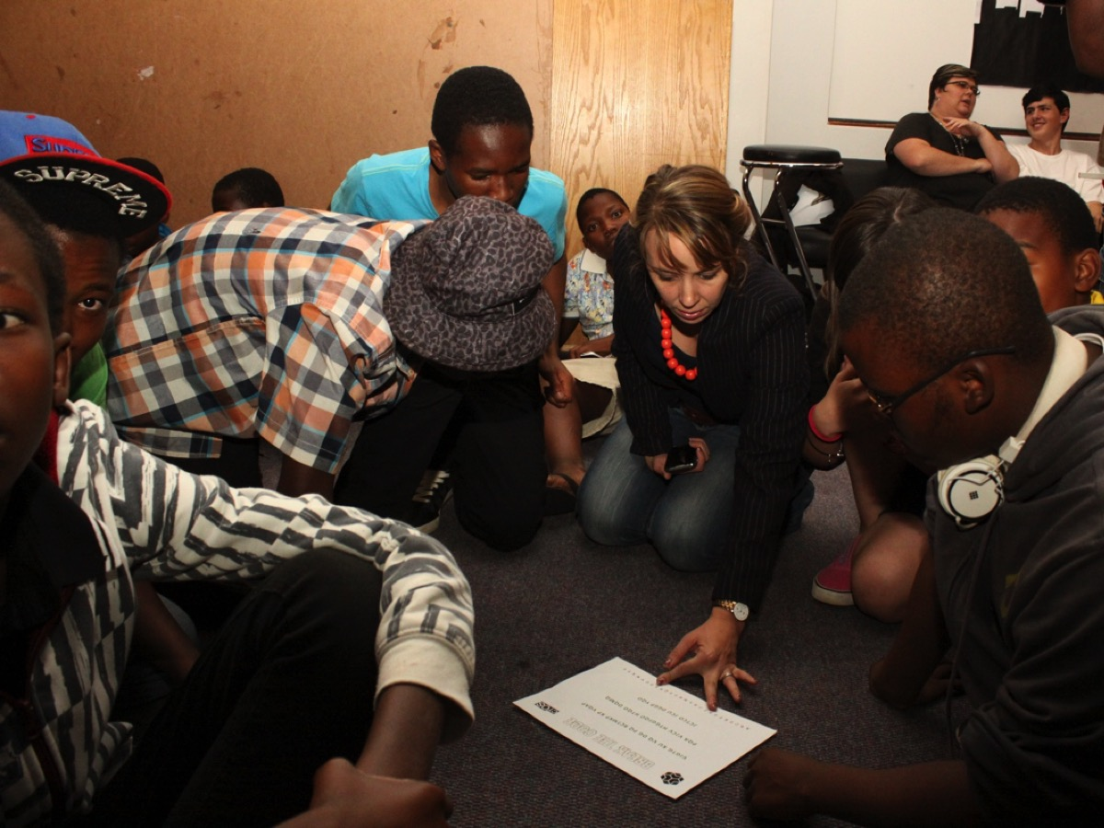

Slide 97
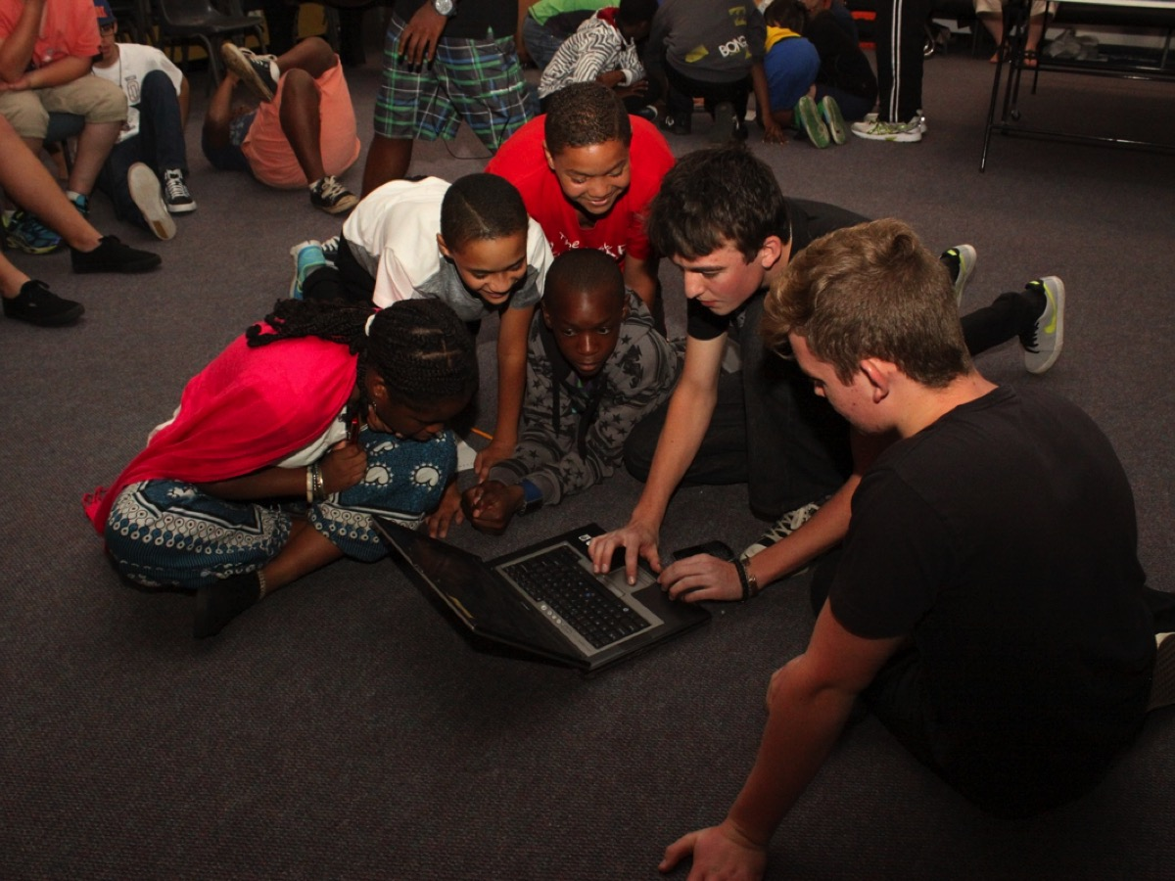

Slide 98


Slide 99


Slide 100

Notes:
Today is week 5 in our Revolution `series!

Slide 101

Notes:
Next Sunday we will be meeting on the top of Northcliff Hill at 6am for our Easter Sunday sunrise service and then coming to church for the 8:30 to 9:30 service.

Slide 102

Notes:
Today is week 5 in our Revolution `series!

Slide 103

Notes:
Reflect: How do you need to improve your weekly announcements?

Slide 104

Notes:
7. Keep Track of Attendance. Developing a system to track attendance is critical to measure growth in your ministry. Our church has a spreadsheet that is updated on a weekly basis and then shared periodically with all the ministry leaders. So on Sunday mornings we do a count of teens, visitors and adult leaders in each service and send the data through to be integrated into the church wide system.

Slide 105

Notes:
Reflect: What system do you have to track attendance at youth events?

Slide 106

Notes:
8. Advertise Your Ministry. This is an area of our ministry that needs to be developed. We have made use of newsletters (specifically aimed at parents); promotional brochures and contributions to our church magazine but are not as consistent as we need to be. Finding someone who will run with this area is critical to ensure that it is done consistently.

Slide 107

Notes:
Reflect: What do you do to advertise your ministry and what should you add?

Slide 108

Notes:
9. Keep a Teen Database. We were using an online database with an SMS and email contact system however the church opted to transition to an app that has not yet taken off among teens. So we find ourselves in a situation where we are currently not contacting teens on a regular basis via SMS but relying on our weekly events to keep teens connected and informed – and of course, the Facebook page helps in this regard as do our various WhatsApp groups. A small youth group could make use of WhatsApp to do this until it gets too big and they make the transition to an online system.

Slide 109

Notes:
Even if you just keep a spreadsheet of teens that would be a great start.

Slide 110

Notes:
Reflect: What system do you have to keep track of teen contact details?

Slide 111

Notes:
10. Create Booklets to Serve the Vision. We have created youth version of all the major resources in the Every Nation movement including the One to One booklet (currently known as the Encounter Book which should probably change to the Engage Book) and the Purple Book (currently known as the Grow Book which should probably change to the Establish Book). This helps us to faithfully transfer the basic to our teens and not have to start from scratch each time we need to share one of the resources. We felt it necessary to create youth-relevant version of all the material to ensure it is interaction and aimed at their level.

Slide 112

Notes:
Here are some of the booklets that we have developed.

Slide 113

Notes:
Reflect: What booklets do you have/need for your disciplemaking process?

Slide 114

Notes:
So, here are some of my keys to administrating ministry: (1) Participate in meetings. (2) Meet with your covering. (3) Create planning systems. (4) Connect with leaders. (5) Display your strategy. (6) Do announcements. (7) Track attendance. (8) Advertise events. (9) Keep a database. (10) Create booklets.

