Slide 1
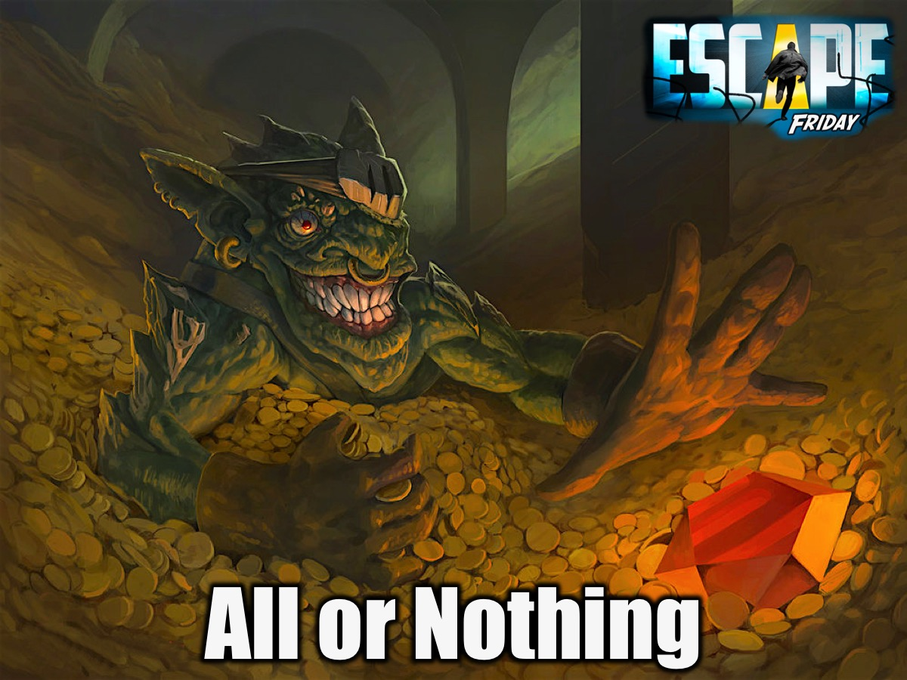
Notes:
This week is All or Nothing Night.

Slide 2

Notes:
Welcome to Escape Friday.

Slide 3

Notes:
On Sunday morning in our Breakout Series we are dealing with Greed.

Slide 4

Notes:
Next Friday is Movie Night.

Slide 5
Notes:
Tonight is our All or Nothing Night.

Slide 6
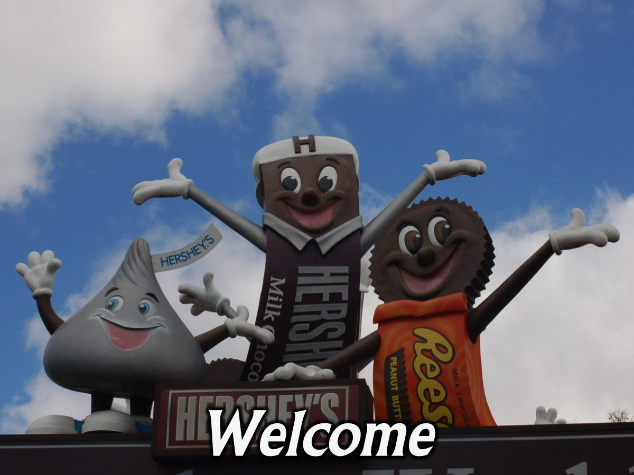
Notes:
Welcome to newcomers and regulars.

Slide 7
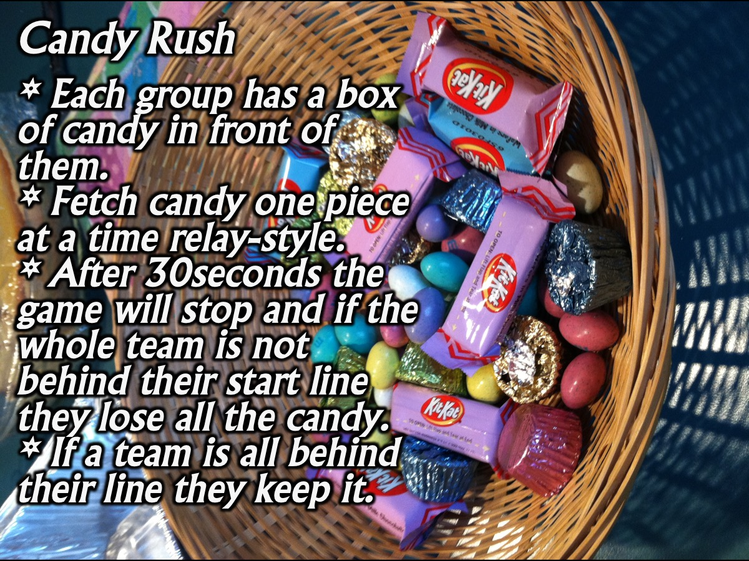
Notes:
1. Candy Rush. Put a container of sweets in front of each group of contestants. Groups have 30 seconds to run relay-style and fetch one sweet at a time and bring it back to their home base. At the end of the 30 seconds you say stop. If they are not behind their home base line they lose all the sweets. If they are all over their home base they keep the sweets they have collected.

Slide 8
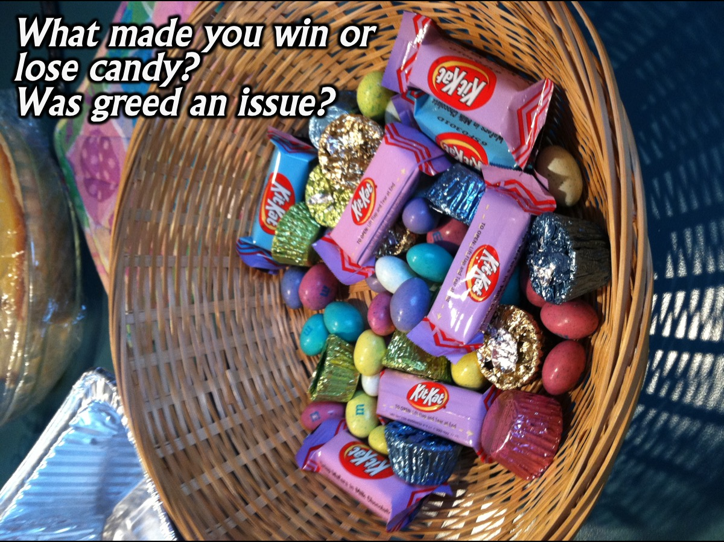
Notes:
Debrief: What made you win or lose candy? Was greed an issue?

Slide 9
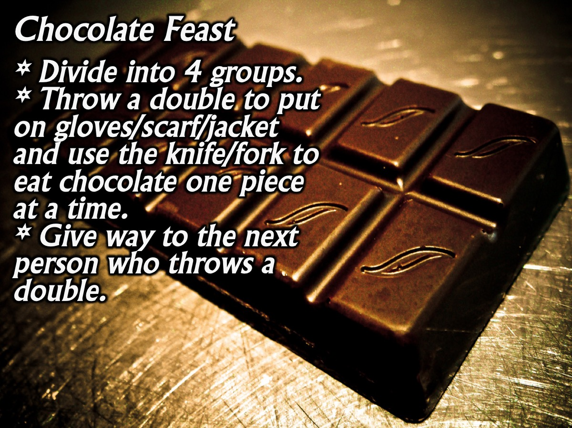
Notes:
2. Chocolate Feast. Divide the big group into five or six smaller groups. Each group is given 2 dice and someone has to throw a pair of sixes before they put on the scarf, gloves and use a knife and a fork to tuck into the slab of chocolate. They can only eat one piece at a time. When the next person throws a double six the person has to stop and take off the gloves and scarf and hand over to the next person who puts on the items and starts to eat chocolate, and so on…

Slide 10

Notes:
Debrief: How did you feel when you did not get to eat enough chocolate?

Slide 11
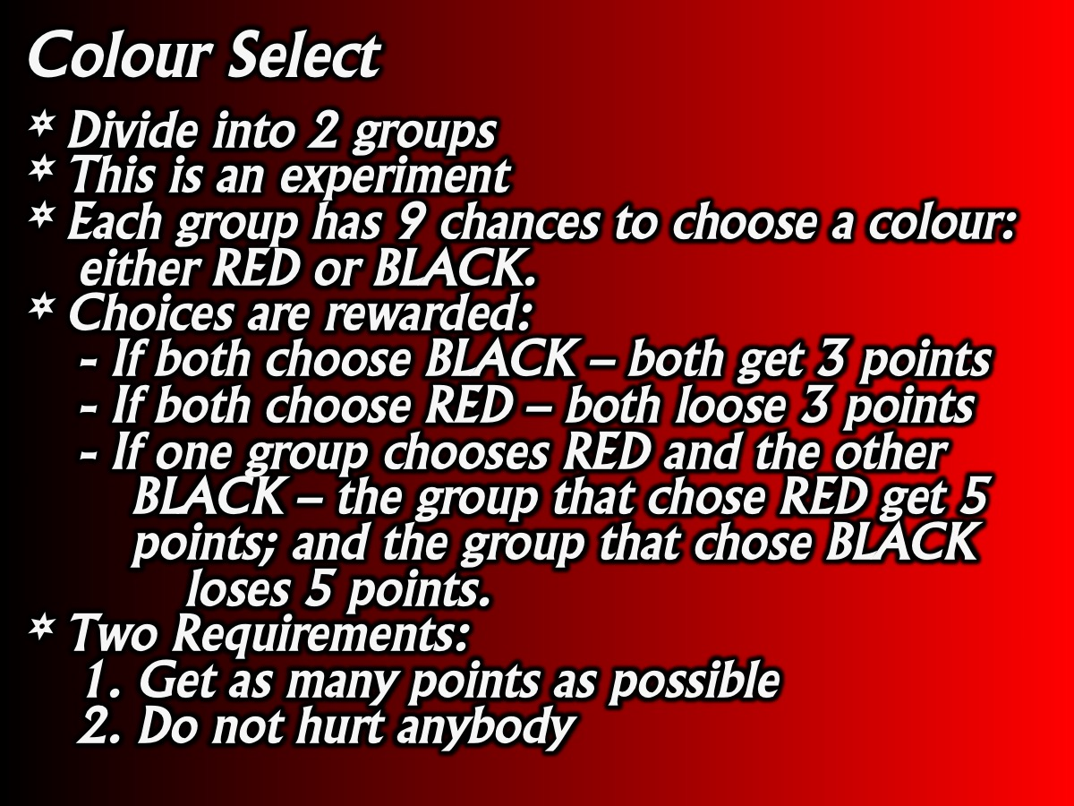
Notes:
3. Colour Select. You need about 20 slips of paper, 2 pencils, and lots of sweets. Divide the large groups into two smaller groups, and explain that an experiment is about to take place. Give the following instructions: Each group will have 9 chances to choose a colour: either RED or BLACK. Choices are rewarded according to the following guidelines:
* If both groups choose BLACK – both get 3 sweets
* If both groups choose RED – both loose 3 sweets
* If one group chooses RED and the other BLACK – the group that chose RED get 5 sweets; and the group that chose BLACK loses 5
Two Requirements: (1) Get as many sweets as possible. (2) Do not hurt anybody.
Game Play: (1) Send the groups to opposite sides of the room and have them decide on their first choice. To make a choice the group simply decides on a colour and writes it on the piece of paper. (2) Then they present their choice to the facilitator. (3) The facilitator rewards the groups according to the instructions. (4) After the 4th or 5th round, ask if the groups want to negotiate – if they do, have them choose a negotiator and give the two negotiators a minute to decide on their strategy for the future choices. Then announce that the next round of choices will be worth three times as much. Continue the game until all rounds are complete.

Slide 12
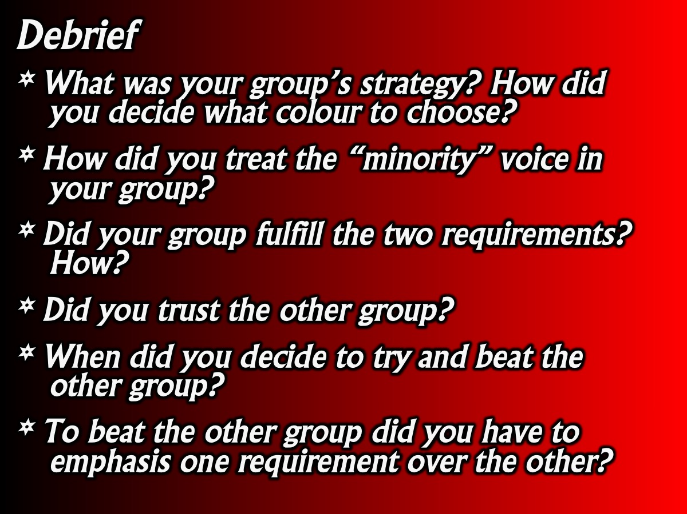
Notes:
Debrief
* What was your group’s strategy? How did you decide what colour to choose?
* How did you treat the “minority” voice in your group?
* Did your group fulfill the two requirements? How?
* Did you trust the other group?
* When did you decide to try and beat the other group?
* To beat the other group did you have to emphasis one requirement over the other?
Conclusion
No mention was made of competition, beating or winning – this is our natural tendency! If both or one group became involved in competition even though no mention was made that the exercise was based on competition lines, suggest that this is our natural tendency to satisfy our ego through being superior to others, or for selfishness and greed. Ultimately this is the cause of poverty, war and oppression in the world. The Bible calls it sin!

Slide 13
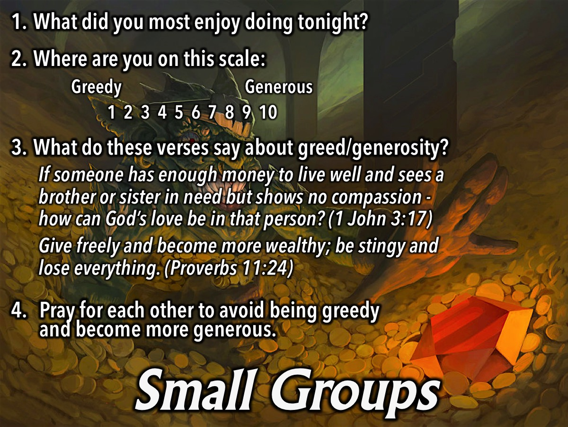
Notes:
Small Groups. Here are the small group questions: (1) What did you most enjoy doing tonight? (2) Where are you on the scale of 1 to 10 - where 1 is Greedy and 10 is Generous. (3) What do these verses say about greed/generosity? “If someone has enough money to live well and sees a brother or sister in need but shows no compassion - how can God’s love be in that person?” (1 John 3:17). “Give freely and become more wealthy; be stingy and lose everything”. (Proverbs 11:24). (4) Pray for each other to avoid being greedy and become more generous.

Slide 14

Notes:
Don’t forget that next Friday is Movie Night - bring a friend.

Slide 15

Notes:
Refreshments are served.

Slide 16
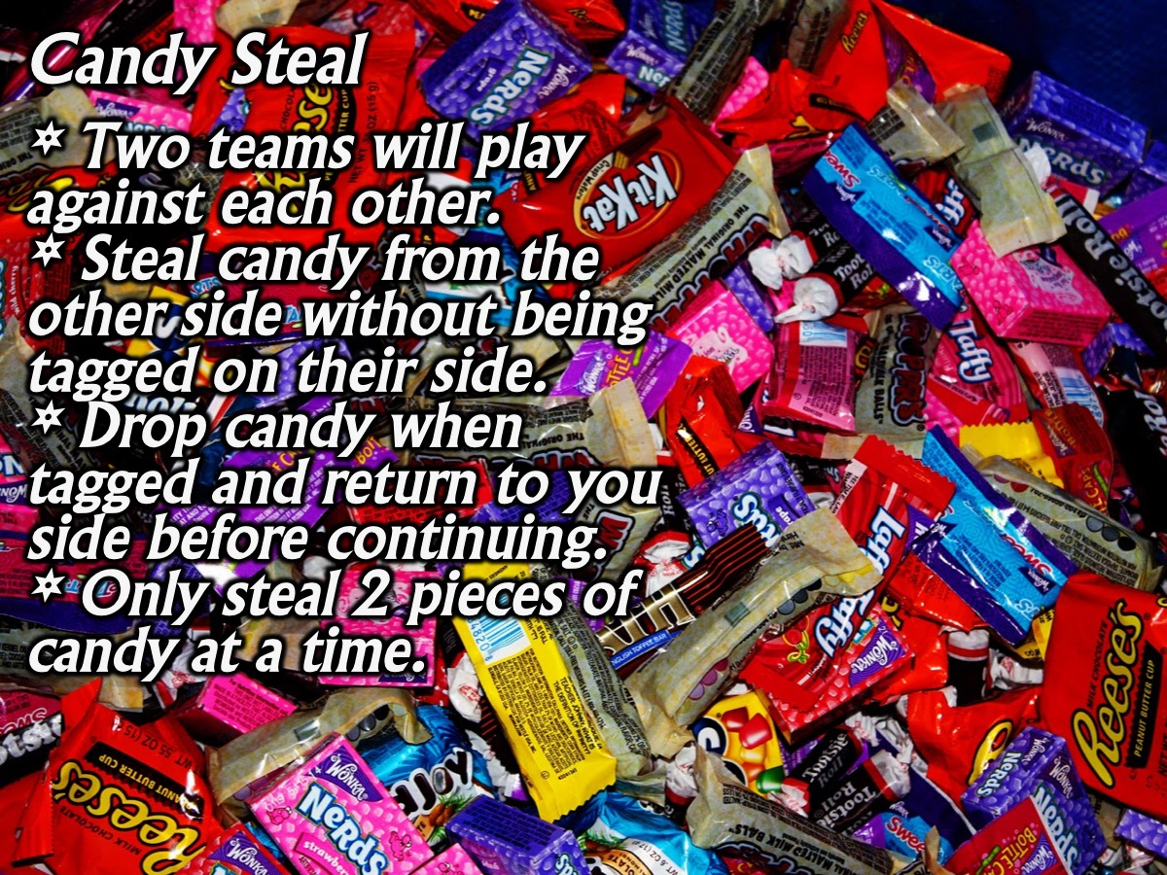
Notes:
Optional Game: Candy Steal. Buy 100 or 200 wrapped candy. Get masking tape to divide the playing area into two halves. Mark a line dividing the playing area in half. Divide the group into two even teams. Throw on the ground an even amount of candy on each side. On GO, players run to the opposing team’s side, grabbing up to two pieces of candy at a time and bringing the them back to their side of the playing area. If tagged while on the opposing team’s side, players drop the candy in their hands and travel back to their side empty handed. Once back on their side, players can continue to grab more candy. The team with the most candy on their side at the end of the game wins. Play for as long as you want, then end the game when time is up. Note: Some players might attempt to grab more than two candy at a time. If that happens, it’s okay. You’re actually setting up that opportunity as a teachable moment for the small group time.

