Slide 1

Notes:
This Friday is a preview of the Alpha Night series for Friday nights.

Slide 2

Notes:
Let’s open our meeting in prayer.

Slide 3
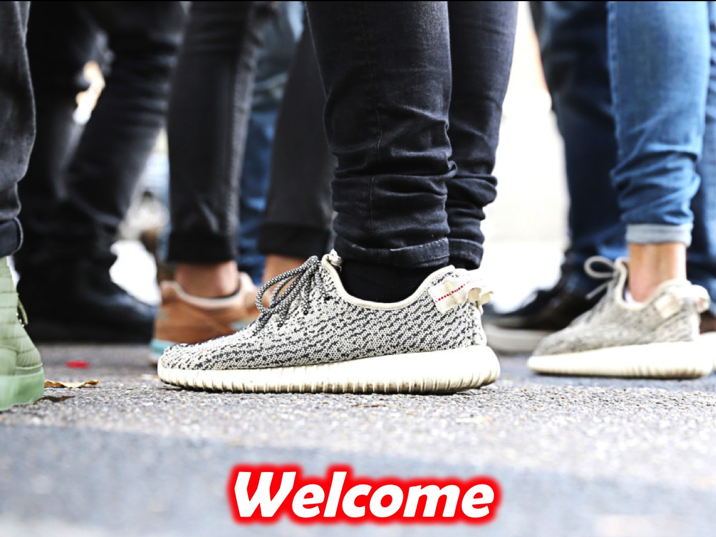
Notes:
Welcome to newcomers and regulars.

Slide 4

Notes:
Next Friday night is the first of our Alpha Friday nights and we will be answering the question: Life: Is this is?

Slide 5

Notes:
On Sunday morning we are launching a brand new series: The Replicate Series

Slide 6
Notes:
This Friday is a preview of the Alpha Night series for Friday nights…

Slide 7
Notes:
Video: Youth Alpha Trailer. Get it on YouTube at: https://www.youtube.com/watch?v=CNnagAo1ns4

Slide 8

Notes:
Welcome to Alpha - this is the first night of a 10 week journey. Tonight we are going to experience what an Alpha night is all about - in fact, we will preview next week’s night (and add some guidelines along the way about how we can run it really well).

Slide 9

Notes:
But first it is time for dinner! Enjoy the meal and be sure to catch up with each person at your table and make sure they feel part of the family - especially if they are newcomers.

Slide 10

Notes:
For the next 30 minutes or so, we will be watching a video and pausing along the way to discuss three questions that are raised…

Slide 11
Notes:
Video Clip 1 - the full 18 minute clip has been cut into 4 smaller parts - pausing to allow time for discussion around the tables before carrying on with the next part of the longer video. Get the full video on YouTube at: bitly.com/YouthAlpha1

Slide 12
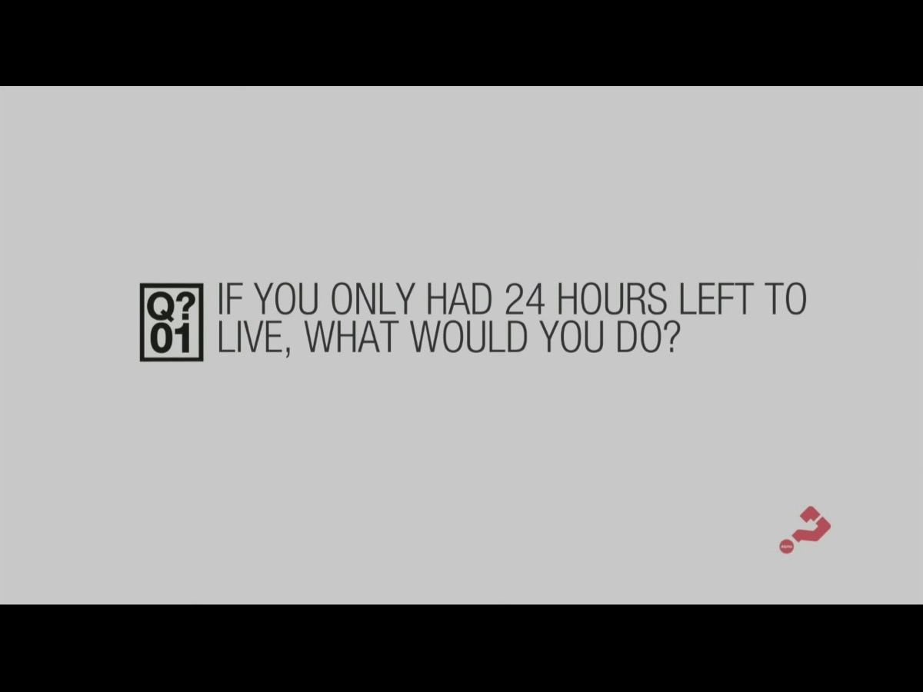
Notes:
Question 1: If you only had 24 hours left to live, what would you do?

Slide 13
Notes:
Video Clip 2 - here is the second video clip.

Slide 14

Notes:
Question 2: Why do you think people find it it awkward to talk about their religious beliefs?

Slide 15
Notes:
Video Clip 3 - here is the third video clip.

Slide 16

Notes:
Question 3: Assuming God is real; if you could ask God one question, what would you ask?

Slide 17
Notes:
Video Clip 4 - here is the last of our video clips for tonight.

Slide 18

Notes:
Time for refreshments - thank you all for coming, we trust you have enjoyed the evening and will come back next Friday night. Refreshments are served.

Slide 19
Notes:
Here is a preview of the questions that we will be exploring during the next 10 weeks (including two sessions on a Saturday afternoon):

Slide 20

Notes:
Life: Is This It? (29th July)

Slide 21
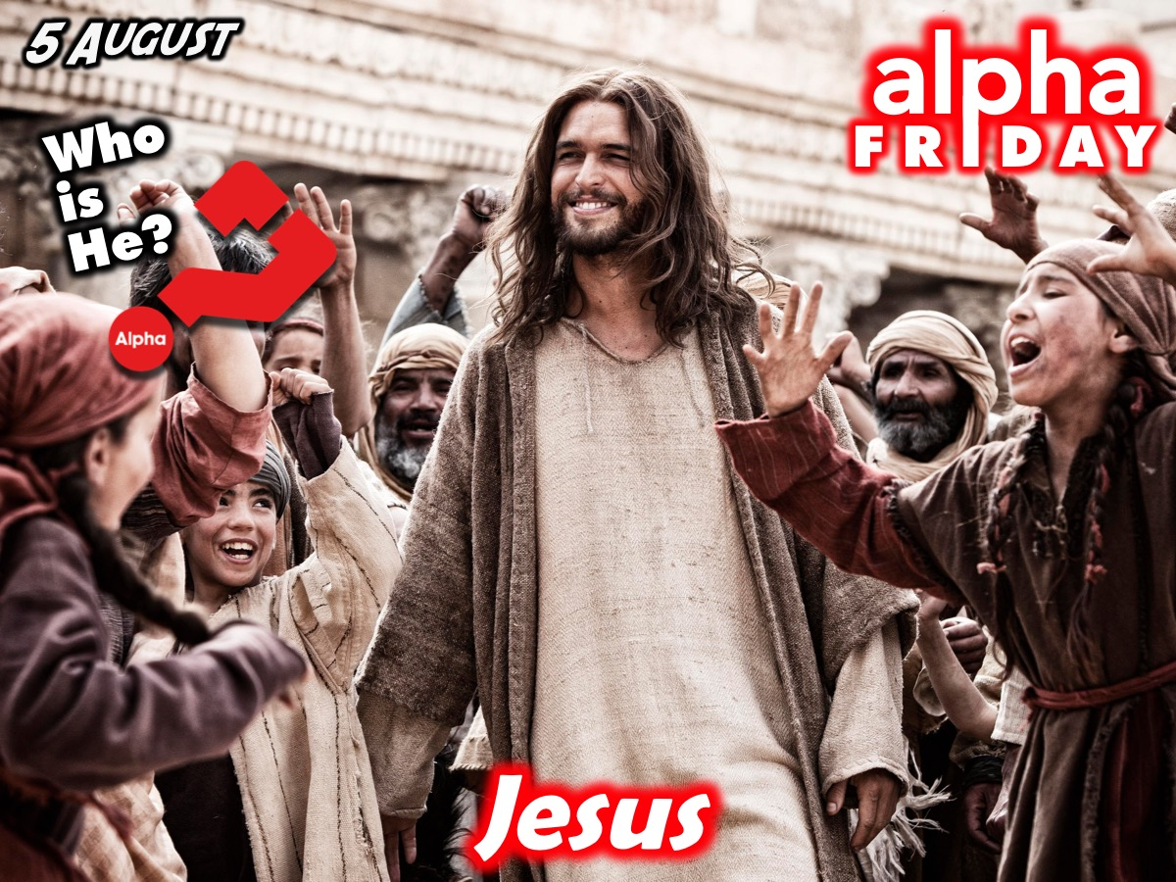
Notes:
Jesus: Who is He? (5 August)

Slide 22

Notes:
Cross: Why did Jesus Die? (12 August)

Slide 23
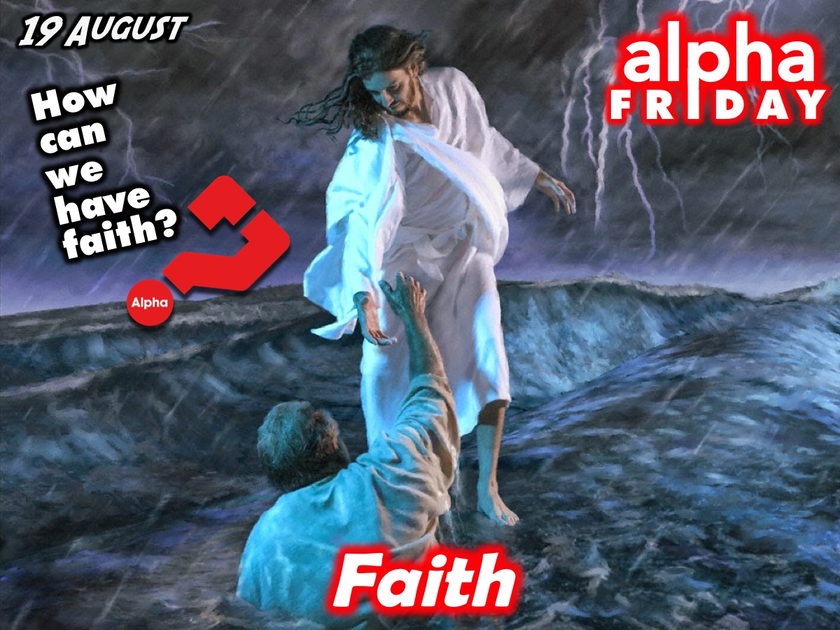
Notes:
Faith: How Can We have Faith? (19 August)

Slide 24

Notes:
Prayer: Why and How Do I Pray? (26 August)

Slide 25

Notes:
Bible: Why and How Do I Read the Bible? (2 September)

Slide 26

Notes:
Spirit: Who is the Holy Spirit and What Does He do? (Saturday 3 September)

Slide 27

Notes:
Fill: How Can I Be Filled with the Holy Spirit? (Saturday 3 September)

Slide 28
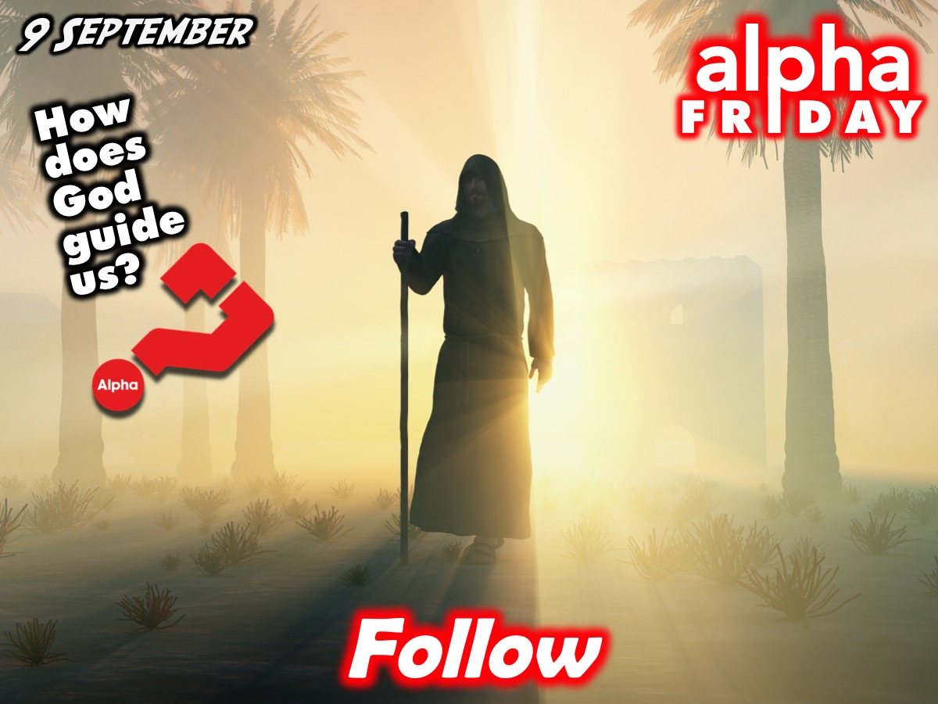
Notes:
Follow: How Does God Guide Us into Full Life? (9 September)

Slide 29

Notes:
Evil: How Can I Resist Evil? (16 September)

Slide 30

Notes:
Healing: Does God Heal Today? (23 September)

Slide 31

Notes:
Church: What about the Church and Telling Others? (30 September)

Slide 32

Notes:
Here are all the questions we will be answering this term on Friday nights.

Slide 33

Notes:
You need to invite an unsaved friend, given them one of these flyer’s and get them to attend from next Friday night.

Slide 34
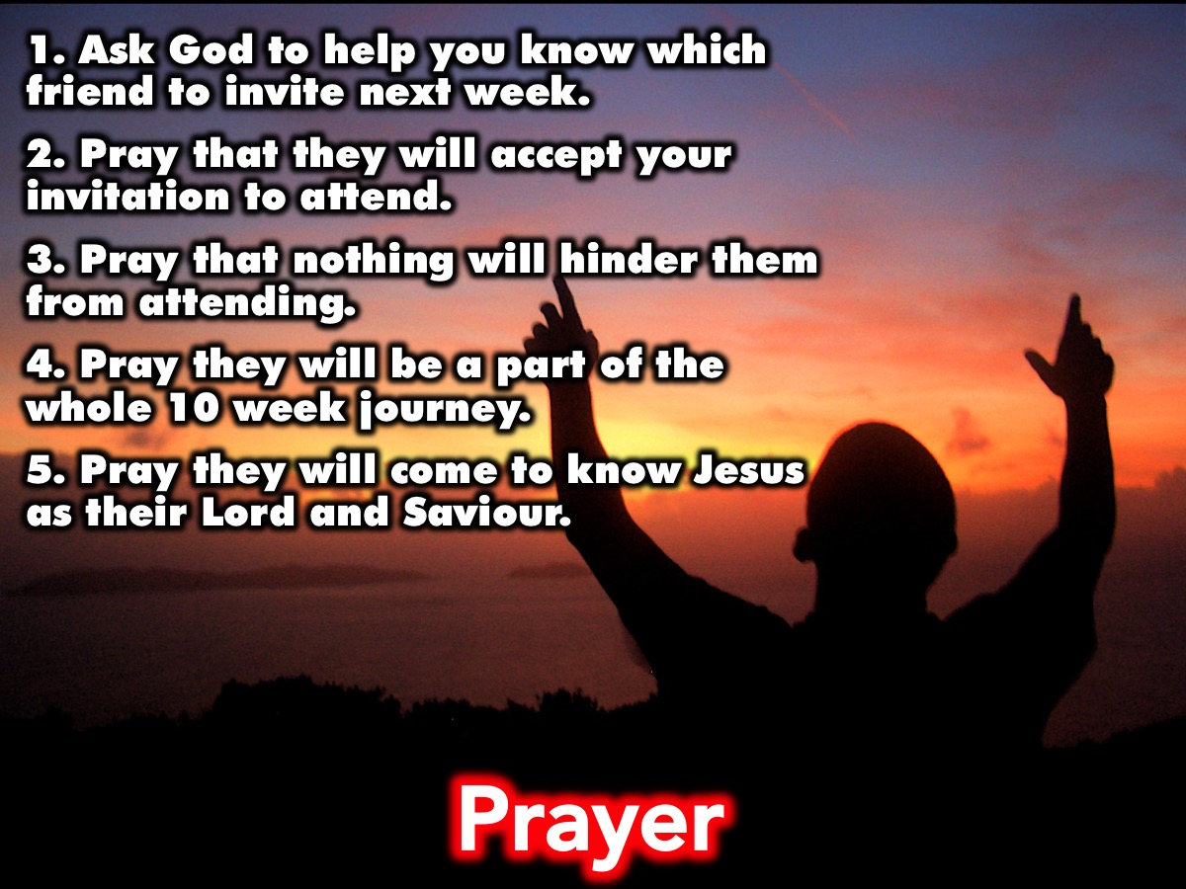
Notes:
Prayer: Let’s spend some time around our tables praying: (1) Ask God to help you know which friend to invite next week. (2) Pray that they will accept your invitation to attend. (3) Pray that nothing will hinder them from attending. (4) Pray they will be a part of the whole 10 week journey. (5) Pray they will come to know Jesus as their Lord and Saviour.

Slide 35
Notes:
Next Friday night is the first of our Alpha Friday nights and we will be answering the question: Life: Is this is?

Slide 36
Notes:
On Sunday morning we are launching a brand new series: The Replicate Series - it is all about how we can reproduce ourselves into the lives of our friends.

Slide 37

Notes:
It is time for Refreshments.

