Slide 1

Notes:
This Friday is Week 5 of the Alpha Friday series.

Slide 2
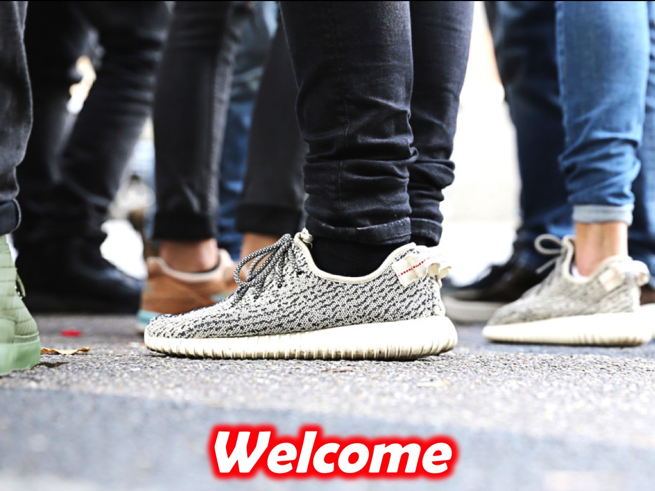
Notes:
Welcome to newcomers and regulars.

Slide 3

Notes:
Welcome to Alpha - this is the fifth night of a 10 week journey.

Slide 4

Notes:
But first it is time for dinner! Enjoy the meal and be sure to get to know people at your table.

Slide 5

Notes:
For the next 30 minutes or so, we will be watching a video and pausing along the way to discuss three questions that are raised…

Slide 6
Notes:
Video Clip 1 - the full clip has been cut into 4 smaller parts - pausing to allow time for discussion around the tables before carrying on with the next part of the longer video. Get the full video on YouTube at: bitly.com/YouthAlpha5

Slide 7

Notes:
Question 1: If you could be any superhero, who would you be?

Slide 8
Notes:
Video Clip 2 - here is the second video clip.

Slide 9
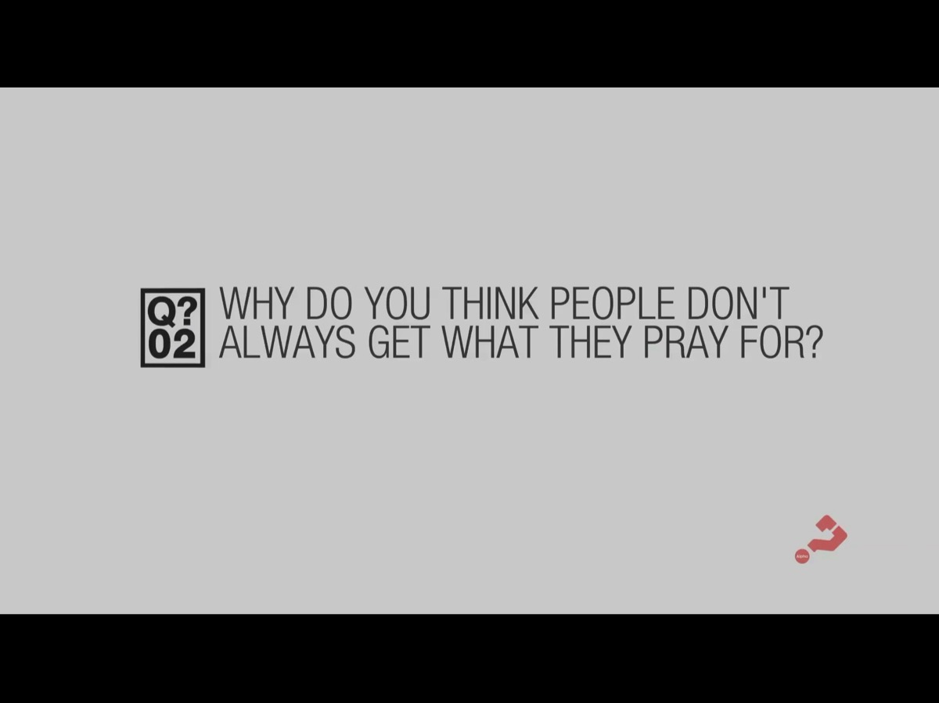
Notes:
Question 2: Why do you think people don’t always get what they pray for?

Slide 10
Notes:
Video Clip 3 - here is the third video clip.

Slide 11
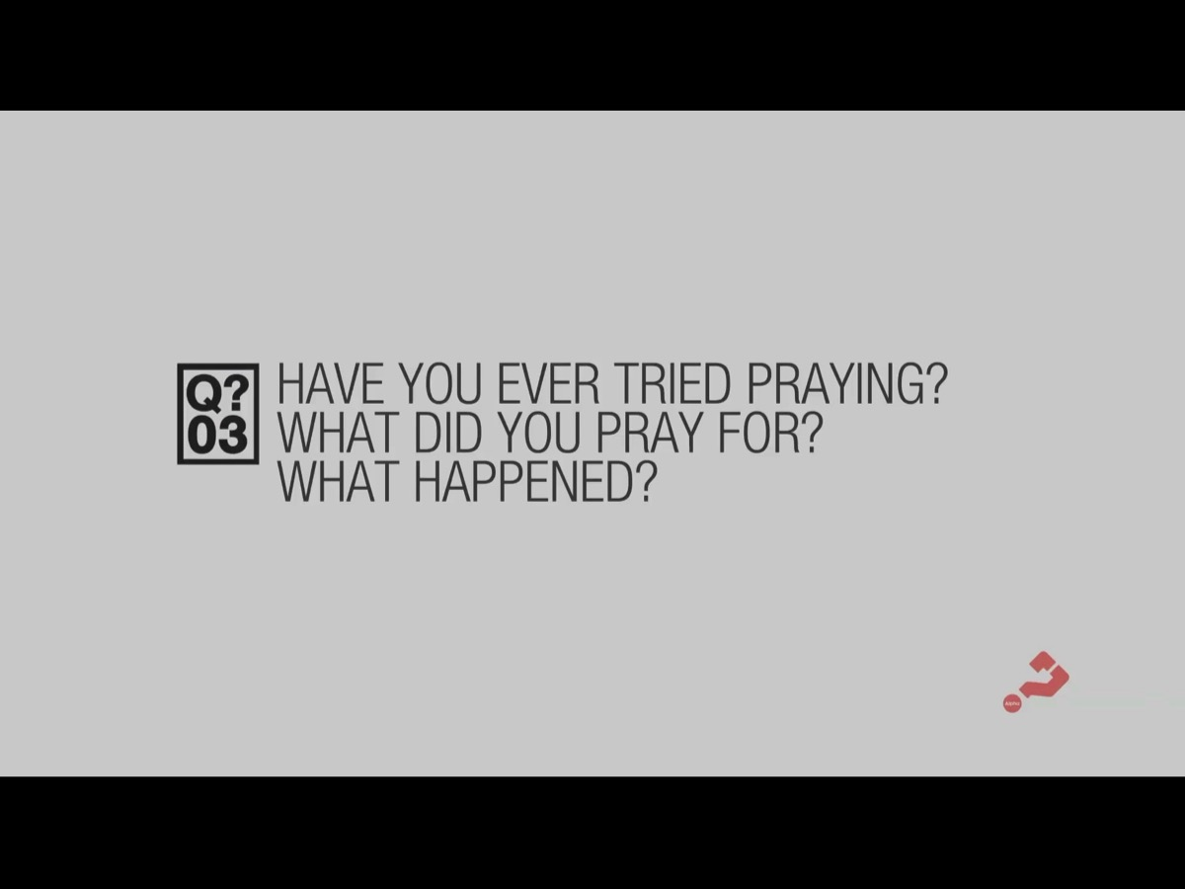
Notes:
Question 3: Have you ever tried praying? What did you pray for? What happened?

Slide 12
Notes:
Video Clip 4 - here is the last of our video clips for tonight.

Slide 13
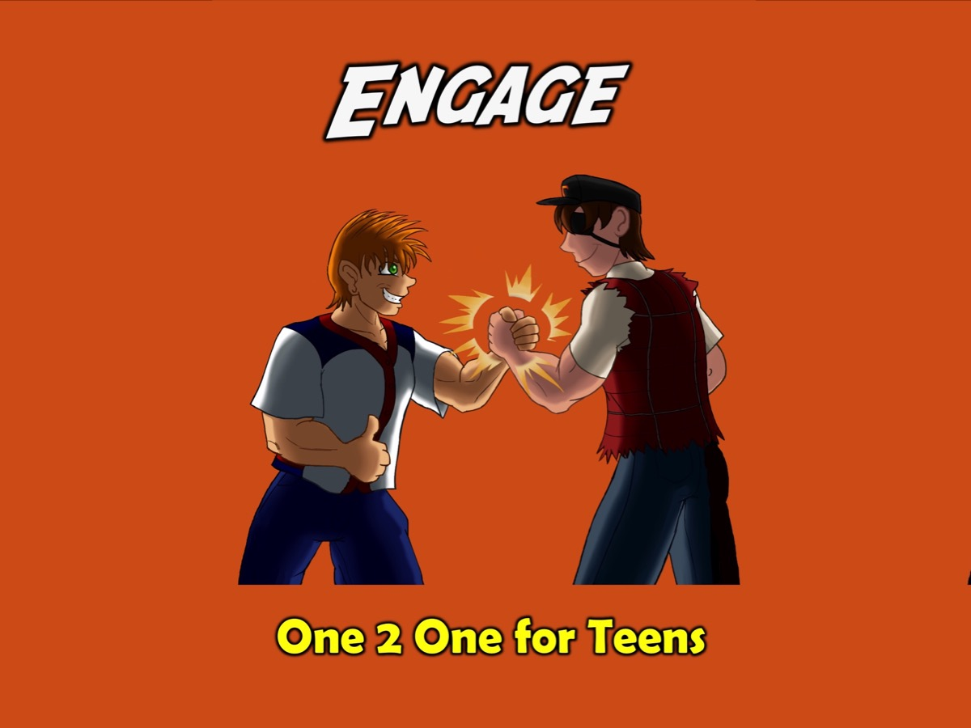
Notes:
Challenge: If you were challenged tonight by the video and joined in the prayer at the end of the video, we would like to give you a copy of our Engage booklet and have one of our leaders follow up with you. The leader at each table has some booklets with them and they will also take your contact details.

Slide 14

Notes:
Next week we will continue our journey in the Alpha series with Bible: Why and How Do I Read the Bible?

Slide 15
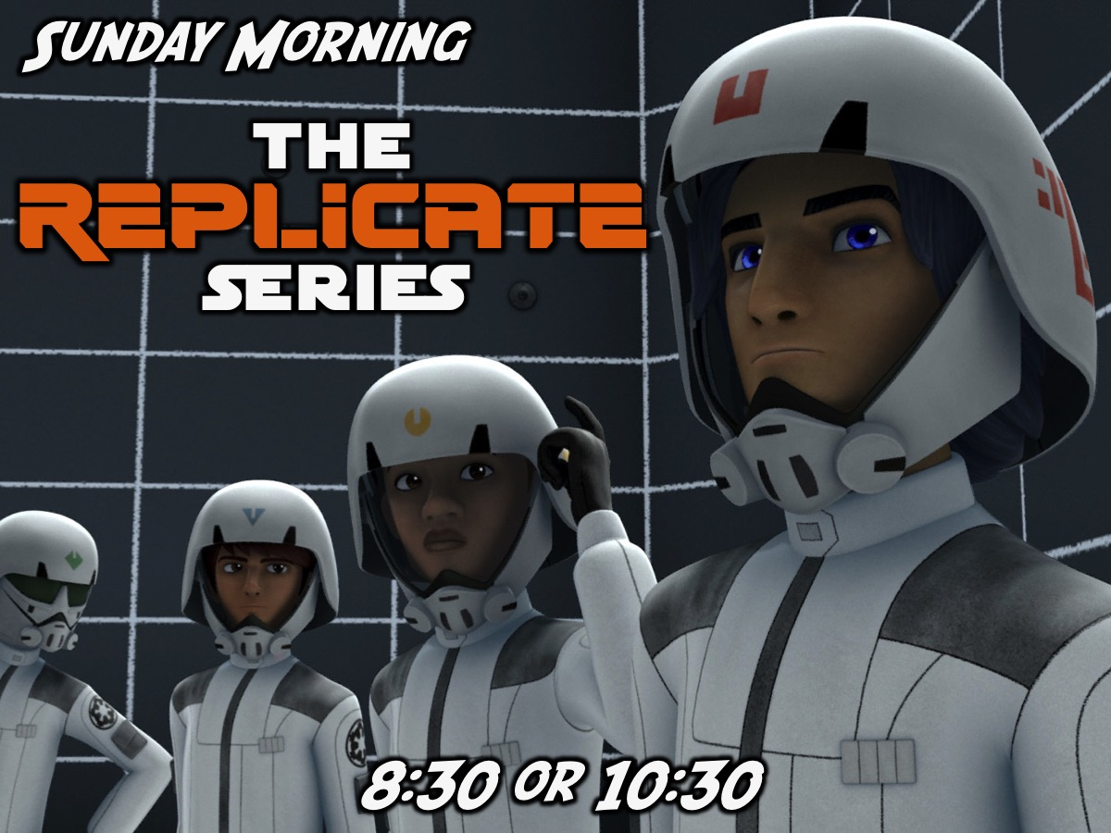
Notes:
On Sunday mornings we meet at 8:30 or at 10:30 - starting in the main sanctuary downstairs before coming upstairs to the youth room. We are busy with the Replicate Series.

Slide 16

Notes:
It is time for Refreshments - thank you all for coming, we trust you have enjoyed the evening and will come back next Friday night. Refreshments are served.

