Slide 1
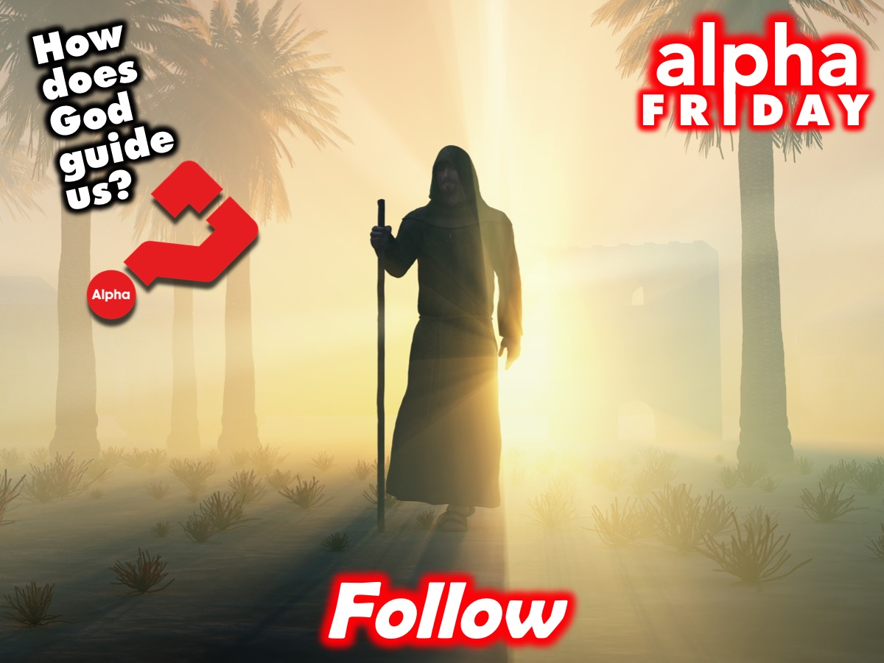
Notes:
This Friday is Week 7 of the Alpha Friday series. Here are the notes from this week’s session:
Follow
God has a great plan for our lives and He guides us into a new and better way of living. As we follow Jesus, our lifestyles are transformed.
“We’ve got to grab onto Jesus and trust Him, because He can see what we can’t, and He’s guiding us to a full life.” - Ben
Question One
Have you ever been lost before? What happened?
A New Way Of Living
+ “Don’t copy the behaviour and customs of this world, but let God transform you into a new person by changing the way you think. Then you will learn to know God’s will for you.” - Romans 12:2
+ One Bible translator, J.B. Phillips, puts it this way: “Don’t let the world around you squeeze you into its mould.”
+ “It wasn’t really about me being allowed or not allowed to do one thing or another, as if I was afraid God was going to strike me with lightning; but that God really loves me, and has a plan for my life, and He wants what’s best for me.” - Jason
+ God leads us into the fullest life.
Our Relationship With God Impacts The Way We Speak
+ “With the tongue we praise our Lord and Father, and with it we curse human beings, who have been made in God’s likeness. Out of the same mouth come praise and cursing. My brothers and sisters, this should not be.” - James 3:9-10
Following Jesus Transforms The Way We Treat Others
+ As we experience God’s love for us, we begin to love others more.
How Does God Guide Us?
+ This episode mentions four different ways that God can guide us through life:
• The Bible
• Our Conscience
• The voice of the Holy Spirit
• Advice from Others (This comes up between question 2 and 3 in the episode)
Question Two
Are God’s instructions old-fashioned and irrelevant or do they still matter today?
• How could the Bible, written so long ago, still be helpful today?
• Do you think God’s instructions bring freedom or inhibit freedom?
A New Way Of Living (continued)
Our Relationship With God Changes The Way We See Money And Possessions
+ “I was really impacted by the words of Jesus: ‘It’s better to give than to receive’” – Kris
Following Jesus Impacts Our Views On Sexuality
+ “Sex has the power to bring people together, build families and give life. And because it’s powerful, it can also cause a lot of damage when it’s misused.” - Jason
New Beginnings
+ “Your yesterday doesn’t determine your tomorrow.” - Ben
+ “Because of the Lord’s great love we are not consumed, for his compassions never fail. They are new every morning; great is your faithfulness.” - Lamentations 3:22-23
+ When a person becomes a Christian, they’re a new person. Their identity, the very core of who they are, is changed by Jesus.
+ “God’s got a great plan for your life, and He wants to guide you along the way.” - Jason
Question Three
How do you feel about the idea that God has a plan for your life?
• Do you think God controls our destiny and guides us, or do we control our own destinies?
God Is A Good Father Who Wants The Best For Us
+ “God gives us boundaries so that we can enjoy life to the fullest. And this is the great paradox: God’s instructions don’t restrict us; they make us free.” - Jason
+ As we pursue God’s will in our lives, we can count on Him to lead.
+ “The Lord is my shepherd, I lack nothing. He makes me lie down in green pastures, he leads me beside quiet waters, he refreshes my soul. He guides me along the right paths for his name’s sake. Even though I walk through the darkest valley, I will fear no evil, for you are with me; your rod and your staff, they comfort me.” - Psalm 23:1-4

Slide 2

Notes:
Welcome to newcomers and regulars.

Slide 3

Notes:
Welcome to Alpha - this is the seventh night of a 10 week journey.

Slide 4

Notes:
But first it is time for dinner! Enjoy the meal and be sure to get to know people at your table.

Slide 5

Notes:
For the next 30 minutes or so, we will be watching a video and pausing along the way to discuss three questions that are raised…

Slide 6
Notes:
Video Clip 1 - the full clip has been cut into 4 smaller parts - pausing to allow time for discussion around the tables before carrying on with the next part of the longer video. Get the full video on YouTube at: bitly.com/YouthAlpha7

Slide 7
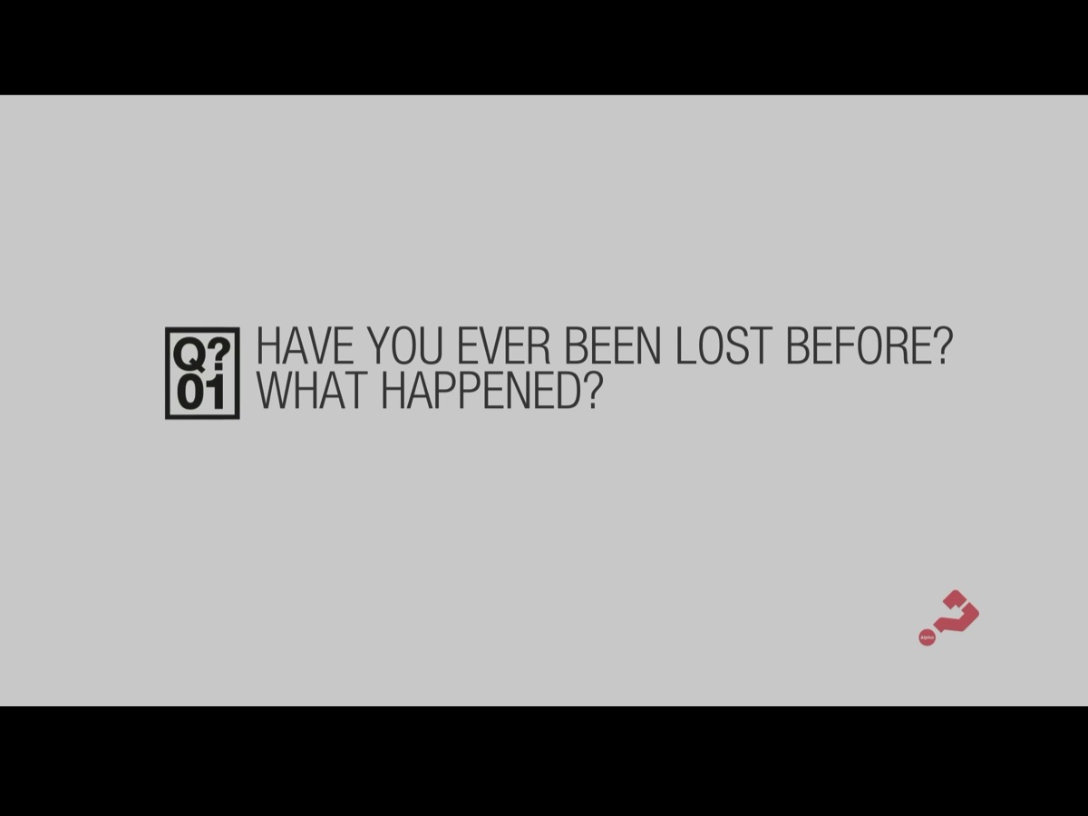
Notes:
Question 1: Have you ever been lost before? What happened?

Slide 8
Notes:
Video Clip 2 - here is the second video clip.

Slide 9

Notes:
Question 2: Are God’s instructions old fashioned and irrelevant or do they still matter today?

Slide 10
Notes:
Video Clip 3 - here is the third video clip.

Slide 11

Notes:
Question 3: How do you feel about the idea that God has a plan for your life?

Slide 12
Notes:
Video Clip 4 - here is the last of our video clips for tonight.

Slide 13

Notes:
Next week we will continue our journey in the Alpha series with Evil: How Can I Resist Evil?

Slide 14

Notes:
On Sunday mornings we meet at 8:30 or at 10:30 - starting in the main sanctuary downstairs before coming upstairs to the youth room. We are busy with the Replicate Series.

