Slide 1

Notes:
This Friday is Week 8 of the Alpha Friday series.

Slide 2
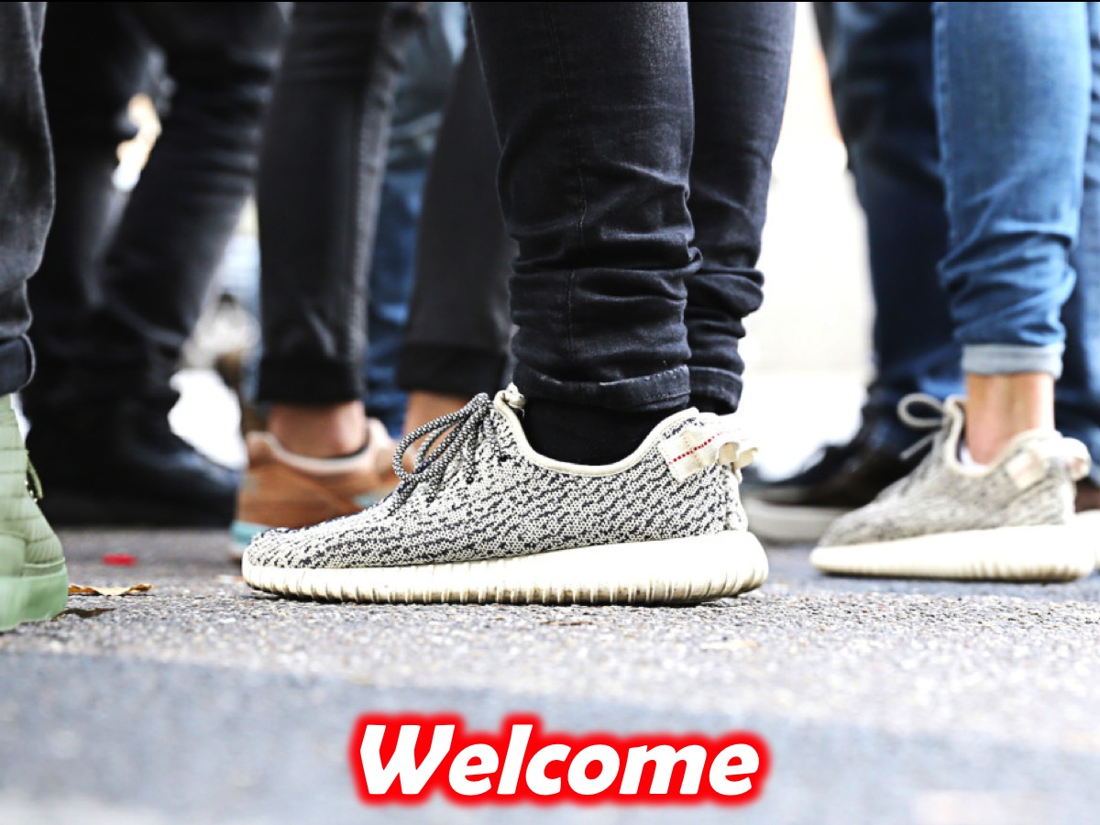
Notes:
Welcome to newcomers and regulars.

Slide 3

Notes:
Welcome to Alpha - this is the eighth night of a 10 week journey.

Slide 4

Notes:
But first it is time for dinner! Enjoy the meal and be sure to get to know people at your table.

Slide 5

Notes:
For the next 30 minutes or so, we will be watching a video and pausing along the way to discuss three questions that are raised…

Slide 6
Notes:
Video Clip 1 - the full clip has been cut into 4 smaller parts - pausing to allow time for discussion around the tables before carrying on with the next part of the longer video. Get the full video on YouTube at: bitly.com/YouthAlpha10

Slide 7
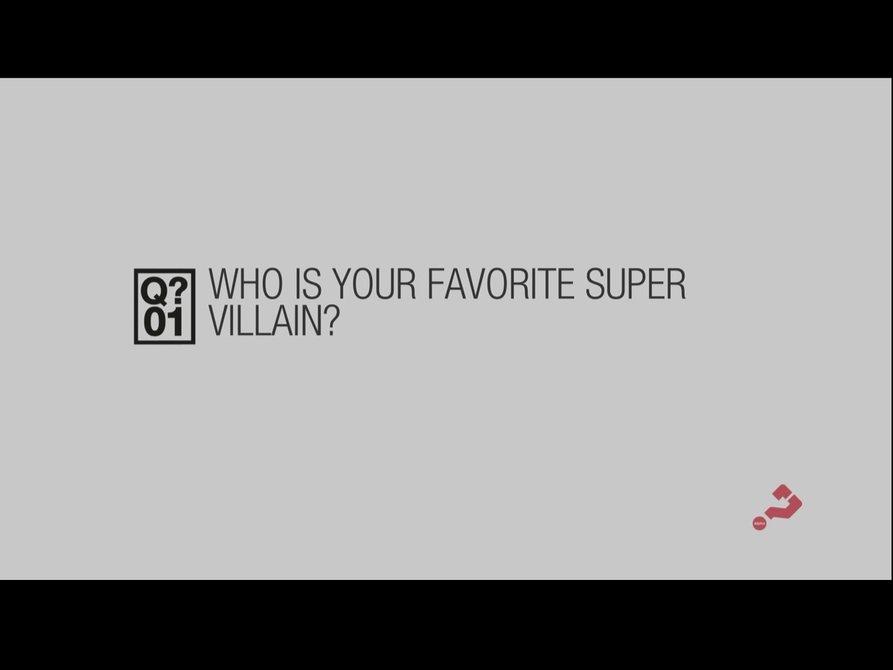
Notes:
Question 1: Who is your favourite super villain?

Slide 8
Notes:
Video Clip 2 - here is the second video clip.

Slide 9

Notes:
Question 2: What are some common lies that people believe about themselves or about God?

Slide 10
Notes:
Video Clip 3 - here is the third video clip.

Slide 11
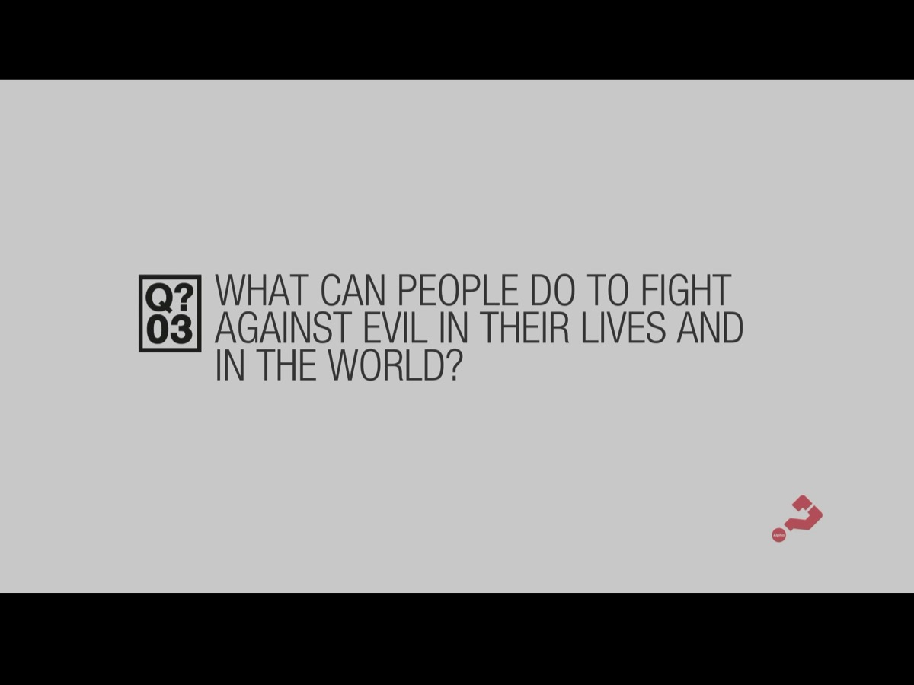
Notes:
Question 3: What can people do to fight against evil in their lives and in the world?

Slide 12
Notes:
Video Clip 4 - here is the last of our video clips for tonight.

Slide 13
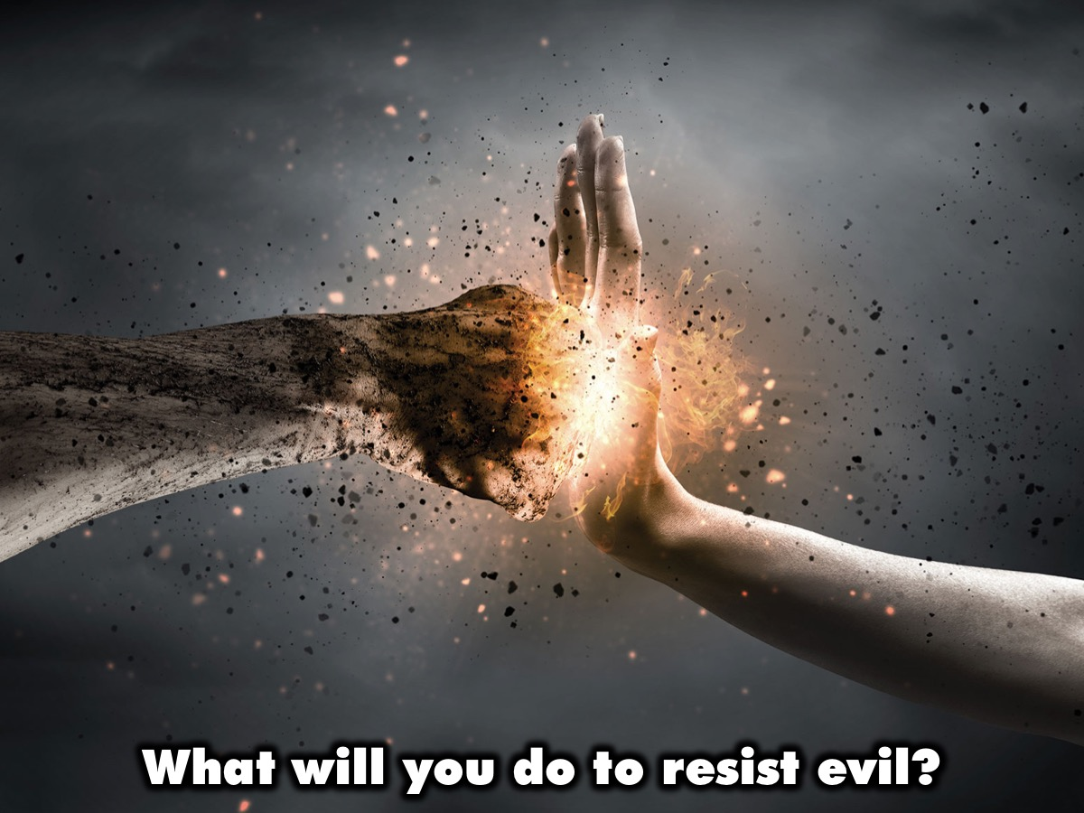
Notes:
Challenge: What will you do to resist evil?

Slide 14

Notes:
Next week we will continue our journey in the Alpha series with Healing: Does God Heal Today?

Slide 15
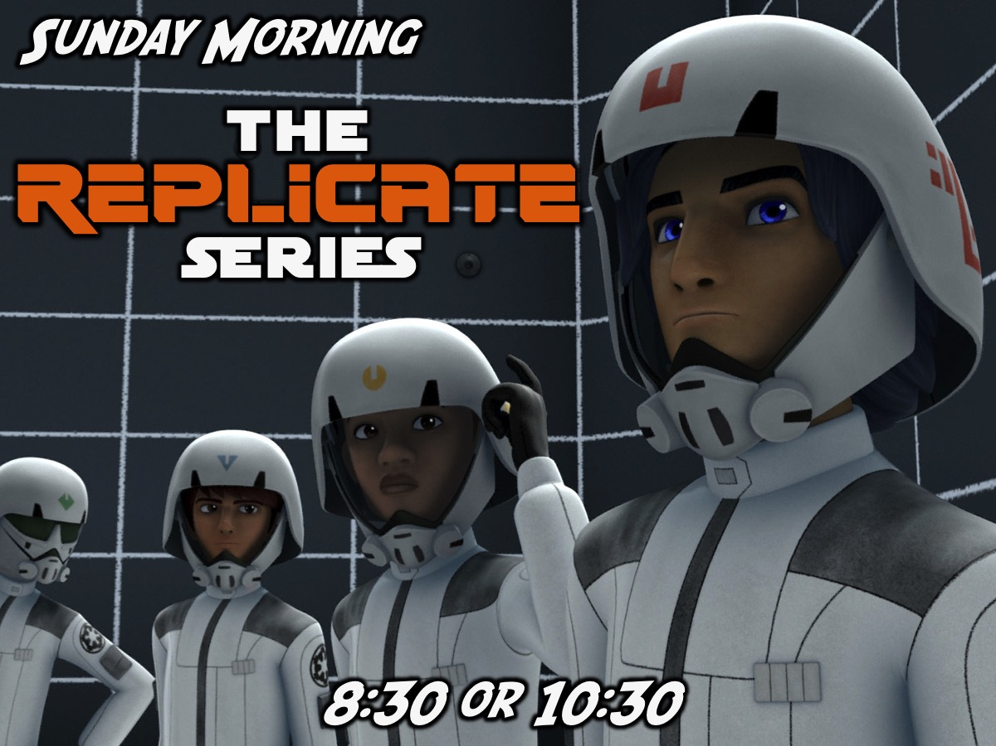
Notes:
On Sunday mornings we meet at 8:30 or at 10:30 - starting in the main sanctuary downstairs before coming upstairs to the youth room. We are busy with the Replicate Series.

