Slide 1

Notes:
This Friday is Week 9 of the Alpha Friday series.

Slide 2

Notes:
Welcome to newcomers and regulars.

Slide 3

Notes:
On Sunday morning because of school holidays we will stay in the service downstairs - for 2 Sundays.

Slide 4

Notes:
Next Friday night there is no youth because of the school holidays. We re-open on the 14th October.

Slide 5

Notes:
Welcome to Alpha - this is the tenth night of a 10 week journey.

Slide 6

Notes:
But first it is time for dinner! Enjoy the meal and be sure to get to know people at your table.

Slide 7

Notes:
For the next 30 minutes or so, we will be watching a video and pausing along the way to discuss three questions that are raised…

Slide 8
Notes:
Video Clip 1 - the full clip has been cut into 4 smaller parts - pausing to allow time for discussion around the tables before carrying on with the next part of the longer video. Get the full video on YouTube at: bitly.com/YouthAlpha12

Slide 9

Notes:
Question 1: What is your favourite viral video?

Slide 10
Notes:
Video Clip 2 - here is the second video clip.

Slide 11

Notes:
Question 2: Is it okay to tell others about Jesus? What stops people from doing it?

Slide 12
Notes:
Video Clip 3 - here is the third video clip.

Slide 13

Notes:
Question 3: Do you see any value in being part of a church?

Slide 14
Notes:
Video Clip 4 - here is the last of our video clips for tonight.

Slide 15
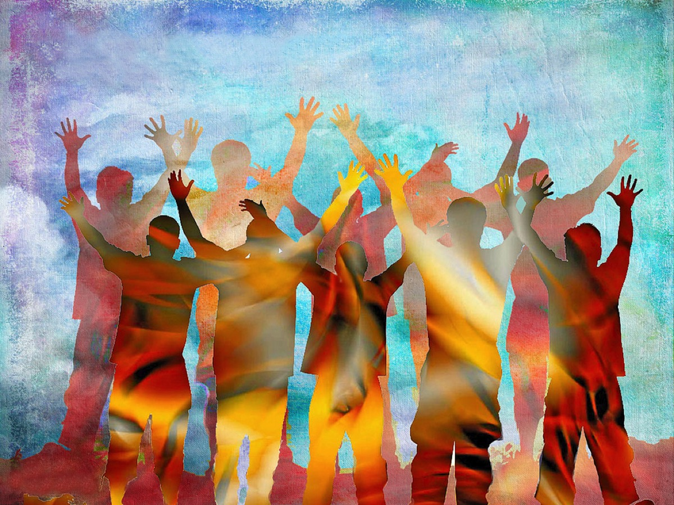
Notes:
Wrap up and prayer

