Slide 1

Notes:
Welcome to Alpha Friday.

Slide 2

Notes:
Welcome to regulars and newcomers!

Slide 3

Notes:
Prayer: Let’s open our meeting in prayer.

Slide 4

Notes:
Tonight we find out what “Alpha” is.

Slide 5
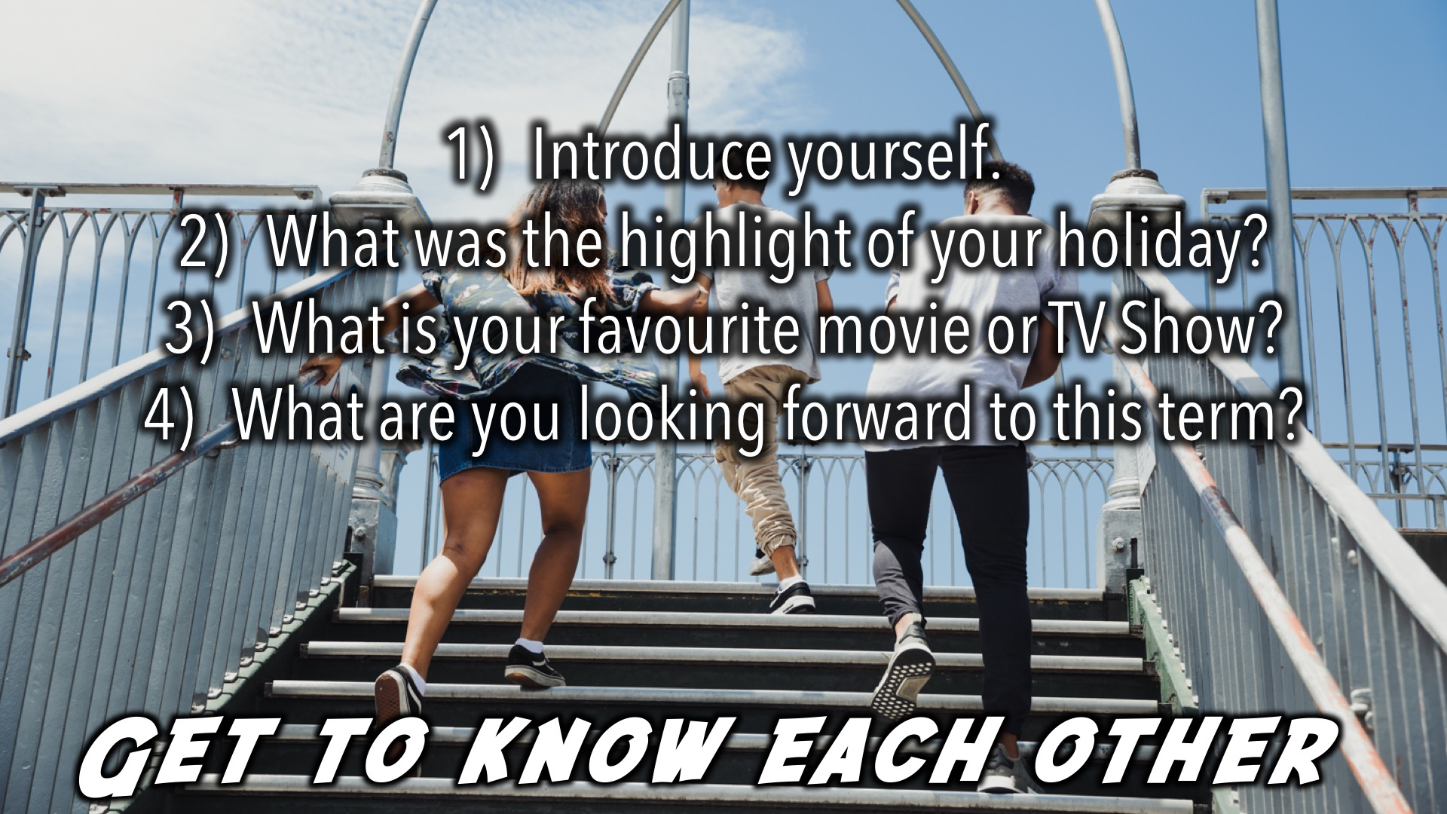
Notes:
Get to Know Each Other: Answer the following questions around your table: (1) Introduce yourself. (2) What was the highlight of your holiday? (3) What is your favourite movie or TV Show? (4) What are you looking forward to this term?

Slide 6

Notes:
Supper Time: A simple meal will be served

Slide 7

Notes:
Alpha Youth Series Official Trailer: Find the trailer by clicking on this dropbox link: https://www.dropbox.com/sh/f0wthyhsb4eu1bm/AAB4OdAVqhfrnsIlGTxlZeh8a?dl=0

Slide 8
Notes:
Video: Find the trailer by clicking on this dropbox link: https://www.dropbox.com/sh/f0wthyhsb4eu1bm/AAB4OdAVqhfrnsIlGTxlZeh8a?dl=0

Slide 9

Notes:
What is Alpha? Alpha is a series of short episodes designed to engage young people in conversations about faith, life and God. Alpha is an invitation to explore life’s biggest questions and a chance to look at the life and message of Jesus. Every opinion and question is welcome. “I am the way and the truth and the life.” (JOHN 14:6) We want others to find out who our Jesus is!

Slide 10

Notes:
The Format: (1) Food – This brings people together, builds community and provides a space for people to get to know each other. (2) The Talk - The talks are designed to engage and inspire conversation. They explore the big issues around faith and unpack the basics of Christianity, addressing questions from Who is Jesus? and How can we have faith? to Why and how do I pray? and How does God guide us? (3) Discussion – This is chance to share thoughts and ideas on the topic, and simply discuss it in a small group. There's no obligation to say anything and there's nothing you can't say (seriously).

Slide 11
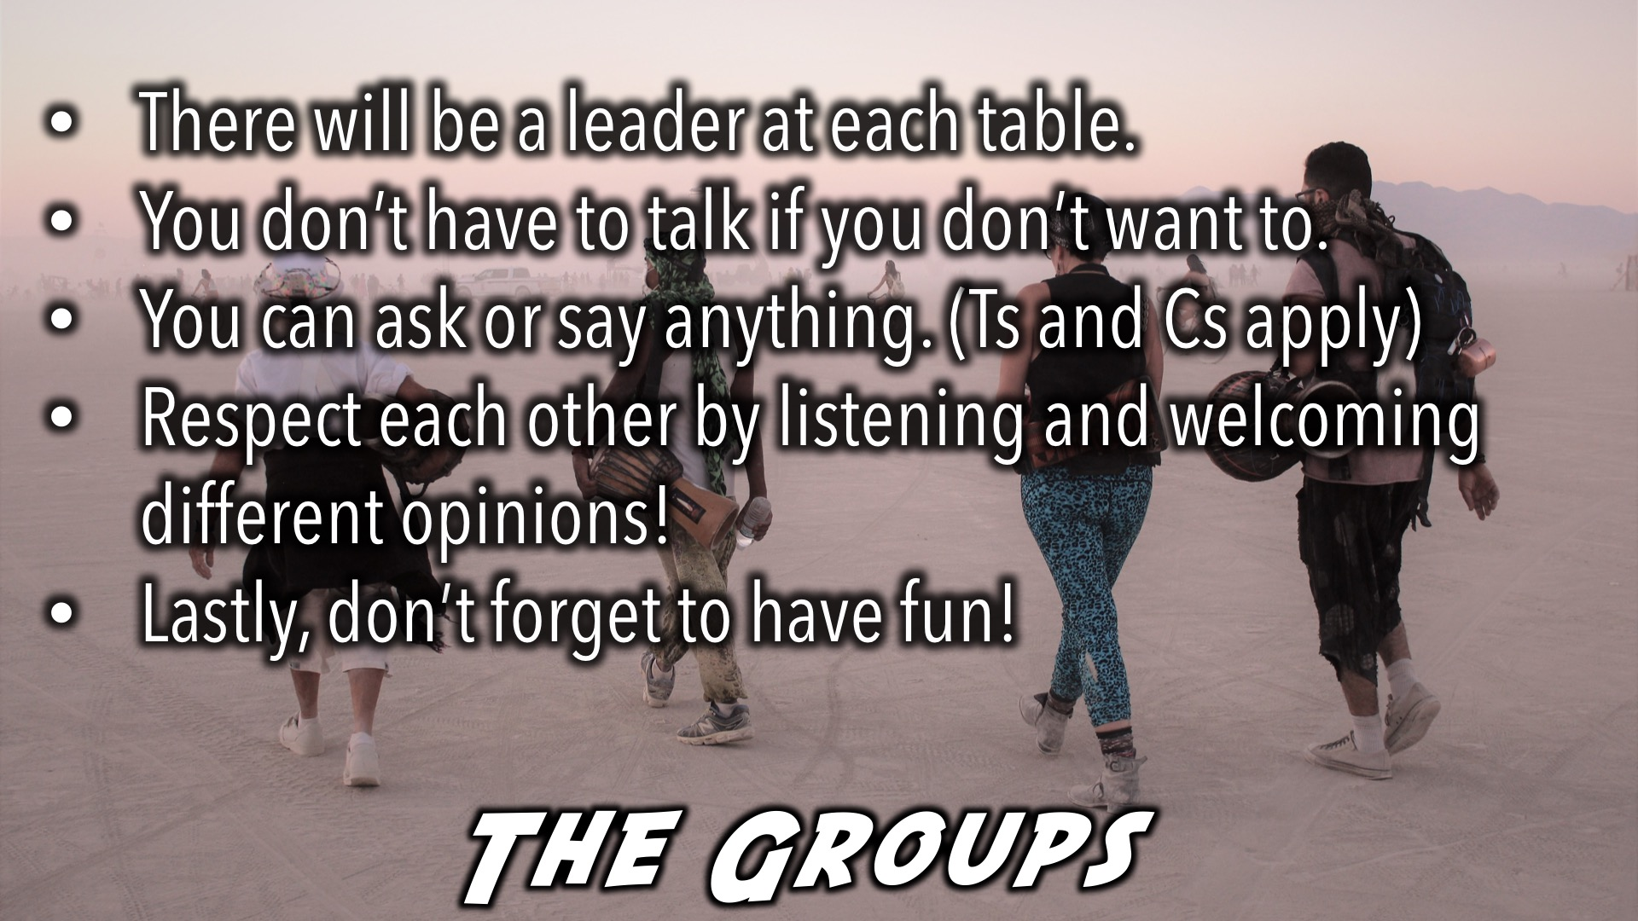
Notes:
The Groups: There will be a leader at each table. You don’t have to talk if you don’t want to. You can ask or say anything, (As long as you’re not putting other people down, or giving them a chance to talk). Respect each other by listening and welcoming different opinions! Keep things that are said at the table, at the table! We are going to be talking about deep stuff! Have Fun!

Slide 12

Notes:
Invite your Just One: We all have questions, your friend included, so invite them along!

Slide 13
Notes:
Friday Night Term Preview: Let’s look at what’s happening this term on Friday nights!

Slide 14

Notes:
20 April - Life

Slide 15

Notes:
27 April – Freedom Day

Slide 16

Notes:
4 May - Jesus

Slide 17

Notes:
11 May - Cross

Slide 18

Notes:
18 May - Faith

Slide 19

Notes:
25 May – Lead the Cause 2018 – No Youth on this Weekend

Slide 20

Notes:
1 June - Prayer

Slide 21

Notes:
8 June - Bible

Slide 22

Notes:
15 June - Evil

Slide 23

Notes:
22 June – Matric Farewell

Slide 24
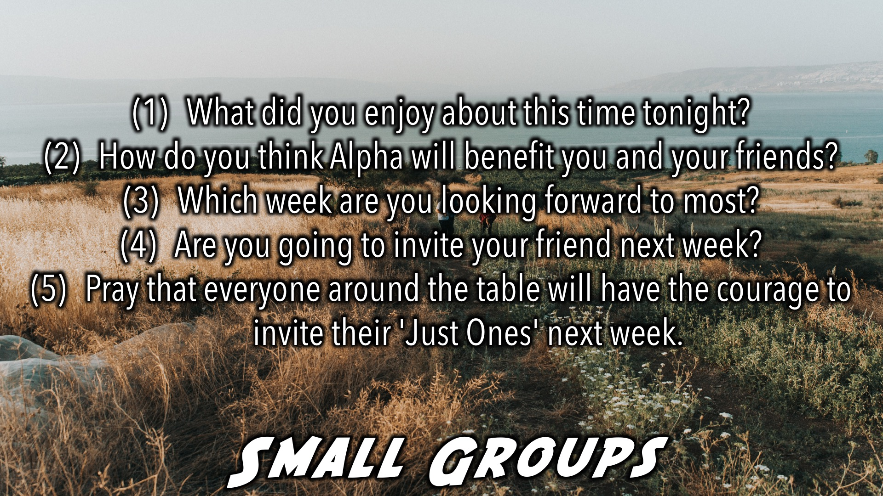
Notes:
Small Group Time: (1) What did you enjoy about this time tonight? (2) How do you think Alpha will benefit you and your friend? (3) Which week are you looking forward to most? (4) Are you going to invite your friend next week? (5) Pray that everyone around the table will have the courage to invite their 'Just Ones' next week.

Slide 25

Notes:
Announcements: Our Botswana Mission trip is taking place at the end of the Term. Stay tuned for more information.

Slide 26
Notes:
25 May – Lead the Cause 2018 – No Youth on this Weekend

Slide 27

Notes:
We are involved in these 3 high schools during the week – if you attend one of these schools, see you there!

Slide 28

Notes:
Join us this Sunday as we begin our Renew Series. The topic for Sunday is ‘Thoughts.’

Slide 29

Notes:
Follow us on Instagram! @EncounterYouth_Rosebank

Slide 30

Notes:
Join our Friday Night WhatsApp group!

Slide 31
Notes:
Thanks for Coming: See you next week Friday!

