Slide 1

Notes:
For the preview night for the Alpha Youth Series we learnt what Alpha is all about, watched the trailer and spent time in small groups getting to know each other and discussing what we thought about the coming term.

Slide 2
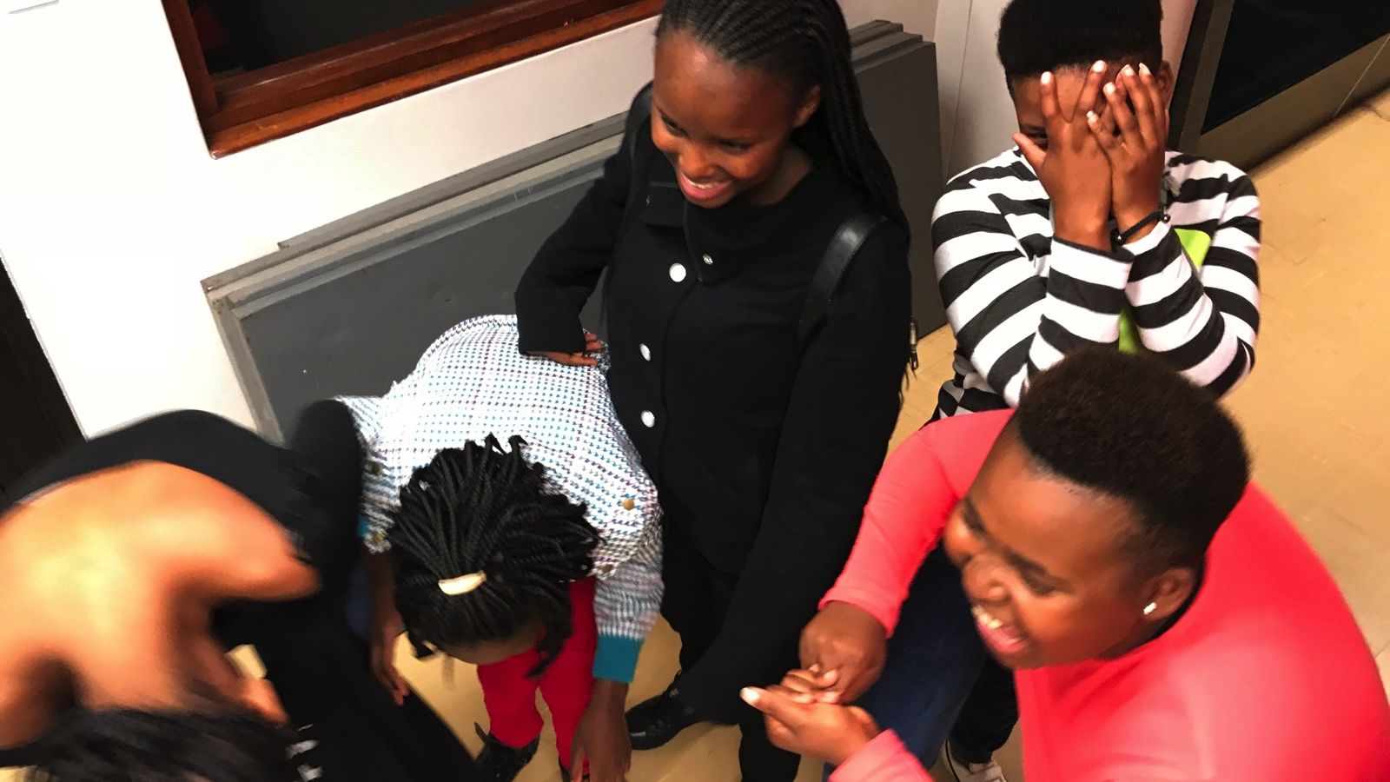
Notes:
Teens chilling before the event started.

Slide 3
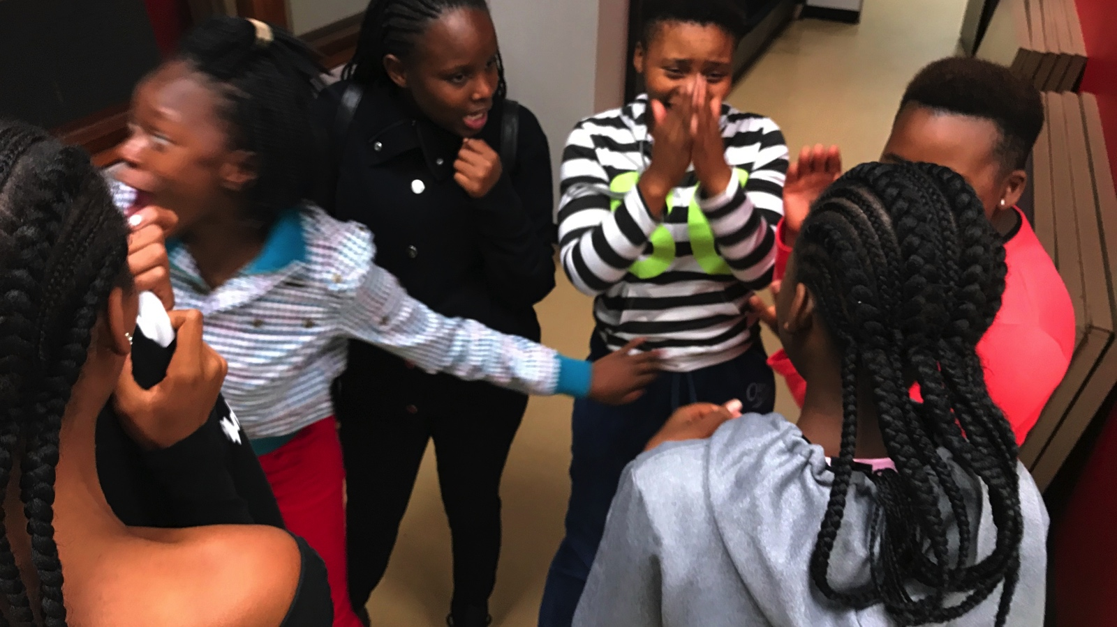
Notes:
Teens chilling before the event started.

Slide 4
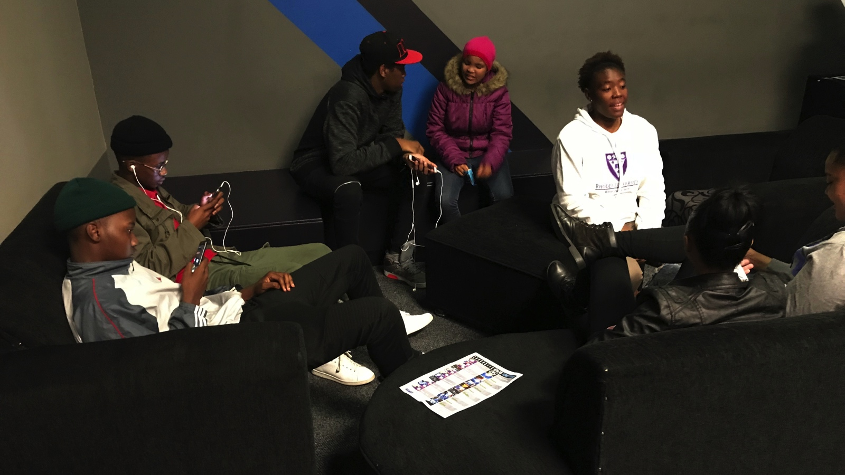
Notes:
Teens chilling before the event started.

Slide 5
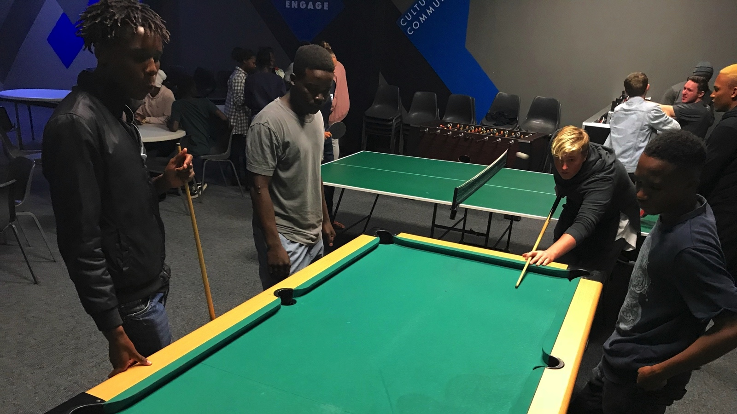
Notes:
Teens chilling before the event started.

Slide 6
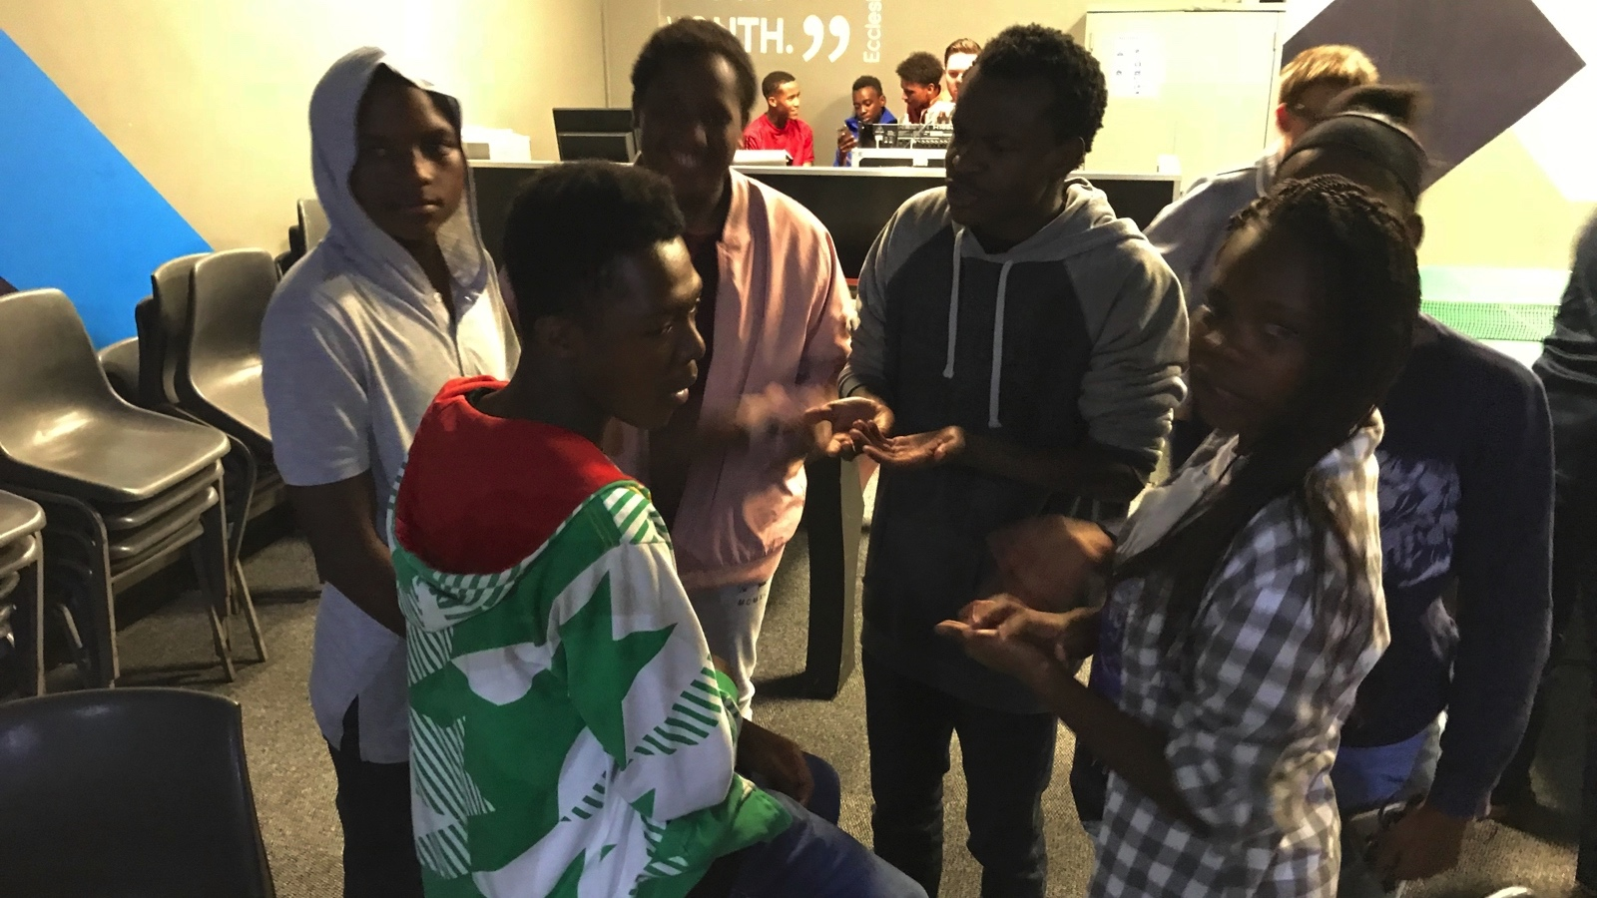
Notes:
Teens chilling before the event started.

Slide 7
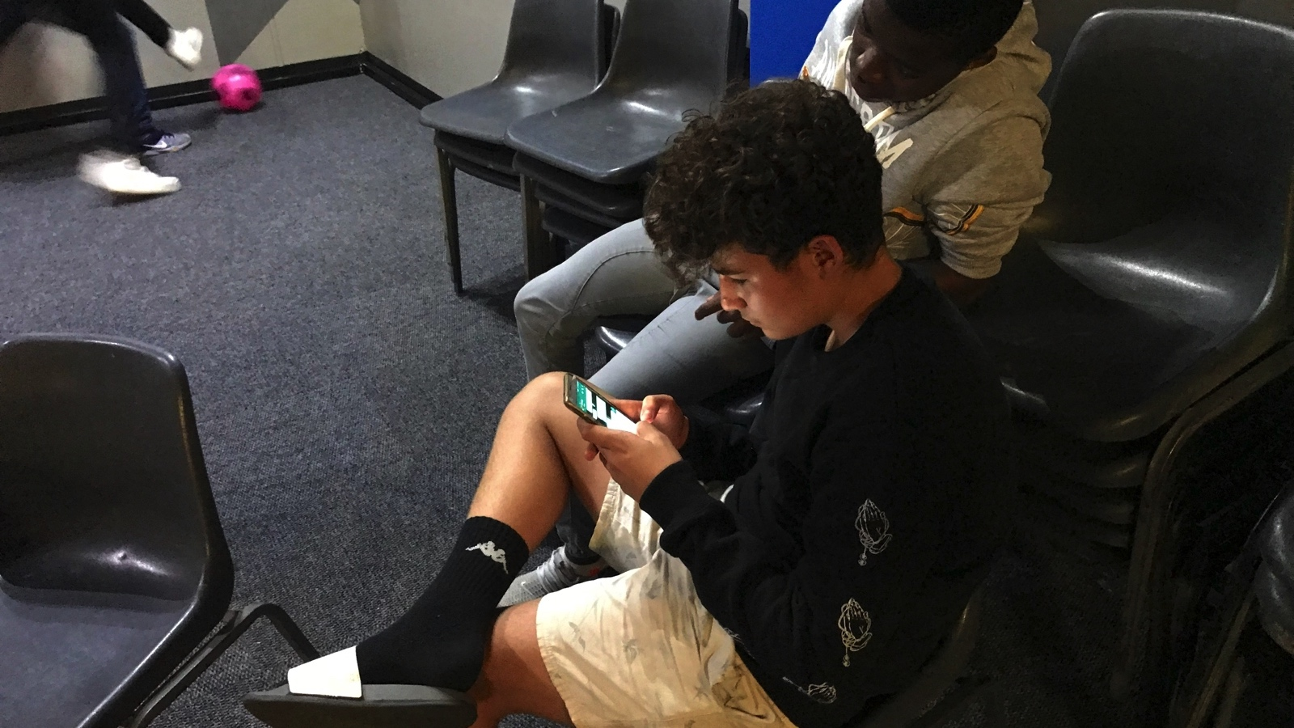
Notes:
Teens chilling before the event started.

Slide 8
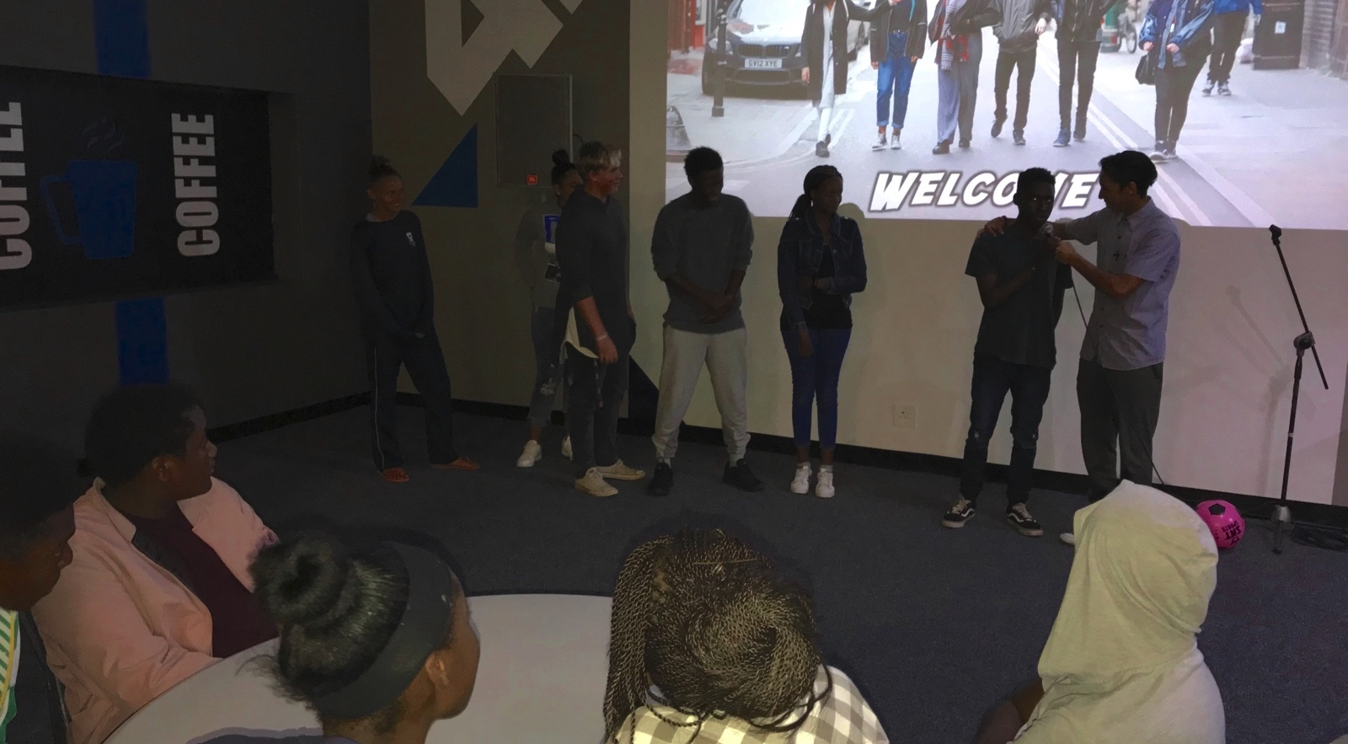
Notes:
Channing introducing newcomers.

Slide 9
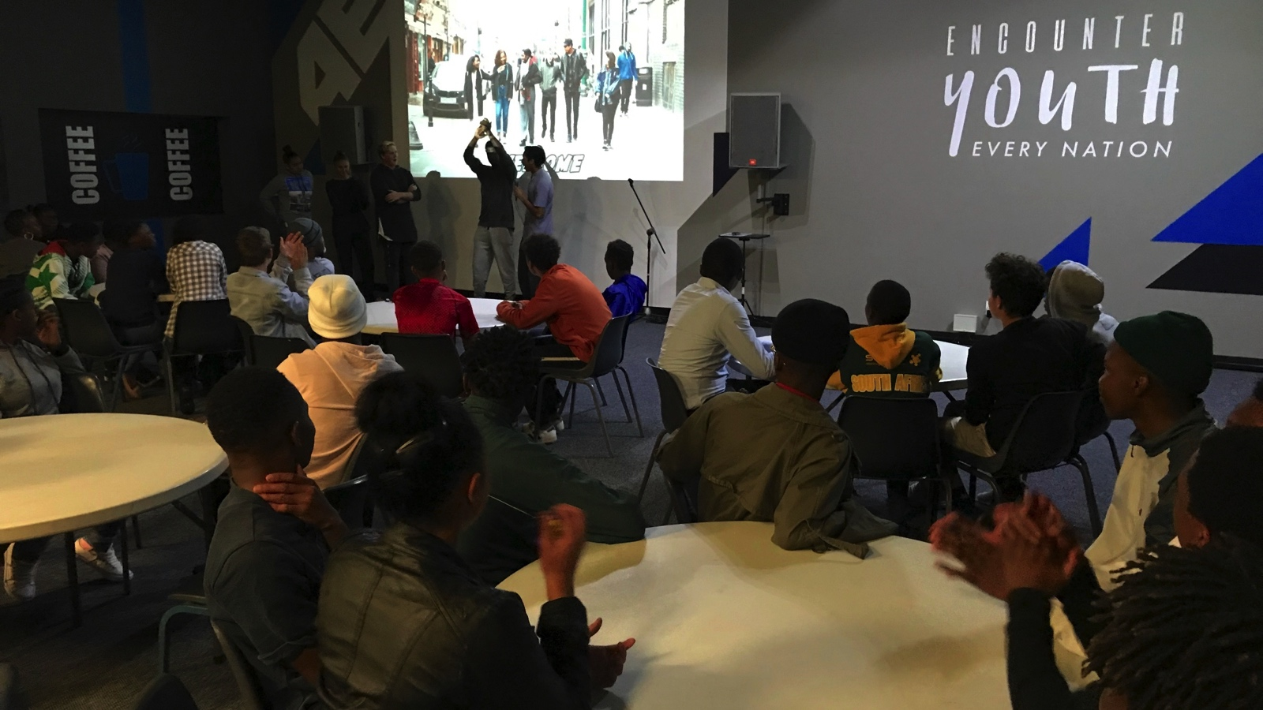
Notes:
Channing introducing newcomers.

Slide 10
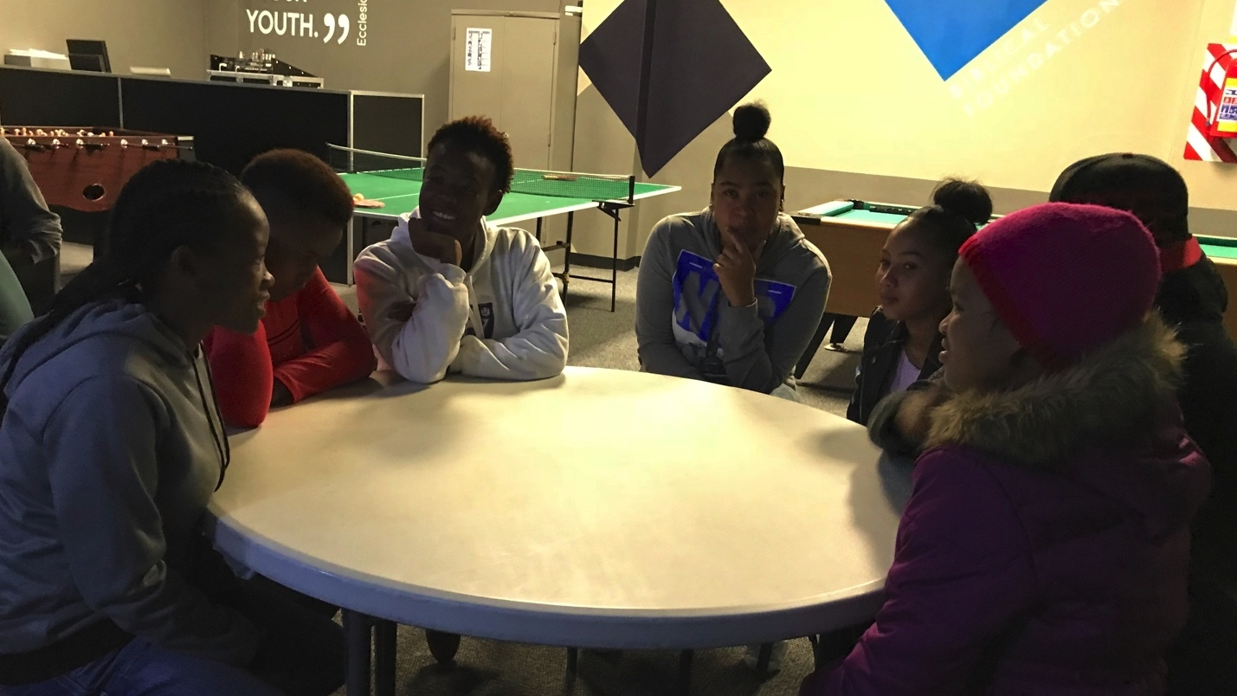
Notes:
Teens getting to know each other around the tables.

Slide 11
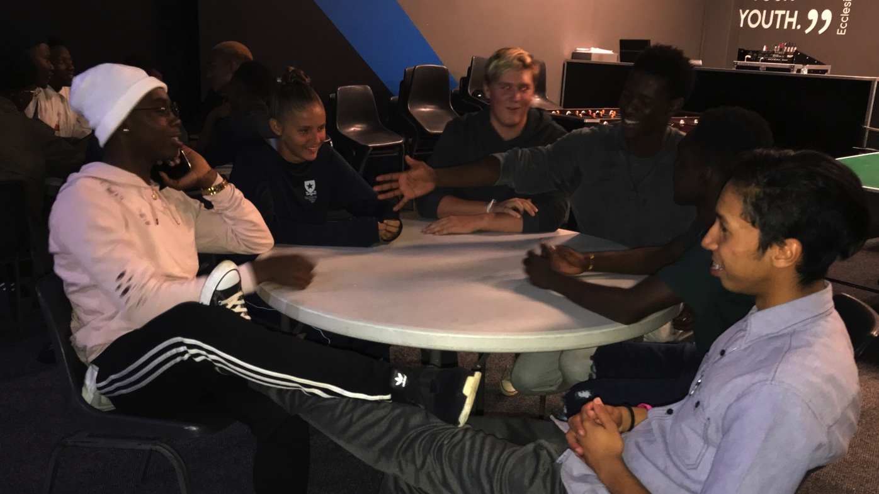
Notes:
Teens getting to know each other around the tables.

Slide 12
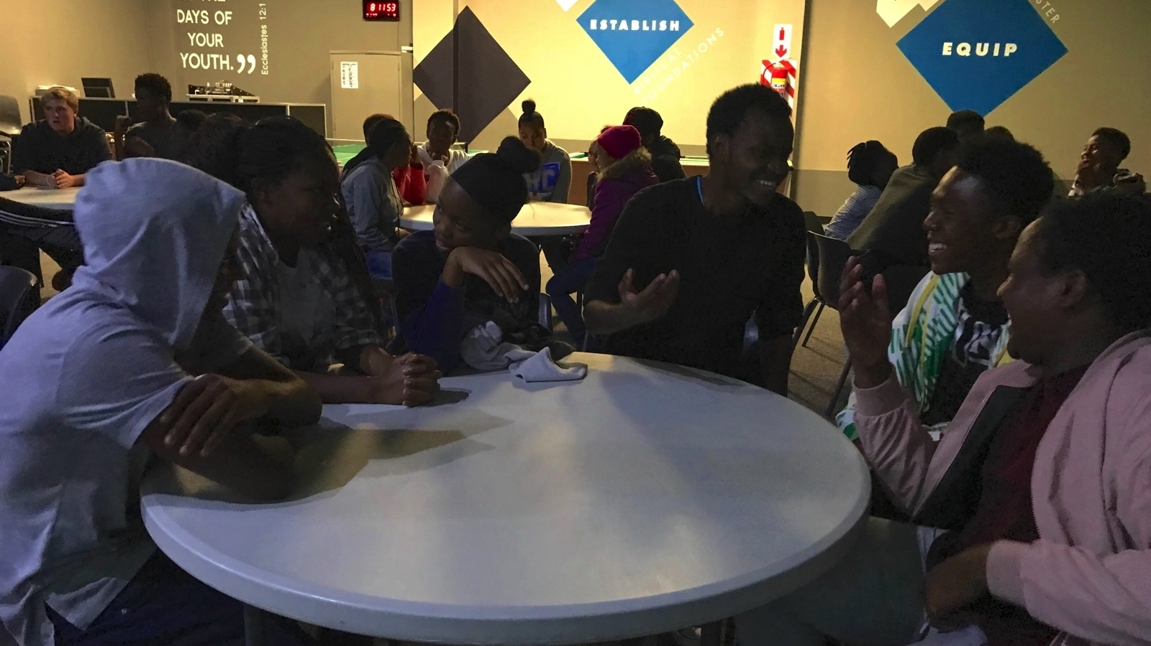
Notes:
Teens getting to know each other around the tables.

Slide 13
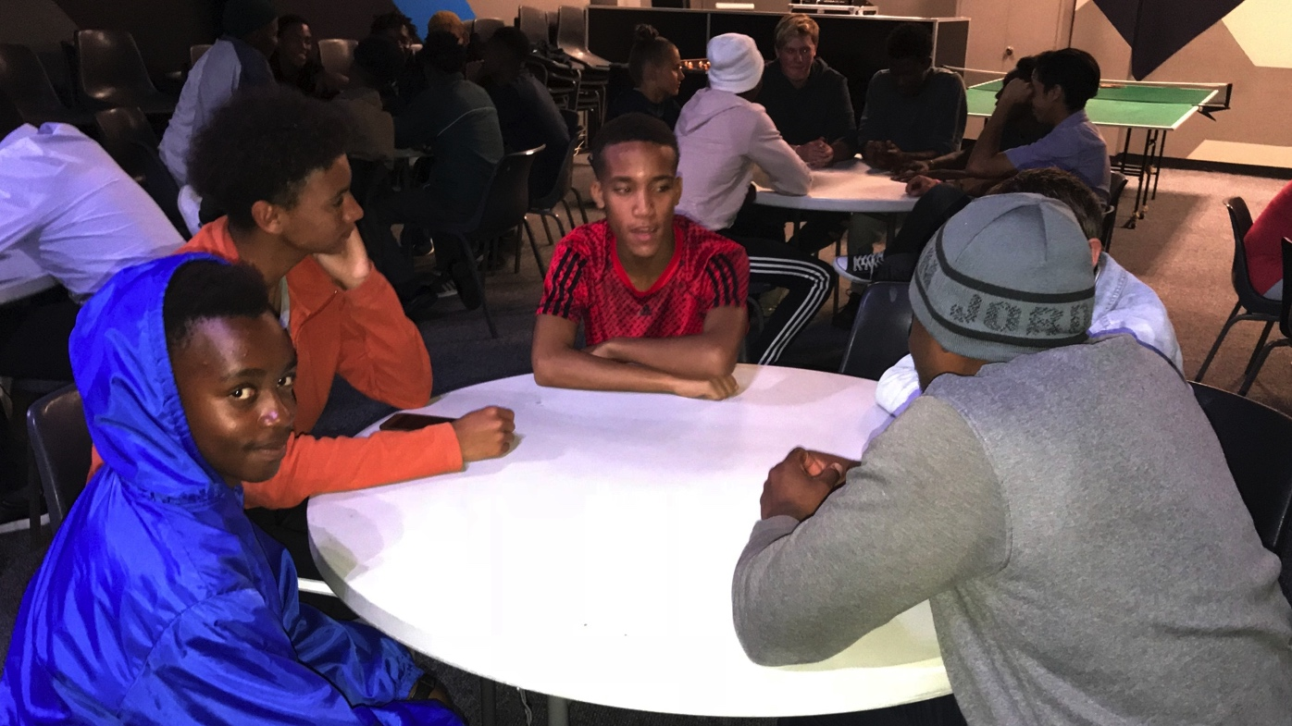
Notes:
Teens getting to know each other around the tables.

Slide 14
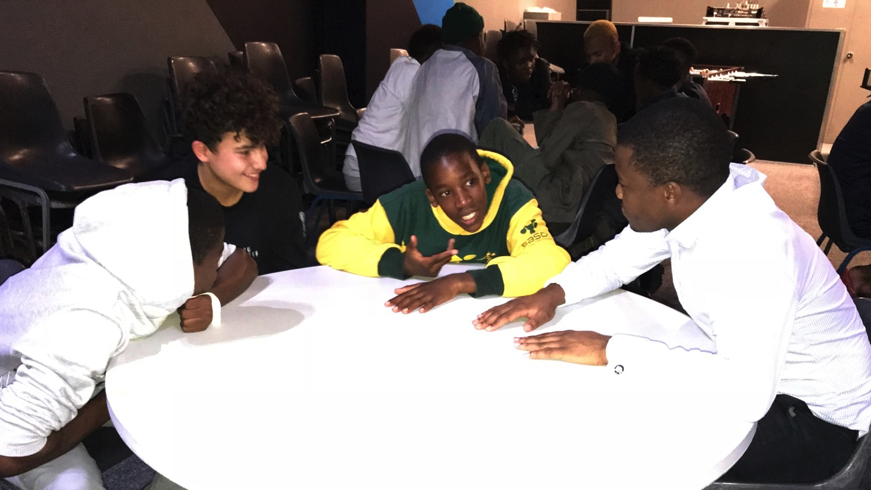
Notes:
Teens getting to know each other around the tables.

Slide 15
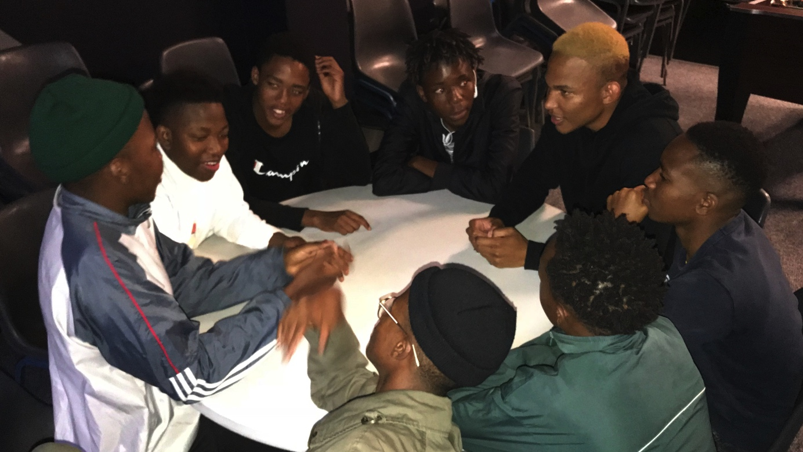
Notes:
Teens getting to know each other around the tables.

Slide 16
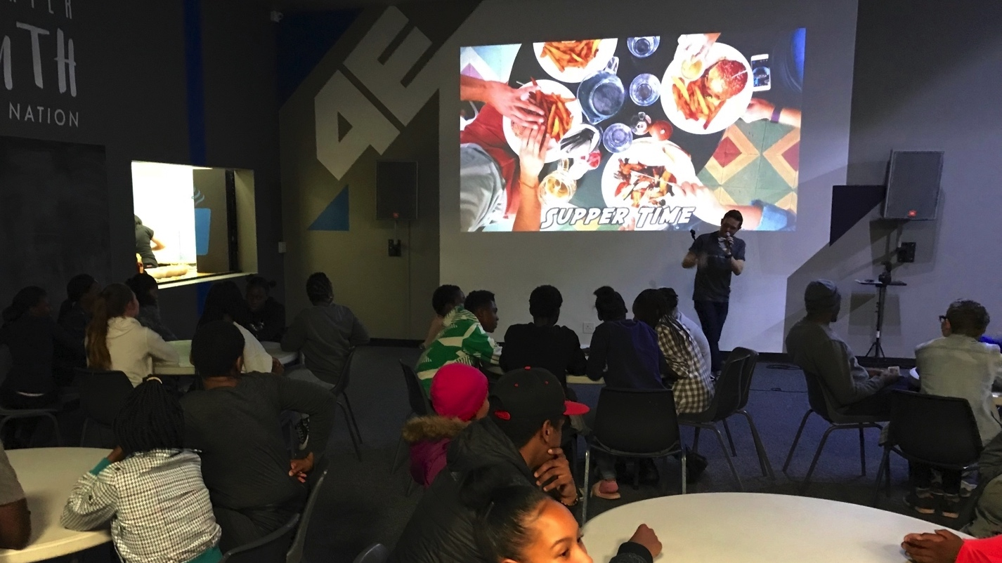
Notes:
Supper time - each Alpha night includes a meal.

Slide 17
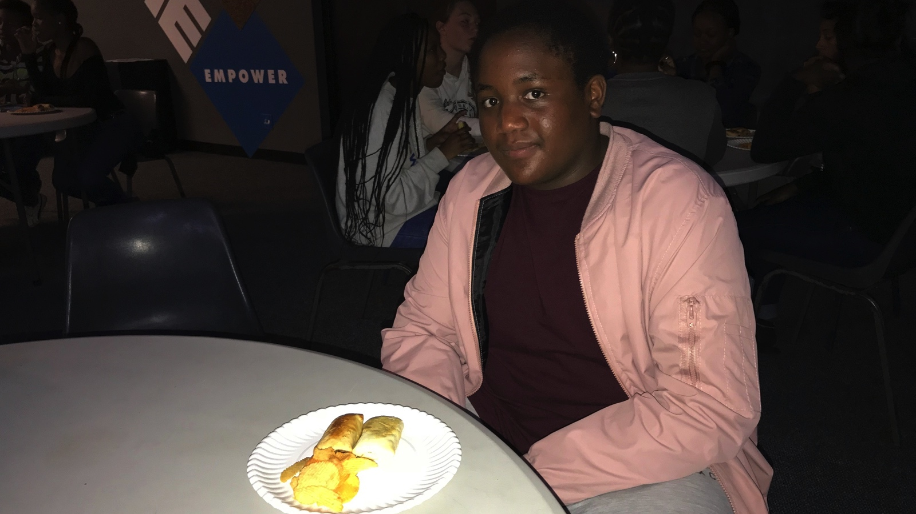
Notes:
Supper time - each Alpha night includes a meal.

Slide 18
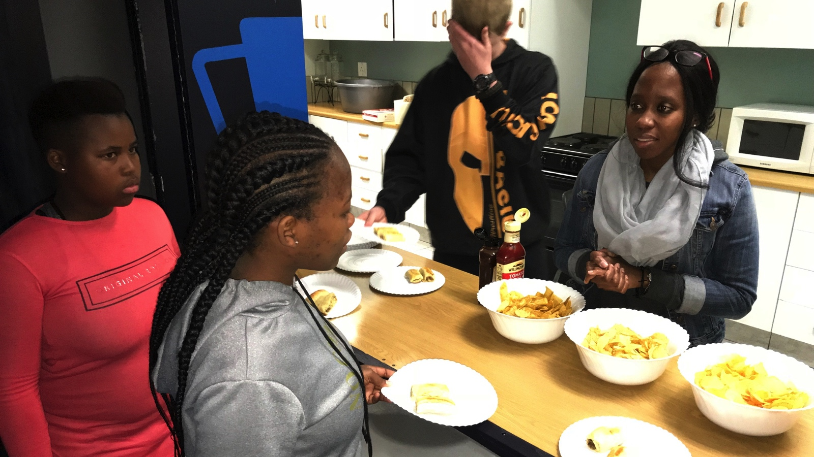
Notes:
Supper time - each Alpha night includes a meal.

Slide 19
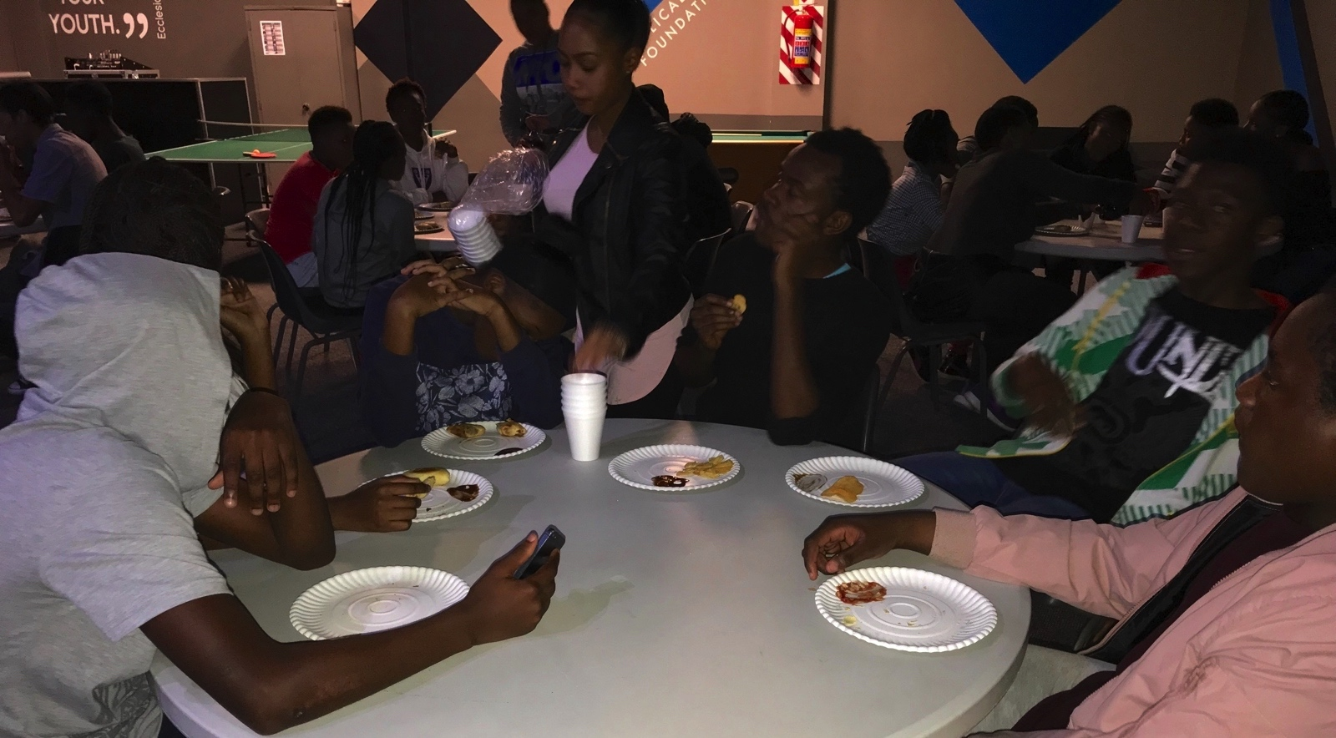
Notes:
Supper time - each Alpha night includes a meal.

Slide 20
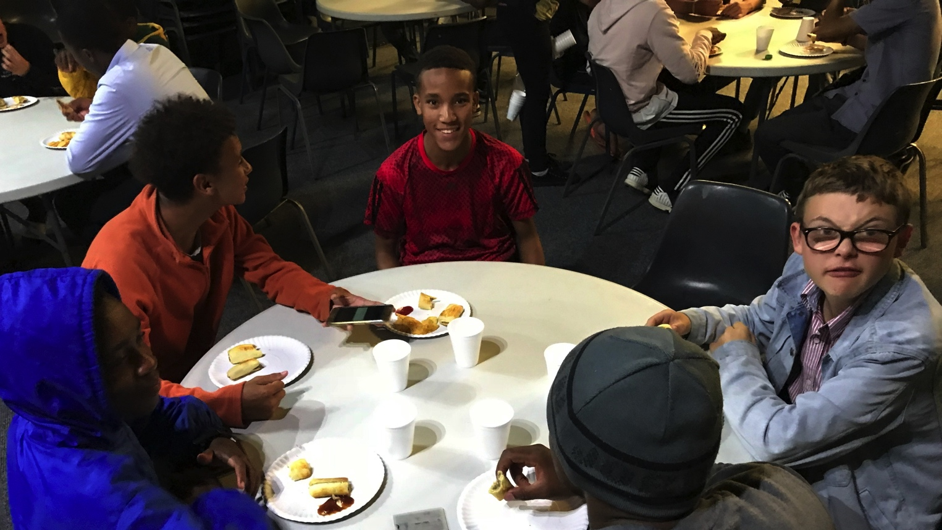
Notes:
Supper time - each Alpha night includes a meal.

Slide 21
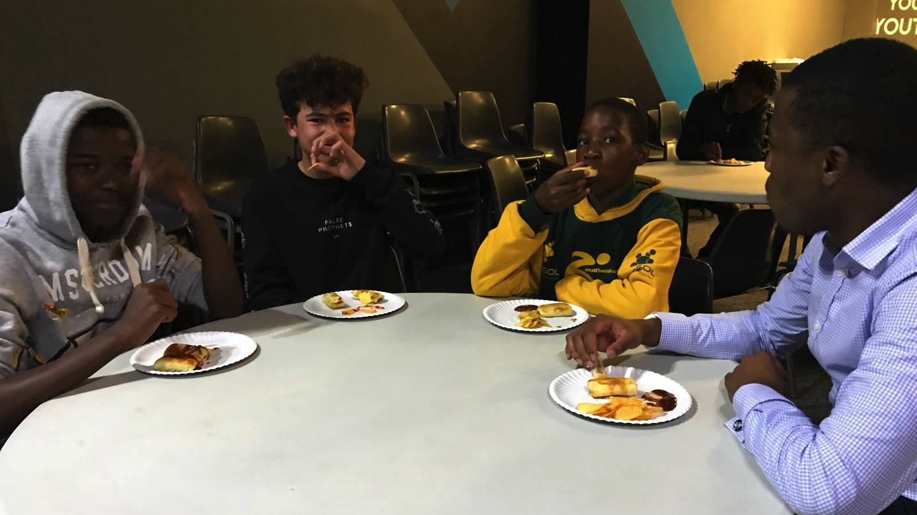
Notes:
Supper time - each Alpha night includes a meal.

Slide 22
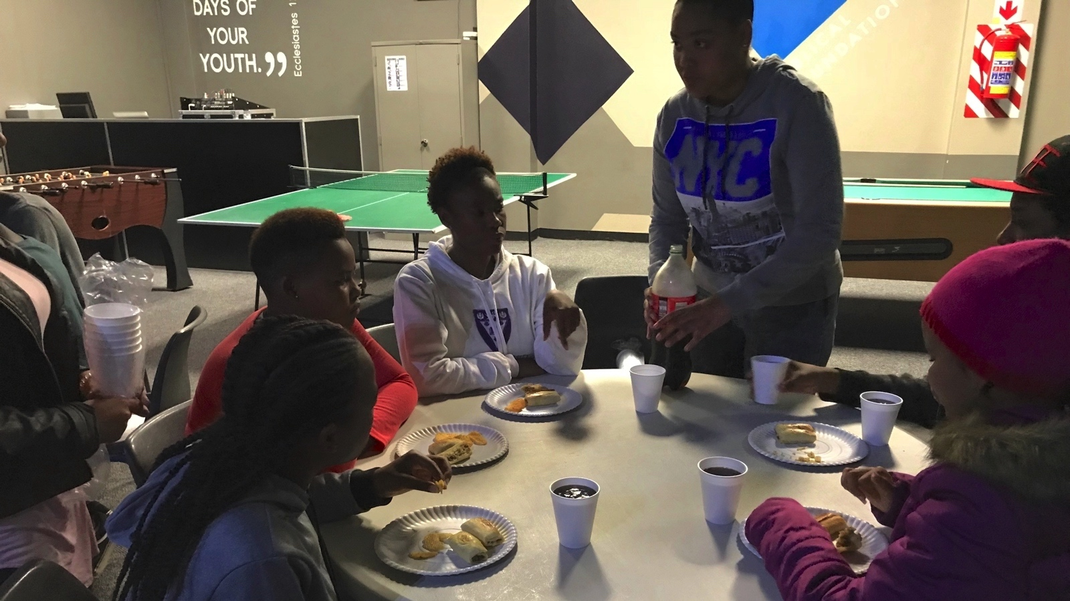
Notes:
Supper time - each Alpha night includes a meal.

Slide 23
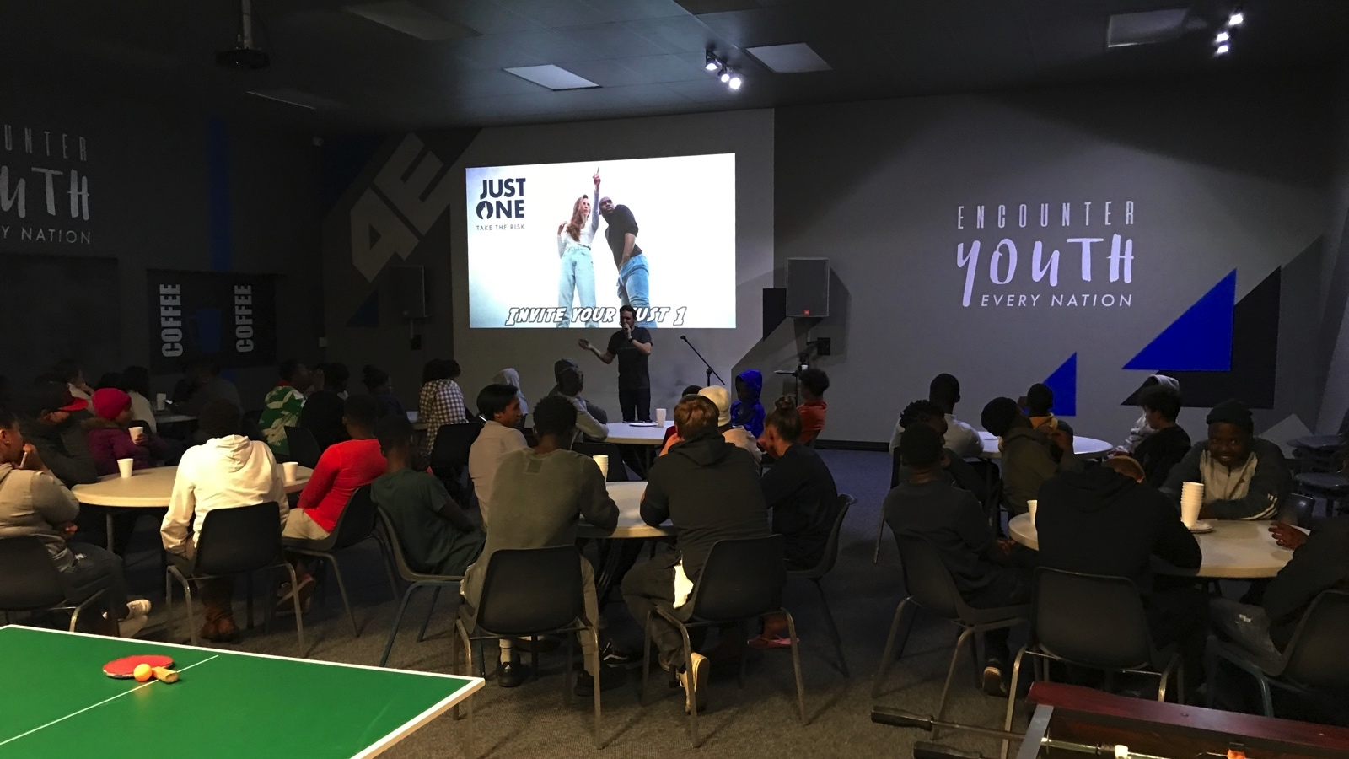
Notes:
Asher challenging high schoolers to bring a friend (their Just One) to Alpha for week 1 of the series next Friday night.

Slide 24
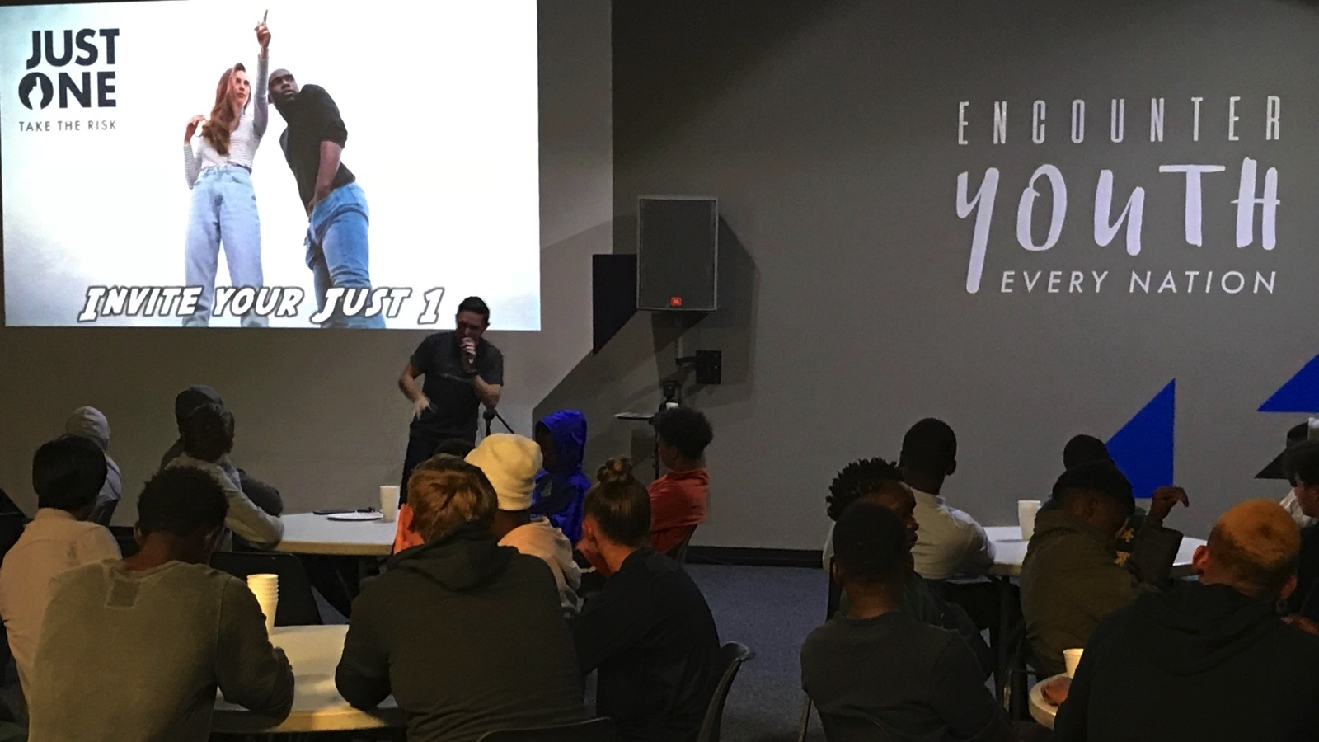
Notes:
Asher challenging high schoolers to bring a friend (their Just One) to Alpha for week 1 of the series next Friday night.

Slide 25
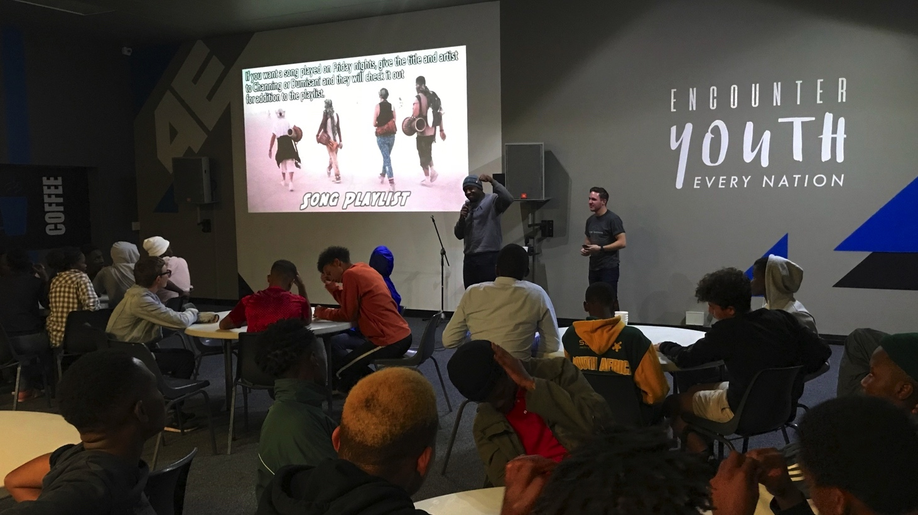
Notes:
Dumisani introducing the new Song playlist system for use at Youth on Friday nights.

