Slide 1

Notes:
Welcome to regulars and newcomers!

Slide 2
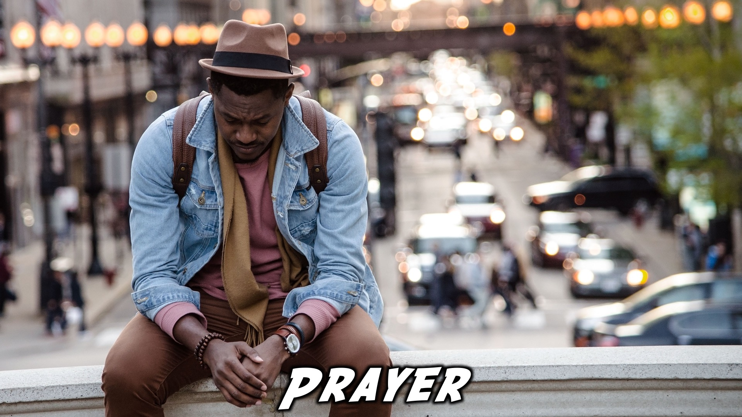
Notes:
Prayer: Let’s open our meeting in prayer.

Slide 3

Notes:
Announcements: Please Listen up to the following announcement.

Slide 4

Notes:
There won’t be youth next week as it is Freedom Day.

Slide 5

Notes:
On Sunday morning we will be exploring the first Building Block (Awareness) as learn learn how to think and act like Champions.

Slide 6

Notes:
On the weekend of the 25-27 May we are attending the Lead the Cause equipping event. Sign up and get an Indemnity Form.

Slide 7

Notes:
We are involved in these 3 high schools during the week – if you attend one of these schools, see you there!

Slide 8

Notes:
Follow us on Instagram! @EncounterYouth_Rosebank

Slide 9

Notes:
Join our Friday Night WhatsApp group!

Slide 10
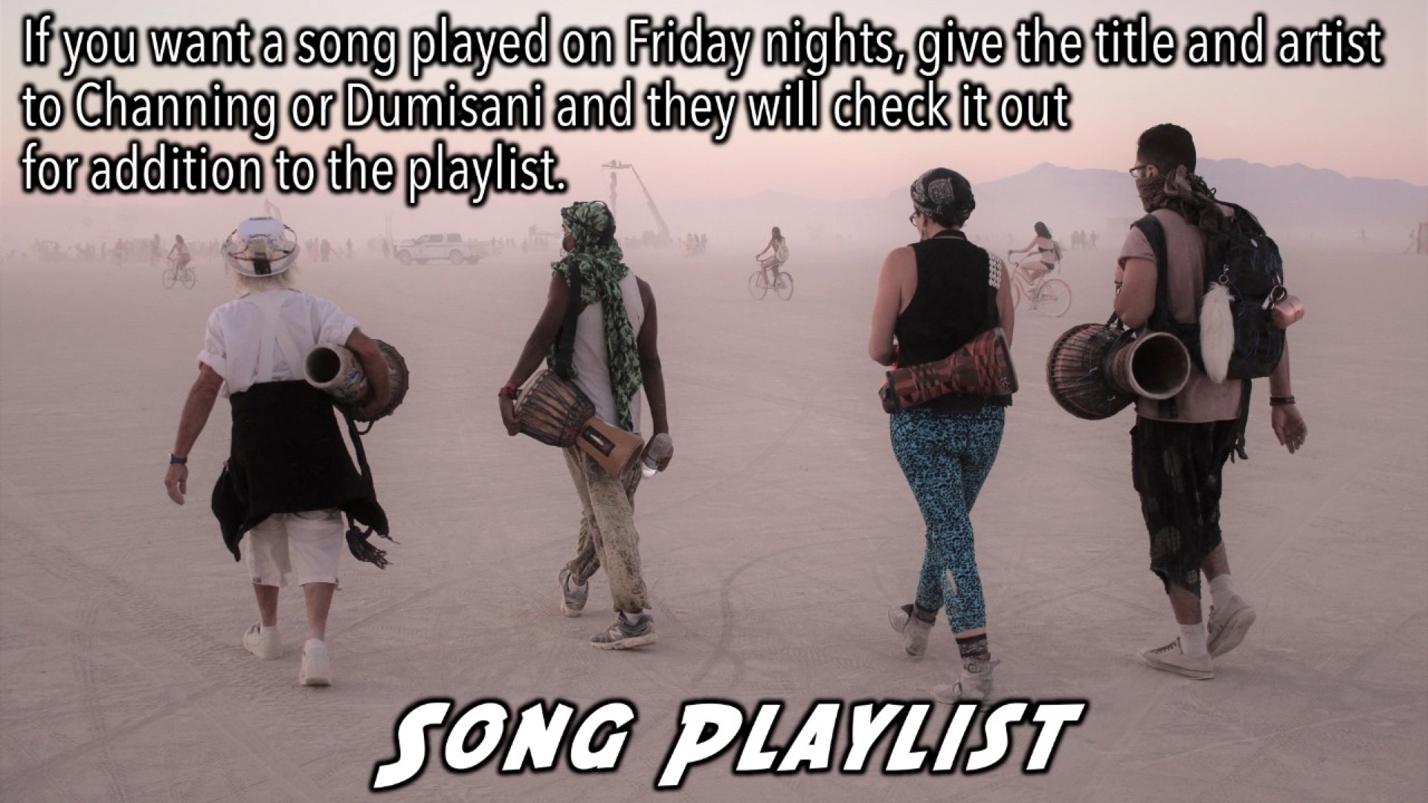
Notes:
If you want a song played on Friday nights, give the title and artist to Channing or Dumisani and they will check it out for addition to the playlist.

Slide 11

Notes:
Tonight: Tonight we answer the question, “Life is this it?”

Slide 12

Notes:
Supper Time: A simple meal will be served. During the meal there are 2 questions up so that teens can get to know each other.

Slide 13

Notes:
Let’s begin the journey.

Slide 14

Notes:
Video: Part 1. The Alpha Youth Series videos can be downloaded from the Alpha Builder website at: https://alpha.org/run

Slide 15

Notes:
Question 1: If you had 24 hours to do anything you wanted, what would you do?

Slide 16
Notes:
Video: Part 2

Slide 17

Notes:
Question 2: What makes you happy?

Slide 18

Notes:
Video: Part 3

Slide 19
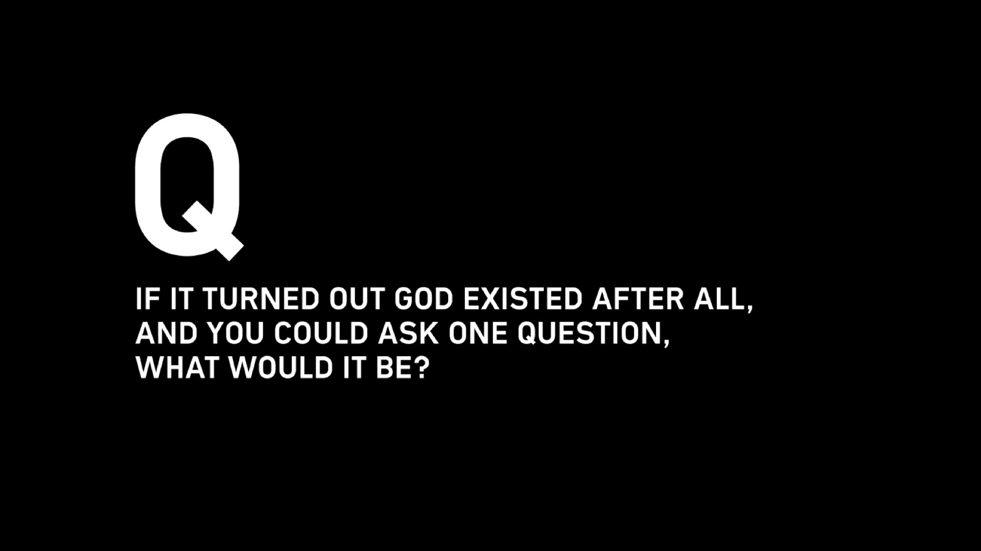
Notes:
Question 3: If it turned out God existed after all, and you could ask one question, what would it be?

Slide 20
Notes:
Video: Part 4

Slide 21

Notes:
Prayer: Close in Prayer

Slide 22

Notes:
Refreshments:

Slide 23

Notes:
Thanks for Coming: See you next week Friday!

