Slide 1

Notes:
Life: Is This It?

Slide 2
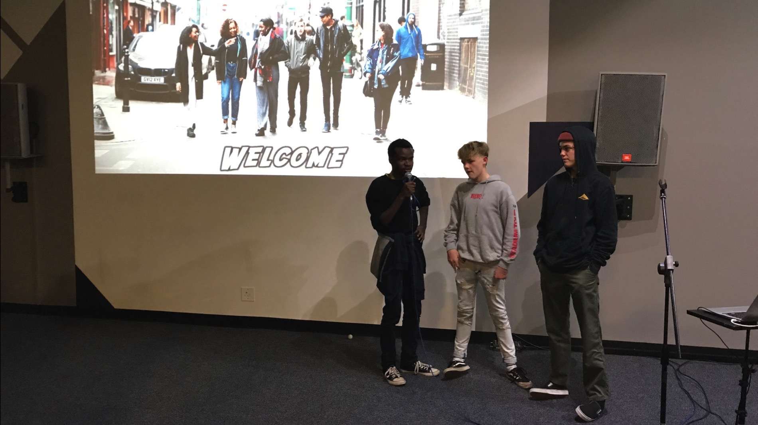
Notes:
For the preview night for the Alpha Youth Series we learnt what Alpha is all about, watched the trailer and spent time in small groups getting to know each other and discussing what we thought about the coming term.

Slide 3
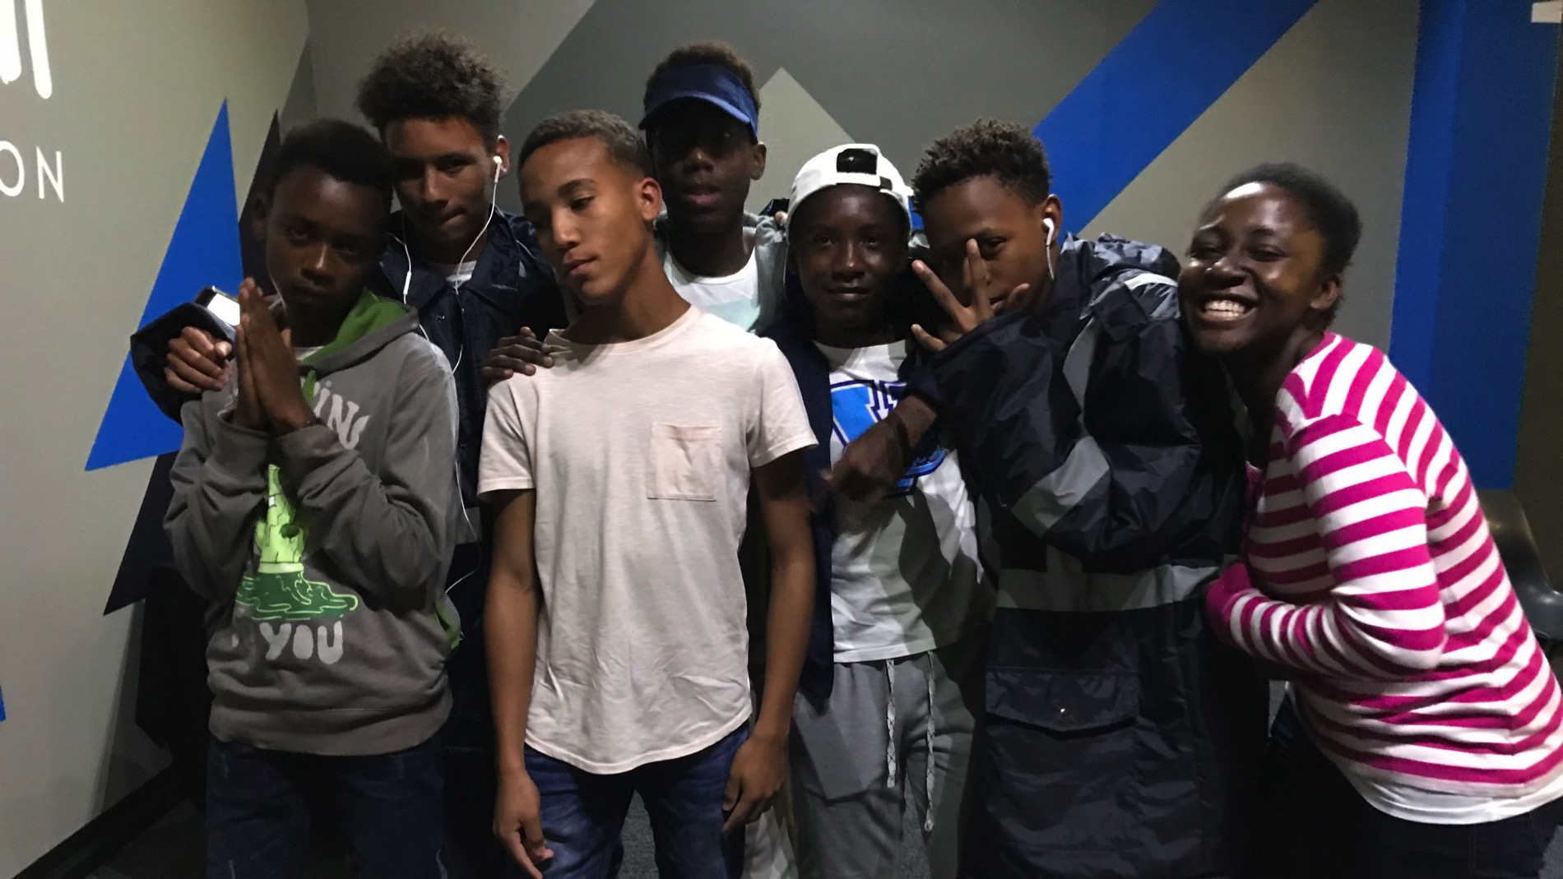
Notes:
For the preview night for the Alpha Youth Series we learnt what Alpha is all about, watched the trailer and spent time in small groups getting to know each other and discussing what we thought about the coming term.

Slide 4
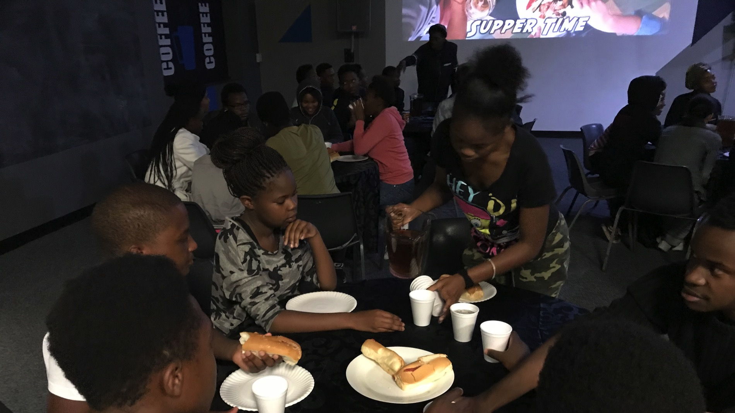
Notes:
For the preview night for the Alpha Youth Series we learnt what Alpha is all about, watched the trailer and spent time in small groups getting to know each other and discussing what we thought about the coming term.

Slide 5
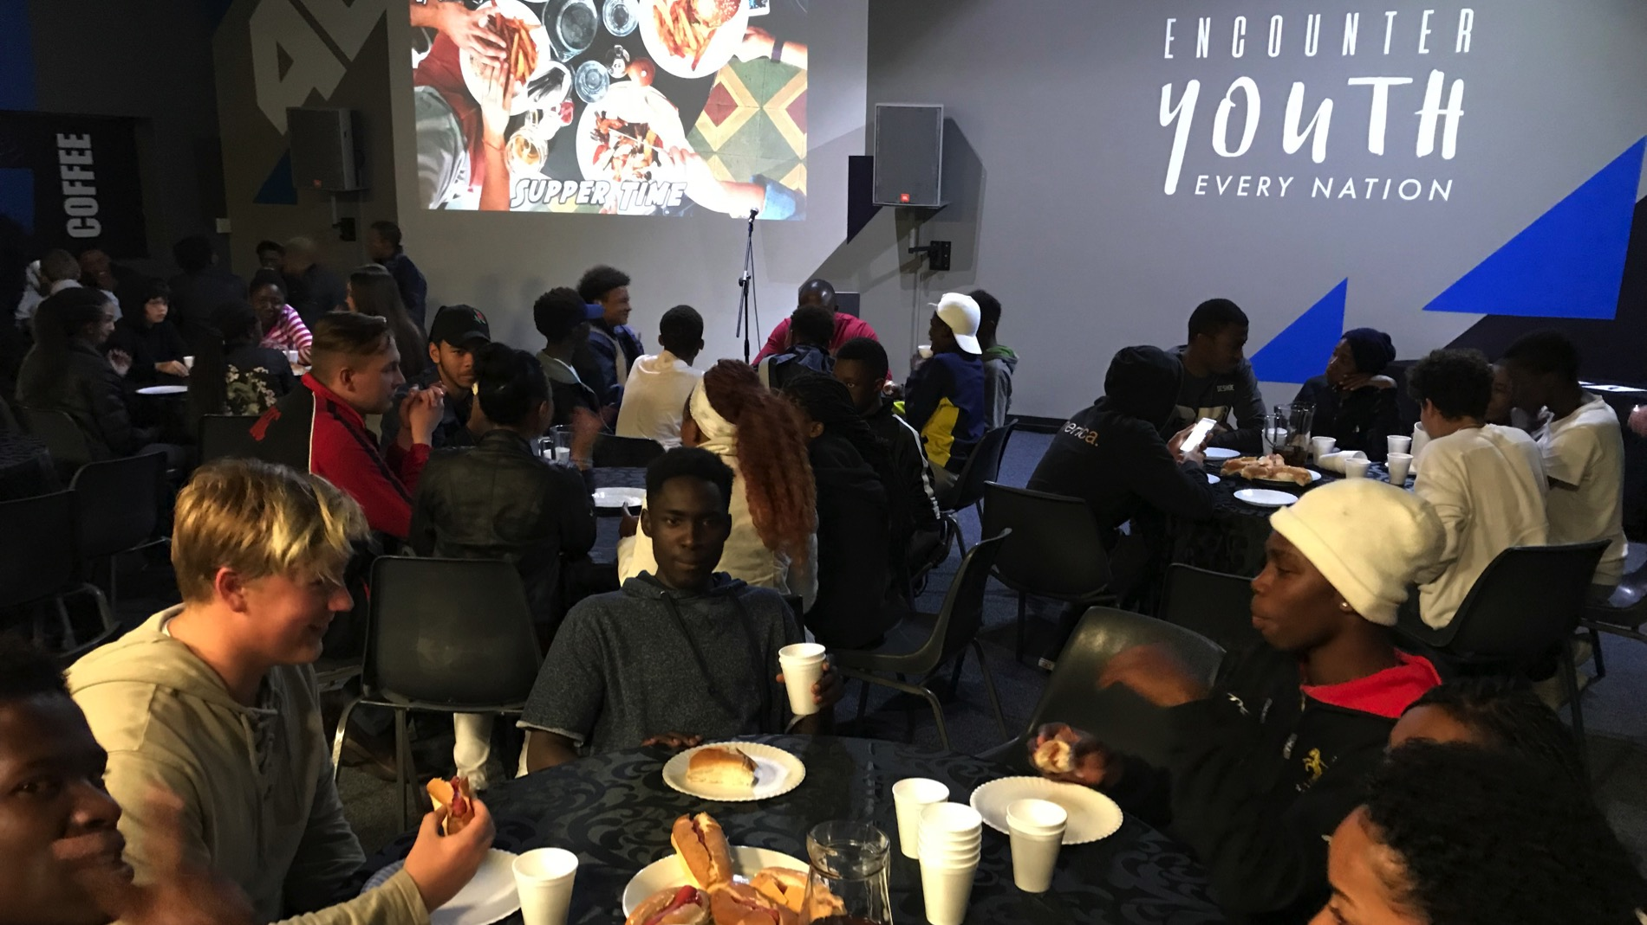
Notes:
For the preview night for the Alpha Youth Series we learnt what Alpha is all about, watched the trailer and spent time in small groups getting to know each other and discussing what we thought about the coming term.

Slide 6
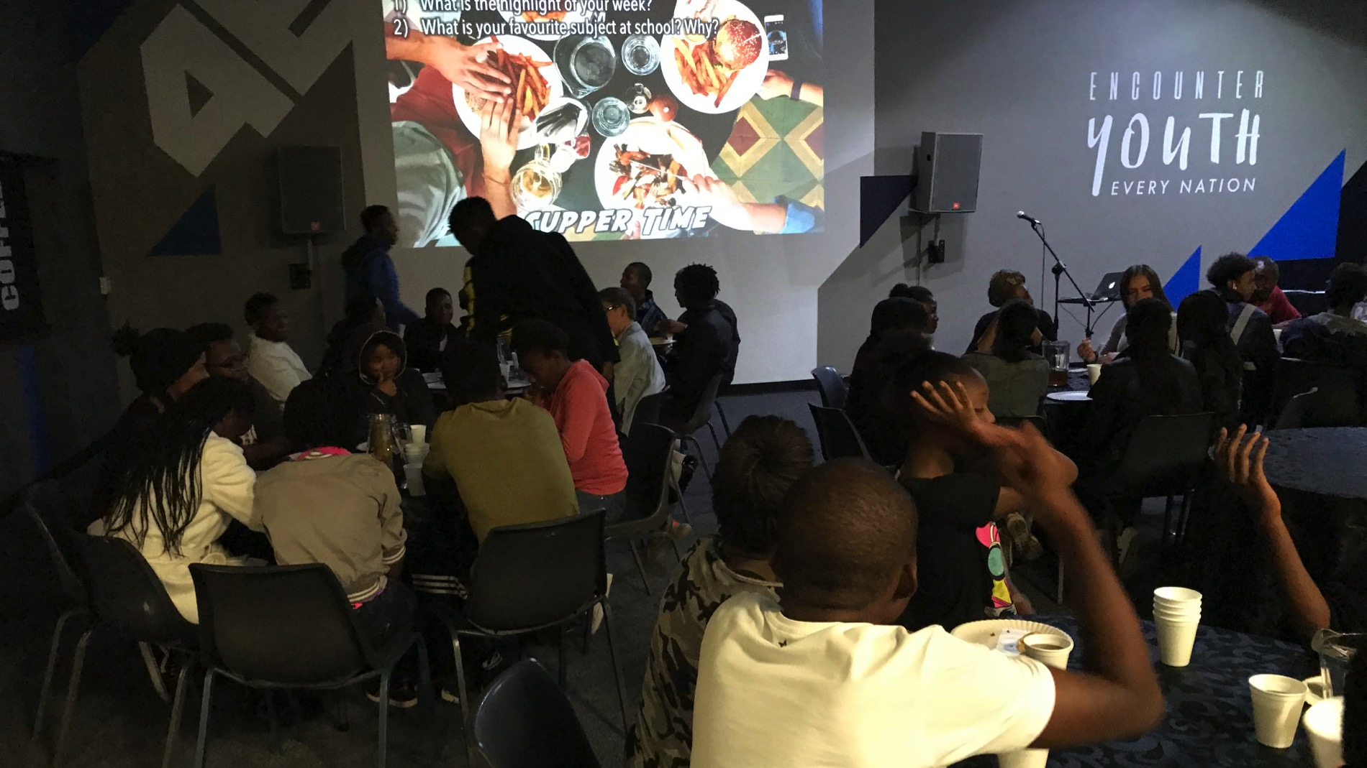
Notes:
For the preview night for the Alpha Youth Series we learnt what Alpha is all about, watched the trailer and spent time in small groups getting to know each other and discussing what we thought about the coming term.

