Slide 1

Notes:
It’s the Alpha Series!

Slide 2

Notes:
Welcome to regulars and newcomers!

Slide 3
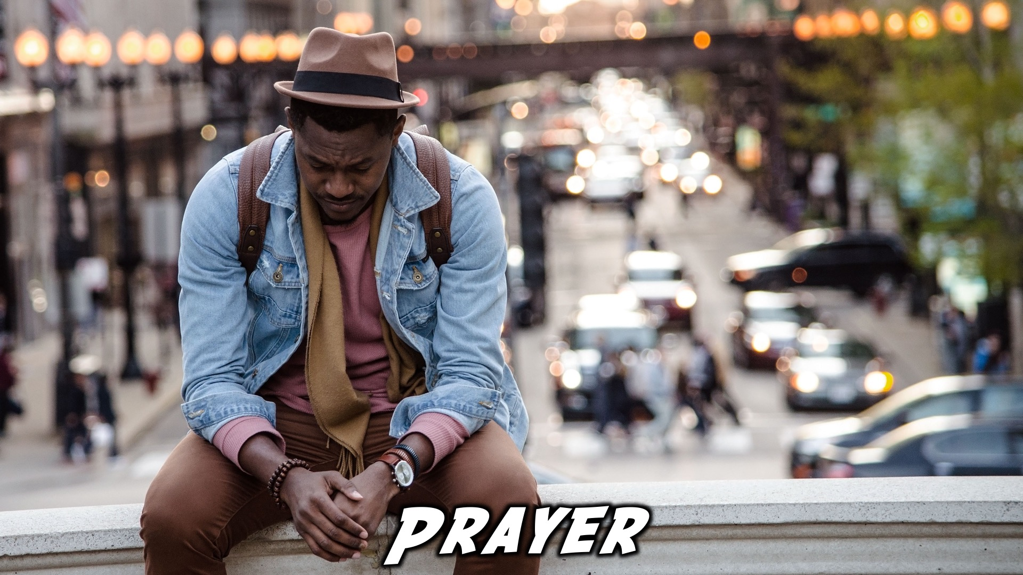
Notes:
Prayer: Let’s open our meeting in prayer.

Slide 4

Notes:
Announcements: Please Listen up to the following announcement.

Slide 5

Notes:
Announcements: Next Friday the topic is, “Faith: How Can We have Faith?”

Slide 6

Notes:
Announcements: On Sunday we are looking at Building Block #4: Intensity

Slide 7

Notes:
25 May – Lead the Cause 2018 – Sign up and get an indemnity Form

Slide 8

Notes:
Announcements: We are involved in these 3 high schools during the week – if you attend one of these schools, see you there!

Slide 9

Notes:
Announcements: Follow us on Instagram! @EncounterYouth_Rosebank

Slide 10

Notes:
Announcements: Join our Friday Night WhatsApp group!

Slide 11

Notes:
Tonight we answer the question, “The Cross: Why did Jesus die.”

Slide 12

Notes:
Dinner Time – A simple meal will be served. During the meal there is a question up so that teens can get to know each other.

Slide 13
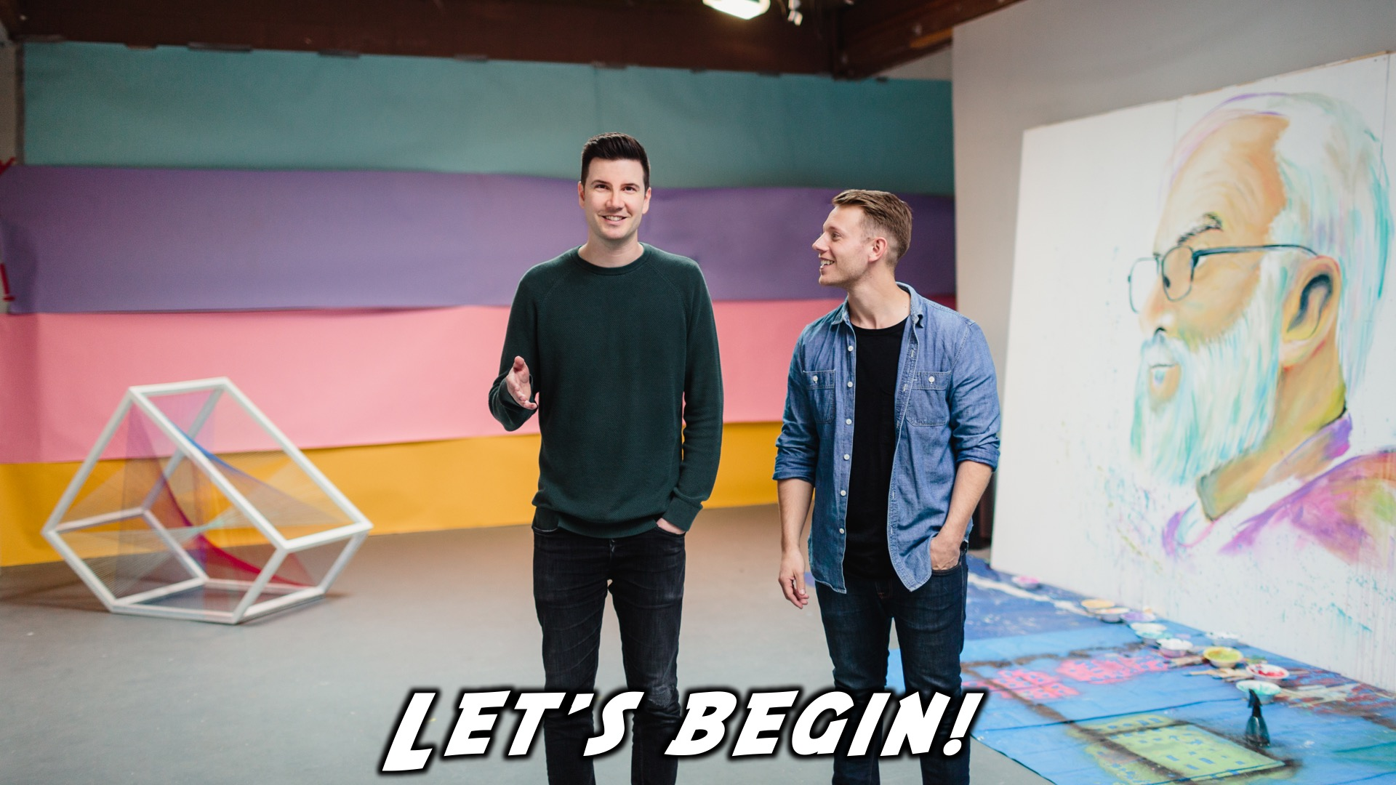
Notes:
Let’s begin the journey.

Slide 14
Notes:
Video: Part 1

Slide 15

Notes:
Question 1: What is the best or worst thing you’ve ever made?

Slide 16
Notes:
Video: Part 2

Slide 17

Notes:
Question 2: How do you see sin in the world around you?

Slide 18
Notes:
Video: Part 3

Slide 19
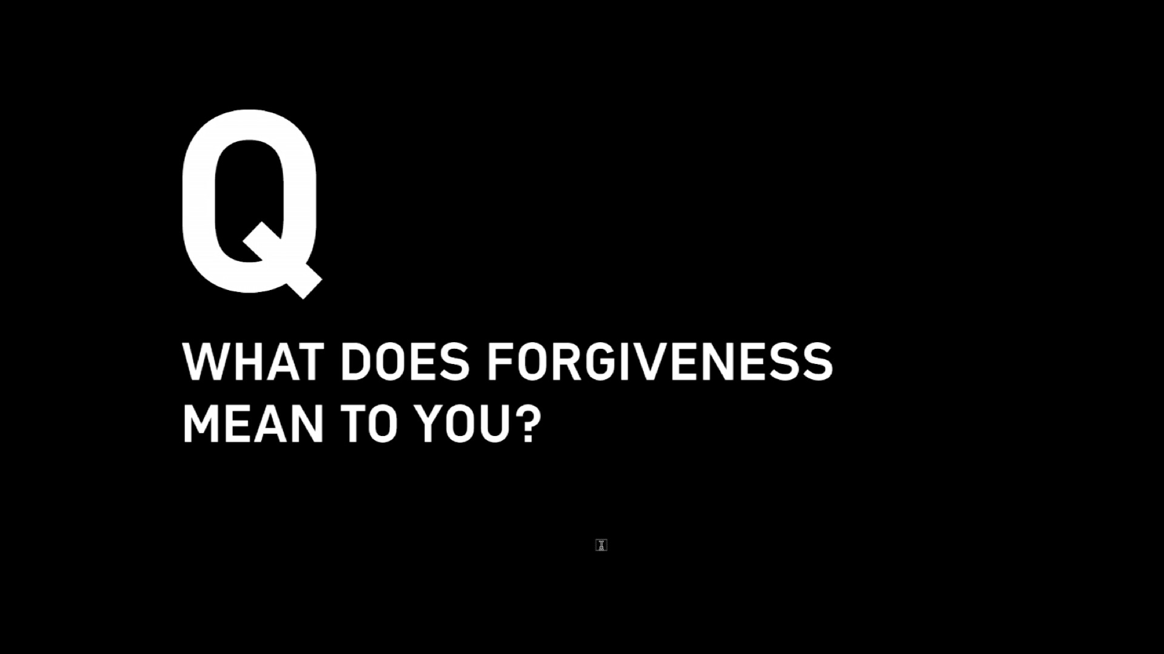
Notes:
Question 3: What does forgiveness mean to you?

Slide 20
Notes:
Video: Part 4

Slide 21

Notes:
Close in Prayer

Slide 22

Notes:
Refreshments

Slide 23
Notes:
Thanks for coming – See you next week Friday!

Slide 24
Notes:
Don’t forget to sign up for LTC!

