Slide 1

Notes:
It’s the Alpha Series!

Slide 2

Notes:
Welcome to regulars and newcomers!

Slide 3
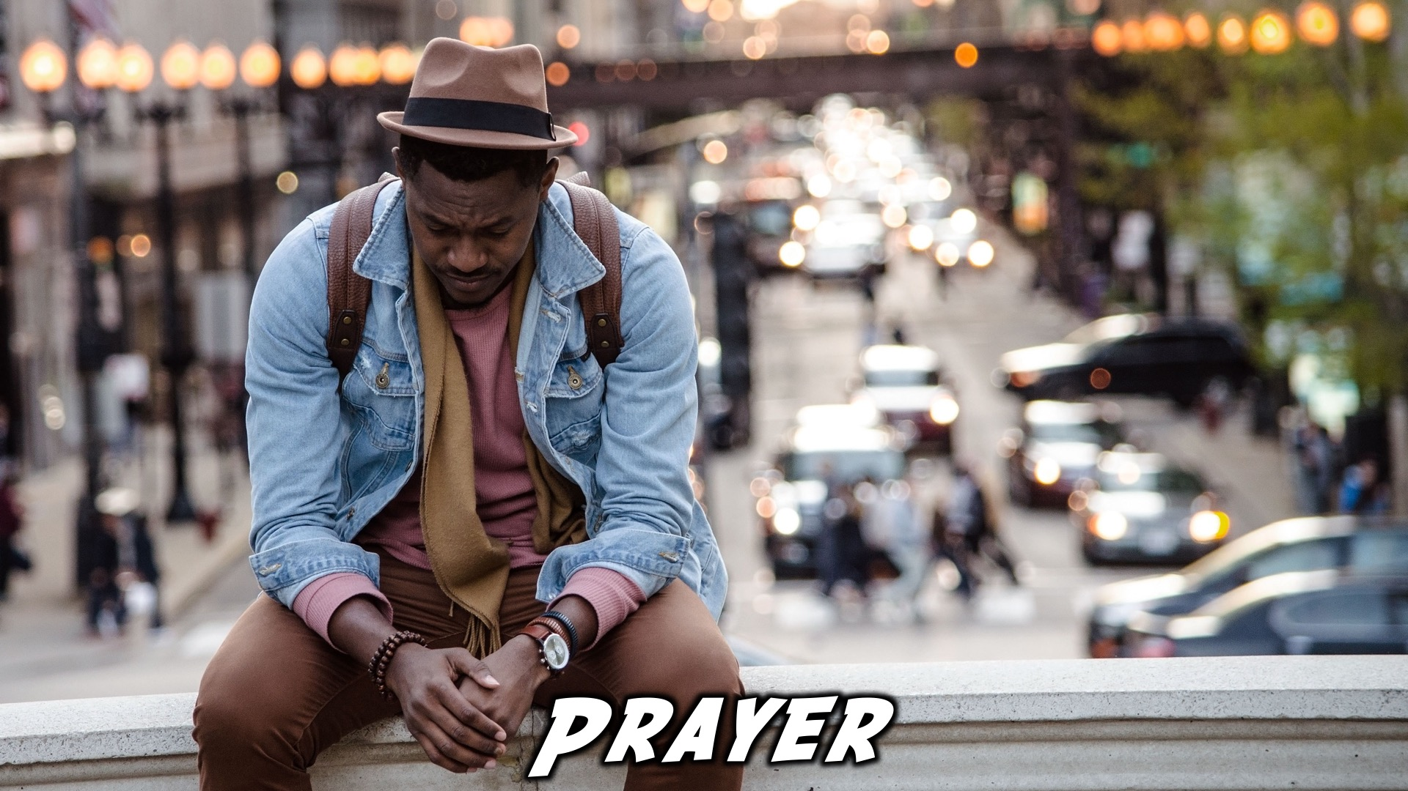
Notes:
Prayer: Let’s open our meeting in prayer.

Slide 4

Notes:
Announcements: Please Listen up to the following announcement.

Slide 5

Notes:
On Sunday we will be looking at Building Block #5: Attention

Slide 6

Notes:
25 May – Lead the Cause 2018 – Sign up and get an indemnity Form

Slide 7

Notes:
Announcements: We are involved in these 3 high schools during the week – if you attend one of these schools, see you there!

Slide 8

Notes:
Announcements: Follow us on Instagram! @EncounterYouth_Rosebank

Slide 9

Notes:
Announcements: Join our Friday Night WhatsApp group!

Slide 10

Notes:
Tonight we answer the question, “Faith: How can we have it?.”

Slide 11

Notes:
Dinner Time – A simple meal will be served. During the meal there is a question up so that teens can get to know each other.
What has been the best part of your week so far?
Have you ever met anyone famous?

Slide 12
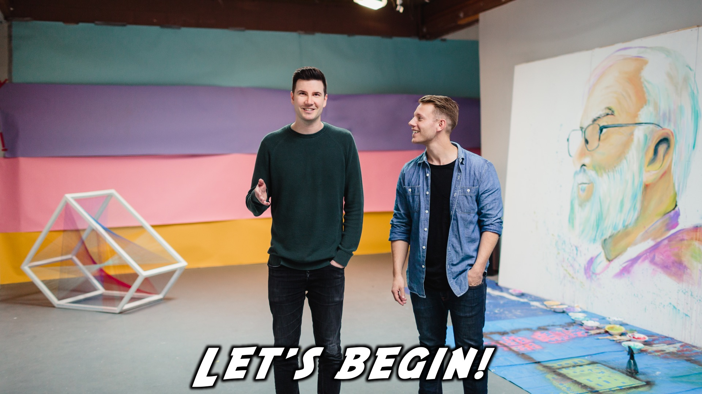
Notes:
Let’s begin the journey.

Slide 13
Notes:
Video: Part 1

Slide 14

Notes:
Question 1: What kind of club would you start?

Slide 15
Notes:
Video: Part 2

Slide 16

Notes:
Question 2: What do you think about Christianity being described in terms of a relationship with God?

Slide 17
Notes:
Video: Part 3

Slide 18
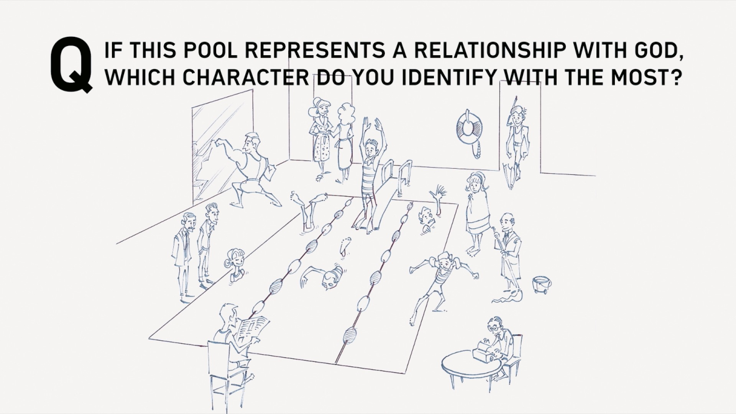
Notes:
Question 3: If this pool represents a relationship with God, which character do you identify with the most?

Slide 19
Notes:
Video: Part 4

Slide 20

Notes:
Close in Prayer

Slide 21

Notes:
Refreshments

Slide 22
Notes:
Thanks for coming – See you next week Friday!

