Slide 1

Notes:
It’s the Alpha Series!

Slide 2
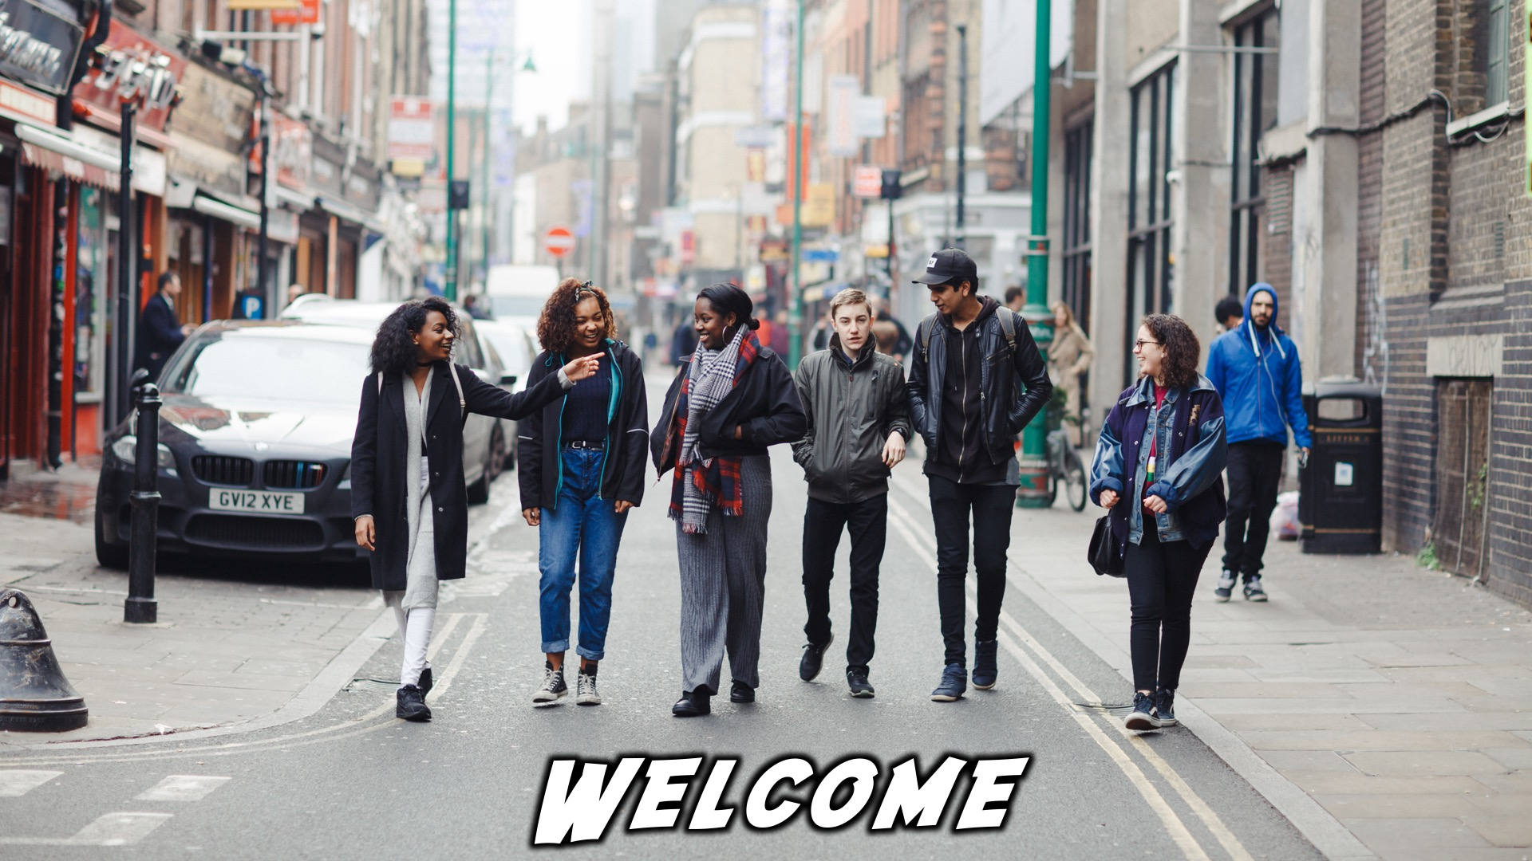
Notes:
Welcome to regulars and newcomers!

Slide 3
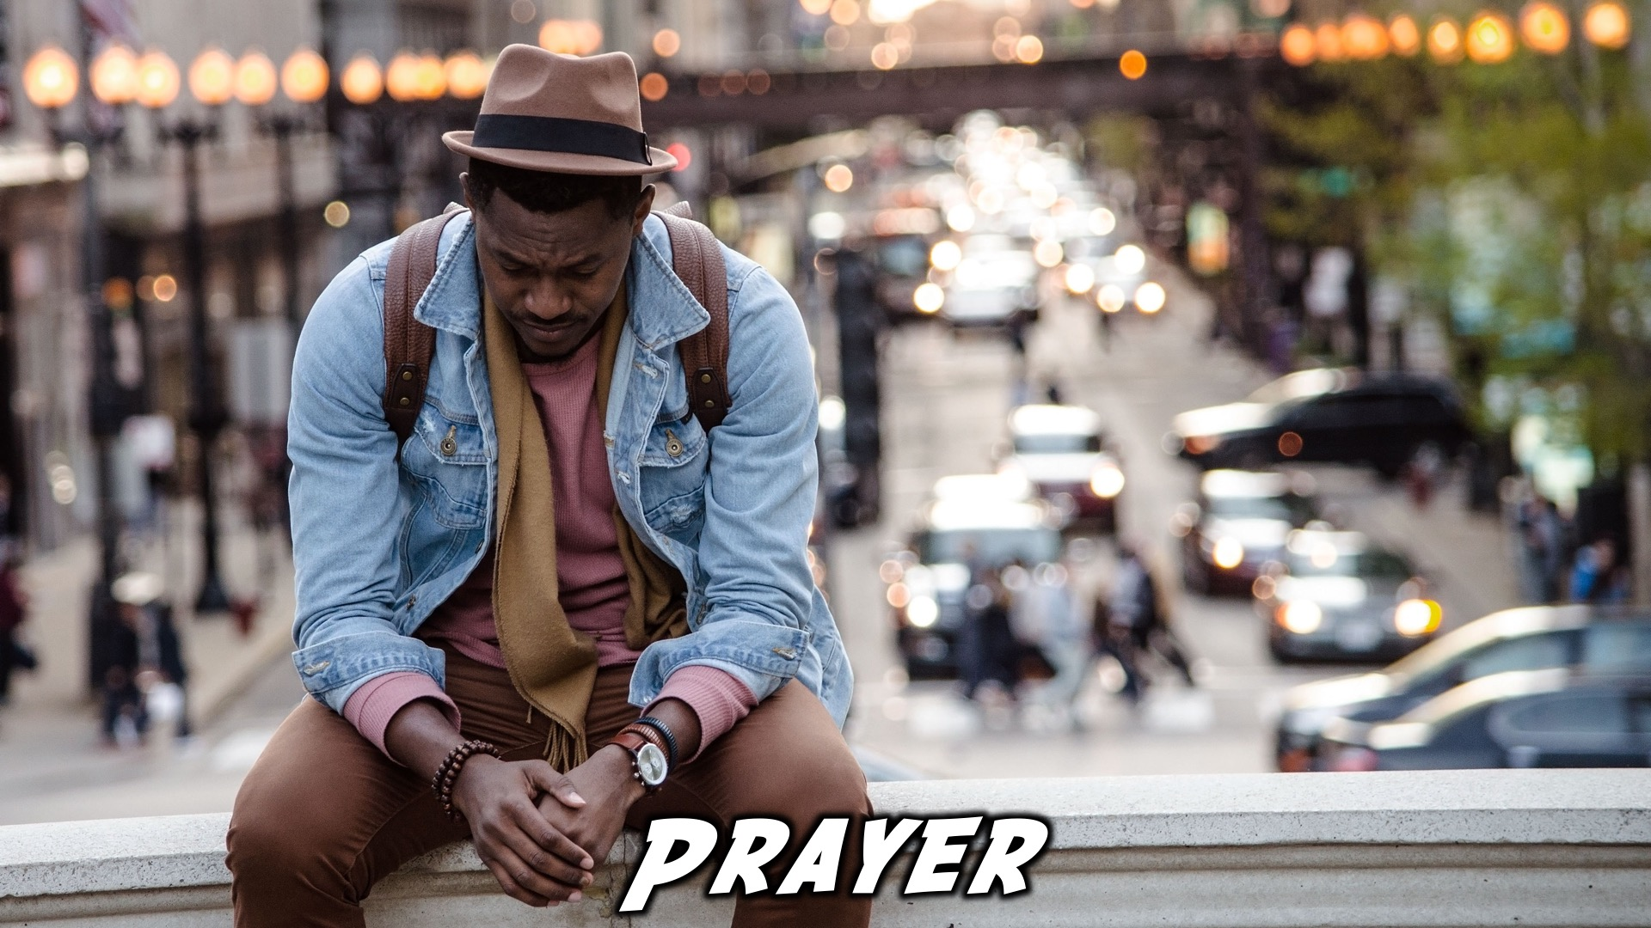
Notes:
Prayer: Let’s open our meeting in prayer.

Slide 4

Notes:
Announcements: Please Listen up to the following announcement.

Slide 5

Notes:
On Sunday we will be looking at Building Block #6: Emotions

Slide 6

Notes:
Next week Friday we are looking at the topic: “Bible: Why and How Do I Read the Bible?”

Slide 7

Notes:
Announcements: We are involved in these 3 high schools during the week – if you attend one of these schools, see you there!

Slide 8
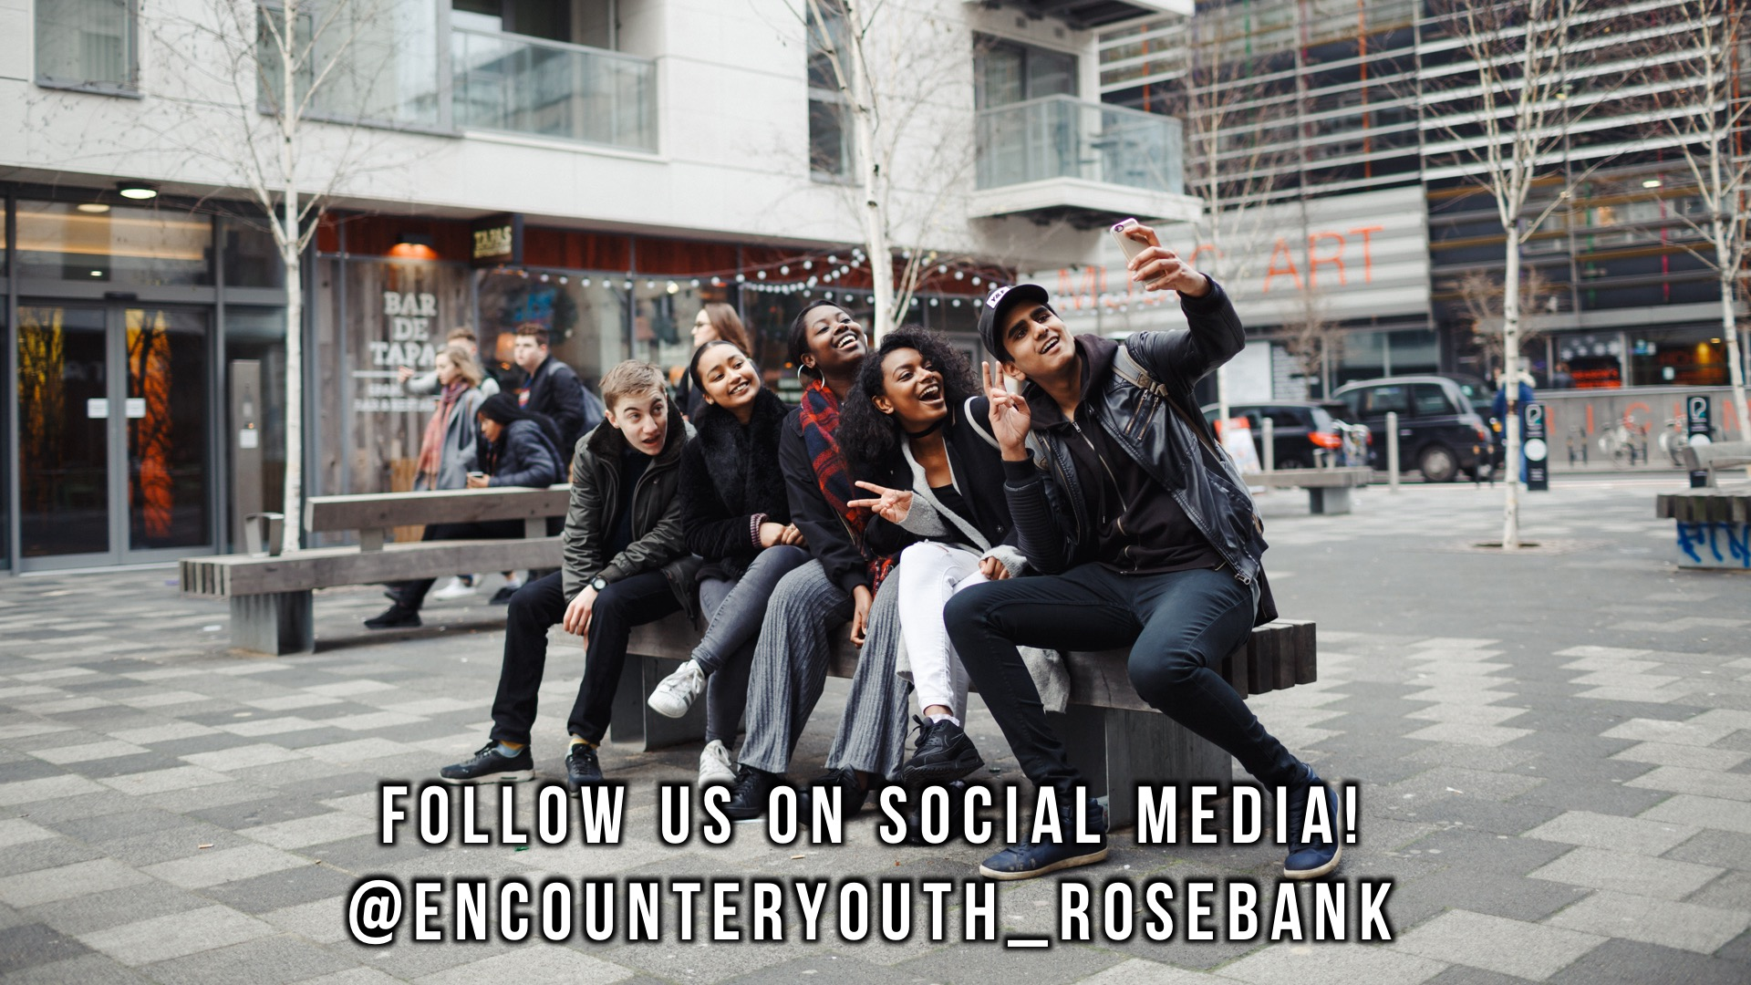
Notes:
Announcements: Follow us on Instagram! @EncounterYouth_Rosebank

Slide 9

Notes:
Announcements: Join our Friday Night WhatsApp group!

Slide 10

Notes:
Tonight we answer the question, “Prayer: How do I pray?.”

Slide 11
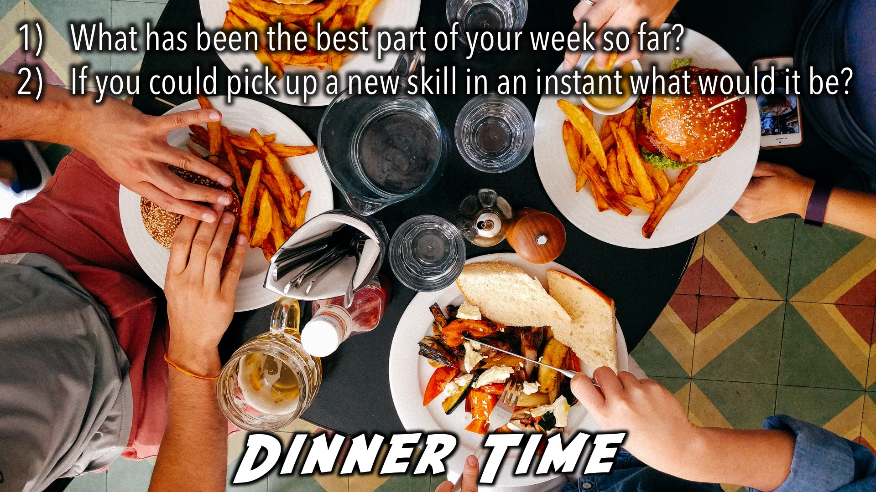
Notes:
Dinner Time – A simple meal will be served. During the meal there is a question up so that teens can get to know each other.
What has been the best part of your week so far?
If you could pick up a new skill in an instant what would it be?

Slide 12
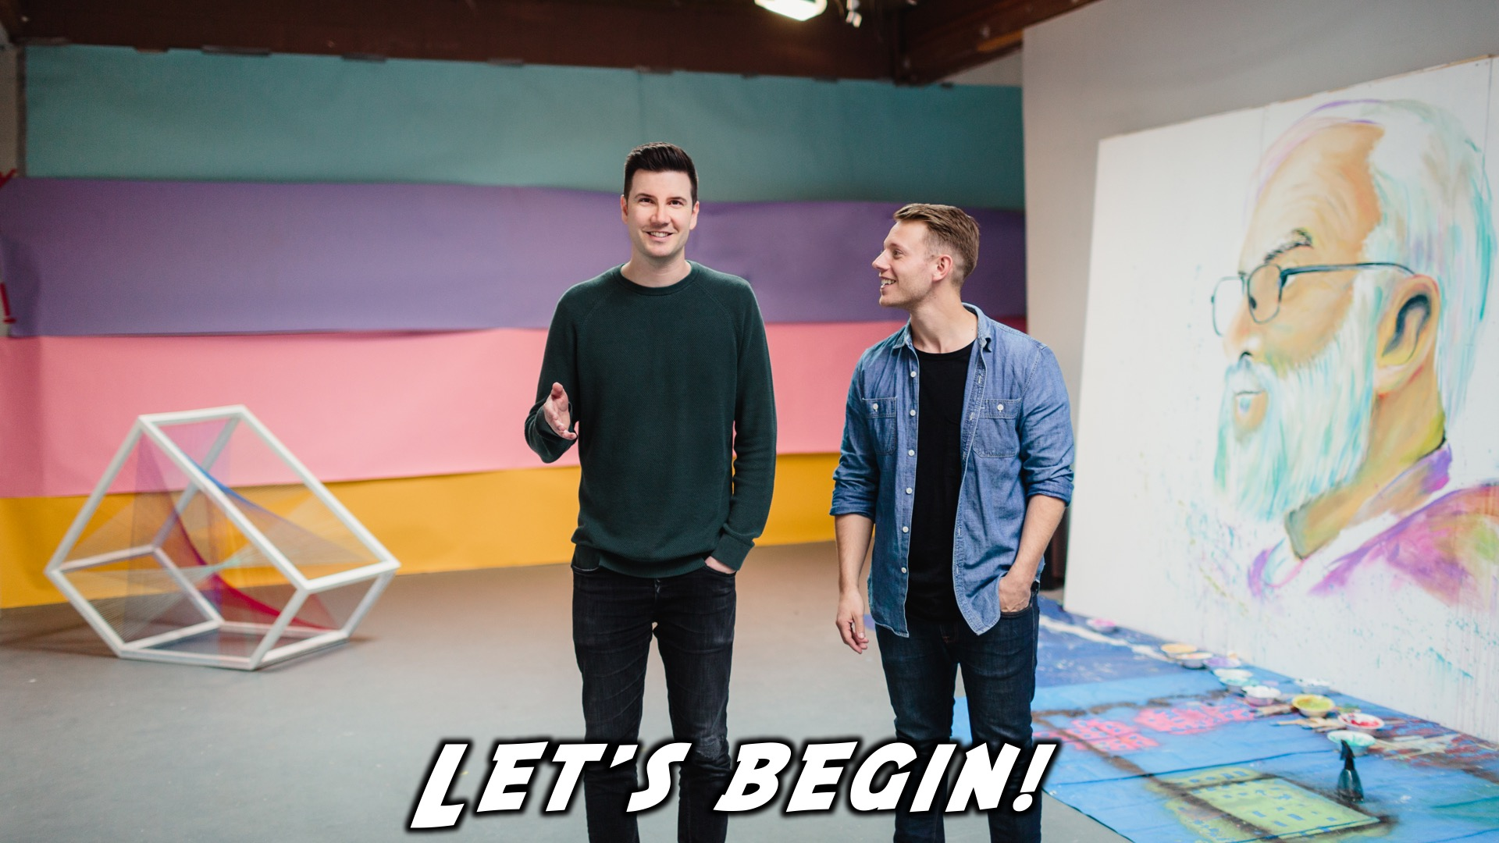
Notes:
Let’s begin the journey.

Slide 13
Notes:
Video: Part 1

Slide 14
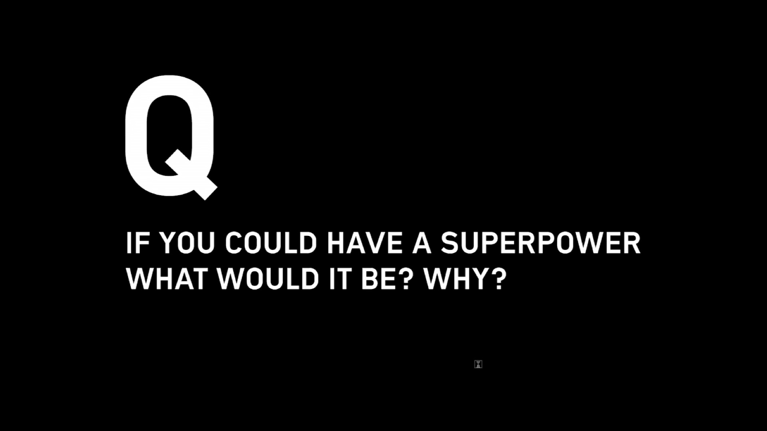
Notes:
Question 1: If you could have a superpower what would it be? Why?

Slide 15
Notes:
Video: Part 2

Slide 16
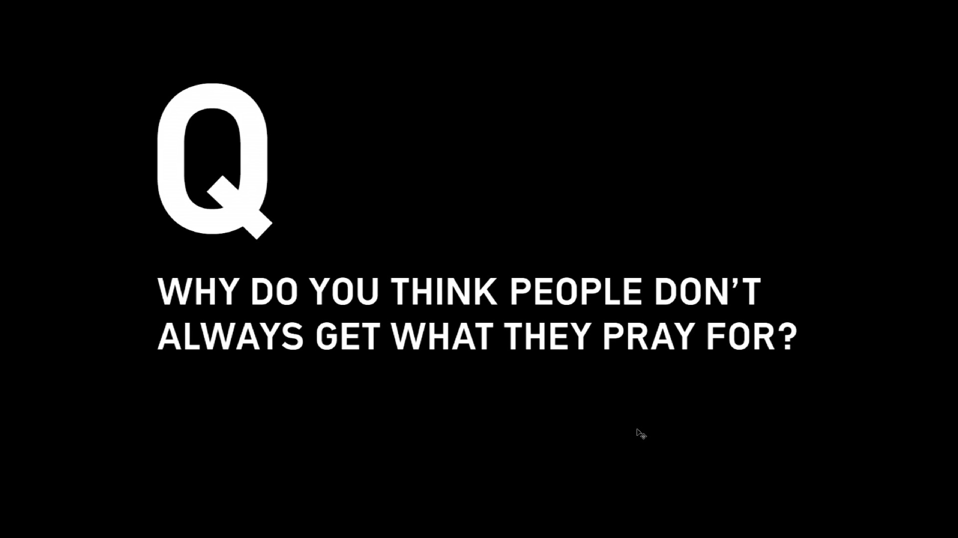
Notes:
Question 2: Why do you think people don’t always get what they pray for?

Slide 17
Notes:
Video: Part 3

Slide 18
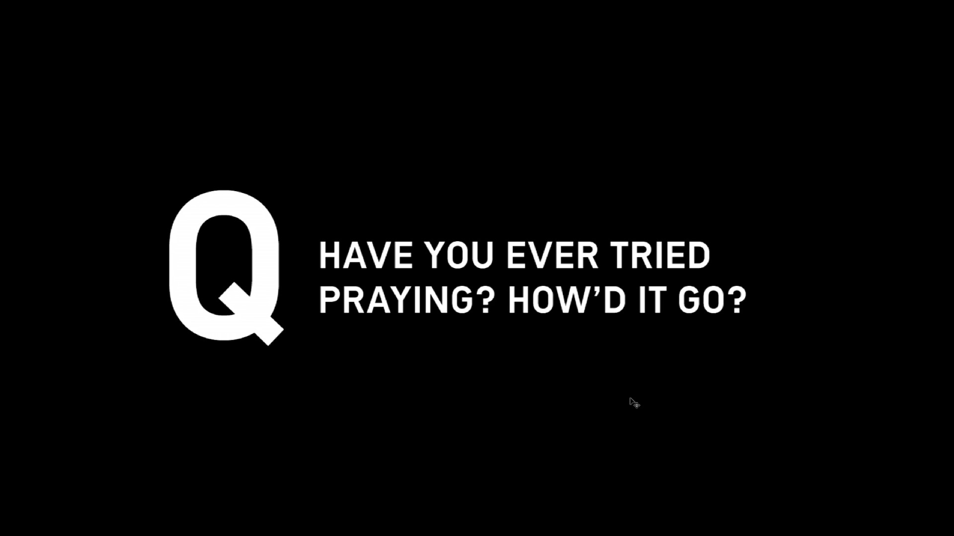
Notes:
Question 3: Have you ever tried praying? How’d it go?

Slide 19
Notes:
Video: Part 4

Slide 20
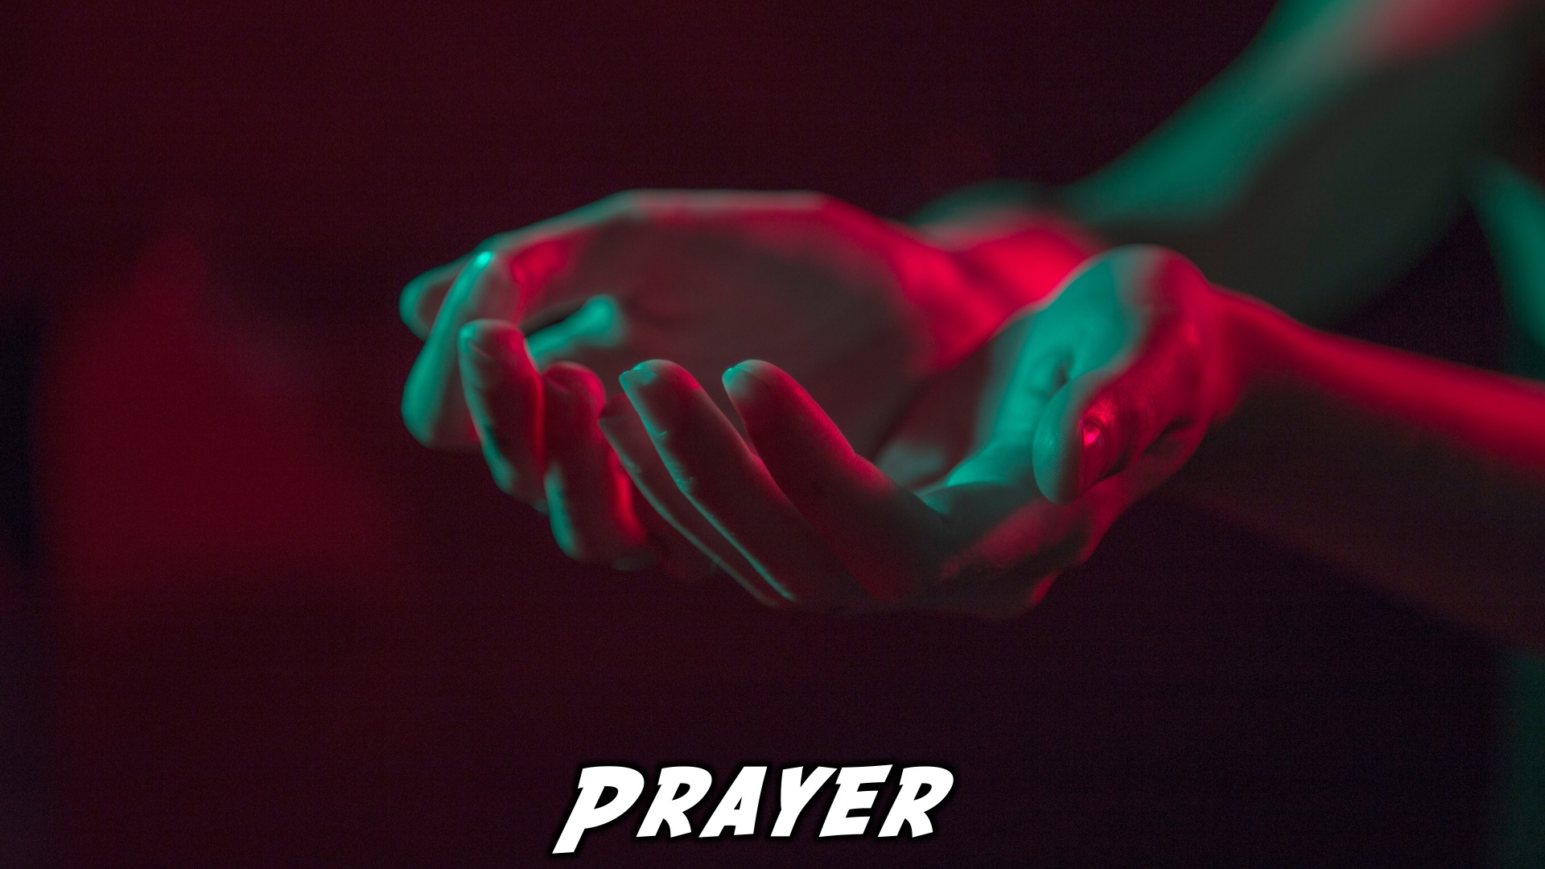
Notes:
Close in Prayer

Slide 21

Notes:
Refreshments

Slide 22
Notes:
Thanks for coming – See you next week Friday!

