Slide 1

Notes:
It’s the Alpha Series!

Slide 2
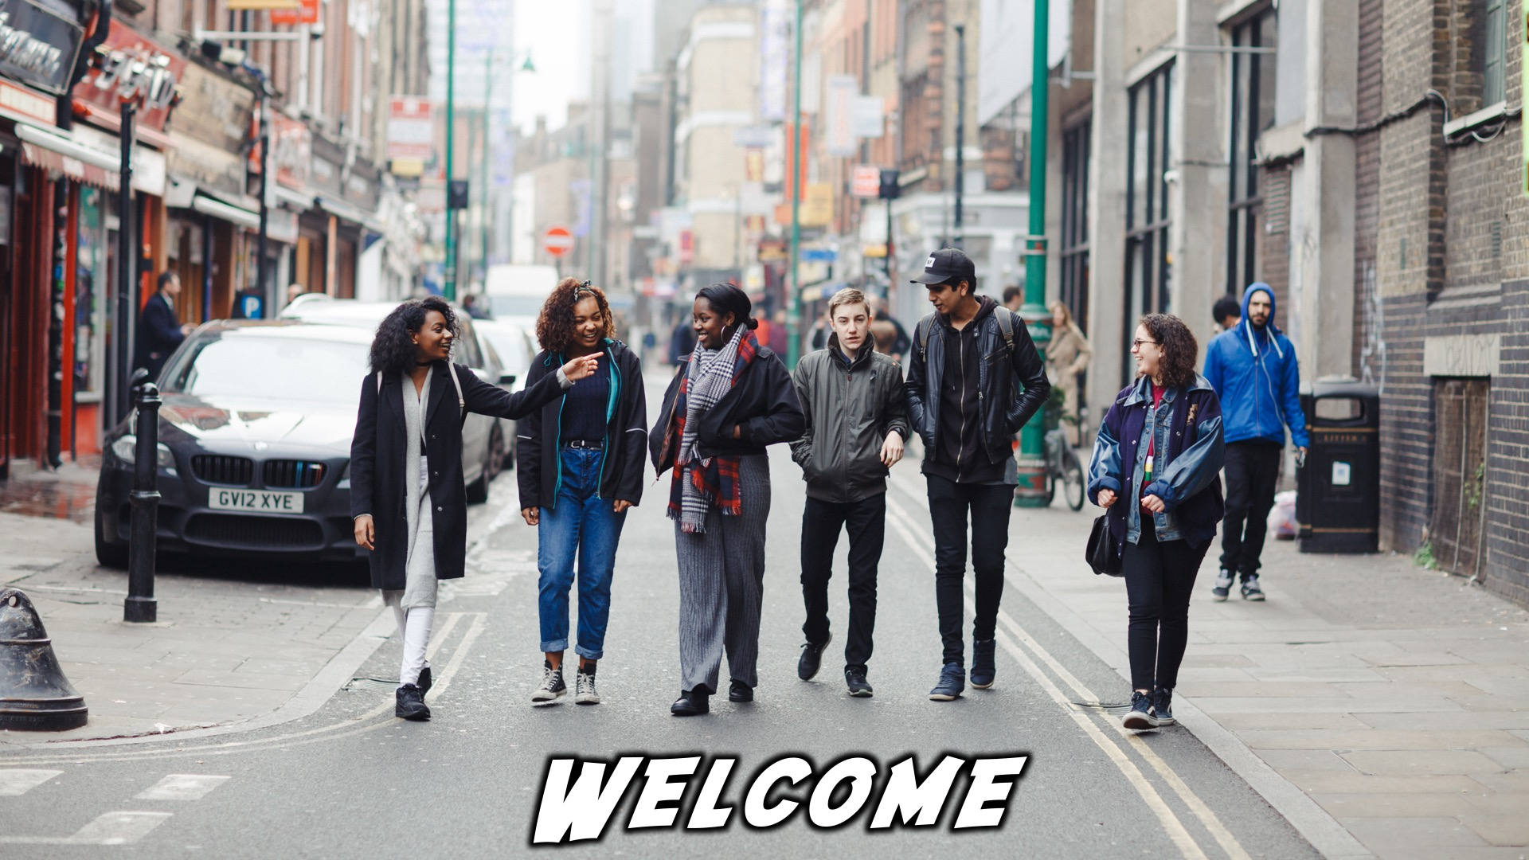
Notes:
Welcome to regulars and newcomers!

Slide 3
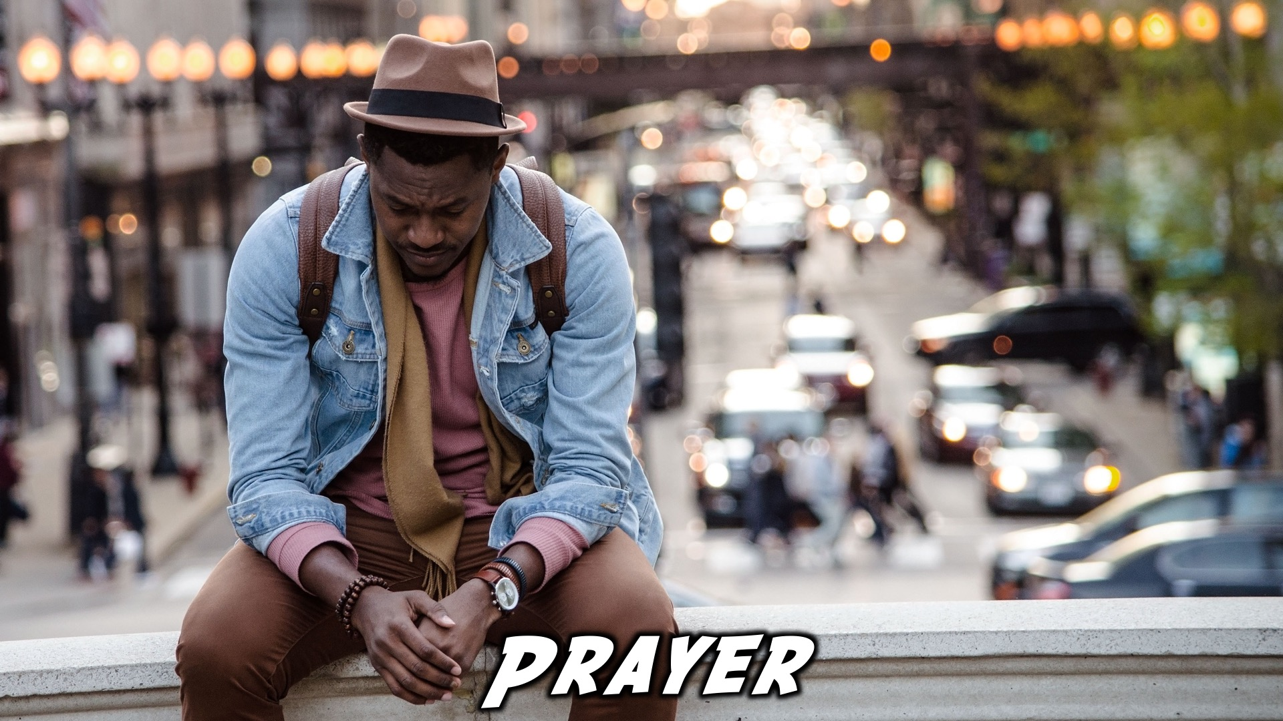
Notes:
Prayer: Let’s open our meeting in prayer.

Slide 4

Notes:
Announcements: Please Listen up to the following announcement.

Slide 5

Notes:
On Sunday we will be looking at Building Block #7 - Rehearsal

Slide 6
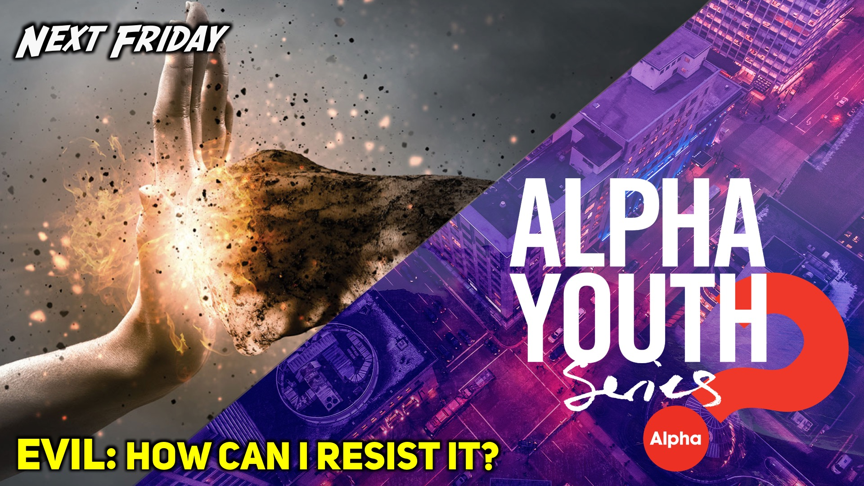
Notes:
Next week Friday we are looking at the topic: “Evil: How can I resist it?”

Slide 7
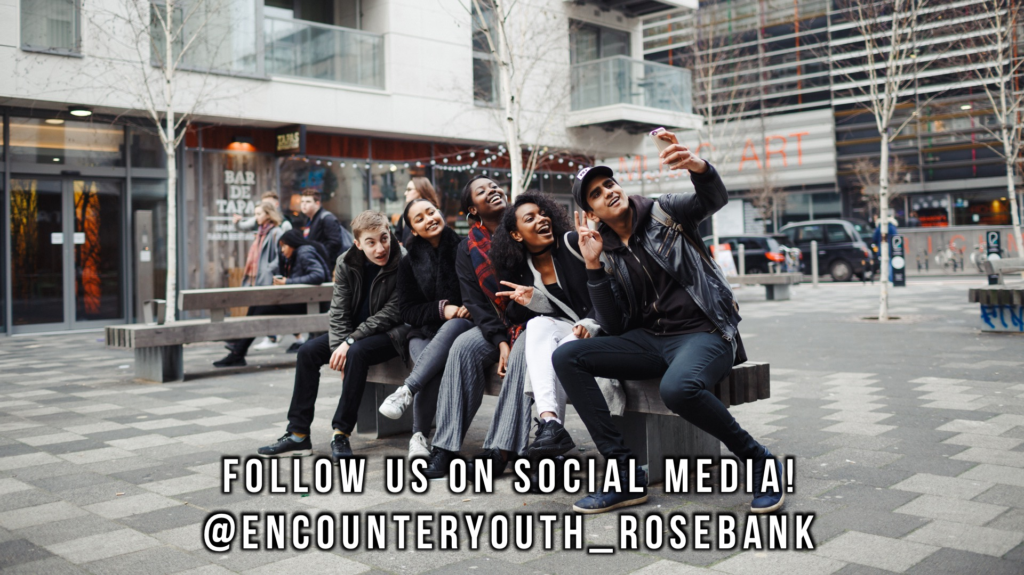
Notes:
Announcements: Follow us on Instagram! @EncounterYouth_Rosebank

Slide 8

Notes:
Announcements: Join our Friday Night WhatsApp group!

Slide 9

Notes:
Tonight we answer the question, “Bible: Why and How Do I Read It?”

Slide 10
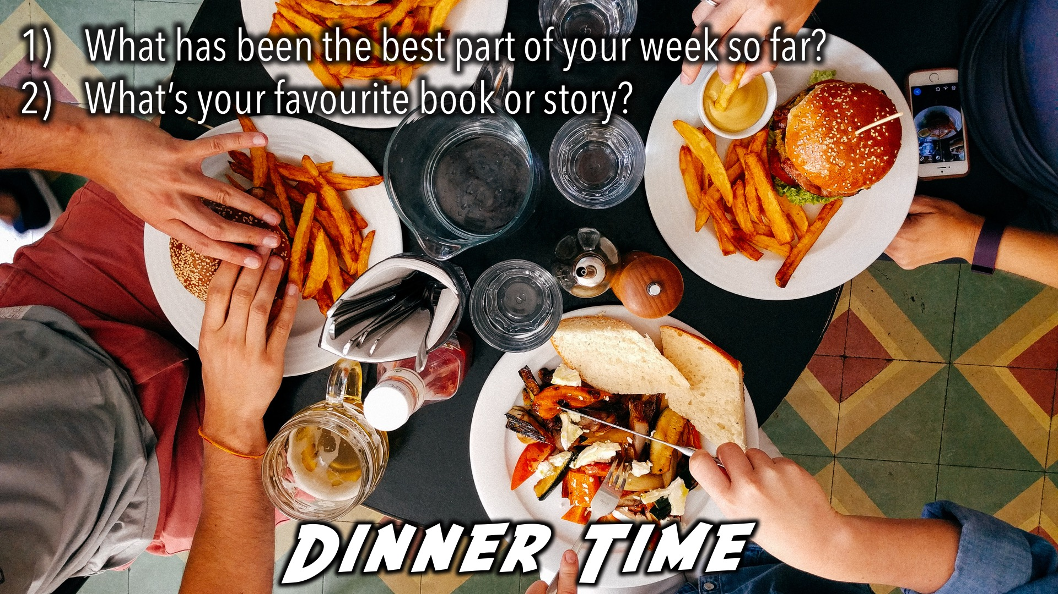
Notes:
Dinner Time – A simple meal will be served. During the meal there is a question up so that teens can get to know each other.
What has been the best part of your week so far?
What’s your favourite book or story?

Slide 11
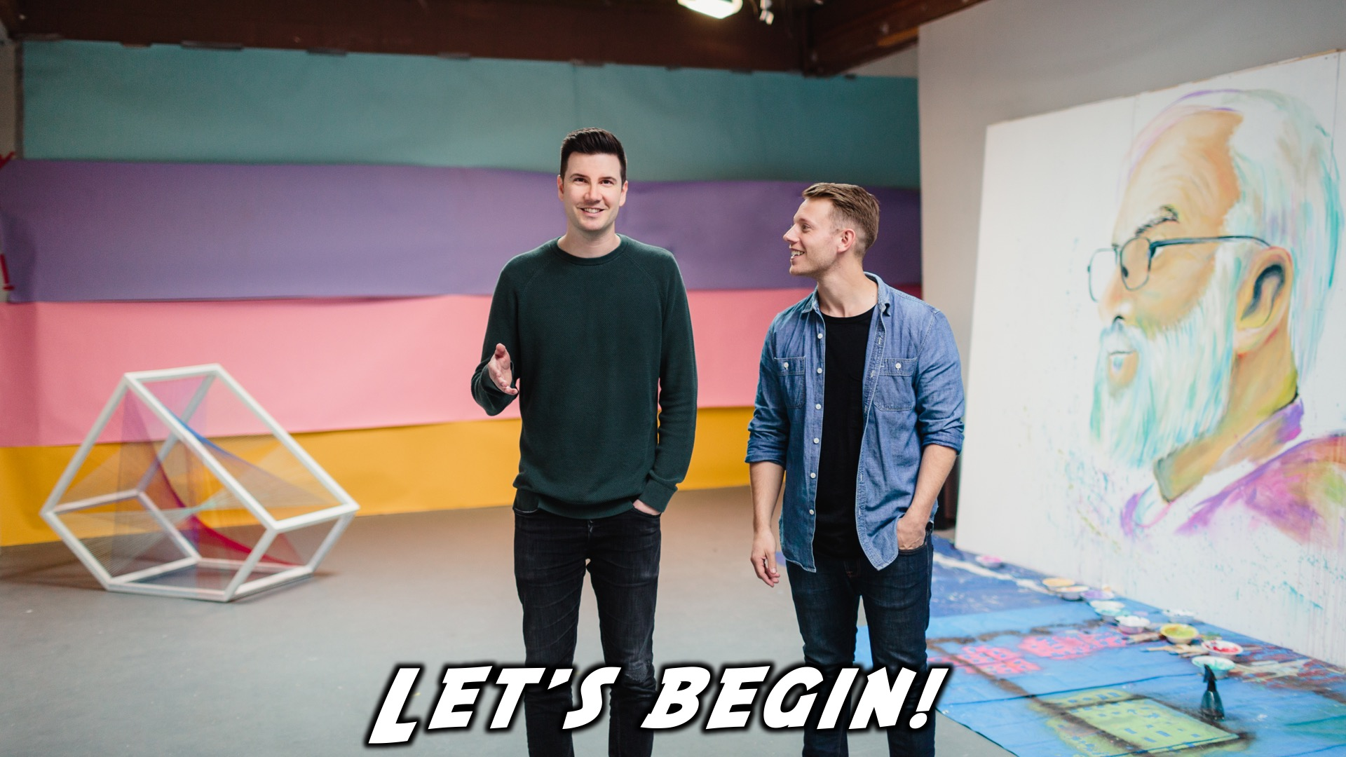
Notes:
Let’s begin the journey.

Slide 12

Notes:
Video: Part 1

Slide 13
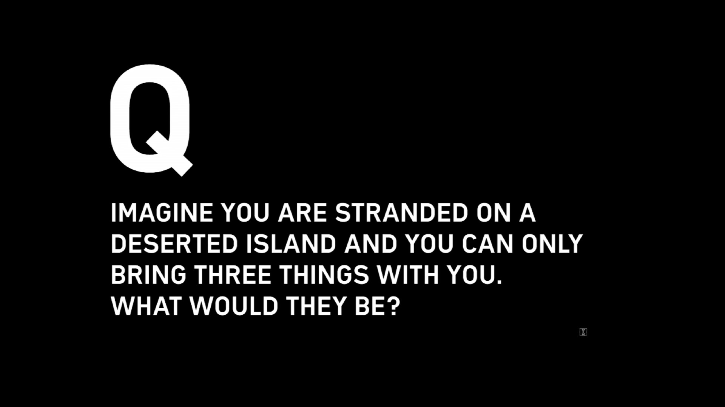
Notes:
Question 1: Imagine you are stranded on a deserted island and you can only bring three things with you. What would they be?

Slide 14
Notes:
Video: Part 2

Slide 15
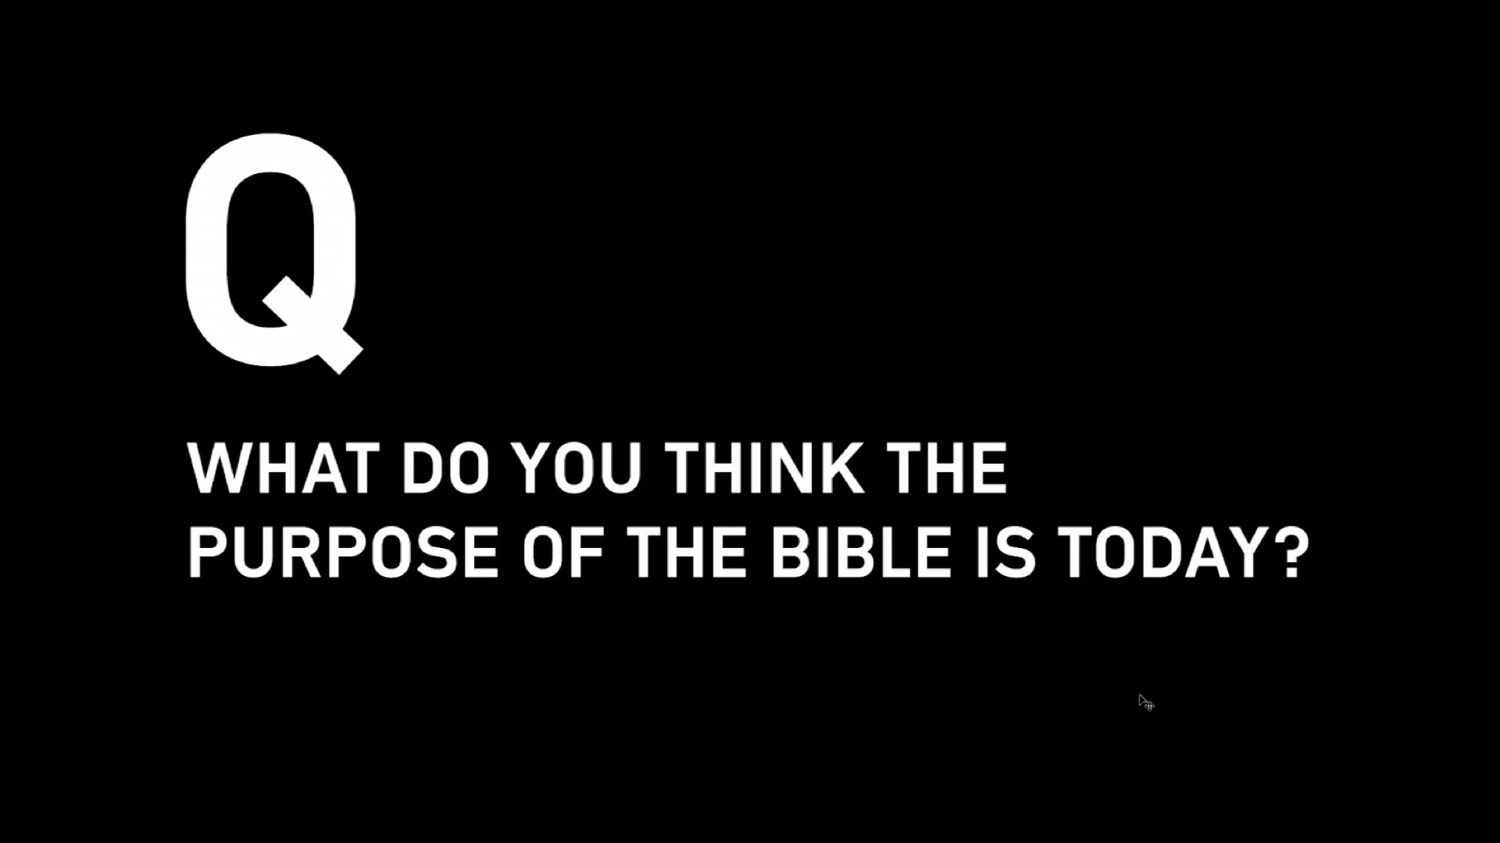
Notes:
Question 2: What do you think the purpose of the bible is today?

Slide 16
Notes:
Video: Part 3

Slide 17
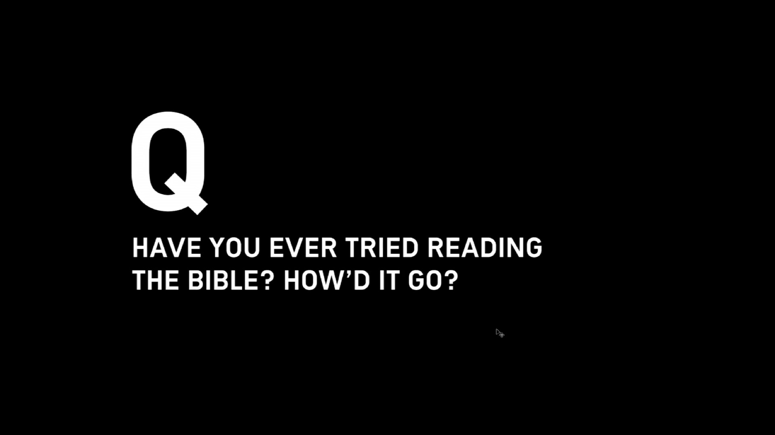
Notes:
Question 3: Have you ever tried reading the Bible? How’d it go?

Slide 18
Notes:
Video: Part 4

Slide 19
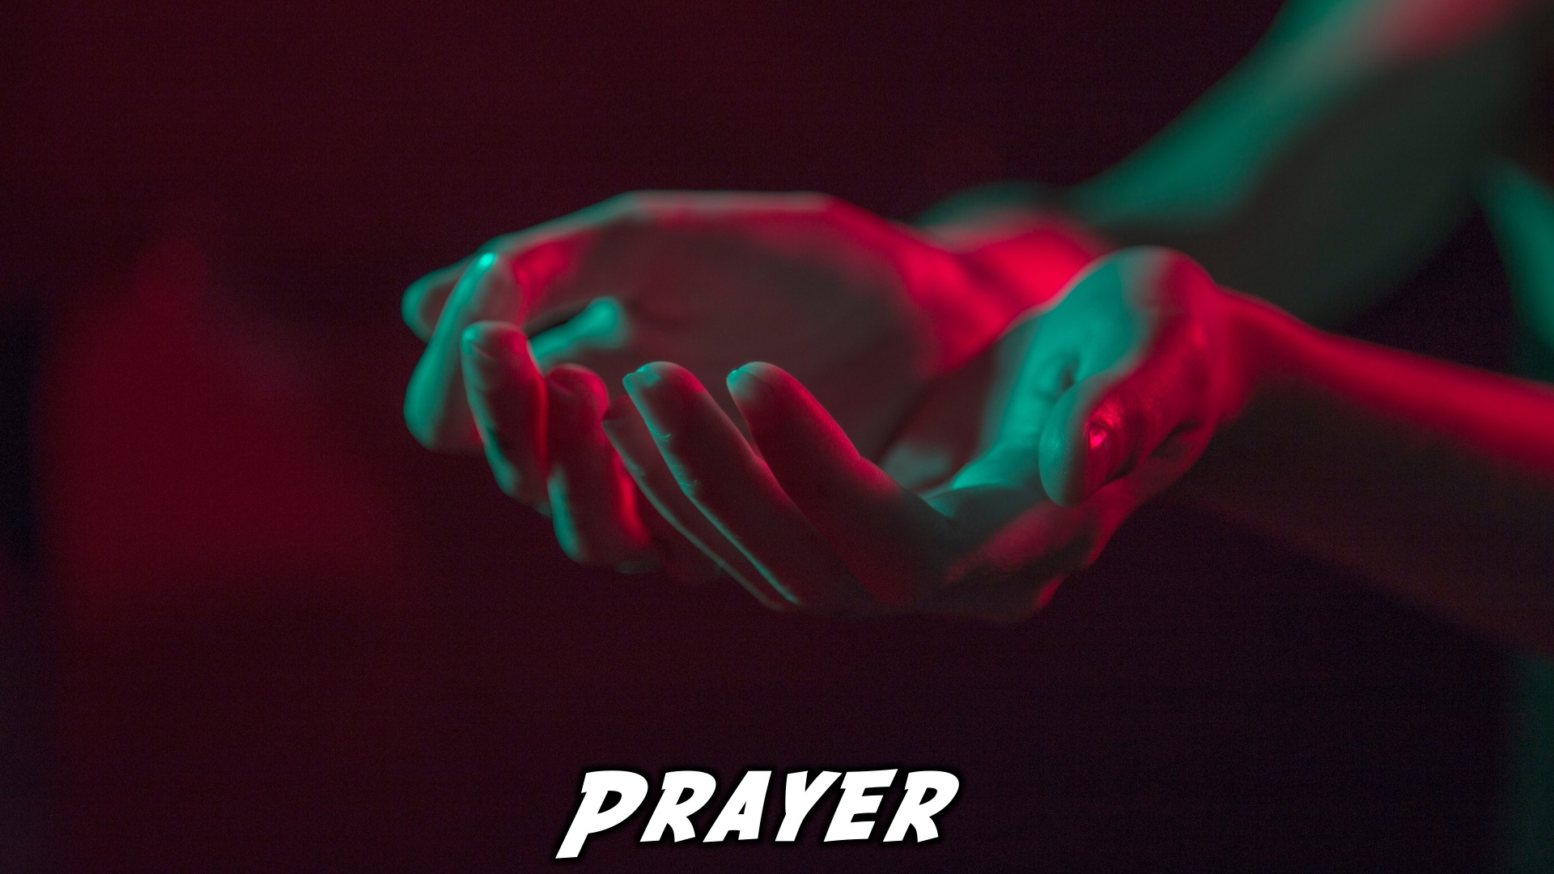
Notes:
Close in Prayer

Slide 20

Notes:
Refreshments

Slide 21
Notes:
Thanks for coming – See you next week Friday!

