Slide 1

Notes:
It’s the Alpha Series!

Slide 2
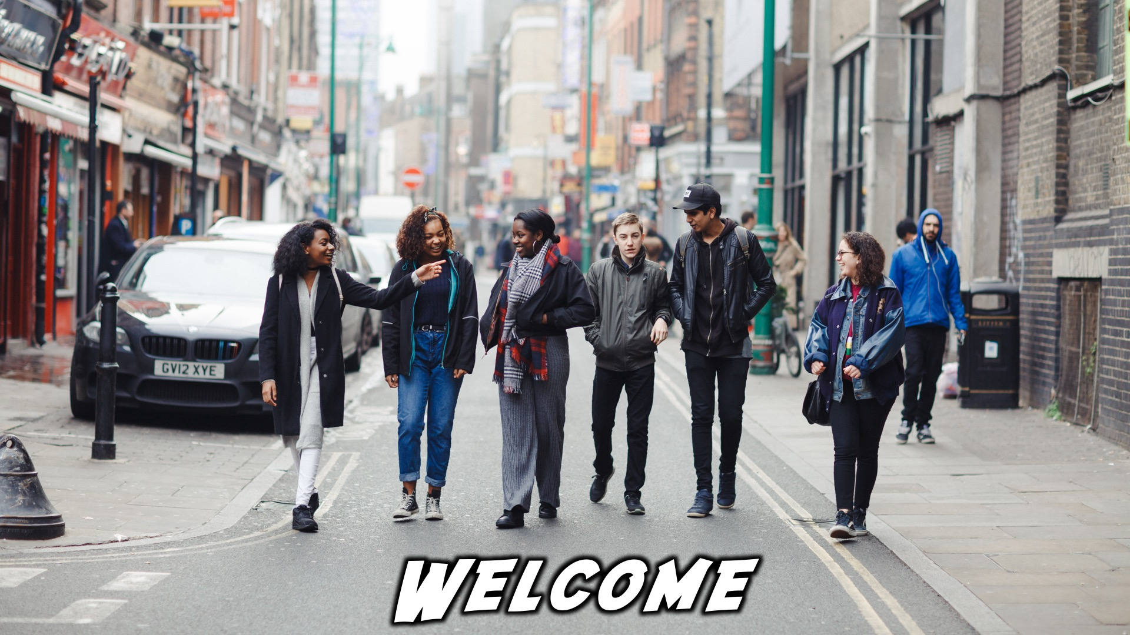
Notes:
Welcome to regulars and newcomers!

Slide 3
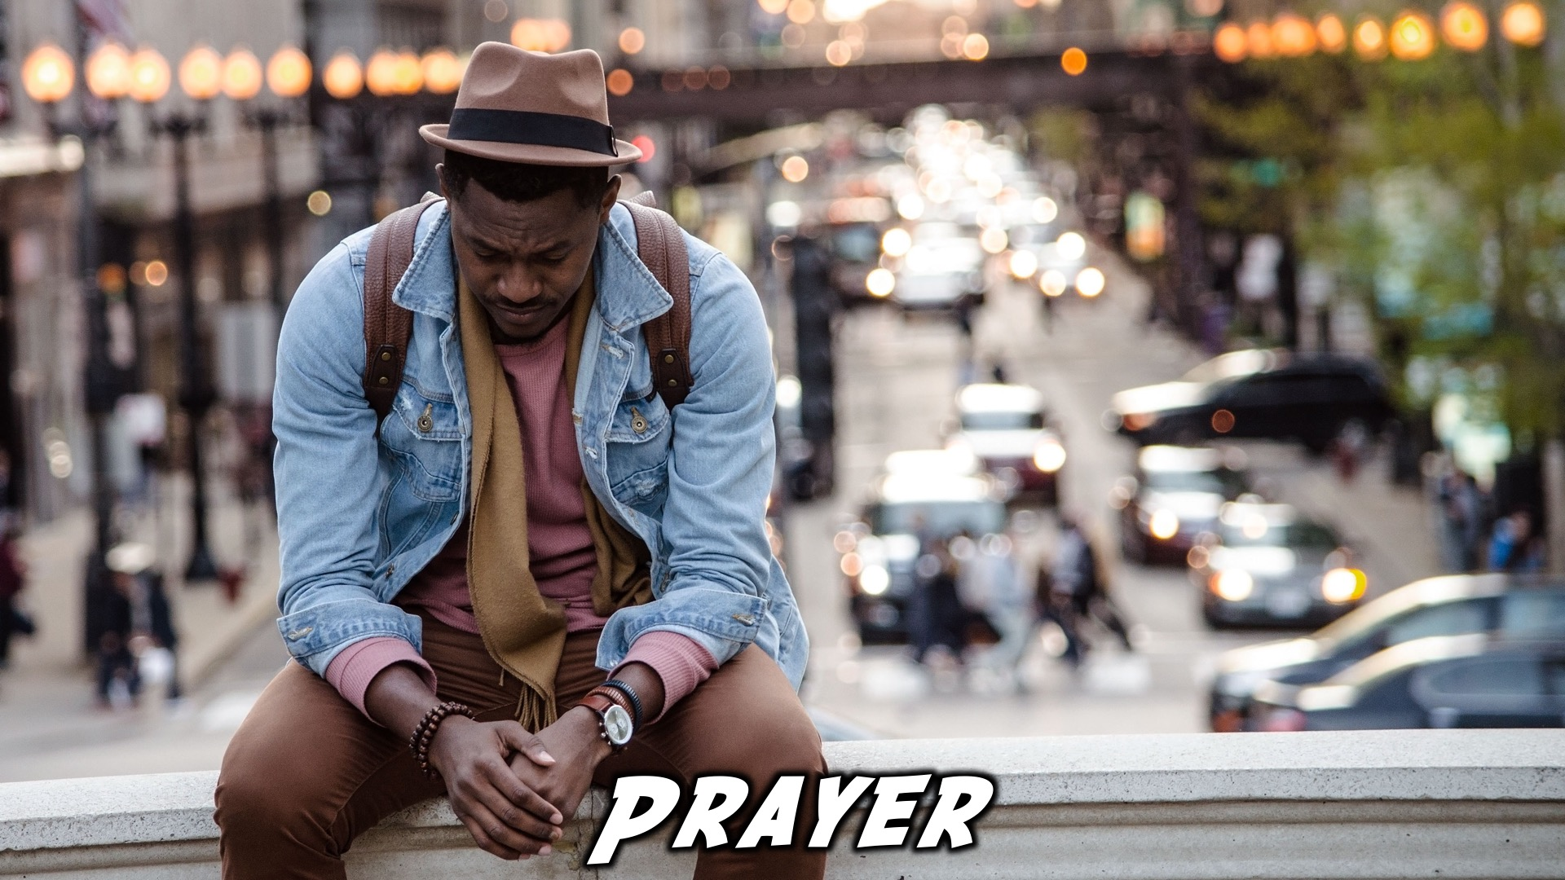
Notes:
Prayer: Let’s open our meeting in prayer.

Slide 4

Notes:
Announcements: Please Listen up to the following announcement.

Slide 5

Notes:
On Sunday we will be looking at Building Block #8 - Routines

Slide 6
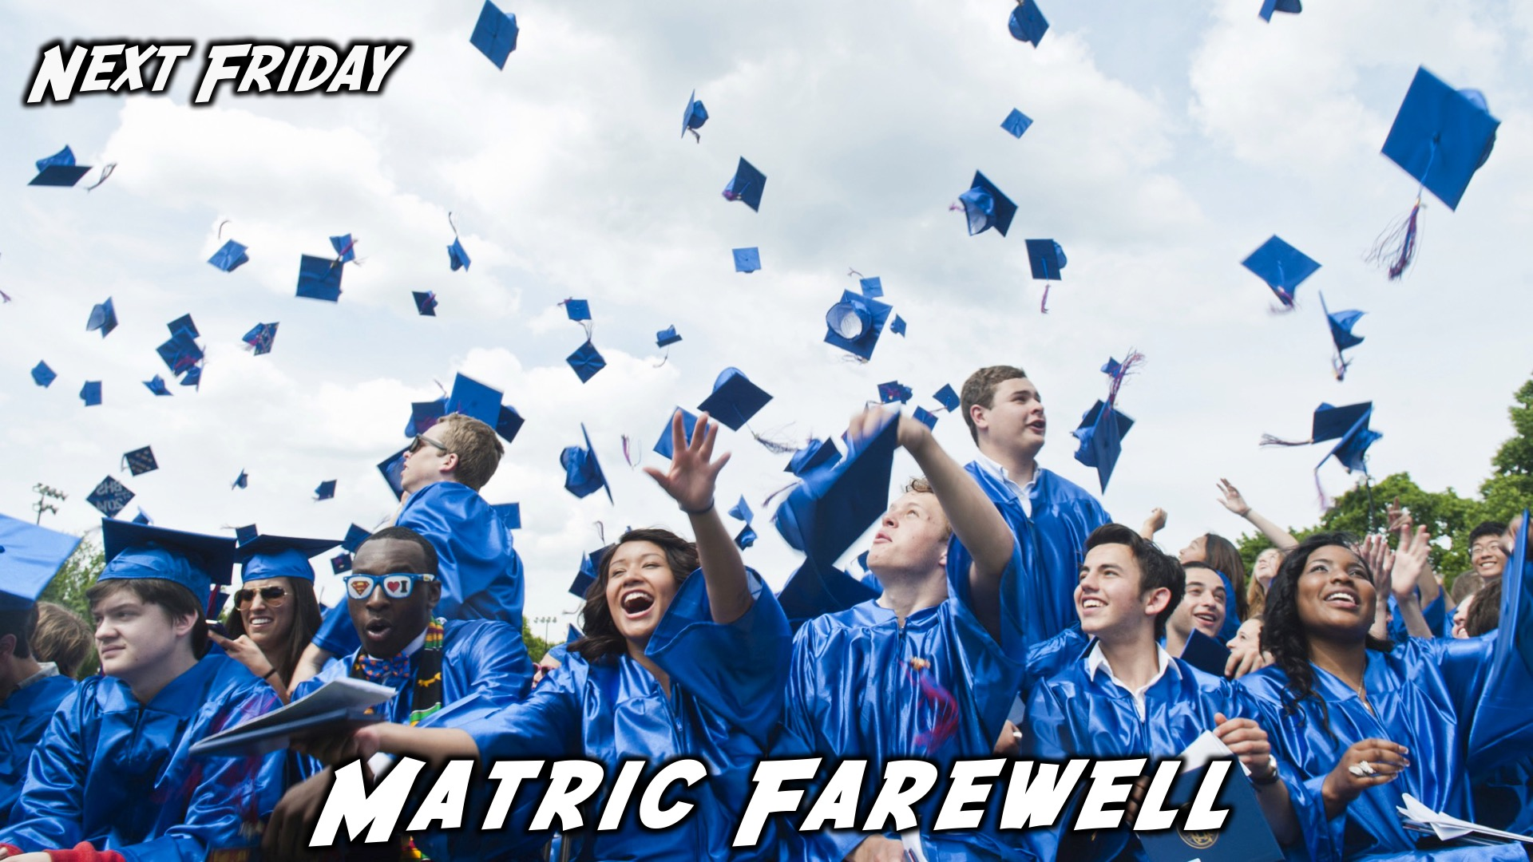
Notes:
Next week Friday is our Matric Farewell!

Slide 7

Notes:
Announcements: Follow us on Instagram! @EncounterYouth_Rosebank

Slide 8

Notes:
Announcements: Join our Friday Night WhatsApp group!

Slide 9
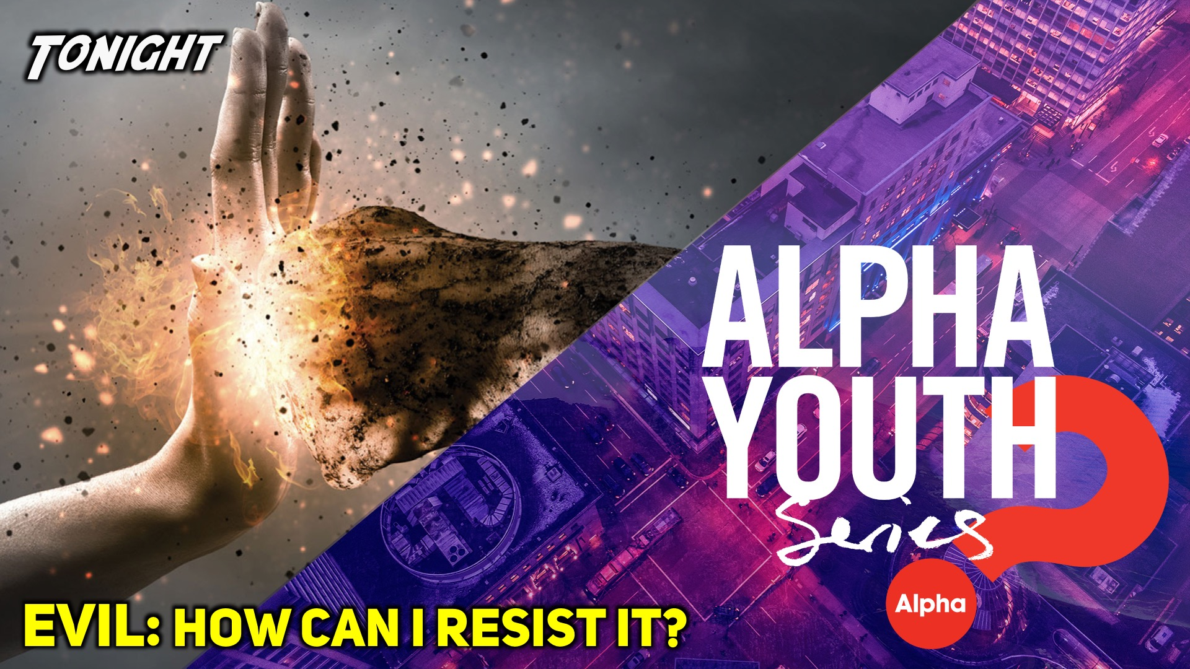
Notes:
Tonight we answer the question, “Evil: How can I resist it?”

Slide 10
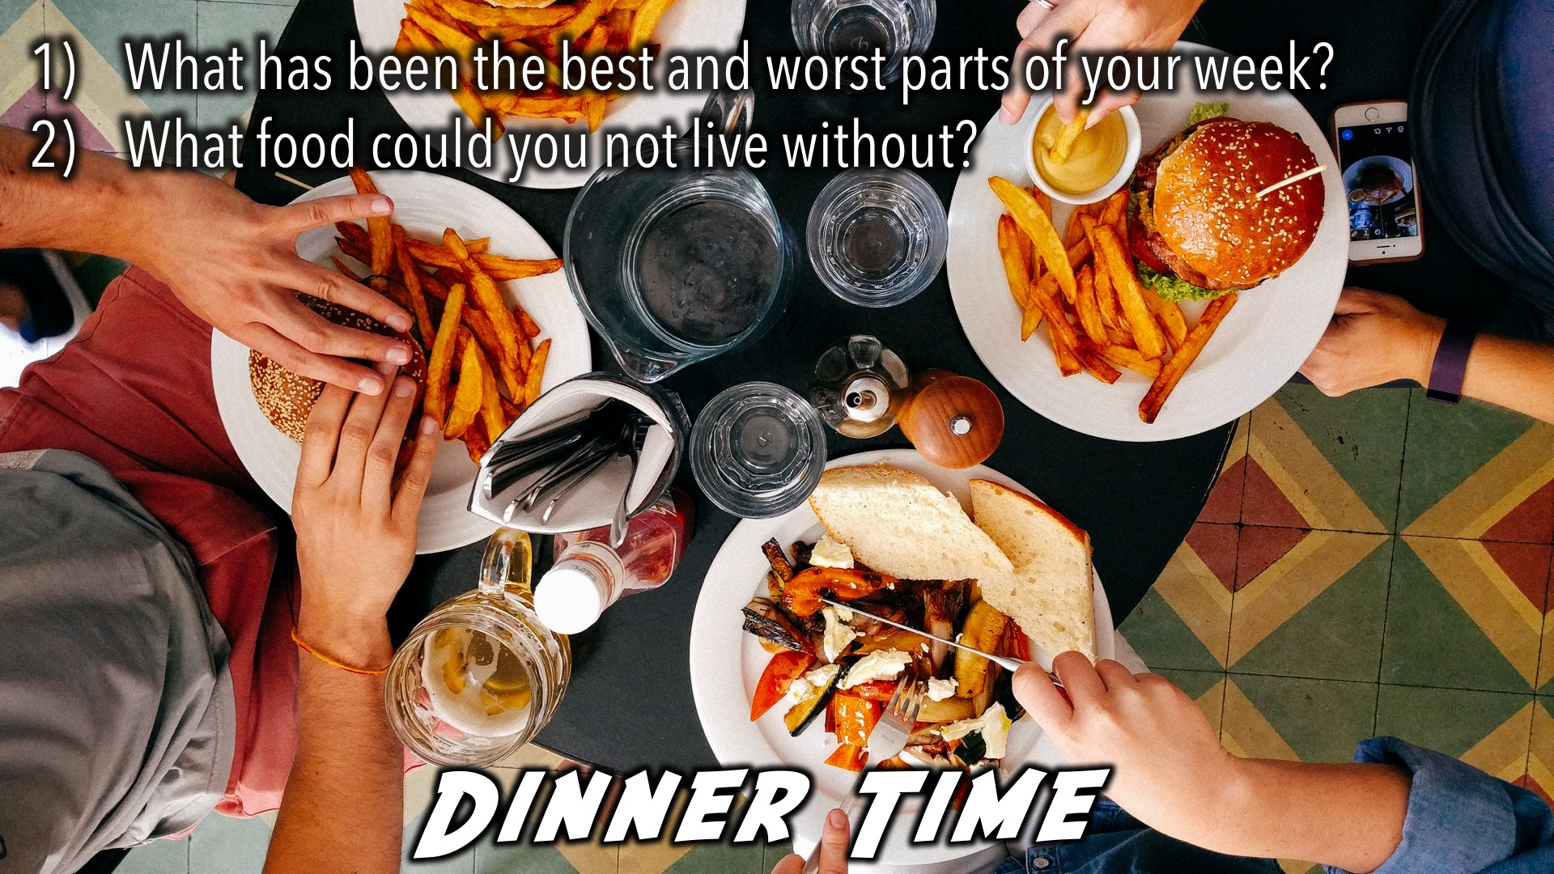
Notes:
Dinner Time – A simple meal will be served. During the meal there is a question up so that teens can get to know each other.
What has been the best and worst parts of your week?
What food could you not live without?

Slide 11
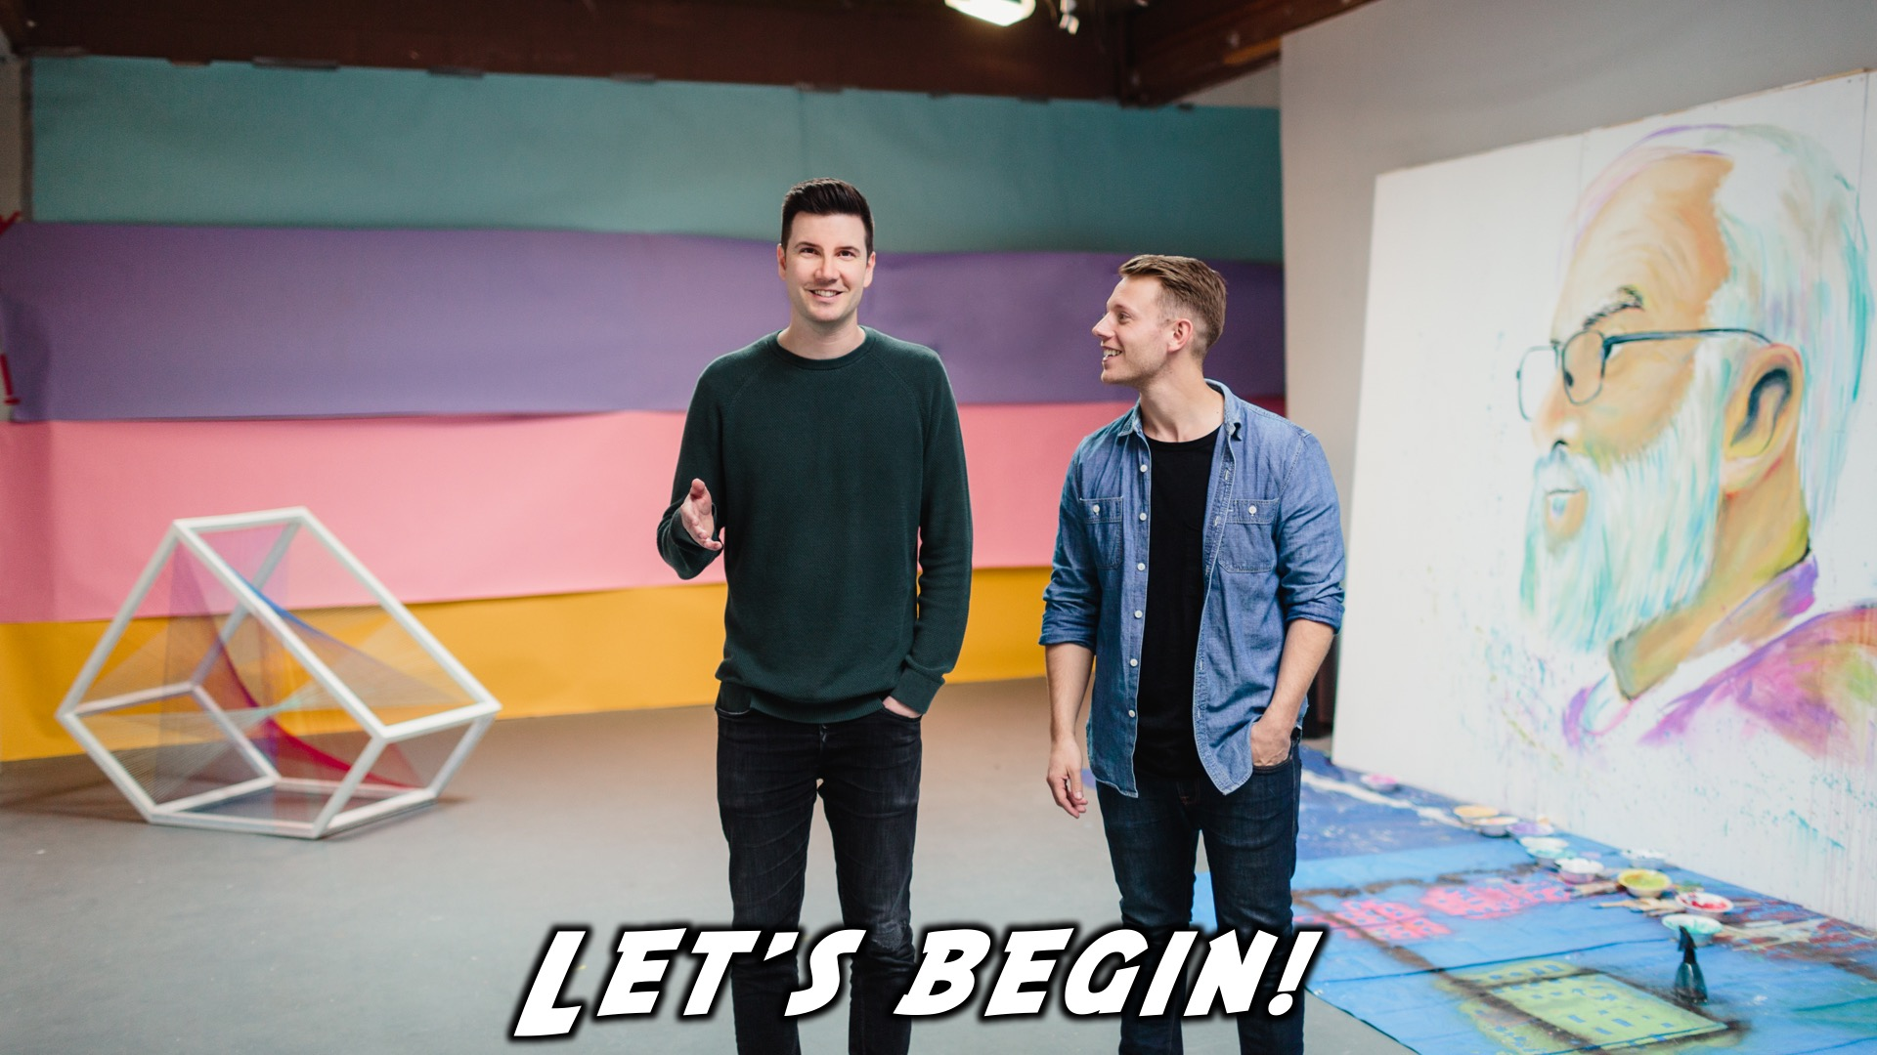
Notes:
Let’s begin the journey.

Slide 12

Notes:
Video: Part 1

Slide 13

Notes:
Question 1: If you had the power to solve one of the world’s big problems, which problem would you solve?

Slide 14
Notes:
Video: Part 2

Slide 15

Notes:
Question 2: What are some of the common lies we believe about ourselves? About God?

Slide 16
Notes:
Video: Part 3

Slide 17
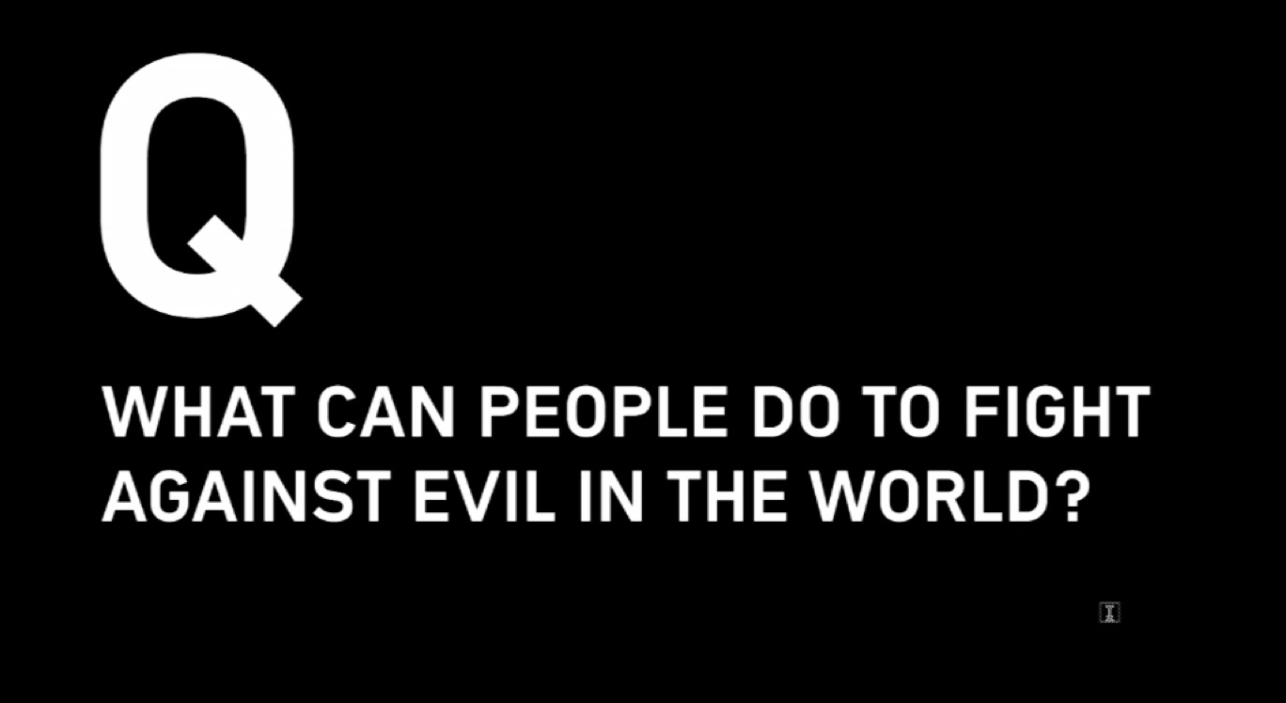
Notes:
Question 3: What can people do to fight against evil in the world?

Slide 18
Notes:
Video: Part 4

Slide 19
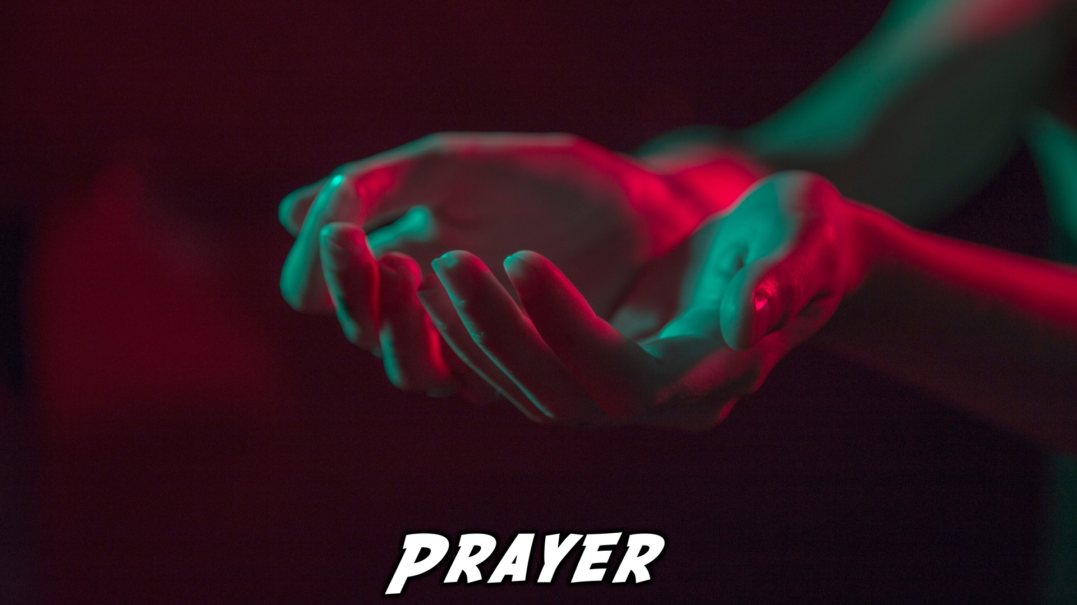
Notes:
Close in Prayer

Slide 20

Notes:
Refreshments

Slide 21
Notes:
Thanks for coming – See you next week Friday!

