Slide 1

Notes:
It’s the Alpha Series!

Slide 2

Notes:
Welcome to Chill Night!

Slide 3

Notes:
Welcome to regulars and newcomers!

Slide 4

Notes:
Prayer: Let’s open our meeting in prayer.

Slide 5

Notes:
Announcements: Please Listen up to the following announcement.

Slide 6

Notes:
On Sunday we will be doing the David Series

Slide 7

Notes:
On Sunday we will be doing the David Series. This Sunday the topic is Destiny!

Slide 8

Notes:
Next week Friday we continue with our Alpha Series – The topic is “Holy Spirit.”

Slide 9

Notes:
Announcements: Follow us on Instagram! @EncounterYouth_Rosebank

Slide 10

Notes:
Announcements: Join our Friday Night WhatsApp group!

Slide 11

Notes:
Tonight is Chill Night.

Slide 12

Notes:
Video: Ant-Man and the Wasp Trailer. Find it on YouTube at https://www.youtube.com/watch?v=8_rTIAOohas

Slide 13
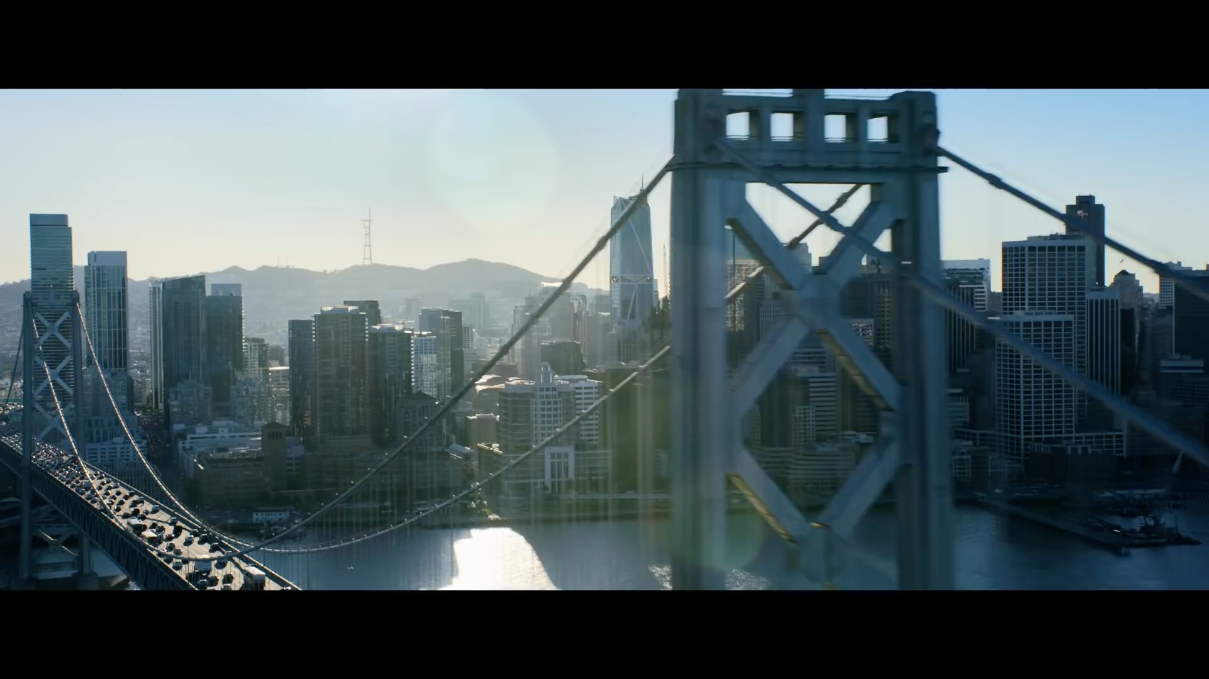
Notes:
Video: Ant-Man and the Wasp Trailer. Find it on YouTube at https://www.youtube.com/watch?v=8_rTIAOohas

Slide 14

Notes:
Speed Relating - form two concentric circles - make sure you are standing opposite someone. You will answer a question and then the inner circle will move to their right before you answer the next question and so on...

Slide 15

Notes:
Speed Relating - form two concentric circles - make sure you are standing opposite someone. You will answer a question and then the inner circle will move to their right before you answer the next question and so on...

Slide 16
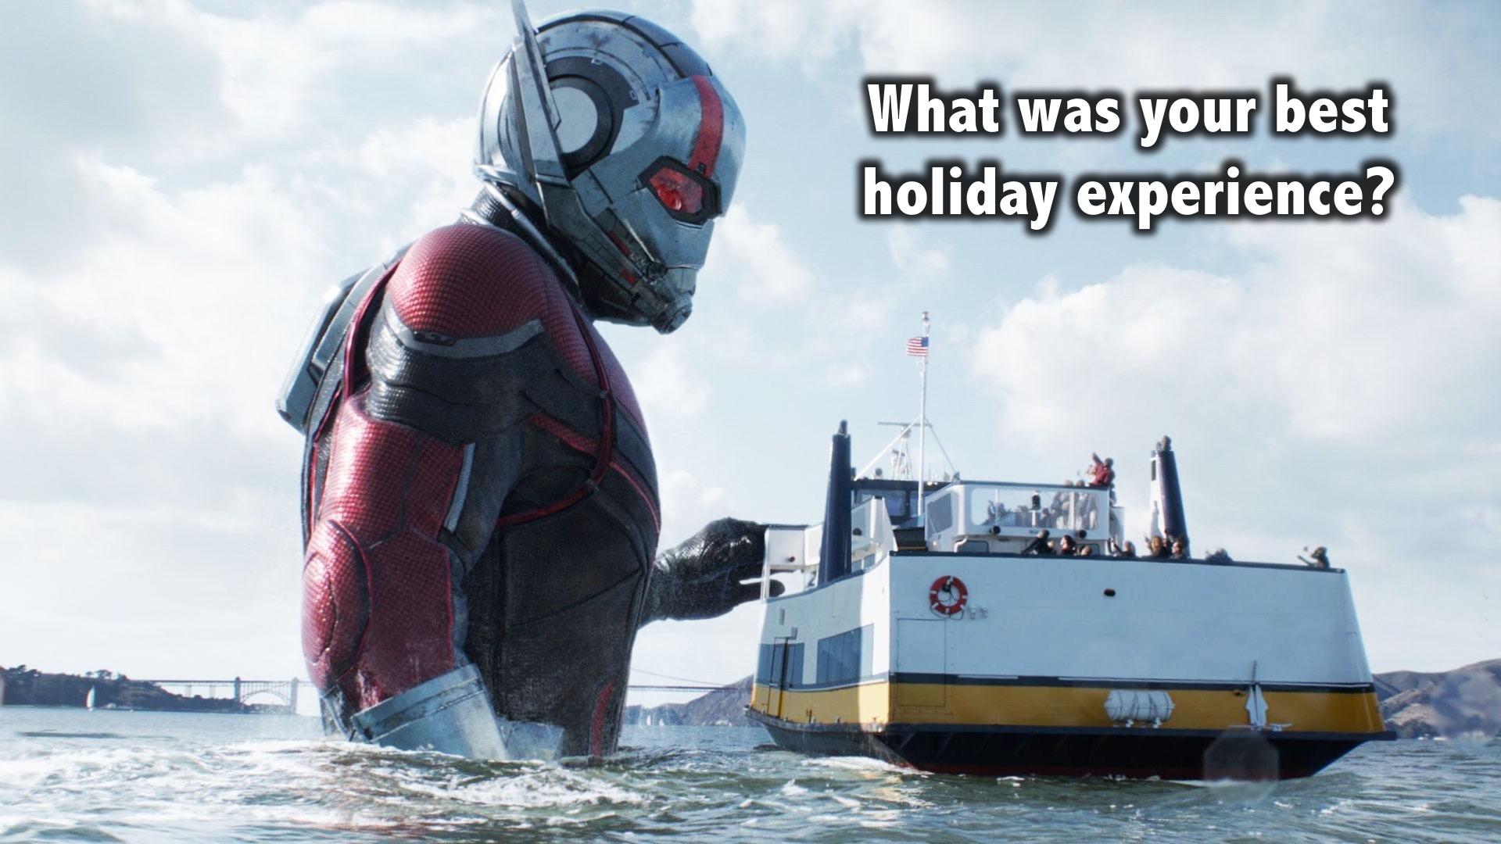
Notes:
What was your best holiday experience?

Slide 17
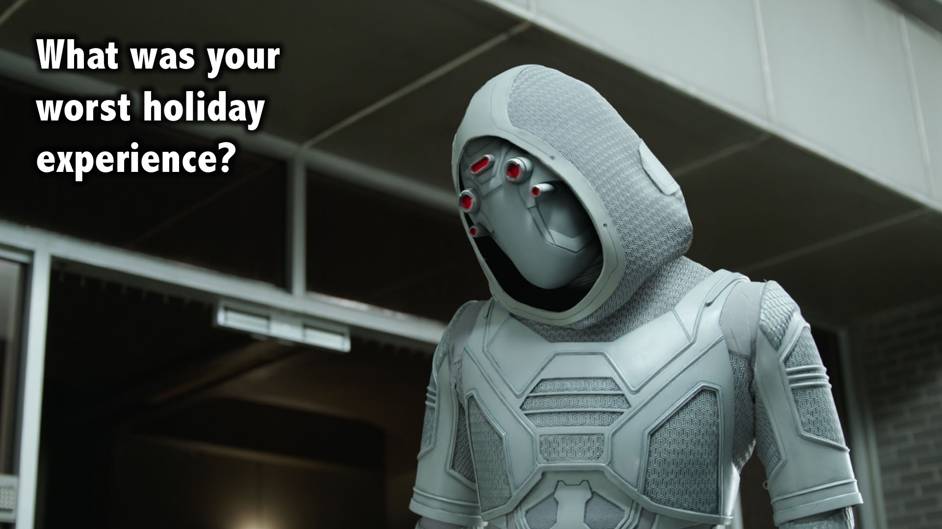
Notes:
What was your worst holiday experience?

Slide 18
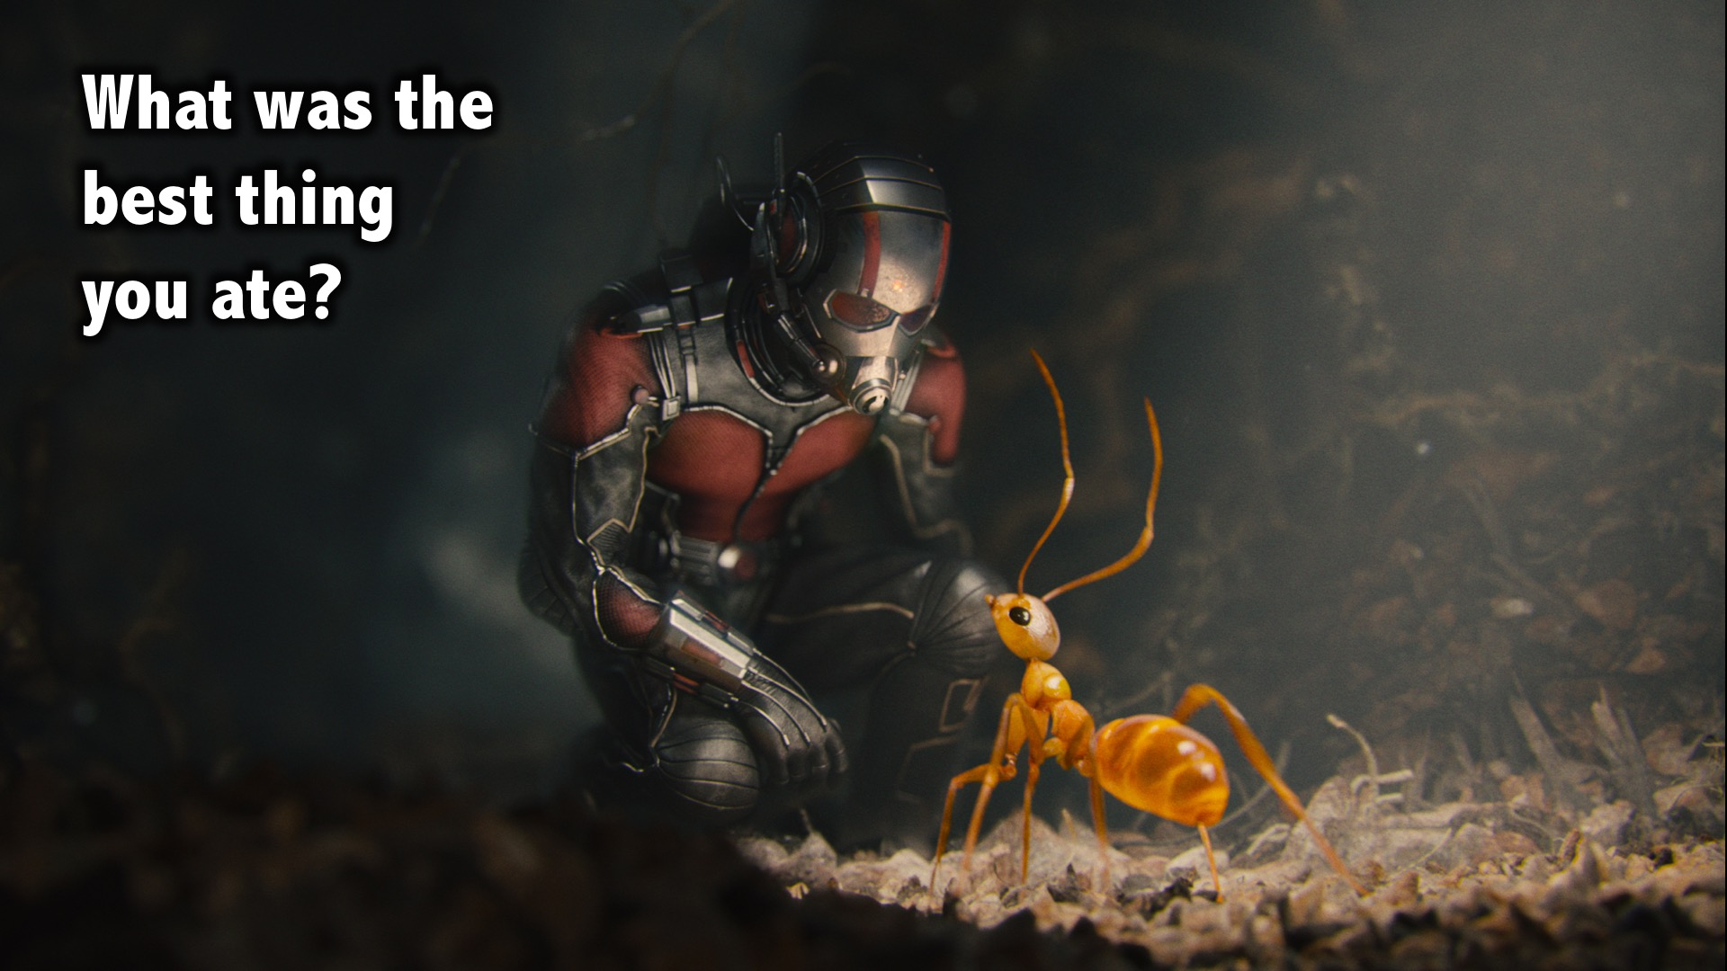
Notes:
What was the best thing you ate?

Slide 19
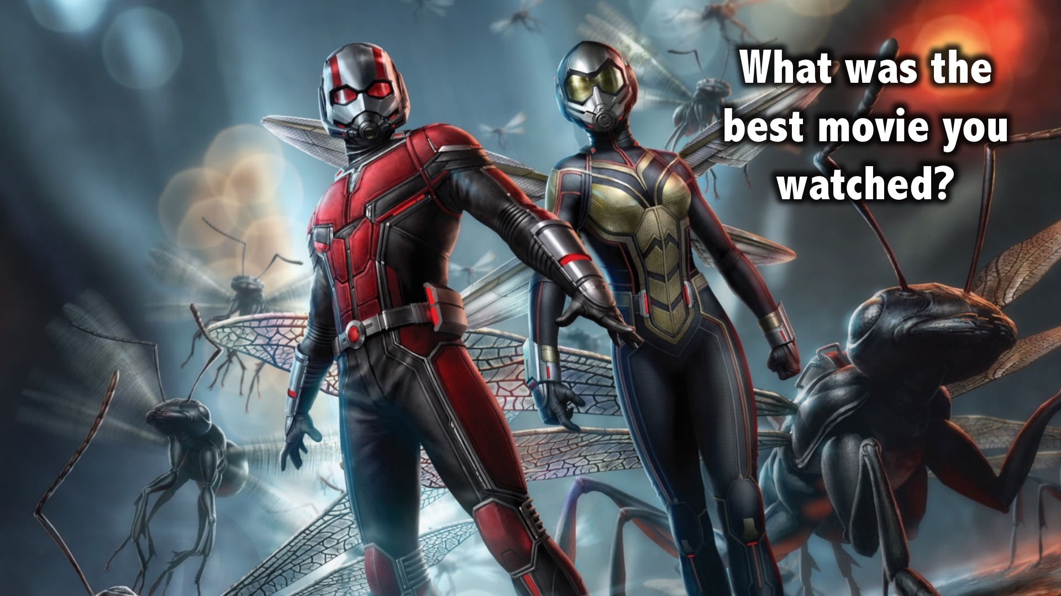
Notes:
What was the best movie you watched?

Slide 20
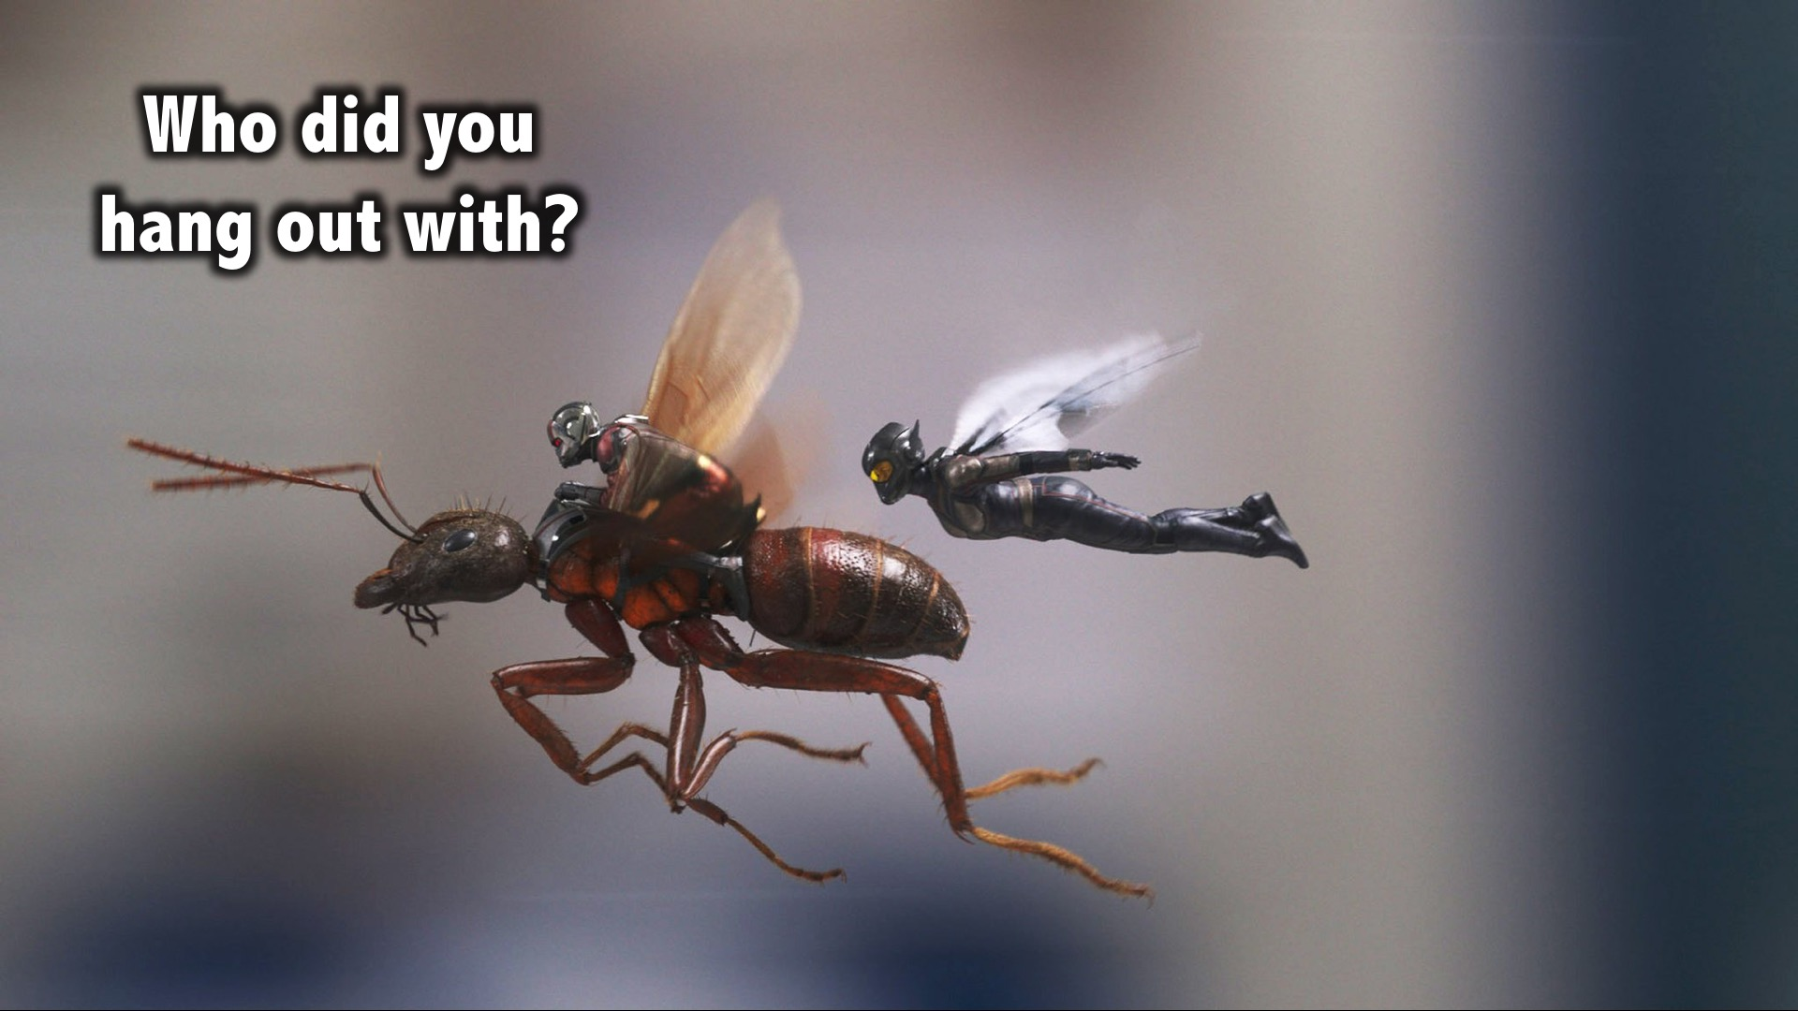
Notes:
Who did you hang out with?

Slide 21
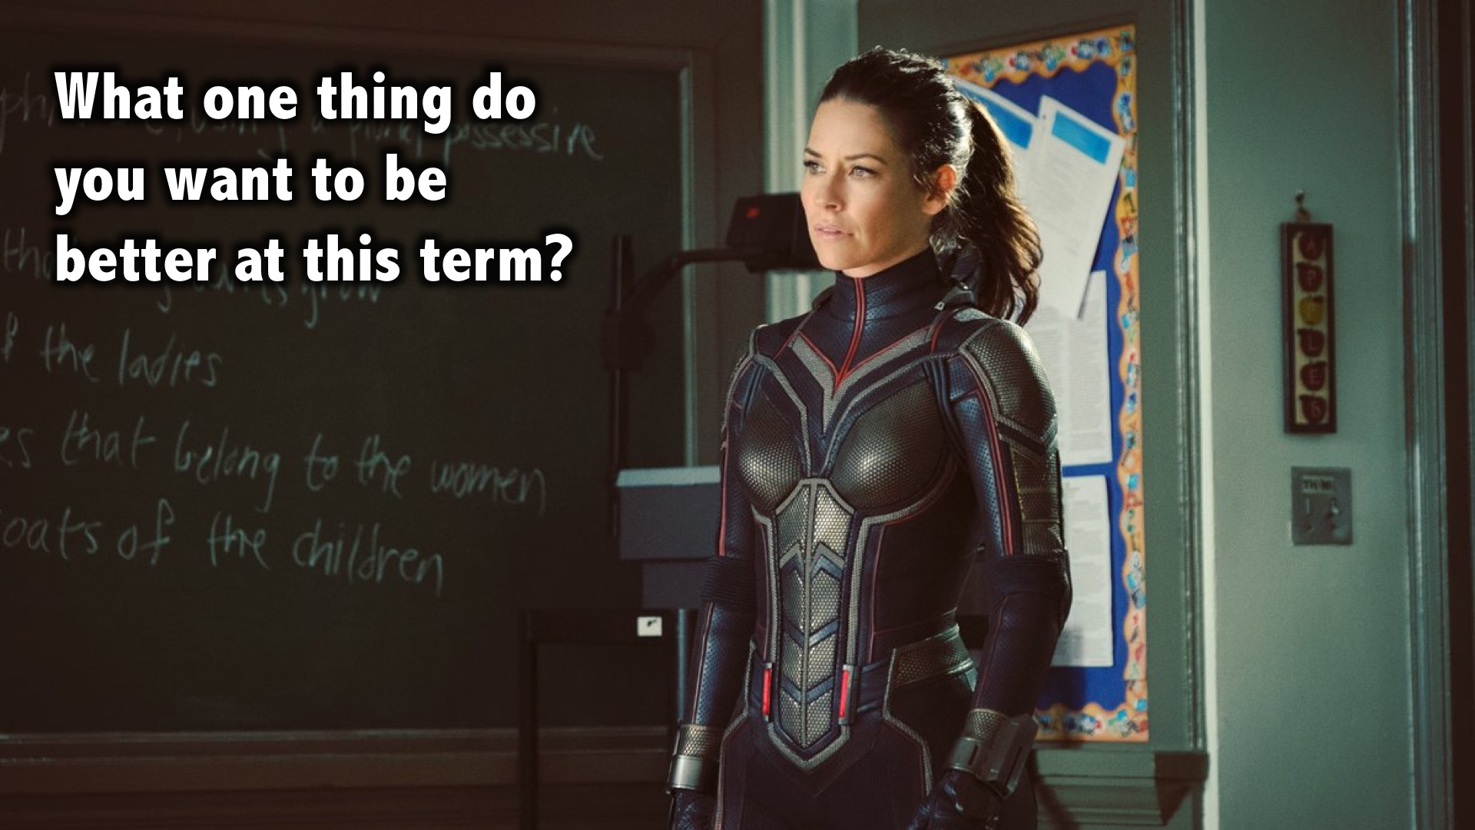
Notes:
What one thing do you want to be better at this term?

Slide 22
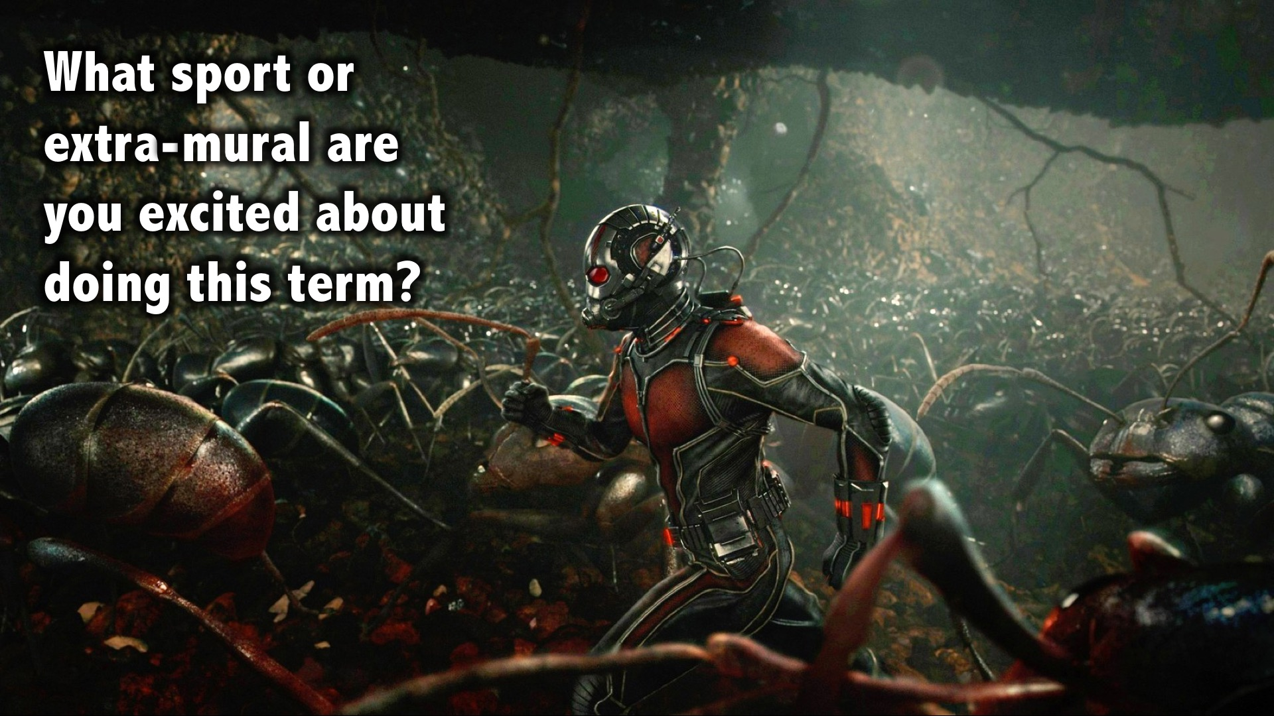
Notes:
What sport or extra-mural are you excited about doing this term?

Slide 23
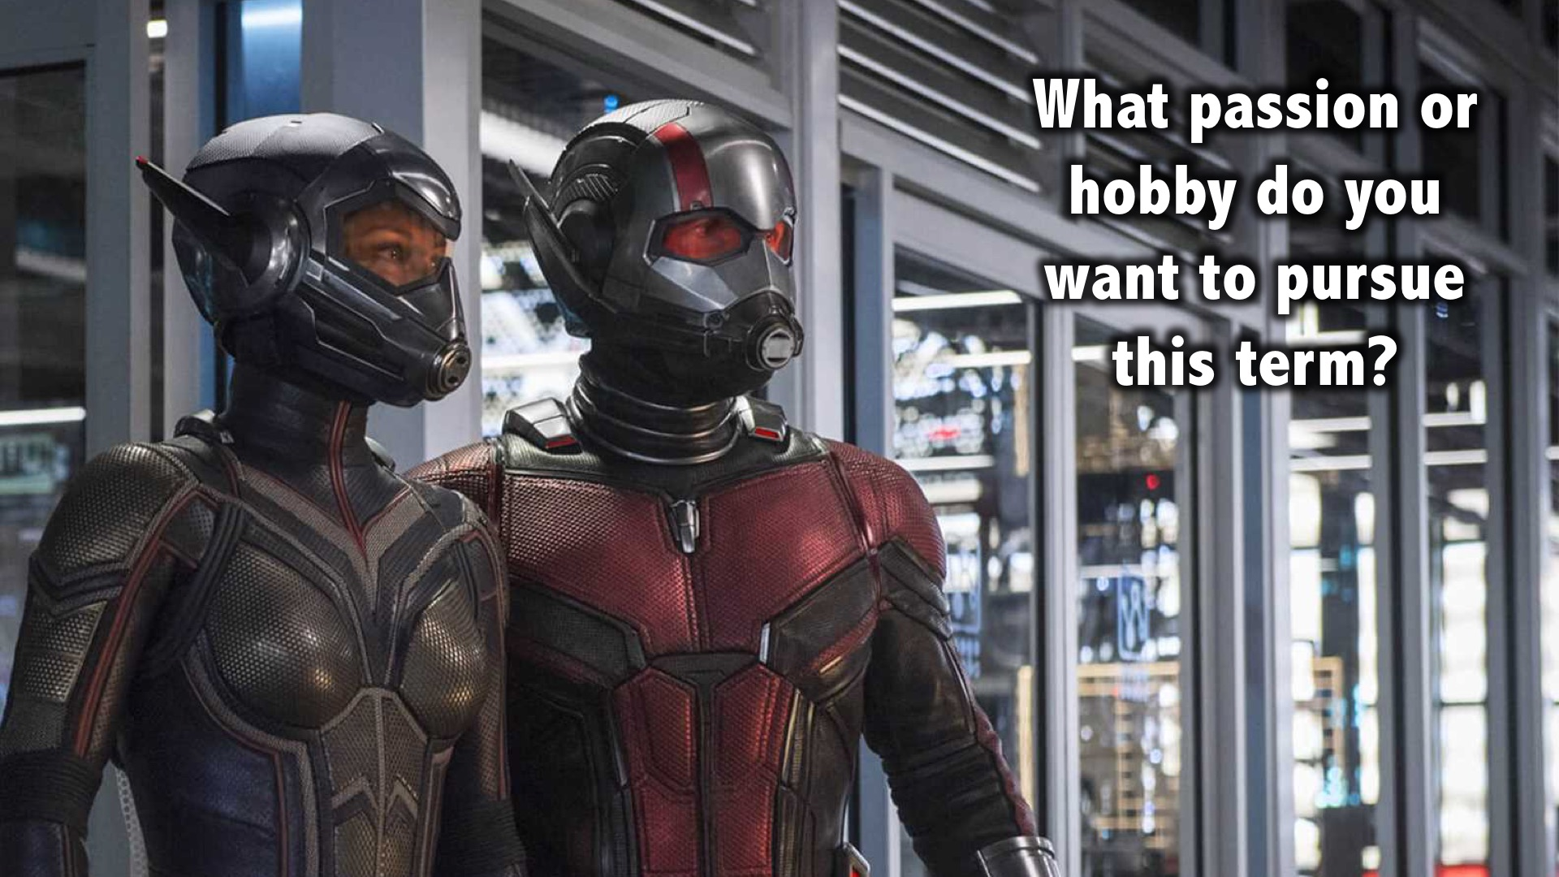
Notes:
What passion or hobby do you want to pursue this term?

Slide 24

Notes:
If you could change one thing about your life, what would it be?

Slide 25

Notes:
What would you be willing to die for?

Slide 26
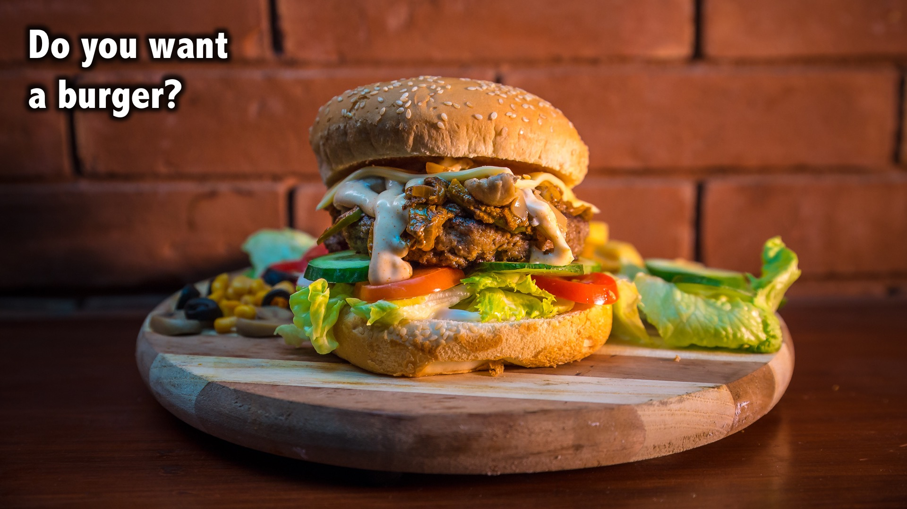
Notes:
Do you want a burger?

Slide 27
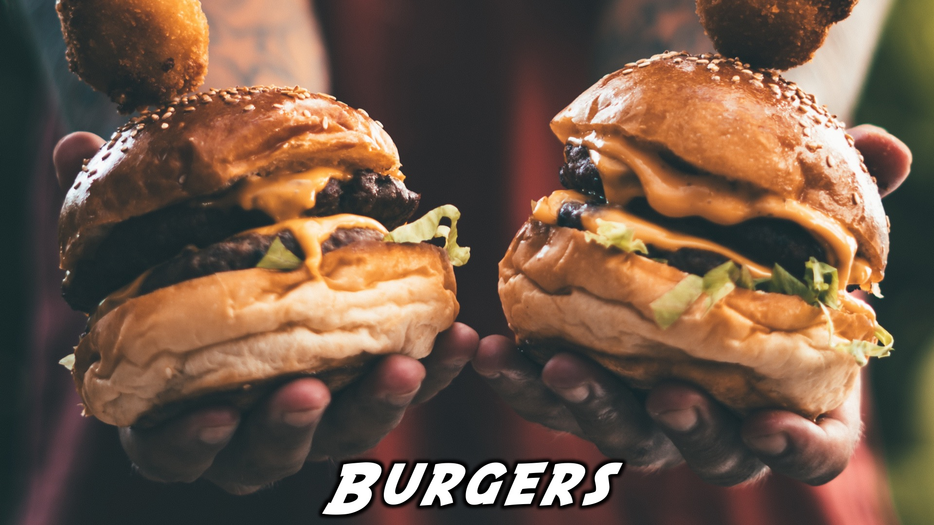
Notes:
Dinner Time: Burgers will be served.

Slide 28
Notes:
It’s chill time!

Slide 29

Notes:
Refreshments

Slide 30
Notes:
Thanks for coming – See you next week Friday!

