Slide 1

Notes:
Welcome to Chill Night!

Slide 2
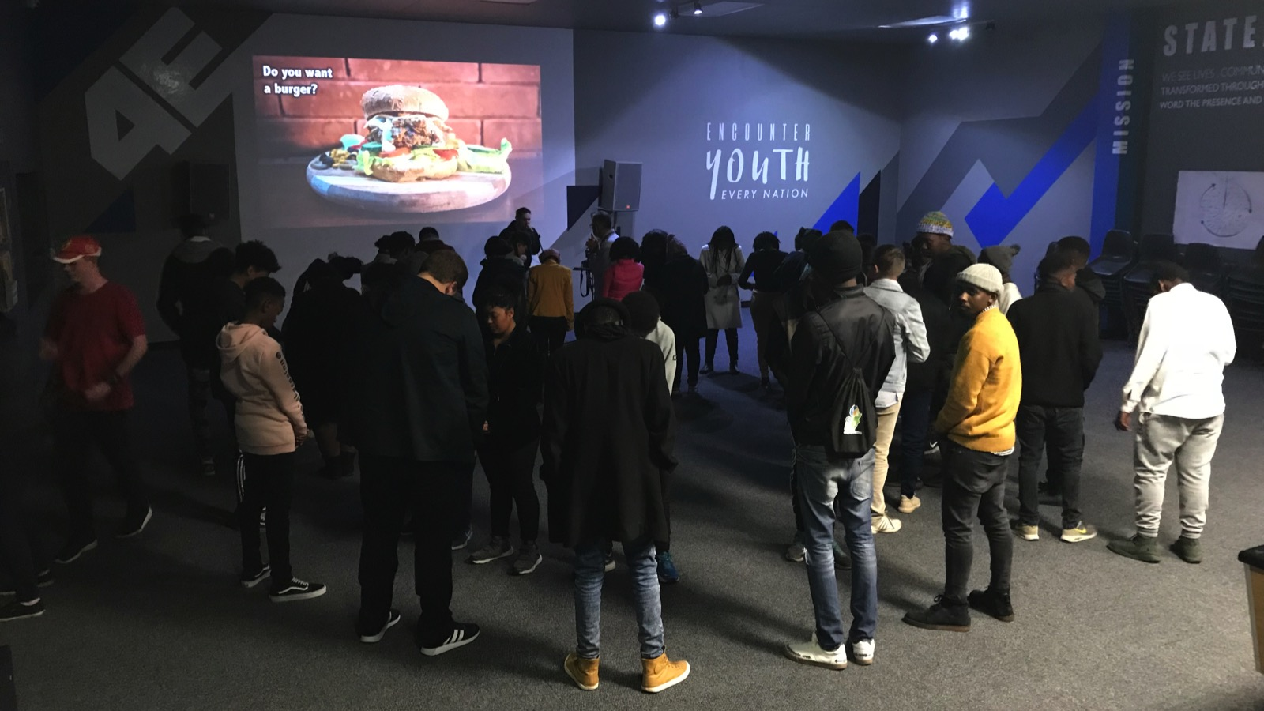
Notes:
Welcome to regulars and newcomers!

Slide 3
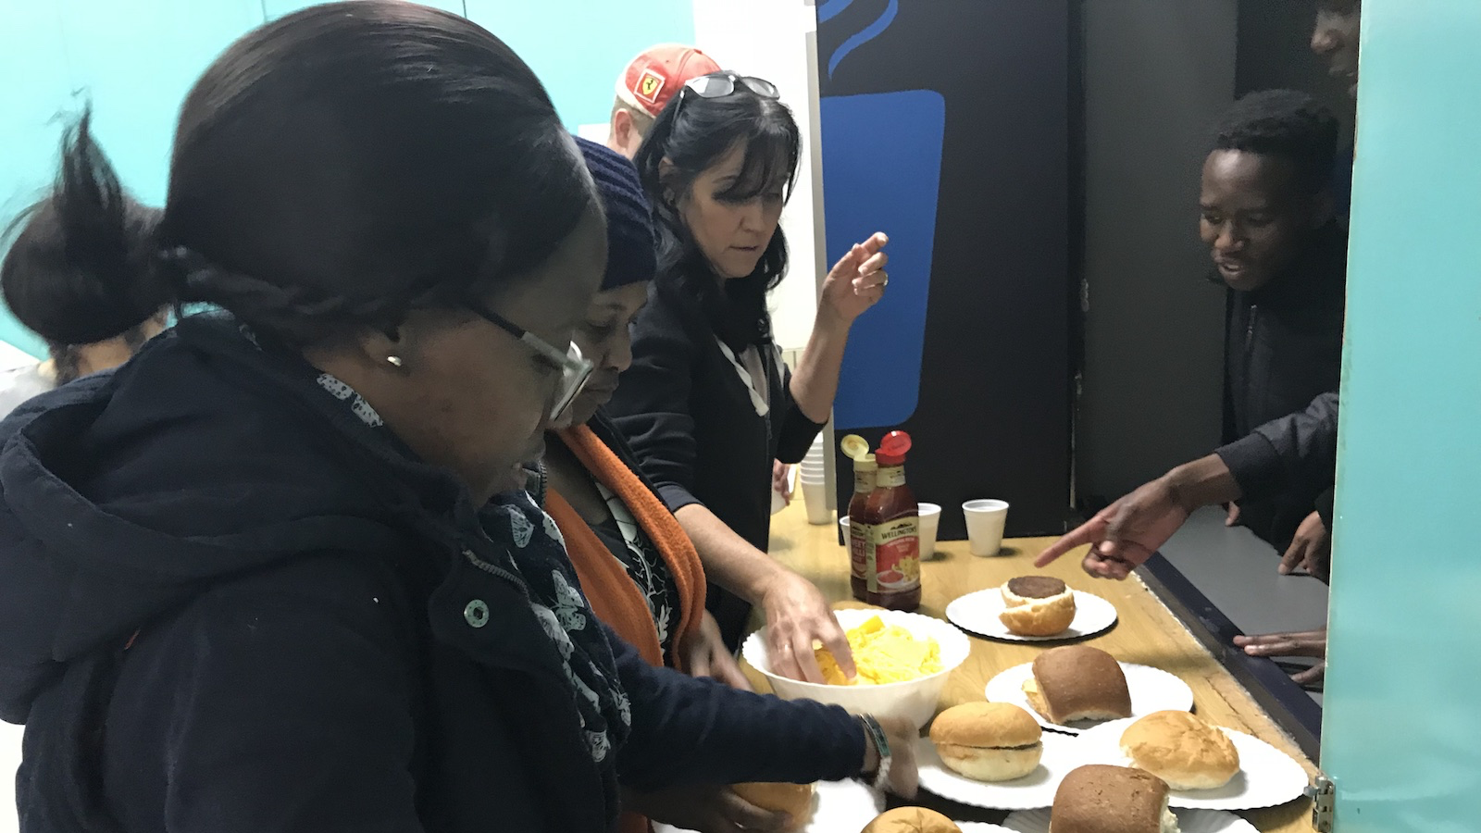
Notes:
Welcome to regulars and newcomers!

Slide 4
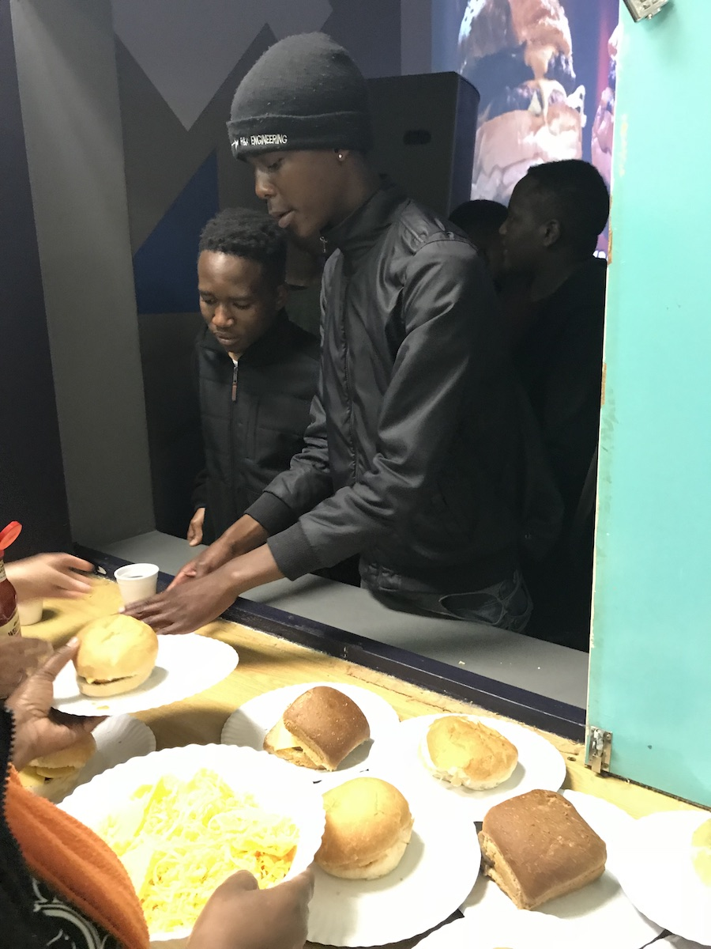
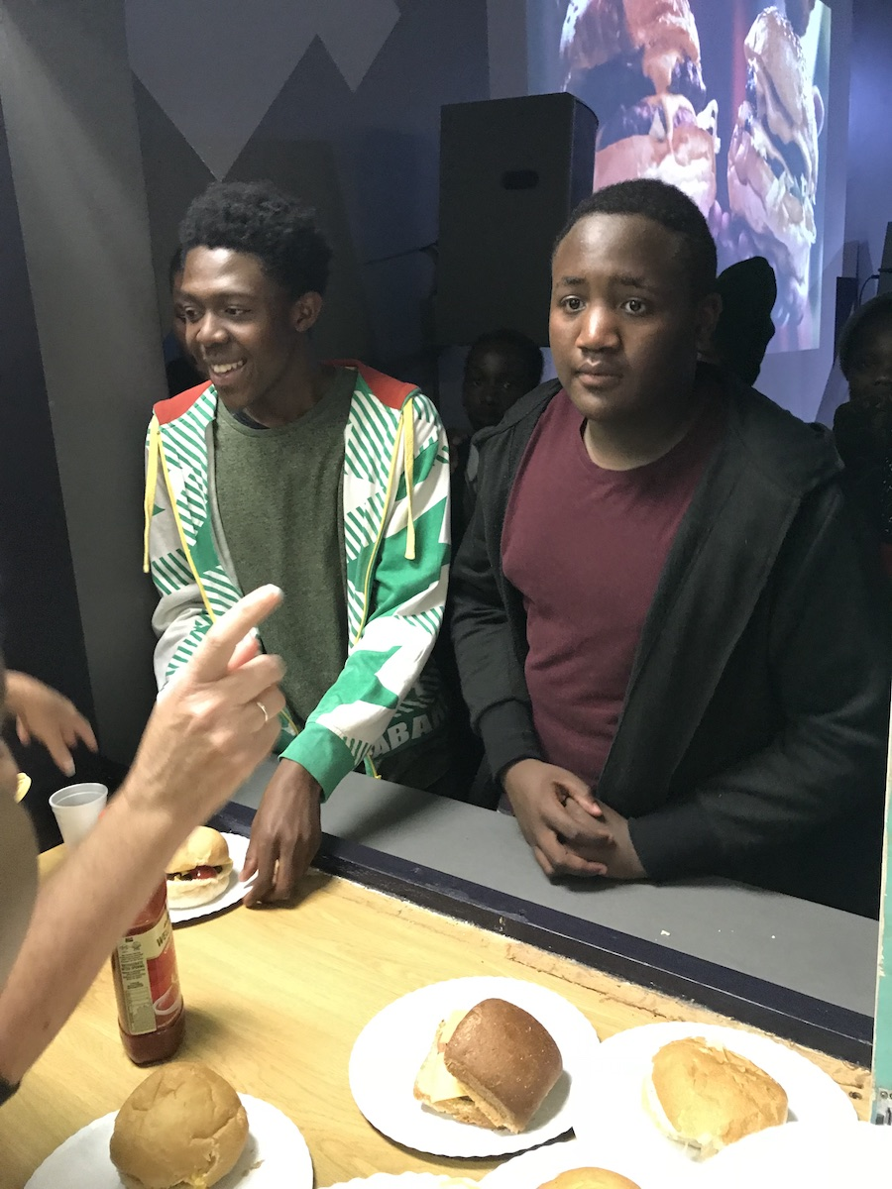
Notes:
Welcome to regulars and newcomers!

